Slide 1
Lessons from ALMA Software Development
Jeff Kern
NRAO/ALMA

Slide 2

Why is Online Telescope Software Not a Solved Problem?
Scaling and Complexity
  SKA is not just a bigger version of existing systems
Higher Expectations
End to End Systems
Archive Services
VO Applications
SKA
USB

Slide 3
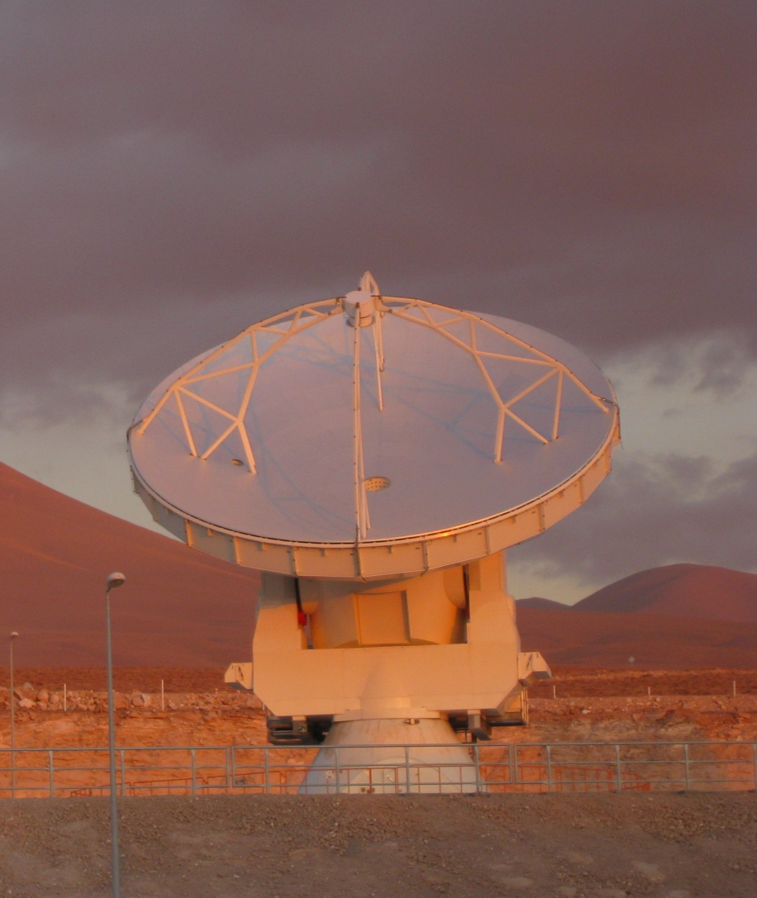
ALMA
Largest Ground Based Radio Astronomy Project
International Collaboration
  NAOJ / ESO / NRAO
Remote Deployment
Distributed Development

Slide 4
Configuration Management
“Oh the code works fine, that’s just a configuration issue.”
In ALMA I would estimate at least a third of our issues have been just a configuration issue.
Configuration is a decentralized problem
  Depends on both development and deployment
Time Dependent
  Not constrained to a “Release Cycle”
Crosses many project boundaries
  Software, Hardware, Operations

Slide 5
What’s so hard… it’s just data.
Computational tasks are usually easy.
  Interesting, lots of research on these types of problems.
  Centralized, one developer can usually solve the problem.
  Scaling can be a problem, but can design for it.
Information flow causes problems.
  Coordinating the information to be stored and agreeing on format.
  Synchronization across a large distributed system.

Slide 6
Scope of the Issue
In ALMA Configuration Depends on:
Hardware Version
Firmware Version
Calibration Data
Software Version
Deployment Scenario
In ALMA Configuration is needed by:
Hardware Engineer
Software System
Maintenance System
Scheduling System
Observing Preparation Tool
Operations Staff

Slide 7
Mitigation
This is a project task, not just a computing team issue .
Comprehensive Requirements Capture.
  Strong, well staffed System Engineering team.
  Design the configuration management system with all stakeholders from start of project.
  Do a few key use cases in detail.
Interface Control Documents
  Need responsive change control system to be effective.
  Should include “Theory of Operations”

Slide 8
Distributed Development
ALMA’s Approach
  Concentrations of people in the larger teams with a few people at other locations to cross-pollinate.
  Smaller teams are fairly isolated.
  Some people split amongst teams.
Advantages
  Intra-team communication good.
  Collocated hardware and software expertise.
Disadvantages
  Us vs. Them mentality very easy to fall into.
  Integration and release is very difficult.
  Split effort is less effective.

Slide 9
Mitigation: Matrix Management
The advantages of collocating a team are too great to ignore.
Break down the “Us vs. Them” mentality by forming cross team groups to deliver specific functionality.
  In ALMA jargon: Function Based Teams.
  3-6 Month spans (ALMA targets 2 months)
  At least one, and sometimes two face to face meetings.
Could be expanded beyond the Computing team (i.e. a team to deliver a hardware component).

Slide 10
Mitigation: Integration Team
Integration is the careful assembly of the software components into a working whole.
  More to this than a simple build and test process.
Integration team should know:
  What the software is supposed to do.
  How it is supposed to work.
  The use cases of the clients in detail.
  How to determine why it’s not working when it fails.
I advocate transitioning the architecture team to an integration role as the system matures.

Slide 11
Commissioning Comes Before Operations
Cannot commission a system from Scheduling Blocks.
  Low level hardware control
  Very different exception handling
  Different use cases.
Most Difficult Problems Come First
  Fastest data acquisition
  Debugging hardware and software simultaneously, need lots of monitoring and logging.
  Edge cases of the system, missing hardware etc.
Mitigation: Invest in time travel?

Slide 12

Summary
Configuration Management
  Project level issue
  Include this from the beginning
  Careful requirements capture with all stakeholders.
Distributed Development
  Integration Team
  Matrix Management
Commissioning Comes Before Operations
  Plan accordingly

