Slide 1
SAFe® for the SKA
Nick Rees and Ian Spence
2 October 2017

Slide 2
Overview
Where software fits in
How SAFe fits in
Solution, program and team level roles
Control and system cadence
Relationship with other parts of the project
Procurement
Implementation and rollout
Support for AIV
Summary

Slide 3
SAFe implications
SAFe® is:
  Flow and cadence based.
  Continuously builds value and reduces risk.
Consequently, SAFe® doesn’t have:
  Fixed product definition
  Fixed requirements
  A definite work breakdown structure
Instead it has:
  An evolving architectural runway.
  A working product demonstrated frequently.
  A building block of 5-10 person long-lived teams.
  Up to a 4 level hierarchy to scale these teams

Slide 4
Where software fits in
SKA Observatory
Project Office
MID Telescope
LOW Telescope
Computing and Software
SDP
TM
CSP Common
Element LMC and Common
Verification
ILS

Slide 5
Where software fits in
There is software in the other parts of the WBS, but it is effectively hardware “drivers”.
  Exposes the capability of the hardware via software API’s.
  Lower level than the LMC layer.
These software API’s must have emulators or an emulation mode, that can run on a commodity architecture.
  Should also be compliable and run on a cloud based architecture.
Goal (at least initially) is to demonstrate functionality and behavior of interfaces, not performance or signal processing.
  Don’t anticipate testing signal chain with emulators.

Slide 6
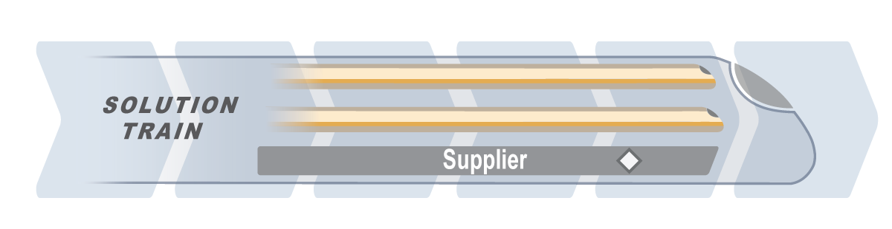
Where SAFe® fits in
SKA Observatory
Project Office
MID Telescope
LOW Telescope
Computing and Software
Verification
ILS
The Computer and Software Work package will be run as a single Solution Train containing a number of Agile Release Trains.
Notes:
Start with the WBS
The zoom in on Software
Then zoom in on Trains
Then zoom in on Solution Train Roles
Then zoom in on a train
Show where the roles come from
Program Level: Product Manager (SKA), RTE and Arch (Separate contracts)
Team Level: Single supplier and mixed supplier teams
This will set Ian up nicely for his contracting bit.

Slide 7
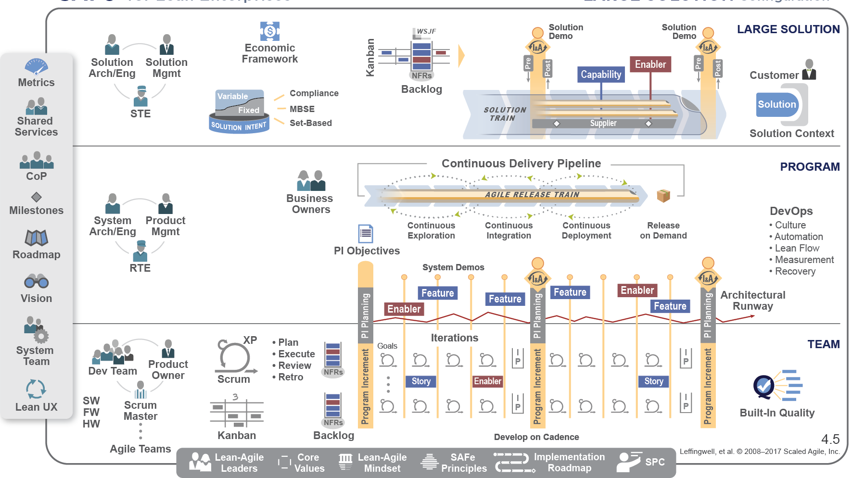
Where SAFe® fits in
Large Solution Level
Computing and Software
SDP
TM
CSP Common
Element LMC and Common
Agile Team
Agile Team
Agile Team
Program Level
Team Level

Slide 8
Where SAFe® fits in

Slide 9
Solution Train Roles
Content Authority, priorities
Design Authority, interfaces
Solution Arch / Eng
Solution Management
Solution Train Engineer
Program
Coordinator
Solution agility, processes, velocity
Vendor and Contract Management, cross-project collaboration
Notes:
Could explain more about each role.
Name the people if they are known.
Editable picture so we can show teams / groups if we want.

Slide 10
Program coordinator role
Manages program procurement, contract management, financial reporting etc.
Reports progress, spend, etc
Manages on-going training and staff development
Provision of suitable facilities, and equipment
Owns, manages and mitigates program-level risks
Enables cross program/cross project collaboration and dependencies

Slide 11

One Shared System Team
The System Team supports the Agile development environment, including continuous integration, test automation and continuous deployment. The SKA System team will include:
SKAO staff (for general coordination) and
ART program team members (for specific expertise)
SKA System Team
Notes:
Can show what services the Solution Level System Team will provide and the make up of the team.

Slide 12



What happens on a train
Propose product management is provided by SKA
Agile Teams:
Possibly distributed – but benefits in co-location and time-zone proximity.
Solution Arch / Eng
Product
Management
Release Train Engineer
Leadership Team:
aligns and steers the train.
UK &
South Africa
Australia
India
India & Australia

Slide 13



What happens on a train
Team composition can vary, but all teams are agile teams
A co-located Team from a single supplier
A co-located Team from a several suppliers
A distributed team
Scrum
Master
Product
Owner
Scrum
Master
Product
Owner
Scrum
Master
Product
Owner
Development Team
Development Team
Development Team

Slide 14
What happens on a train
The Agile teams are:
7 ± 2 full-time people
Empowered
Self-organized, self managing
Cross functional
Stays together, preferably co-located
Produces working software every two weeks
Applies basic scientific practice: Plan—Do—Check—Adjust
Exemplifies agile values
Scrum
Master
Product
Owner
Development Team
Notes:
Ties back to the previous presentation.
We can tune the words to reflect the SKA situation if required.

Slide 15
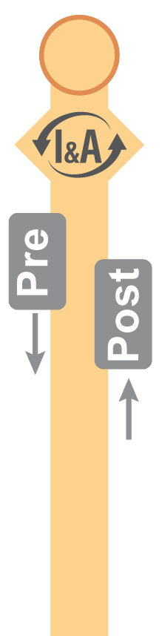
All Release Trains on the Same Cadence
Solution
Demo
Solution
Demo
Shared Time-Line
Common cadence
Everyone working in the solution train will be on the same cadence:
Quarterly – 4 Program increments per year.
All Sprints 2 weeks – 6 sprints per cycle.
Notes:
Cadence and Synchronization section starts here
Everyone on the same PI
What this means for non-SAFe Teams / Work Packages
How a train stays on the tracks
Measurement and empiricism etc

Slide 16
In fact, everyone will be on the same cadence
Solution
Demo
Solution
Demo
Shared Time-Line
Common cadence
Other Work Packages
Notes:
Cadence and Synchronization section starts here
Everyone on the same PI
What this means for non-SAFe Teams / Work Packages
How a train stays on the tracks
Measurement and empiricism etc

Slide 17
Cadence-based Updates and Alignment
2. The Agile Release Trains that make up the Computing and Software Work Package go off to do their planning for the next Program Increment. Other Work Streams reflect on what they have learnt.
Solution
Demo
1. Everyone gets together for a SKA wide demonstration, retrospective and update on how the plans are going with a particular focus on what will be happening during the next planning cycle.
3. Everyone gets a quick update on the revised plans and in particular when and where the next PI’s Features and Releases will be available.
Non-software parts of the WBS contribute emulators to the demos on an agreed time scale

Slide 18
Keeping the trains on the tracks
The teams will define and measure metrics to provide a measure of value flow. For example:
  The Scrum Master, RTE and STE CoP will be responsible for defining and developing metrics.
  The system team will provide supporting infrastructure to ensure metrics are automatically measured and tracked.
  The Solution management, Product management and Product Owner CoP will ensure that the backlog and work in progress is appropriate for the amount of resource available.
The program coordinator will report the results to SKA project management and highlight problems that need external support.

Slide 19
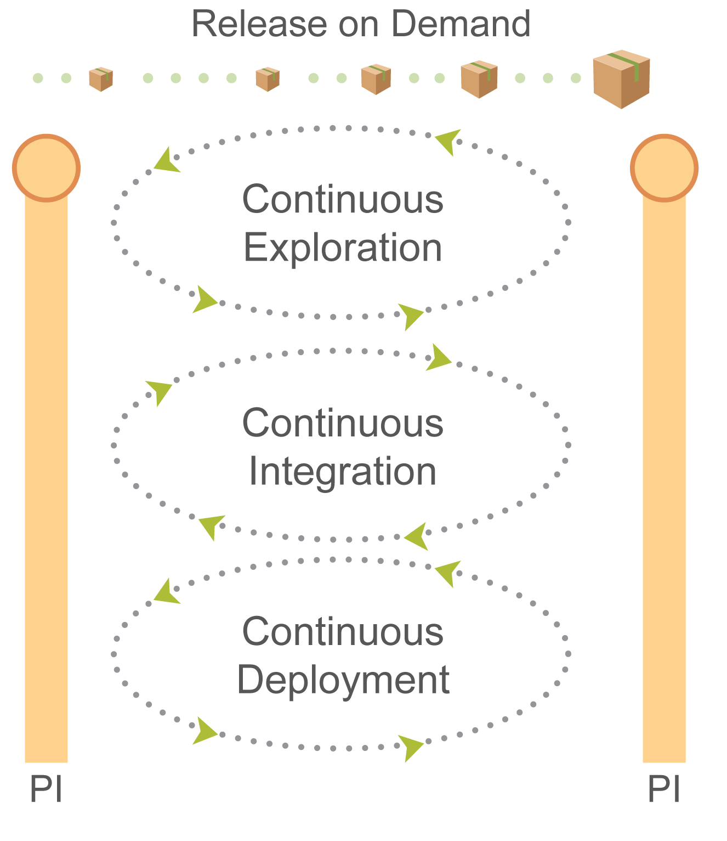
Integration, Deployment and Release
The process continually generates tested, working products.
  Investigating best feature design
  Automatic integration and testing of features.
  Making available to end users.
End users can choose which version to use.
  Release on Demand
Notes:
We should say something about the policies in this area and how they are empowering
Stress the pull model

Slide 20
Procurement
Ian Hastings will talk about this later, but the assumptions are we are working with lean-agile suppliers.
This means we need to have appropriate contracts
  Must avoid the us/them relationship
  Focus must be on customer needs, rather than pre-defined deliverables
  Aim to build long lasting, trusting, relationships.
The SKA must emphasise this with a clear ethos of working flexibly together.
  Remember Conway’s conclusion!

Slide 21
Procurement
Start with frameworks negotiated with suitably qualified suppliers (including in-kind suppliers).
Resources will be procured from the frameworks for Agile Release Trains managed by the Program coordinator in consultation with ART program team.
Resource requirements will be negotiated as part of the commitment agreements made at the quarterly planning (program increment) meetings.
In-kind contributions will be managed with the help of management organizations in these countries.

Slide 22
Implementation and Rollout
SKAO will have a number of trained SPC’s.
  Will do this in the next few months and may open a course for external attendees as well.
Will contracting vendors using lean-agile contracts
  Demonstrated successful SAFe experience will be a positive.
Provide SAFe leader training, if required. For example:
  SAFe Product Owner/Product Manager
  Leading SAFe
  SAFe Scrum Master
Provide SAFe for Teams kick-off training for Agile Release Teams.

Slide 23
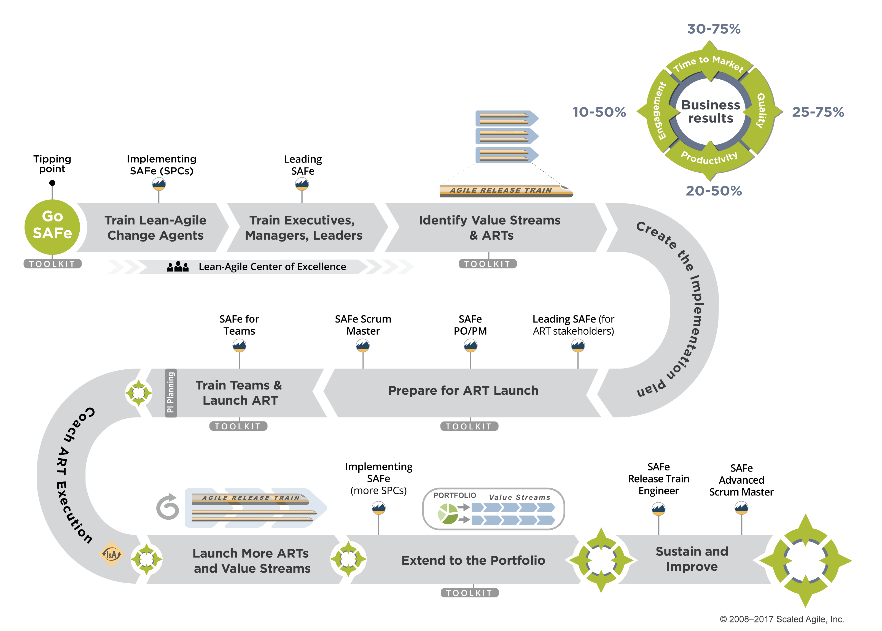
Implementation Roadmap
Notes:
Finally, let's discuss implementation. We'll describe that using our Implementing SAFe 1-2-3 model.
Number 1 is to train the Lean-Agile change agents. We call those SAFe Program Consultants.
With a sufficient staff of Lean-Agile change agents onsite, and working with your partners, you'll have the ability to train the executives and leaders and managers—the people responsible for managing the people who deliver value.
They'll then be in a position to support the launch of the Agile Release Trains. And one train at a time, you'll build that Agile portfolio.

Slide 24
Transition from construction
Verification and testing approach
  Bulk of functional verification will be done via Continuous Integration and System Demos
  Performance verification will be larger tests with performance verification milestones
The transition between Construction and Operations should be a soft transition

Slide 25
Support for AIV
Propose to ramp up SKAO staff in the site countries in preparation for AIV.
  Start with 5-10 staff to support AIV, and ultimately grow to full on-site support requirements.
  Resource level would be such that velocity of development should not be impacted by AIV.
  Staff would spend an initial period working with the construction agile teams in order to gain familiarity with the software.
  After this initial period, SKAO in-country teams would form additional agile teams.
    Work at the same cadence and prioritize work in the same way.
    If they were idle they could inherit tasks from the construction ART’s

Slide 26
Handling the smaller systems
Computing and Software
SDP
TM
CSP Common
Element LMC and Common

Slide 27
Handling the smaller systems
Computing and Software
SDP
TM, LFAA and LMC
CSP Common
Element LMC and Common
My inclination is to move them into the TM ART.
  This has already been suggested by others
  Would increase TM ART from 4 agile teams to probably 7.
  Concern is LFAA - 2 of the additional teams would be predominantly LFAA.
Comments welcome…

Slide 28
Summary
All the SKA project will run with a 3 month cadence.
SAFe will be used for the Computing and Software area of the WBS
Other parts of the WBS will develop software drivers and emulators for their hardware.
The solution train level and the product management will be provided by SKAO.
There is an additional solution level role of “Program Coordinator” because of the complex environment.
Program and team levels will be contracted.
Procurement will be matched to the lean-agile ethos.
AIV will be supported by SKAO software staff.
Inclination is to merge TM and smaller LMC’s into one ART.

Slide 29
Questions and Answers

