Slide 1
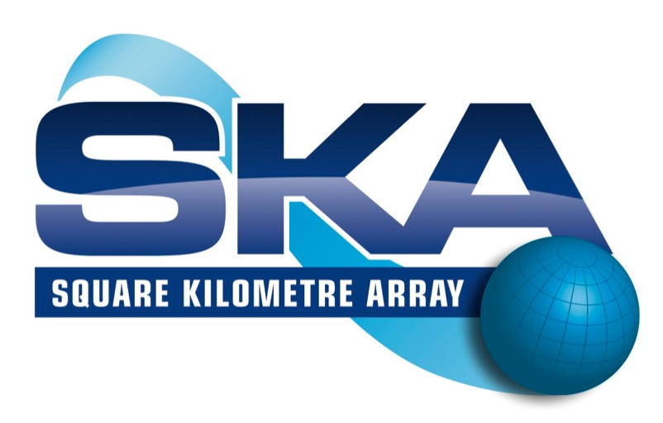
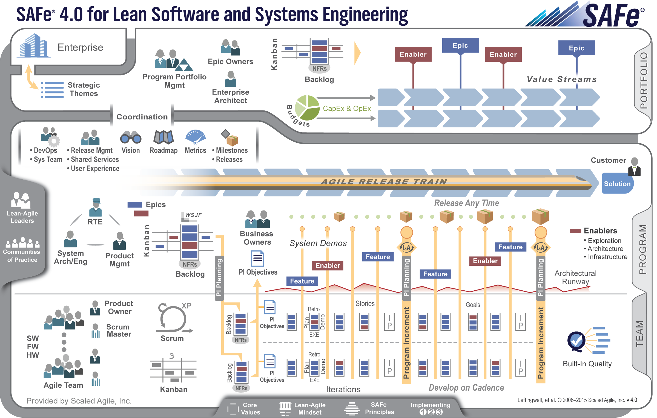
A Brief Introduction to SAFe®
Ian Spence
Monday 2nd October 2017

Slide 2
Agenda
Why Agile?
Why SAFe ®?
Coordinating Large Solutions and Distributed Teams
Q & A

Slide 3




Nothing beats an Agile Team
7 + or - 2 full-time people
Empowered
Self-organized, self managing
Cross functional
Stays together, preferably co-located
Produces working software every two weeks
Applies basic scientific practice: Plan—Do—Check—Adjust
Exemplifies agile values
Product
Owner
Scrum
Master
Development
Team
Your one-stop shop for working software
Notes:
Cross-functional, self-organizing entities that can define, build and test a thing of value
Applies basic scientific practice: Plan—Do—Check—Adjust
Delivers value every two weeks

Slide 4
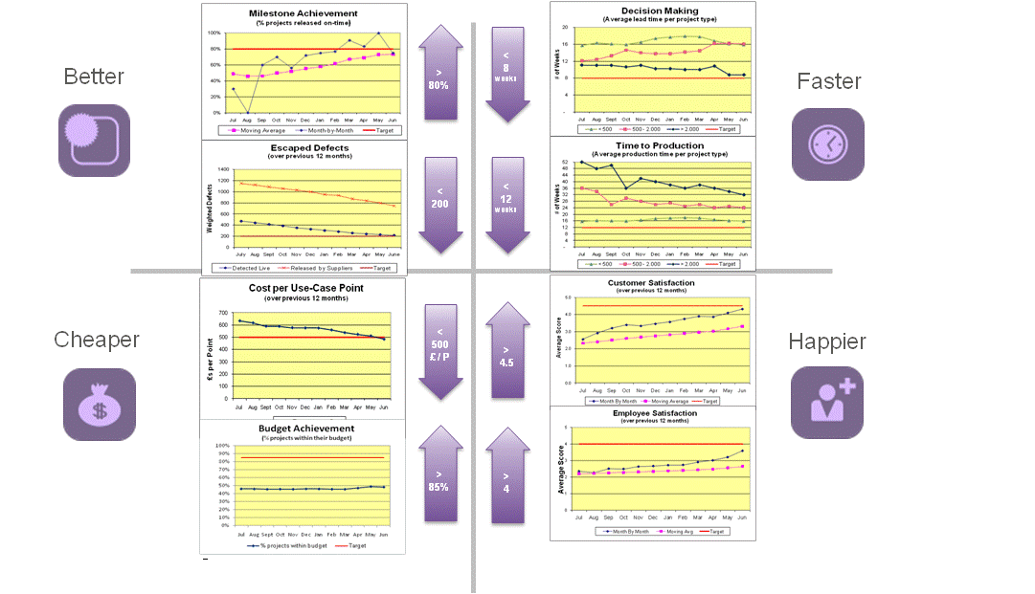
Agility has many benefits
Increased predictability
Faster feedback
Increased transparency
Empowerment
Reduced cycle times
Increased probability of success
BETTER
FASTER
CHEAPER
HAPPIER
From big-bang delivery
To incremental delivery
To continuous availability…
…with release on demand

Slide 5
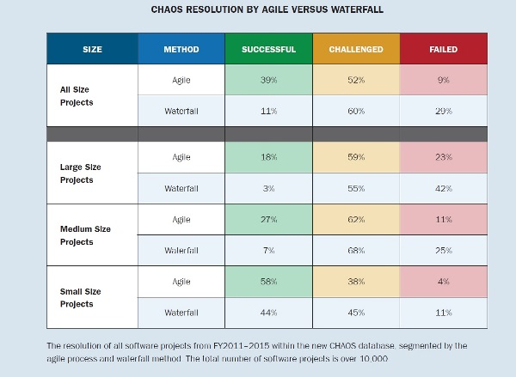
Waterfall versus Agile
https://www.infoq.com/articles/standish-chaos-2015

Slide 6
Waterfall versus Agile
“The overall results clearly show that waterfall projects do not scale well, while agile projects scale much better.”
Standish Chaos Report 2015
https://www.infoq.com/articles/standish-chaos-2015

Slide 7
Agenda
Why Agile?
Why SAFe ®?
Coordinating Large Solutions
Q & A

Slide 8
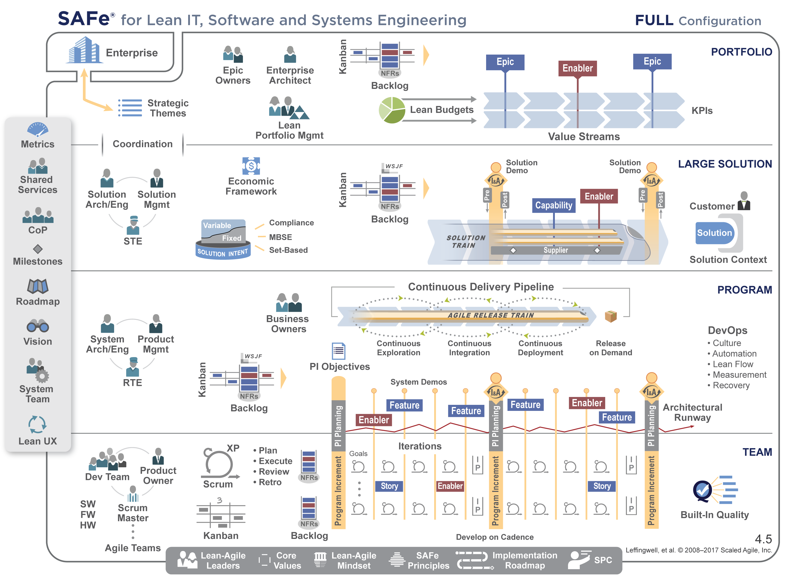
The Scaled Agile Framework (SAFe®)
SAFe® is a freely revealed knowledge base
of integrated, proven patterns for enterprise Lean-Agile development.
ScaledAgileFramework.com
Core Values
Code Quality
Program Execution
Alignment
Transparency
Synchronizes alignment, collaboration, and delivery for large numbers of teams
Knowledge for people building the world's most important systems

Slide 9
The Scaled Agile Framework (SAFe®)

Slide 10
The Scaled Agile Framework (SAFe®)

Slide 11
The Scaled Agile Framework (SAFe®)

Slide 12
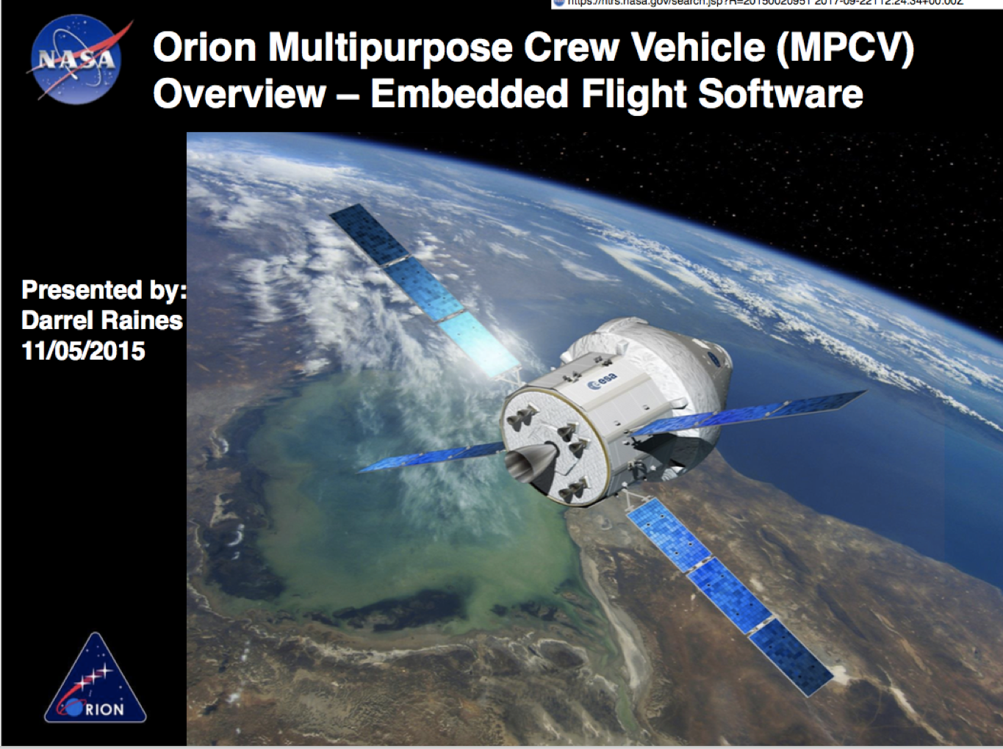
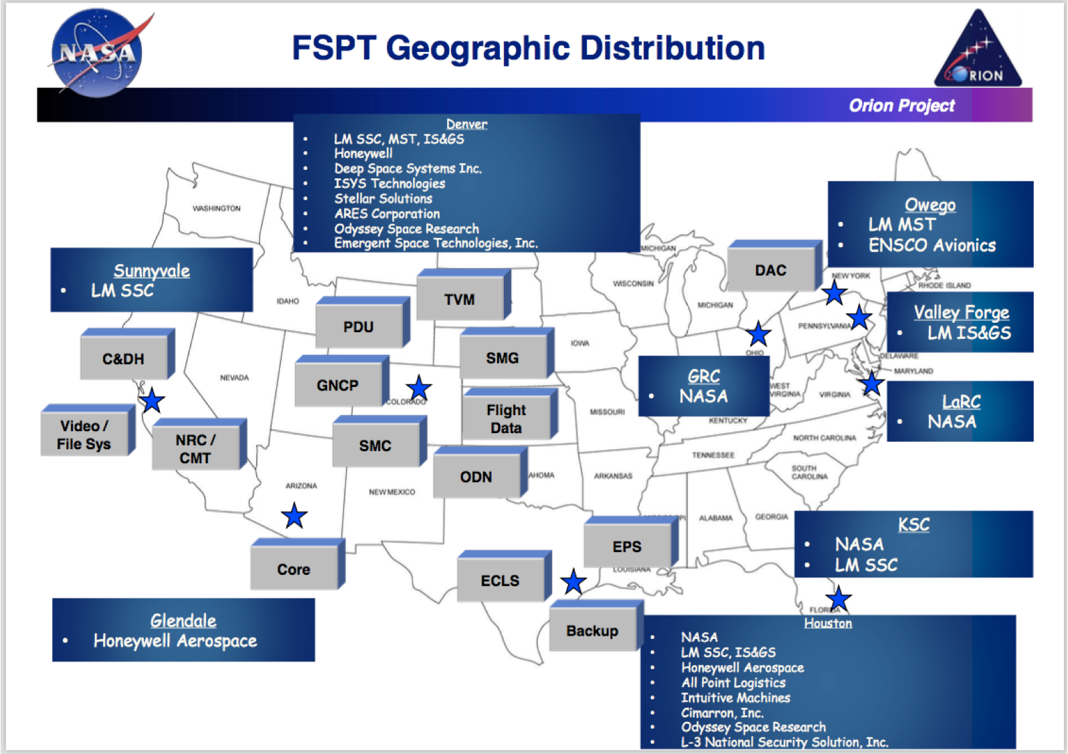
Safe @ NASA

Slide 13
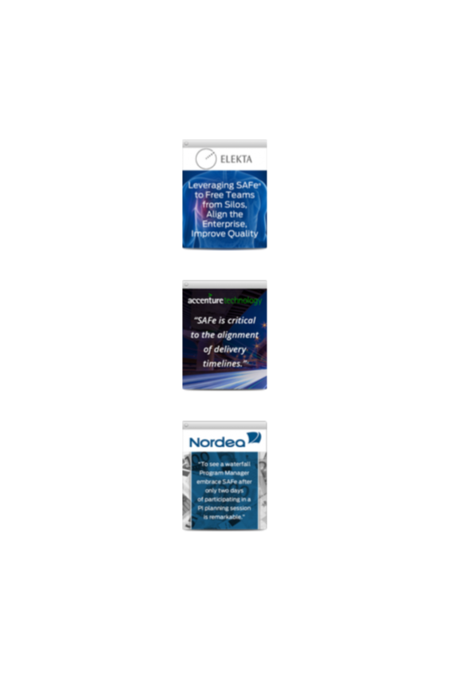
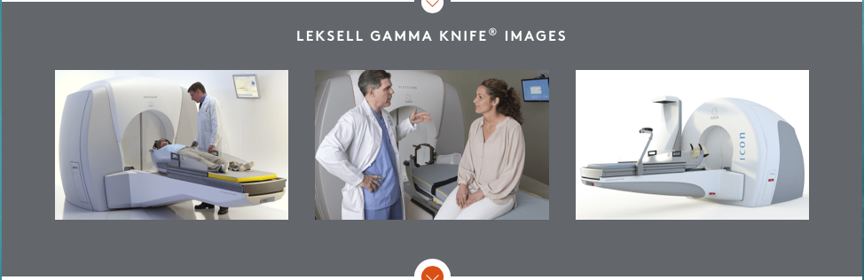

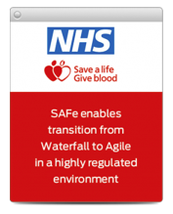
My experiences
Brain Surgery Without the Knife
Deutsche Bank
PI Planning without meeting.
Distributed trains and teams across five countries

Slide 14
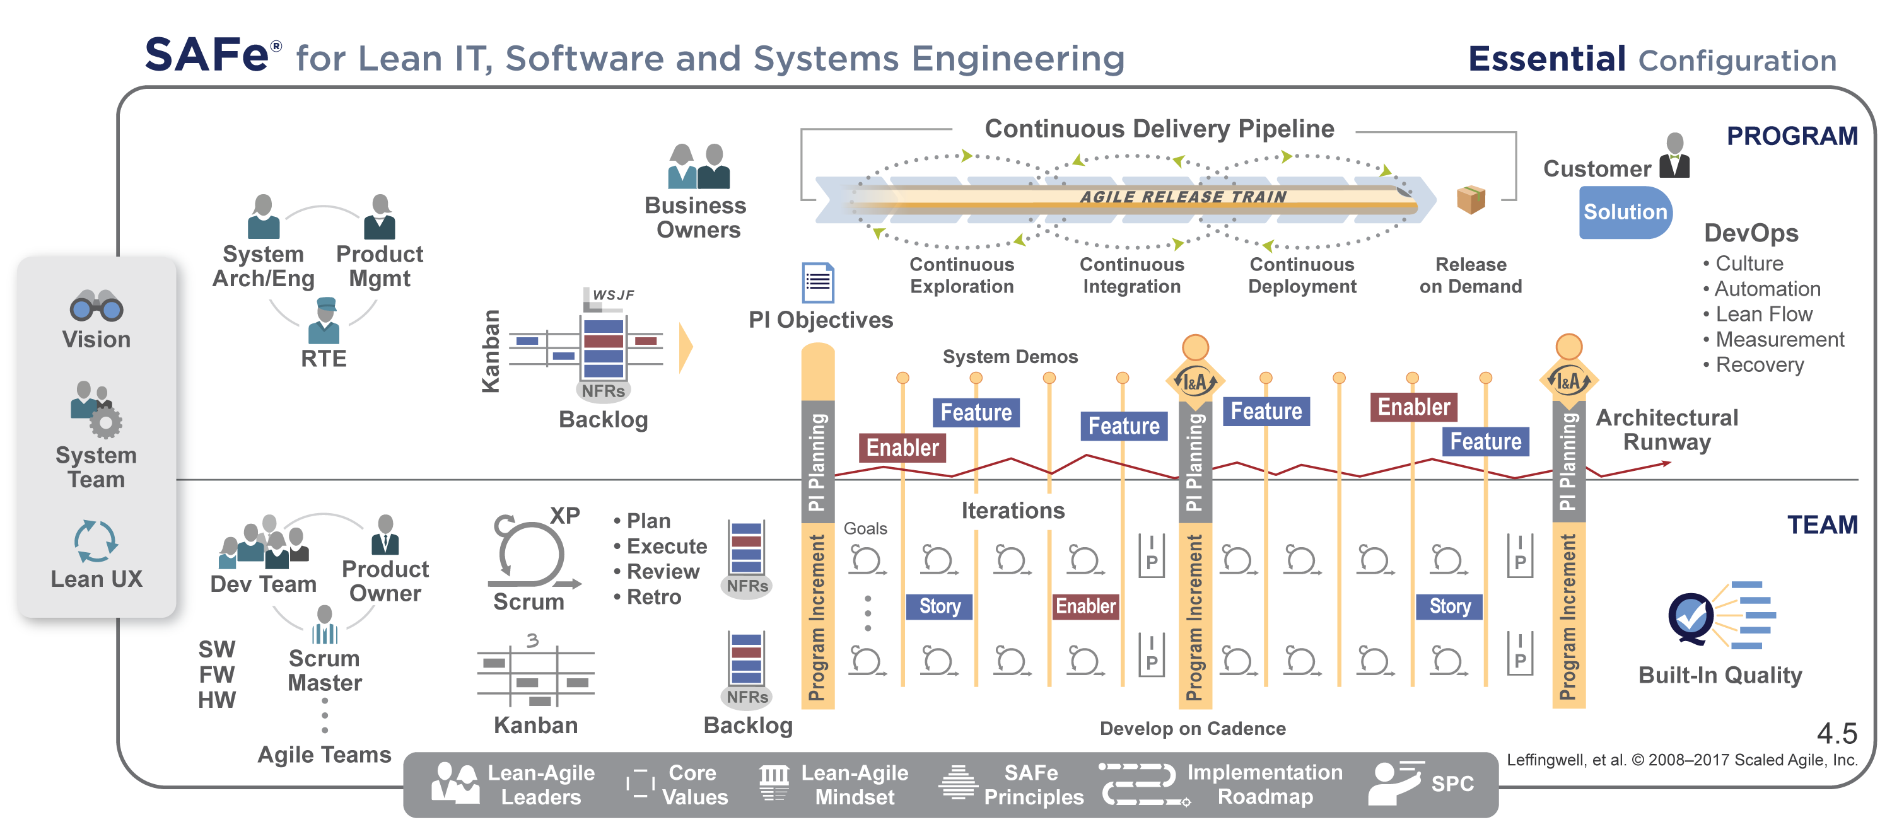
Essential SAFe ® provides the basis for success

Slide 15
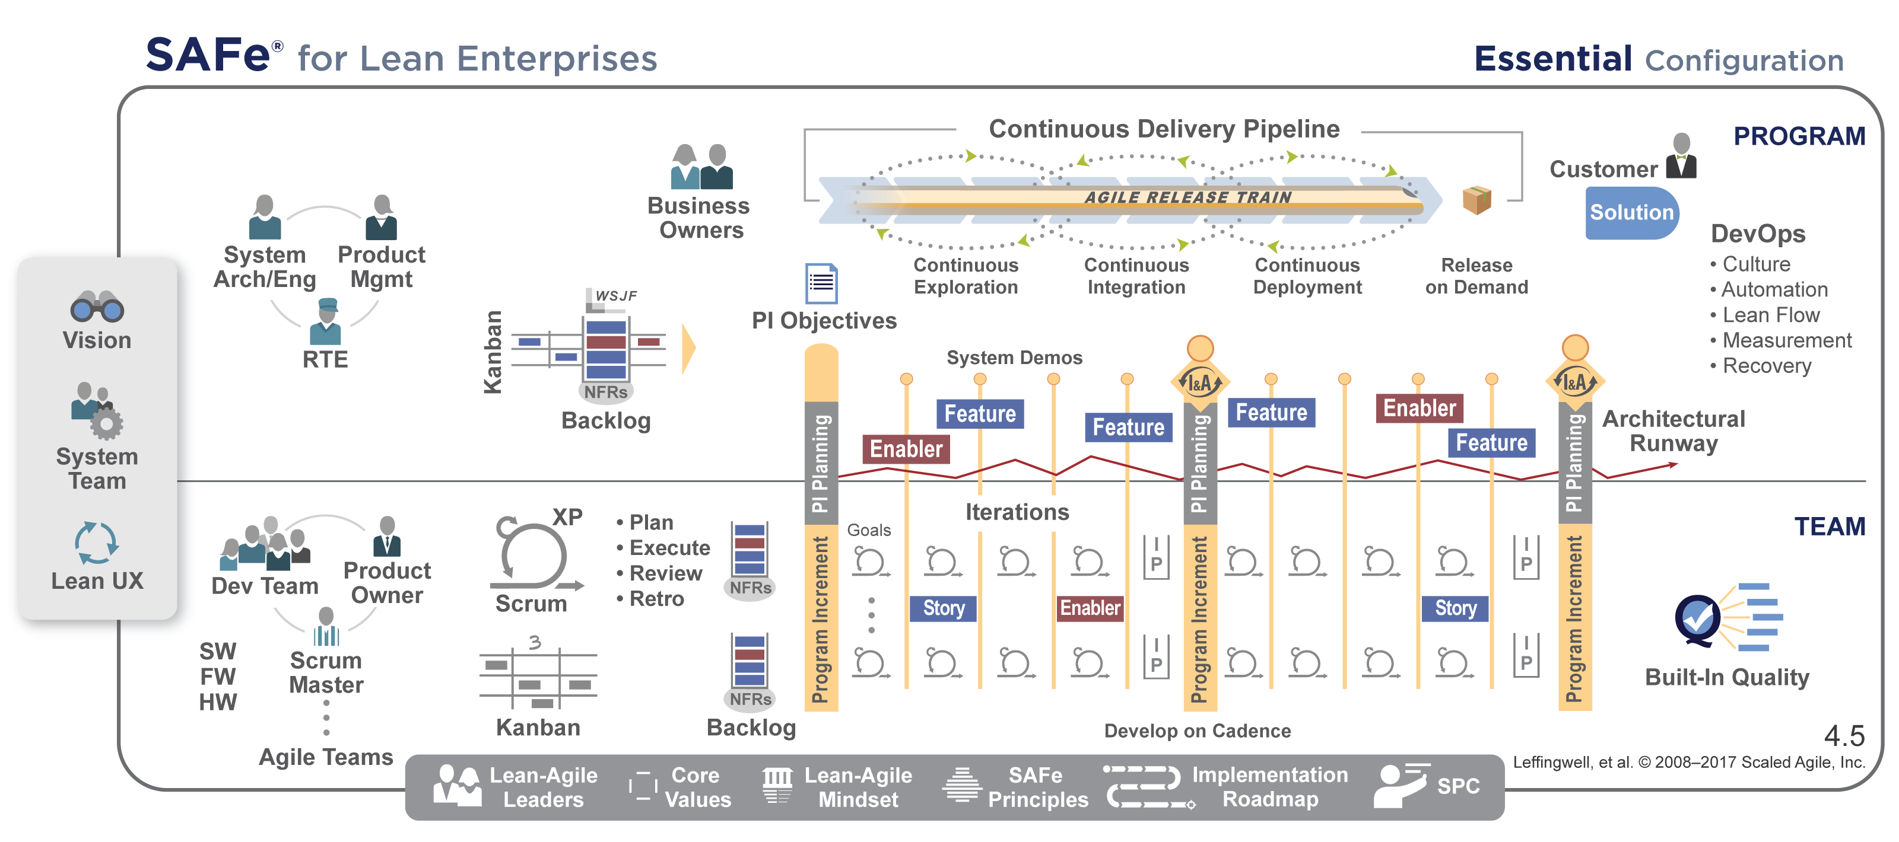
Aligning a team of Agile Teams
Align 50-125 practitioners to a common mission
Apply cadence and synchronization, Program Increments every 6-12 weeks
Provide Vision, Roadmap, architectural guidance
D
C
A
P
D
C
A
P
D
C
A
P
D
C
A
P
D
C
A
P
D
C
A
P
D
C
A
P
D
C
A
P
Notes:
Previously we said “nothing beats an Agile Team”….. Actually though, there is one thing that beats an Agile Team. That's a team of Agile Teams.
They work together and take an approach that says, "Let's take these plan-do-check cycles, and let's accumulate those into larger cycles."
We call this the Agile Release Train.
The Agile Release Train aligns 50 to 125 practitioners to a common mission.
We apply cadence and synchronization, program increments every 6 to 12 weeks. So these sprints, or iterations in SAFe, add up very quickly into larger amounts of value.
We provide vision, roadmap, and architectural guidance. There may be 10 or 15 teams on this train.
For example: Let's say we're going to implement single sign-on…. We need to decide how to do that, and we want everybody to do it the same way to make sure that we don't introduce security holes in our single sign-on mechanism.

Slide 16

With some Architectural Runway
Architectural Runway—existing code, hardware components, etc. that technically enable near-term business features
Feature
Enablers build up the runway
Features consume it
Architectural Runway must be continuously maintained
Enablers extend the runway
Feature
Feature
Implemented now …
Enabler
… to support future features
Architectural Runway
Notes:
Those teams have some Architectural Runway.
Architectural Runway isn't a model or a design; it's existing code. It's hardware components and software functionality that technically enable near-term business features.
We show this red runway line going up and down because it does go up and down. We build some, we use some…. we build some, we use some….. build some…. use some…
We use the term "Enablers," to refer to a construct or work item that helps us build the things that we need to host the features that we’ll require. And they build up the runway and extend it.
Features consume the runway. The business features use the runway, so pretty soon we need some more. That means we must continually maintain the Architectural Runway….. So we build it, use it, and extend the runway over time.

Slide 17







Bringing together the necessary people
Business
Product
Mgmt
Arch/
Sys Eng.
Program
Hardware
Software
Testing
Deployment
AGILE RELEASE TRAIN
Notes:
The ART truly takes a systems view.
It brings together the people we need to deliver larger amounts of value. That includes our business owners, our representatives from the customers, product management, architecture, systems engineering, hardware, software, testing, people involved in manufacturing or deployment of our solution…. We create this virtual program.
And the virtual program now has the skills they need. So the ART is cross-functional as well. And it typically contains about 50 to 125 people.

Slide 18
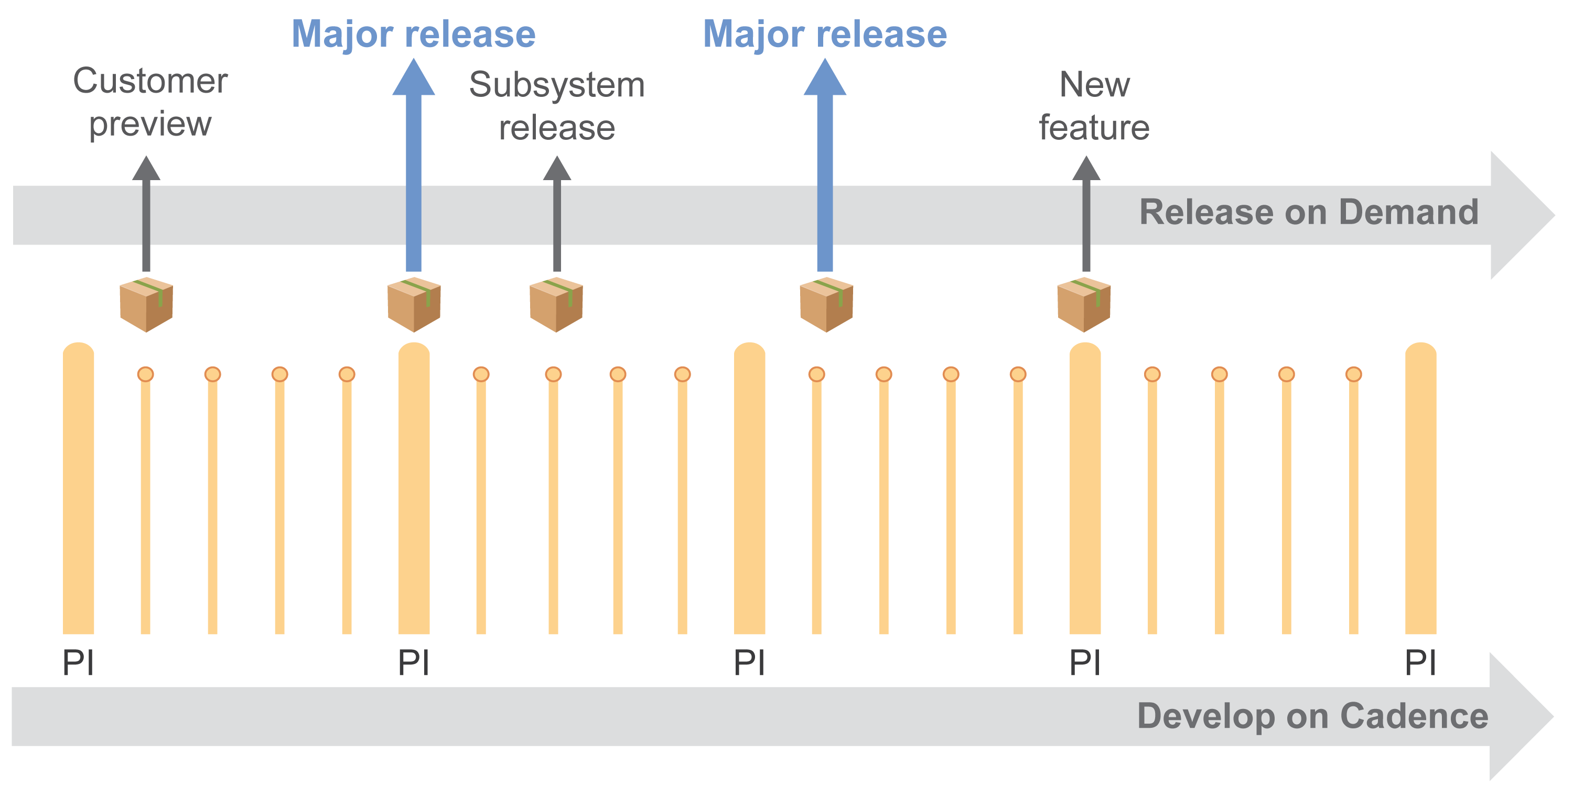
Release on Demand

Slide 19
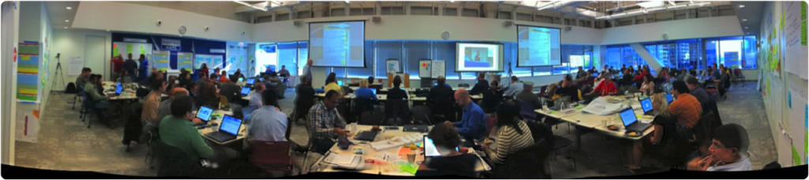
Synchronizes with PI Planning
Future product development tasks can’t be pre-determined. Distribute planning and control to those who can understand and react to the end results.
— Michael Kennedy, Product Development for the Lean Enterprise
All stakeholders face-to-face (but typically multiple locations)
Management sets the mission, with minimum possible constraints
Requirements and design emerge
Important stakeholder decisions are accelerated
Teams create—and take responsibility for—plans
For a short video PI planning example, see: https://youtu.be/ZZAtl7nAB1M
Notes:
The ART synchronizes its work with PI Planning.
Michael Kennedy explained it as: "Future product development tasks can't be predetermined. Distribute planning and control to those who can understand and react to the end results."
Here you see a picture of a distributed planning session. There are actually three countries at work here. There's a large group in Mumbai, India; they're not present. There are a lot of folks from Chicago, and some leads and some managers from the teams in Serbia. They're all planning together over a two-day period.
Typically PI Planning is face to face, but, if it's a large organization, you may not be able to have everybody face to face every time.
Management sets the mission, with minimal possible constraints—that's a key philosophy of Lean Thinking.
Requirements and design emerge. We talk about emergent design as one of the key aspects of Agile, and it emerges here. We call this PI Planning, but there's far more than planning that happens. People collaborate, they determine new requirements, they negotiate teams and dependencies.
Business owners add features and take out features to manage scope. Important stakeholder decisions are accelerated in a day—not after six weeks of emails banging around, trying to find the right person to make the decision, but right now.
In this picture, one group of managers at a PI Planning had a sign that said, "Help Desk—we're here to help." That was a great underscored the important construct that if decisions need to be made, they could make those decisions.
Ultimately, teams create and take responsibility for the plans, and that's a big difference from our traditional command-and-control, centralized program-planning model. In this case, management sets the vision, but the teams create the plans.

Slide 20
What is an Agile Release Train?
Portfolio
Epic
Program
Program Backlog
8-12 week
Program Increment (PI)
1..n
Feature
Fits In
PI
Product
Manager
Release
Train
Engineer
Architects
Team
2 week Sprint
1..n
Team Backlog
Story
Product
Owner
Scrum
Master
Fits In
Sprint
Development Team

Slide 21
What is a Program increment?
Portfolio
Epic
The bigger time-box that synchronizes the work of all the teams in the program and provides the regular planning cadence for the work.
The program increment is to the program as a Sprint is to an Agile Team
Develop on Cadence – Release on Demand
Program
Program Backlog
8-12 week
Program Increment (PI)
1..n
Feature
Fits In
PI
Product
Manager
RTE
Architects
Team
2 week Sprint
1..n
Team Backlog
Story
Product
Owner
Scrum
Master
Fits In
Sprint
Development Team

Slide 22
PI Planning – Aligning the Whole Team
Commitment
Goals
W
Input
Vision & Roadmap
Event Calendar
Prioritized Features
Capacity Plan
Velocity Forecast
Current Situation
Output
Commitment
Revised Forecasts
Revised Backlogs
Program Boards
Risks
Adjusted Teams
Alignment
t
PI Start
Set the Scene
Share the goals
Outline the events
Share strategy
Create alignment
Declare capacity
Pull
Collaborate
Commit
To objectives
To collaborations
To the PI objectives

Slide 23





PI Planning: Team Breakouts / Whole Team Planning
Input
Output
Sprint 1.1
Velocity: 34
Load: 30
Sprint 1.2
Velocity: 34
Load: 30
PI OBJECTIVES
Objectives /
Business Value
….
….
….
Stretch Objectives
1. ….
Program PI Objectives
Team A PI Objectives
Sprint 1.3
Velocity: 34
Load: 30
Sprint 1.4
Velocity: 34
Load: 30
RISKS
Team B PI Objectives
My
Team
Team C PI Objectives
Team J PI Objectives
...
My
Team
My
Feature
 |  | Sprint 1.1 | Sprint 1.2 | Sprint 1.3 | Sprint 1.4 | IP | Next PI >>
Milestones / Events
Team 1
Team 2
Team 3
Team 4
System Team
Help Needed | Shared Resource
 | External
My
Team
Product
Owner
My
Team
Team
Program Board
1. The Product Owner pulls a Feature for the Team to plan
2. The Team breaks the features up into stories and plans these reflecting their intentions in their Sprint boards and PI Objectives.
3. Feature completion and help needed are shown on the Program Board. Team Objectives are rolled up into Program Objectives

Slide 24
PI Planning: The Program Board
 |  |  | Sprint 1.1 | Sprint 1.2 | Sprint 1.3 | Sprint 1.4 | IP | Next PI >>
Milestones / Events
Team 1
Team 2
Team 3
Team 4
System Team
Help Needed | Shared Resource
 | External
Notes:
Draw our own program board…….

Slide 25
The Key to Success - Making and Meeting Commitments
Resistant Reluctant Existent Compliant Committed Compelled
Obsessed
Not bought in
Wait and see
Go through the motions
Do what you’re told
Self-motivated.
Go the extra mile.
No matter what, find a way to reach your goals
Whole team planning
Everyone does it at the same time
The teams commit to their objectives and one another
Two-Part Commitment:
The teams commit to their agreed objectives
If it becomes apparent an objective is not achievable then the team agrees to escalate immediately

Slide 26
Essential SAFe ®
Builds alignment:
  Face to face planning for teams of teams
  Shared backlog
  Shared events
Keeps things simple
  Features to prevent you drowning in Stories
  Fits into your organization so you don’t have to change everything
  A de-facto standard and common vocabulary
Keeps you going:
  Architectural runway
  Innovation and planning Sprints
  Program-level Inspect and Adapt
  Continuous integration

Slide 27
Agenda
Why Agile?
Why SAFe?
Coordinating Large Solutions
Q & A

Slide 28
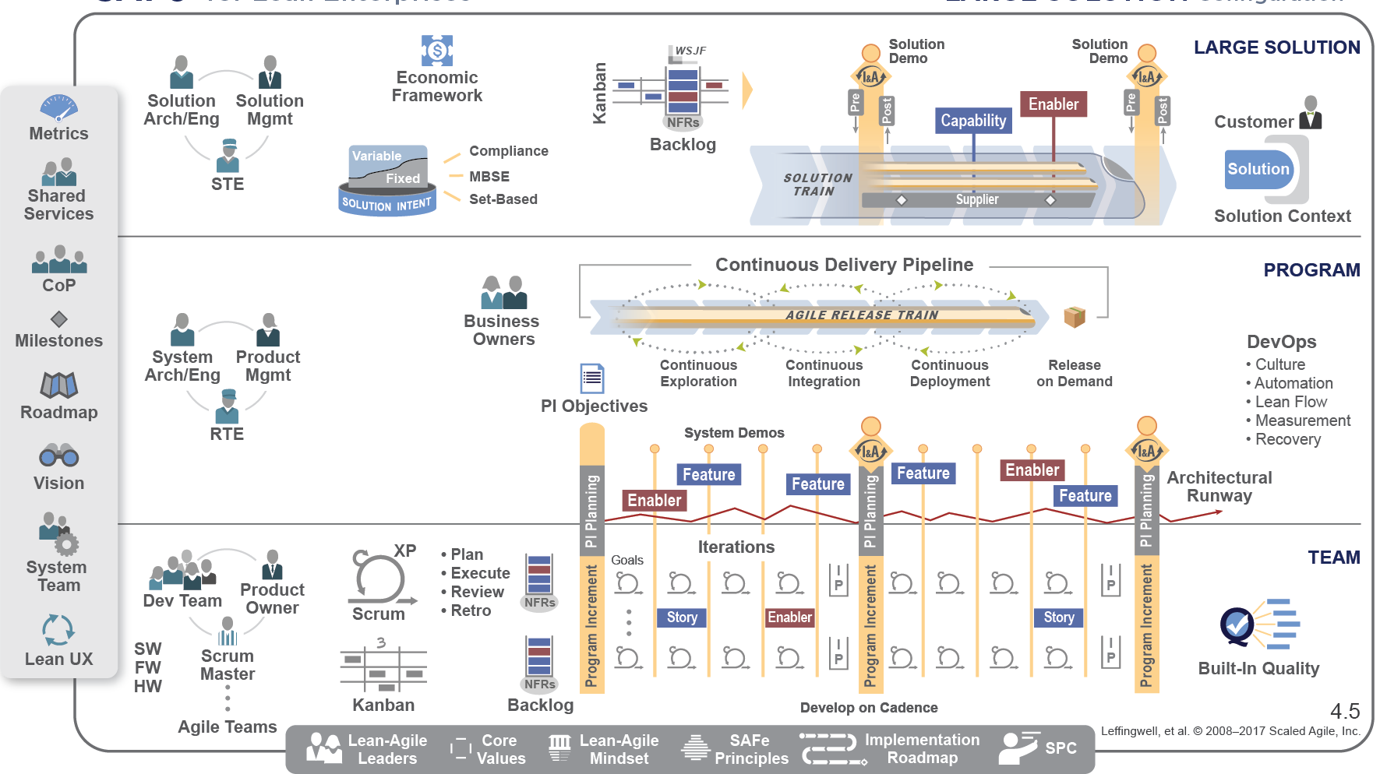
Large Solution SAFe ® coordinates ARTs with a Solution Train
Notes:
Coordinates development of large Solutions
Synchronizes multiple ART Value Streams
Manages Solution Intent
Integrates suppliers as partners
Value delivery via Capabilities

Slide 29
A recursive organization with three clear roles
Solution Architect
/ Solution Engineer
The overall technical authority for the solution
A team not an individual
Responsible for the technical excellence of the solution
Facilitates the creation of the architectural runway
Works with Solution Management to evolve the solution intent.
Solution Management
Product Management for the solution as a whole
A team not an individual
Responsible for the overall solution backlog and the prioritization of the work
Works with the Solution Architects to evolve the solution intent.
Solution Train Engineer
The Release Train Engineer for the train-of-trains
The closest thing to a program manager
Responsible for flow, health, hygiene and culture
Notes:
Coordinates development of large Solutions
Synchronizes multiple ART Value Streams
Manages Solution Intent
Integrates suppliers as partners
Value delivery via Capabilities

Slide 30
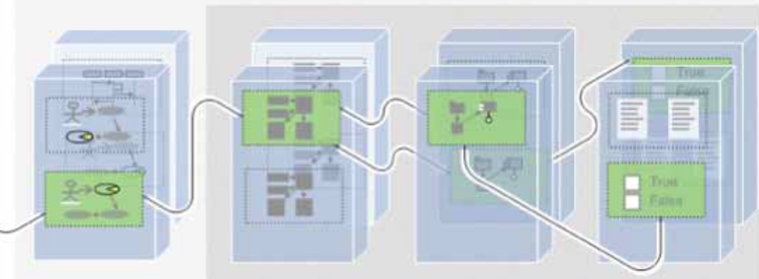
Solution Intent
Compliance
Model-Based System Engineering
Set-Based
Feature
Story
Story
Story
Story
Requirements / Use-Cases
Architecture & Design Models
Components
(Code &Run-time)
Test Assets and Test Results
The system is built in slices, each of which has clear value to the users.
Notes:
Coordinates development of large Solutions
Synchronizes multiple ART Value Streams
Manages Solution Intent
Integrates suppliers as partners
Value delivery via Capabilities

Slide 31
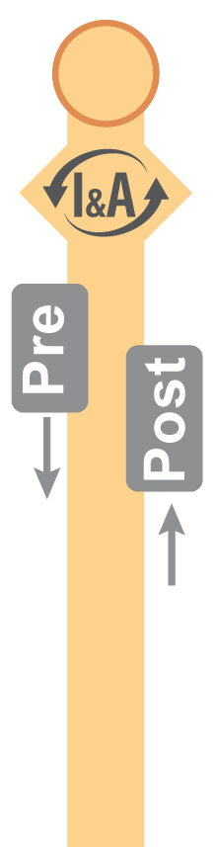
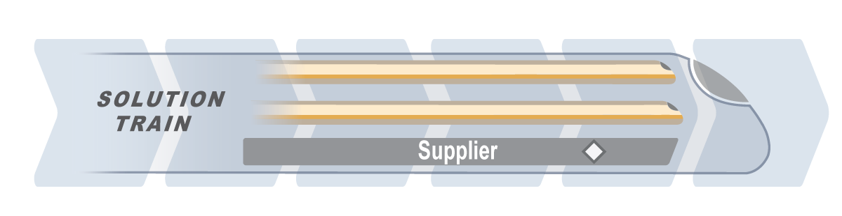
Pre and Post PI-Planning Meetings
Solution
Demo
Solution
Demo
Shared Time-Line
Common cadence
Waterfall contributor
Typically attended by: Customers, STE, Solution Mgmt, Solution Architects/Eng, Solution Train stakeholders and select representatives from the programs / trains
Pre-meeting helps build an aligned plan for the next PI and match solution demand to ART capacities
Post-meeting reviews, recaps, communicates and provides feedback
Notes:
Coordinates development of large Solutions
Synchronizes multiple ART Value Streams
Manages Solution Intent
Integrates suppliers as partners
Value delivery via Capabilities

Slide 32


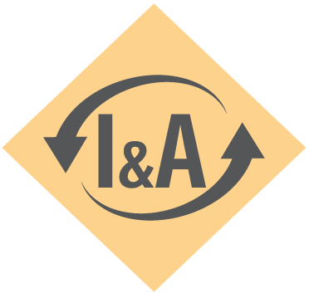
Frequent, planned integration across the whole solution
Frequent Solution integration and testing provides the best objective evidence
A joint responsibility of the Programs’ and Solution Train’s system teams
Provides early validation and regular risk reduction
Increases actual velocity
Full solution integration
Full or partial integration during the PI
Solution
System Teams
Program Increment
Program Increment
Program
Waterfall contributor

Slide 33
Distributed Teams – PI Planning
Portfolio /
Solution
No distribution 2 days
Distributed Trains 3 days
Distributed Teams 5 days
Pre and Post Planning Events
Context setting
Solution Management Reviews
Local time
Shared
Shared Time
Local Time
Program Context
Draft Plan Reviews
Final Plan reviews
Program
Team Breakouts
Team
The further distributed and time and space the teams are the longer the ceremonies take.

Slide 34
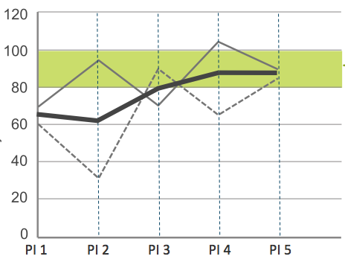
Full Transparency at all Times
Teams produce their own plans
Teams commit to one another
Teams work in an agile fashion
Teams deliver Features by
implementing stories
Other useful measures include program velocity, test coverage, escaped defects,
lead time, cycle time and cumulative flow diagrams amongst others
Feature Burn Up
Commitment Tracking
Program Predictability
Feature Burnup
Team 1 | S1 | S2 | S3 | S4
Obj1 |  | ✓ | ✓ | ✓
Obj2 |  |  | ✓ | ✓
Obj3 |  |  |  | ✓
Obj4 |  |  |  | ✓
Obj4
Notes:
Add some measurement stuff….

Slide 35


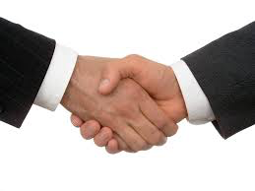
Separating targets, forecasts and commitments
Aspirational
Relative
SMART
Targets
Unbiased
Limited detail
Based on past performance
Forecasts
Time-boxed
Reflect targets & forecasts
Trend monitoring
Commitments

Slide 36
Moving to SAFe®: It’s a leadership challenge
From a Traditional Approach |  |  | To a SAFe Approach
#1 | Centralized control
#2 | Project overload
#3 | Detailed project plans
#4 | Centralized long-term planning
#5 | Work Breakdown Structures w. man-day estimates
#6 | Project-based funding and control
#7 | Progress via waterfall milestones and sign-offs
#8 | Big up-front, fully detailed requirements and design
Decentralized decision-making
Capacity management and
continuous flow
Program boards, backlogs and
team boards
Decentralized, rolling-wave,
planning
Content breakdown w. relative
estimates
Self-organizing, self-managing
departments, programs and teams
Progress via working,
tested systems
Just-in-time, flow-based evolution
of the system as a whole

Slide 37
Thank You
Any further questions contact:
ispence@ivarjacobson.com

Slide 39
Further implications
SAFe® is:
  Flow and cadence based.
  Continuously builds value and reduces risk.
Consequently, SAFe® doesn’t have:
  Fixed product definition
  Fixed requirements
  A definite work breakdown structure
Instead it has:
  An evolving architectural runway.
  A working product demonstrated frequently.
  A building block of 5-10 person long-lived teams.
  Up to a 4 level hierarchy to scale these teams

Slide 40
Further implications

