Slide 1
SAFe Construction Planning Workshop
AIV Discussion
Richard Lord
2 October 2017

Slide 2
Overview
AIV embraces the agile approach to software development and roll-out
Integrate often
Release as needed
Software functionality adapted according to the availability of products
System verification adapted to the availability of software functionality

Slide 3
Roles & Responsibilities
Assume that AIV is represented in the System Team
Reminder: The roll-out of software functionality should be dictated primarily by commissioning objectives
Need to clarify AIV's roles & responsibilities

Slide 4
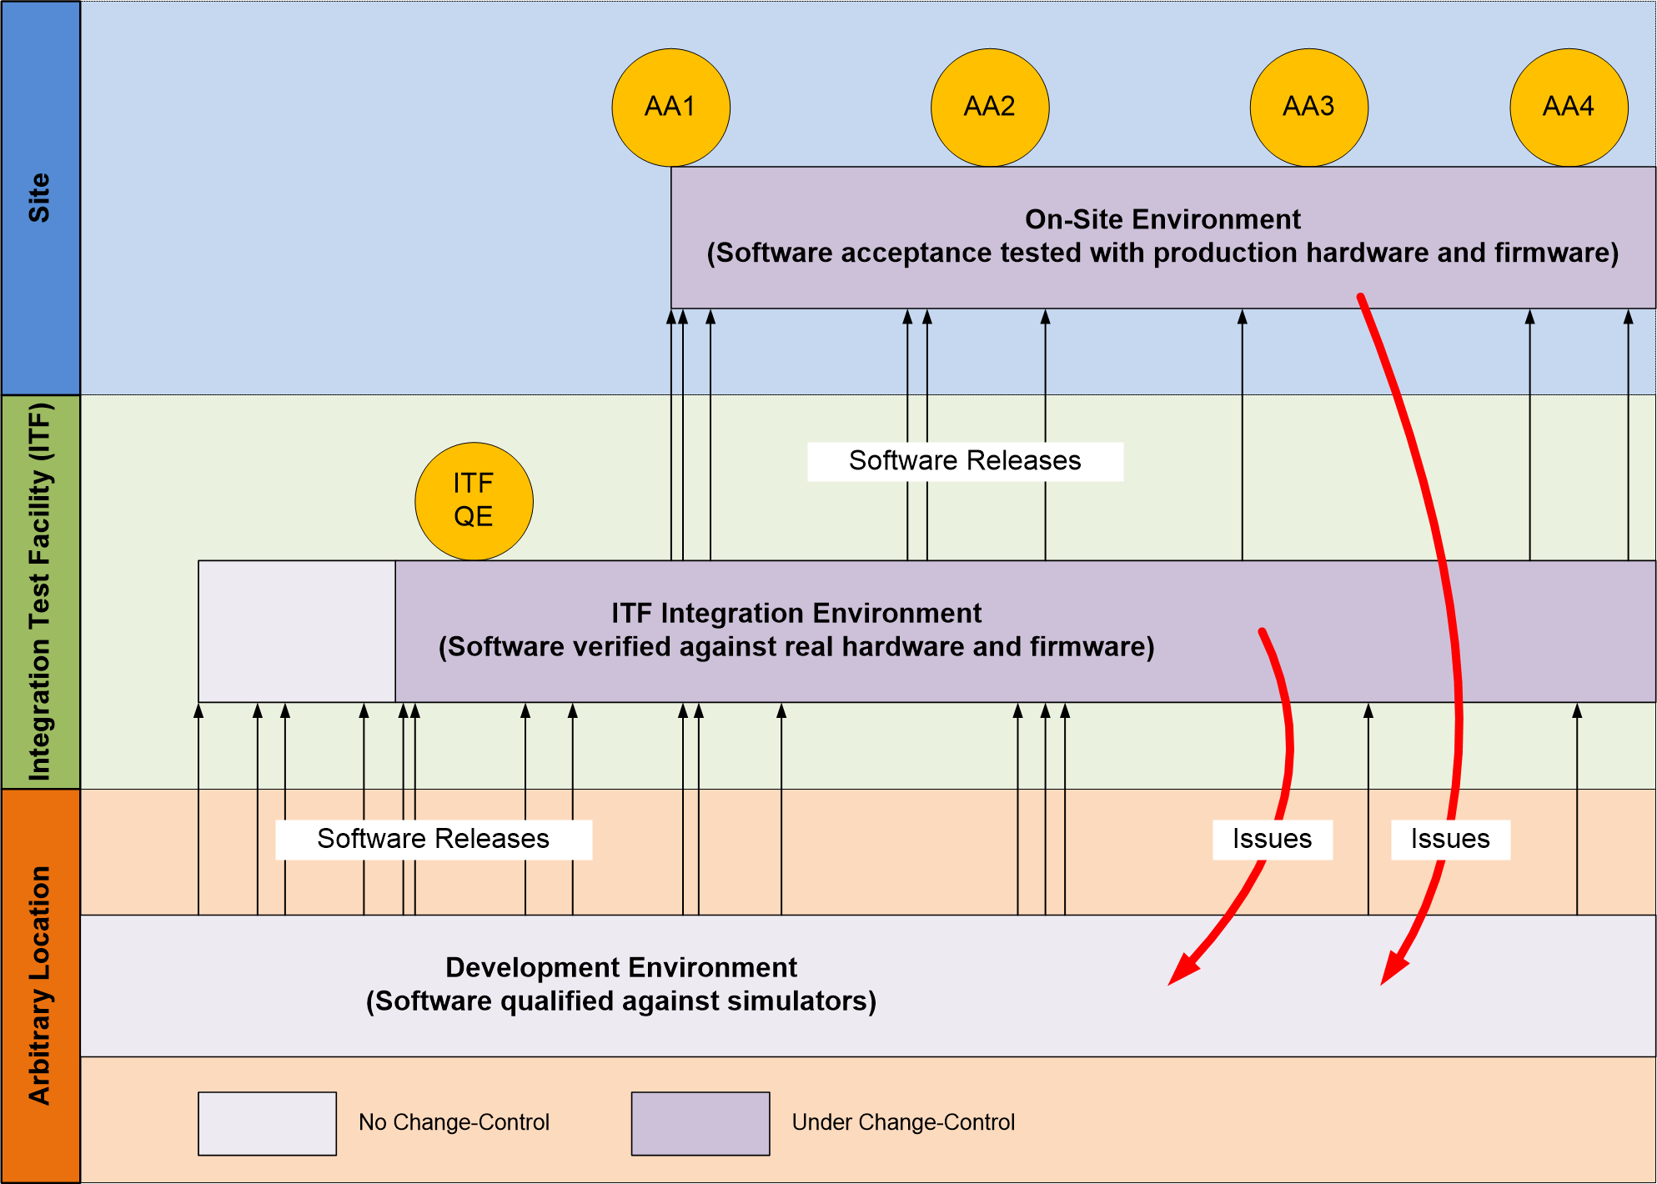
Roll-Out Plan Rev 5 (discuss)

Slide 5
Roll-Out Plan Rev 6 (discuss)
Software Development Environment
Continuous
Integration
Release
on Demand
Release
on Demand
Virtual ITF ^{(*)}
(Cloud Environment)
System ITF
On-Site
^{(*)} Has this been costed for?

Slide 6
Configuration Management
The term “Revision Control” might be more applicable than “Change Control”
Software needs to be able to roll-back to a previous stable release
The revision of software needs to be known as part of documenting test configurations

Slide 7
Concerns
Not many
Agreeing on an agile software development approach does not mean we can defer proper planning
Program Increment Meetings: Need to be managed well to reach their objectives (many people involved)

Slide 8
^{Thank You}

