Slide 1
SAFe Workshop - Oct 17
Presenter: Ray Brederode

Slide 2
Agenda
Basic Assumptions
Implications of SAFe for TM
Work Breakdown Structure
Resource Breakdown Structure
Effort Estimates
Schedule Approach
Agile Teams
Concerns

Slide 3
Basic Assumptions
Implement Large Solution SAFe
SAFe applies to all software apart from hardware interfaces\software that cannot be compiled on a commonly available architecture (emulator\simulator needs to be provided in that case)
SKA will provide cost cover for Solution Level as well as parts of system and shared service teams.
Support infrastructure e.g. software repositories, website for documentation, continuous integration and test frameworks for developers, communication tools (issue tracking etc) will be provided by SKA
Program Increment and Solution Demos will be defined 3 monthly. Team Level Sprints to run 2 weekly.
Construction consortia to provide emulators\simulators etc for other consortia.
Solution Level virtual ITF will be provided by SKA (outside scope of TM contractor)
Program \ Team level Development Infrastructure to be provided by TM contractor

Slide 4
Implications for TM?
Work Breakdown Structure
Alignment with SAFe
Resource Breakdown Structure
Alignment with SAFe roles
Product Manager
Product Owners
SCRUM Masters
Etc
Travel Estimates
PI Planning
F2F Every 3 months
Cost Model \ Cost Report
Alignment with WBS (work)
Alignment with RBS (roles)
Update travel costs
Schedule
Prepare high-level schedule
Prepare rolling-wave 3 PI lookahead schedule
Identify Fixed Date & Learning Milestones
Construction Plan
Alignment with SAFe Approach
Implications for SEMP...
Incremental Design & Qualification Baseline per AA

Slide 5
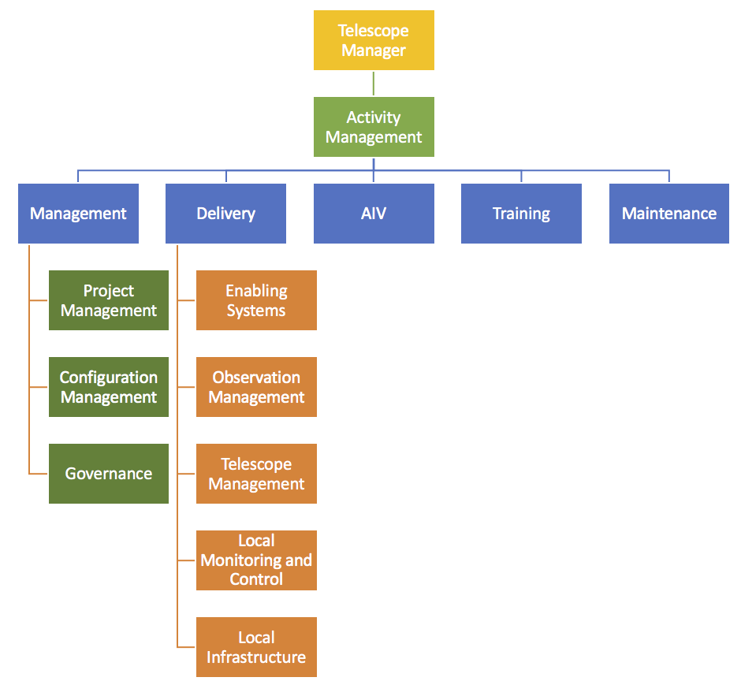
Current Work Breakdown Structure

Slide 6
New Work Breakdown Structure
Telescope Manager
Management
MGT
Agile Development
DEV
Suppliers
SUPP
Integration Verification Deployment Support
IVDS
Program Management
PM
Agile Team #1
Local Infrastructure
LINFRA
Observatory
OBS
Configuration Management
CFG
Agile Team #2
A A A
MID Telescope
MID
Governance
GOV
Agile Team #3
LOW Telescope
LOW
Agile Team #4

Slide 7
New Resource Breakdown Structure
Project Leader
System Architect
Product Manager
Development Manager
Release Train Engineer
Configuration Manager
System Engineers
Product Owners
SCRUM Masters
Software Engineers
Support Engineers
Test Engineers

Slide 8
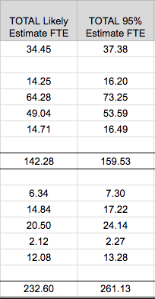
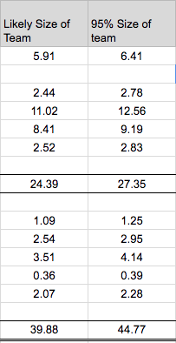
Effort Estimate Updates
4 Agile Teams:
6-7 individuals Each
Includes Product Owner and Scrum Master
~50% allocation of Product Owner and Scrum Master per team

Slide 9
Schedule Impacts
Different Approach to the Schedule…
Plan to have a high-level schedule
Captures high-level fixed date milestones
Captures high-level learning milestones
Plan to have a more detailed rolling-wave 3 PI schedule (Roadmap) at time of construction
Plan to have a Vision
Functional Roll-Out as per MID\LOW Roll-out Plans
Functions are allocated to more than one Element i.e. at Epic\Capability Level
Capabilities prioritized using WSJF
Capabilities refined to features during pre-PI planning and implemented

Slide 10
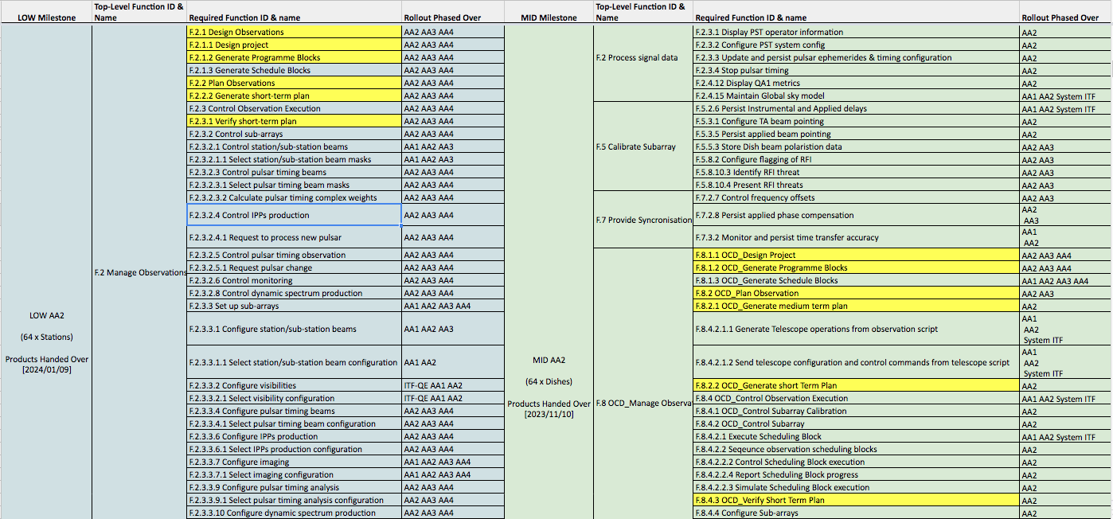
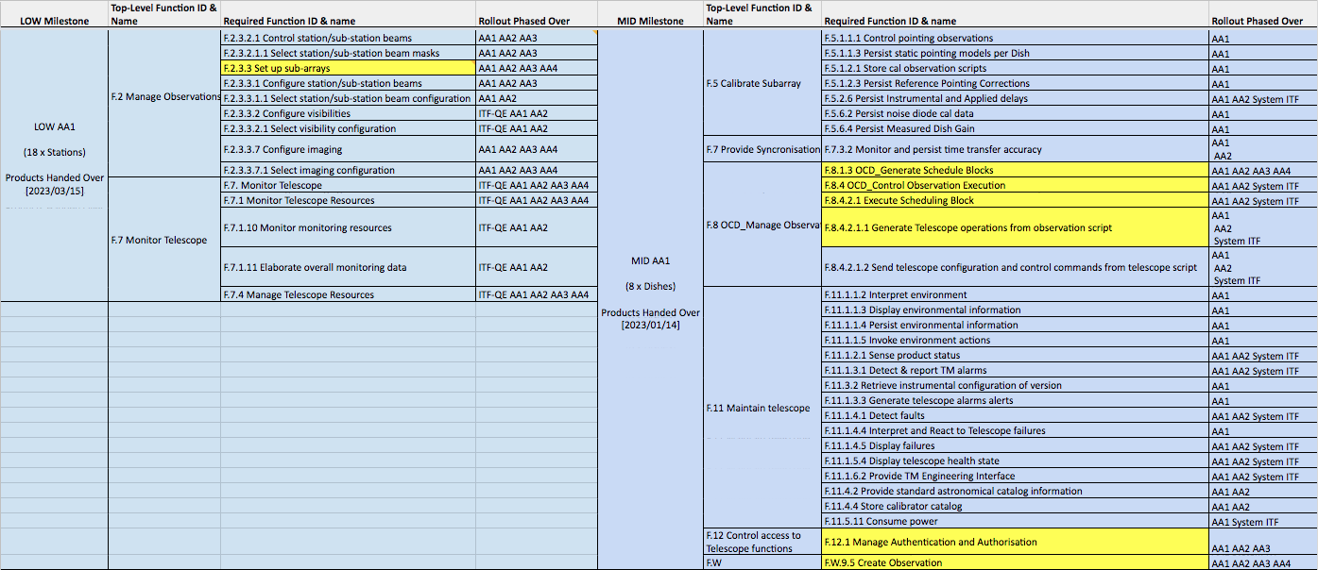
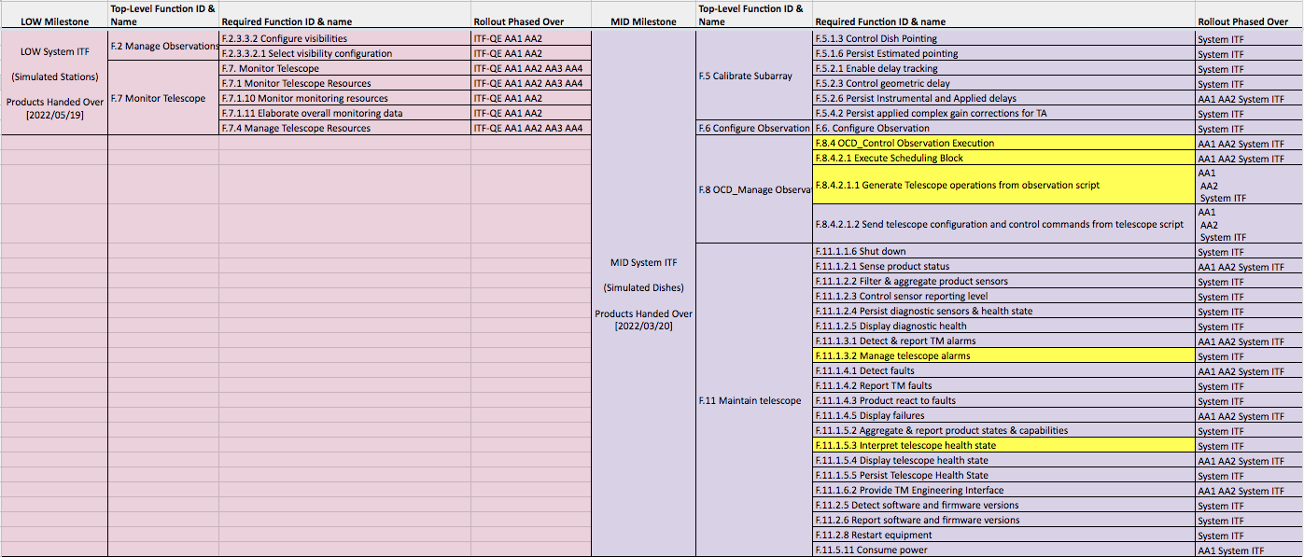
TM Vision

Slide 11
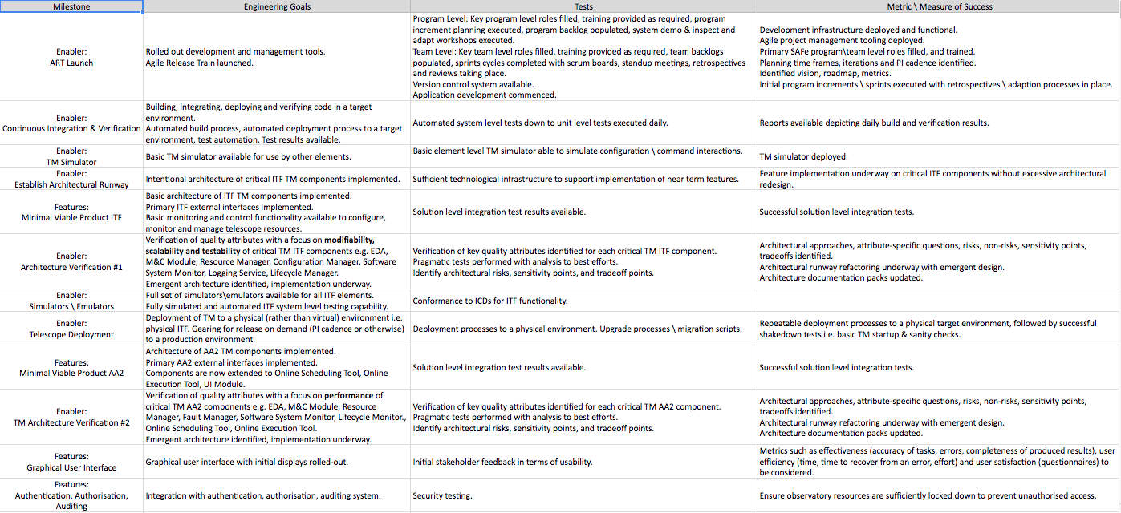
Learning Milestones
Milestone | Engineering Goals | Tests | Metric \ Measure of Success
Enabler: ART Launch | Rolled out development and management tools. Agile Release Train launched. | Program Level: Key program level roles filled, training provided as required, program increment planning executed, program backlog populated, system demo & inspect and adapt workshops executed. Team Level: Key team level roles filled, training provided as required, team backlogs populated, sprints cycles completed with scrum boards, standup meetings, retrospectives and reviews taking place. Version control system available. Application development commenced. | Development infrastructure deployed and functional. Agile project management tooling deployed. Primary SAFe program\team level roles filled, and trained. Planning time frames, iterations and PI cadence identified. Identified vision, roadmap, metrics. Initial program increments \ sprints executed with retrospectives \ adaption processes in place.
Enabler: Continuous Integration & Verification | Building, integrating, deploying and verifying code in a target environment. Automated build process, automated deployment process to a target environment, test automation. Test results available. | Automated system level tests down to unit level tests executed daily. | Reports available depicting daily build and verification results.

Slide 12
Concerns
Geographical splits within an Agile team
Product Owner in particular?
Allocation of Product Owners \ Scrum Masters to teams...50% basis...is it enough?
Allocation of features to Agile teams
Not clear how this will be done when multiple teams want to take up the work?
Who has the authority to delegate work to a particular team?
Who is the customer for SKA, how will the customer be represented in SAFe framework?
What are the expectations for configuration Reviews \ Baselines during construction?
What is the role of verification events in the Continuous Integration and Verification landscape of SAFe?

