Slide 1
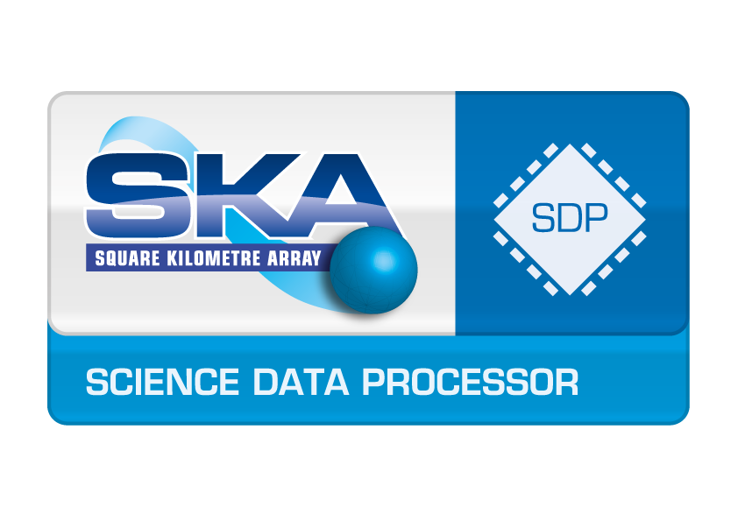
SAFe Workshop SDP
Ferdl Graser
SDP Systems Engineer
2 October 2017

Slide 2
Milestones
SAFe defines 3 types of milestones
PI milestones: objectively evaluate progress towards the technical or business hypothesis. Occur at PI cadence.
Fixed-date milestones: milestones driven by external events, third-party deliverables, external constraints, etc. These often call for fixed-date milestones that are distinct from the development cadence.
Learning milestones: demonstrate evidence of the viability of the current in-process solution.

Slide 3
Milestones
PI & Learning Milestones
Provide objective evidence of working systems
Performance Verification milestones
Risk driven step-wise performance evaluation of SDP at scale
Evaluation of alternative design options (set-based design)
The specific date at which these milestones occur is not important, rather the value added by objective measurement of a working system.

Slide 4
Milestones
Milestone background:
No reviews, sign-offs or formal baselines
Minimal Viable Product as early as possible
Incremental build-up of content
Working and tested systems
plan/milestones will change
Based on output of learning milestones
Continuous improvement: removing waste (non value adding activities)

Slide 5
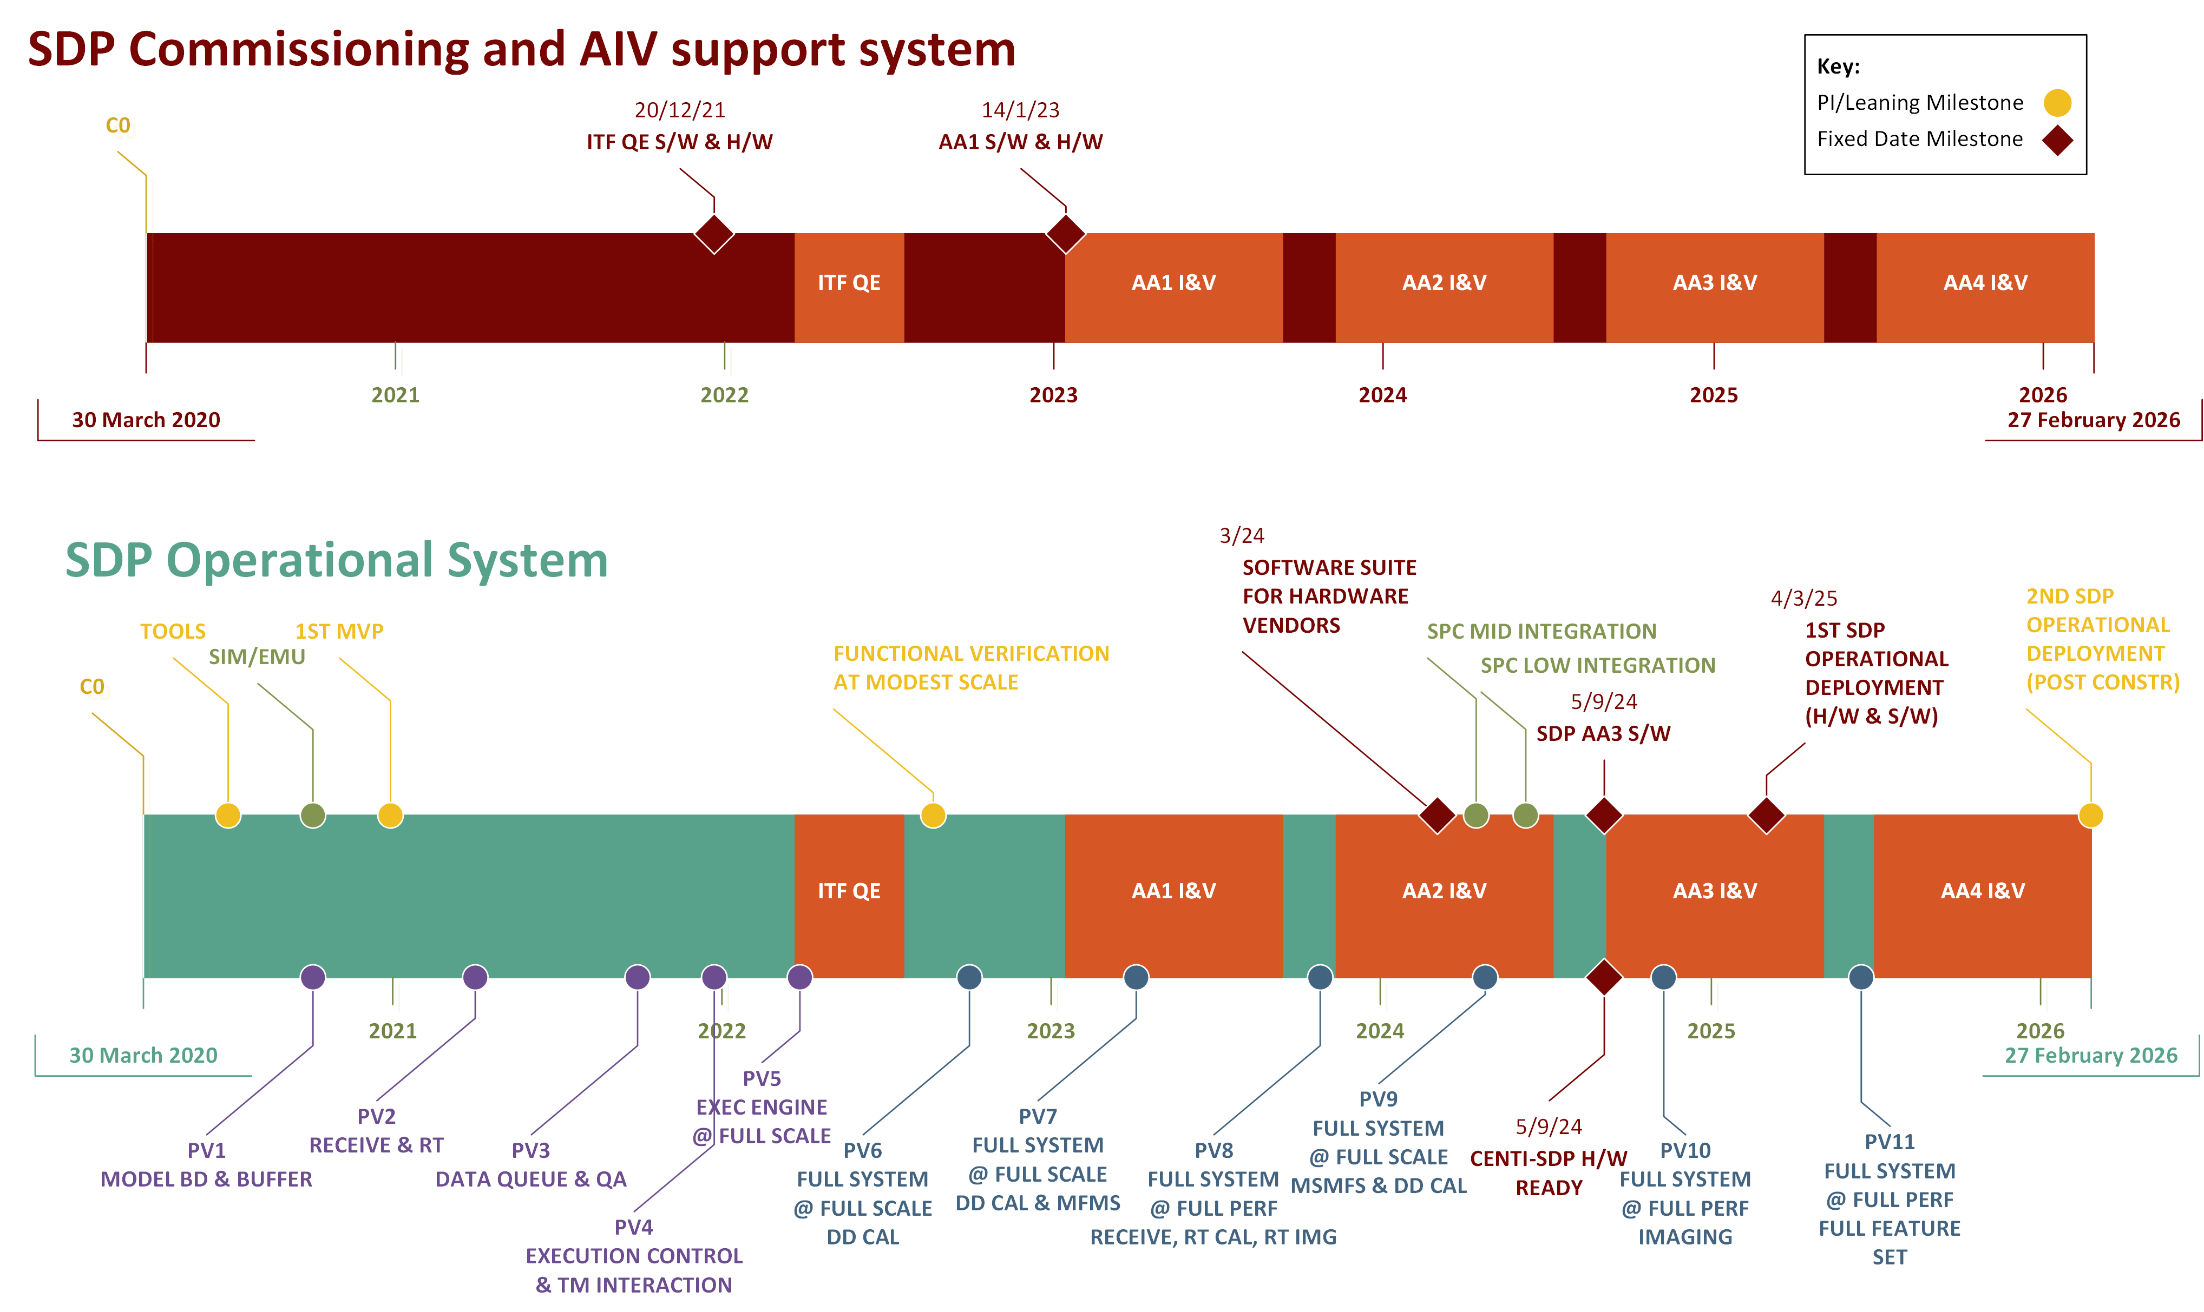
Notes:
2 track approach:
SDP Commissioning & AIV support system
- To support commissioning & AIV activities as required
- on-site system (ITF, MID & LOW)
SDP Operational System
- MVP in 9 months – first significant solution level integration
- Performance Verification testing ~6 months

Slide 6
Construction pre-meeting material

Slide 7
Construction Plan Vision
SAFe is essential for SDP construction
Risk driven
Balance lifetime cost against performance
Requires close stakeholder (SKAO) interaction to do trade-offs
Lots of unknowns
Construction Plan has been designed to minimise cost and risk
SDP Cost Estimate is based on the same principles and plan
Based on experience and risk register from SDP pre-construction

Slide 8
Construction Plan Vision
2 track s/w construction approach
SDP Commissioning and AIV support system
SDP Operational System
Minimal viable product established early on
Functionality and performance added according to WSJF (driven by science value)
Set-based design and construction elements
Execution Frameworks
Continued architecture refinement and detailed design through to product delivery

Slide 9
Construction Plan Vision
Verification and testing approach
Bulk of functional verification will be done via System Demos
Performance verification will be larger tests, see performance verification milestones
Transition between Construction and Operations can be a soft transition

Slide 10
Program Solution Intent
Solution intent is the repository for storing, managing, and communicating the knowledge of current and intended Solution behavior. Where required, this includes documented, fixed, and variable specifications and designs; reference to applicable standards, system models, functional and nonfunctional tests; and traceability.
Specifications: L2 requirements (incl ASRs), ICDs
Design: Architecture documentation (views & beyond) & supporting documentation, analysis, etc.
Tests: functional & performance verification/testing documentation

