Slide 1







Aperture Array Design & Construction Consortium
Low Frequency Aperture Array (LFAA)
LFAA Software Development
STFC (UK ATC)
Prepared by: Hermine Schnetler and Alessio Margo

Slide 2
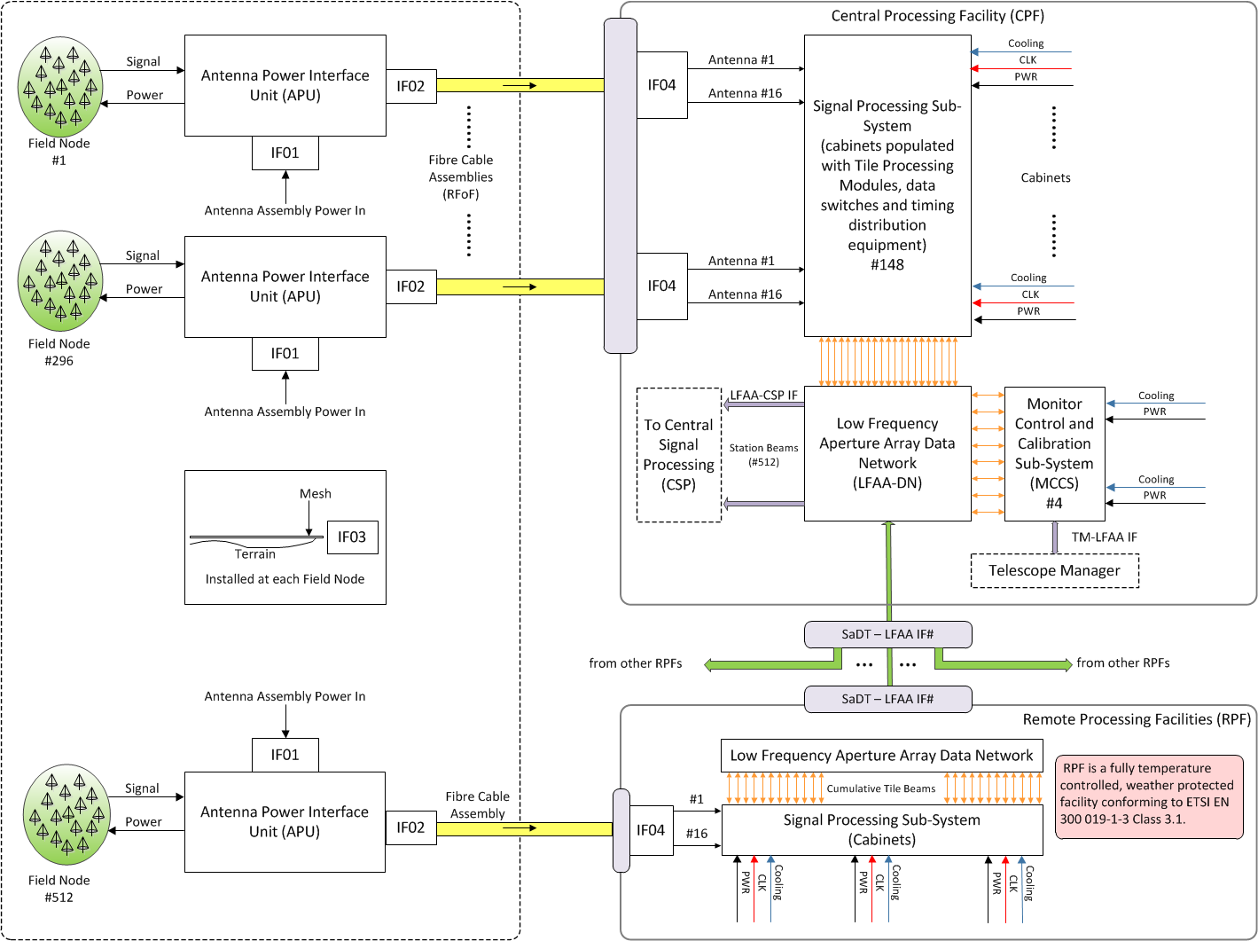

Slide 5
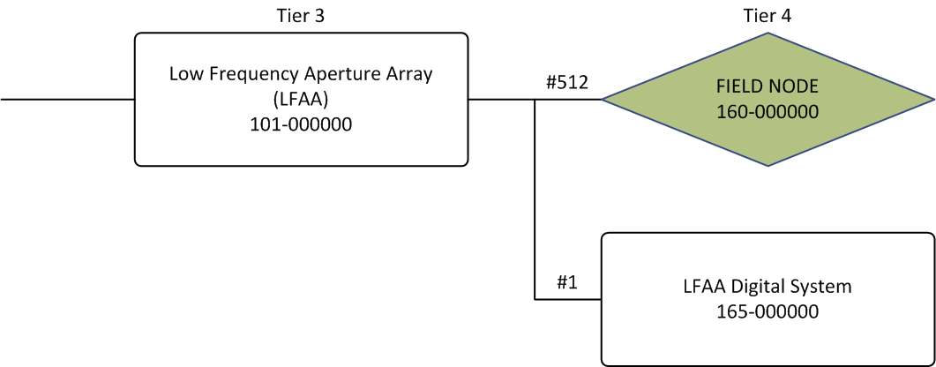
LFAA Product Breakdown Structure
WP1811 Contract Management

Slide 6
WP1814 Field Installation

Slide 7
Digital System (DS)
WP 1813 Assembly and Testing of LFAA Digital System
WP1813 LFAA Digital System Assembly and Testing

Slide 8

Software Configuration Items
WP1812 SW delivery
RTE
SA
PM

Slide 9
LFAA Software Configuration Items
Many aspects of the software for the LFAA can fall in-line with the operational/commissioning setup standardised for the SKA as a whole. These include:
  LMC system
  Hardware platforms and OS
  Most software products (correlation for calibration, calibration, signal diagnosis)
  Software development life-cycle (we currently use Scrum)
  Continuous integration and testing
  Continuous product assurance of software products
  Incremental development, release management etc.

Slide 10
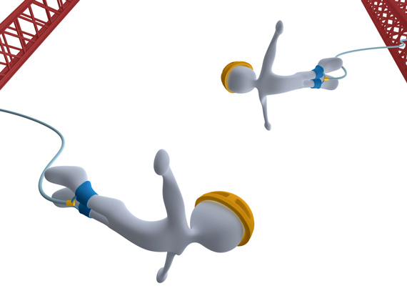
WP1812 SW Delivery:
Monitor, Control & Calibration Sub-system

Slide 11

SW 1812 Software Delivery
SPS Software

Slide 12
TPM FPGA

Slide 13
Tile Processing Modules (TPM)
  The software which controls the TPM is quite complex and difficult to simulate.
  For operating within a station, 16 TPMs need to be initialised and synchronised together. In order for incrementally updating the software (FPGA) for this we need either:
    A separate setup for continuous testing of new updates and features, or
    The possibility of using a subset of the deployed array and TPMs which is made available for this (can be scheduled as a “testing observation” from an operational point of view)
  Additionally, TPM firmware updates need to be reflected with associated software updates (can be tested in the same way as above)

Slide 14

Additional points
  Operations which require real-time data from the TPM (such as calibration) need data delivered from a TPM (probably can be simulated, but a digital board is very good at not sending packets in bursts, so this behaviour needs to be simulated as well).
  Hardware control (switches, PDUs etc. software updates need to be tested as well (on deployed hardware or separate setup for tests)?
  Probably best to be able to perform hardware-centric tests on parts of the deployed system or gold standard HW

Slide 15


