Slide 1
SKA HPC Co-design
Stefano Corda and Manuel Stutz
stefano.corda@epfl.ch
manuel.stutz@fhnw.ch
01-06-2023
SKACH Spring Meeting

Slide 2
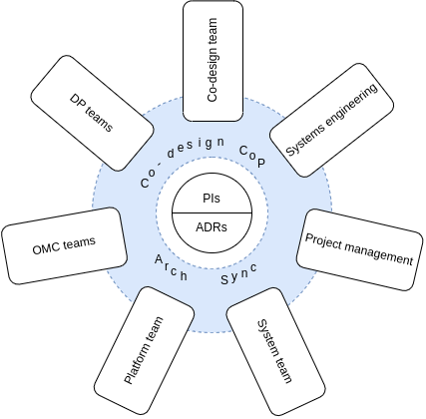
SCOOP Team
Shan Mignot (Product Owner) CNRS/OCA
Neil Quinn (Scrum Master) CGI
Chris Broekema ASTRON
Stefano Corda EPFL
Aristide Doussout CNRS
Anass Serhani INRIA
Manuel Stutz FHNW
Mission: “lead the co-design effort maximizing the yield of the SDP systems”

Slide 3
PI18 features

Slide 4
SDP-bench Refactoring
Quality assurance using Gitlab CI
2 Pipelines
Basic pipeline Lint, UnitTests, Validation of Dependencies, etc… Running on SKAO ST Shared Runners
Extended pipeline Run the real workloads on a cluster Running on CSCS Piz Daint

Slide 5
SDP-bench – Extended Pipeline
Running Gitlab CI Jobs on a cluster is non-trivial
Middleware between Gitlab CI Runner & Scheduler is required
Jacamar CI
Notes:
The runner generated script is submitted to the scheduler using sbatch. The runner controls the schedulers --output, --wait, and --job-name arguments while all user defined SCHEDULER_PARAMETERS are also integrated into the request.
Throughout the duration of the job the runner obtains the stdout/stderr by tailing the file (slurm-%j.out). All output to this file is reported back to the CI job log.
Once a job has been completed the final state is determined by the exit status of sbatch --wait ...

Slide 6
SST (lowest priority)
Collect program execution traces
Build network topology
Collect and “replay” traces
Demo

Slide 7
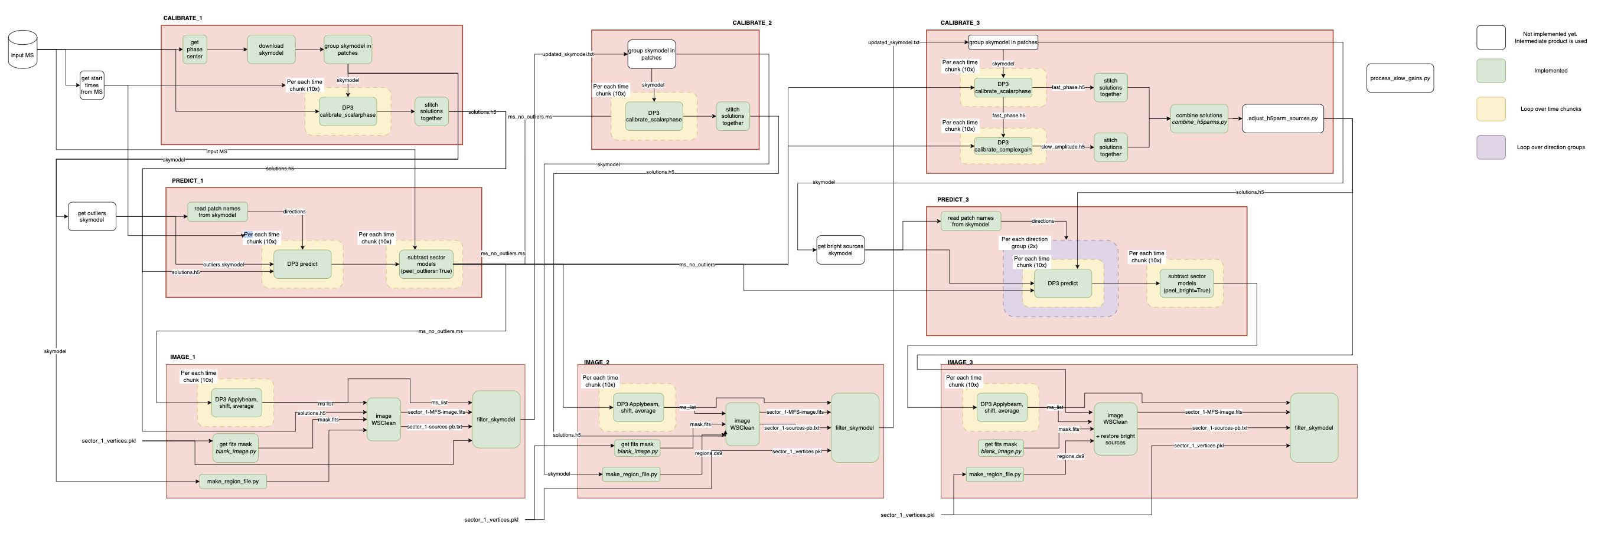
SKA low self-calibration pipeline
First three iterations of the Rapthor pipeline (DD self-calibration)
Completed in 8 steps with ~30 GB dataset
Python routine (delivered by SCHAAP Team) calls DP3 & WSClean
Notes:
Iteration 1:
Calibrate_1: based on the phase center of the MS, the skymodel is downloaded and grouped in patches Those are used for a phase-only calibration.
Predict_1: the sources which lie outside the field we want to image are predicted and subtracted in the visibility space. This produces the Ms: ms_no_outliers, which is further used throughout the pipeline
Image_1: The dataset is imaged and the solutions in calibrate_1 are applied while imaging.
Iteration 2:
Calibrate_2: using the new skymodel produced by image_1, run a phase_only calibration
Image_2: Same as image_1, whith updated solutions
Iteration 3:
Calibrate_3: using the new skymodel produced by image_2, run two DDECal: scalarphase and complexgain. The solutions are then combined.
Predict_3: extract the bright sources from the skymodel and predict them. Those are subtracted from the MS in the visibility space. This creates the MS: ms_no_out;liers_no_bright_sources, which is further used for imaging.
Image_3: the dataset is imaged. Afterwards, the bright sources are put back in the image and in the output skymodel.

Slide 8
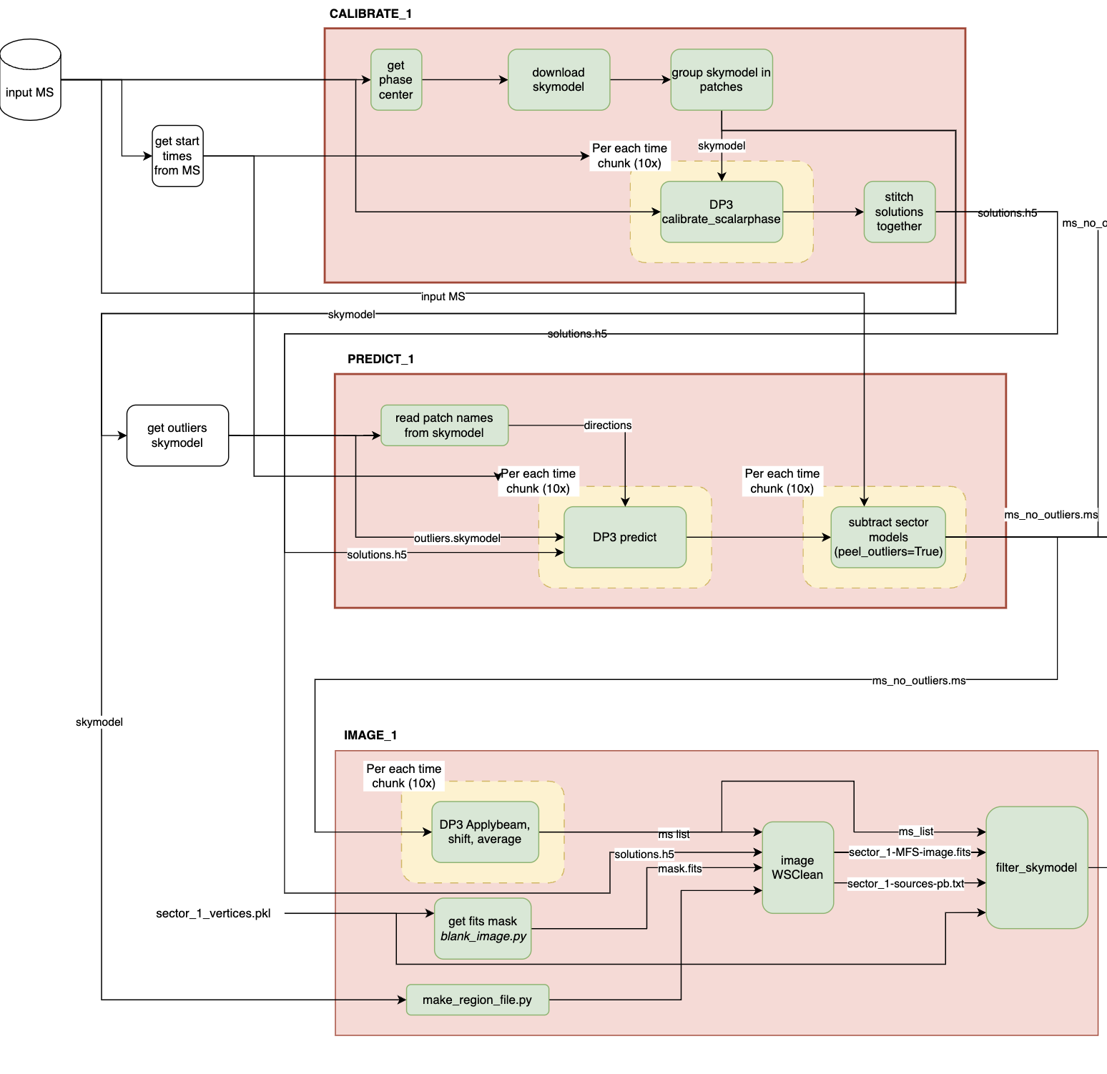
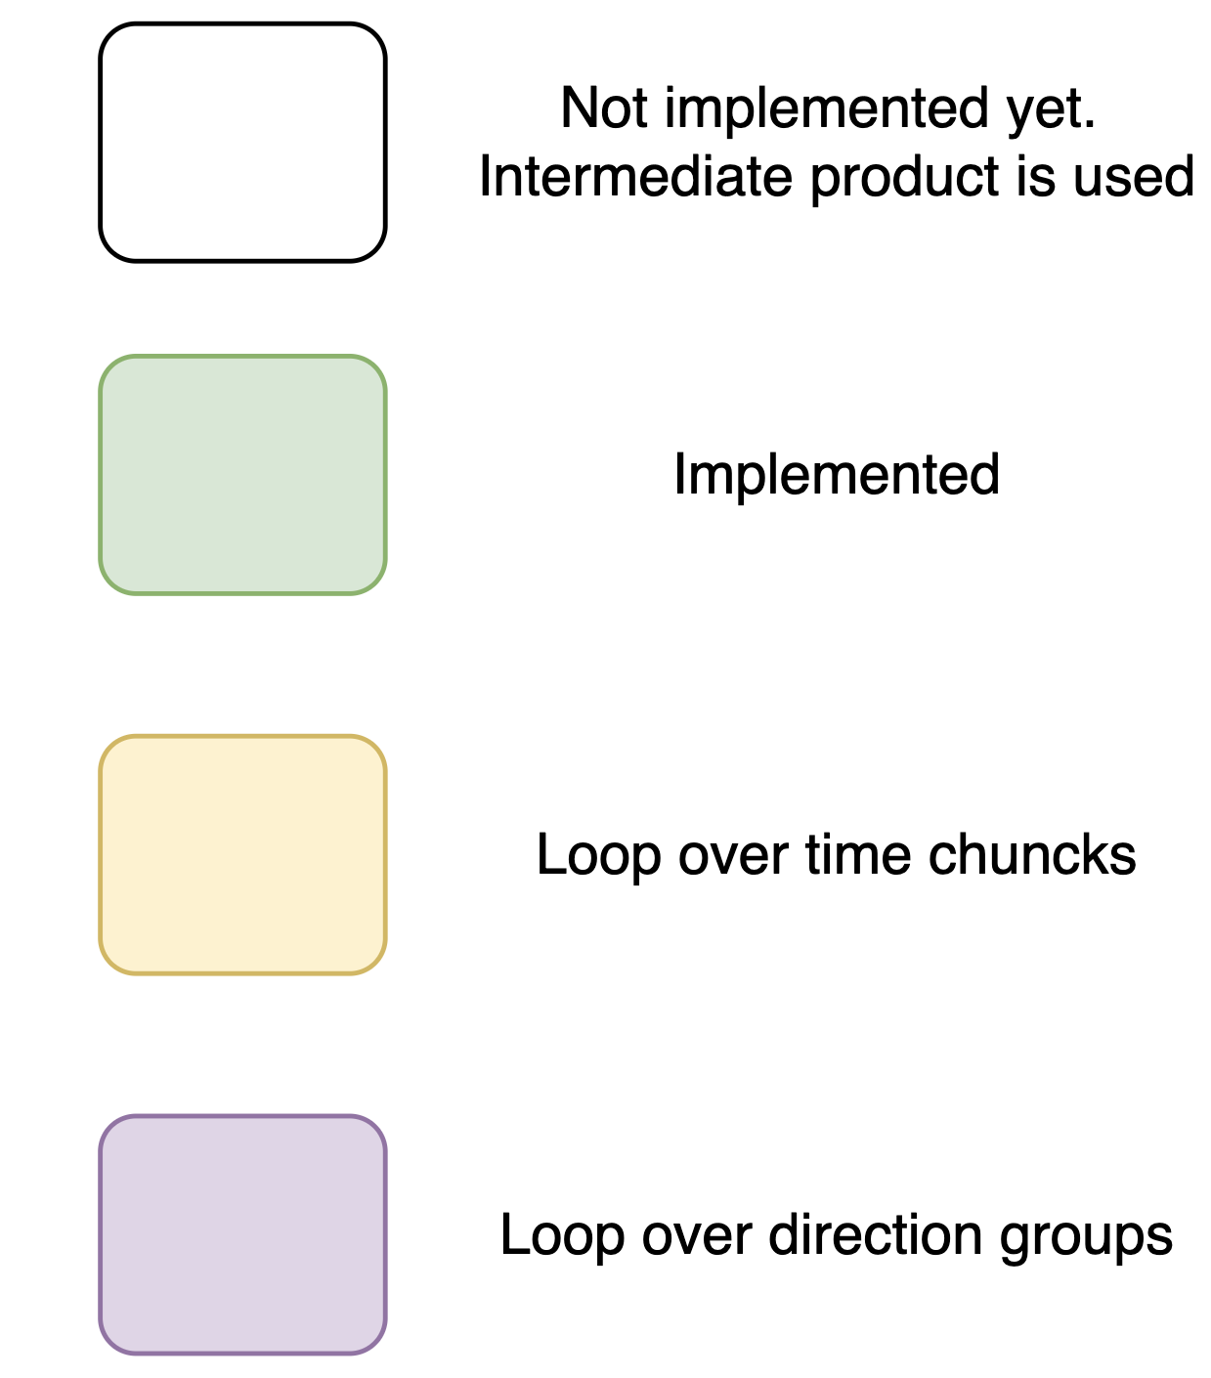
Notes:
Iteration 1:
Calibrate_1: based on the phase center of the MS, the skymodel is downloaded and grouped in patches Those are used for a phase-only calibration.
Predict_1: the sources which lie outside the field we want to image are predicted and subtracted in the visibility space. This produces the Ms: ms_no_outliers, which is further used throughout the pipeline
Image_1: The dataset is imaged and the solutions in calibrate_1 are applied while imaging.

Slide 9
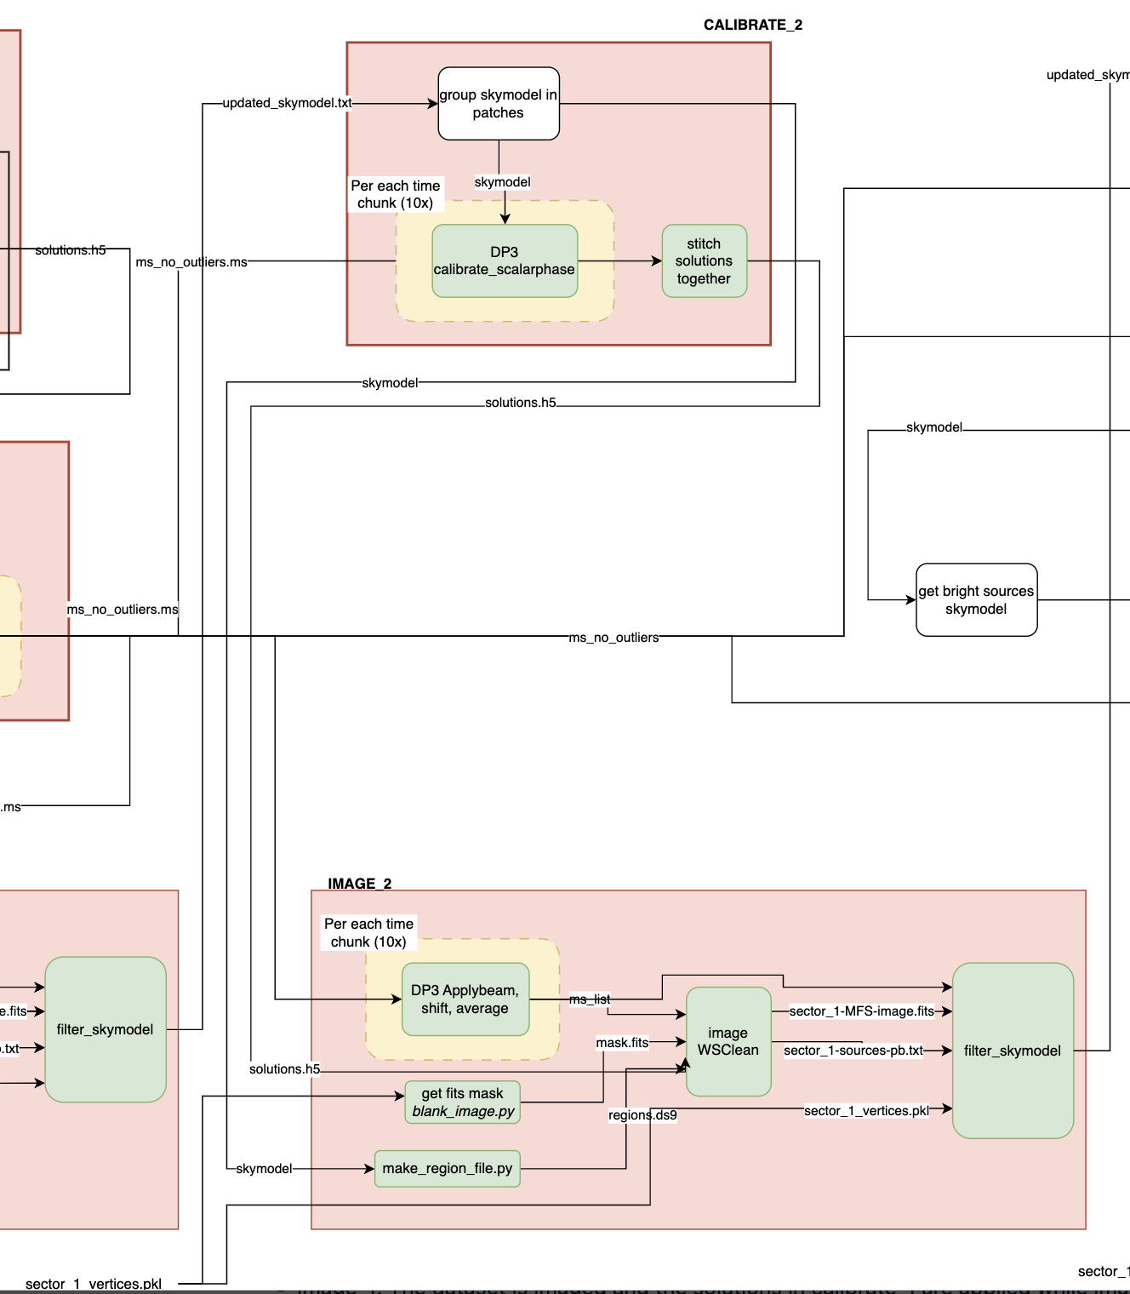
Notes:
Iteration 2:
Calibrate_2: using the new skymodel produced by image_1, run a phase_only calibration
Image_2: Same as image_1, whith updated solutions

Slide 10
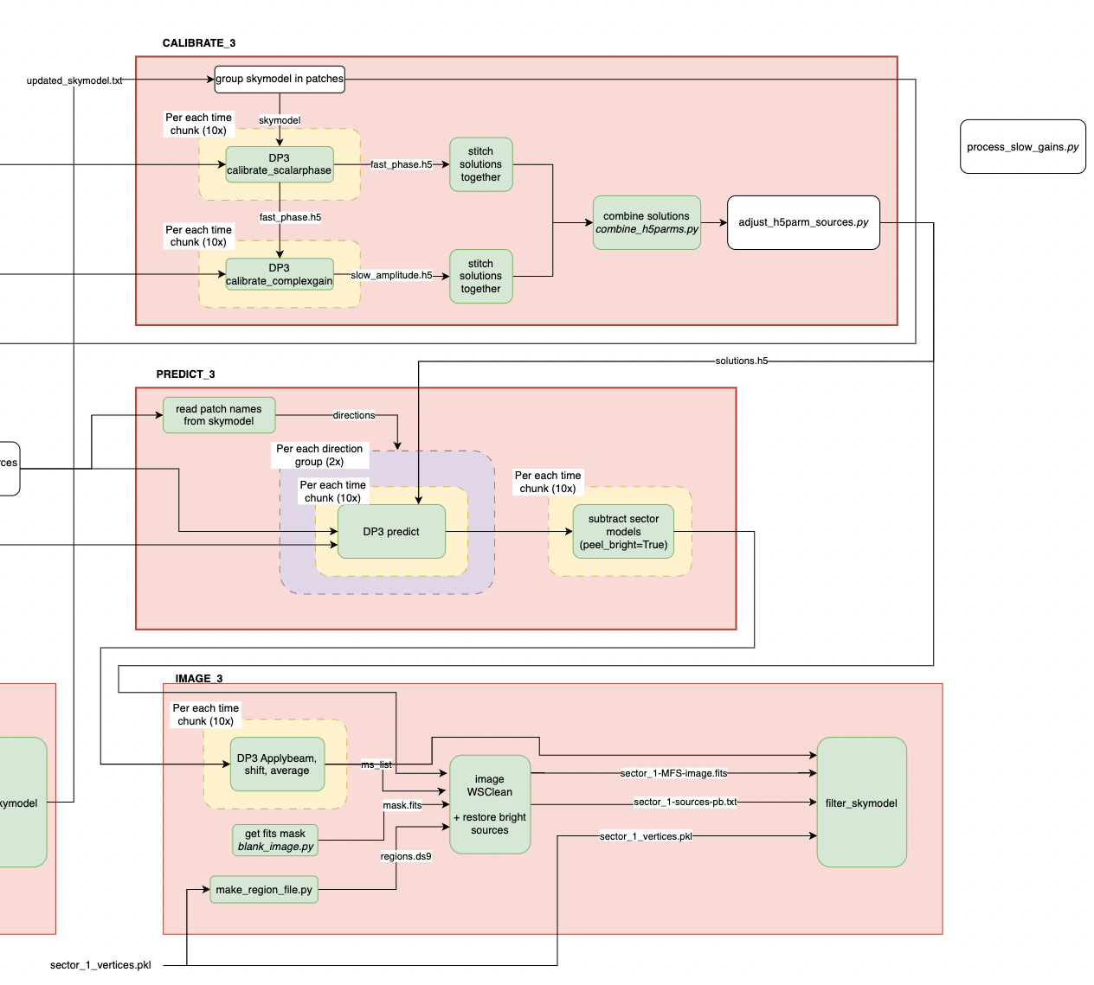
Notes:
Iteration 3:
Calibrate_3: using the new skymodel produced by image_2, run two DDECal: scalarphase and complexgain. The solutions are then combined.
Predict_3: extract the bright sources from the skymodel and predict them. Those are subtracted from the MS in the visibility space. This creates the MS: ms_no_out;liers_no_bright_sources, which is further used for imaging.
Image_3: the dataset is imaged. Afterwards, the bright sources are put back in the image and in the output skymodel.

Slide 11
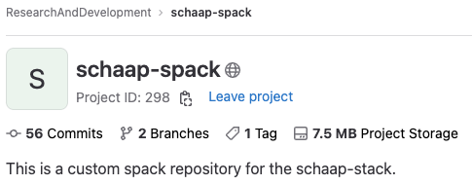
“Portable” installation of DP3/WSClean
Fix Aoflagger/DP3 spack recipes
Custom casacore spack recipe (WRST data)
Dysco spack recipe
RUM spack recipe
CI/CD on ASTRON DAS-6
Install DP3/WSClean on several clusters (EPFL, CSCS, Jean-Zay)
https://git.astron.nl/RD/schaap-spack
https://gitlab.com/ska-telescope/sdp/ska-sdp-rum
https://github.com/aroffringa/dysco
https://github.com/lofar-astron/DP3
https://gitlab.com/aroffringa/aoflagger
https://gitlab.com/aroffringa/wsclean

Slide 12
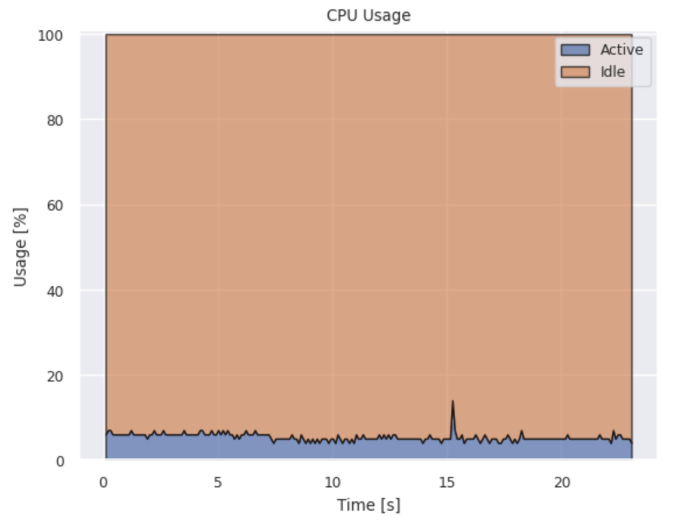
Resource Usage Monitoring (RUM) - Profiling
RUM
Collecting cpu/disk/memory/network usage statistics from system files (e.g. diskstat, meminfo)
PMT (Power Measurement Toolkit):
Larger dump interval to file
https://gitlab.com/ska-telescope/sdp/ska-sdp-rum
https://git.astron.nl/RD/pmt
S. Corda, B. Veenboer and E. Tolley, “PMT: Power Measurement Toolkit”, SC 2022 (HUST)

Slide 13
Calibrate_3 fails
Discussing with SCHAAP team

Slide 14
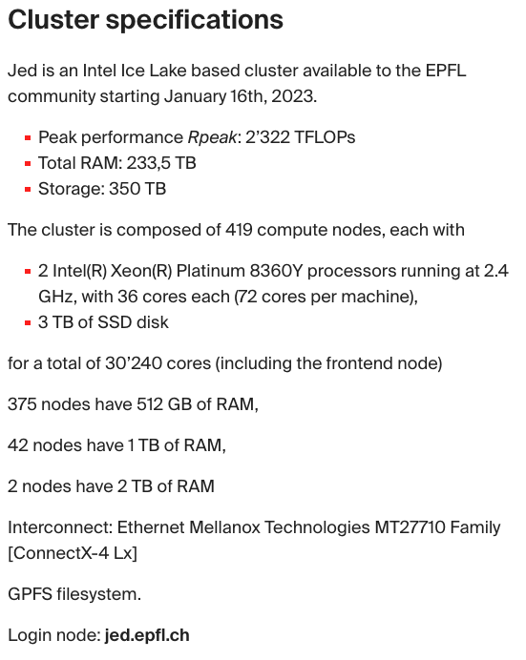
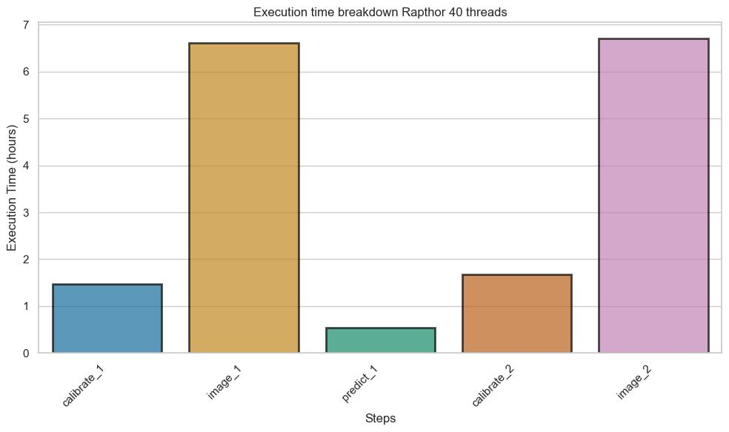
Execution time
The application runs with the default setting of 40 threads

Slide 15
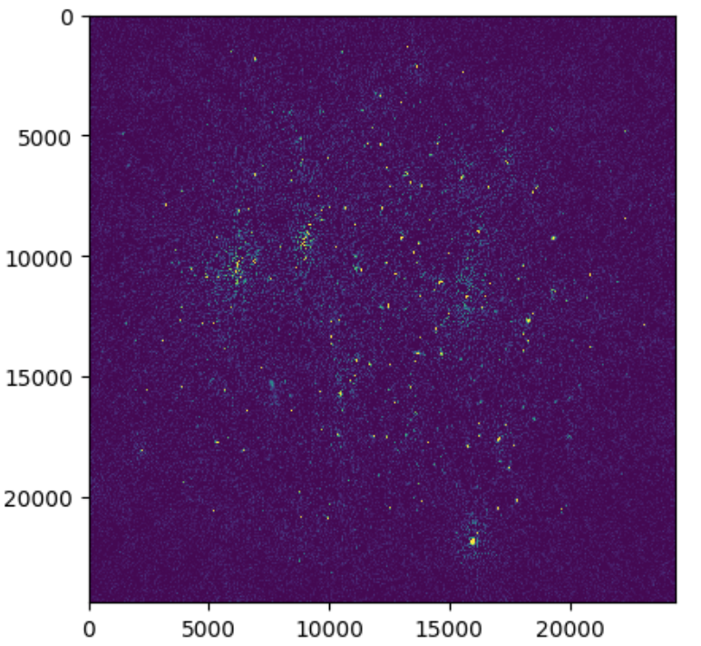
image_1

Slide 16
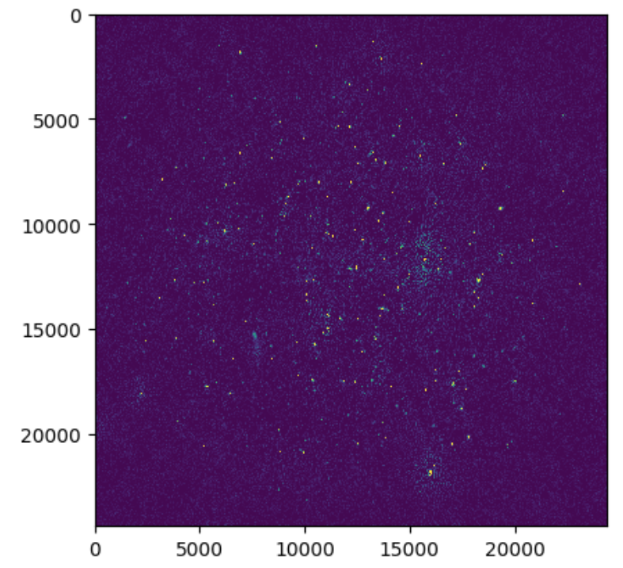
image_2

Slide 17
Perf (calibrate_1 and predict_1)

Slide 18
Perf (image_1 and calibrate_2)

Slide 19
Perf (image_2)
The image steps spend a lot of time on fft (copy input and output) and gridding.
The calibrate steps spend most a good percentage of time on complex multiplications and sincos operations.
The predict step spends time on sincos and, ApplyCal::ApplyDiag and OnePredict::Process.

Slide 20
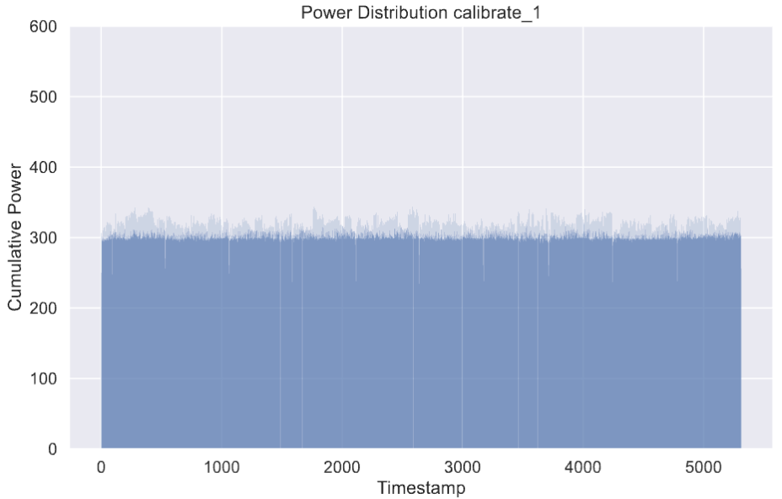
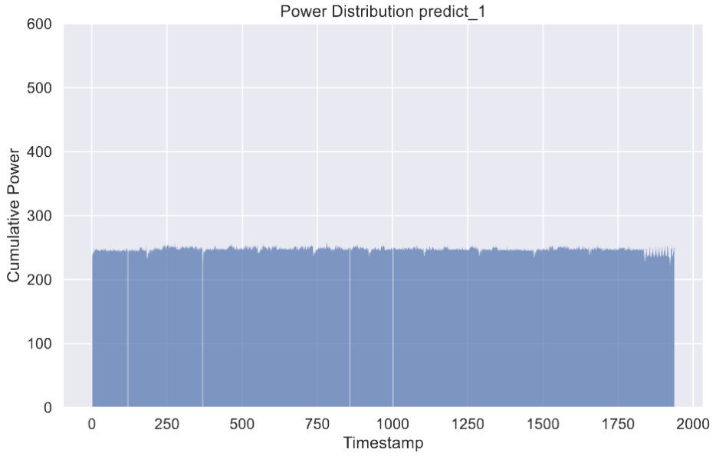
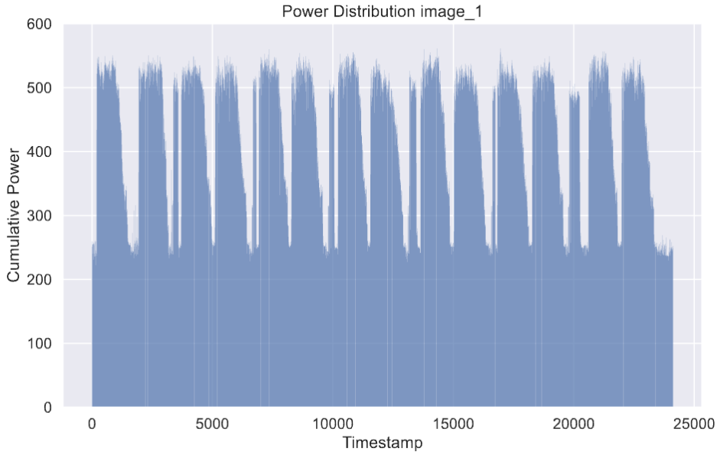
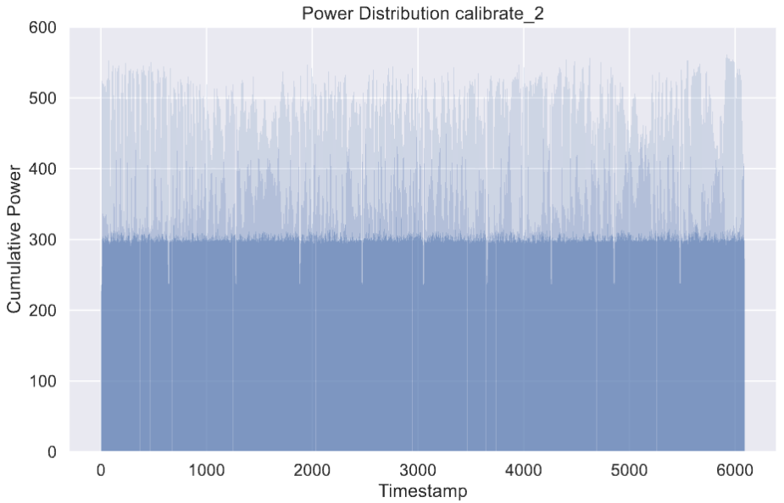
Power distribution (PMT-rapl)
TODO: fix PMT bug (negative values RAPL)

Slide 21
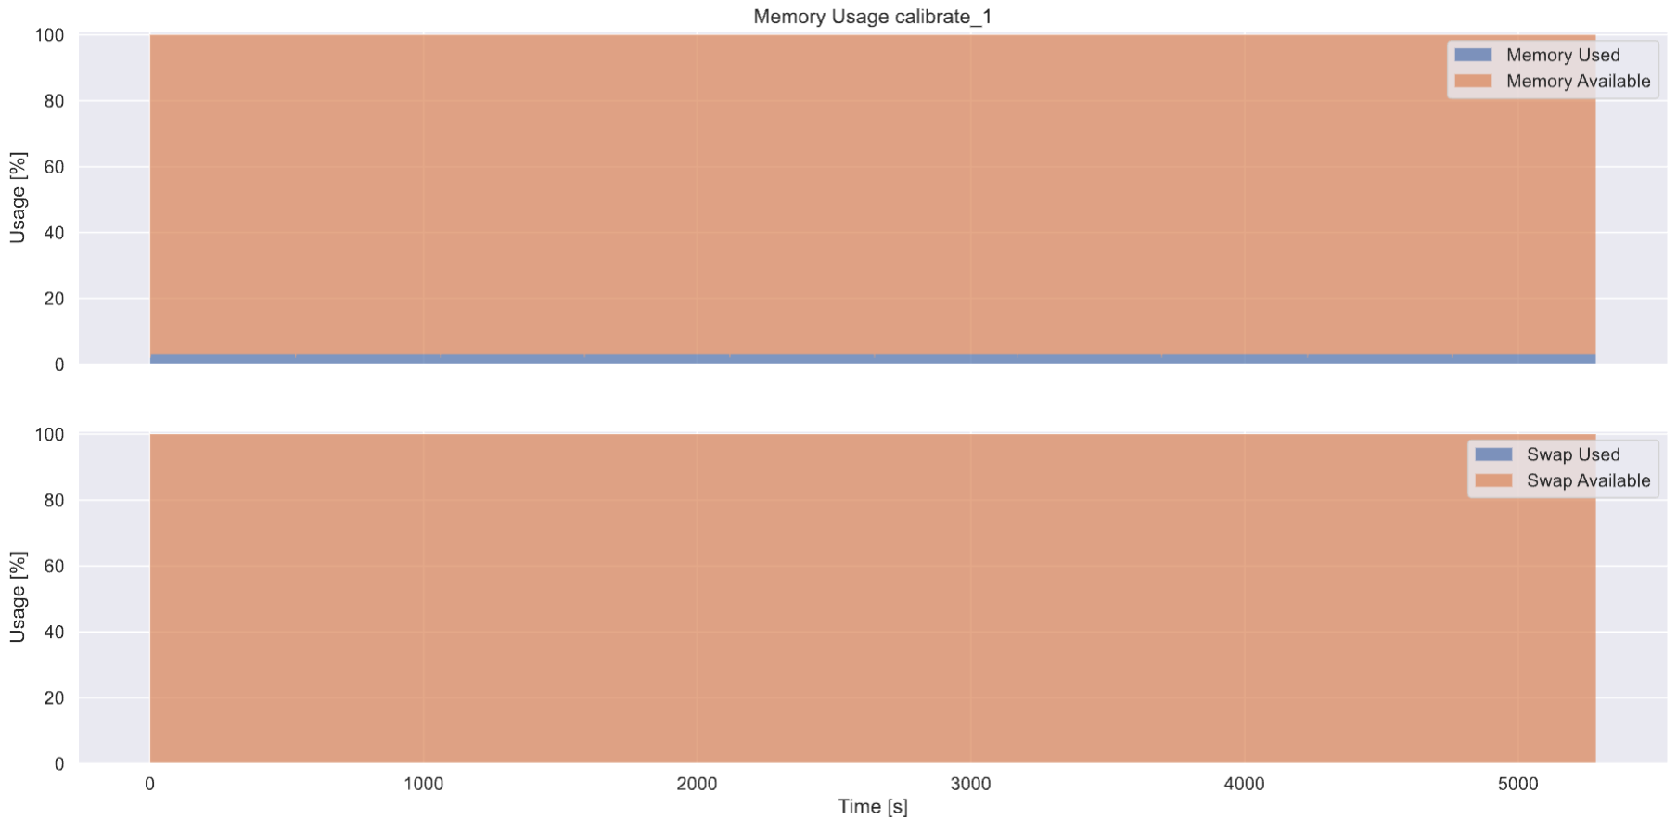
CPU and Memory usage
Low CPU and memory usage

Slide 22
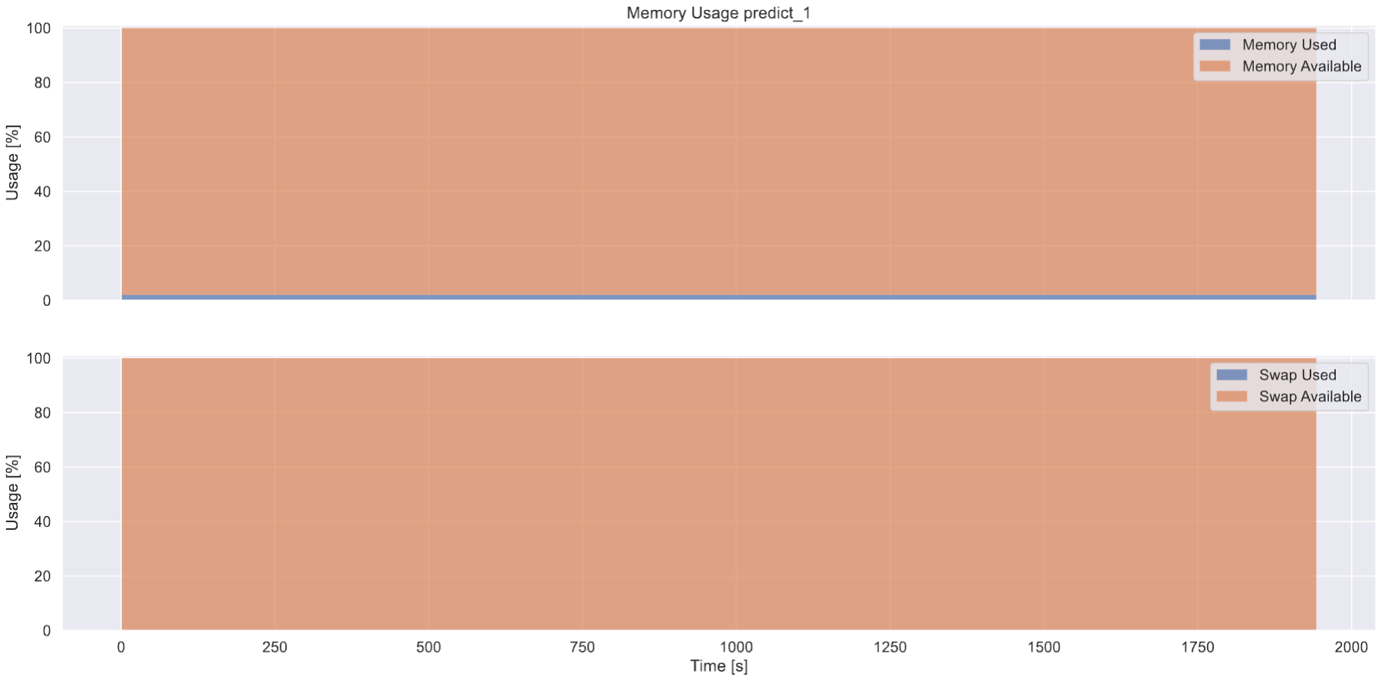
CPU and Memory usage
Low CPU and memory usage

Slide 23
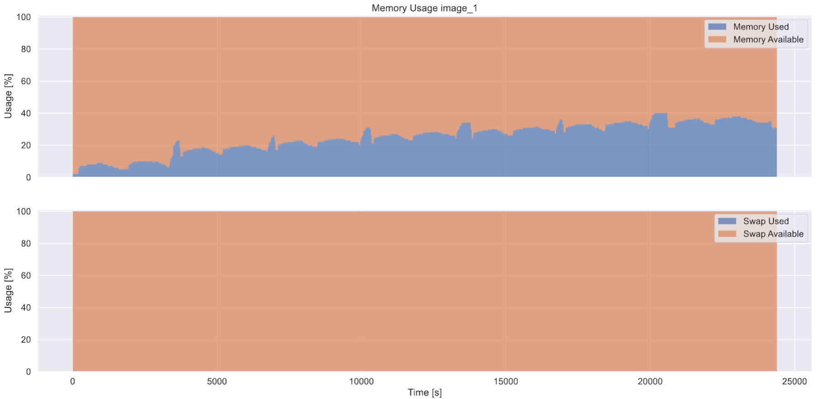
CPU and Memory usage
Medium CPU and memory usage
Notes:
Memory

Slide 24
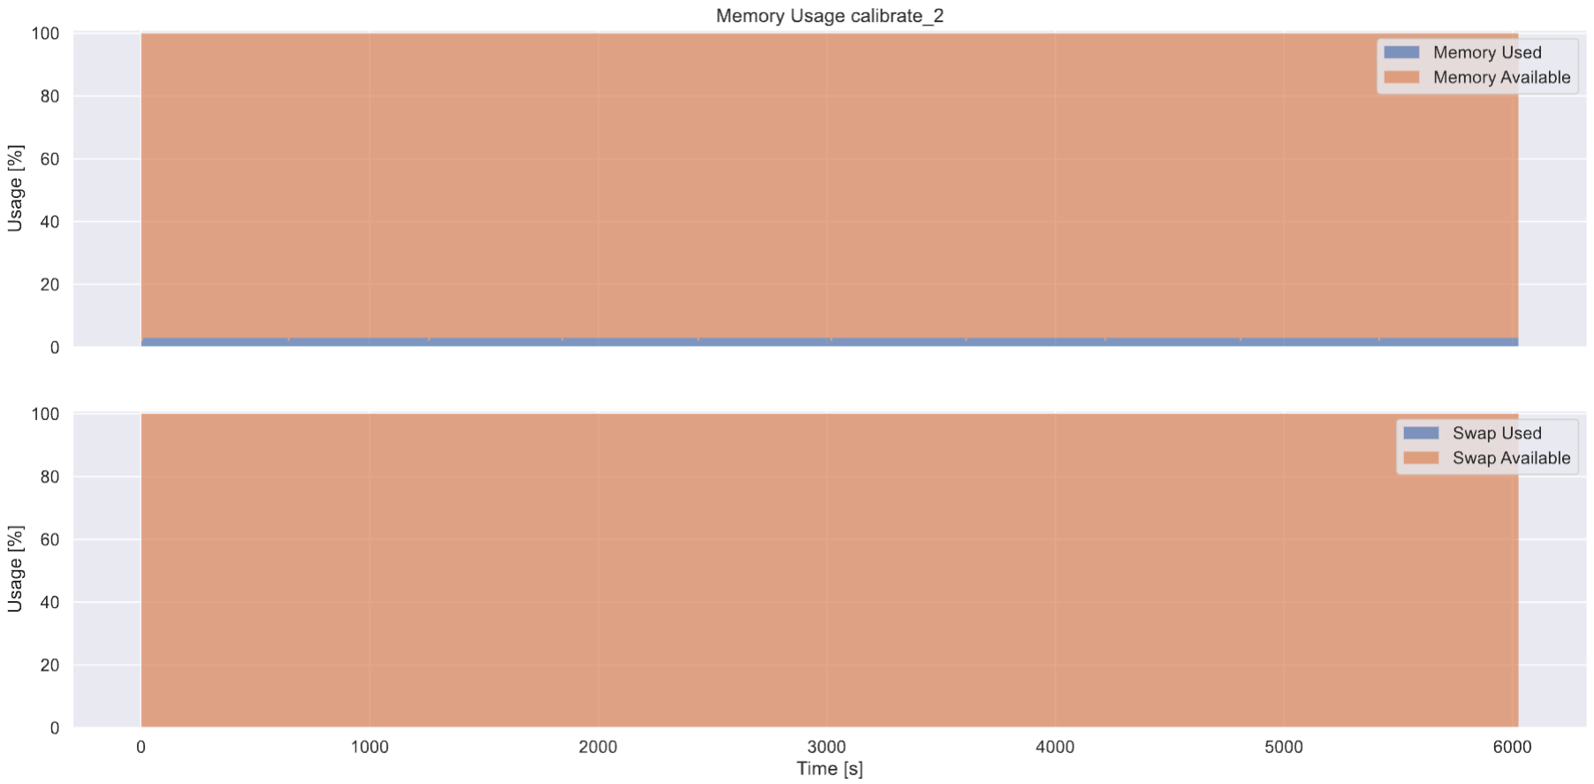
CPU and Memory usage
Low CPU (weird) and memory usage

Slide 25
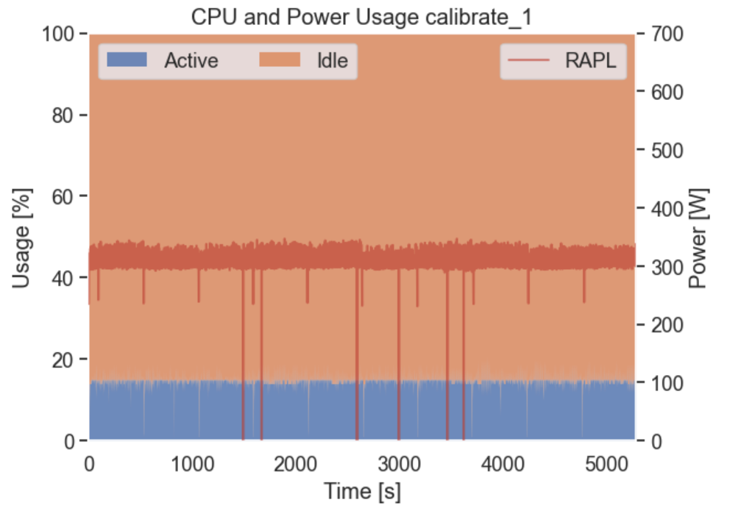
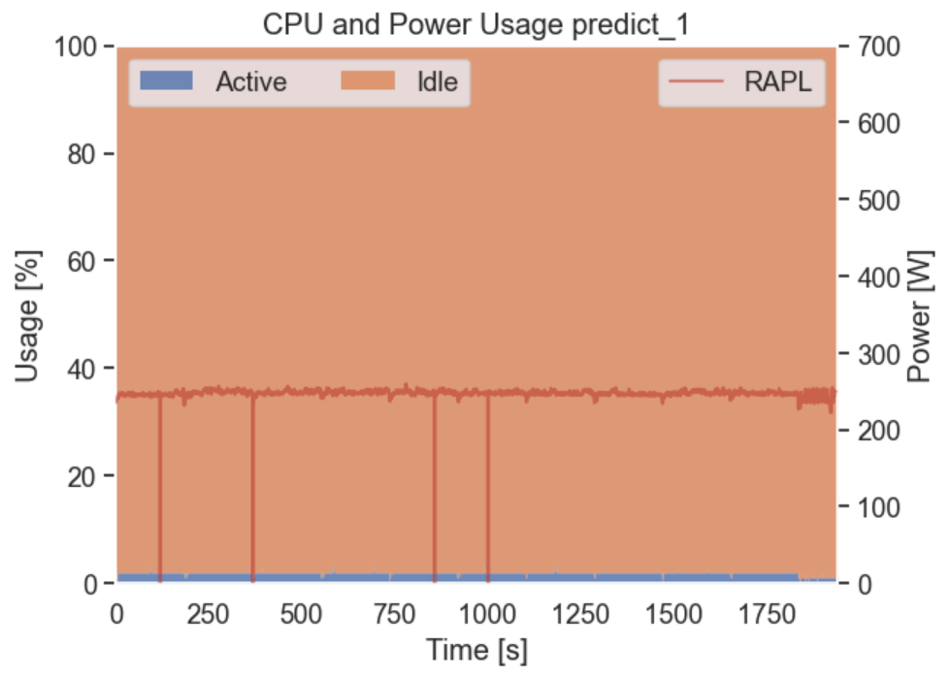
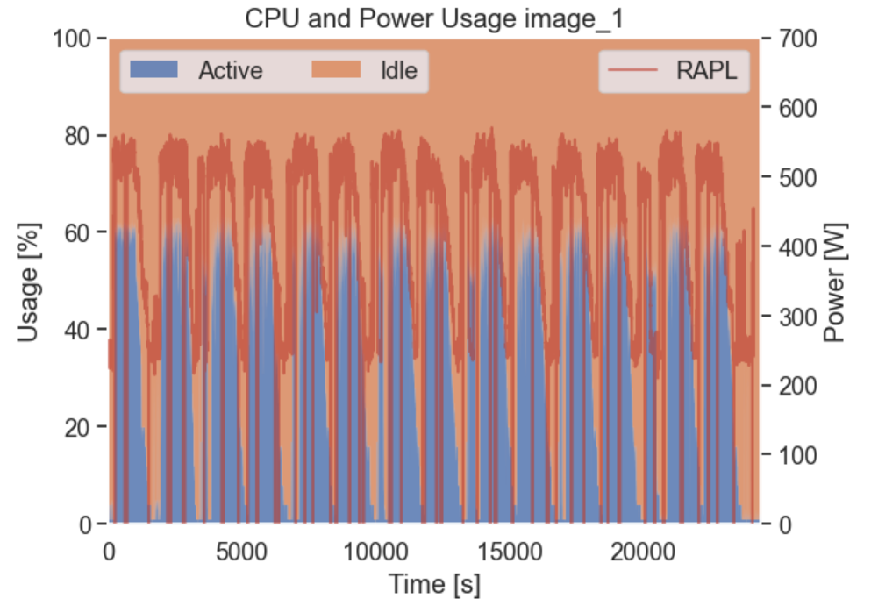
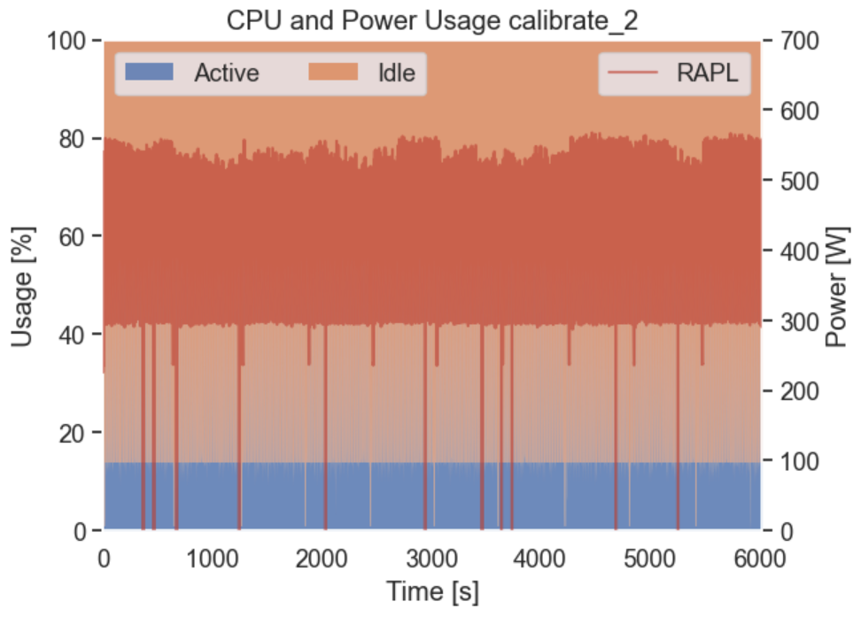
CPU & Power usage
CPU usage & Power usage are striclty correlted

Slide 26
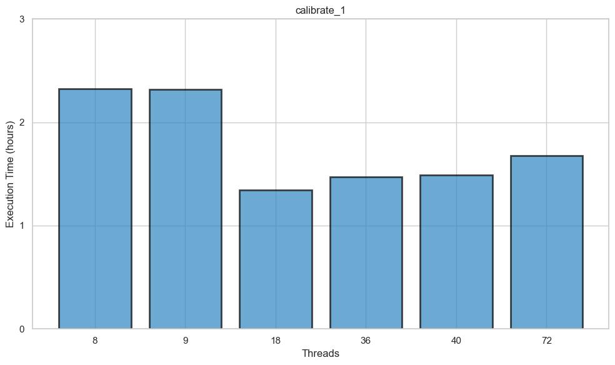
Scaling threads (calibrate_1)
Threads trade-off?

Slide 27
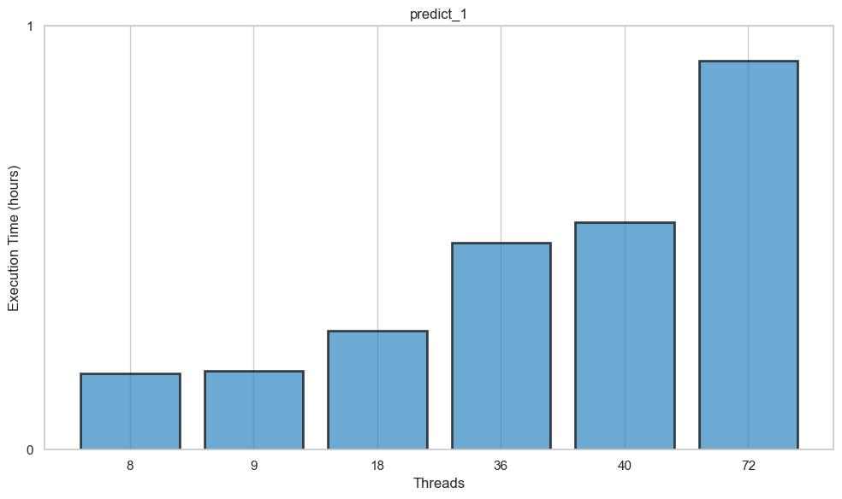
Scaling threads (predict_1)
Less threads → faster

Slide 28
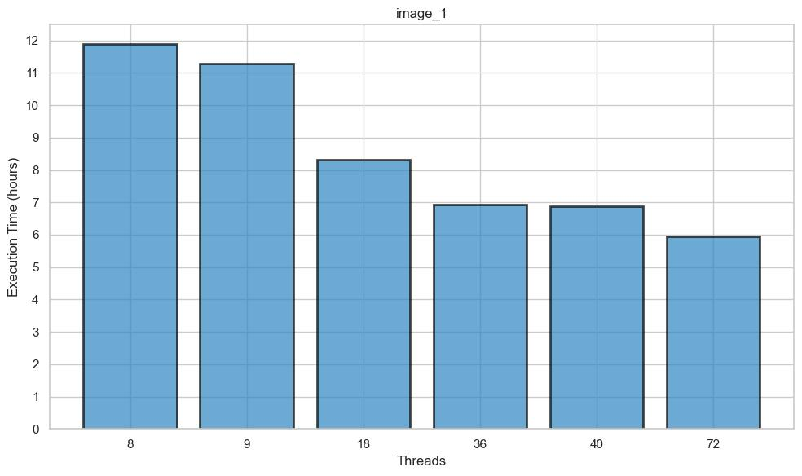
Scaling threads (image_1)
More threads → faster

Slide 29
Scaling & pin threads (calibrate_1)
1 socket > 2 socket

Slide 30
Next steps
Next week: PI19 planning
Possible next steps:
Further benchmarking of the LOW self-calibration pipeline
Benchmark MID self-calibration pipeline
Automatic performance (RUM/PMT) extraction and report in SDP-bench
Add new tests to SDP-bench (LOW self-cal)

Slide 31
SKA HPC Co-design
Q &A
Stefano Corda and Manuel Stutz
stefano.corda@epfl.ch
manuel.stutz@fhnw.ch
01-06-2023
SKACH Spring Meeting

