Slide 1
Swiss SKAO Day
Doing Business with the SKA Observatory
Ian Hastings, Head of Procurement Services
Zurich - 6 Sept 2023

Slide 2
Topics
Legal Framework & Policy
Procurement Fundamentals
Procurement Fundamentals in Practice
Country of Origin
Type of Agreements
What do we Procure?
Allocation of Work Between Members
Invitation to Tender Process
Working with SMEs
Current SKA Project Procurement Status
The SKAO Supplier Portal

Slide 3
Legal Framework & Policy
The SKA Observatory (SKAO) is an Intergovernmental Organisation (IGO).
As an IGO the SKAO is not a legal entity under national or European law but governed by public international law.
The SKAO benefits from immunity from national jurisdiction and execution. Thus, legal disputes between the SKAO and its suppliers and contractors are not submitted to national courts but solved via international arbitration.
Furthermore, the SKAO is entitled to establish its own internal rules necessary for its proper functioning, including its own policies and procedures covering procurement.
These internal policies and procedures are drafted to reflect the highest ethical standards and current best practices around the sourcing and procurement of goods, services and works internationally.

Slide 4
Procurement Fundamentals
SKAO’s procurement activity built on the following fundamentals:
Fair Work Return - procurement opportunities are first provided to suppliers from within Member countries
Equality – all suppliers from Member countries are treated equally
Transparency – all procurement activities are open and transparent
Competition – unless there is strong justification, procurement is competitive
Notes:
Principles and underpinning behavior.

Slide 5
What this Means in Practice
Procurement is restricted to legal entities established in the SKAO Member countries & appropriate participating countries.
Invitation to Tender documentation drafted to ensure fair competition.
Generally speaking, SKAO’s tendering procedure is competitive but selective, and does not take the form of open invitations to tender or price enquiries.
There is strict confidentiality around the opening, evaluation and negotiation of tenders.
Most tenders are evaluated based on value for money rather than on a lowest price basis, i.e., quality and price are weighted.
Notes:
Principles and underpinning behavior.

Slide 6
Country of Origin
Can be a tricky topic:
Supply Contracts – country of last significant transformation
Service Contracts – country in which the service provider has their legally registered office
Insofar as tenderers are reasonable, Procurement Services does not normally challenge country of origin declarations

Slide 7
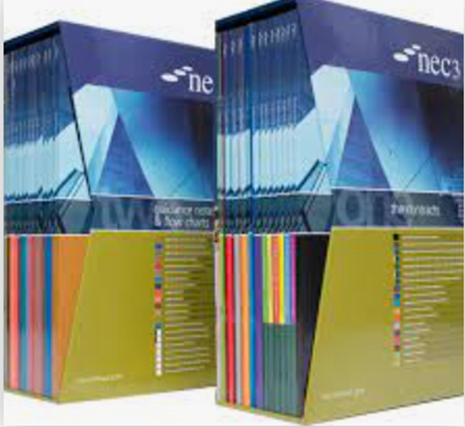
Type of Agreements
Purchase orders – always preferred for COTS products with a catalogue part number
NEC4 Contracts used when a purchase order won’t work - the SKAO buys an eclectic mix of goods, works and services and a ‘standard’ contract just won’t cover all the bases.
The NEC4 suite of contracts meets most of our contracting needs:
Professional Services Contract (PSC) and its subcontract and short form
Engineering and Construction Contract (ECC) and its subcontract and short form
Term Services Agreement (TSA) and its short form
Supply Contract (SC) and its short form
Framework Contract (FC)
•NEC4 contracts were developed by the UK Institution of Civil Engineers to be collaborative, fair and non-adversarial.
•The NEC4 contract ethos align perfectly with SKAO culture and values.

Slide 8
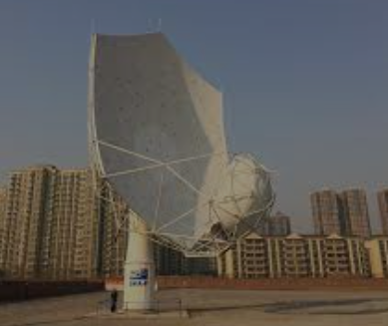
What do we Procure?
Civil Engineering
Power and utilities - renewables
Metallic structures - dishes and antennas
Low RFI electromechanical equipment
Shielding and shielded enclosures
Receivers and digitisers
Cryogenic equipment
Computing devices and networks
Software development
Shipping, transport and logistics
Engineering services
Corporate services – travel, audit, banking, insurance
Most products procured are non-standard………
Notes:
Principles and underpinning behavior.

Slide 9
Allocation of Construction Work between Member Countries
The procurement methodology being applied to the current SKA Project can be described as ‘allocative’ – virtually all construction work-packages (contracts) were allocated to SKAO Member countries from the outset based on their strategic interest and levels of funding.
Very few SKAO construction contracts have therefore been competed internationally. However, most have been competed between domestic suppliers.
The allocative methodology enabled Members to continue with the work they were historically invested in during pre-construction.
Insofar as planned work-allocations are broadly respected all Member’s target FWR should be achieved.
The methodology has largely met its objectives and all Members, including Switzerland, are on track to achieve minimum promised FWR.
Whilst nearly all SKA Construction work-packages were allocated to Members there are frequent, non-allocated, commercial opportunities for suppliers in Member countries – opportunities are advertised on the SKAO Supplier Portal.
Notes:
Principles and underpinning behavior.

Slide 10
High Value Invitation to Tender Process
Invitation To Tender process:
Led by Procurement Services with independent Technical Evaluation Panel
SKAO Industrial Liaison Officer Network given 21 days prior notice of procurement opportunities
Market Survey (EoI) published on the Supplier Portal
Pre-qualification of potential tenderers
Shipping costs are excluded from commercial evaluations (all bids assumed FCA, seller’s works)
Two envelope system
Weighted, value for money award criteria (‘most economically advantageous bid’)
Please Note: The SKAO won’t normally negotiate on price, always make your best offer your first offer

Slide 11
SKAO and Working with SMEs
SMEs are encouraged to work with the SKAO:
A high percentage of construction contracts awarded to SMEs – value of work to SMEs > € 80M
Significant opportunity for SMEs in SKAO Member countries
Complex design and prototyping (AA0.5) often undertaken by SMEs. However, industrial AA* volumes favours larger manufacturers
Several interesting construction contracts awarded to tech start-ups such as Fourier Space in Australia
Direct contracts with leading global universities (Porto, Guangzhou, Oxford, Curtin, EPFL) as well as organisations closely associated with leading universities such as ICRA in Australia
The Observatory does have a contract value/percentage of turnover rule. However, this is always applied ‘reasonably’

Slide 12
Construction Procurement Status
The SKAO has awarded 69 large value Construction Contracts with an overall value of € 562M.
There are approximately 25 construction contracts to award and most of these are well underway.
Significant contract awards to Switzerland include:
- Mid and Low Frequency and Timing (Mazers)
- SW development
- SPC Co-design
Procurement of Mid Band 1 Feed Horns from Swiss industry is also underway (as a sub-contract with the Swedish Tier 1 Band 1 Contractor)
Notes:
Principles and underpinning behavior.

Slide 13
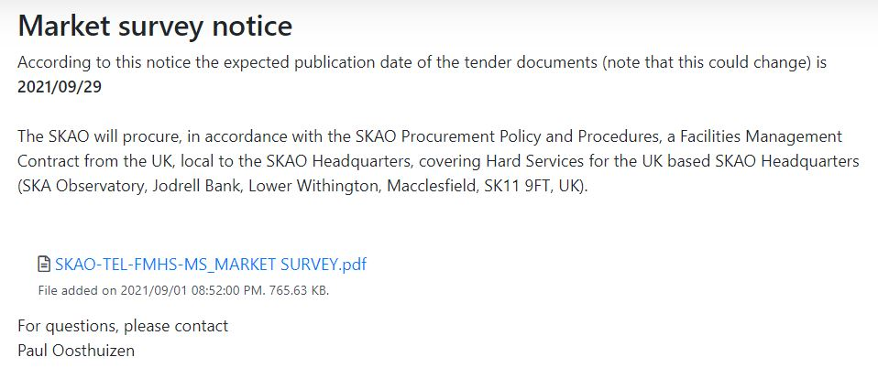
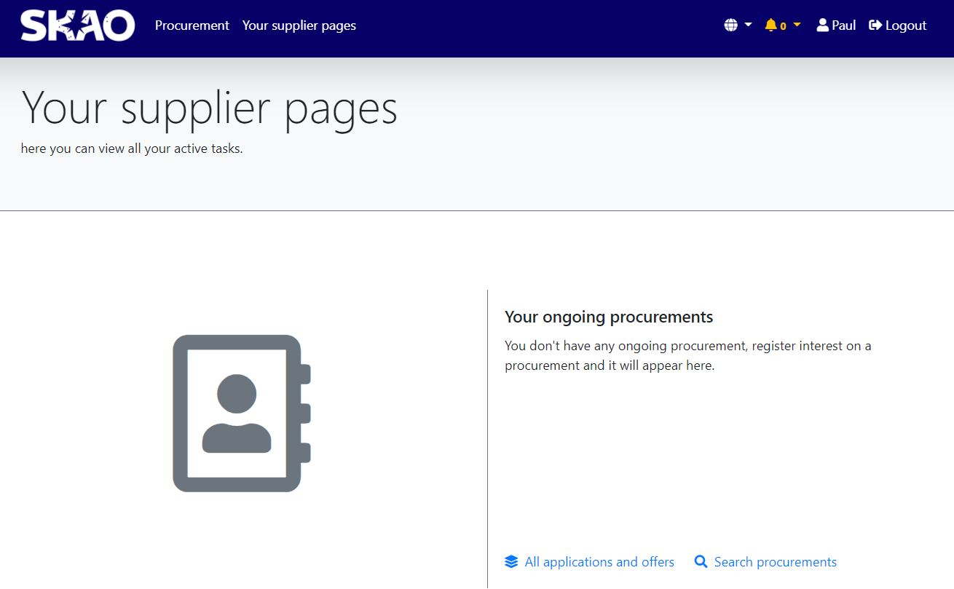
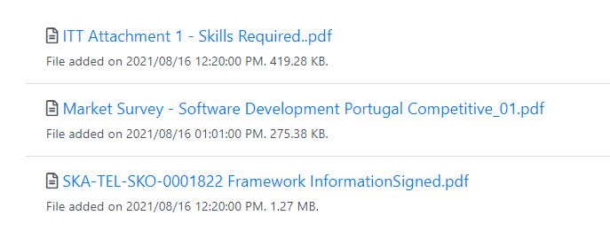
SKAO Supplier Portal

Slide 14
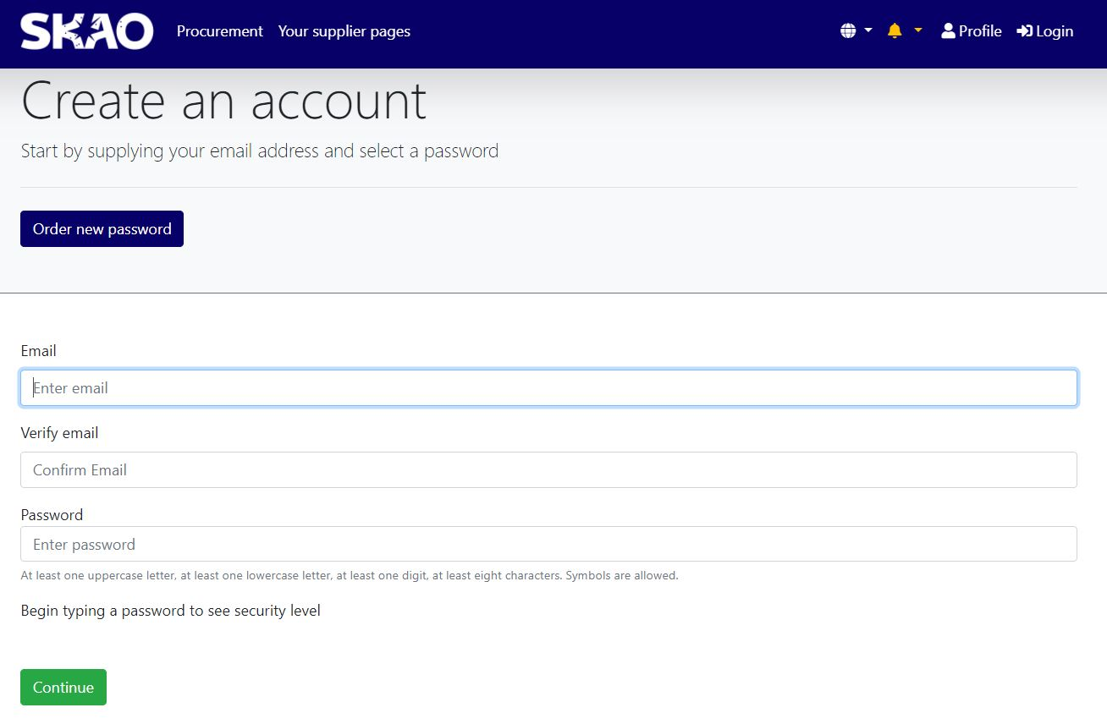
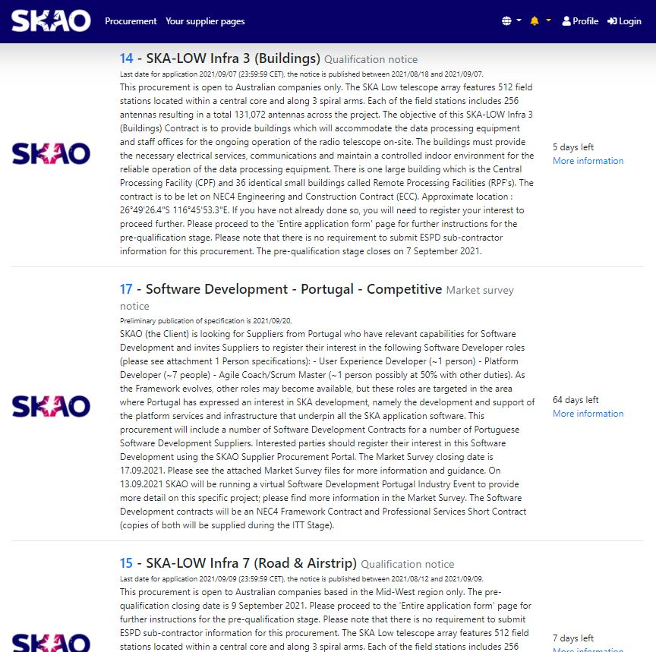
Register on the SKAO Supplier Portal
The SKAO Supplier Portal facilitates communication between the SKAO and suppliers. You can safely view procurement notices, exchange messages, register your interest, submit tenders and much more.
The SKAO Supplier Portal is a free of charge service to suppliers. As soon as the supplier has created and activated their account, they can access the pages that the SKAO has invited them to see.
If in doubt speak to Dr Michel Hubner, Swiss Industrial Liaison Officer

Slide 15
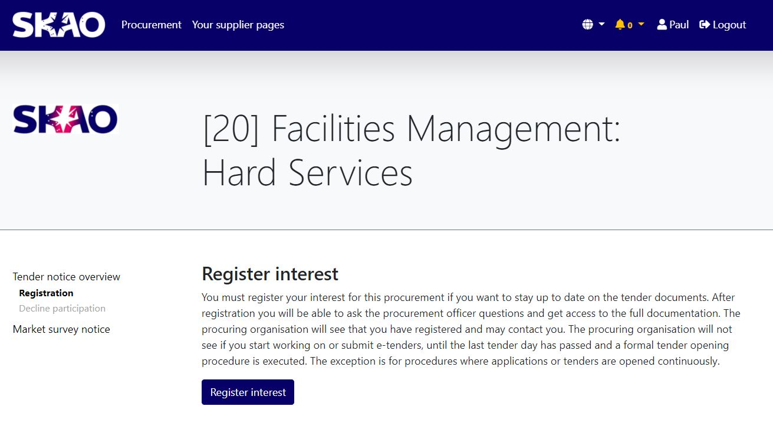
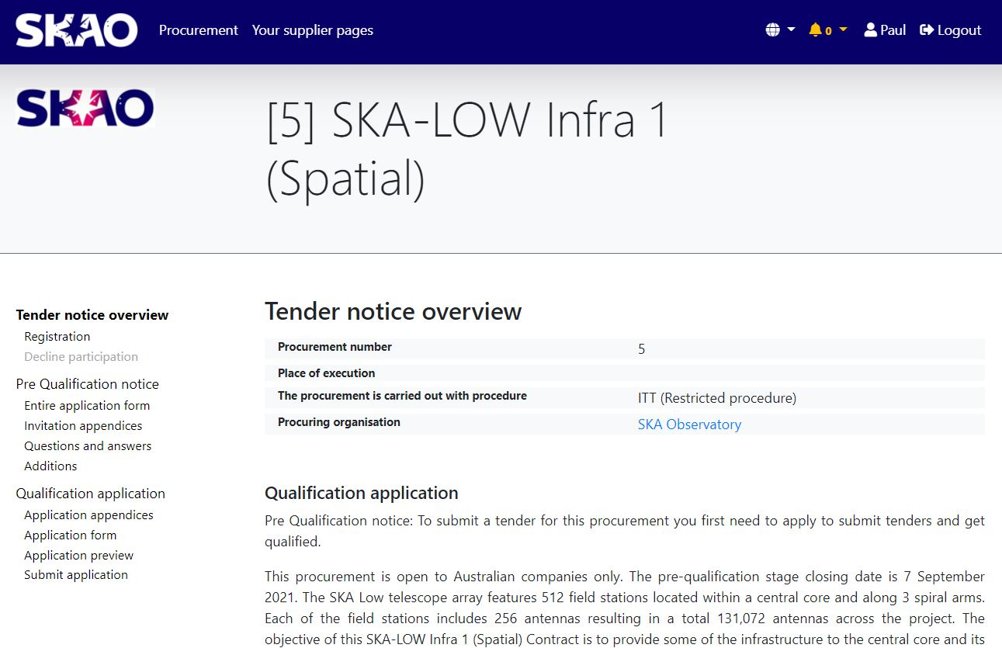
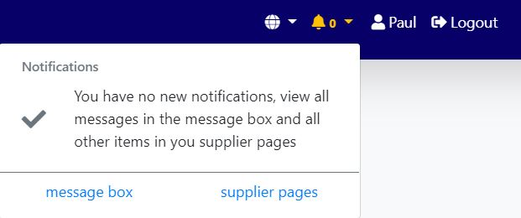
Procurement Processes managed through the Supplier Portal
Prior Notice to ILOs
Publication of Market surveys (Expression of Interest)
Pre-qualification
Invitation to Tender
Tender Evaluation
Questions and Answers
Notifications

Slide 16
For Further Information or any Procurement issues:
Any issues registering on the Portal contact:
Head of Procurement: Mr. Ian Hastings
To discuss opportunities on the Portal either/and:
The nominated Procurement Officer
Ian Hastings
The Swiss Industrial Liaison Officer (ILO) Dr Michel Hubner
Notes:
Principles and underpinning behavior.

Slide 17
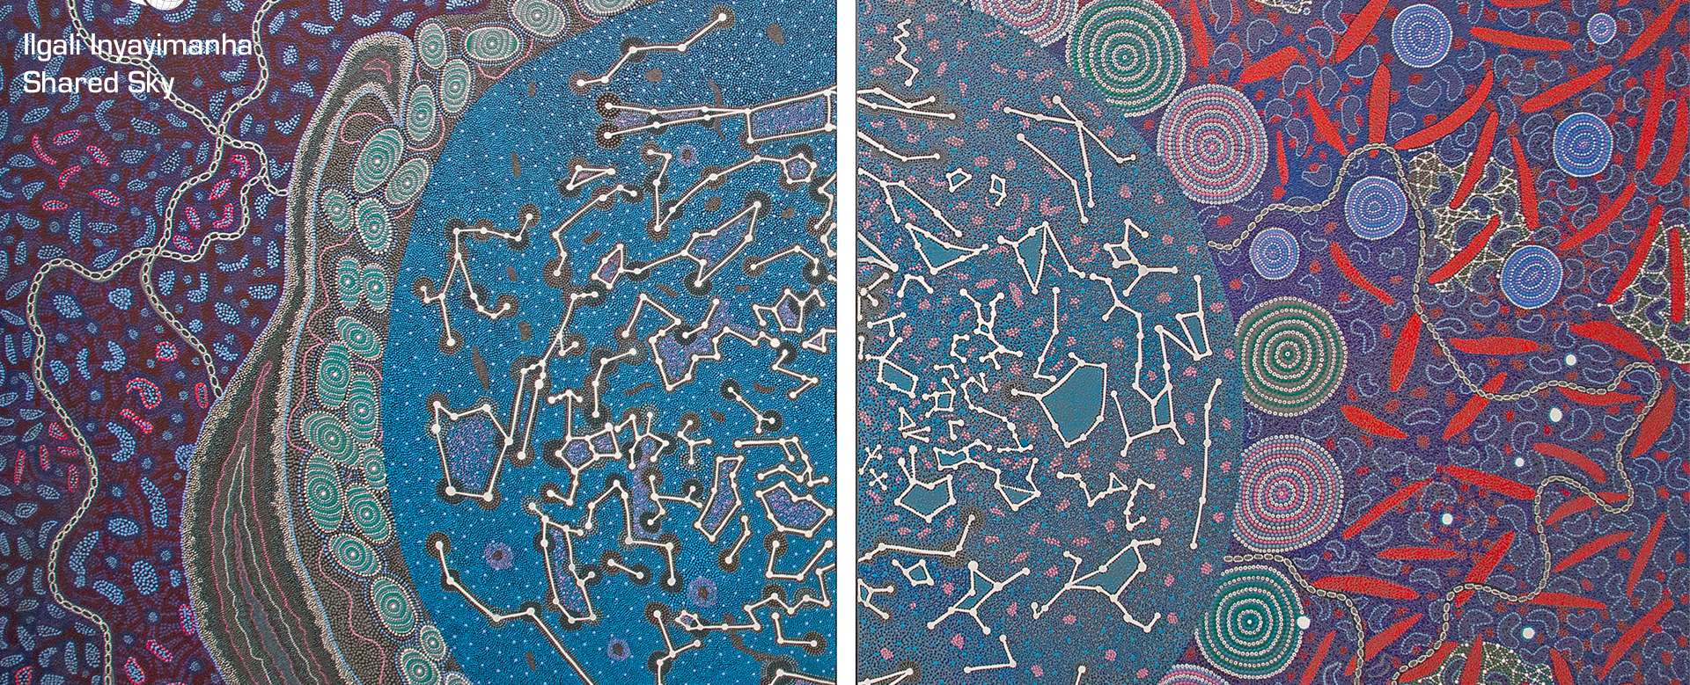
Thank you & Questions
The SKA Observatory (SKAO) recognises and acknowledges the indigenous peoples and cultures that have traditionally lived on the lands on which the SKAO facilities are located

