Slide 1



PMT: Power Measurement Toolkit
Stefano Corda, Bram Veenboer, Emma Tolley
stefano.corda@epfl.ch
06-09-2023
SKACH days

Slide 2
Power-hungry hardware

Slide 3
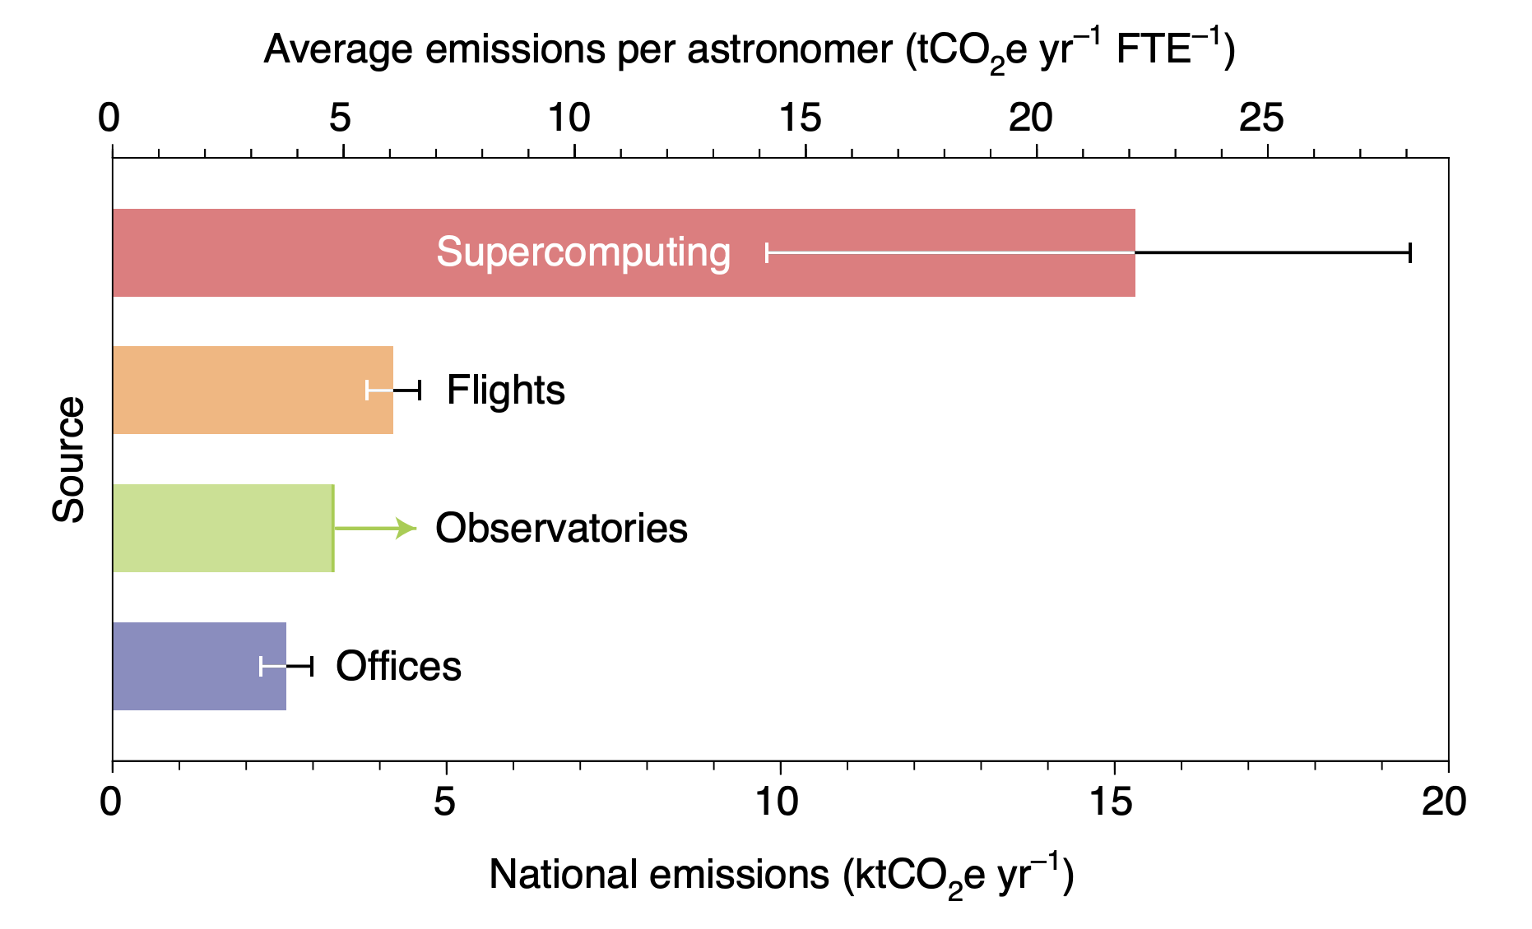
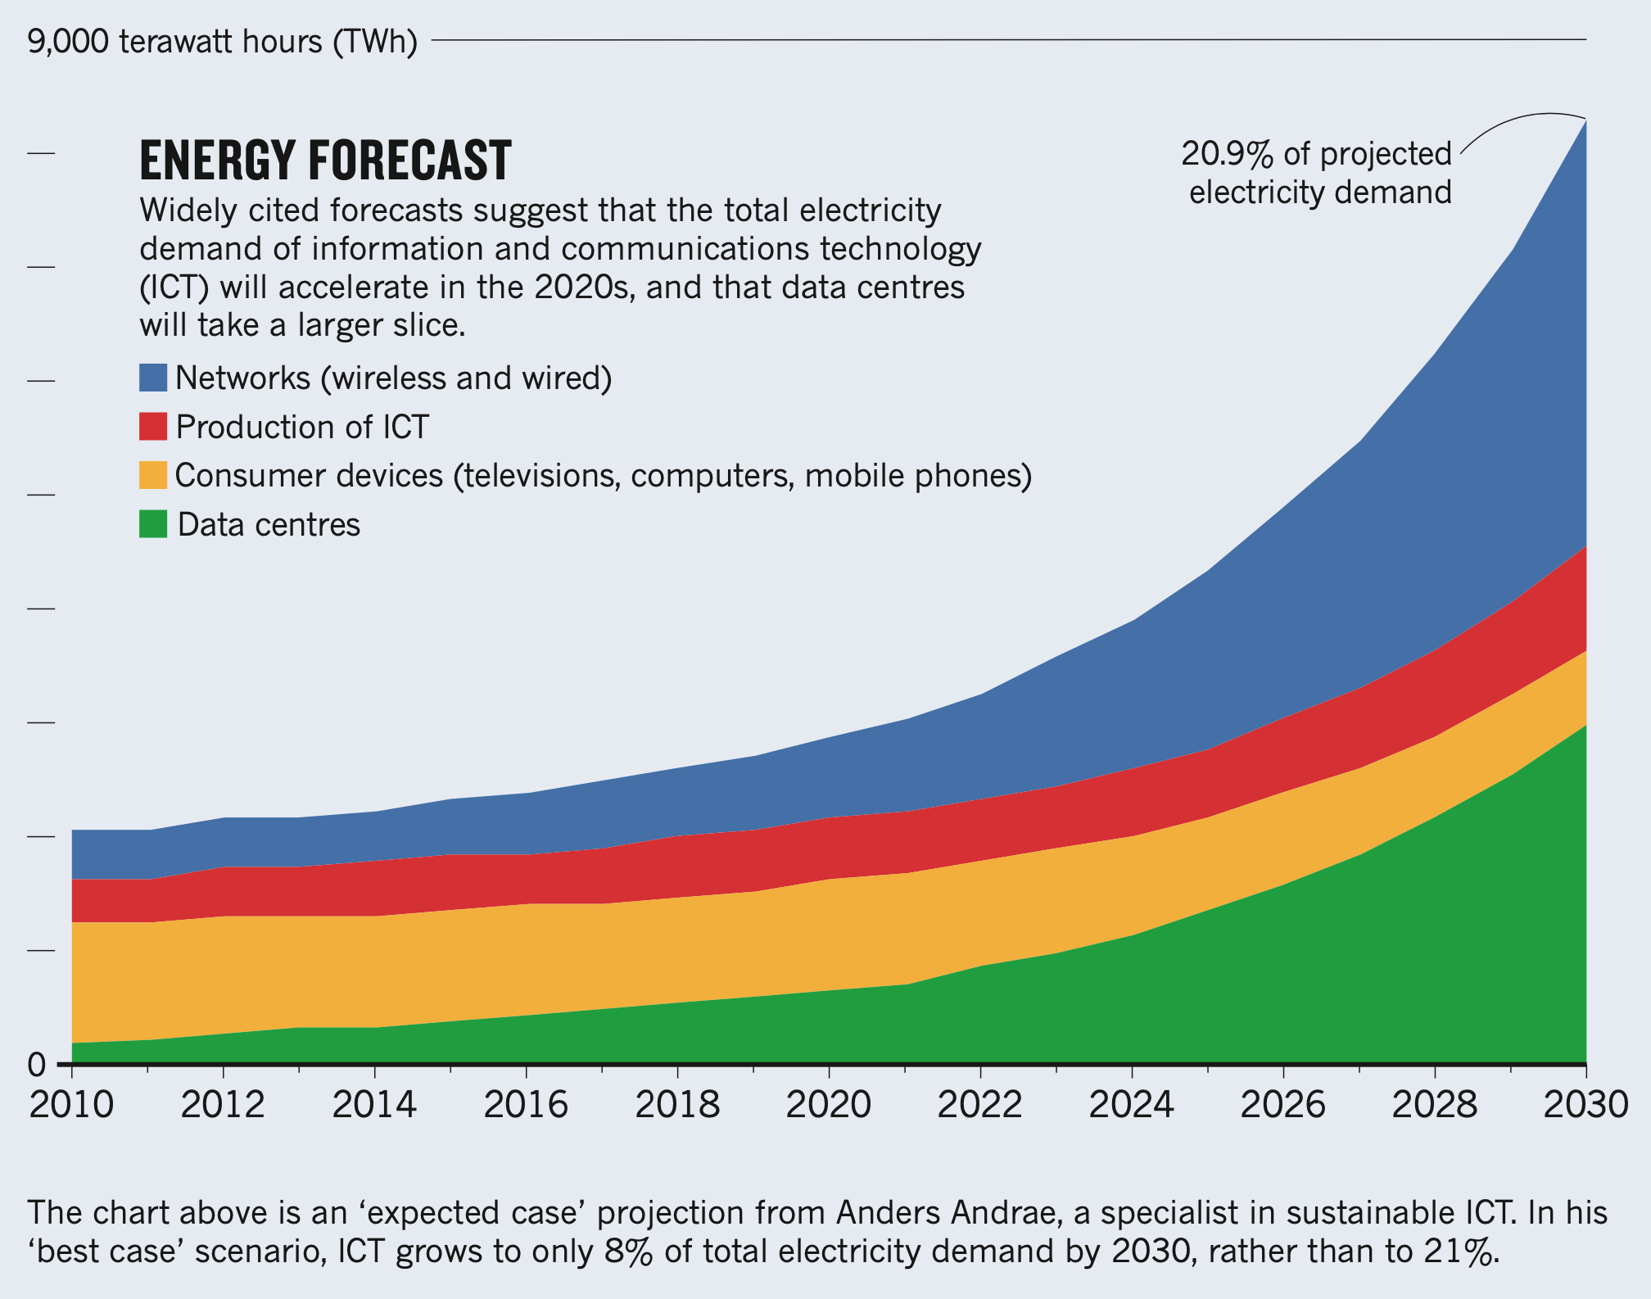
Supercomputers: energy & emissions
A. Stevens et al., “The imperative to reduce carbon emissions in astronomy” Nature Astronomy 2020
Andrae, Anders SG, and Tomas Edler. "On global electricity usage of communication technology: trends to 2030." Challenges 6.1 (2015)

Slide 4
Related work
Hardware power meters remain the most accurate method to monitor the power consumption of current computing systems.
Built-in sensors can be used for quick and reliable estimates.
Prior work:
  PowerSensor2
  LIKWID
  PAPI
  SW libraries based on NVML
J. W. Romein et al., “PowerSensor2: A Fast Power Measurement Tool”, ISPASS 2018
J. Treibig et al., “Likwid: A lightweight performance-oriented tool suite for x86 multicore environments”, ICPPW 2010
H. Jagode et al., “Papi software-defined events for in-depth performance analysis”, International Journal of HPC Applications 2019
M. Chadha et al., “Unified power and en- ergy measurement api for hpc co-processors”, IPCCC 2016

Slide 5
PMT: Power Measurement Toolkit
GOAL: provide a high-level library for power measurement in C++ and Python, not limited to HPC.
PMT:
PMT (background thread) interfaces with several power measurement back ends: NVIDIA NVML, AMD ROCM, RAPL, PowerSensor2, Xilinx Alveo, etc.
PMT is a C++ library. We provide Python bindings and Python decorators to enable power measurement in Python-user contexts.
Two modes: 1) measurement; 2) dump.
Who would use PMT?
HPC application developers (C++) to monitor and evaluate energy efficiency of their code.
Python developers that would like to measure the power consumption of their application with a simple tool.
Open source: https://git.astron.nl/RD/pmt/
PMT: Power Measurement Toolkit, S. Corda, B. Veenboer and E. Tolley, HUST (SC 22)

Slide 6
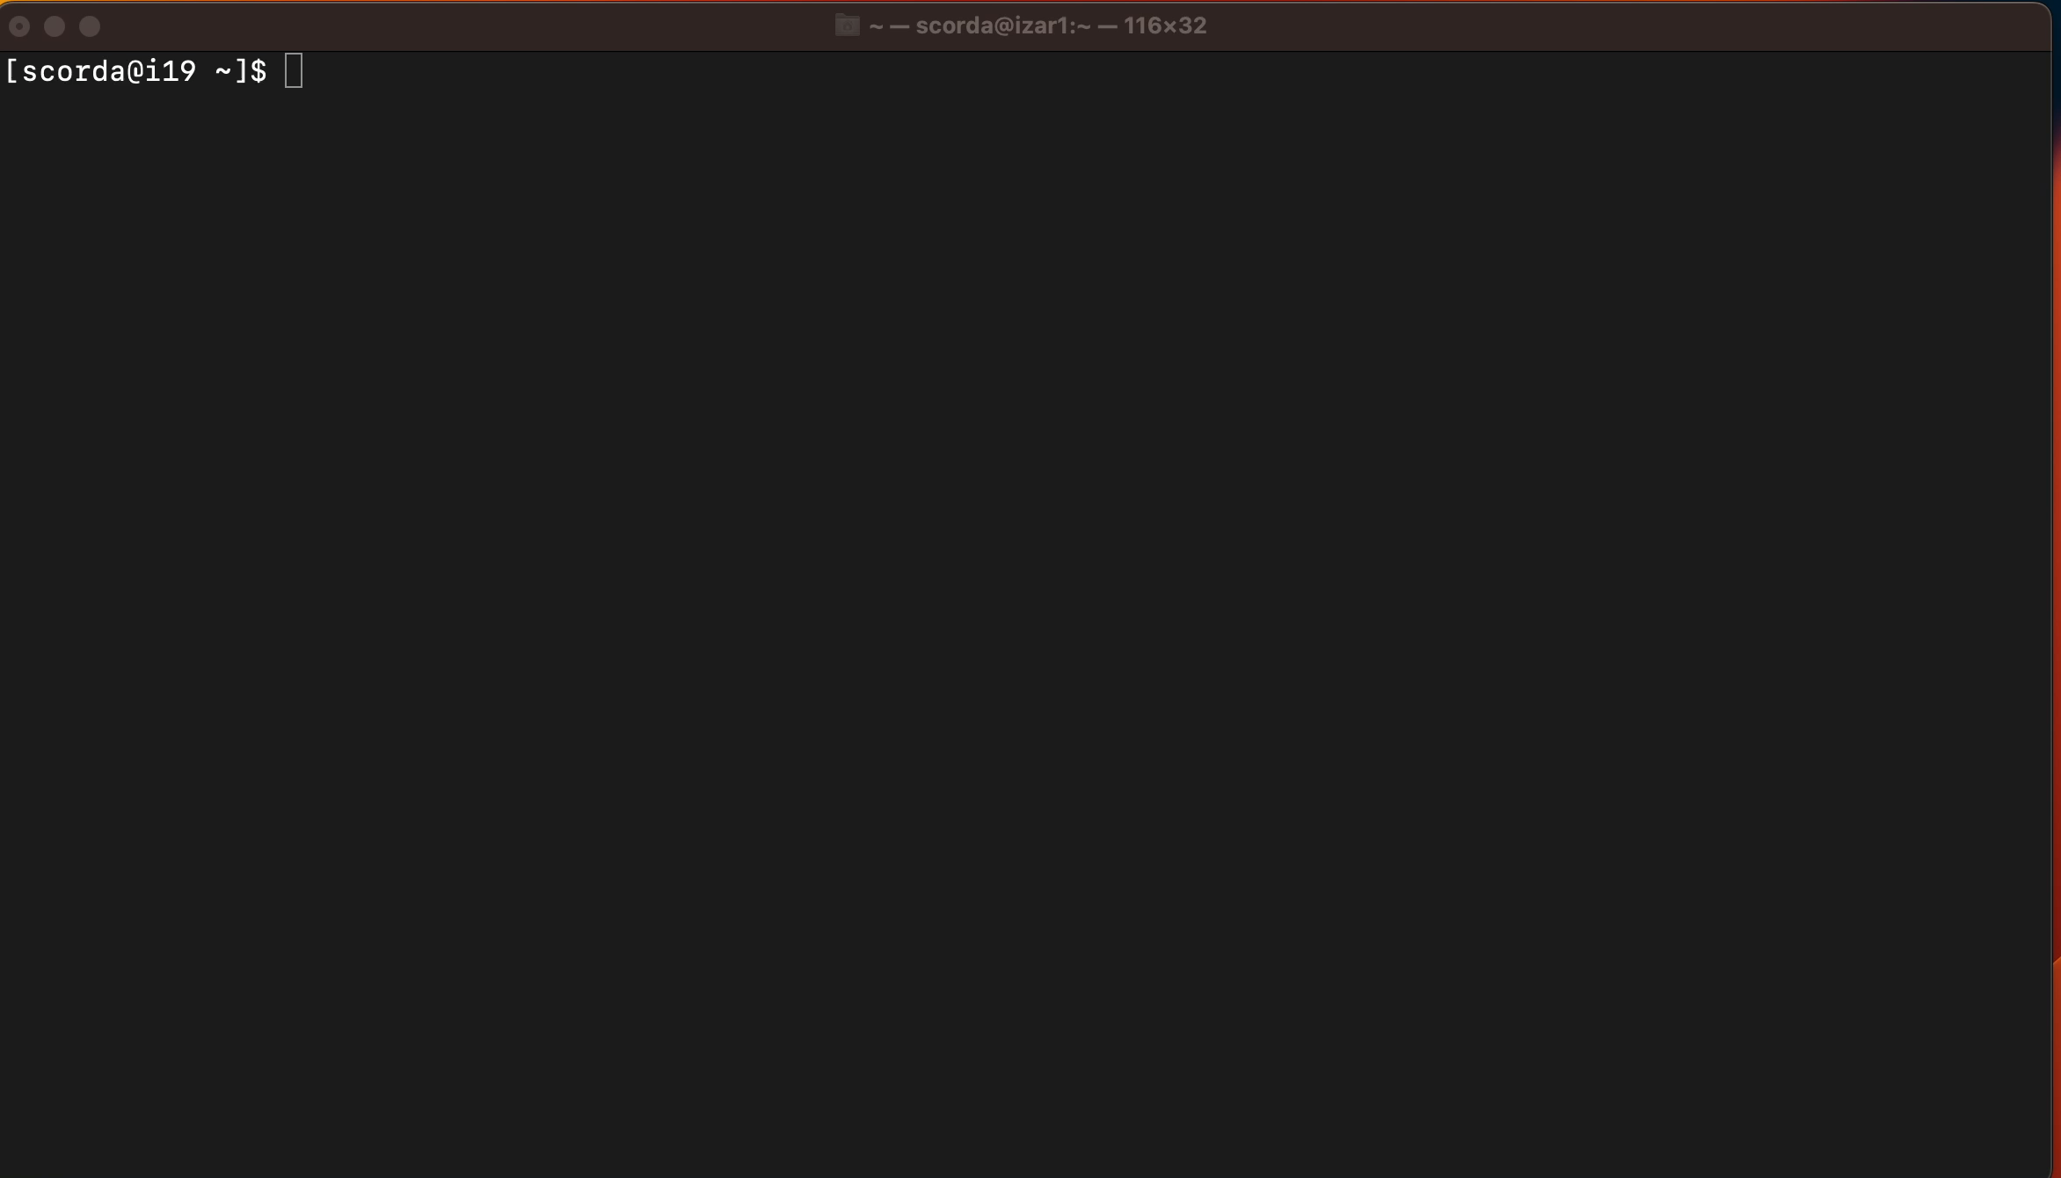
Installation (CMake)

Slide 7
Installation (Spack)
Add the custom recipes: https://git.astron.nl/RD/schaap-spack
Add PMT to your environment and install, e.g.:
spack repo add schaap-spack
spack add pmt+nvml+python
spack install

Slide 8
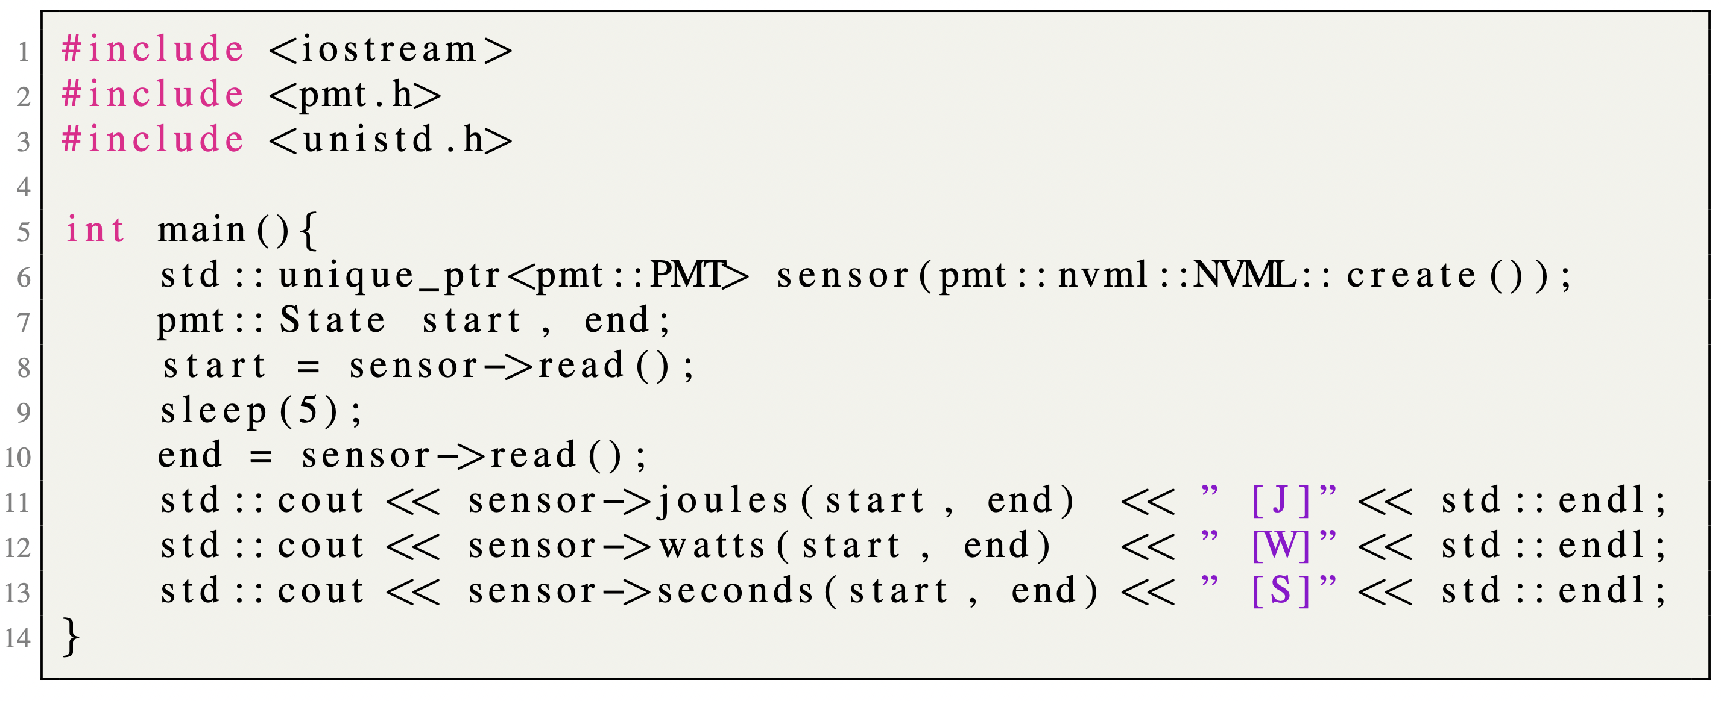
Embed PMT in C++

Slide 9
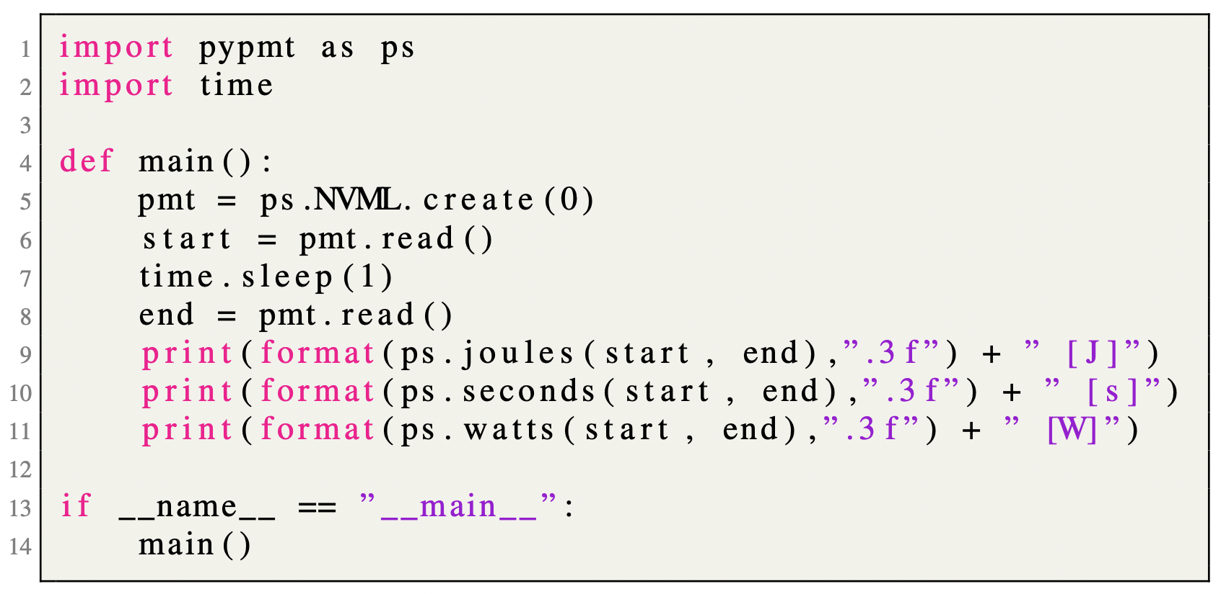
Embed PMT in Python

Slide 10
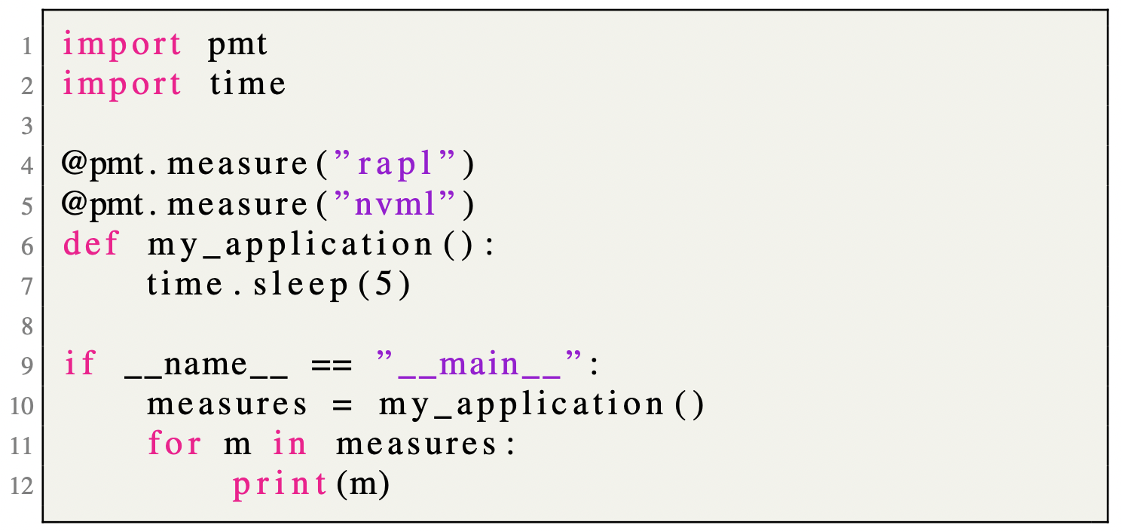
Embed PMT in Python (decorators)

Slide 11
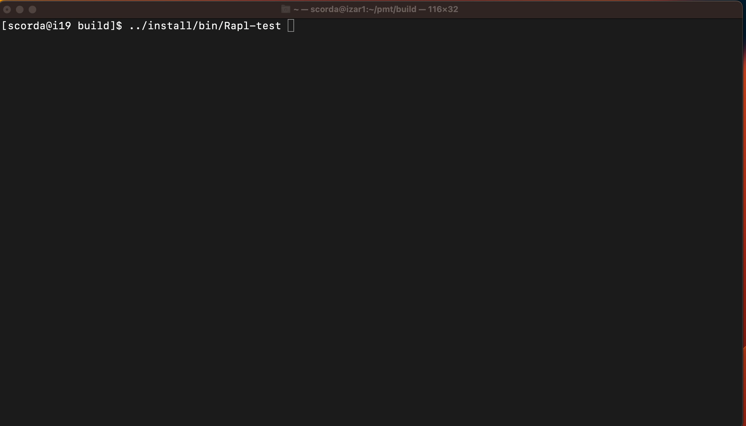
PMT (SW) power readers

Slide 12
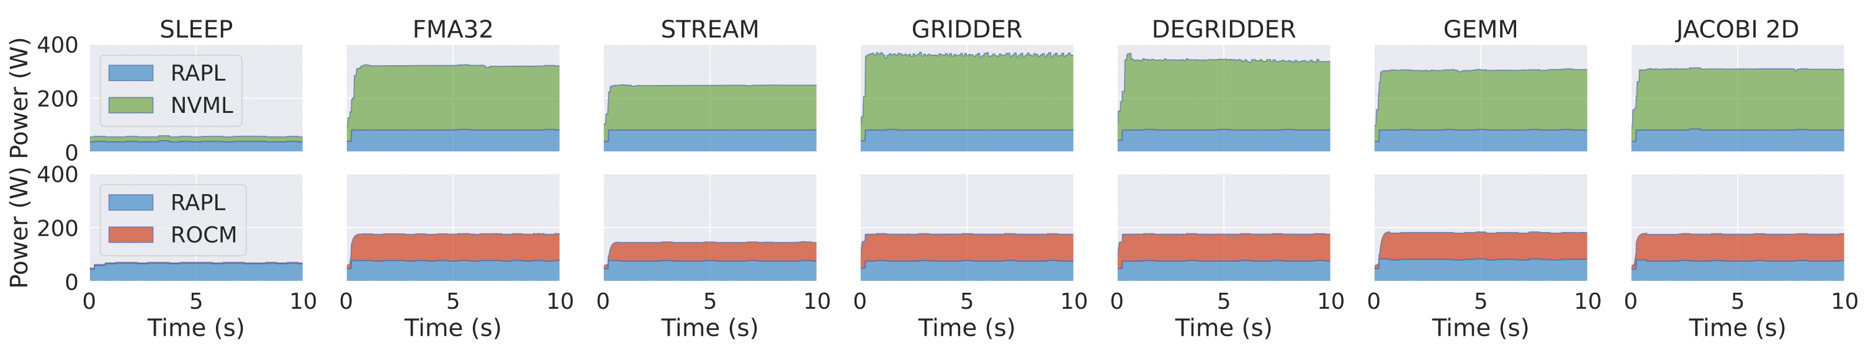
Benchmarking
Systems:
AMD Threadripper 3970x + NVIDIA RTX Titan
AMD Threadripper 3970x + AMD W6600
Benchmarks:
Microbenchmarking: SLEEP (no computation), FMA32 (many FMAs), STREAM (bandwidth test)
Radio-astronomical imaging motifs: GRIDDER and DEGRIDDER
Linear-algebra (Polybench): GEMM and JACOBI 2D

Slide 13
Cray back end test
Total power
Stacked power values

Slide 14
Conclusion
Summary:
  PMT: a high-level library for power consumption measurements and monitoring with a simple interface on various hardware.
  PMT is an open-source library.
  PMT is currently employed in radio-astronomical imaging production code for LOFAR, e.g. IDG (https://gitlab.com/astron-idg/idg).
  PMT is used for power consumption monitoring in the context of SW/HW HPC co-design activities for the Square Kilometre Array (SKA).
Future work:
  PMT support for new back ends, e.g. Intel GPUs (Ponte Vecchio).
  Integration into SDP-benchmark suite.
  Magic command for Jupiter Notebooks.

