Slide 1


LOW self-calibration benchmarking
Stefano Corda
stefano.corda@epfl.ch
06-09-2023
SKACH days

Slide 2
SKA low self-calibration pipeline
  First three iterations of the Rapthor pipeline (DD self-calibration)
  Completed in 8 steps with ~30 GB dataset
  Python routine (delivered by SCHAAP Team) calls DP3 & WSClean
https://github.com/lofar-astron/DP3 https://gitlab.com/aroffringa/wsclean
Notes:
Iteration 1:
Calibrate_1: based on the phase center of the MS, the skymodel is downloaded and grouped in patches Those are used for a phase-only calibration.
Predict_1: the sources which lie outside the field we want to image are predicted and subtracted in the visibility space. This produces the Ms: ms_no_outliers, which is further used throughout the pipeline
Image_1: The dataset is imaged and the solutions in calibrate_1 are applied while imaging.
Iteration 2:
Calibrate_2: using the new skymodel produced by image_1, run a phase_only calibration
Image_2: Same as image_1, whith updated solutions
Iteration 3:
Calibrate_3: using the new skymodel produced by image_2, run two DDECal: scalarphase and complexgain. The solutions are then combined.
Predict_3: extract the bright sources from the skymodel and predict them. Those are subtracted from the MS in the visibility space. This creates the MS: ms_no_out;liers_no_bright_sources, which is further used for imaging.
Image_3: the dataset is imaged. Afterwards, the bright sources are put back in the image and in the output skymodel.

Slide 3
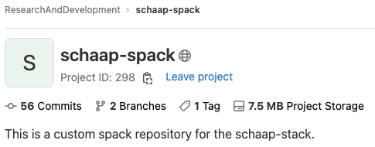
“Portable” installation of DP3/WSClean
  Fix Aoflagger/DP3 spack recipes
  Custom casacore spack recipe (WRST data)
  Dysco spack recipe
  RUM spack recipe
  CI/CD on ASTRON DAS-6
  Install DP3/WSClean on several clusters (EPFL, CSCS, Jean-Zay)
https://git.astron.nl/RD/schaap-spack
https://gitlab.com/ska-telescope/sdp/ska-sdp-rum
https://github.com/aroffringa/dysco
https://github.com/lofar-astron/DP3
https://gitlab.com/aroffringa/aoflagger
https://gitlab.com/aroffringa/wsclean

Slide 4
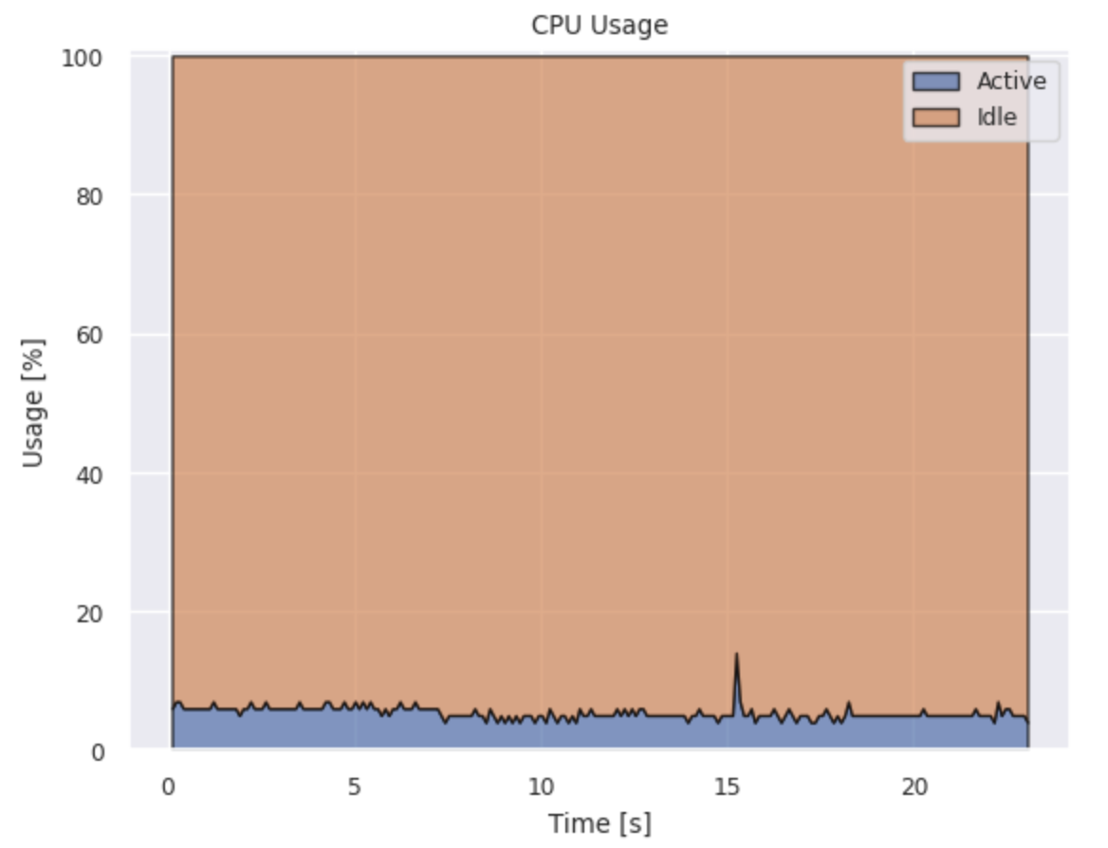
Resource Usage Monitoring (RUM) - Profiling
RUM
  Collecting cpu/disk/memory/network usage statistics from system files (e.g. diskstat, meminfo)
PMT (Power Measurement Toolkit):
  Larger dump interval to file
  Cray back end
https://gitlab.com/ska-telescope/sdp/ska-sdp-rum
https://git.astron.nl/RD/pmt
S. Corda, B. Veenboer and E. Tolley, “PMT: Power Measurement Toolkit”, SC 2022 (HUST)

Slide 5
PI18-19

Slide 6
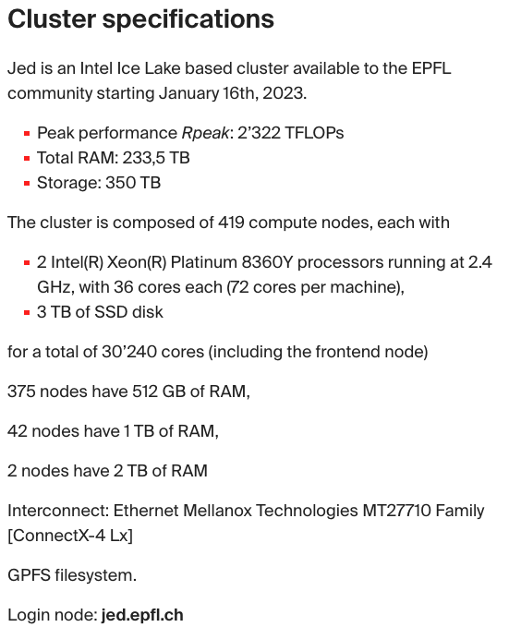
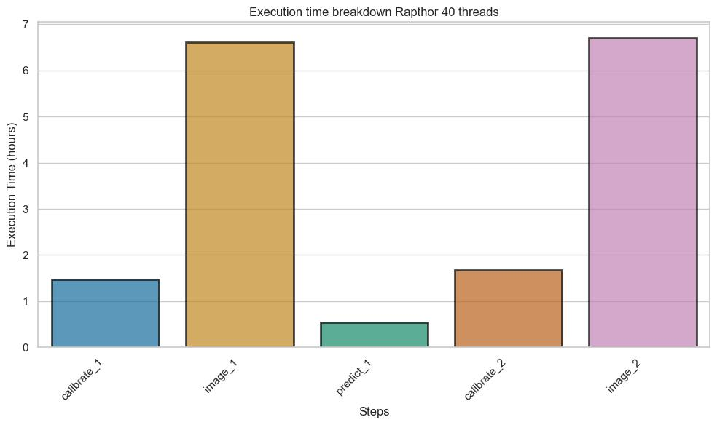
Execution time
The application runs with the default setting of 40 threads

Slide 7
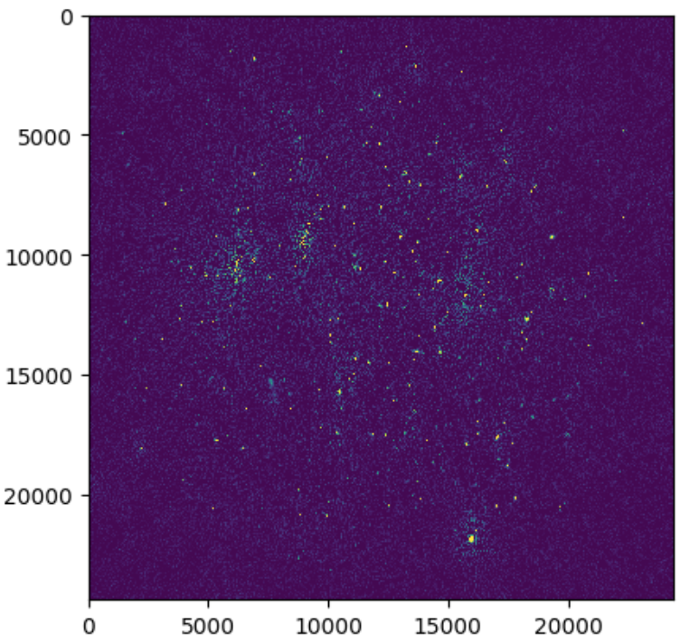
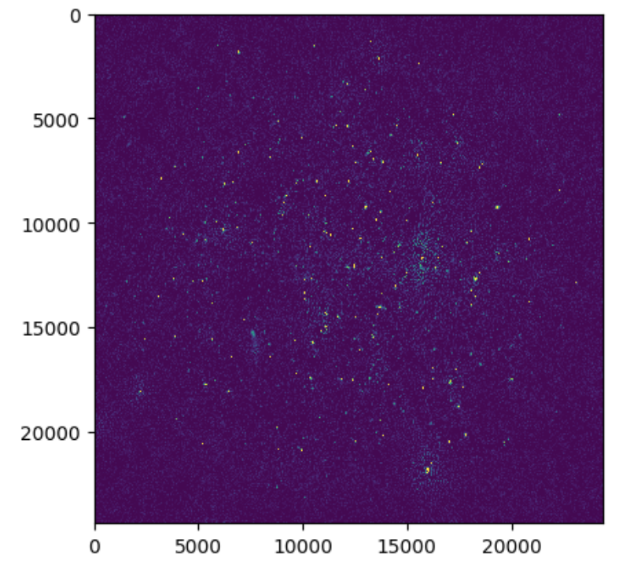
Output samples

Slide 8
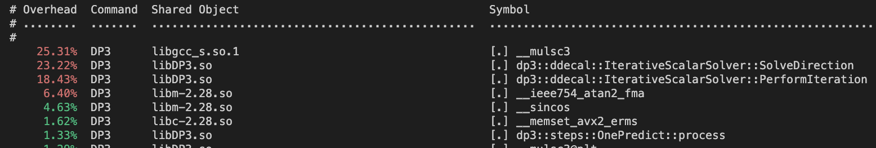
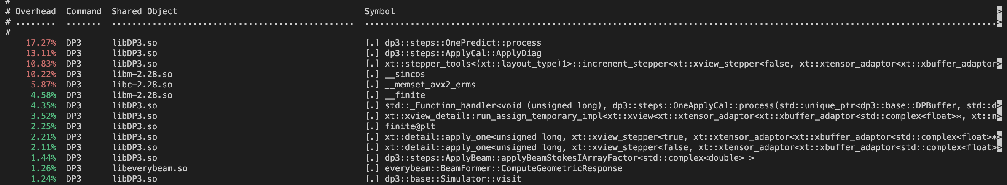
Perf (calibrate_1 and predict_1)

Slide 9
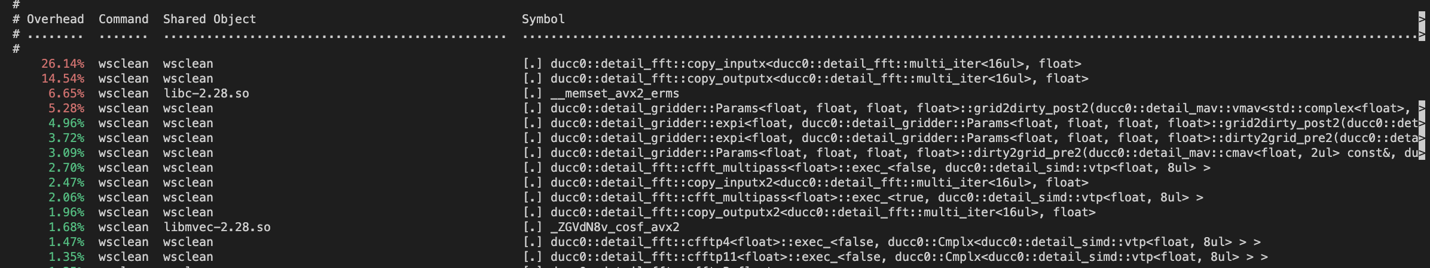
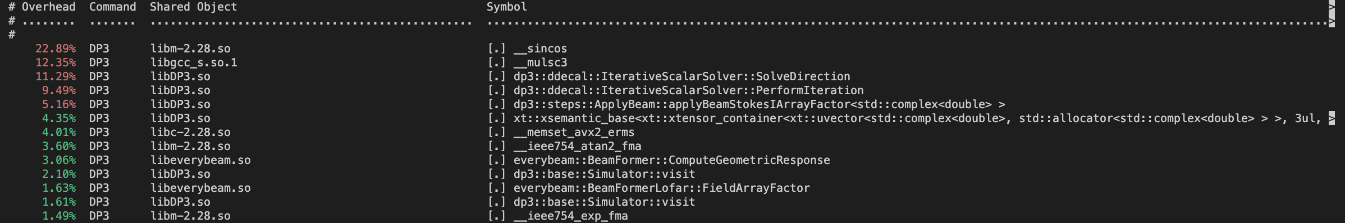
Perf (image_1 and calibrate_2)

Slide 10
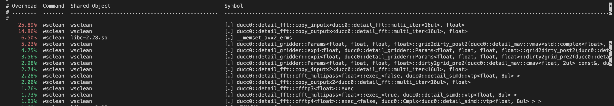
Perf (image_2)
The image steps spend a lot of time on fft (copy input and output) and gridding.
The calibrate steps spend most a good percentage of time on complex multiplications and sincos operations.
The predict step spends time on sincos and, ApplyCal::ApplyDiag and OnePredict::Process.

Slide 11
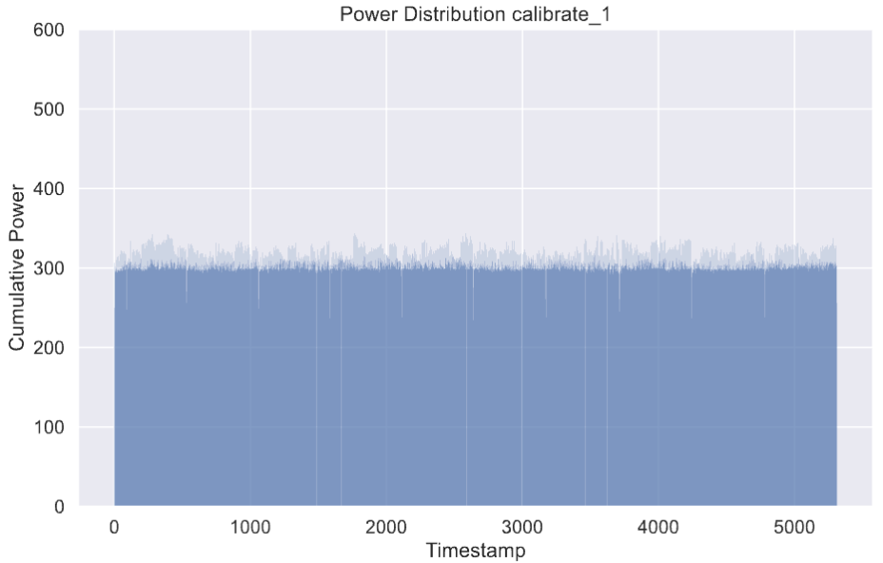
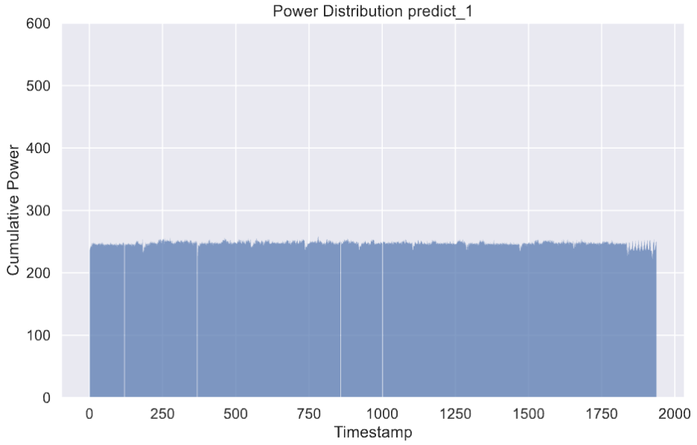
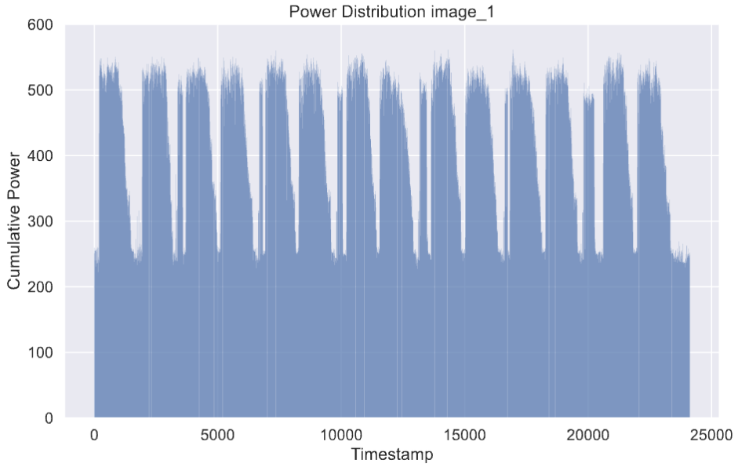
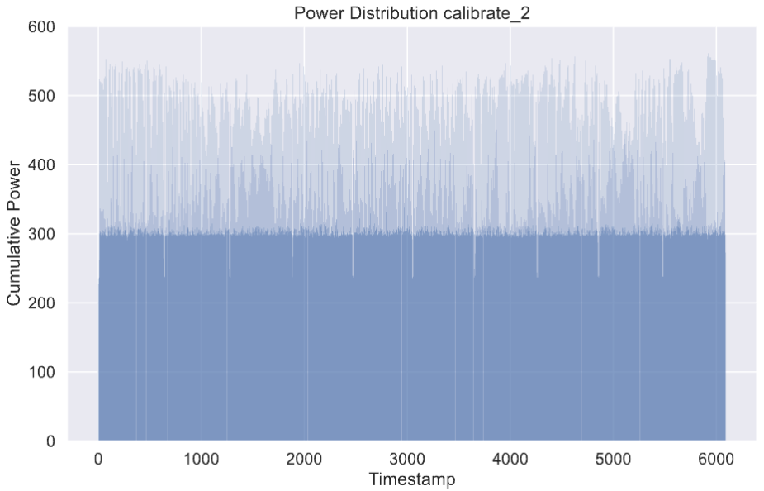
Power distribution (PMT-rapl)
TODO: fix PMT bug (negative values RAPL)

Slide 12
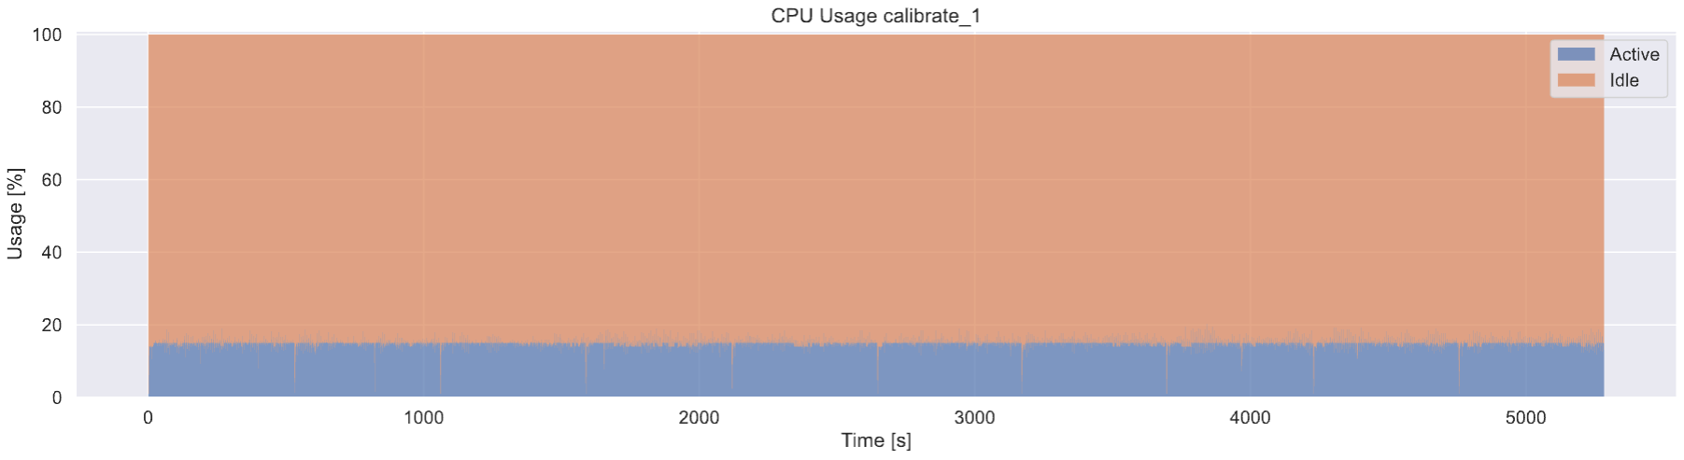
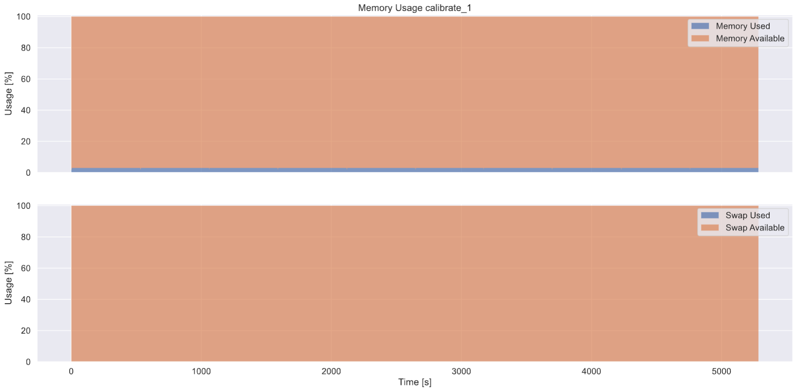
CPU and Memory usage
Low CPU and memory usage

Slide 13
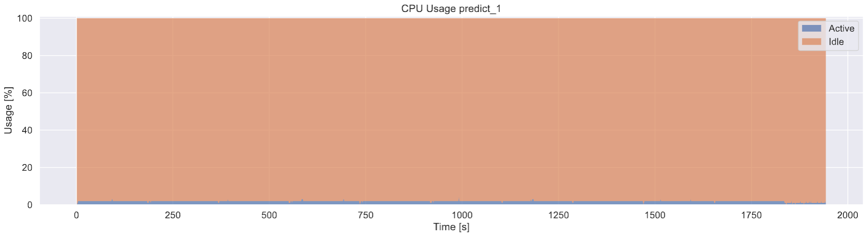
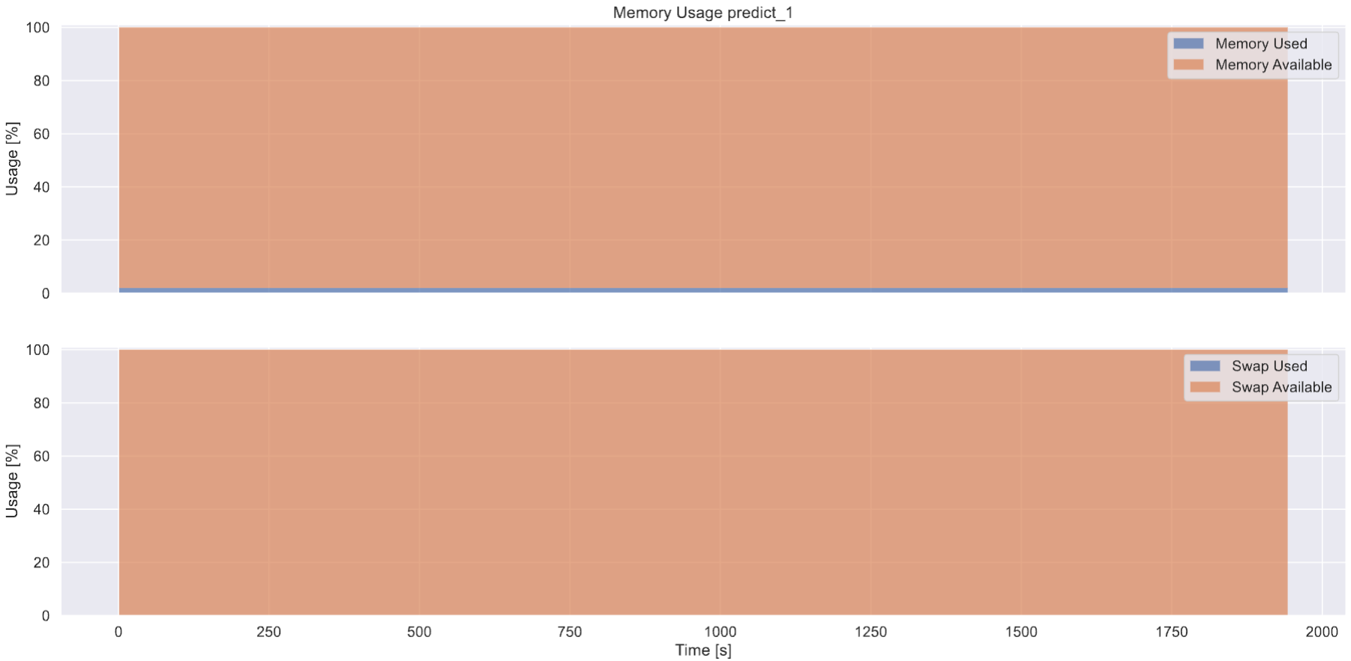
CPU and Memory usage
Low CPU and memory usage

Slide 14
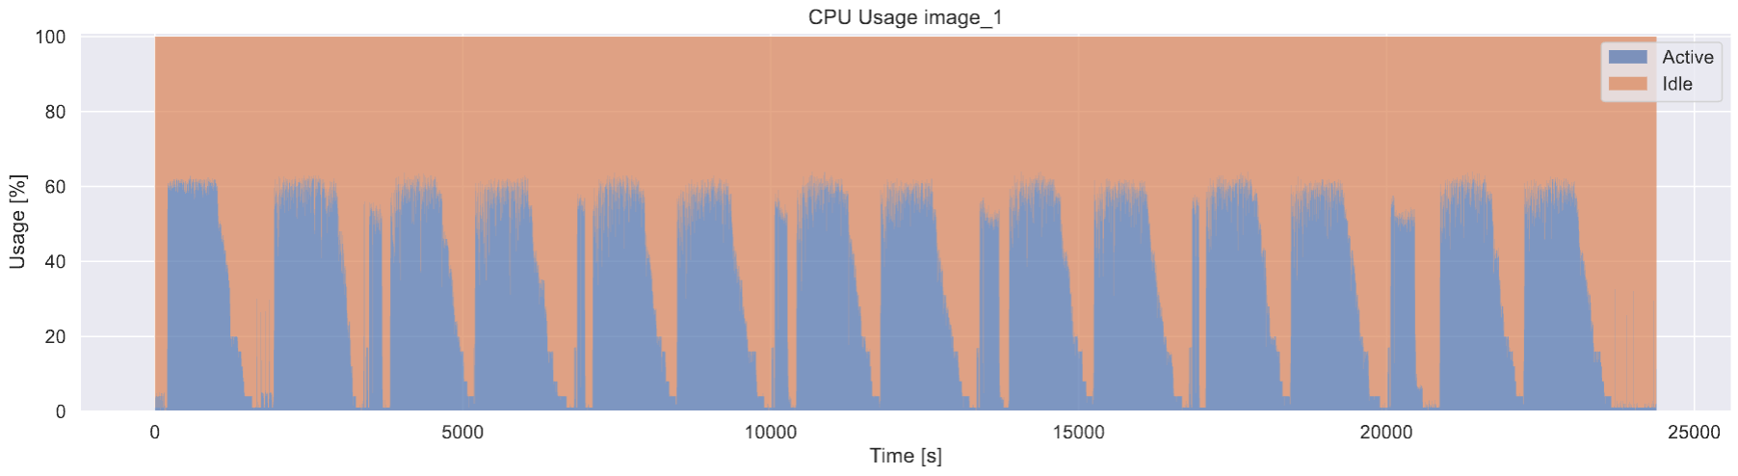
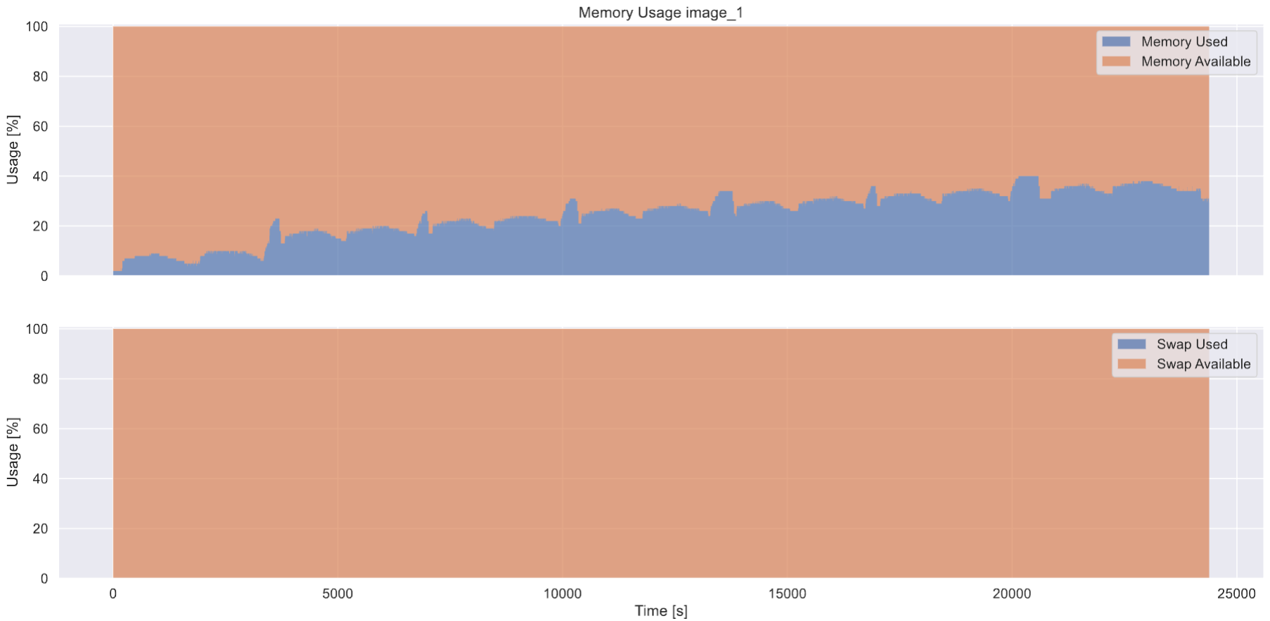
CPU and Memory usage
Medium CPU and memory usage
Notes:
Memory

Slide 15
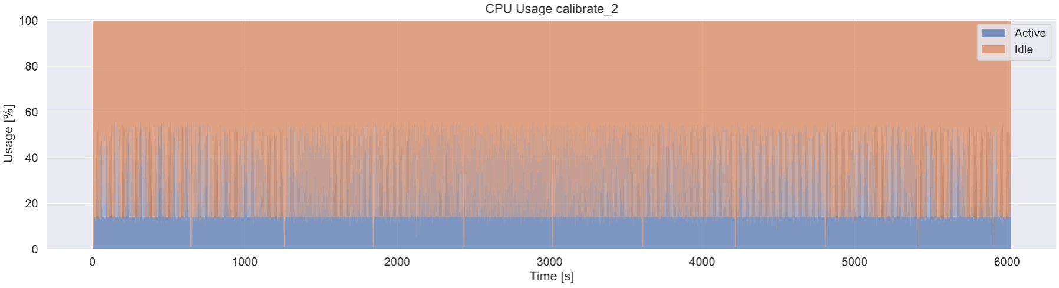
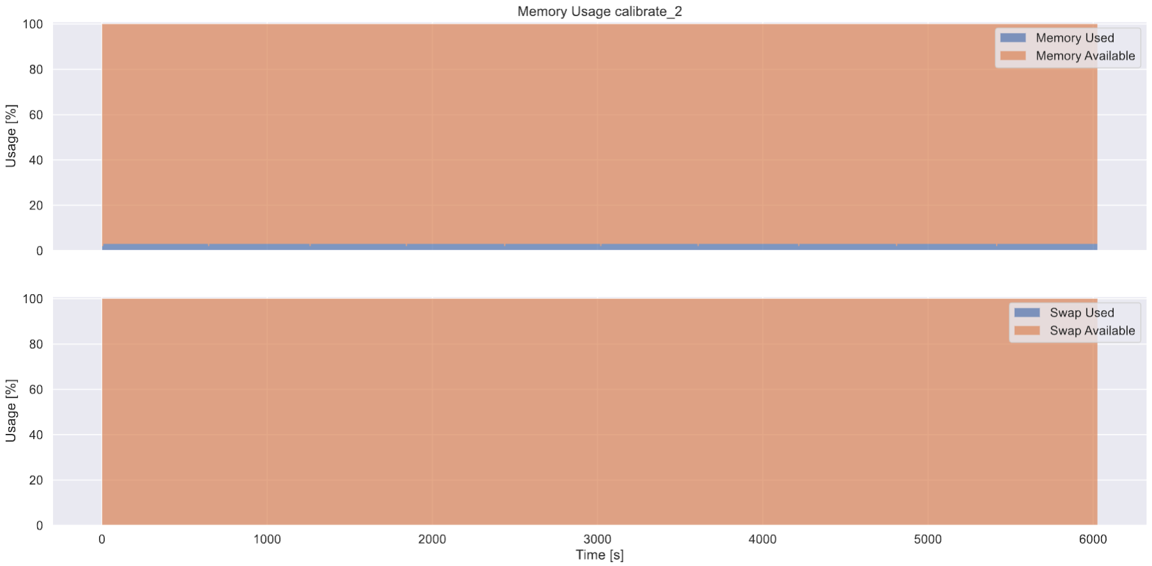
CPU and Memory usage
Low CPU and memory usage

Slide 16
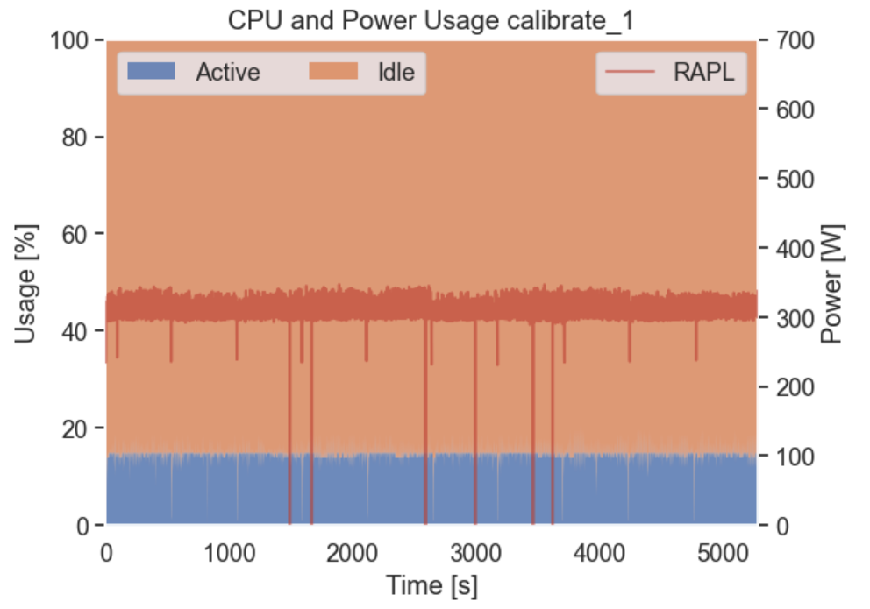
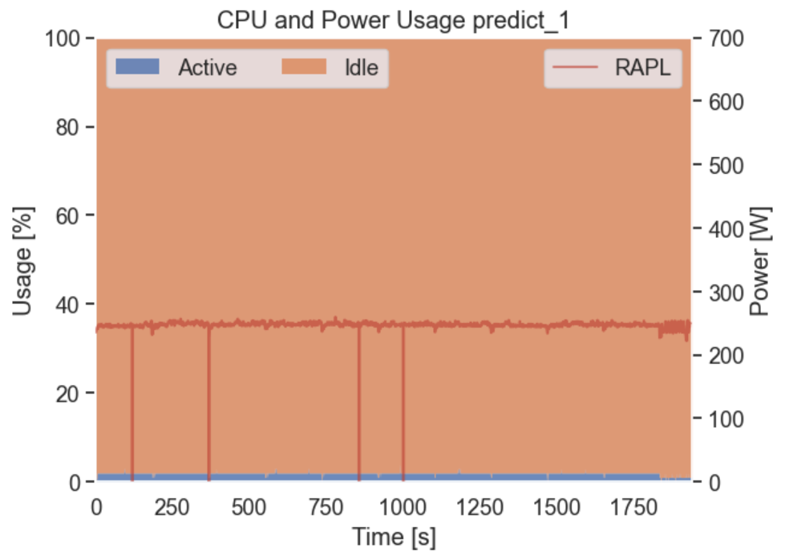
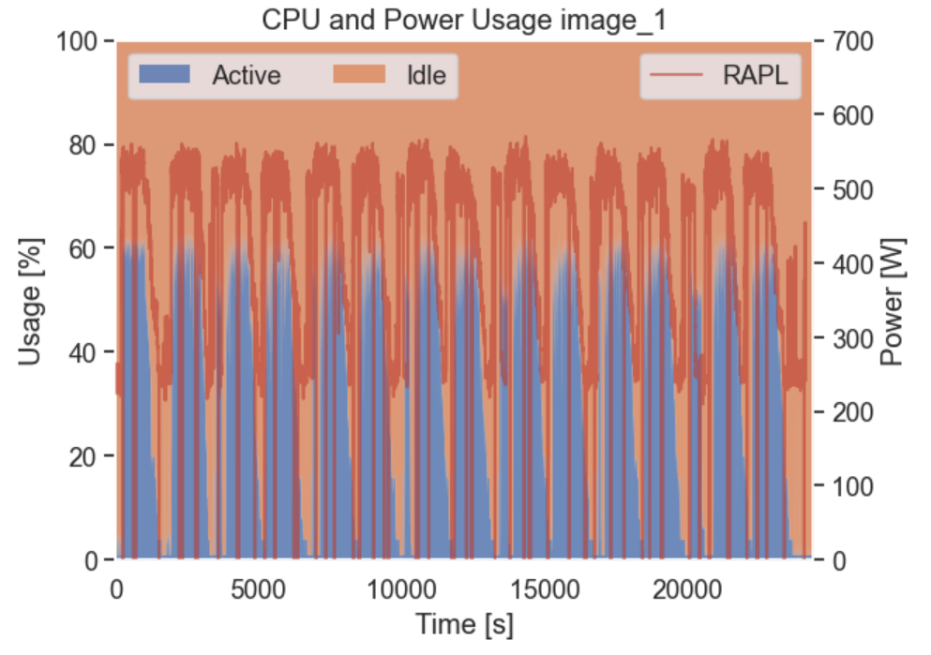
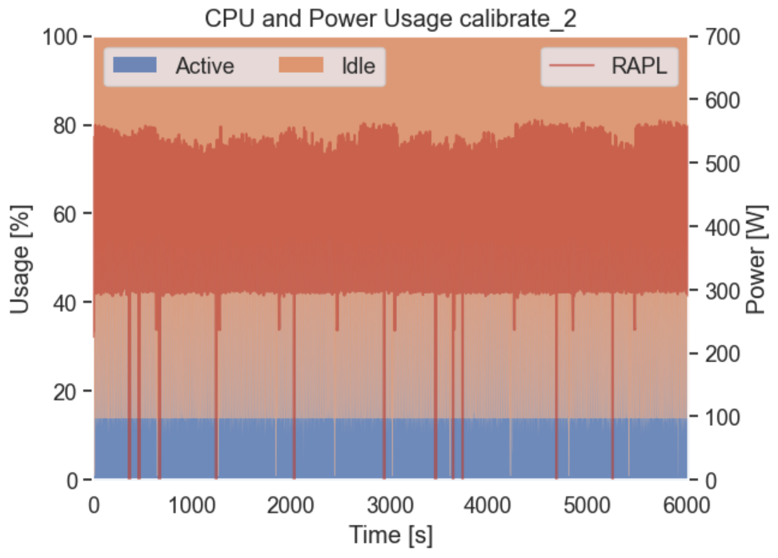
CPU & Power usage
CPU usage & Power usage are strictly correlated

Slide 17
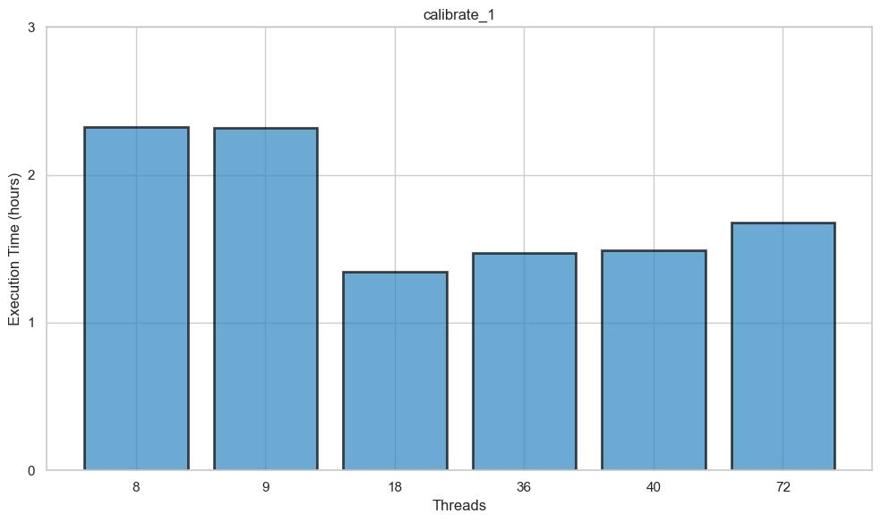
Scaling threads (calibrate_1)
Threads trade-off?

Slide 18
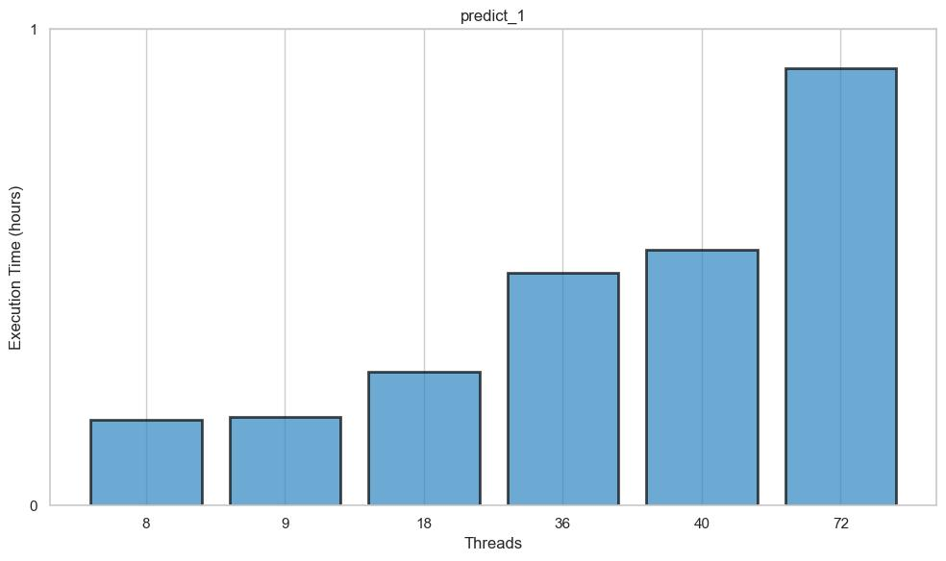
Scaling threads (predict_1)
Less threads → faster

Slide 19
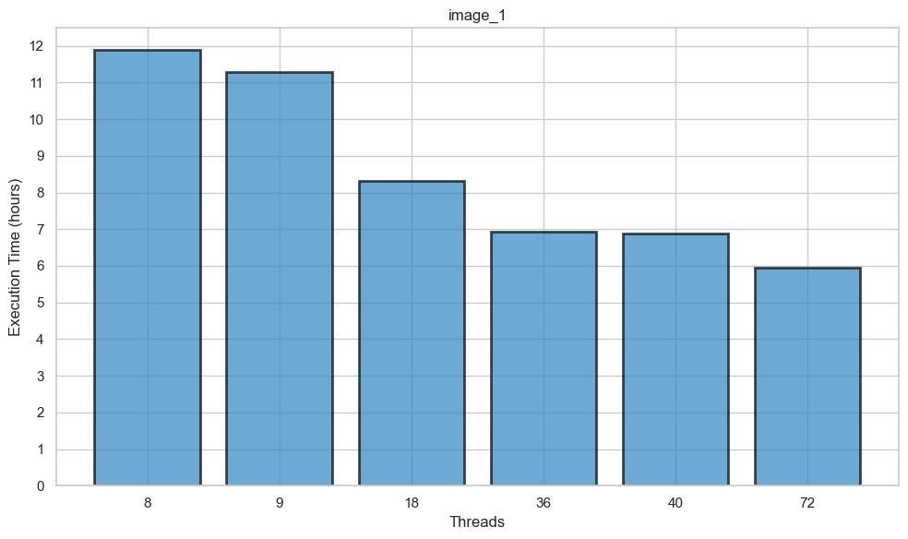
Scaling threads (image_1)
More threads → faster

Slide 20
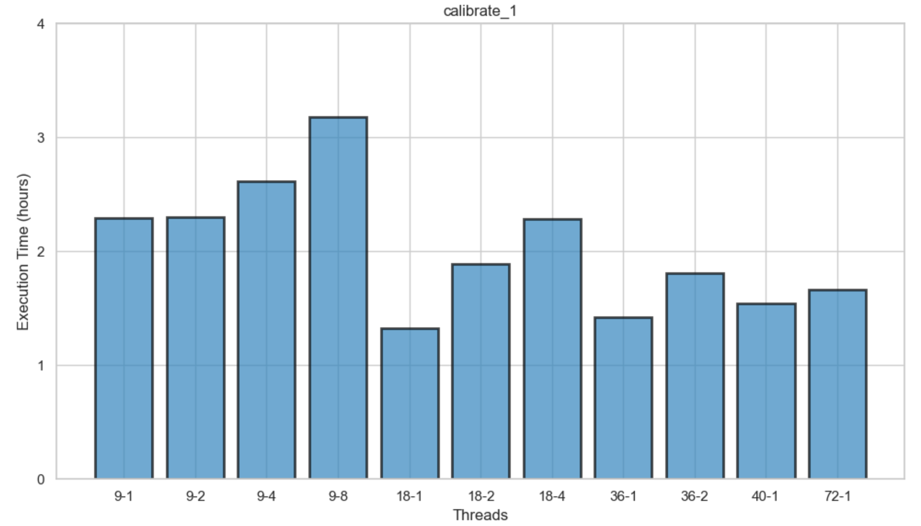
Scaling & pin threads (calibrate_1)
1 socket > 2 socket

Slide 21
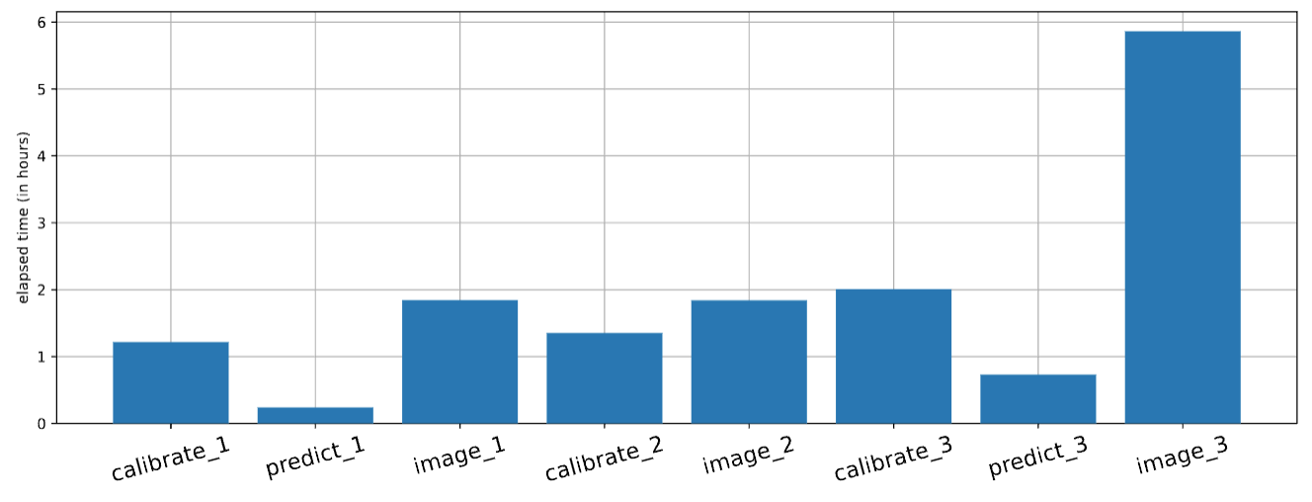
Jean Zay (reduced dataset)
calibrate_1
predict_1
image_1
Credits: Aristide Doussot

Slide 22
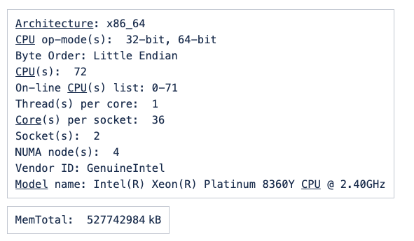
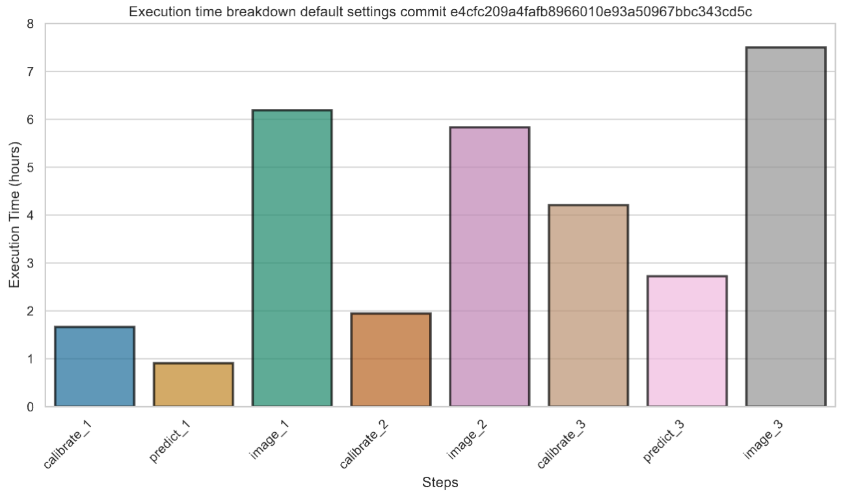
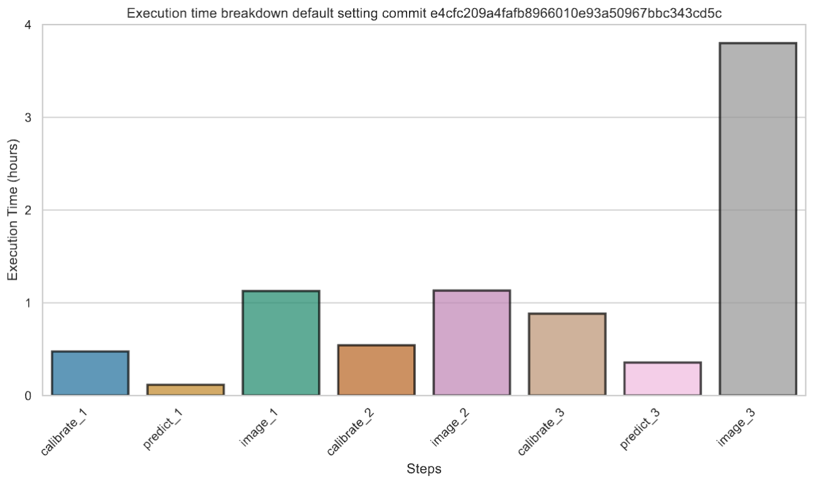
EPFL jed (reduced dataset)
PI18 dataset
Reduced dataset

Slide 23
CSCS Piz Daint
  Installed the same GCC version as in other clusters (9.4.0):
    Support for binutils & install_missing_compilers
  Installed all the needed libraries (everybeam, DP3, WSClean, Dysco …) in /store/ska/sk04/spack181
  Everybeam issue (spack 0.4.0 & pip 0.5.1) → uninstall the pip version
  HDF5 issue --> export HDF5_USE_FILE_LOCKING=FALSE (login nodes vs compute nodes)
  Report in /scratch/snx3000/scorda/rapthor_working_dir

Slide 24
Ex. Time breakdowns
Jean Zay
Credits: Aristide Doussot
Piz Daint
Jed

Slide 25
Summary
  A lot of debugging activities…
  Good understanding of the LOW self-calibration
  Deployment on several systems
  Initial benchmarking activities
  Initial integration into the SDP benchmark suite (see other presentation today)

Slide 26
Improvement items PI20 onward
  Run multi-node LOW self-cal pipeline.
  Detailed (vendor dependent) profiling (VTune etc.).
  Optimizations proposals (and possibly implementations).
  Include pipeline in simplified benchmark suite.

