Slide 1
SDP benchmark suite
Stefano Corda and Manuel Stutz
stefano.corda@epfl.ch
manuel.stutz@fhnw.ch
06-09-2023
SKACH days

Slide 2
SDP benchmark suite
Spack software manager: https://github.com/spack/spack
Reframe regression testing framework: https://github.com/reframe-hpc/reframe
Conda: python environments
Goals:
Easy to use/deploy benchmark suite for procurement decision for the SDP.
Support DP-ART developer benchmarking.

Slide 3
SDP-benchmark suite
Basic concepts:
Test: What to test
System: Where is the test allowed to run
Environment: What environment is the test expecting
@rfm.simple_test class FunclibDftTest(RunOnlyBenchmarkBase):
def __init__(self): super().__init__() self.valid_prog_environs = ['funclib-test'] self.valid_systems = filter_systems_by_env(self.valid_prog_environs)

Slide 4
Execution pipeline
@run_after / @run_before hooks
@run_after('setup') def set_conda_cmds(self): self.prerun_cmds += self.env_manager.emit_conda_activate_cmds().split(';')

Slide 5
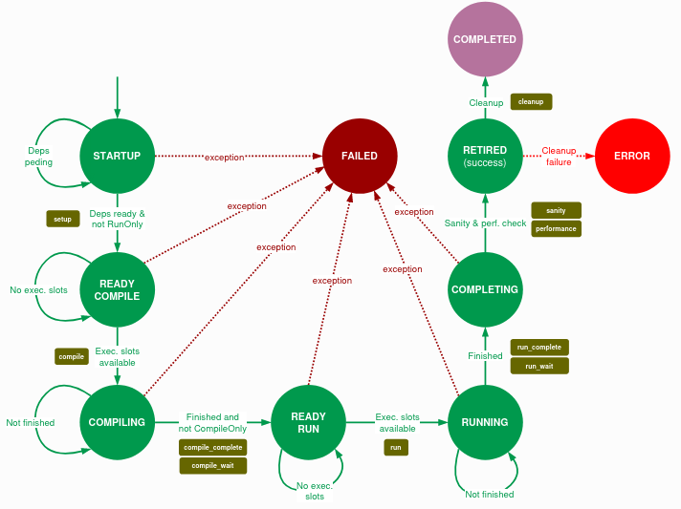
Execution Pipeline

Slide 6
Post-run checks
Sanity Phase
Performance phase
@run_before('sanity') def set_sanity_patterns(self): patterns = [ sn.assert_not_found('error', self.stderr), sn.assert_not_found('Error', self.stderr), ]
@run_before('performance') def set_perf_patterns(self): self.perf_variables = {'elapsed_time_v00_cpu': self.extract_v00_cpu_time()}
@performance_function('s') def extract_v00_cpu_time(self): return sn.extractsingle(rf'^Elapsed Time\s+(?P<elapsed_time>\S+)\s+s', self.stdout, 'elapsed_time', float, 0)

Slide 7
Previous PI improvements
Progress in the last few PIs
Multiple statistical runs of a test
UsesInternet safeguard
Power measurement (libpowersensor) → deprecated
CI Pipeline on Cluster
Extending the benchmark suite
Hippo Funclib Test
IDG Micro Test
FFT CPU / GPU Test

Slide 8
PI19 update
Jean Zay (French Server):
System configuration
LOW self-cal (calibrate 1) runs (with hacks)
Grid5000 (French Server):
System configuration
Basic tests
CSCS Piz Daint:
Integration (with hacks) of profiling libraries (PMT/RUM) & performance visualization utilities
Hacks = not clean solution (NOT mergeable)

Slide 9
Improvement items PI20 onward (WIP & Q/A)
Simplify Benchmark Suite structure (easy to deploy on new systems and to hand over to HW vendors).
Integrate profiling libraries and tools (VTune, Nsight, etc.) wrapping run phase (running on compute nodes).
Remove system configurations (a script should be able to create and log the system configuration).
Remove/Improve conda manager (conflicts with python packages installed with spack).
…

Slide 10
PI20 plan
Assess the reproducibility of benchmark results and bias induced by benchmarking overhead.
Identify how to normalize outputs of benchmarking and corresponding data analysis scripts.
Complete assessment of the state of applications in the benchmark suite.
Produce a roadmap for further developing the benchmark suite.

