Slide 1
SKACH Communications: Achievements 2022/23
Presented by: Tanya Petersen
September 7, 2023

Slide 2
Background
Switzerland officially joined the SKA as a full member of the SKAO in January, 2022
Worked closely in Coordination with the SKAO Communications Office
Key communications platforms and tools developed and launched
- Brand
- Website
- Social Media Channels
- Podcasts in development
Participation with large events

Slide 3
SKACH Branding Activities
Finalise Mission and Vision
Finalise Name
Work with Graphic Designer for Logo
Website and other materials

Slide 4
Recap: Mission and Vision:
Objectives
Vision
Mission
Advance Switzerland’s impact in the SKAO and SRCs through:
Creating synergies between Swiss government, academia, and industry.
Engaging in leading-edge scientific research.
Providing Swiss solutions to SKAO and SRC big data and hardware challenges.
Competing for national and international funding for the Swiss Components of the SKAO and SRCs.
Ensuring returned value for money for the Swiss economic contributions to the SKAO and SRCs.
Fostering connections with other precursor radio astronomy facilities.
Further Swiss leadership in the global radio astronomy community.
Ensure meaningful contributions to the SKAO and SRCs through the development and delivery of
cutting-edge Swiss solutions to key science goals, big data research, technology, and services.

Slide 5
Logos:

Slide 6
Website: SKACH.org
Notes:
we have finally added (almost) everyone in the consortium on the Team page (and use that as a reminder that they should send photos of themselves), that we created an “In the Media page” to highlight media coverage of SKACH, and having an open jobs and a news page that are (somewhat) up-to-date.

Slide 7
Social Media:
X / Twitter: @ska_switzerland
Facebook: skaswitzerland
Instagram: skaswitzerland
Linkedin: SKACH – The SKA Switzerland Consortium
Video: https://youtu.be/fKAokUEKDqo
Notes:
Posted from events such as SKA meetings and the EPFL Portes Ouvertes – building presence and followers as our work continues and grows.

Slide 8
Making Waves Podcast:
Secured funding for a mini-series of 5 episodes
Initially in French, may look for additional funding to develop a German or Italian sister program
Content planning to start this month
Notes:
We received 5000 Francs from the Swiss Society for Astrophysics and Astronomy last fall/winter
We received 5000 euro from the IAU Office for Astronomy Outreach this past spring
We have contracted with a production company in Geneva to get started
Mark Sargent would host

Slide 9
Cosmos Archeology
Notes:
Art exhibit - Cosmos Archaeology empowers us to explore stars and galaxies formed over 13.7 billion years and to grasp the extent and evolution of our immense Universe in unprecedented ways.
Curated by Prof. Jean-Paul Kneib, Director of the Laboratory of Astrophysics and eSPACE Center and Sarah Kenderdine, Lead Laboratory for Experimental Museology
Started at EPFL - Moving to Shanghai

Slide 10
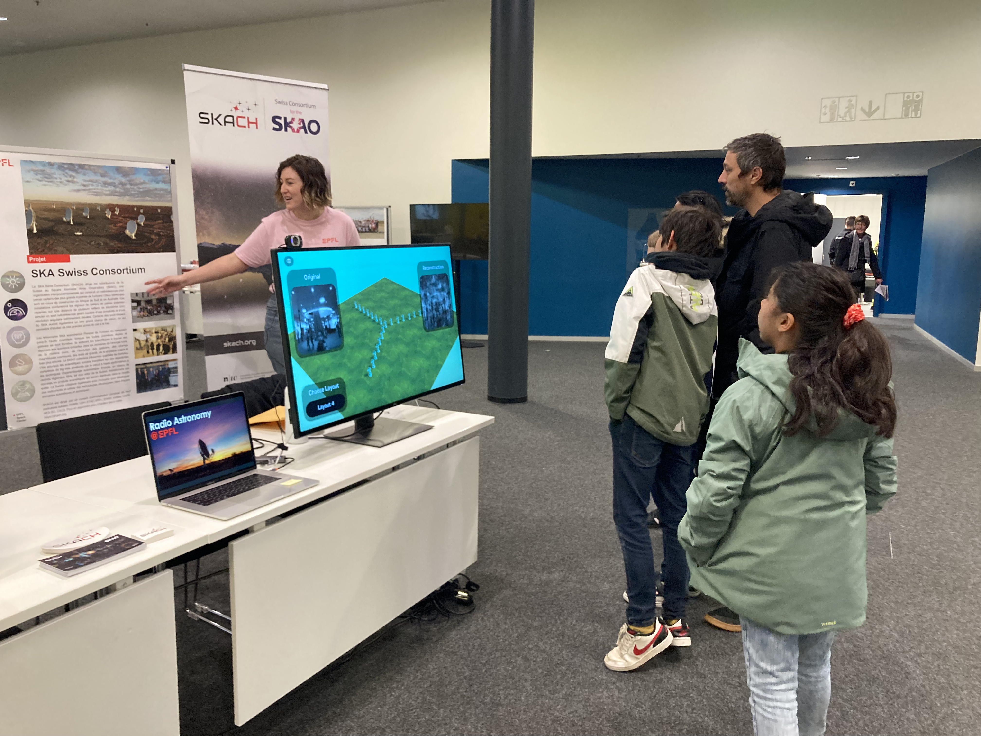
EPFL Open Days:
Notes:
Over 25,000 people attended the Open Days on April 29 and 30, to discover the captivating and exciting world of EPFL through exhibitions, animations, conferences, workshops and many other events.
Open Days is actually a nice point! Emma Tolley along with Shreyam Krishna, Michele Bianco and one other person, I don’t remember, presented a very cool radio telescope simulator. I can’t remember if Emma created it alone or if they all worked on it. It basically allowed visitors using a webcam to see what an image of themselves would look like depending on how an array of radio telescopes were arranged. And the whole group did an excellent job explaining radio astronomy in French! Also, the SKA Digital Twin exhibit from the Cosmos Archaeology exhibition was part of the Portes Ouvertes as well.

Slide 11
SKACH - Comm & Outreach Contacts:
Carolyn Crichton - SKACH Director, Chair of the Board, SKACON Steering Committee - Carolyn.Crichton@epfl.ch
Tanya Petersen - SKACH Communication and Outreach Program Chair - tanya.petersen@epfl.ch
Hamsa Padmanabhan - SKACH Communication and Outreach Program Co-Chair - Hamsa.Padmanabhan@unige.ch

