Slide 1
Band-Pass Filter Design For MID-band 6 Receiver
Mohammad Reza KHALVATI, Mohammad Azadifar, Dominique Bovey

Slide 2
Outline
MID-band 6 digitizer architecture
Anti-Aliasing filter Spec.
Fixed filters design for SKACH/EBB
R&D of Band-Pass tunable filter for SKACH/EM

Slide 3
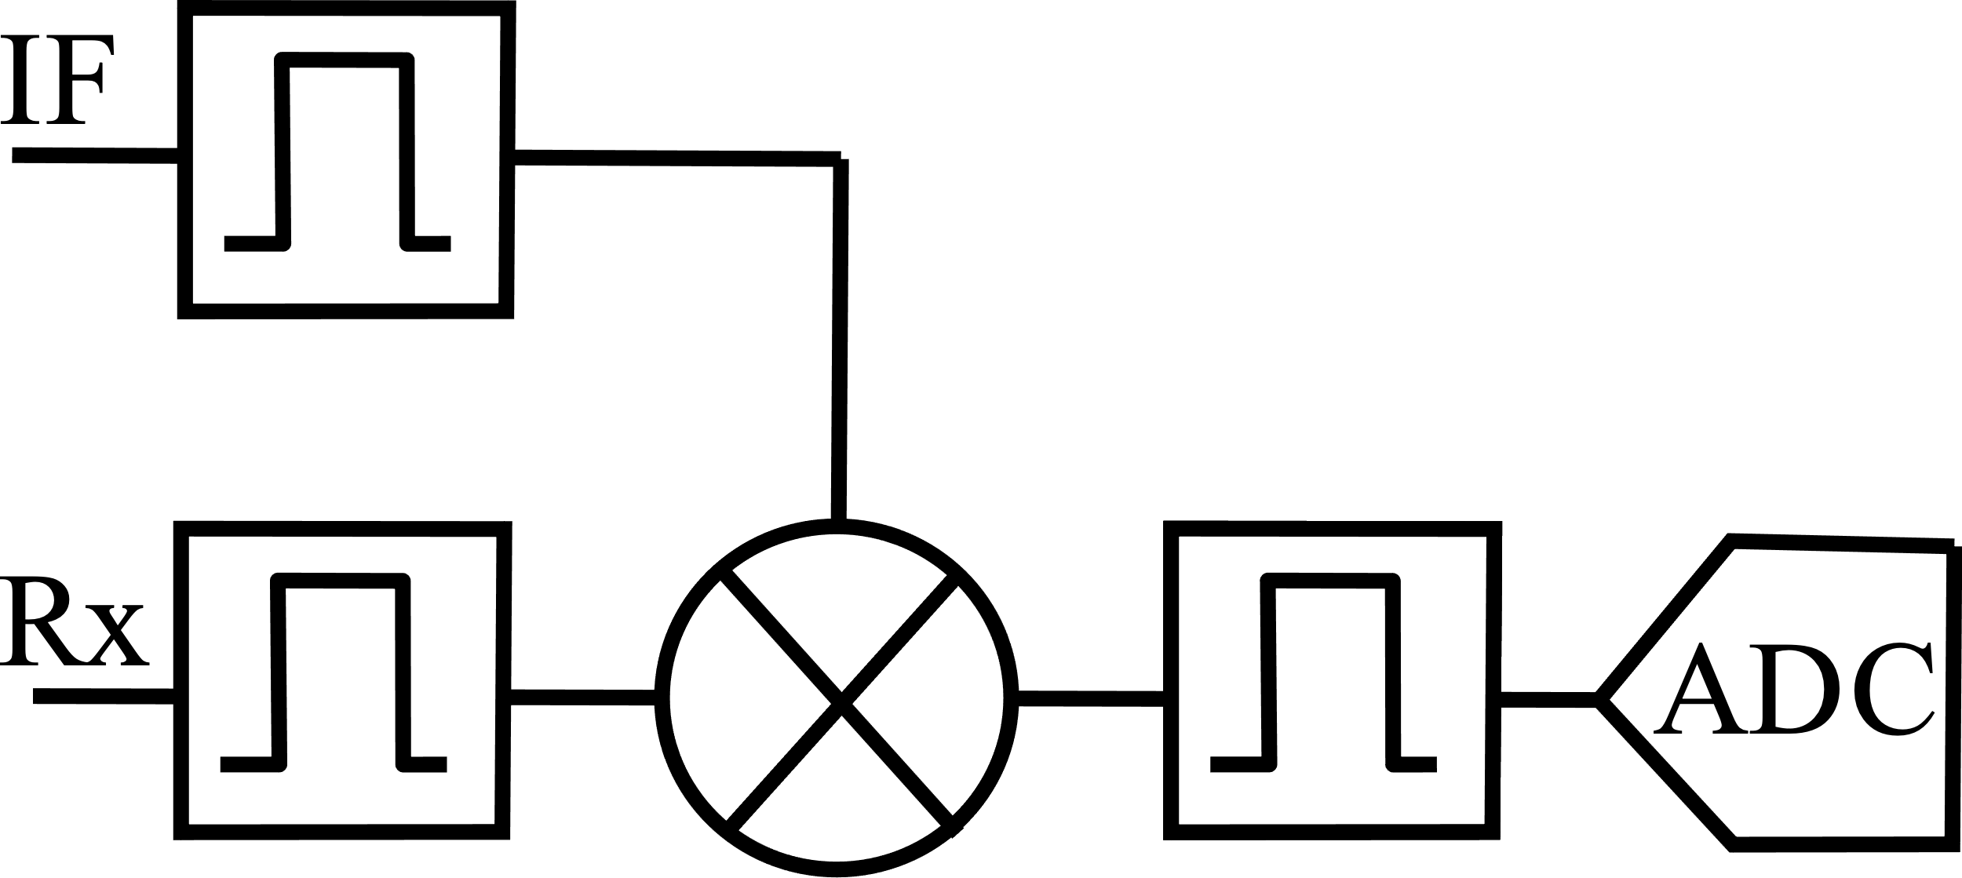
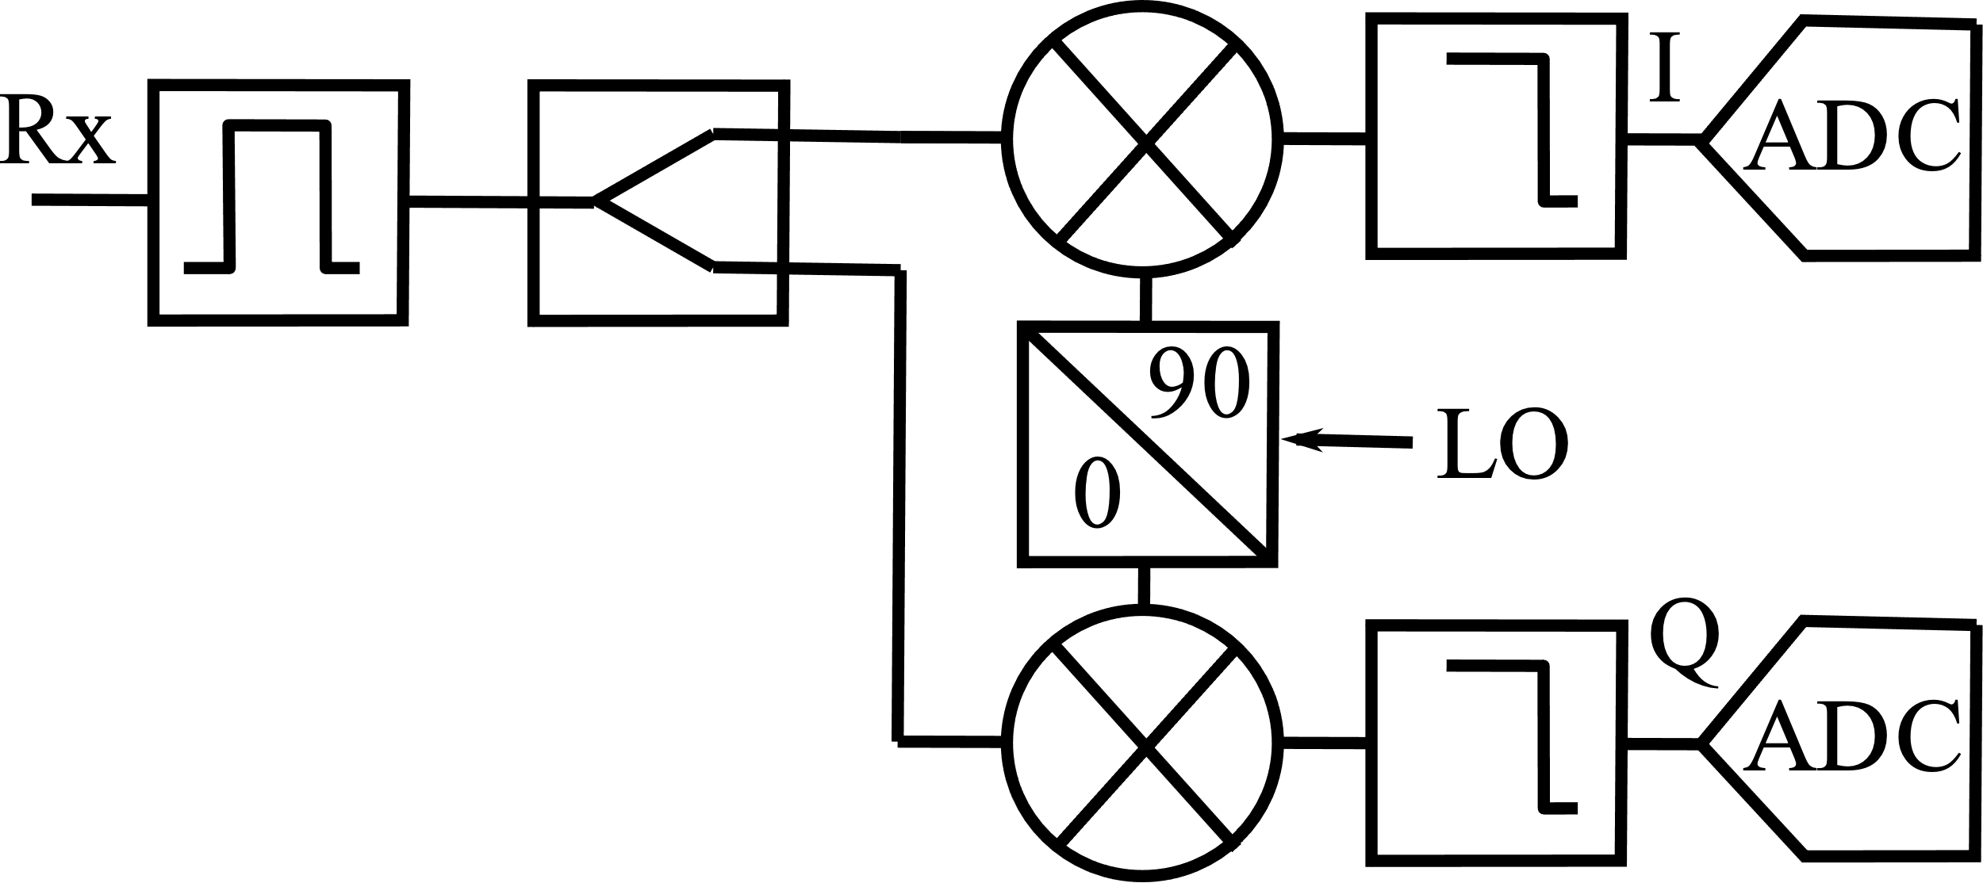
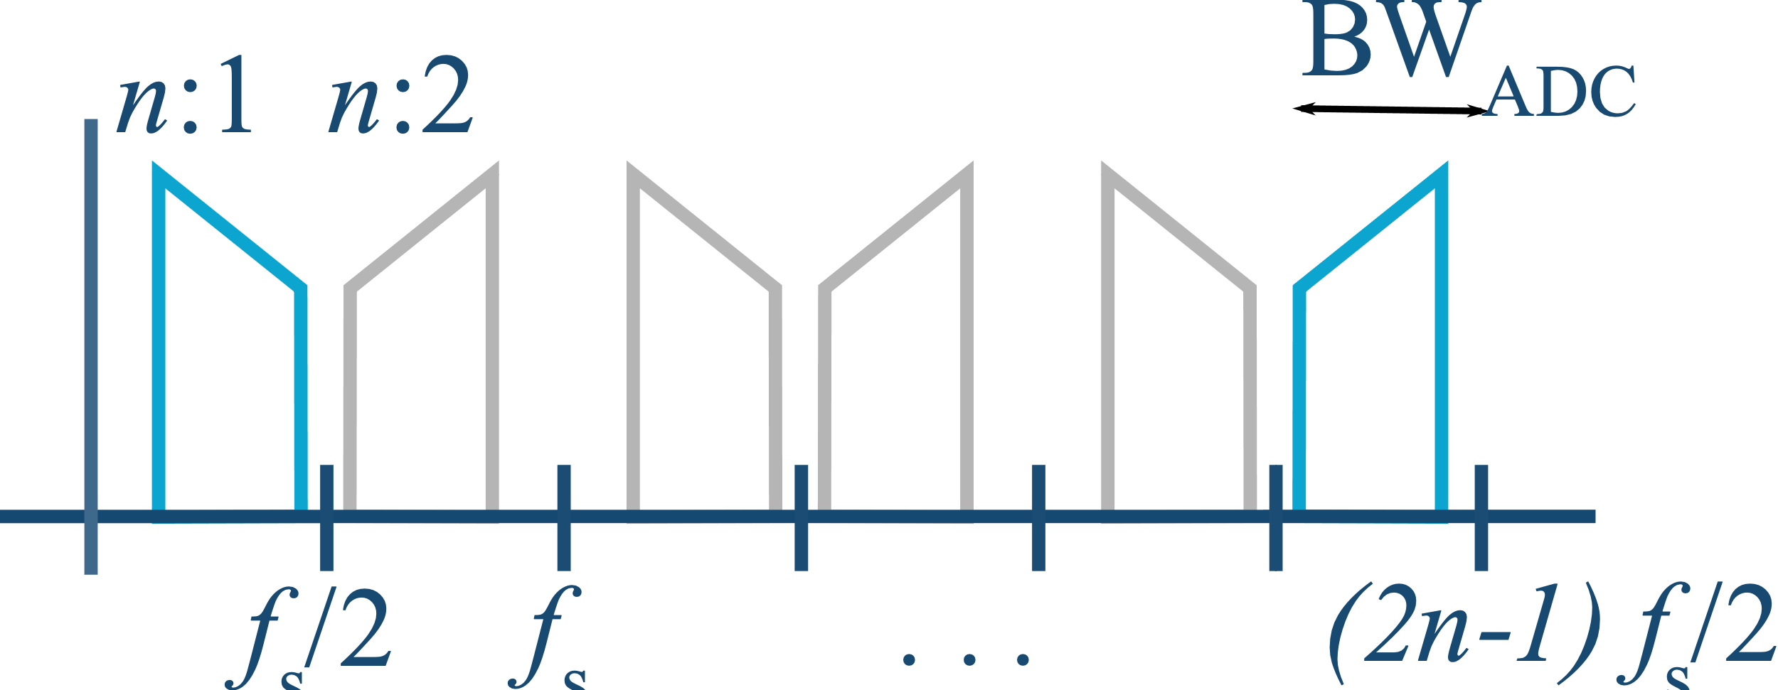
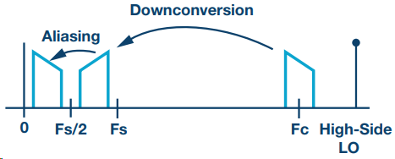
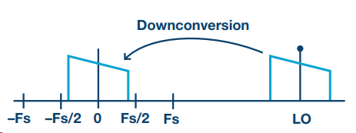
Sampling Strategy of MID-6a
Possible Receiver Architectures:
Heterodyne
Pros:
✔ Proven trusted
✔ High performance
✔ Optimum spurious noise
✔ High dynamic range
✔ EMI immunity
Cons&Challenges :
❌ SWaP
❌ Many filters
Down-Conversion/Zero IF
Pros:
✔ Maximum ADC bandwidth
✔ Simplest wideband option
Cons&Challenges:
❌ Image rejection (I/Q balance)
❌ In-band IF harmonics
❌EMI immunity (IP2)
❌DC and 1/f noise
❌SWaP
Direct under Sampling
Pros:
✔ Simple architecture
✔ No mixer
Cons&Challenges :
❌ ADC input bandwidth must be high.

Slide 4
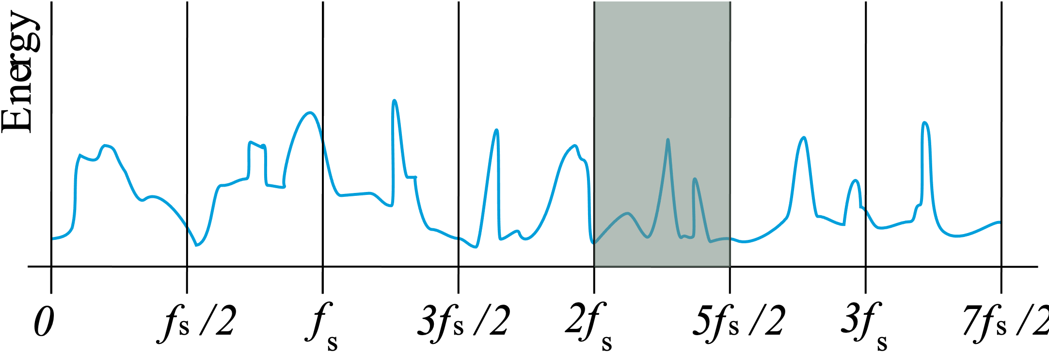
Sampling Strategy of MID-6
Received analog signal x(t)
Direct under sampling: efficient, simple architecture but requires:
→ Under-sampling theory
→ Anti-Aliasing filter is essential
→ Required a wideband and high-speed ADC
ADC: 10 Bit, BW_{3dB}:35GHz, f_{smax}:12.8GSPS
Operating range: 15-25 GHz

Slide 5
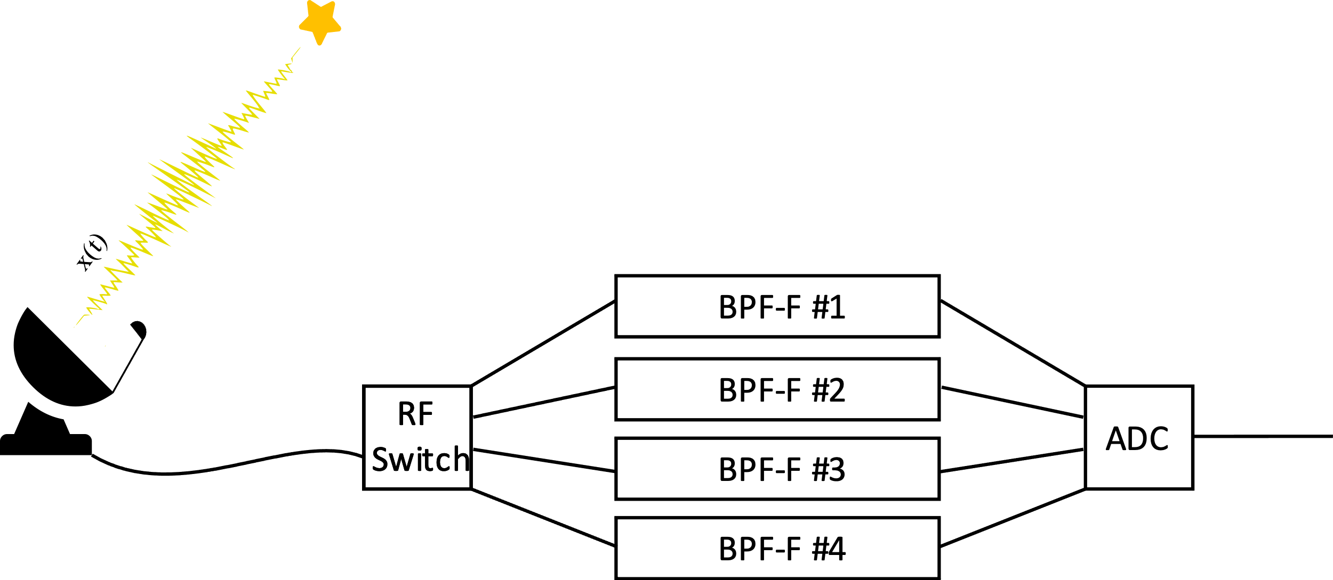
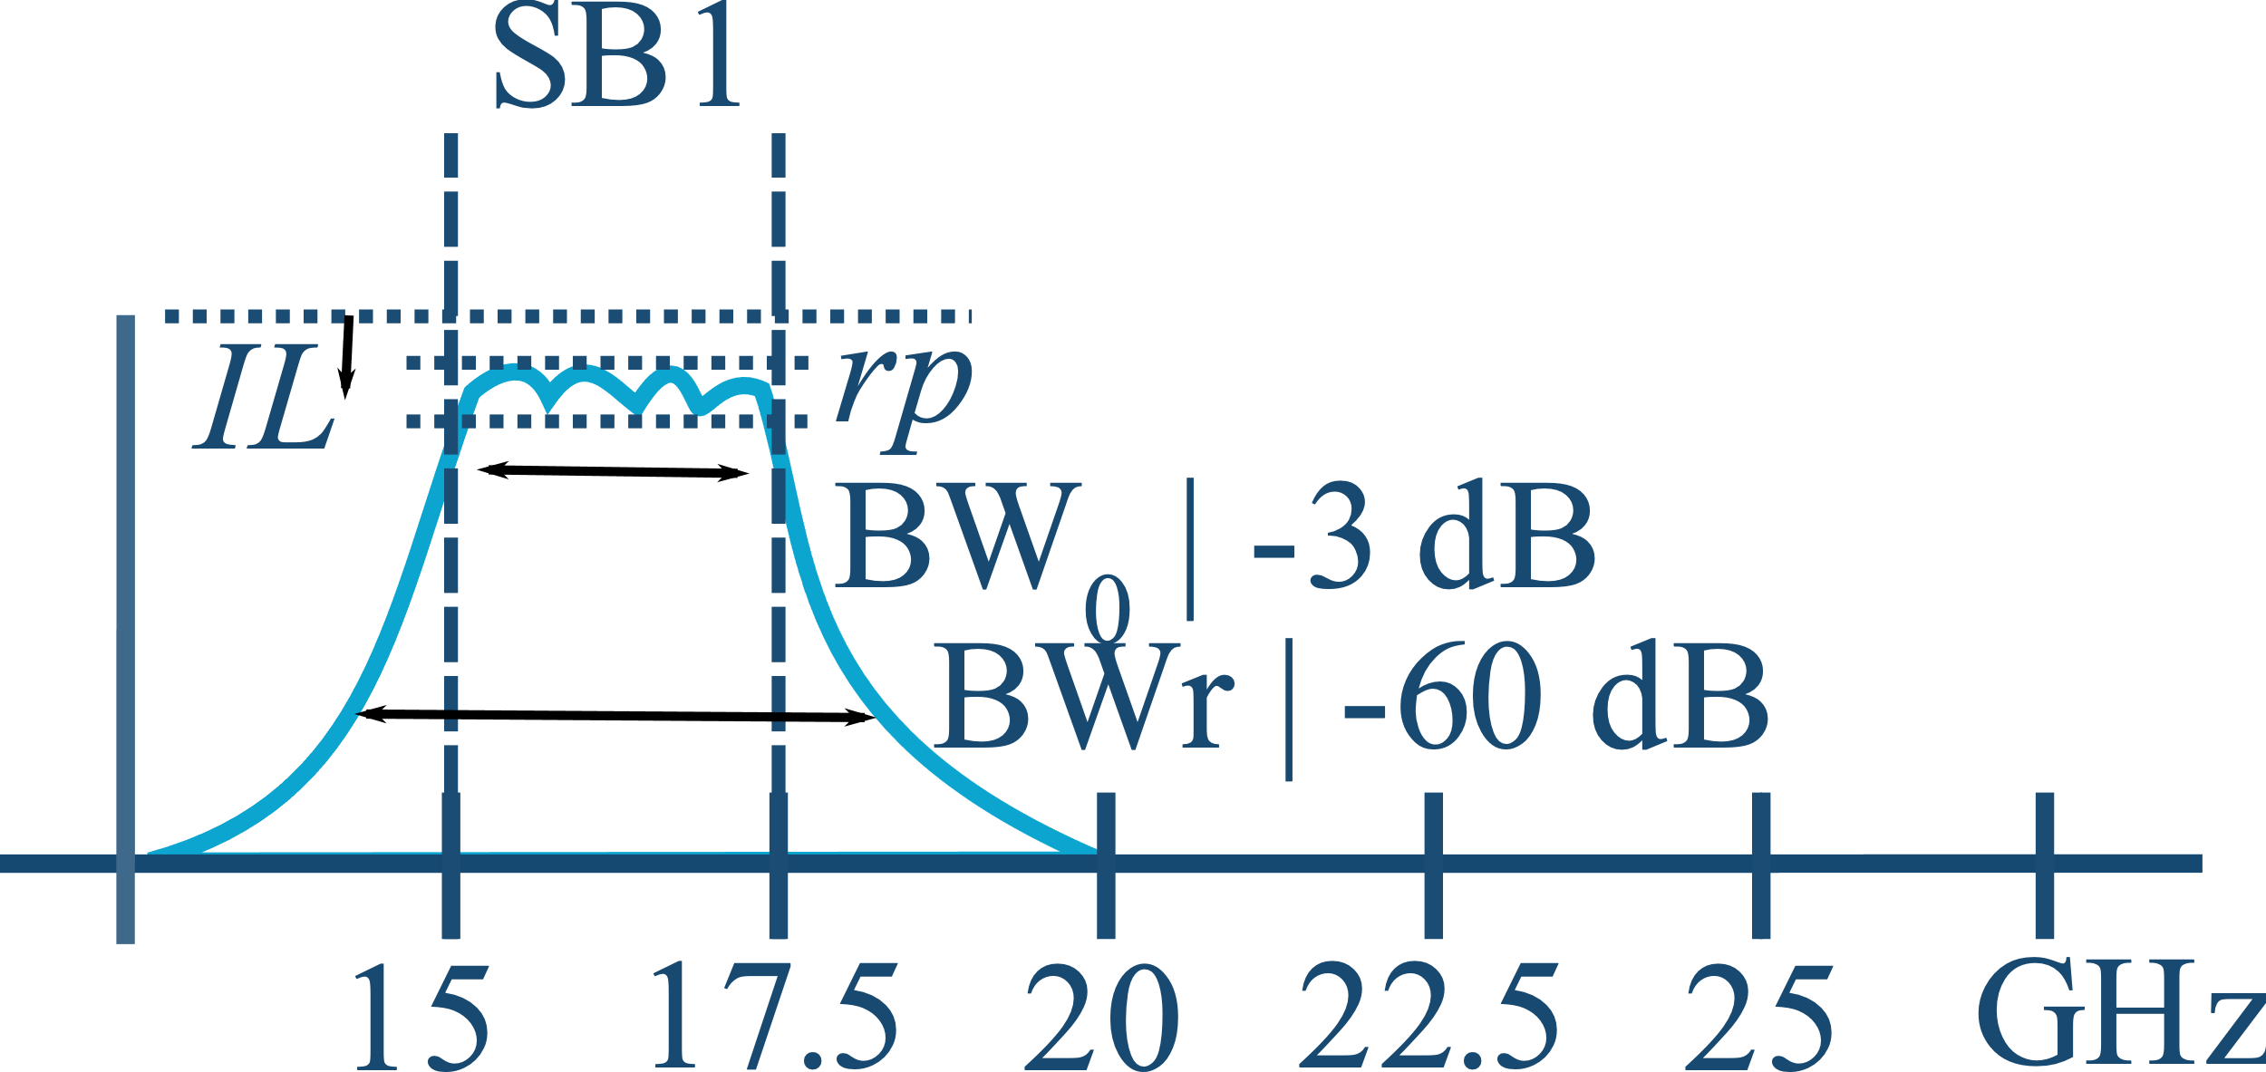
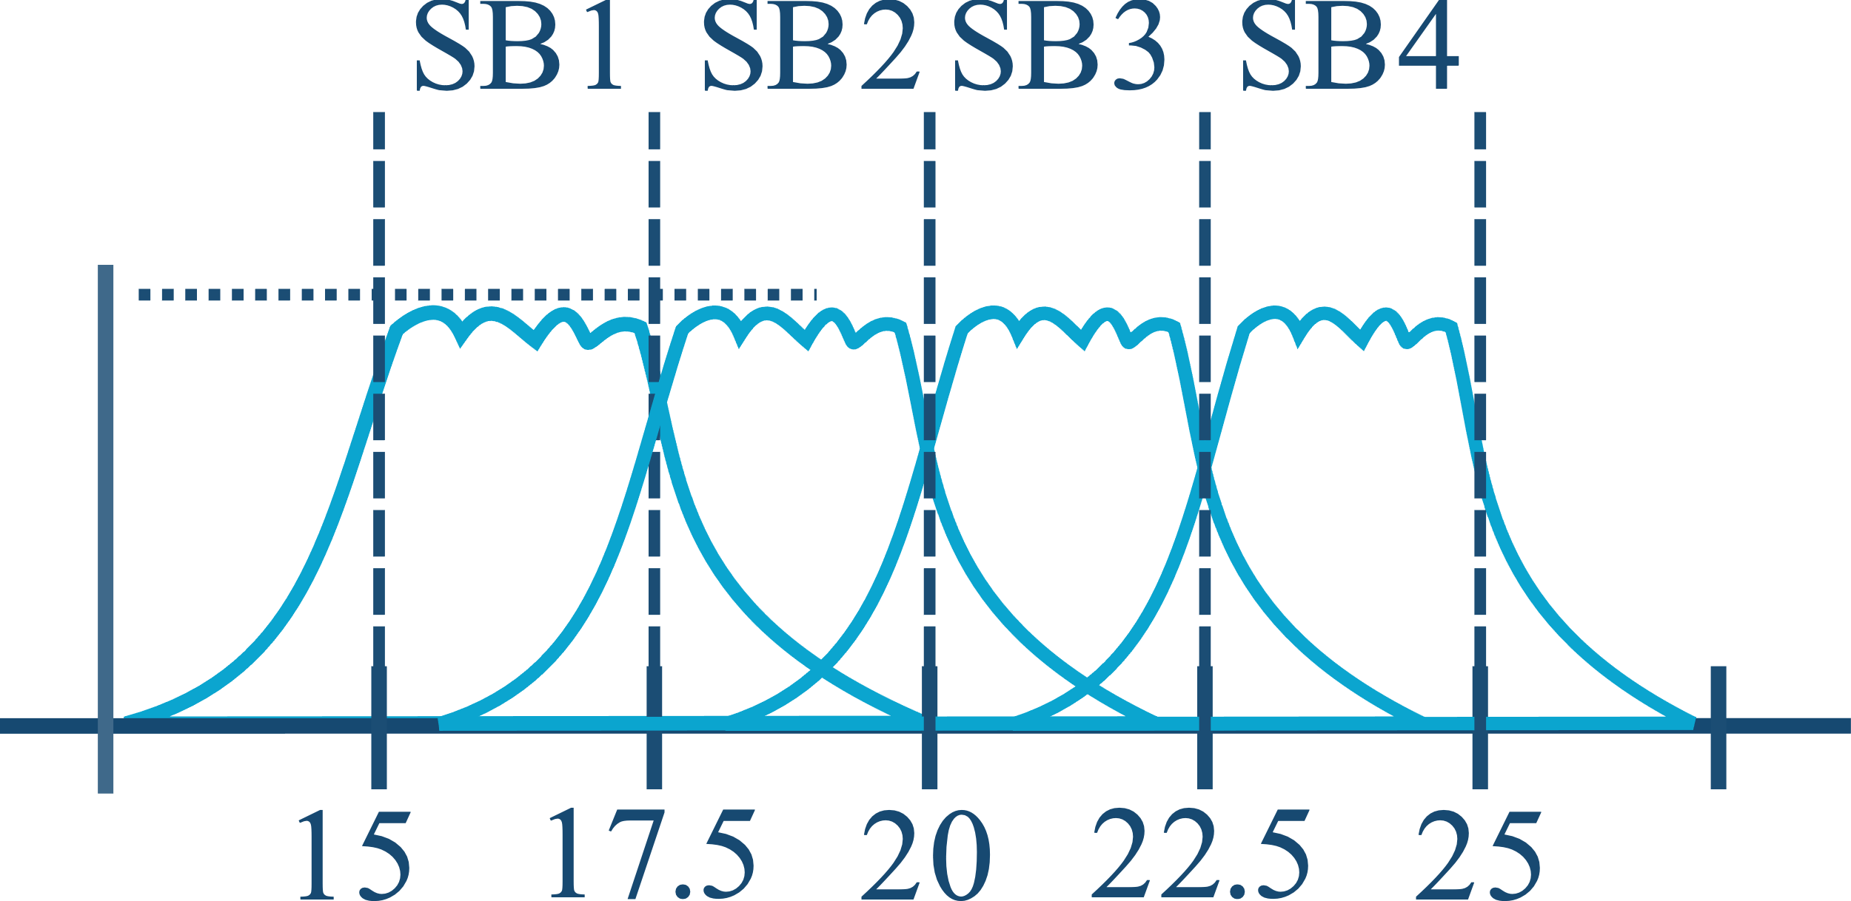
Fixed Filter Design for EBB
4 Anti-Aliasing filter to cover entire 10 GHz BW
Each Sub-Bands(SB)
3 dB BW: 2.5 GHz
Rejection BW: -40 dB
Chebyshev response

Slide 6
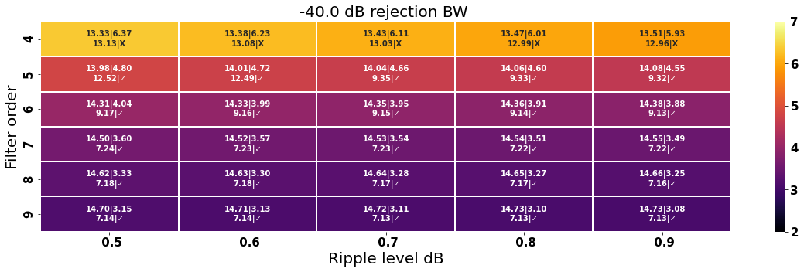
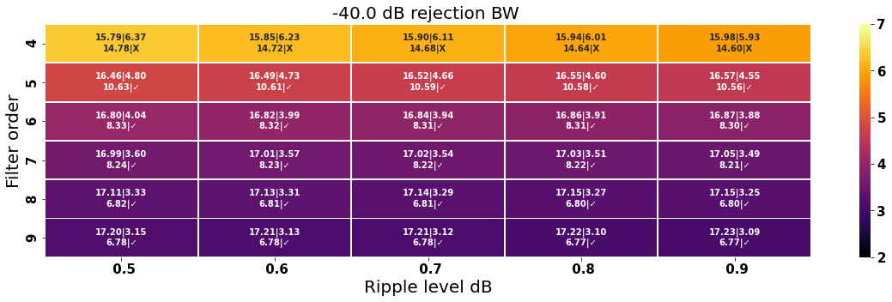
Filter Specification
Estimate filter order, Q, IL, minimum f_{s} , BW_{r} and driving the required coupling matrix elements for a given Ripple level (Rp).
Python modules are developed for:
- Filter Synthesis
- Embedding modules in controller of EM for custom filter tuning

Slide 7
Design Process
Starting from Filter Specifications, IL, RL, Frequency bands
Design Single Cell
(Q-unloaded)
Use Space-Mapping and local optimization to Reach to the Desired Specs
Derive the Coupling Matrix of filter
Design Coupling Elements (M)
Calculate: Q-unloaded, Coupling elements, Q-external
Design Feed Elements
(Q-External)

Slide 8
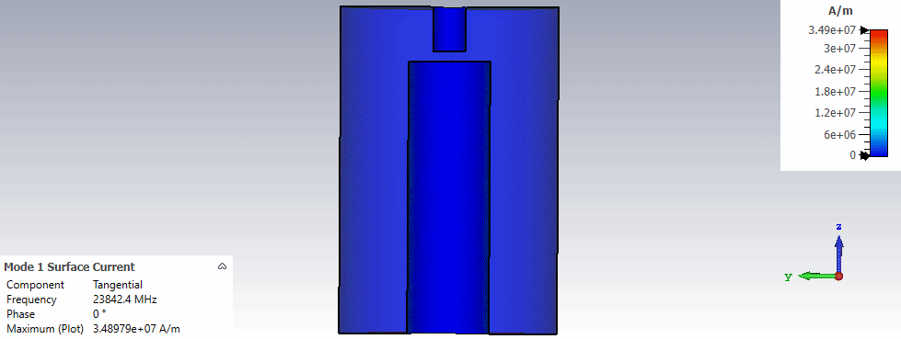
Cell Design
Round resonator configuration is considered.
Eigenmode solver is used, to observe the resonance frequency of cell and the unloaded Q factor.
Q of 1700 is designed to account for extra losses and the second mode is at 66 GHz.

Slide 9
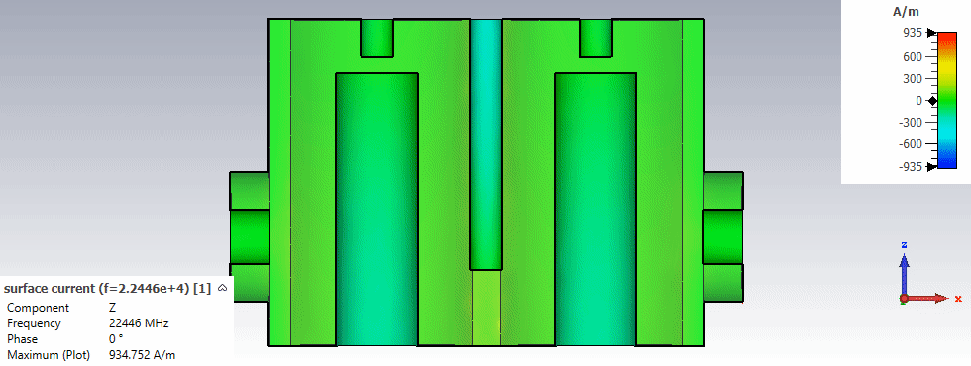
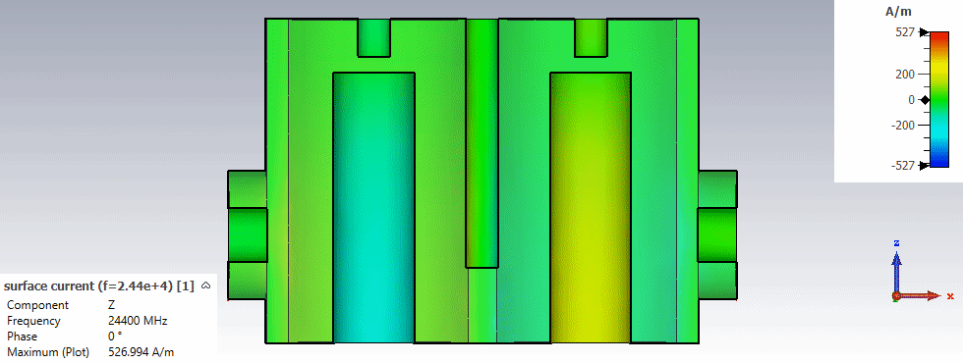
Inter-cell Coupling
Even and odd modes of the two cells configuration can be observed below:

Slide 10
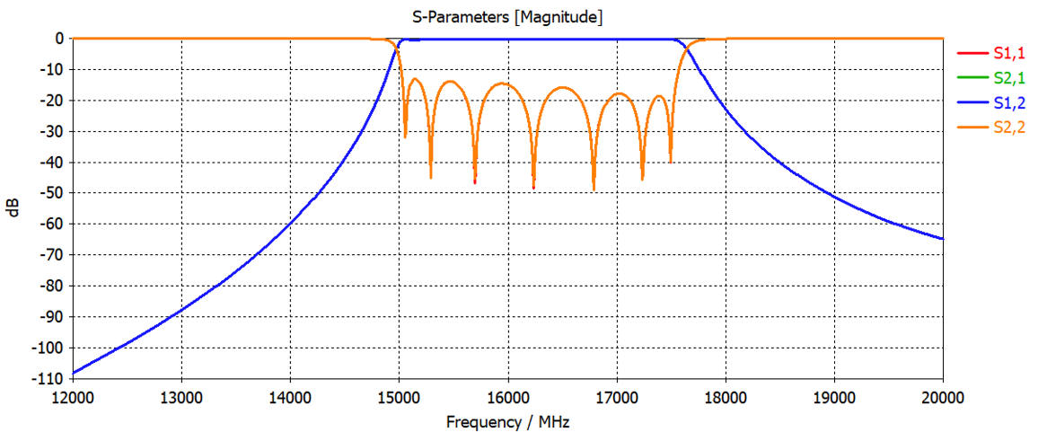
Designed Filter SB1

Slide 11
Designed Filter SB1(MAC compatible)

Slide 12
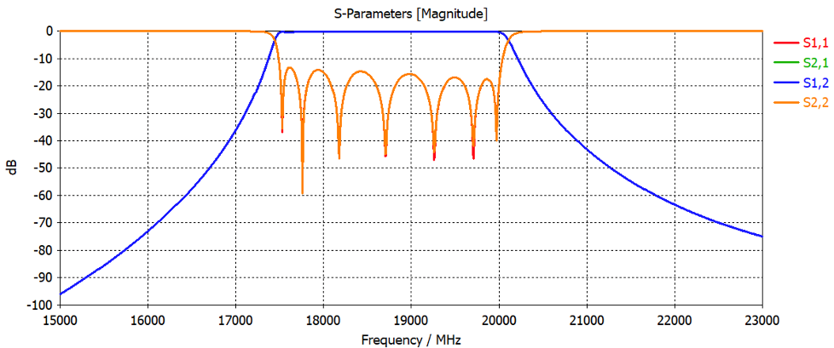
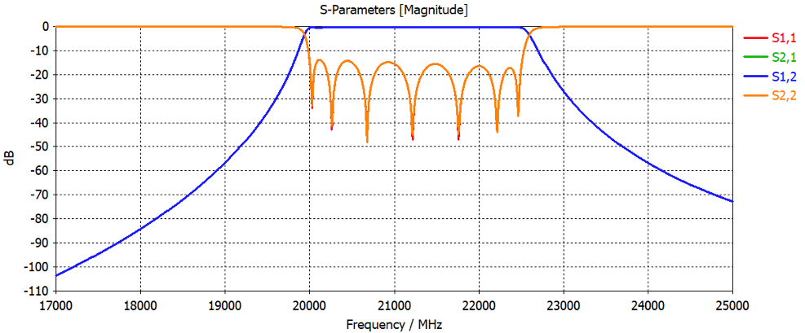
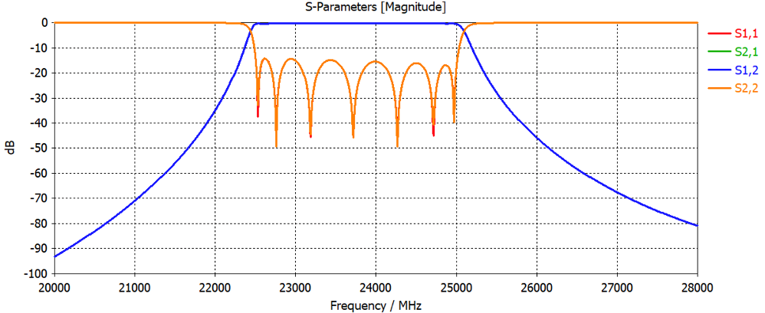
Fixed Filters SB1..4

Slide 13
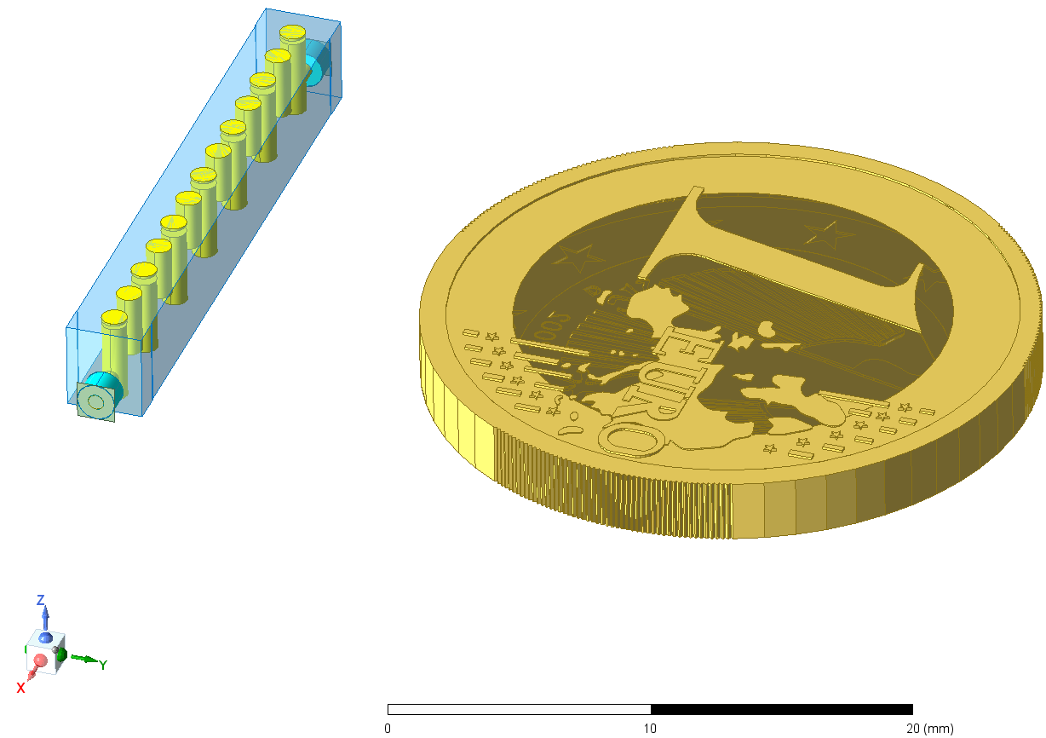
Challenges of Fixed Filters
Maintaining Constant Bandwidth and a Reasonable Return Loss Over a Wide Tuning Range
Maintaining a Constant High Q Value Over a Wide Tuning Range
Integration of Tuning Elements with 3D Filters Linearity
Tunability of Q external (Coupling from Coax to Cavity) over wide range
Lowering the number of needed tuners

Slide 14
Yield Sensitivity Analysis
In order to study the effect of manufacturing tolerances on the performance of a tuned filter, we performed sensitivity analysis of s-parameters in response to the tolerance values.
In communication with Manufacturing partner, tolerances of order of 10 micrometers has been considered.
In order to estimate the effect of error of all dimensions, one need to find the worse case scenario by running for all possible combinations of error contributions.
This will be quite cumbersome in terms of computational cost.

Slide 15
Yield Sensitivity Analysis
Our numerical software offers a smart way of finding the worse case condition:
Calculate S-parameter of a given design
Perform extra calculations to obtain derivative of s-parameters
Run a Monte-Carlo simulation to find S-parameter distributions

Slide 16
Yield Sensitivity Analysis
Obtained results for 15 to 17.5 GHz for nominal design vs Worse case:

Slide 17
Filter Design-Tunable
Goal: To further reduce the complexity of receiver, improve efficiency, decrease losses and reduce number of connectors and cables, smaller dimension and cross-talk between different ports on switches.
Arising additional practical challenges compare fixed filter:
1- Tunable inlet and outlet.
2- Tuning resonant frequency of the cavity over a very wide BW (10 GHz).
3- Need a precise automatic control system (15 tuners for 7th order filter).
Only for SKACH EBB
For future EM

Slide 18
Design procedure
The coupling synthesis matrix method is used to design BPF-V.
The prototyping has been done on 8 times scaled structure (1.9-3.1 GHz) for a EU project(Radioblocks).
The same technology can be applied for SKACH EM filter.
Design Single Cell. Possibility to tune Q_{ext} over whole frequency range
Optimizing coupler. Verifying if enough coupling level is achievable
Fine optimizing a 7th cell structure with 15 tuners.

Slide 19
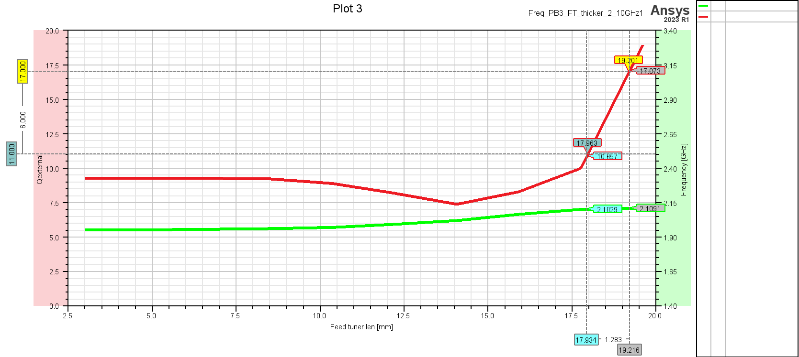
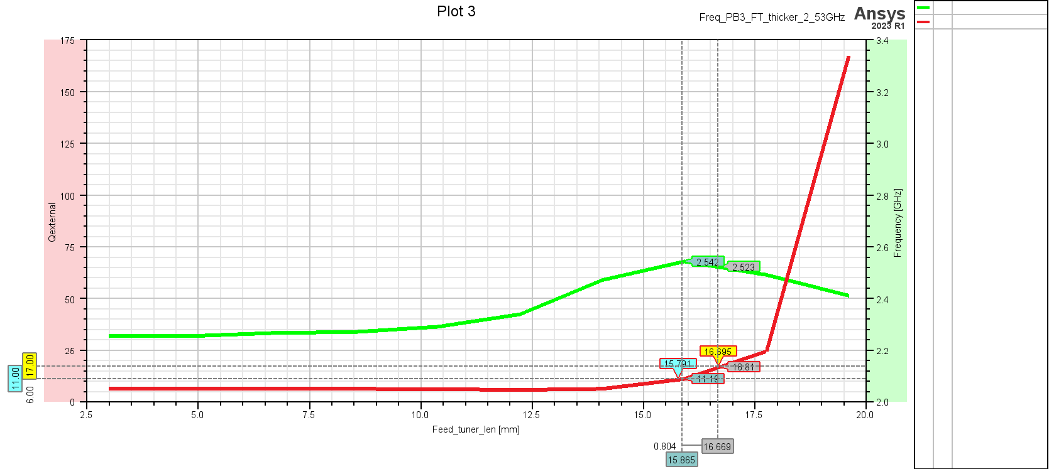
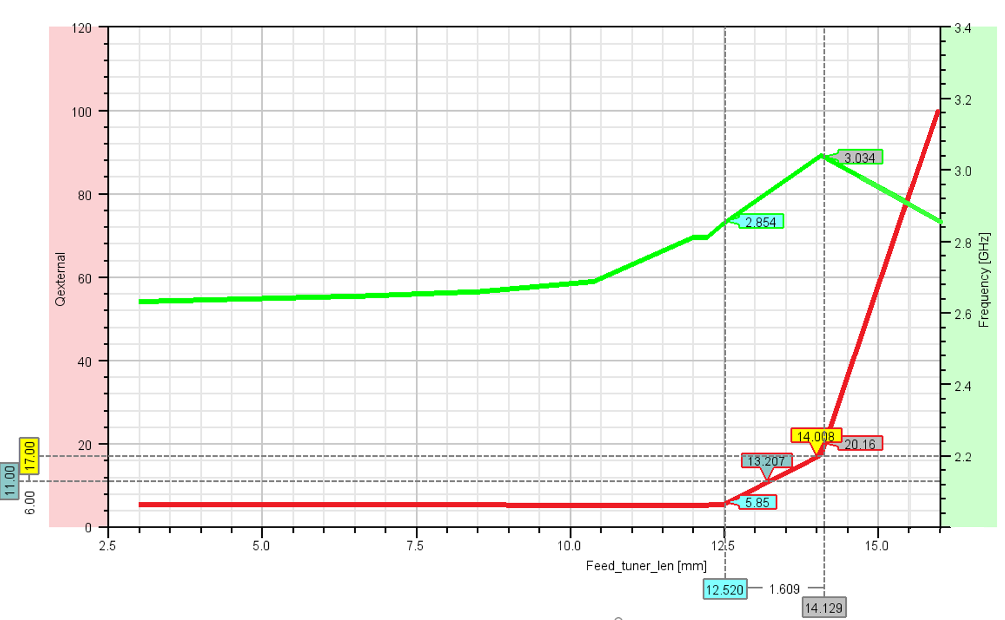
BPF-V cell
A single cell cavity is designed.
Two tuning plungers foreseen to tune:
11< Qext <17
2 GHz < f_{c} < 3 GHz
Tuner #1
Tuner #2
Signal inlet

Slide 20
Summary
Filter requirements, type and topology are determined.
Fixed filters are designed and optimized using full-wave EM solver
Currently starting developing mechanical drawing, CAD files.
Hardware and software to test digitizer on EBB are being developed
The single cell of pass-band tunable filter has been developed and mechanical drawing has been designed.
Start manufacturing the first prototype soon.

Slide 21
Contacts
SKACH Instrumentation Program chair:
Dominique Bovey (HEIG-VD)
dominique.bovey@heig-vd.ch
+41 24 557 27 54 / +41 79 327 71 53
HES-SO-level administration/coordination ()
SKACH board member for HES-SO
Evelina Breschi evelina.breschi@hes-so.ch
Phone: +41 58 900 01 12
HEIG-VD-level administrative contact:
Pascal Coeudevez
pascal.coeudevez@heig-vd.ch
+41 24 557 27 61

