Slide 1
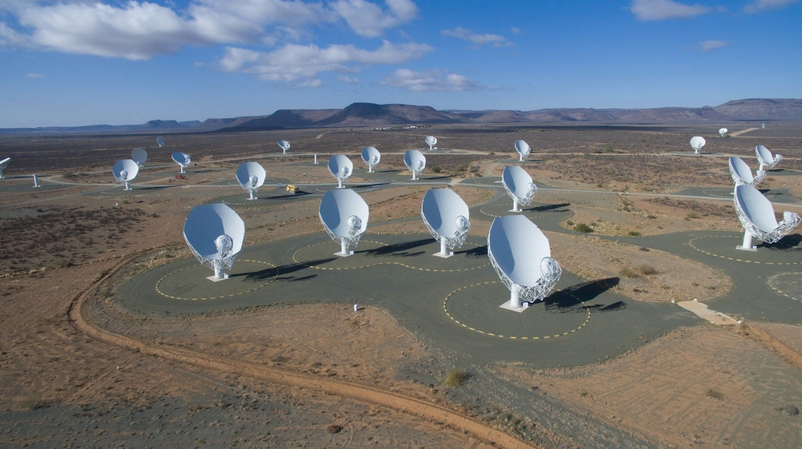
Simulating HI Intensity Mapping for MeerKAT/SKA Mid
Luis Fernando Machado Poletti Valle (ETH Zürich)
SKA Days 2023
8. September 2023
ETH Zürich: Alexandre Refregier, Devin Crichton, Marta Spinelli, Pascale Berner, Pascal Hitz, Jennifer Studer
FHNW: André Csillaghy, Simon Felix, Rohit Sharma, Vincenzo Timmel, Lukas Gehrig, Filip Schramka
Image Credit: https://www.manchester.ac.uk/discover/news/the-meerkat-radio-telescope-in-south-africa-receives-prestigious-award-of-the-royal-astronomical-society/

Slide 2
Outline
Introduction
Simulation Pipeline
Input HI Source Catalog
Visibilities and Dirty Images
Mosaic of Pointings
Primary Beam Correction
Next Steps
08.09.2023
2
Notes:
HI IM → probe large volumes of the Universe → study intermediate cosmological scales
→ more efficient than galaxy surveys → because we get redshift for free
fluctuations of HI are a tracer for dark matter fluctuations → reconstruct the dark matter density field from HI intensity mapping

Slide 3
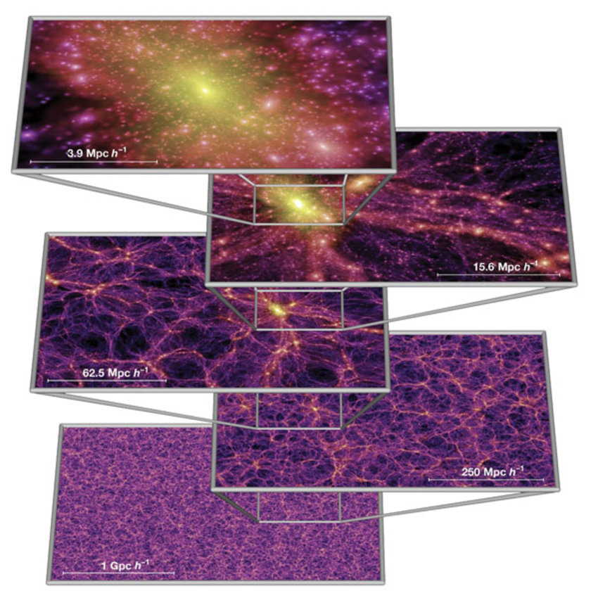
Introduction
HI is a tracer of DM fluctuations in post-EoR Universe (z < 6)
Focus: MeerKAT + SKA Mid
HI Intensity Mapping (IM) helps reconstruct DM density field
Efficient probe: large cosmological volumes at low spatial resolutions
High frequency (and therefore redshift) resolution
Figure from: Simulations of the formation, evolution and clustering of galaxies and quasars. (2005)
08.09.2023
3
Notes:
→ more efficient than galaxy surveys → because we get redshift for free

Slide 4
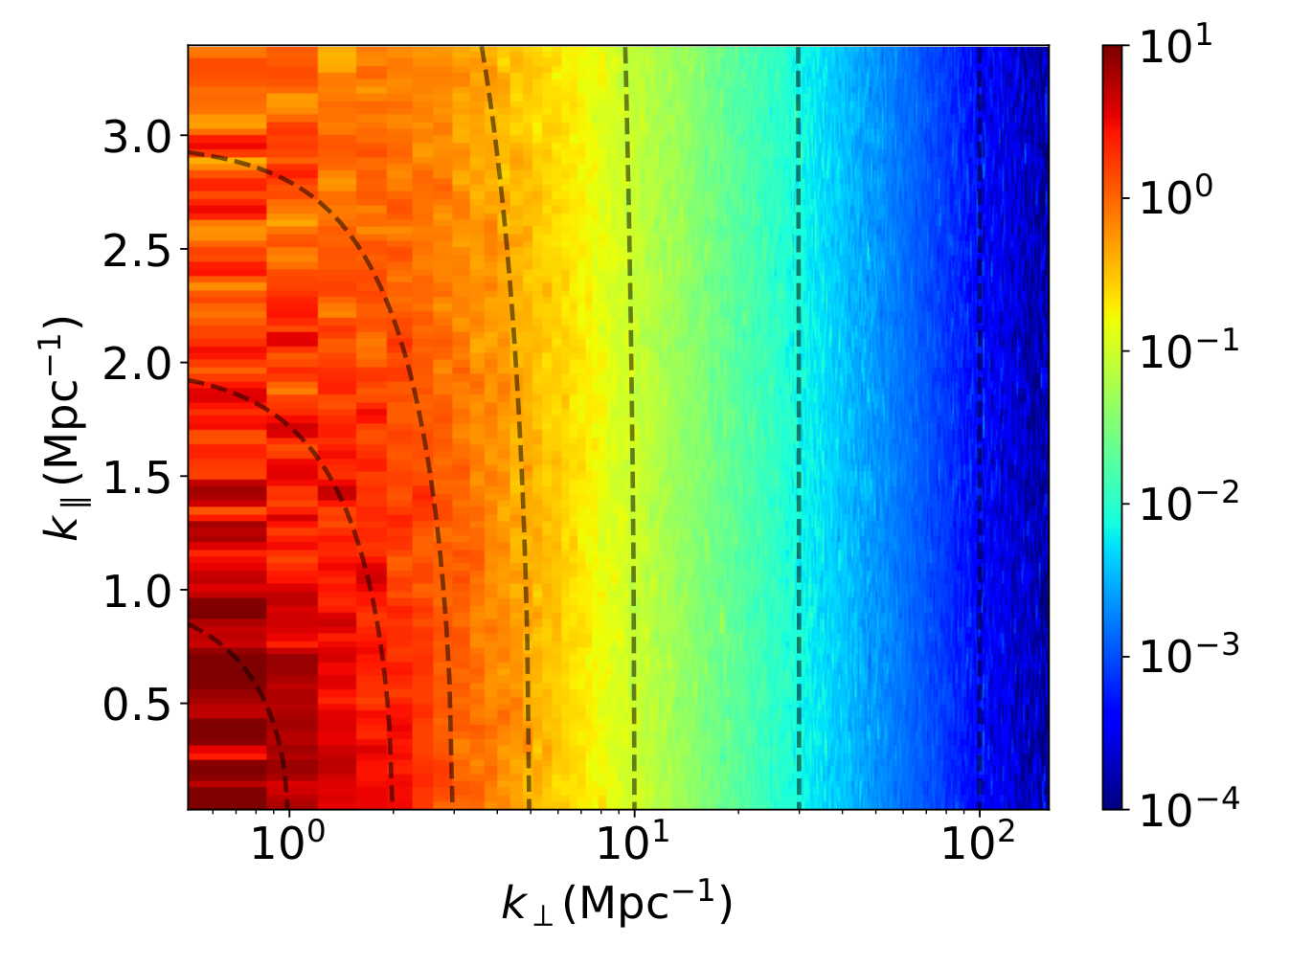
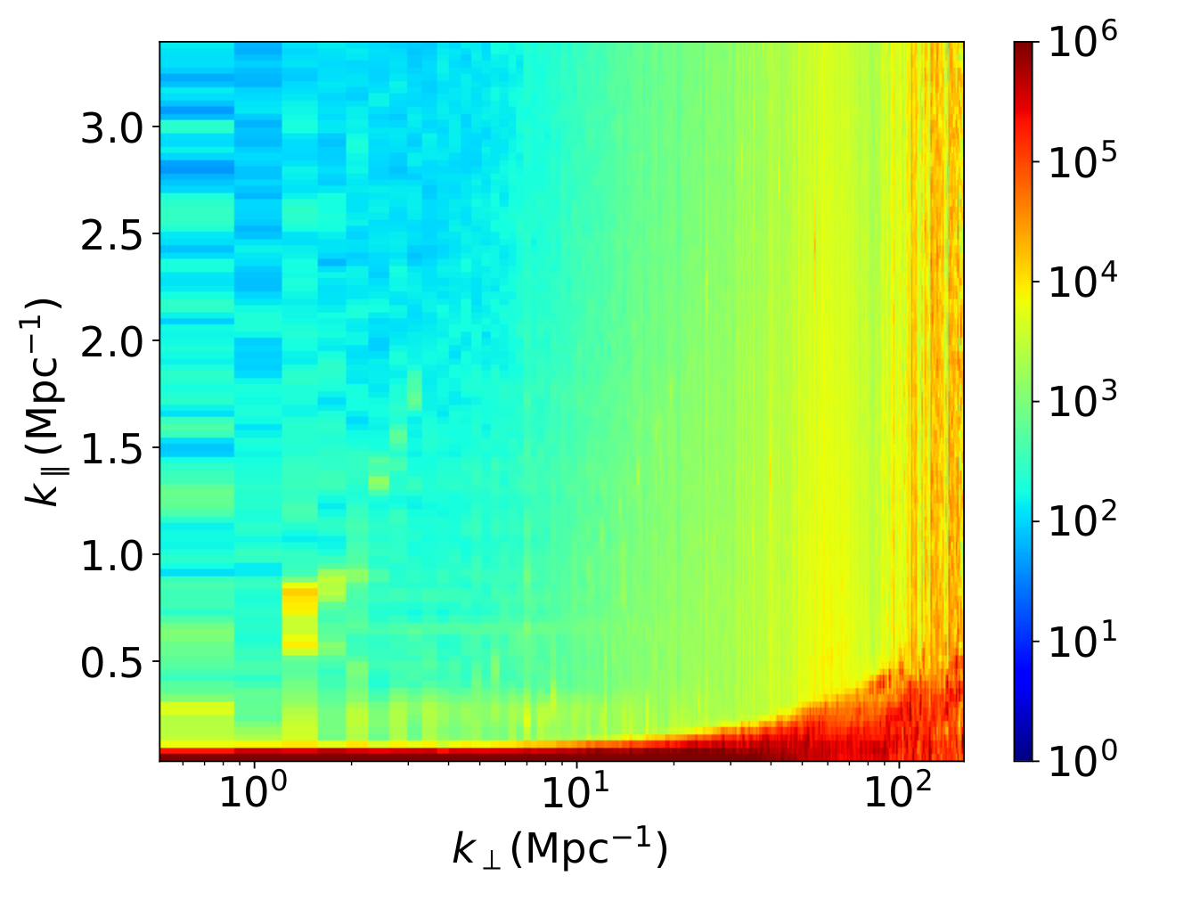
Systematics
21cm Signal
Signal + Foregrounds
Figure from: Sourabh Paul, et al. (2021)
Systematics (instrument + foregrounds) dominate 21 cm signal
Goal: Karabo = simulation pipeline to help quantify impact of systematics
08.09.2023
4
Notes:
Units of 2D power spectrum: mK^2 * Mpc^3
Right plot: red region is the foreground wedge
->Developing a simulation pipeline for interferometric intensity mapping with MeerKAT and SKA Mid.

Slide 5
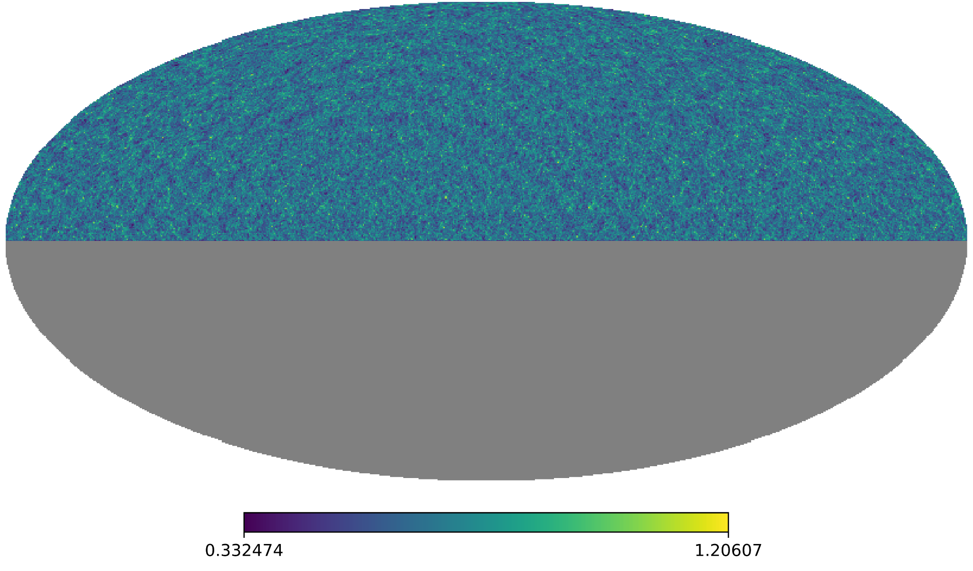
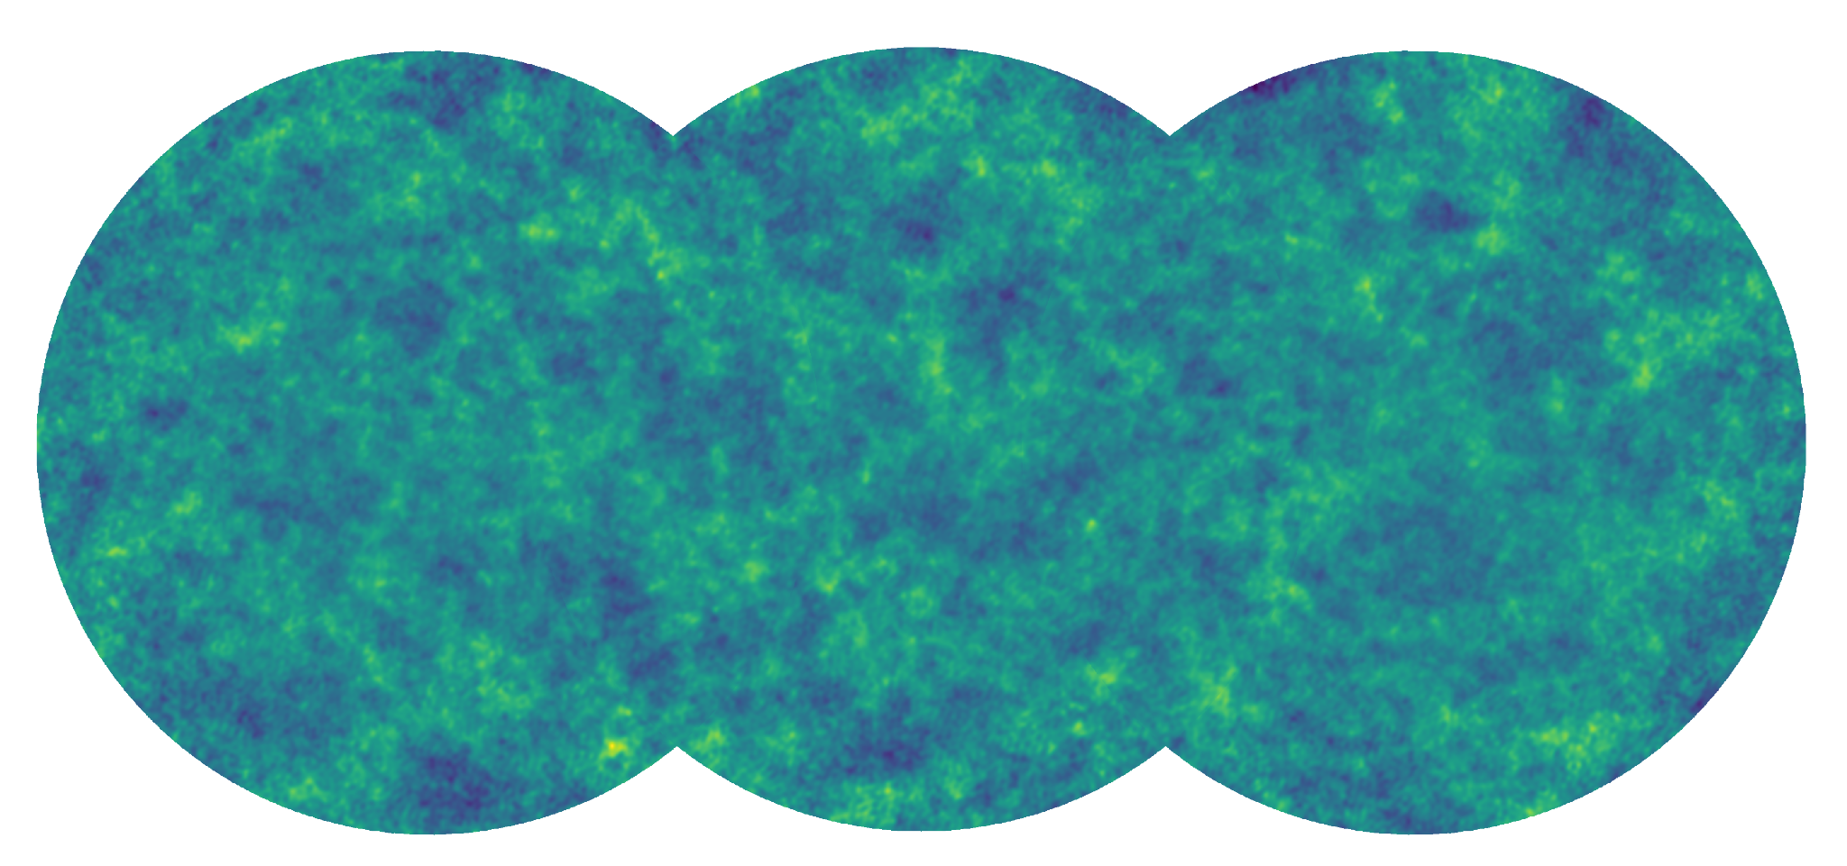
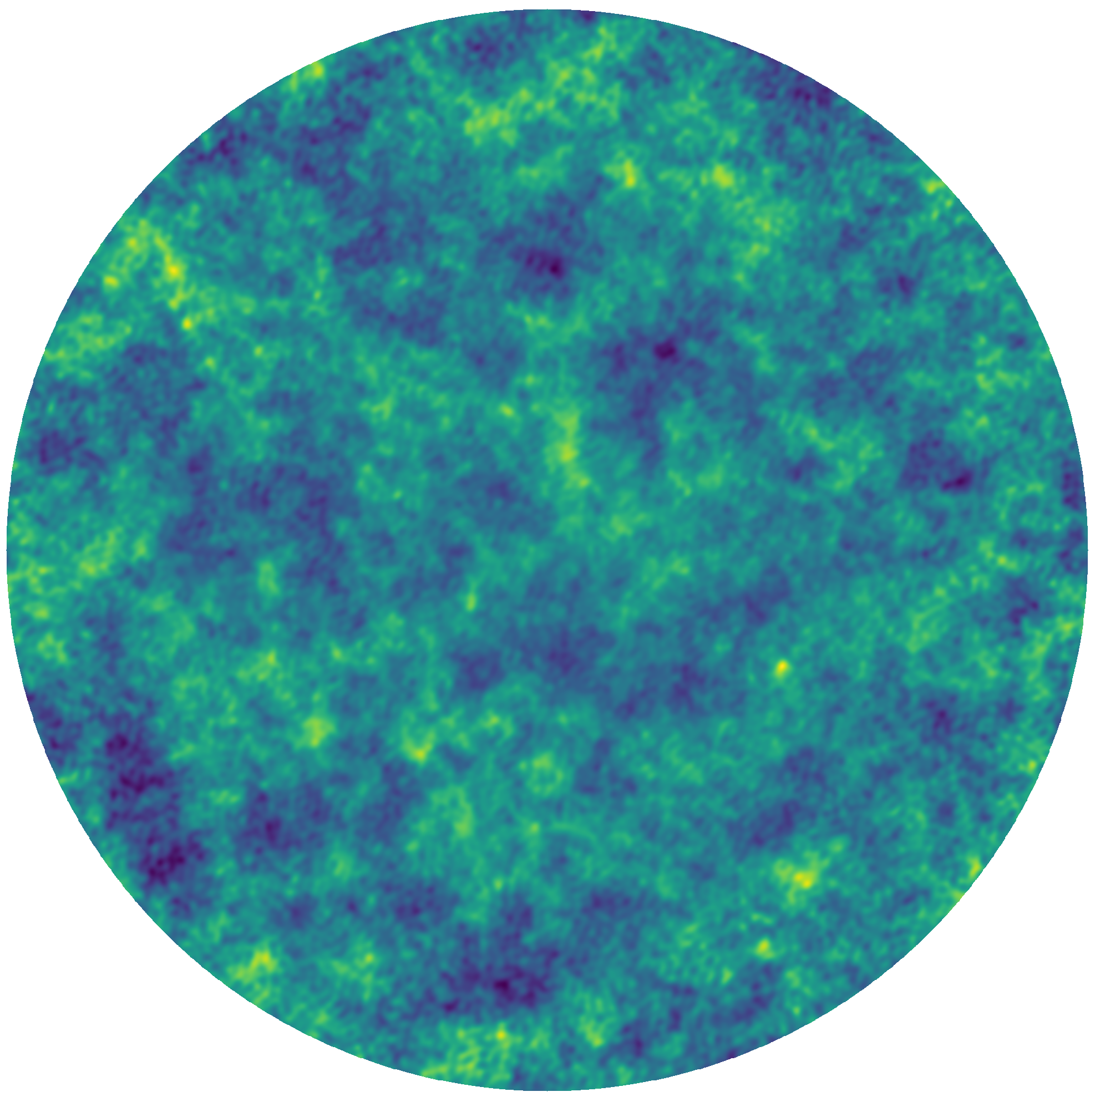
Power Spectra
Overview of the Pipeline
Options: OSKAR, RASCIL (WIP)
Input:
HI Source Catalog (RA, Dec, z)
(Generated by Pascal Hitz)
Complex Visibilities
Dirty Images,
PSF
Interferometer
Imager
Choose telescope, frequency channels, time steps, UV distance ranges
Options: OSKAR, RASCIL
Primary Beam Correction
Mosaic of Pointings
Mosaic
08.09.2023
5
Notes:
Input: sky catalog of HI sources, obtained from PINOCCHIO DM halos and a DM-to-HI best-fit (see Pascal’s presentation later today)
Karabo pipeline: choose telescope, apply instrumental effects, compute visibilities and dirty images for each redshift slice
OSKAR: designed for SKA simulations
RASCIL: developed by SKA Science Data Processor (SDP), in active development

Slide 6
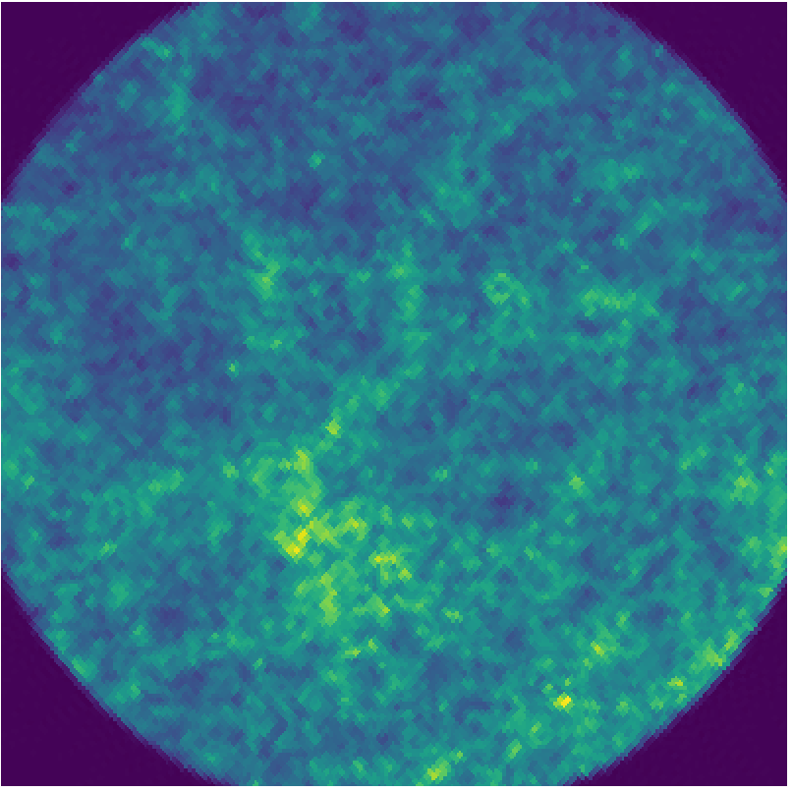
From Sky Model to Dirty Images
Input Sky Model (HEALPix flux map with NSIDE = 4096)
Dirty Image, after primary beam correction
Pointing Centered at RA, Dec = 20°, -30°
with Diameter ~ 2°
08.09.2023
6
Notes:
Slice input catalog into redshift bins
Compute visibilities and dirty images for each channel
Apply primary beam correction to each dirty image (more on this later)
Add dirty images together to produce right-hand side

Slide 7
Mosaic of Sky Pointings
Details:
3 pointings each with a diameter of 2.17°
FWHM of Gaussian primary beam at the mid frequency: 1.8°
Mosaic size: 2.5° x 6.0°
20 bins for redshifts 0.76 - 1.04
Runtime on 30 nodes: ~ 2 nodehours
Actively working on reducing runtime (parallelization), to scale up simulations
08.09.2023
7
Notes:
Runtime can be improved with parallelisation (next step)

Slide 8
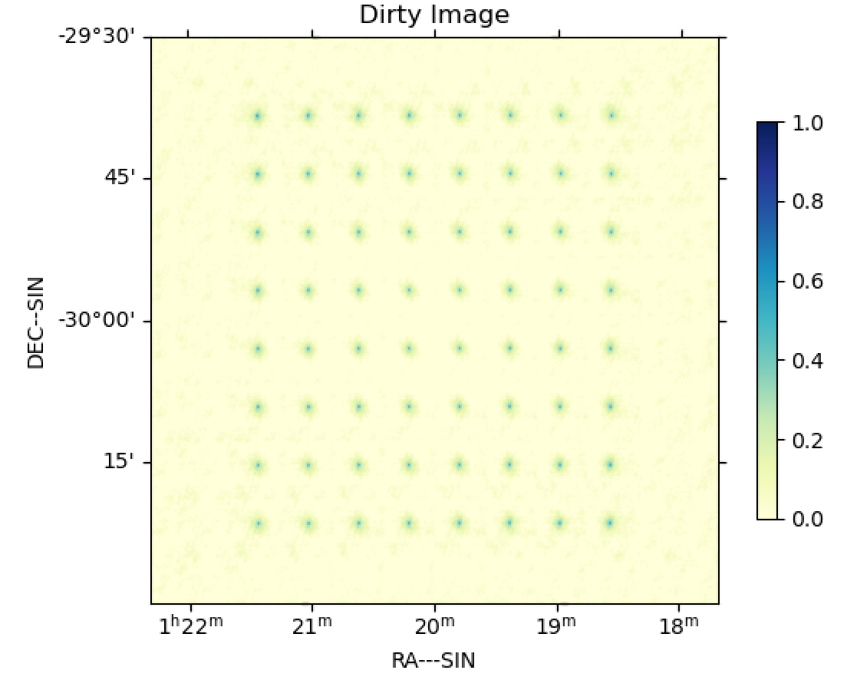
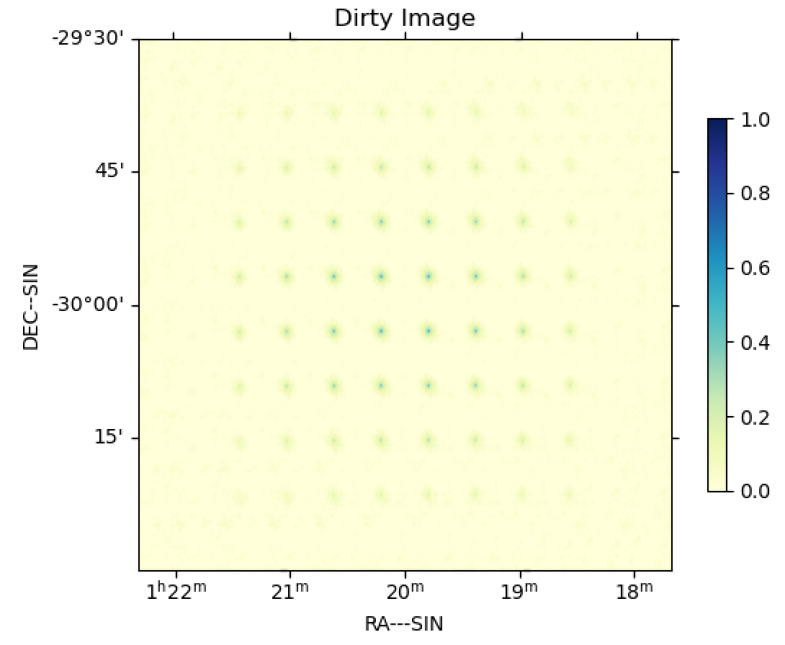
Primary Beam Effects (Gaussian Beam)
No Primary Beam Effect
Gaussian Primary Beam
08.09.2023
8
Notes:
Left: dirty image from sources without primary beam
Right: dirty image including primary beam effect

Slide 9
Primary Beam Correction
Final Dirty Image, without primary beam correction
Final Dirty Image, with primary beam correction
08.09.2023
9
Notes:
Apply beam correction to each redshift slice first, then add corrected dirty images together

Slide 10
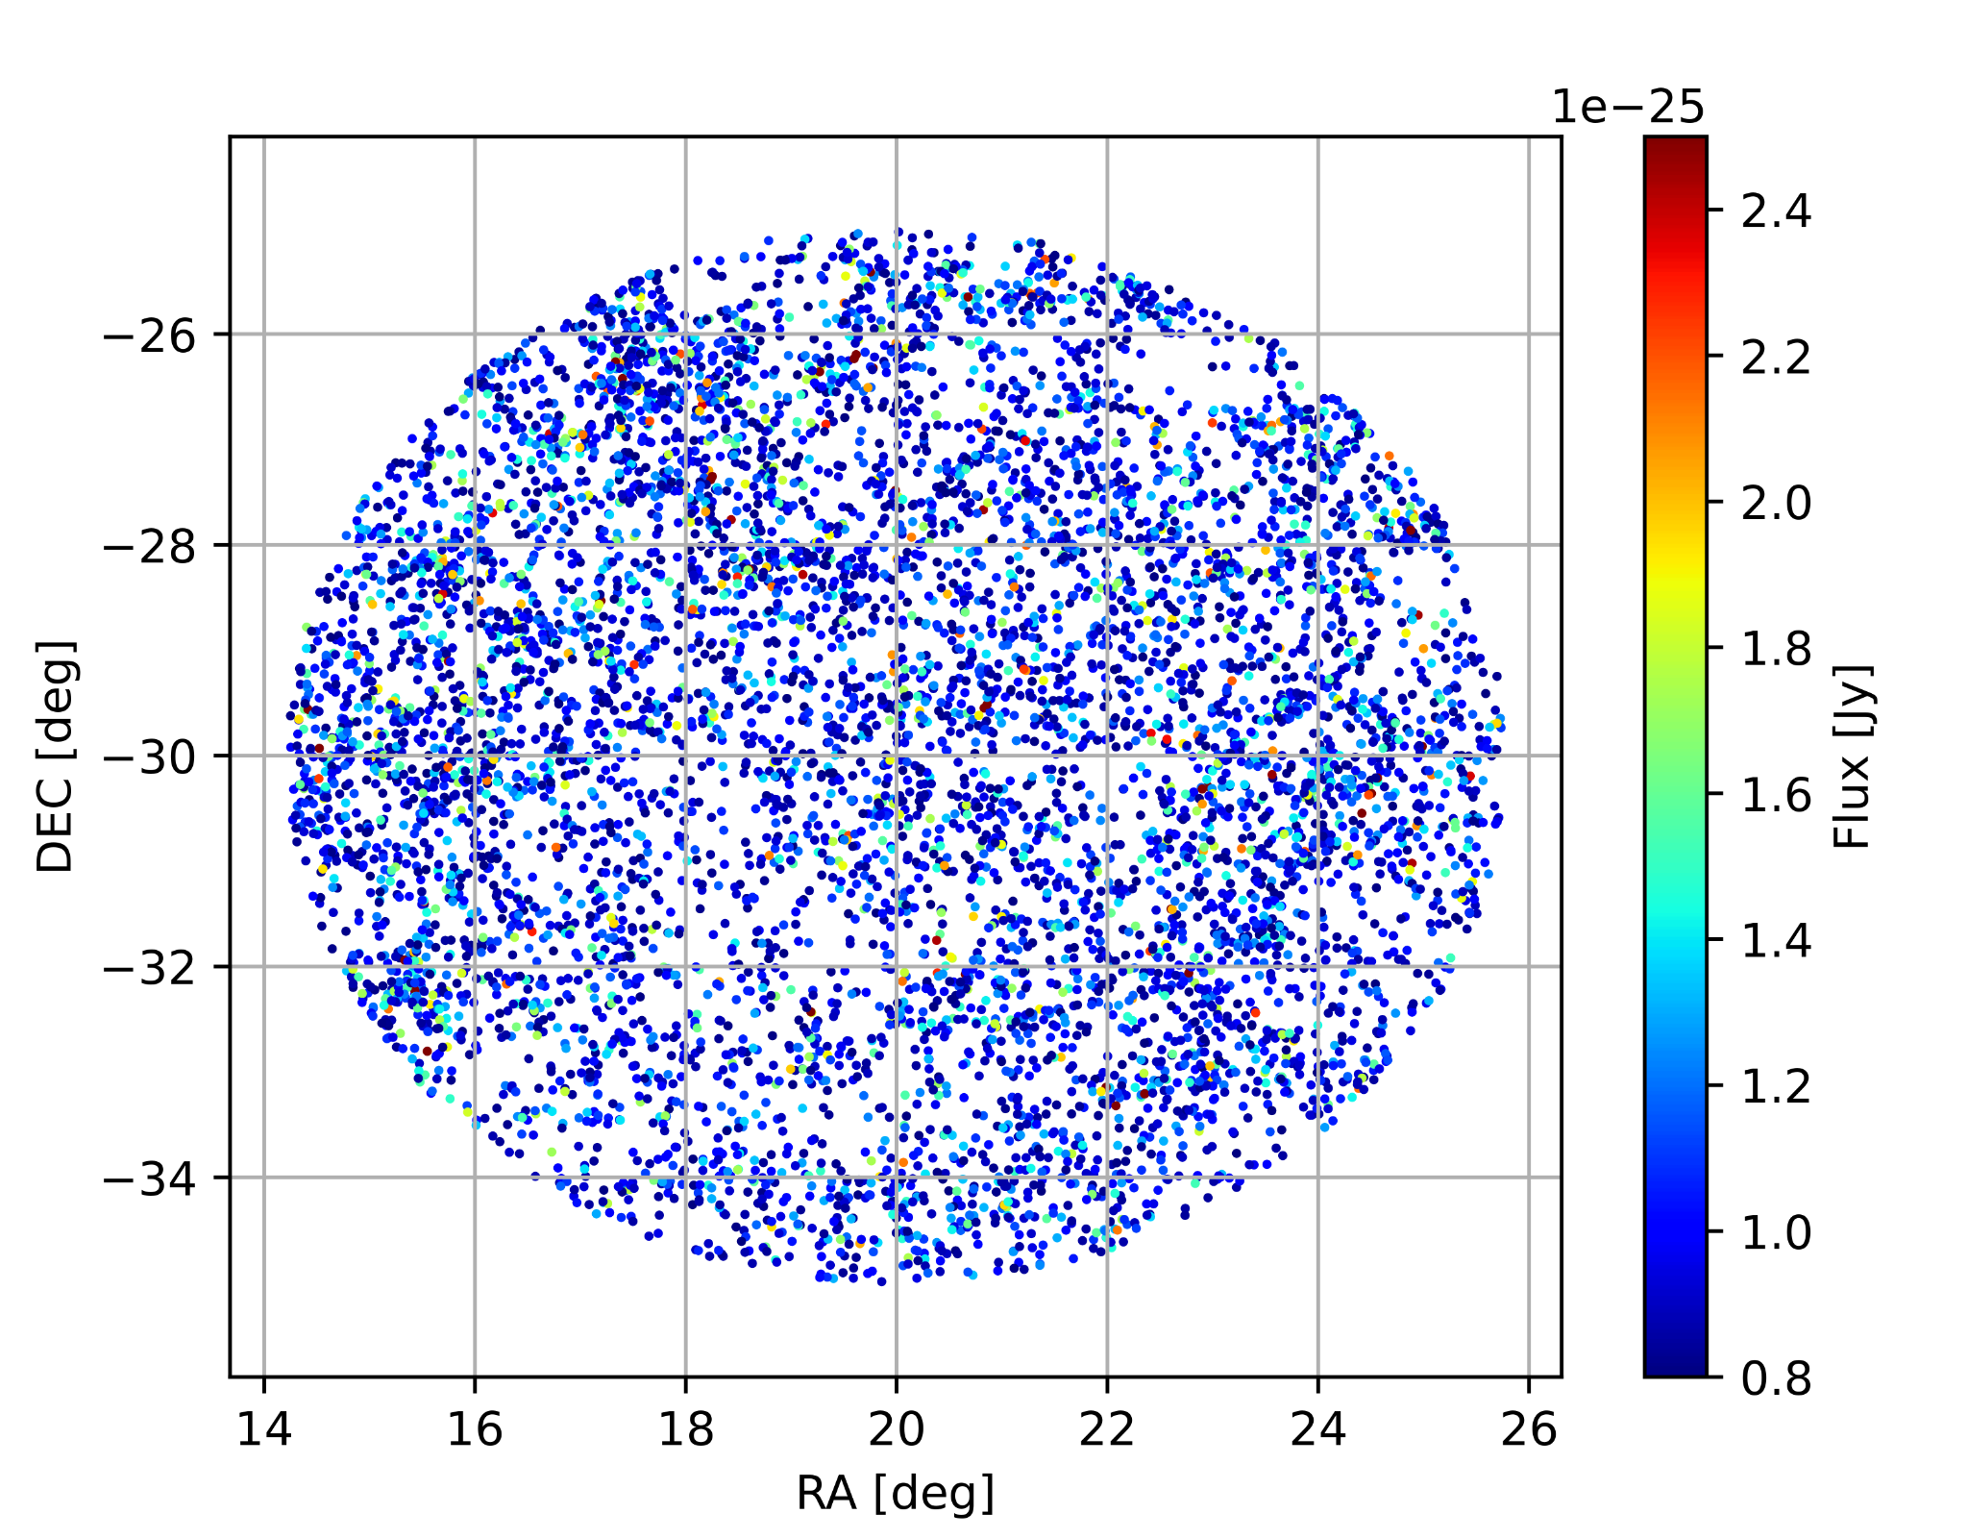
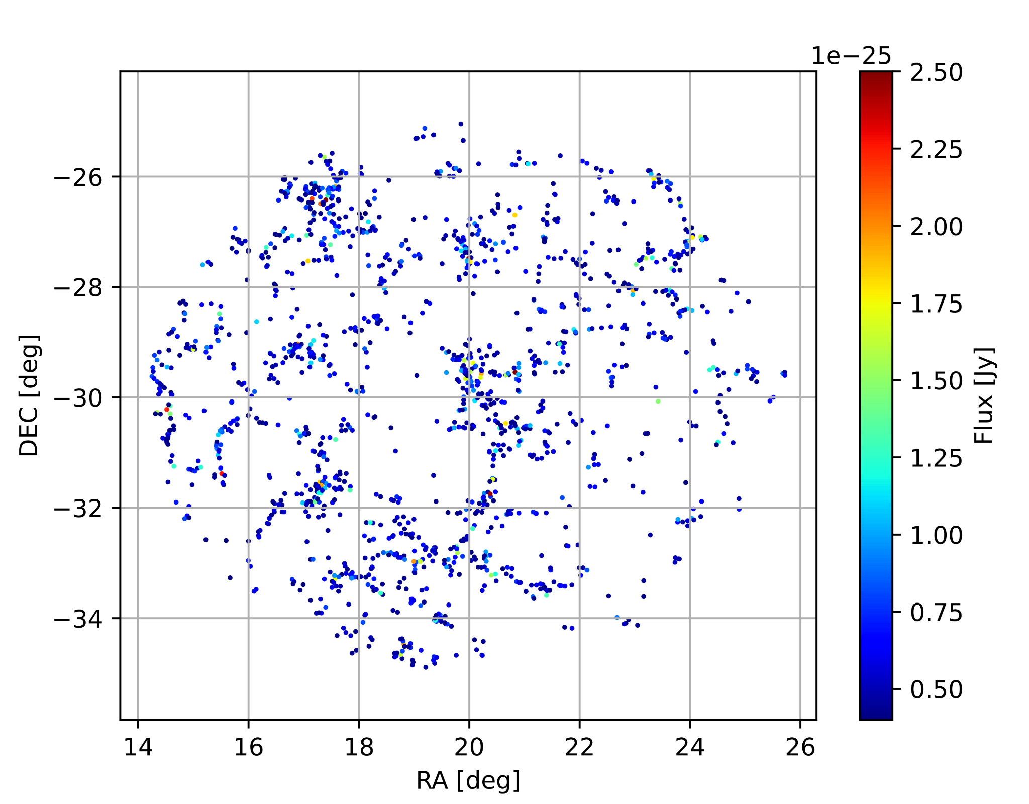
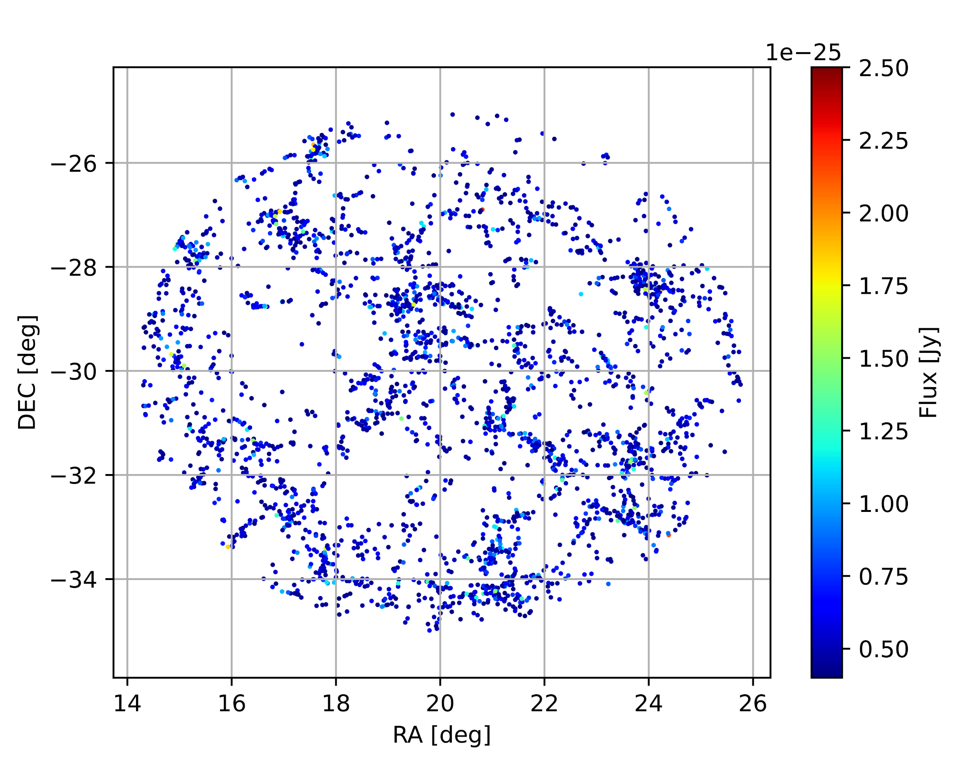
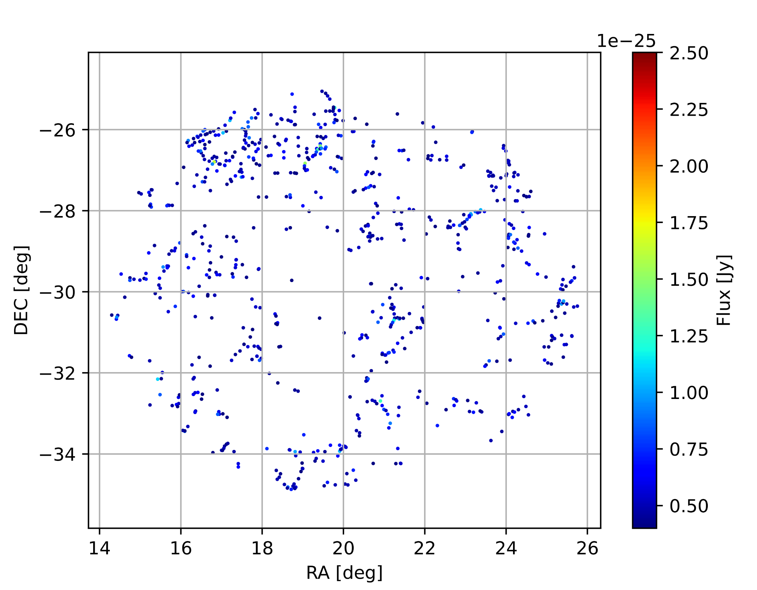
Sky Slices
(Line emission)
Observed Redshift
0.8
0.9
1.0
800 MHz
750 MHz
700 MHz
Frequency
Δz = 0.01
Δf = 5 MHz
08.09.2023
10
Notes:
The sources we are interested in emit line emission → flux of observing freq can be approx by a delta function
Line emission: Oskar on which Karabo is based on, reconstructs continuous emission
→ Delta fct means we reconstruct small redshift slices to simulate line emission
Add them at the end to get the whole picture
Or receive a 3dim sky
→ Easy to parallelise

Slide 11
Tomography: z slices in HI maps
08.09.2023
11

Slide 12
Current Developments and Next Steps
Current
Custom (non-Gaussian) Primary Beams
Explore RASCIL interferometer and imager, incorporate into Karabo
Simulate higher resolution halo catalogs, run fully in CSCS
Future
Compute HI Power Spectrum
Add extended sources and foregrounds
Include deconvolution (e.g., CLEAN) to reconstruct clean images
08.09.2023
12

Slide 13
Questions?
Credit: https://www.manchester.ac.uk/discover/news/the-meerkat-radio-telescope-in-south-africa-receives-prestigious-award-of-the-royal-astronomical-society/

Slide 14
Appendix

Slide 15
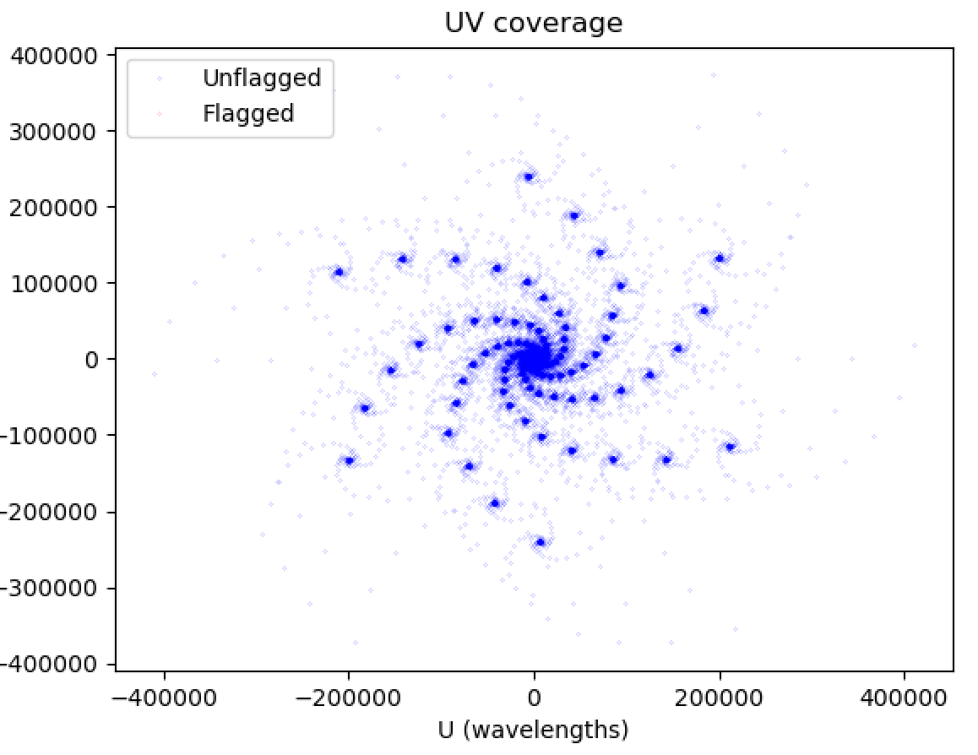
SKA Mid
08.09.2023
15

Slide 16
Overview
HI flux distribution based on DM halos from PINOCCHIO (Generated by Pascal Hitz)
Mosaic of Dirty Images, for a given frequency band
Simulating HI IM observation by MeerKAT/SKA Mid
08.09.2023
16
Notes:
Input: sky catalog of HI sources, obtained from PINOCCHIO DM halos and a DM-to-HI best-fit (see Pascal’s presentation later today)
Karabo pipeline: choose telescope, apply instrumental effects, compute visibilities and dirty images for each redshift slice

Slide 17
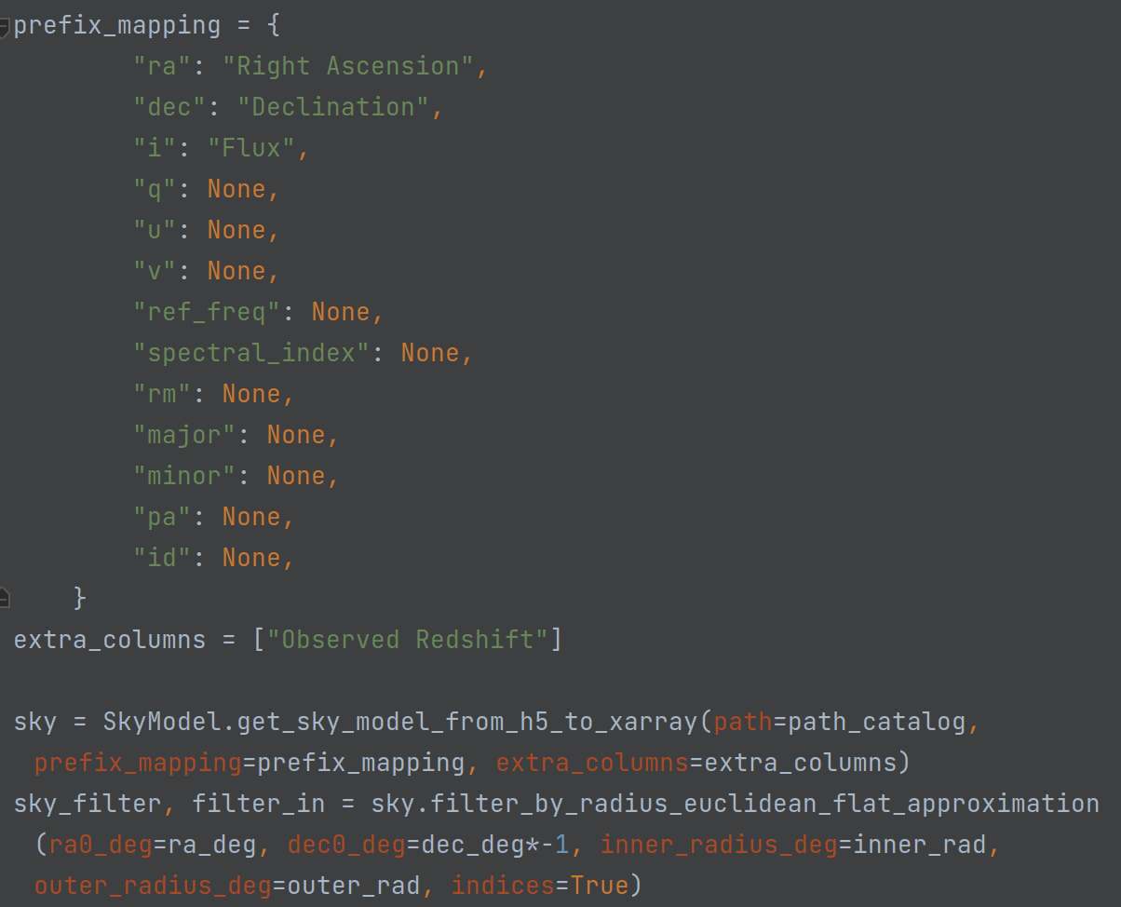
Load Input Sky Catalog using Karabo
Read in catalog directly with Karabo
Redshift range: 0.76 – 1.04
Frequency range: 703 MHz – 807 MHz
Density: 80700 sources/deg2
08.09.2023
17
Notes:
For SKA MID and MeerKAT, only need a small patch of the PINOCCHIO large sky catalog
! BUT we are also working on HIRAX pipeline, which will benefit from fullsky catalogs - hence we start from a fullsky and cut it down as needed
Disclaimer: source fluxes here could be incorrect, we are investigating the specific values from the DM-to-HI model we use

Slide 18
Mosaic Primary Beam Correction
08.09.2023
18

Slide 19
