Slide 1
Towards Realistic Mock Observations
Chris Finlay, Shreyam Krishna,
Michele Bianco, Tianyue Chen & Karabo Team

Slide 2
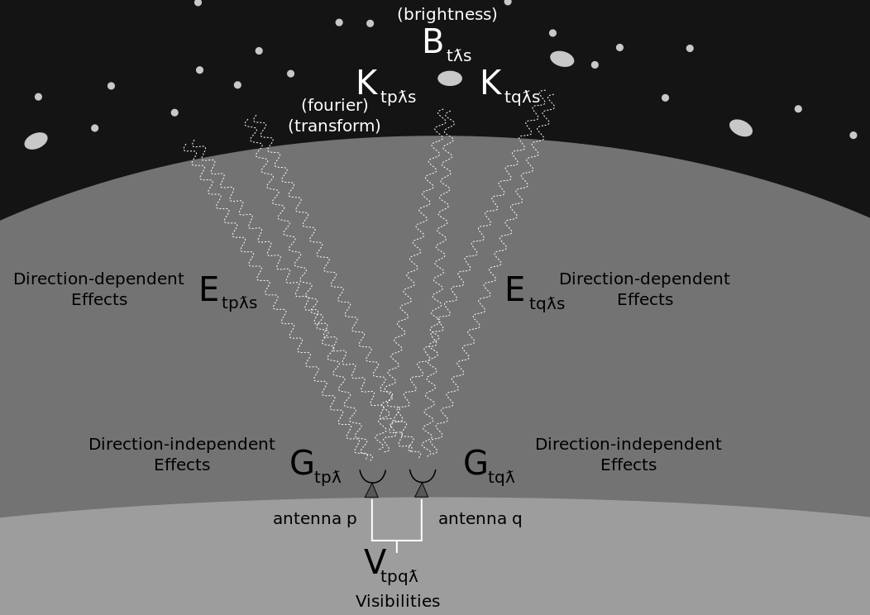
(Simplified) Radio Interferometric Measurement Equation
1
G_{p} - Direction Independent (DI) gains for antenna p
E_{p} - Direction Dependent (DD) gains for antenna p in
direction s
B - Sky brightness as seen by the baseline pq
N - Additive Receiver Noise
1:[RATT RU Radio Interferometry Course, EPFL Radio Sky II]

Slide 3
21 CM IM/EoR Papers | Additive Noise | DI Gain Errors | DD Gain Errors
Removing Astrophysics in 21 cm Maps with Neural Networks | X | X | X
Deep learning approach for identification of H ii regions during reionization in 21-cm observations |  | X | X
THE APPLICATION OF CONTINUOUS WAVELET TRANSFORM BASED FOREGROUND SUBTRACTION METHOD IN 21 cm SKY SURVEYS |  | X | X
21 cm TOMOGRAPHY WITH FOREGROUNDS |  | X | X
Separating the EoR signal with a convolutional denoising autoencoder: a deep-learning-based method | X | X
Machine Learning to Decipher the Astrophysical Processes at Cosmic Dawn |  | X
Foreground removal and 21 cm signal estimates: comparing different blind methods for the BINGO Telescope |  | X | X
Blind foreground subtraction for intensity mapping experiments |  | X
SKAO Hi Intensity Mapping: Blind Foreground Subtraction Challenge |  | X

Slide 4
Current State of the Art for 21 cm IM/EoR simulations
Most do not properly incorporate the complexity of the radio interferometric signal capture process
Additive Noise - System Equivalent Flux Density (SEFD)
Where incorporated - DD effects are mostly including gaussian primary/synthesized beams
No cross-polarisation leakage - only xx and yy components - usually identical

Slide 5
MeerKlass cross-correlation Single dish Intensity Mapping
10.5 hours (6 nights) overlapping with the WiggleZ 11hr field (~200 sq. deg. )
973 - 1015 MHz (0.40 < z < 0.46)
30 PCA components removed v/s 8 in simulations
Wang 2021, Cunnington 2022

Slide 6
MeerKAT auto-correlation Single Dish Intensity Mapping
Calibration Errors ~ 10⁻⁵
Paul et. al. 2023

Slide 7
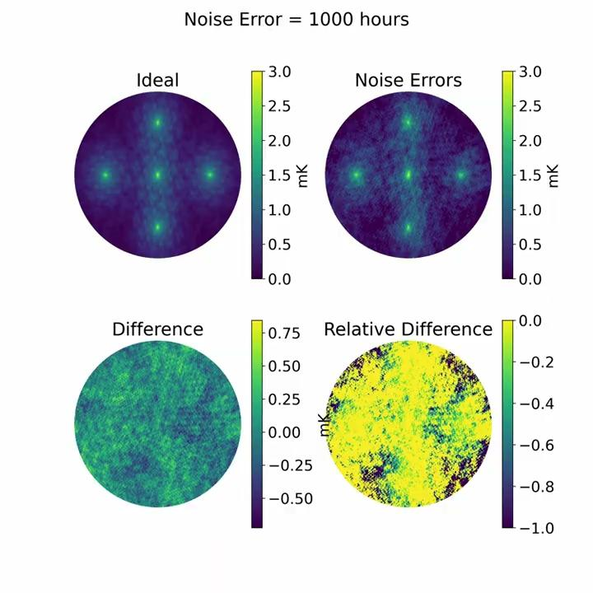
Additive Noise Model
Independent over all dimensions
Increasing noise buries signal
Reduce noise with more data
Antennas
Time integration
Antennas
Channel width

Slide 8
Direction Independent Gain Model
1
h_{𝜈} - Band pass error
p_{i} - Antenna dependent error 𝛿_{𝜈i} - Statistical amplitude error 𝜏_{i} - Antenna phase error 𝜖_{𝜈i} - Statistical phase error
1 + G_{pq} = Gain_{p} x Gain_{q}
1:[Wang, Chen, Masui et al. 2022]

Slide 9
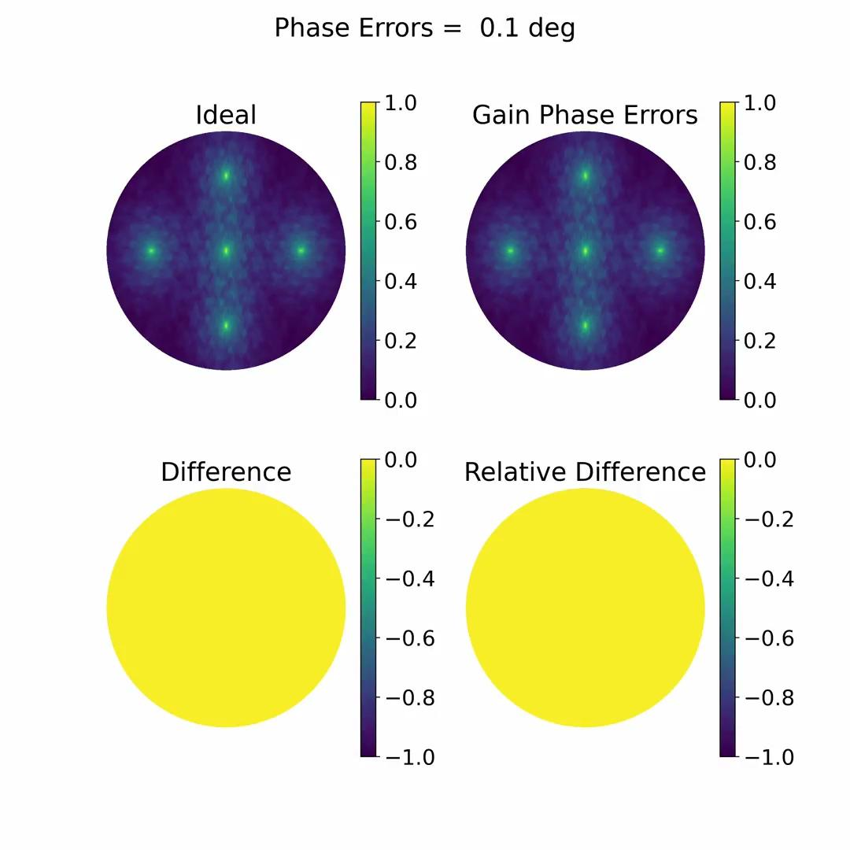
DI Gain Amplitude and Phase Errors
Varies over baseline, time and frequency
The same across the entire image
Gain Amplitudes
Amplitudes modulate signal strength
Gain Phases
Phase errors defocus the telescope
Spread out the signal

Slide 10
Direction Dependent Gain Model
v₁
n₁
v₂
n₂

Slide 11
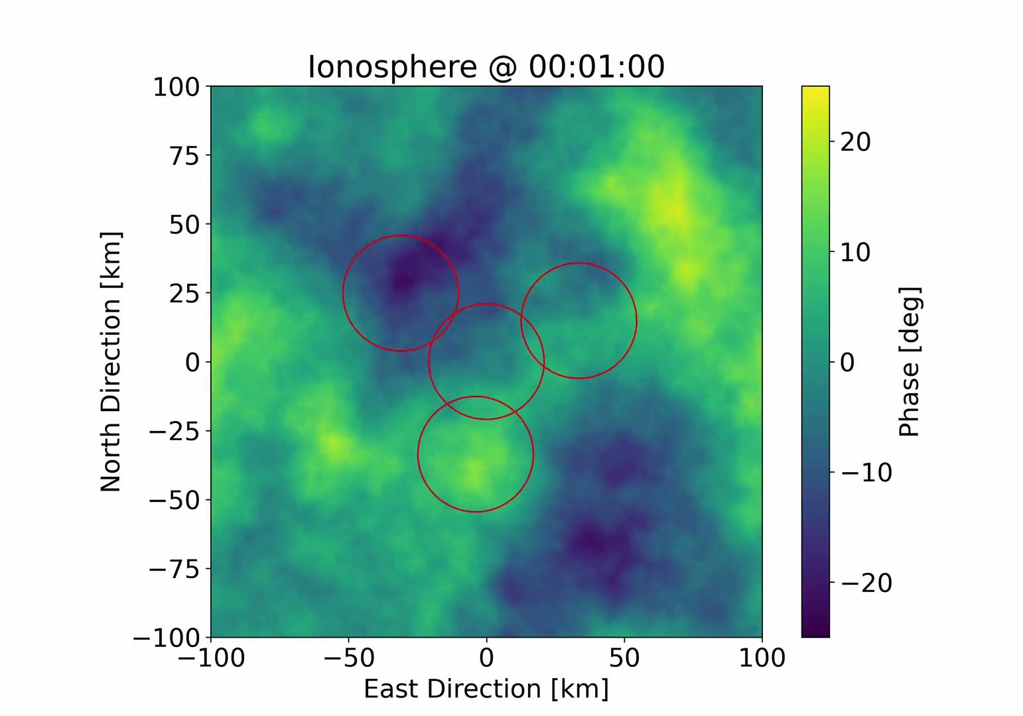
Ionosphere
Varies over space, time, frequency and antenna (potentially)
For wide FoV
Different across the FoV
For large arrays
Each antenna sees a different sky

Slide 12
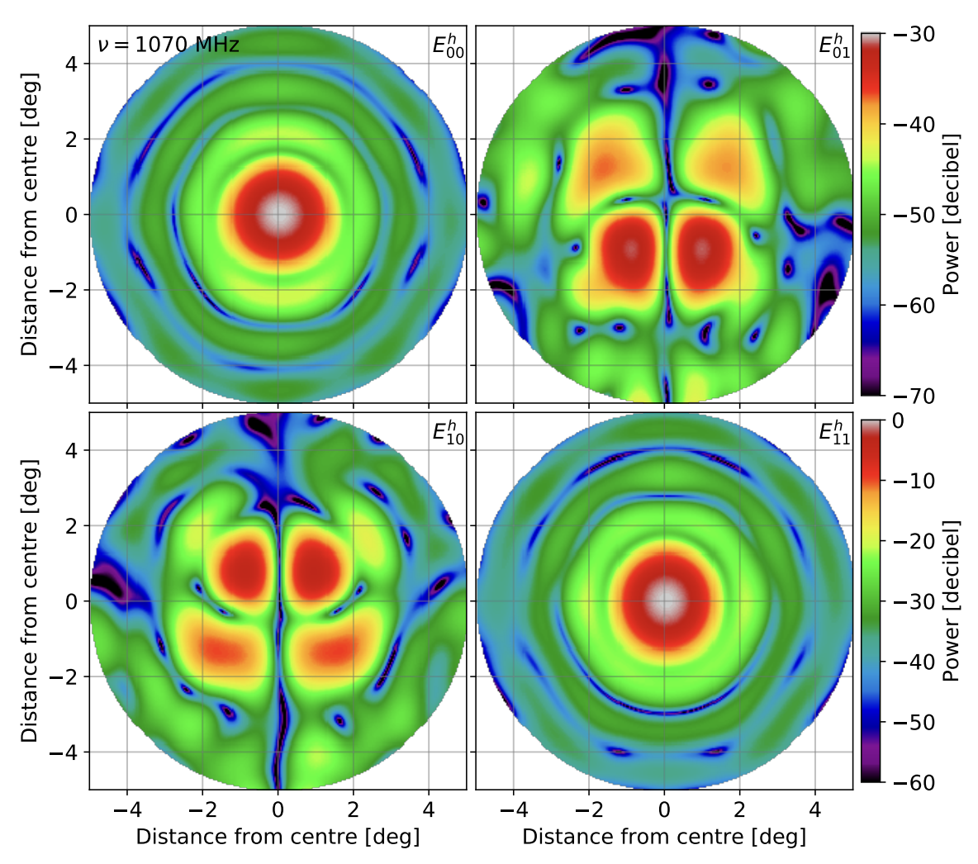
Primary Beam
Directional sensitivity of antenna/station to different polarised components
Most radio telescopes have finite, non-zero polarisation leakage
Can cause synchrotron sources to overpower cosmological 21 cm signal
Asad et al 2019

Slide 13
Conclusion
State of 21 cm EoR simulations nowhere close to observations.
Modelling instrumental effects essential - 0.02% calibration error = contaminant order of magnitude larger than signal AFTER removal
More complex effects - time varying primary beam, different primary beam for different antennas, coloured noise, gain drift

