Slide 1
SKACH Communications Workshop
September 7, 2023

Slide 2
About me

Slide 3
Agenda for the Workshop
Exercise around our common goal – developing a SKACH communications plan.
Content
Audience
Languages
Events

Slide 4
Logos:
Icebreaker:
Developing a SKACH communications plan

Slide 5
Content:
The key themes of the SKAO communications strategy:
Science
Technology
Collaboration
Impact
Relevance
Sustainability
Notes:
Posted from events such as SKA meetings and the EPFL Portes Ouvertes – building presence and followers as our work continues and grows.

Slide 6
Audience:
• Decision makers – e.g., government ministers, senators, prime ministers
• Key influencers – e.g., senior officials, ambassadors, policy makers, key industrial
sectors, chief scientists
• Interest groups – e.g., users and potential users, the wider scientific community, industry
groups, lobbyists, local communities and Indigenous knowledge keepers around
telescope sites
• Multipliers – e.g., journalists (TV, press, radio), social media influencers, celebrities,
science communicators, teachers
• General audiences – e.g., general public, voters, school kids, academia
Notes:
We received 5000 Francs from the Swiss Society for Astrophysics and Astronomy last fall/winter
We received 5000 euro from the IAU Office for Astronomy Outreach this past spring
We have contracted with a production company in Geneva to get started
Mark Sargent would host

Slide 7
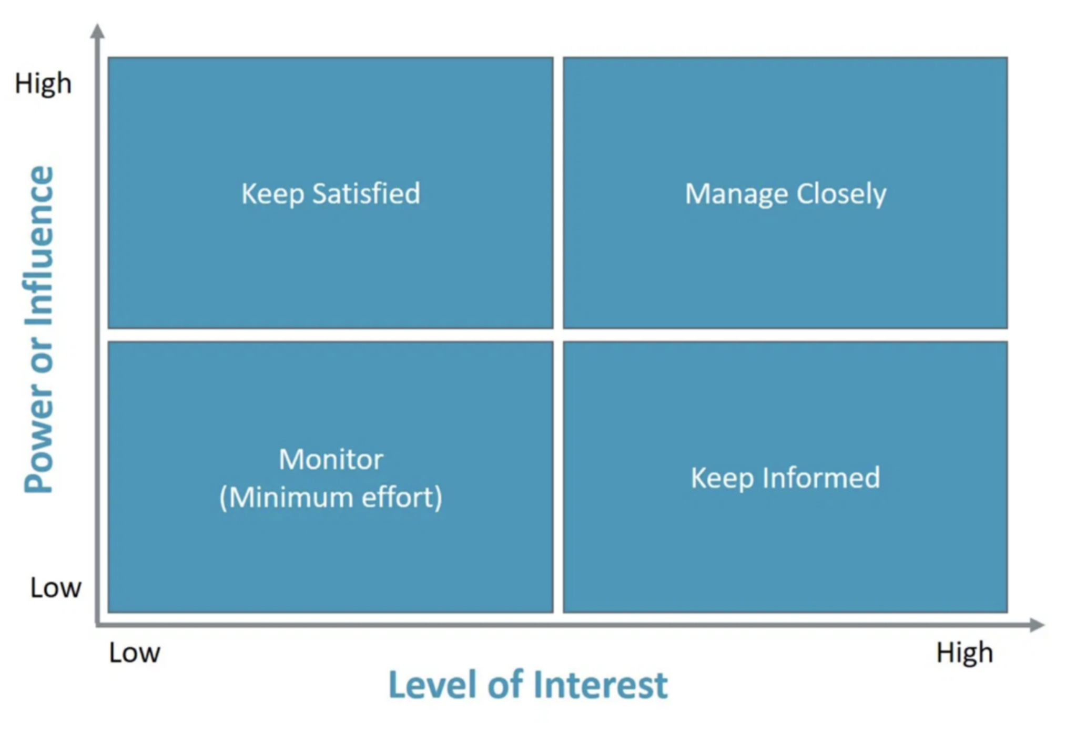
Power interest matrix
• Decision makers
• Key influencers
• Interest groups
• Multipliers
• General audiences
Notes:
Art exhibit - Cosmos Archaeology empowers us to explore stars and galaxies formed over 13.7 billion years and to grasp the extent and evolution of our immense Universe in unprecedented ways.
Curated by Prof. Jean-Paul Kneib, Director of the Laboratory of Astrophysics and eSPACE Center and Sarah Kenderdine, Lead Laboratory for Experimental Museology
Started at EPFL - Moving to Shanghai

Slide 8
Languages :
English
German
French
Italian
?
Notes:
Over 25,000 people attended the Open Days on April 29 and 30, to discover the captivating and exciting world of EPFL through exhibitions, animations, conferences, workshops and many other events.
Open Days is actually a nice point! Emma Tolley along with Shreyam Krishna, Michele Bianco and one other person, I don’t remember, presented a very cool radio telescope simulator. I can’t remember if Emma created it alone or if they all worked on it. It basically allowed visitors using a webcam to see what an image of themselves would look like depending on how an array of radio telescopes were arranged. And the whole group did an excellent job explaining radio astronomy in French! Also, the SKA Digital Twin exhibit from the Cosmos Archaeology exhibition was part of the Portes Ouvertes as well.

Slide 9
SKACH Events
Events
What sort of events planning would be most useful for you?
How would you like to contribute to an events calendar?
What sort of events would you propose?

Slide 10
SKACH - Comm & Outreach Contacts:
Carolyn Crichton - SKACH Director, Chair of the Board, SKACON Steering Committee - Carolyn.Crichton@epfl.ch
Tanya Petersen - SKACH Communication and Outreach Program Chair - tanya.petersen@epfl.ch
Hamsa Padmanabhan - SKACH Communication and Outreach Program Co-Chair - Hamsa.Padmanabhan@unige.ch

