Slide 1
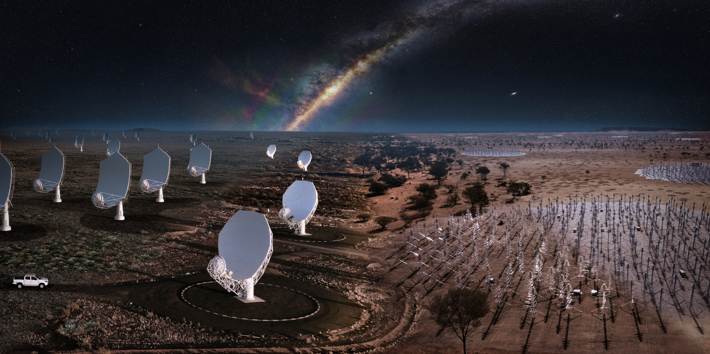
Sharing a baseline a pilot project linking young people and radio observatories
Robert Cumming Chalmers University of Technology, Sweden
Mischa Brendel ASTRON, Netherlands Silvia Casu INAF Sardinia, Italy Cristina García Miró
Yebes Observatory (OAN/IGN), Spain
Joni Tammi Metsähovi Radio Observatory, Aalto University, Finland Stefania Varano INAF Medicina
Ioanna Kazakou
JIVE, Netherlands

Slide 2
Introduction, why and how
Opportunity
International projects with spectacular radio telescopes are exciting, but hard to visit.
The SKA offers new opportunities and new challenges.
Aim
To give kids science capital, and a taste of international science
Target group
School classes, ages 14-16
Pilot project
Learn by doing first – then extend to SKA countries. Start with smaller European observatories. Similar time zones. English as standard language.
Funding
5000 EUR from SKAO and IAU NOC funding scheme (plus 2500 EUR from JIVE)
Timeline
start in August 2023, activities Jan-June 2024, evaluation from Sep-Dec 2024

Slide 3
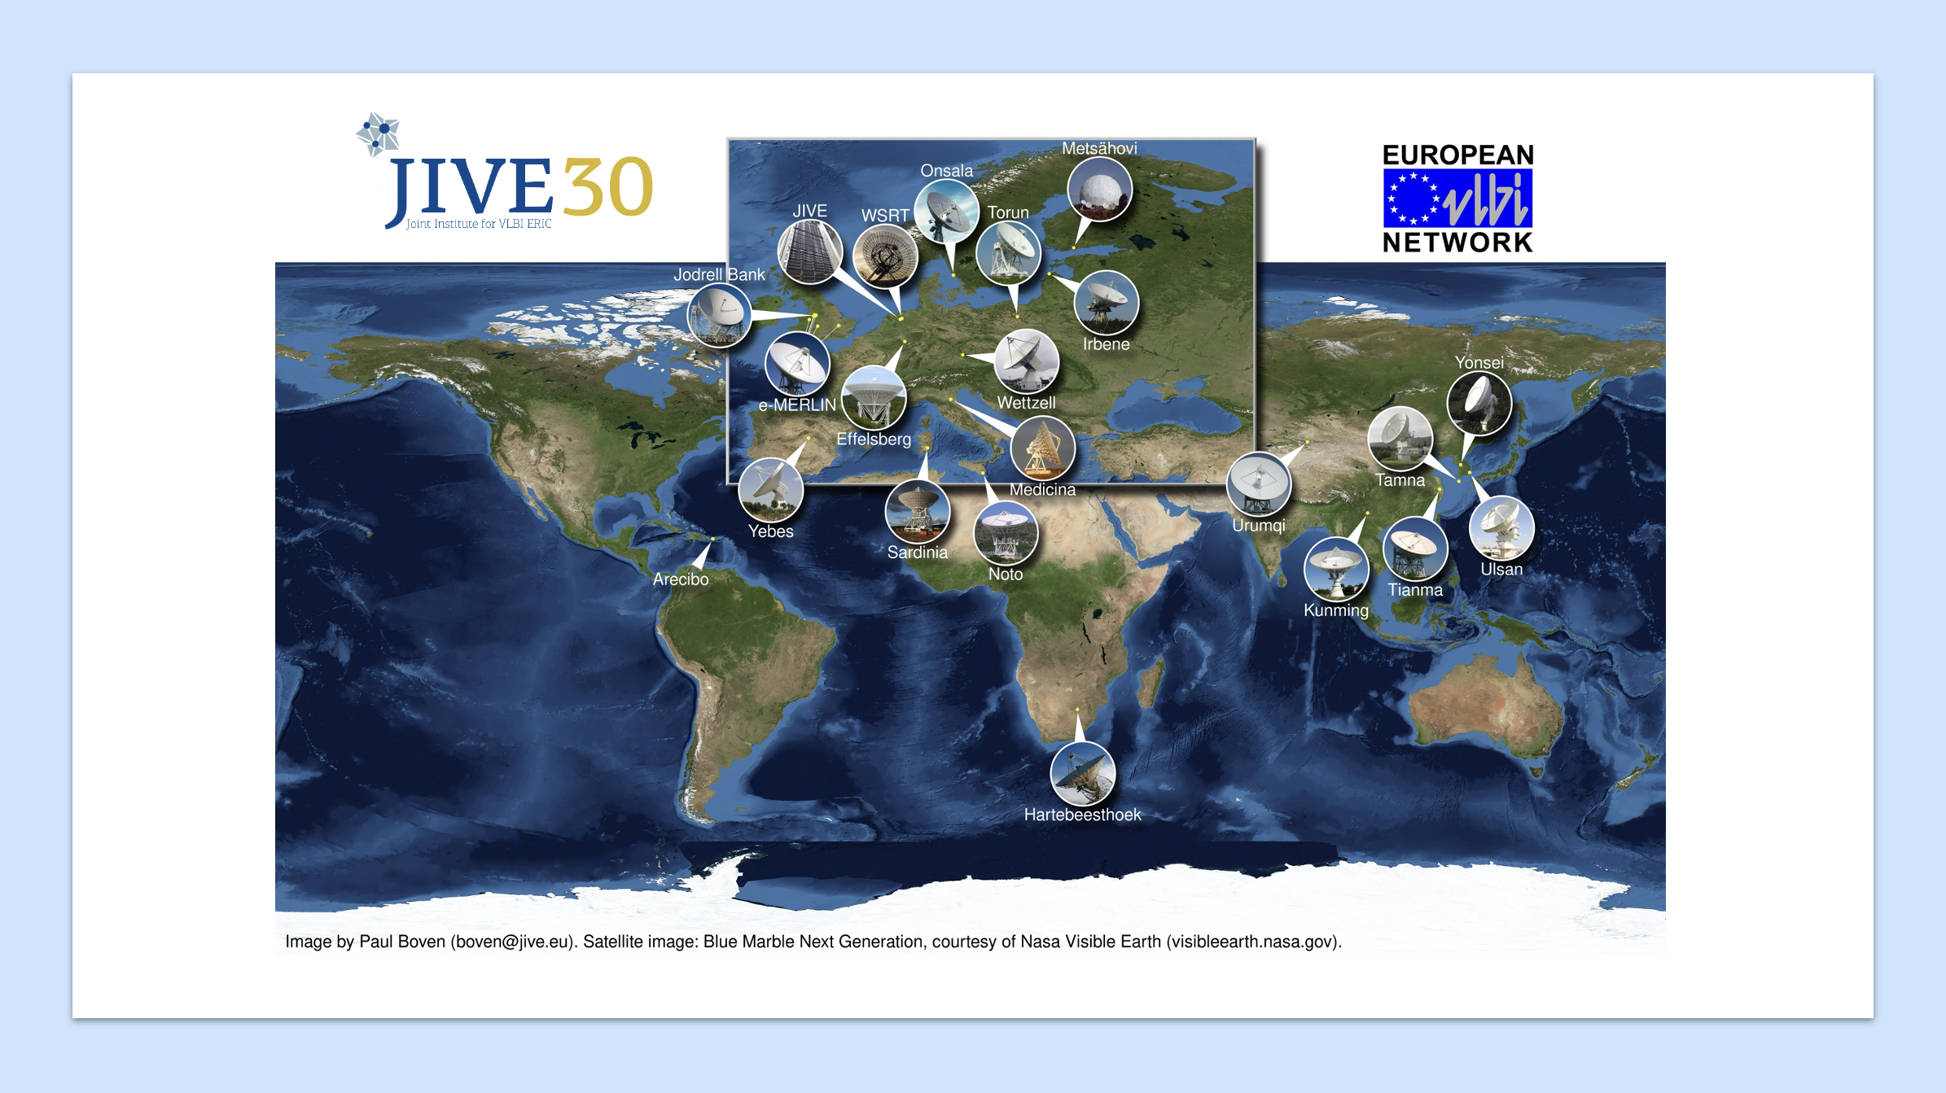
Paul Boven (boven@jive.eu). Satellite image: Blue Marble Next Generation, courtesy of NASA Visible Earth (visibleearth.nasa.gov).

Slide 4
Paul Boven (boven@jive.eu). Satellite image: Blue Marble Next Generation, courtesy of NASA Visible Earth (visibleearth.nasa.gov).

Slide 5
Just three planned activities …
1. Scientist visits class
2. Class visits observatory
3. Classes connect digitally
Project work / presentations
Noun Project/glyph.faisalovers/Hey Rabbit/Azam Ishaq/David Khai/Cattaleya Thongsriphong

Slide 6
Sweden / Onsala Chalmers Robert Cumming
Netherlands / Dwingeloo
ASTRON / JIVE
Mischa Brendel
Finland / Metsähovi
Aalto university
Joni Tammi
Wolfsbos school, Hoogeveen, 20 km
Preliminary visit to school 15 Jan
Scientist visit 20 March
Visit to ASTRON/JIVE 10 April
Visit to LOFAR & Geopark 15 April
Meetup with Sardinia 5 June
Sannaskolan, Gothenburg, 40 km
Observatory visit 19 March
Scientist visit 21 March
Astronaut event 9 April
Meetup with Italy 15 May
Jokirinteen koulu, Kirkkonummi, 19 km
Scientist visit 8 Feb
Observatory visit 27 March
Meetup with Spain 16 April
Spain / Yebes
IGN
Cristina García Miró
Italy / Medicina
INAF
Stefania Varano
Italy / Sardinia
INAF
Silvia Casu
IES Brianda de Mendoza. Guadalajara
Scientist visit 12 Jan
Observatory visit 18 Jan
Meetup with Finland 16 April
Trip to space facility 17 June
Liceo Euclide, Cagliari
Scientist visit April
Observatory sleepover late April
Meetup with Netherlands 5 June
Liceo A. Volta, Lodi Scientist visit 2 May,
Meetup with Sweden 15 May
Observatory visit 7 May, 18 September
IGN; Ira Matilainen/Aalto University; INAF; INAF/Paolo Soletta; ASTRON; Chalmers/Anna-Lena Lundqvist

Slide 7
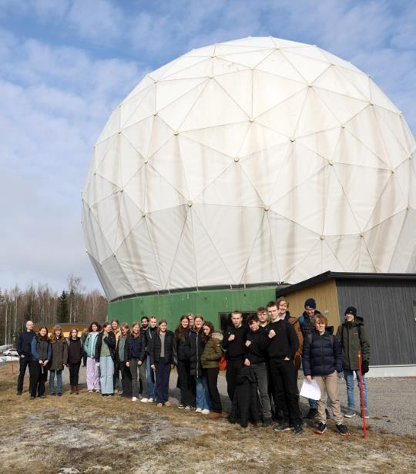
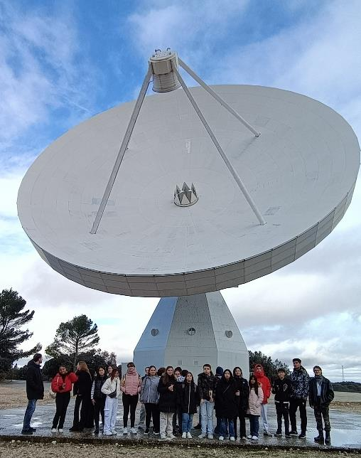
Aalto University/Joni Tammi; Yebes Observatory/Cristina García Miró

Slide 8
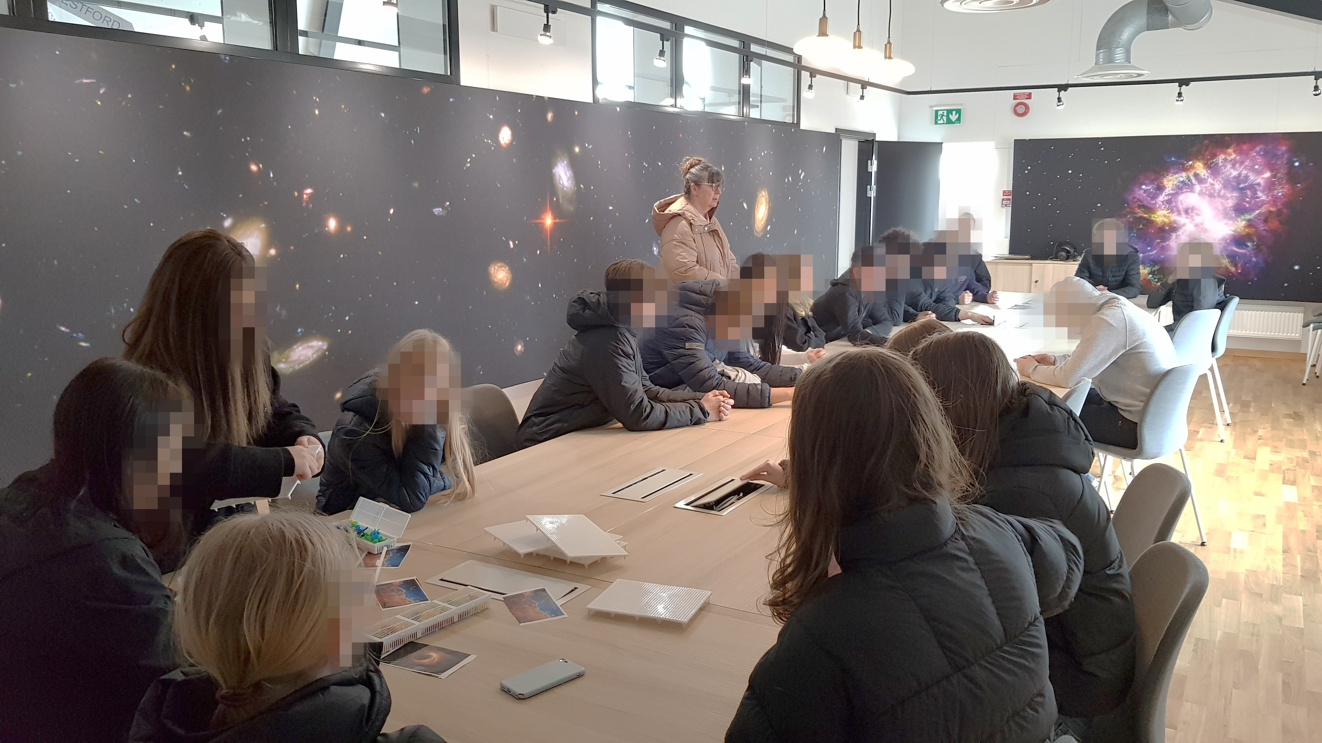
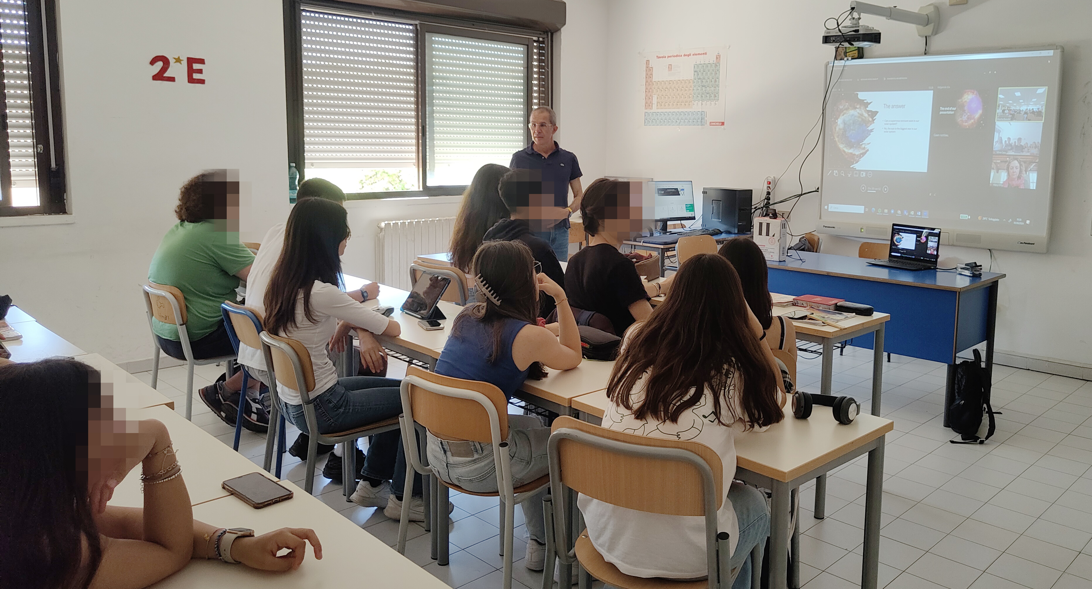
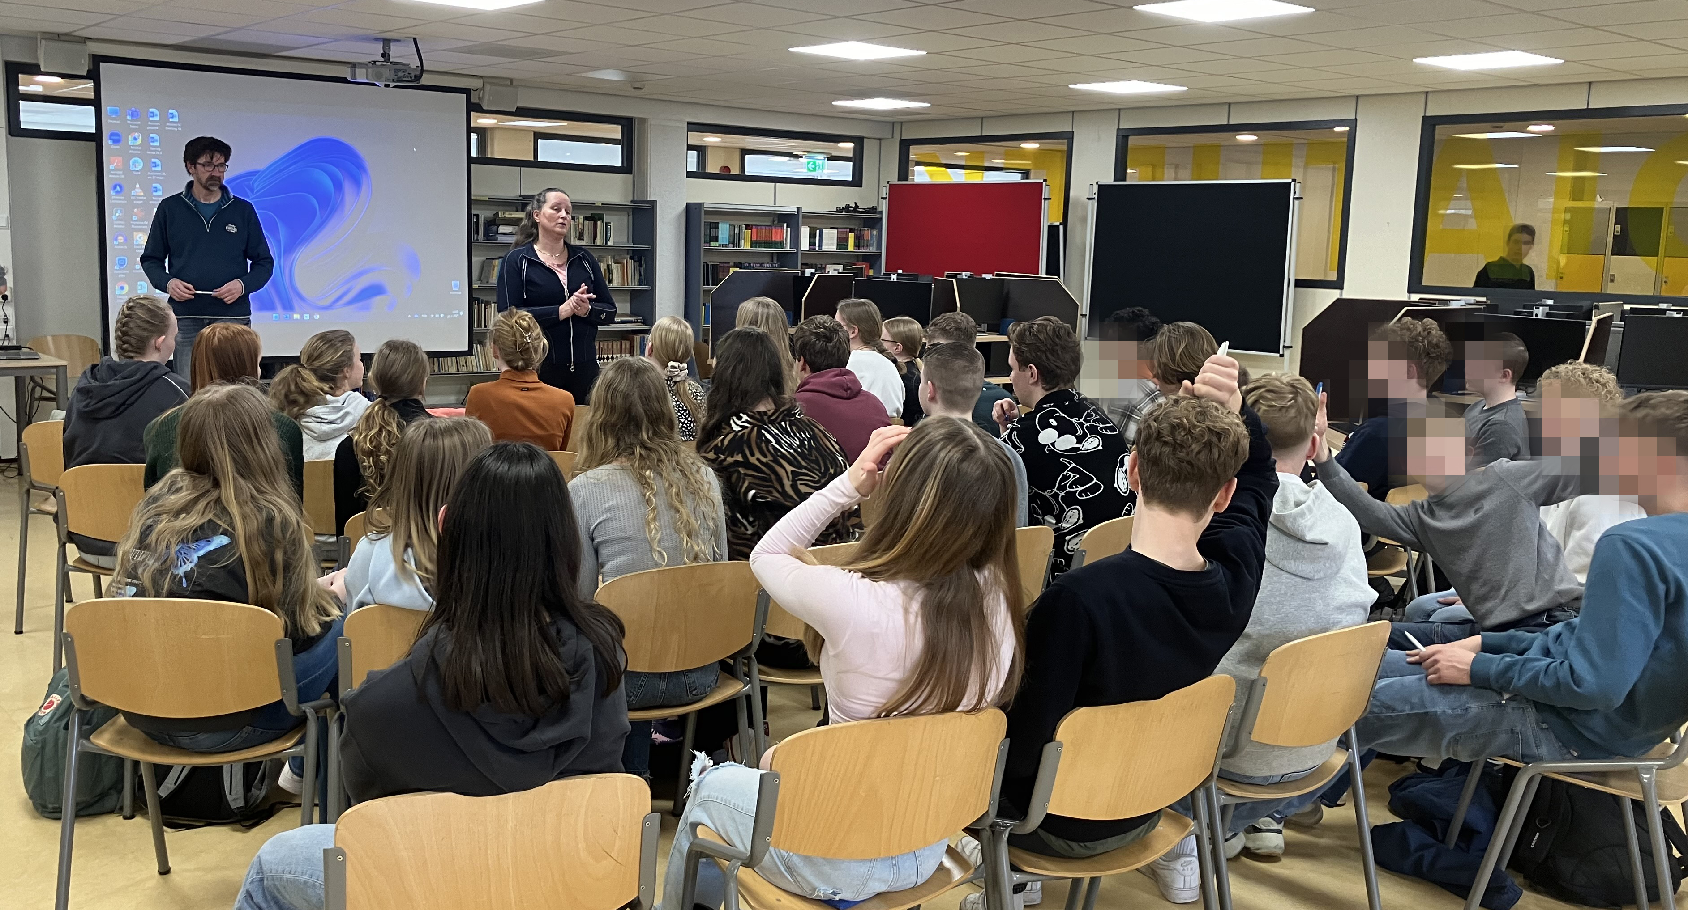
Chalmers/R. Cumming; ASTRON/M. Brendel; INAF/S. Casu

Slide 9
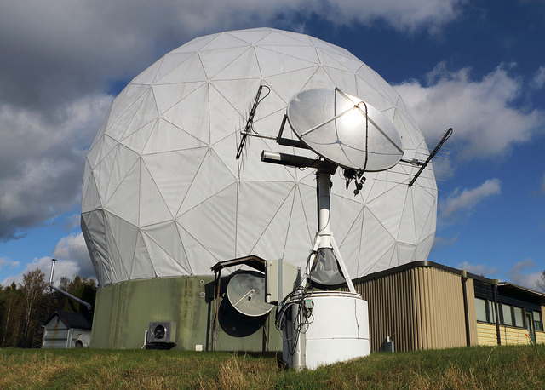
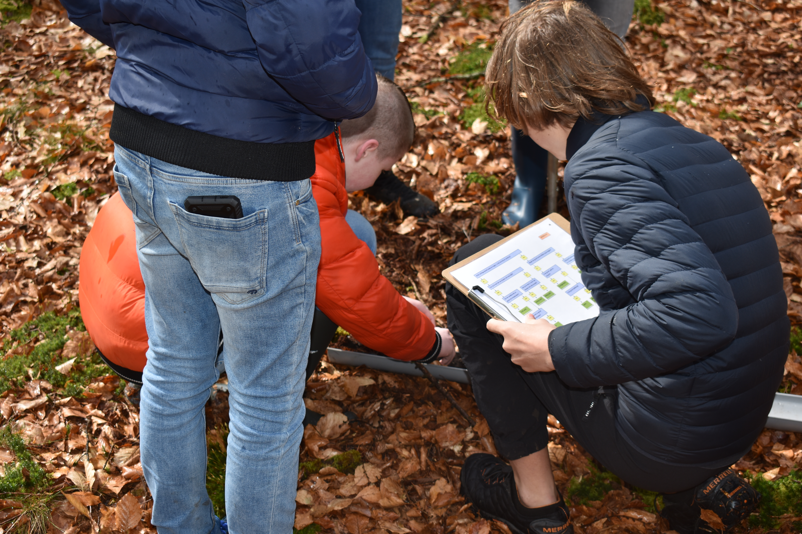
Aalto University; ASTRON/M. Brendel

Slide 10
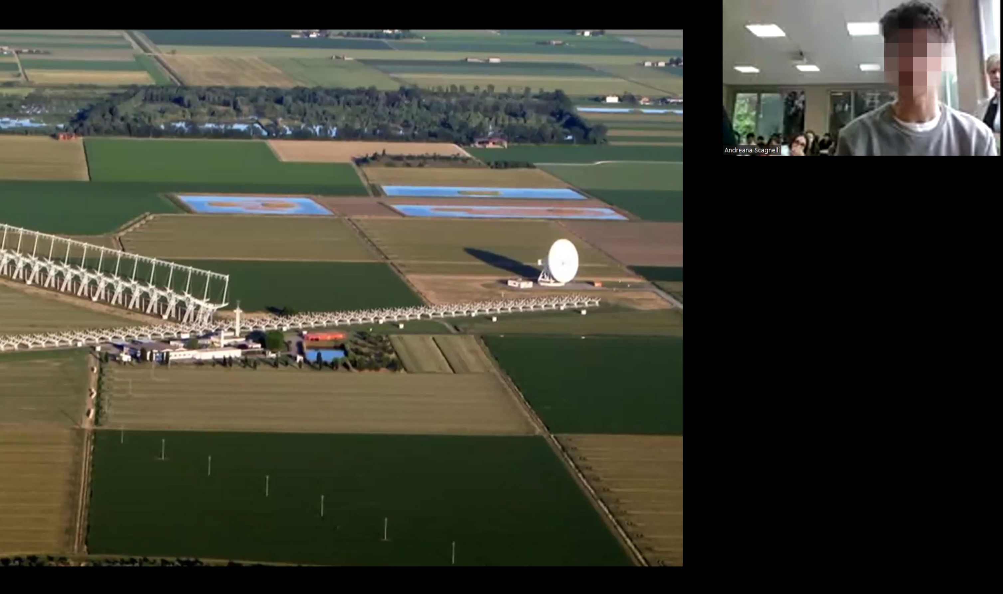
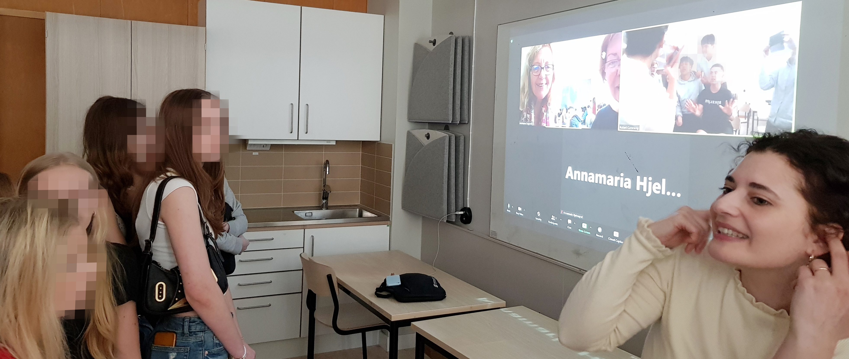

Slide 11
Challenges
Team
For team members, just finding time was tricky
Recruiting classes
Contacting new people is hard; schools are very busy.
Countries’ education systems are surprisingly different.
Activities
Need clarity about what activities are required, expected and what value they have.
International coordination
How to pair up nodes? Scheduling was the best solution.
How and when to connect nodes? We left most connection work to the end
Can we all work in English? Language barriers were bigger than expected
Communication
Who else needs to know? Media, VIPs, branding, sponsors all seem promising
Aalto University/Joni Tammi; Yebes Observatory/Cristina García Miró

Slide 12
Feedback
Questionnaire for team, scientists and teachers
😁Students got quality contact with science and scientists
😁A few chose to pursue STEM as a result of the project
😁The online meetups were a positive experience
🧐It’s worth preparing practical experiments and exercises
🤨Schools will do fact-finding project work unless otherwise instructed
🤔Online activity and documentation doesn’t happen naturally
“It would be great […] if the amount of extra work for the teacher would stay as small as possible.” (teacher Finland)
“The joint activities between schools/countries need to be developed and designed way more beforehand.” (team member Finland)
“I think a very good idea should be sharing the science results with all the countries instead of sharing them with only one country.” (teacher Spain)
“[Better to work] one week instead of a couple of hours for several weeks.” (teacher Netherlands)
Aalto University/Joni Tammi; Yebes Observatory/Cristina García Miró

Slide 13
Towards Sharing a baseline 2025-6
Successes
Classes and teachers enjoyed the project and are keen to do it again
We achieved a non-competitive balance between classes and countries
We learnt from each other and shared material
14-15 year-olds are challenging and fun to work with
Room for improvement
Explore different ways of connecting classes digitally
Better official resources and descriptions
Provide infrastructure for students to document and present their activities
Room for development
Explore different age groups
Integrate with existing programmes
Co-create activities with subject matter experts in other fields
More time for scientist-teacher interactions
Show students what they can do next
Explore potential for science diplomacy and communication interventions
Aalto University/Joni Tammi; Yebes Observatory/Cristina García Miró

Slide 14
