Slide 1
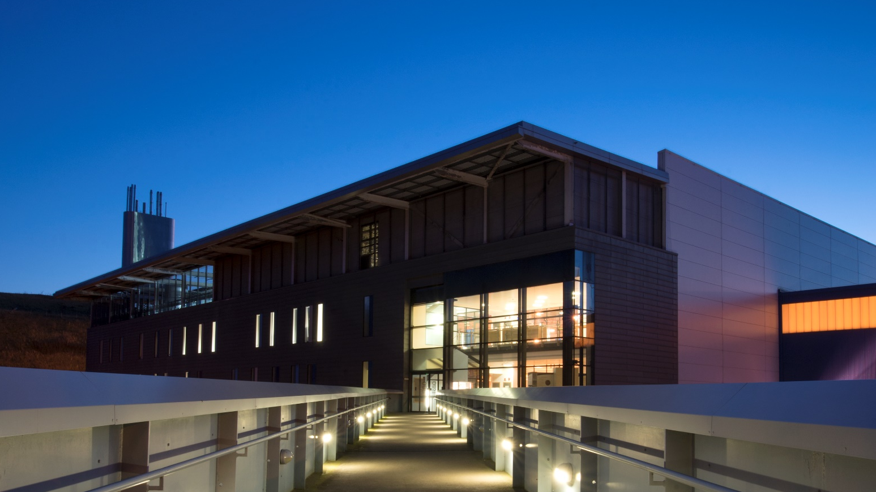

From Experimental Hall to Exhibition Hall:
Public Engagement at a Large-Scale Facility
Dr Preeti Kaur, ISIS Neutron and Muon Source

Slide 2
Overview
Introduction to ISIS Neutron and Muon Source
ISIS Public Engagement Programme
Our activities – embedding EDI
Staff development
Campus Open Week

Slide 3
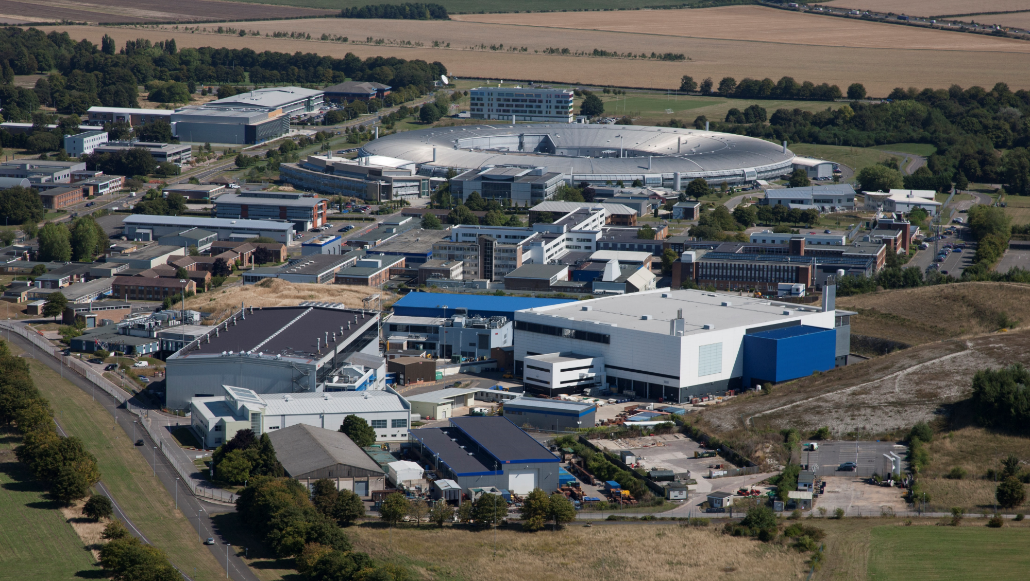
Rutherford Appleton Laboratory
Diamond Light Source
RALSpace
Central Laser Facility
Research Complex
ISIS Neutron and Muon Source

Slide 4
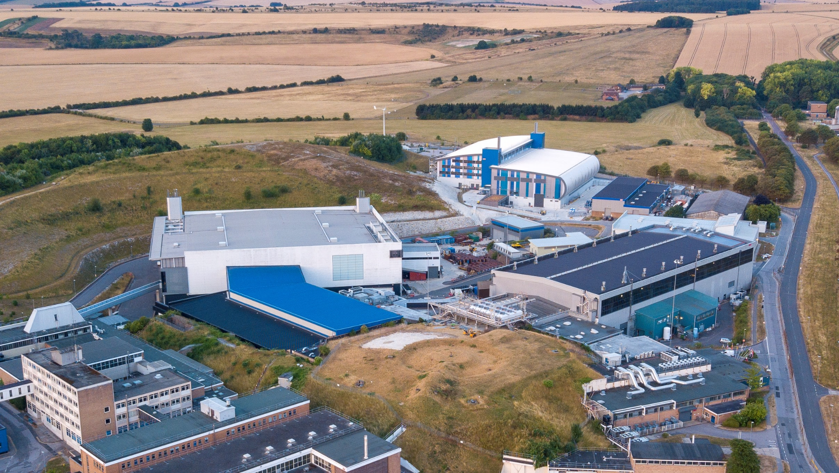
ISIS Neutron and Muon Source
Diamond Light Source
Target Station 2
Target Station 1
ISIS Neutron and Muon Source

Slide 5
Accelerator-driven source
Diamond Light Source
Neutron Target 2
Neutron Target 1
Muon Target
ISIS Neutron and Muon Source
High energy protons

Slide 6




What is ISIS?
World-leading materials science research centre serving the UK and international scientific community.
  3500 visits by scientists from over 30 countries every year
  1200 experiments per year
Neutron and Muon Source
Study materials at the atomic level using a suite of advanced scientific instruments
30
Neutron
instruments
7 muon
experimental areas

Slide 7
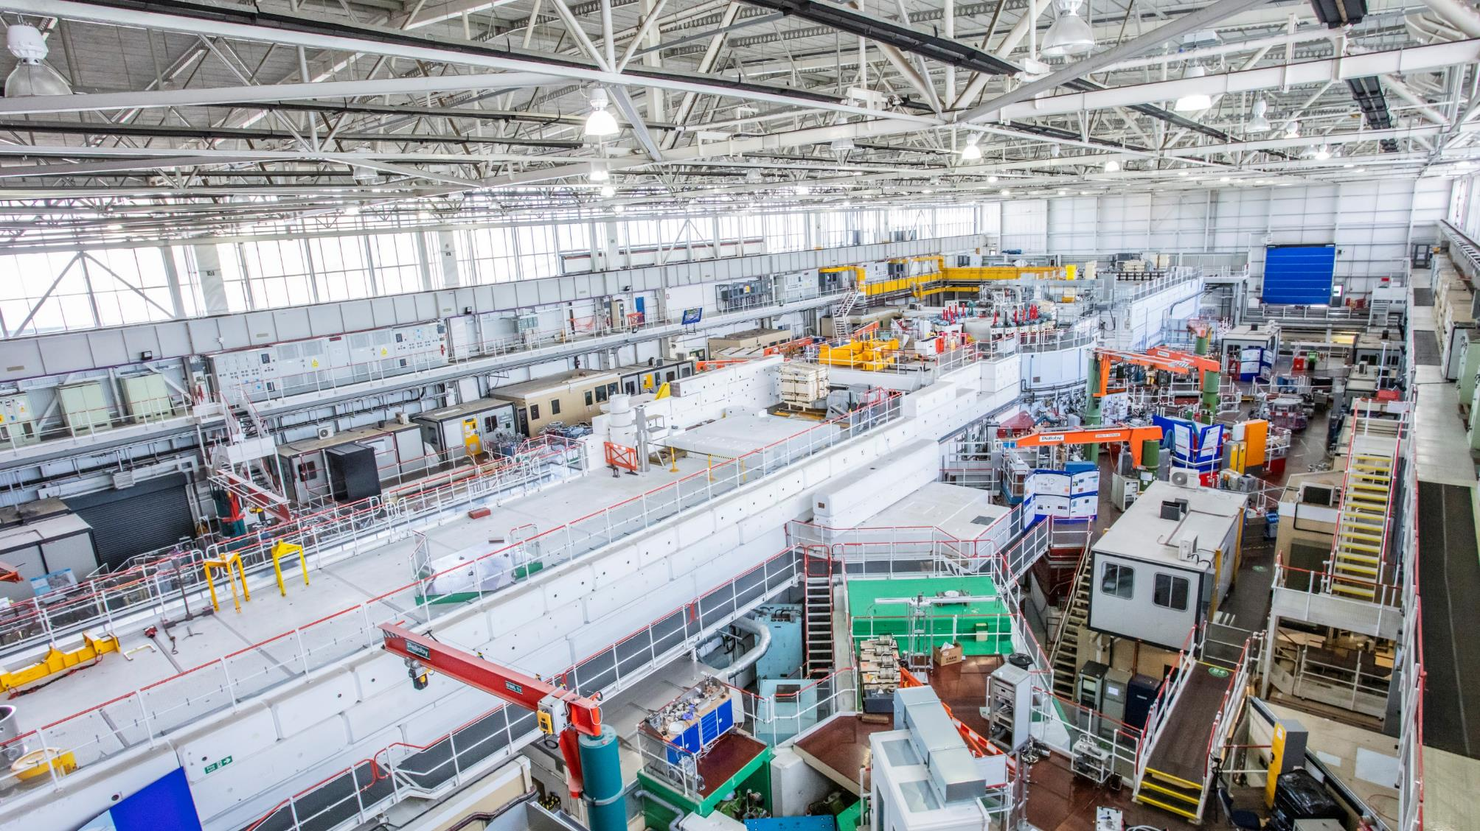
ISIS Target Station 1

Slide 8
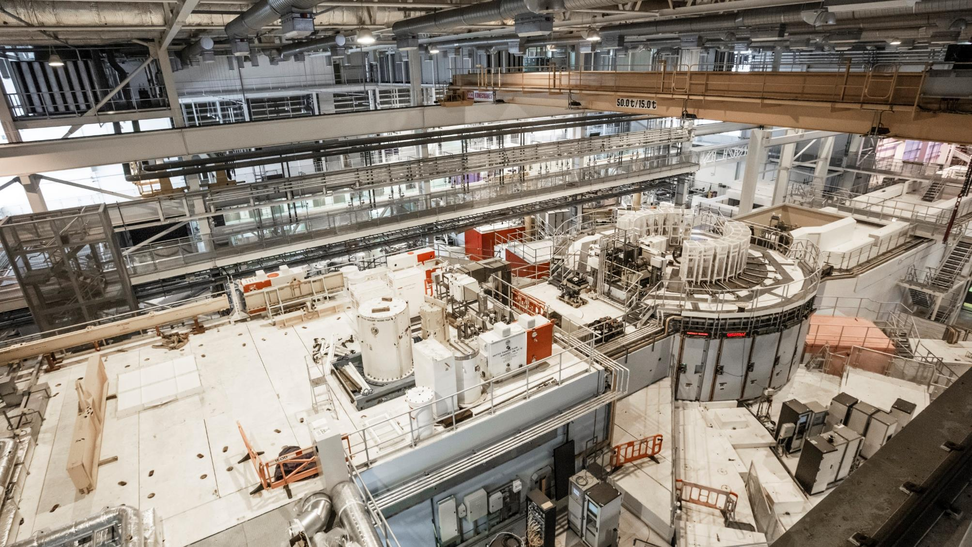
ISIS Target Station 2

Slide 9
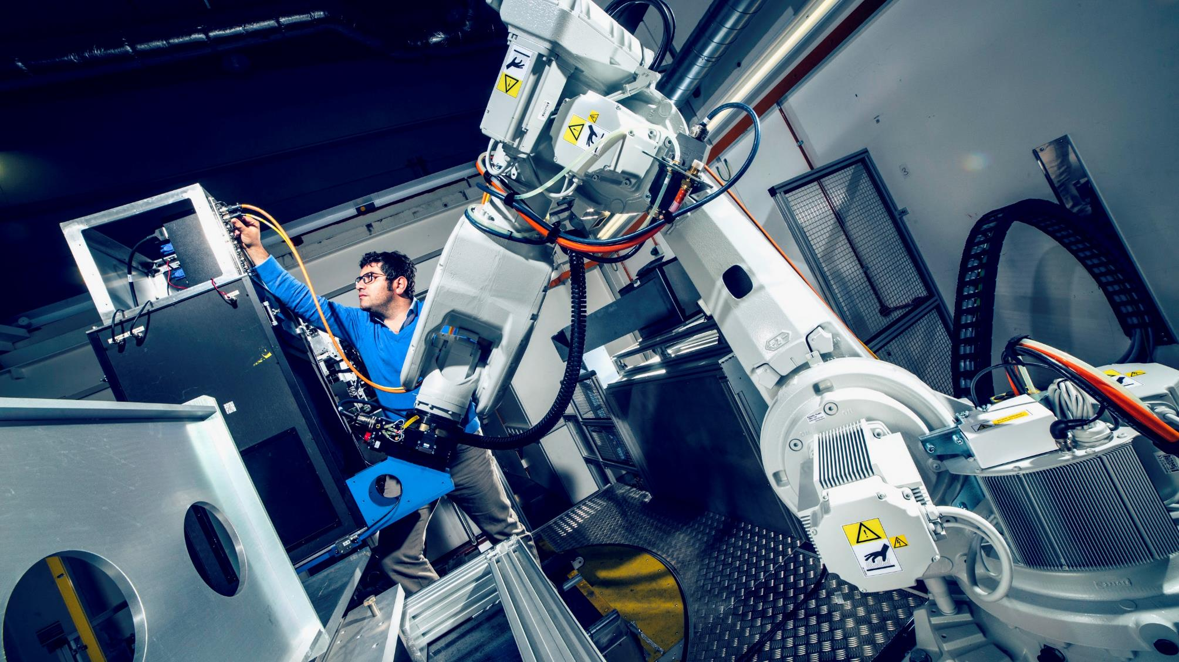
IMAT beamline

Slide 10
Argus beamline

Slide 11

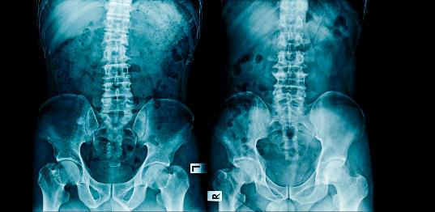

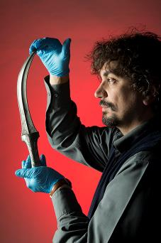





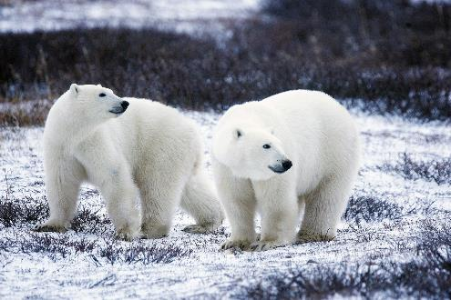
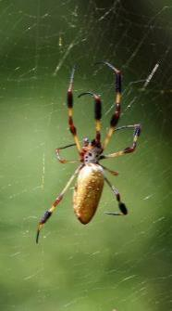



A materials world

Slide 12


Public Engagement is
a key strategic objective
Maximise the impact of our inspirational scientific programme to engage the public in science and technology and encourage the next generation to pursue careers in Science, Technology, Engineering and Mathematics (STEM) subjects.
Notes:
STFC strategic aim. Important in embedding PE within the organization.
STFC PE strategy, Vision: For a society in which all people feel able to engage with STEM, research and innovation

Slide 13

Opportunity to inform and inspire the public
Showcase STEM on a scale beyond that experienced at school
Access to large-scale facilities provides a unique experience for visitors
Strengthen our identity in the local community and nationally
Demonstrate diversity of roles and career pathways at a large-scale scientific facility
Demonstrate the impact and value of our science and technology

Slide 14








Welcoming
Large groups of general public
Access to large-scale facilities provides a unique experience for visitors
Different needs
Safe
Accessible
Including children
Without disruption to our operations
Notes:
How do we take a large-scale working laboratory and turn it into a welcoming, accessible and safe space for thousands of public visitors, including children, every year without disruption to our operations?
Communicating across borders theme – communicating across operational barriers

Slide 15
ISIS Public Engagement Programme
Review
Consolidate
Framework
Reviewed our existing activities
What we were doing
    Resourcing
    Feedback
    Research
Created cohesive programme of activities and events
Diverse offering, spanning a range of age groups and themes
Standard tour routes for public and secondary school children (ages 11+).
Workshops and shows for primary school children (ages <11).
Standard offering for work experience (1-2 week placements).
Risk assessed with documentation!
Collaboration with H&S, Operations, Radiation Protection, RAL Public Engagement
Notes:
Created ISIS PE programme and established a framework for school and public visits

Slide 16
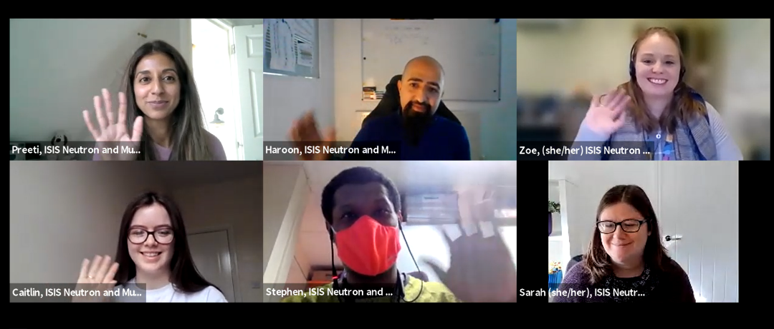


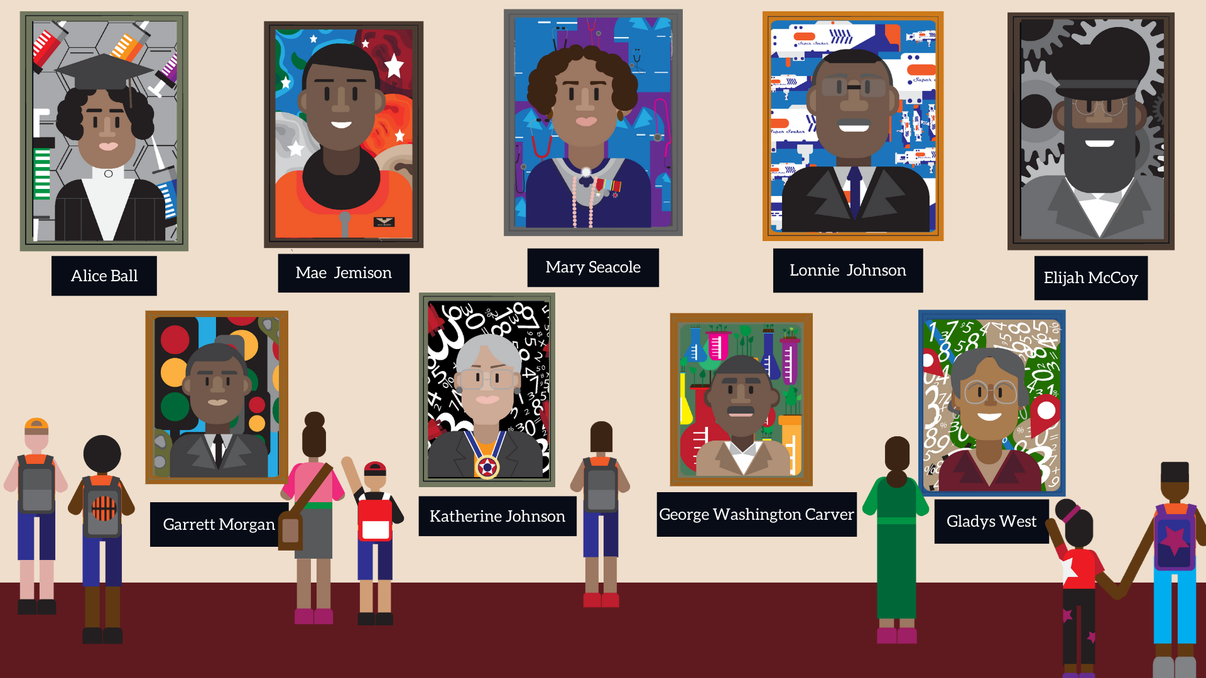
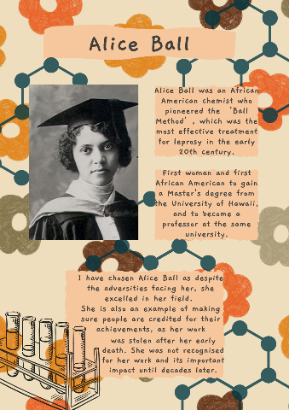
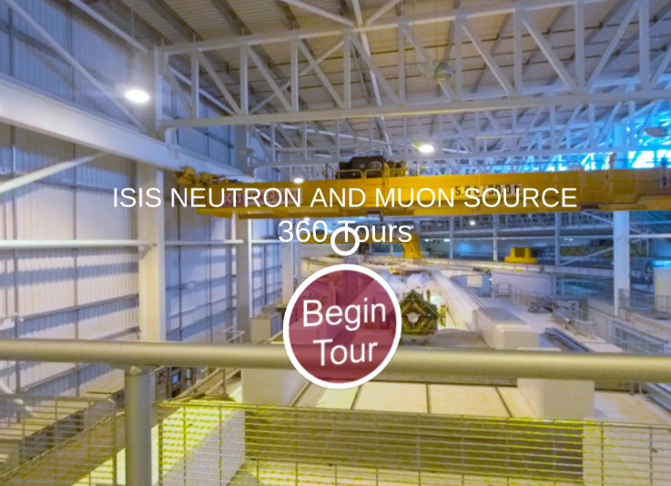
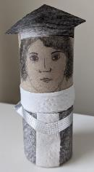
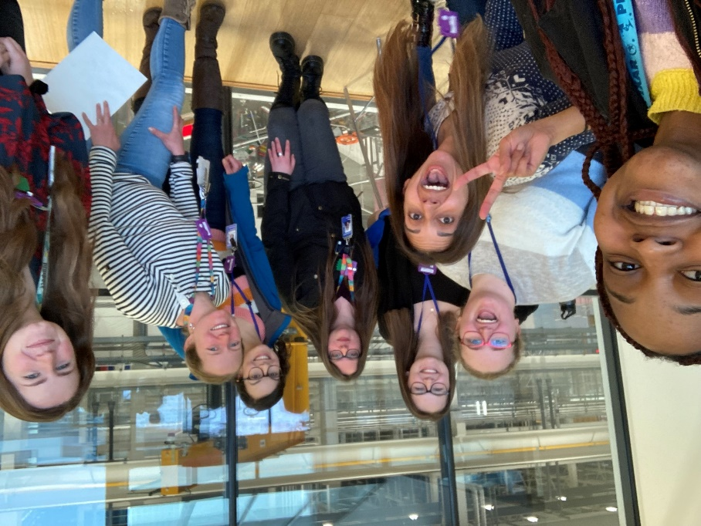
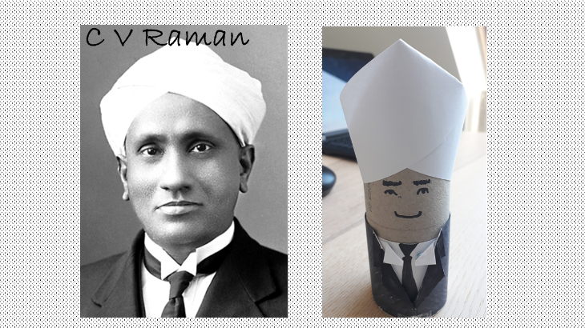
ISIS Public Engagement Programme
Embedding EDI
Accessible tour routes
Virtual tours
Online workshops
Targeting under-represented audiences
Diverse role models
Diverse career pathways
Celebrating diversity in STEM
Black Pioneers in STEM
Notes:
All activities looked at through a lens of improving equity of access.
Opportunity to build science capital and strengthen science identity.

Slide 17
ISIS Public Engagement Strategy
To promote our world-class facility, research and expertise so ISIS is recognized and valued nationally and internationally for its scientific and technical work, for the benefit of ISIS, the wider organisation and the UK.
Schools
Public
Institution
Encouraging school students to pursue STEM subjects and careers
Strengthening our identity, and demonstrating the impact and value of our science and technology
Engaged institution.
Offering training and support.
Recognising contributions and celebrating successes!

Slide 18
Staff development
and capacity building!
Training
Skills
Recognition
STEM Ambassador
Safeguarding
Tour Guide Training
Activity Training
Shadowing opportunities
Communication
Presentation
Interpersonal skills
Active listening
Thinking on your feet
Awards and rewards
Appraisals
Staff talks and newsletters
Feedback

Slide 19
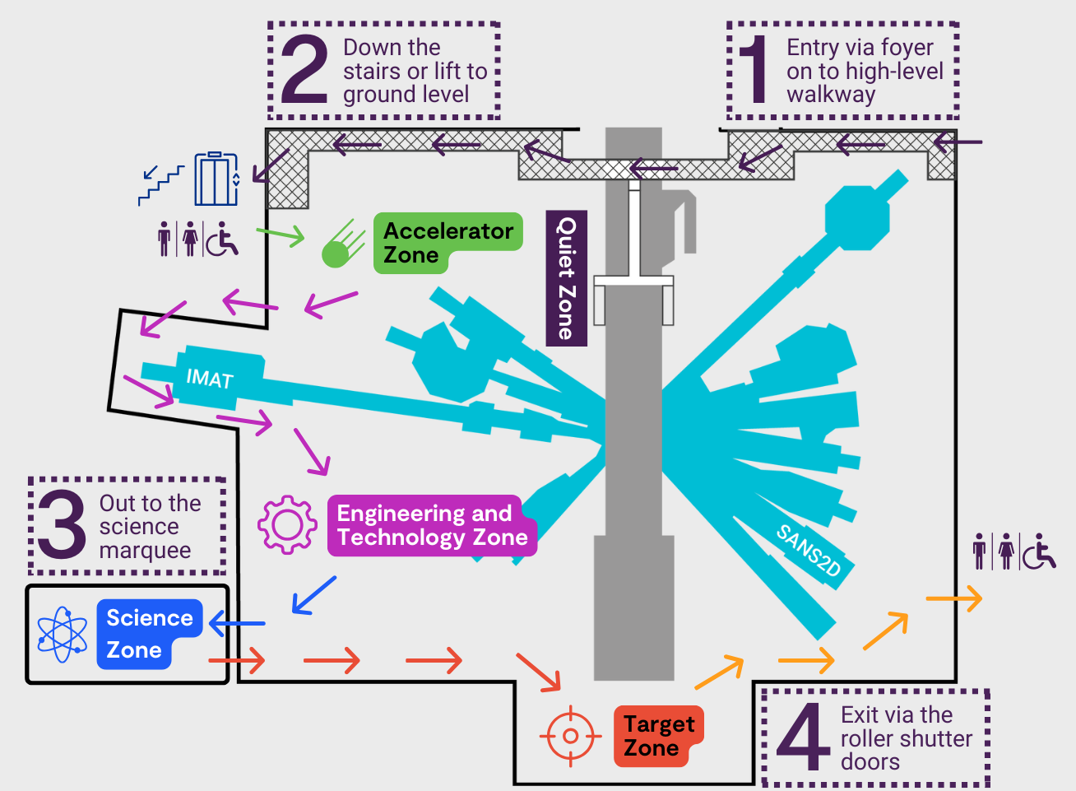
Campus Open Week June 2024
Self-guided accessible tour route through our experimental hall and science marquee
Sharing our work
Encouraging science for all
Engaging underserved communities
Fostering staff pride and wellbeing
Notes:
Foundation in place to turn experimental hall into exhibition hall.
Embedded principles: safety, accessibility and inclusivity, sustainability, skills, evaluation.

Slide 20
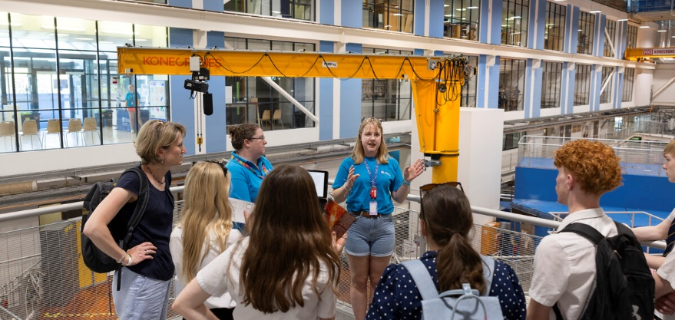
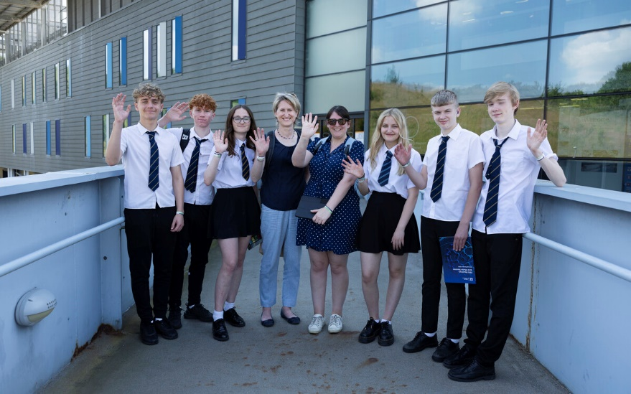
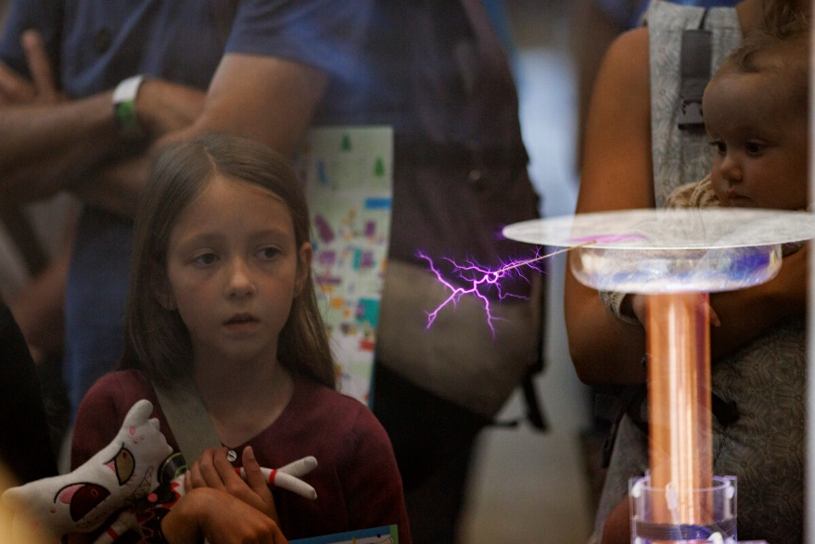
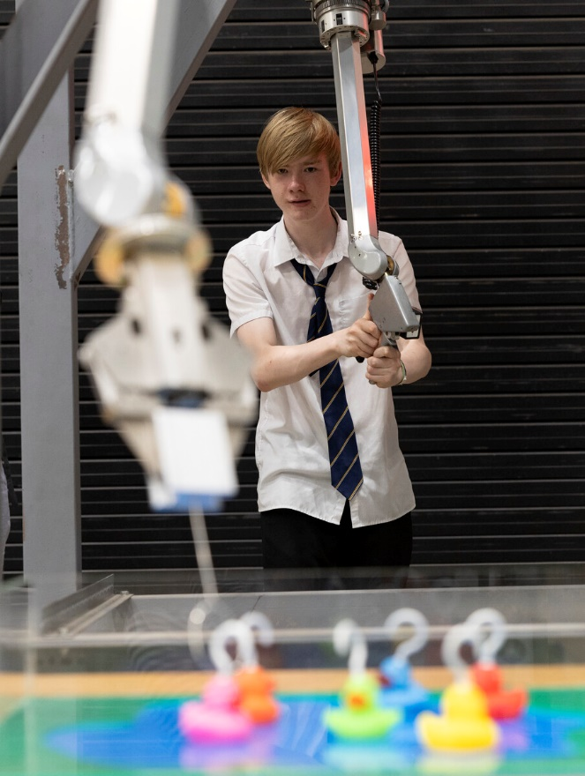
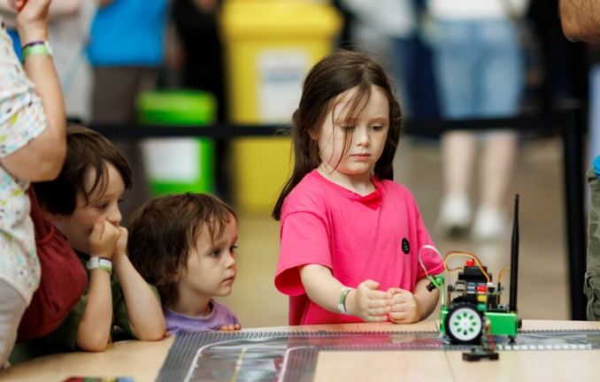
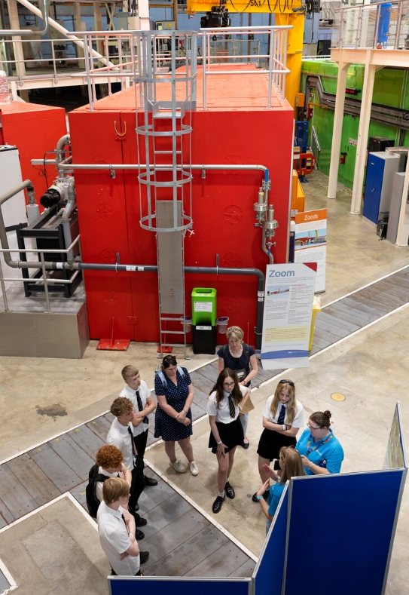
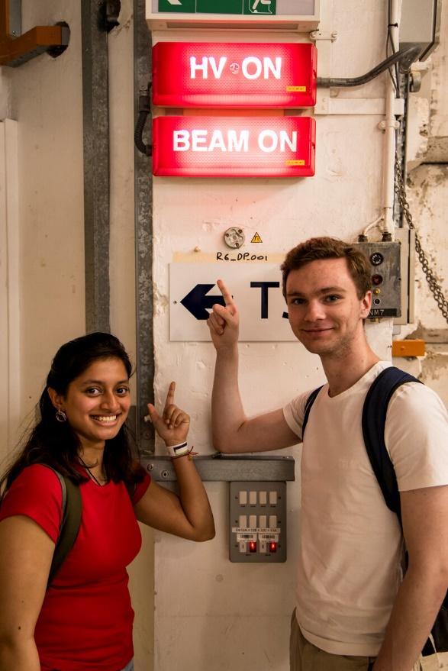
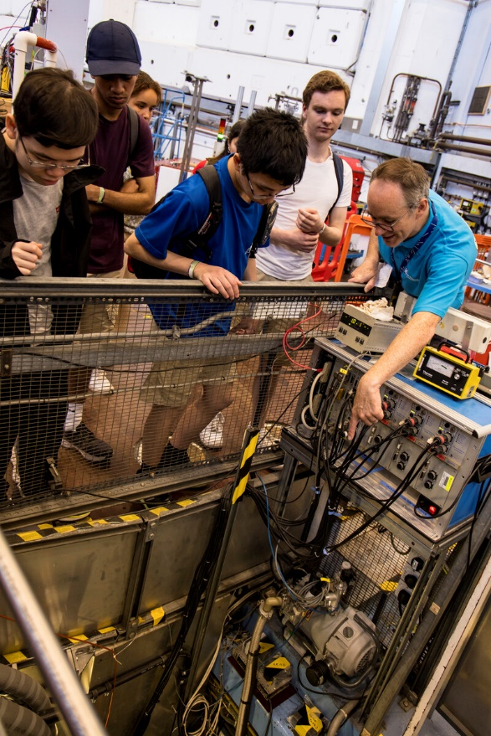
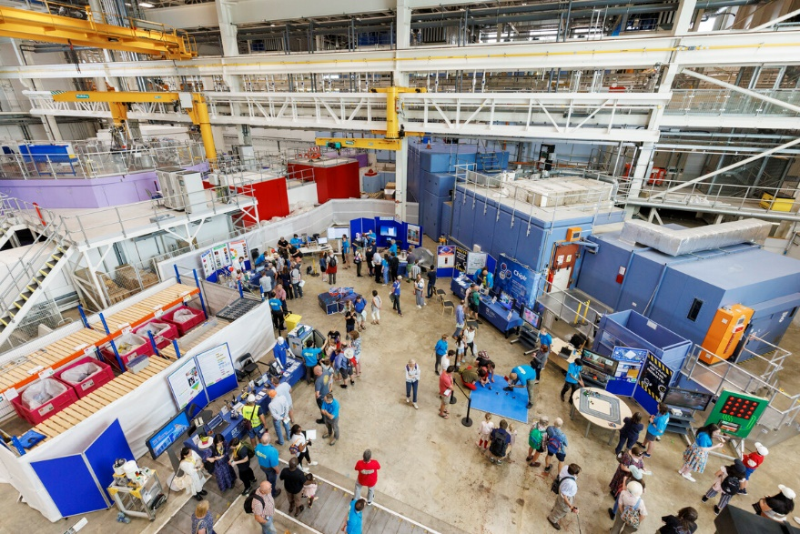
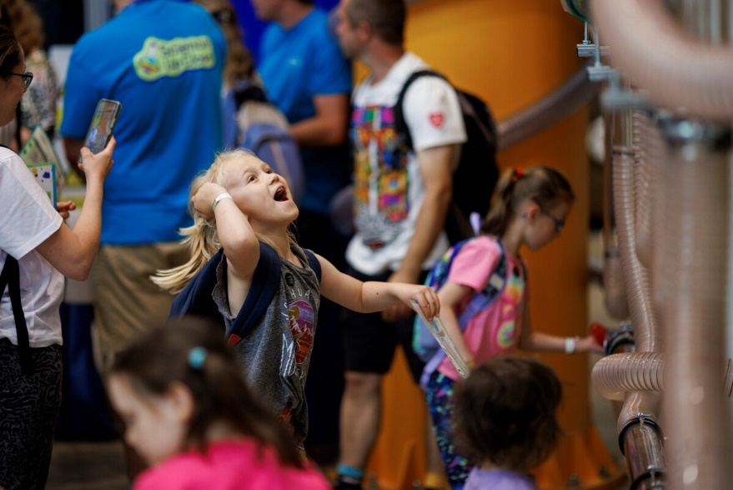
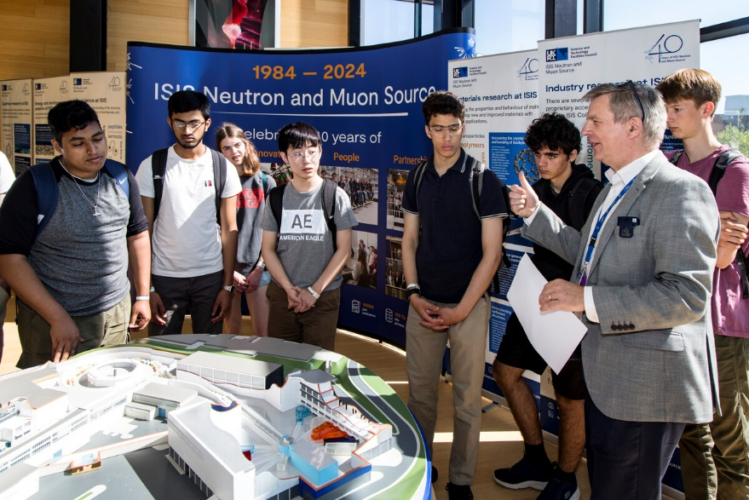
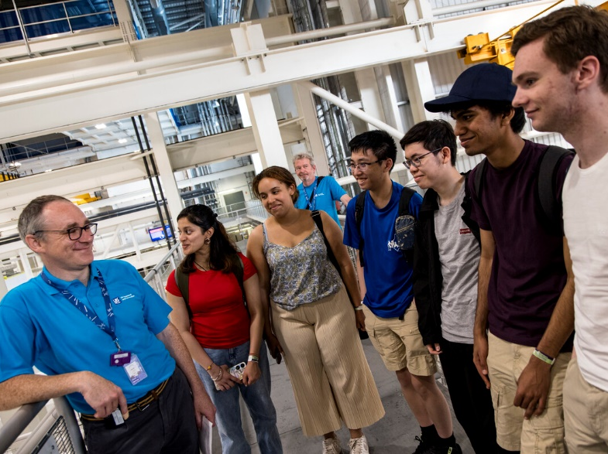
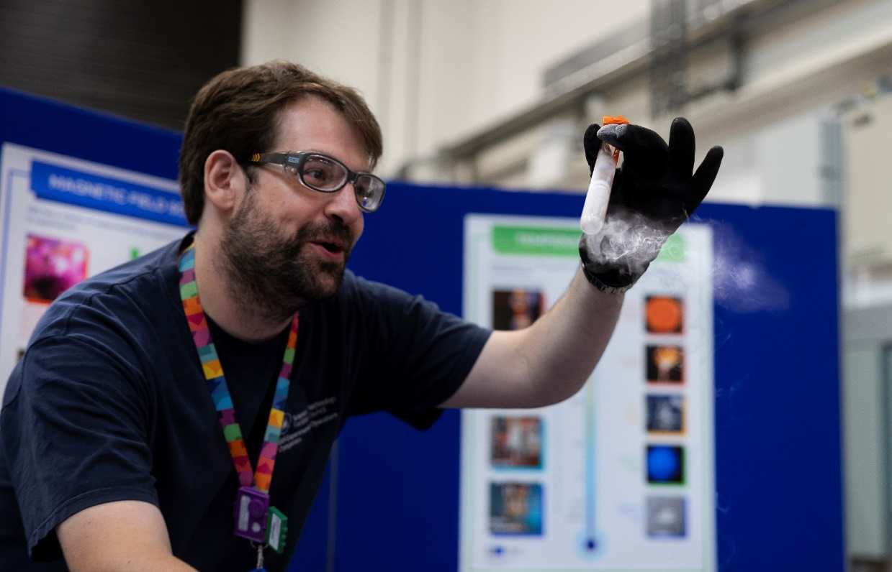
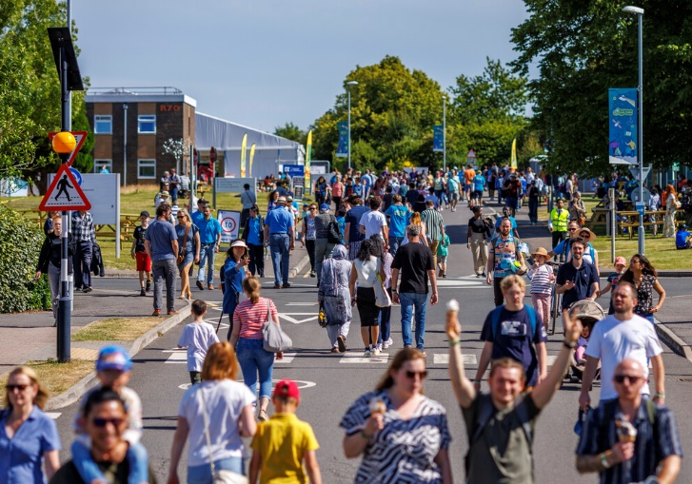
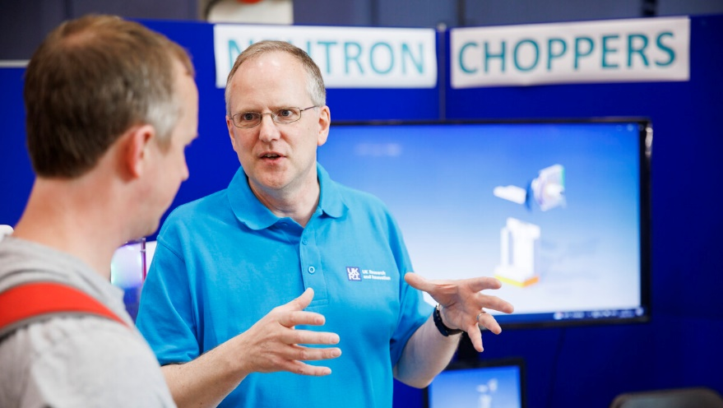
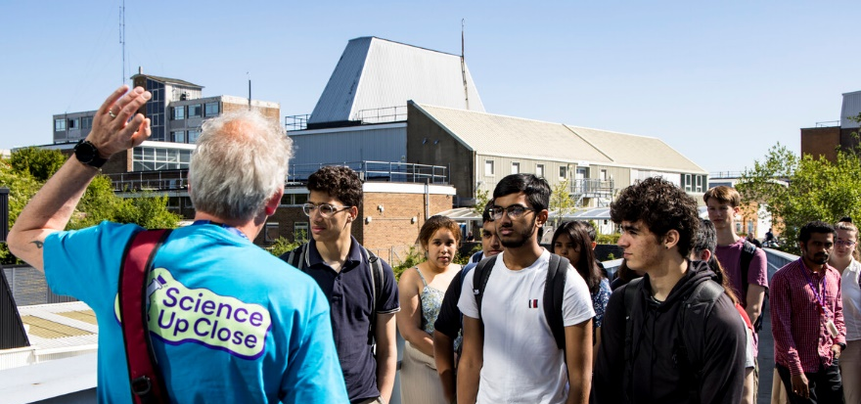
Campus Open Week June 2024
3700 visitors

Slide 21
Campus Open Week June 2024
Tours

Slide 22
Campus Open Week June 2024
Displays

Slide 23
Campus Open Week June 2024
Demos and shows

Slide 24
Campus Open Week June 2024
Hands-on activities

Slide 25
Campus Open Week June 2024
Meet our staff and hear their stories

Slide 26
Campus Open Week June 2024
93% public visitors left with greater understanding of our scientific activities
86% students felt they could work in science
92% staff felt a sense of pride in where they work
ISIS was epic. I never ever saw a synchrotron before…
ISIS was fantastic. The staff were brilliant. I learned so much about how it is used and for what purpose. Really impressed.
Didn’t realise there was such an amazing wide science facility so near to us!
I loved ISIS.
Interactive displays, especially at ISIS. Knowledgeable and helpful staff.
Particularly enjoyed visiting Isis. I know about the technology but visiting such a large scale facility and seeing it for myself is something completely different.

Slide 27
Summary
Collective endeavour
Culture of engagement
Framework
H&S teams
Operations team
Comms, other support staff
Scientists, engineers, other technical staff
PE teams
Strategy
High-level support
Staff training
Recognition
Diverse activities
Embed EDI
Supporting documentation
Evaluation

Slide 28
Thanks for listening!
Acknowledgements
Maddie Wildridge, ISIS PE student
Chris Frost
Philip King
All previous ISIS PE students!
RAL Public Engagement
ISIS Operations
ISIS H&S and Health Physics Team
RPAs
All our volunteers!

