Slide 1
How to survive from a website upgrade Ana Belén Martínez, ALBA Synchrotron, Barcelona (Spain)

Slide 2
The ALBA Synchrotron
A large research infrastructure in Spain, aimed at generating synchrotron light.
2,500 users come to our facility every year to analyse the inner details of matter in a wide variety of fields.
A complex of electron accelerators 3GeV
11 operational beamlines and 3 under construction / in commissioning. Joint-electron microscopy center with 3 microscopes
A public consortium funded in equal parts by the Spanish and Catalan governments.

Slide 3
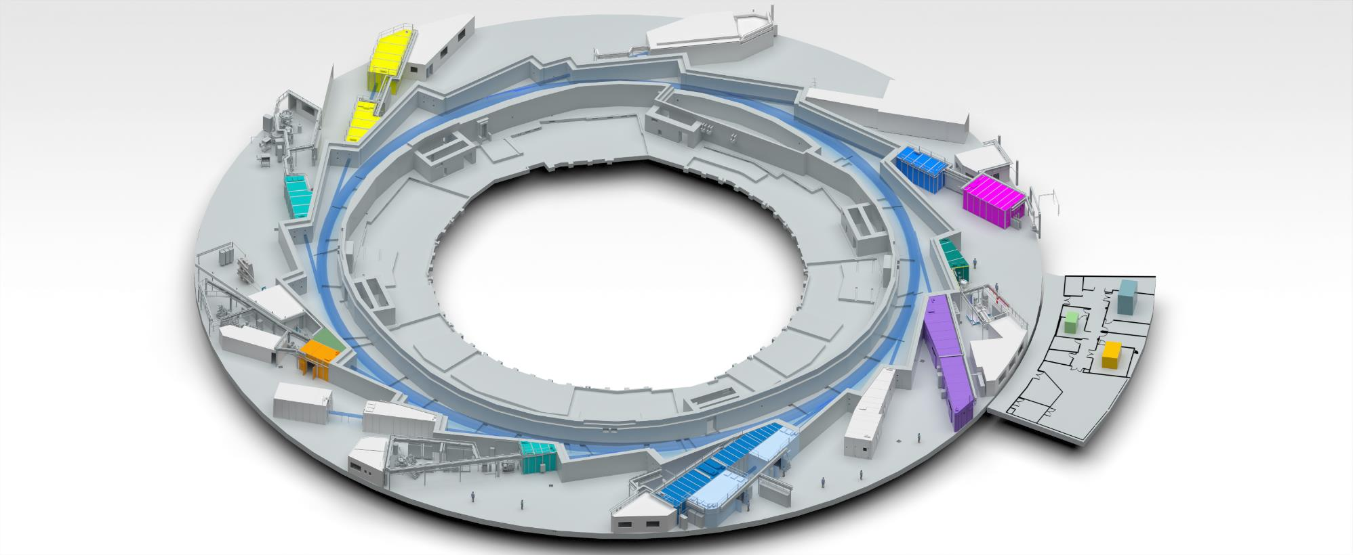
ALBA’s analytical instruments
Instruments for life science
Instruments for material science
FAXTOR
MIRAS
Instruments for metrology
MSPD
BOREAS
XAIRA
MINERVA
MISTRAL
CIRCE
Cryo-EM
METCAM
CLAESS
XALOC
NCD-SWEET
LOREA
NOTOS
3SBAR

Slide 4
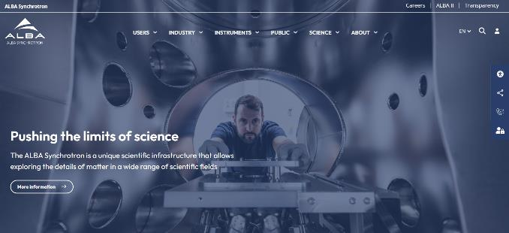
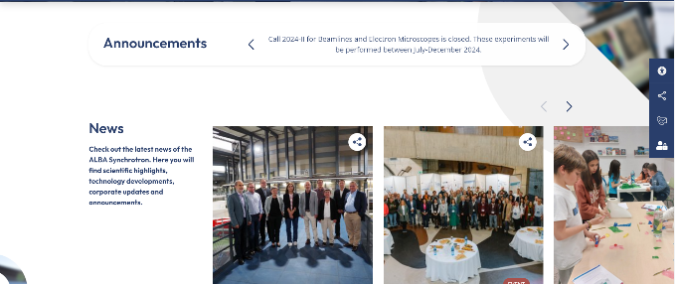
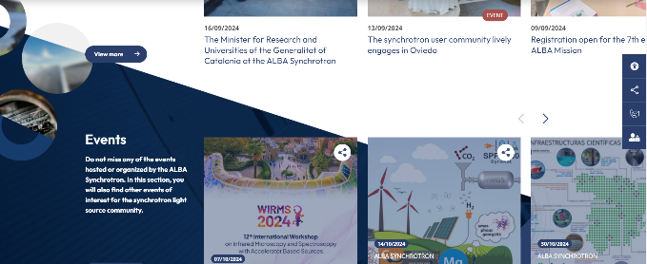
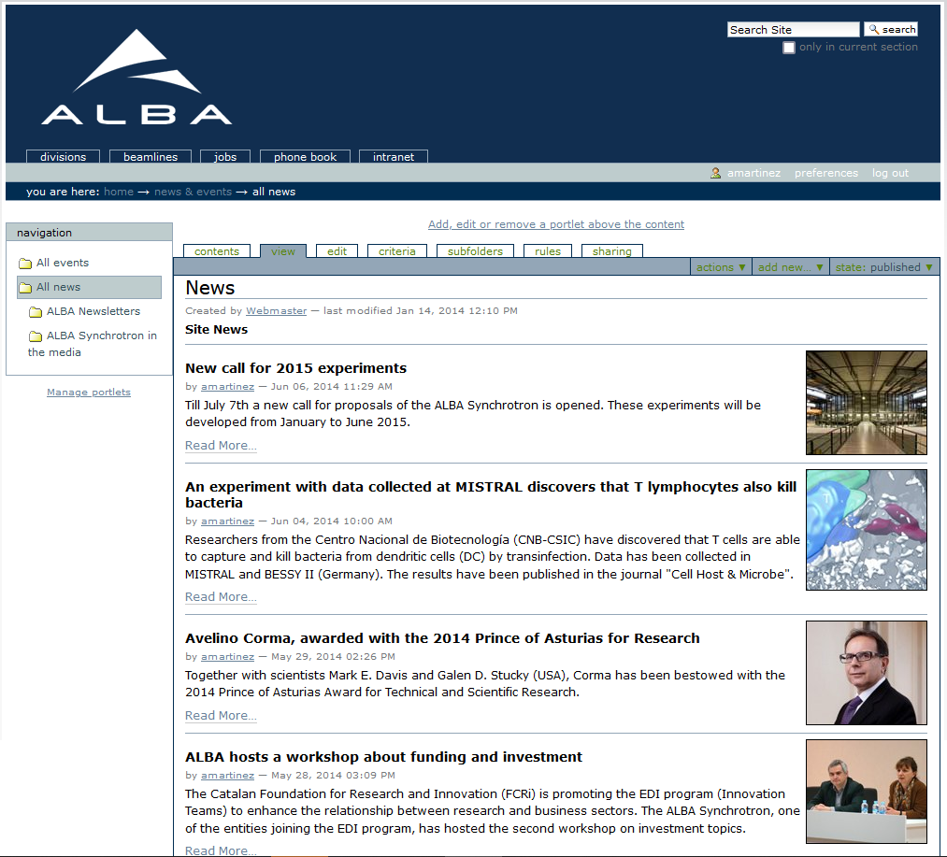
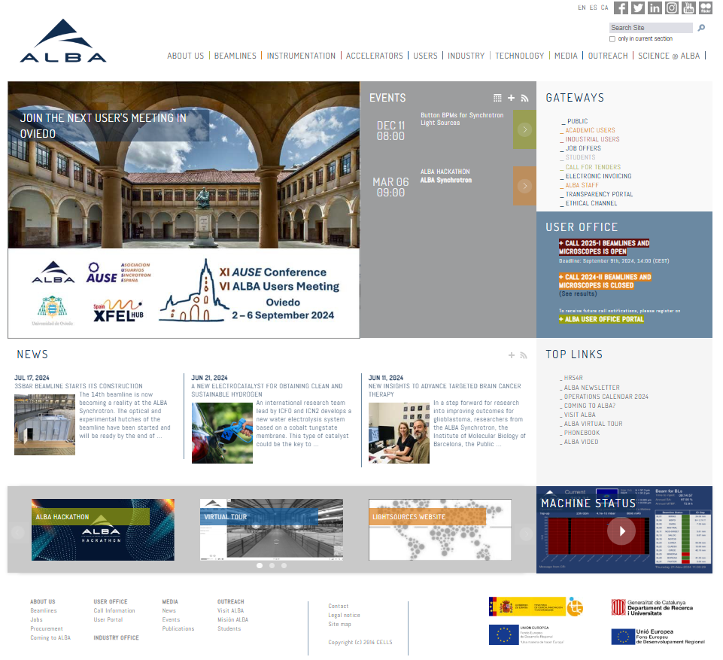
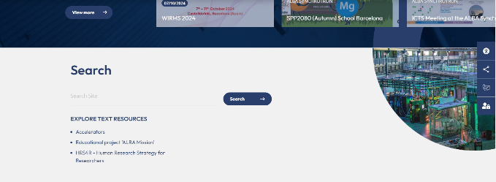
ALBA’s website
3 websites in 20 years - All in Plone CMS
High impact and use: 9,000 objects, 9 GB data, 100 editors
Content management relies on Communications & Outreach office
Software development and maintenance relies on Computing
2024
2004
2014

Slide 5
The importance of a website
© LUCY DANZIGER / domino.com, © FRANCESCO LAGNESE / domino.com
Notes:
Like a home, idea from CREAF
-Needs maintenance
-Organised is helpful and comfortable
-Talks about you

Slide 6
The requirements for new website
Review the hierarchy of contents and orientate them to website users
Update contents and renovate the image and look & feel
Save time and offer more robustness for editors
Integrate internal tools like Single Sign-On (SSO) through CAS, User Office data (publications, users’ visits, etc.), Jobs Portal, Call for Tenders
Improve the adaptability to different platforms
Increase accessibility

Slide 7
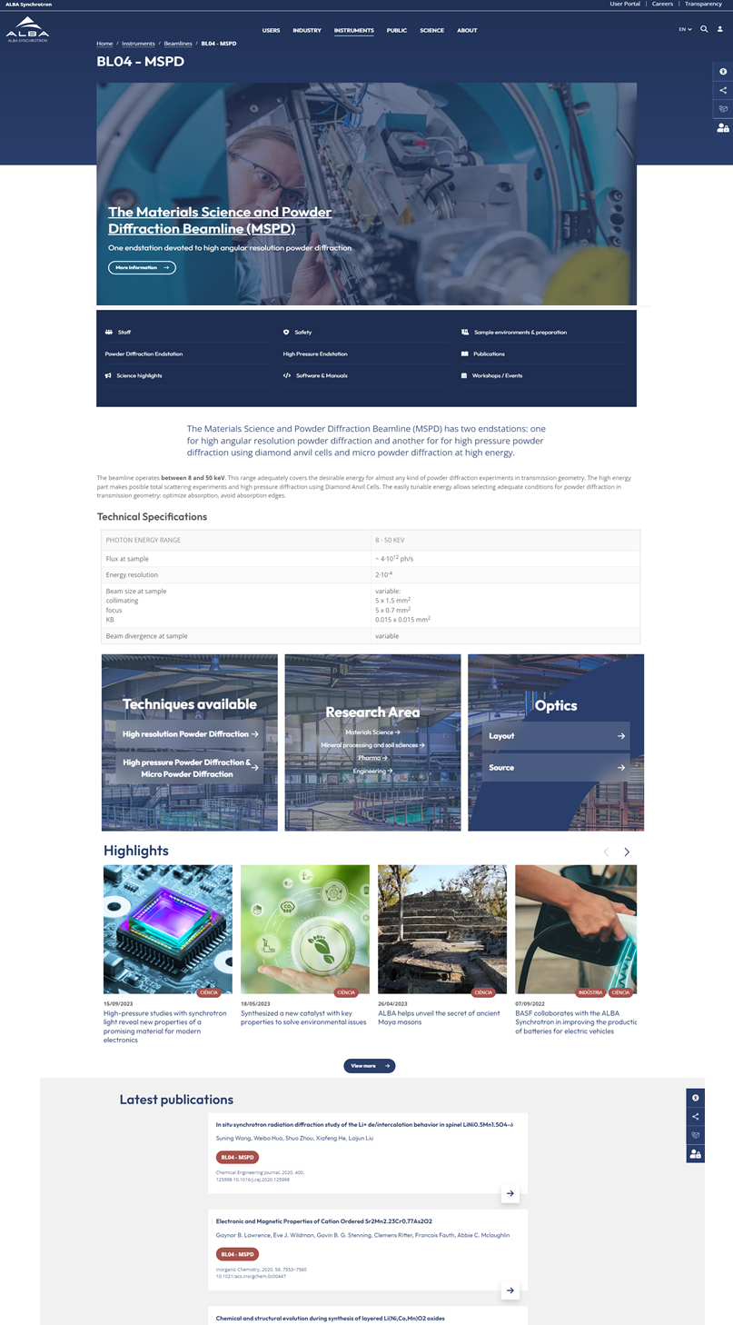
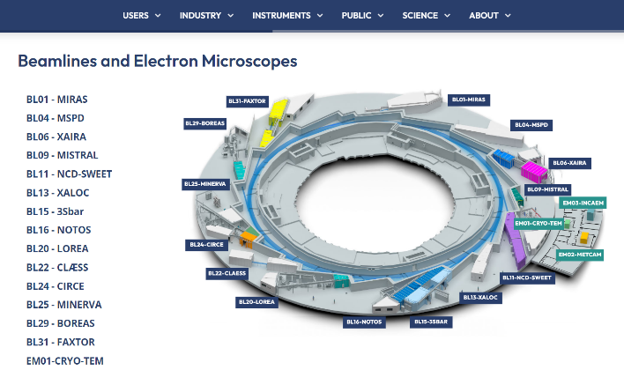
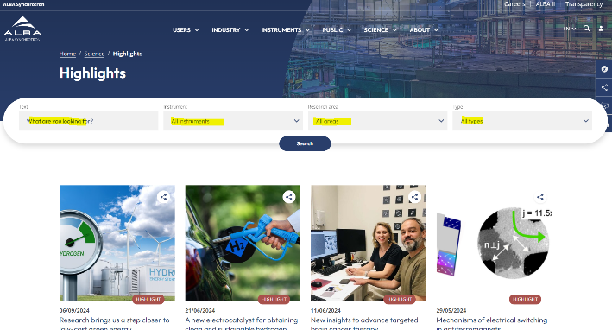
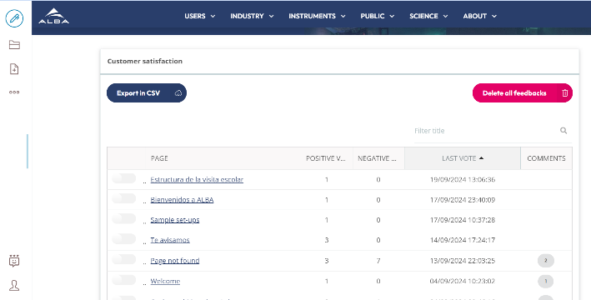
The new ALBA website
Modern aspect, high-impact images
Related content (instruments, news, events categorizations) for better search and information filters
Fully responsive and prepared for being accessible (WCAG) 2.1
Internal tools to improve editors’ work: automatic translation plugin, users’ satisfaction channel, massive upload of documents

Slide 8
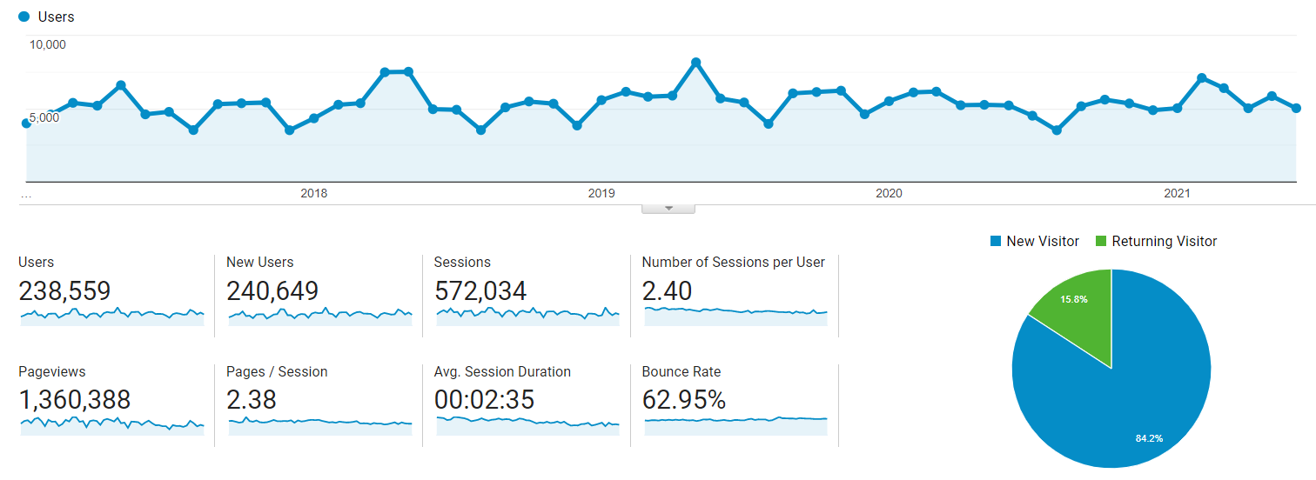
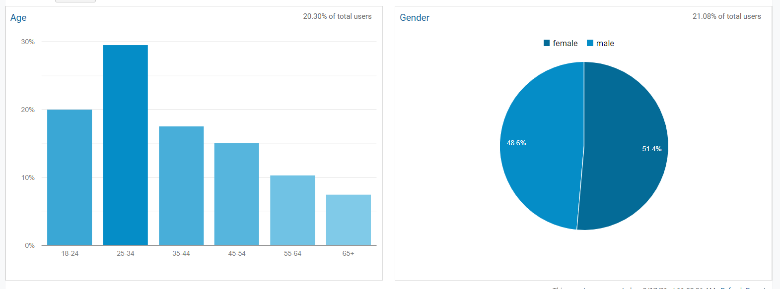
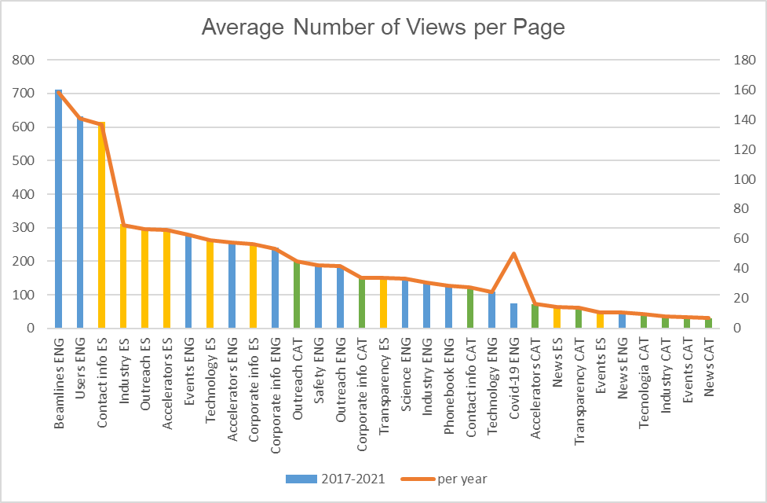
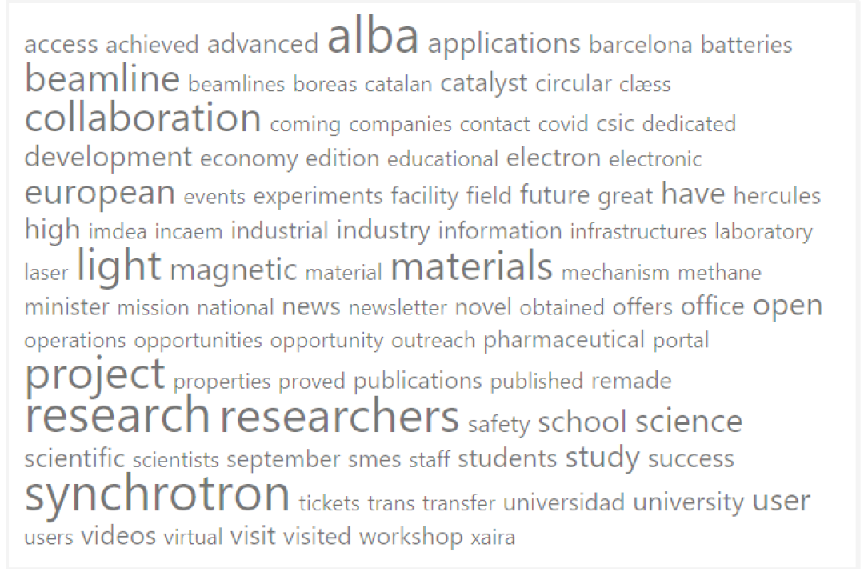
1 Analyse your website ‘What do your users want?’
Detailed Google Analytics review
Most popular contents in social media
Talk to key users - Focus group
How content is written in your website. SEO Site Checkup

Slide 9
2 Choose the right technology and the right partner
Content Management System (CMS) is Plone
From Plone 4 to Plone 6.0.8 + Volto for Front End development
Reasons to keep using Plone
Experience of the technical team
Robustness and security
Small company from Lleida (Catalonia), specialized in Plone CMS and with deep knowledge on public institutions websites and open data portals.
Budget: 38k€ for design and CMS development

Slide 10
3 Involve the key members in your organisation
Analysis & Benchmarking
Content architecture
Re-writing contents and selecting imports
Contents’ validation
Web Release
Renovating photographs portfolio
Management Board should be enrolled in the project
Listen to Users and Editors
Kick off meeting – May 2023
September 2024

Slide 11
4 Keep calendar tight Dedicate a team and prioritise the website
15 months’ project

Slide 12
5 Training is a must
Multiple editors but only one validation channel (Comms & Outreach Office)
Editors have limited permissions to add or modify content on specific pages.
Training to editors done at the end of September. Guidelines available.

Slide 13
amartinez@cells.es

