Slide 1
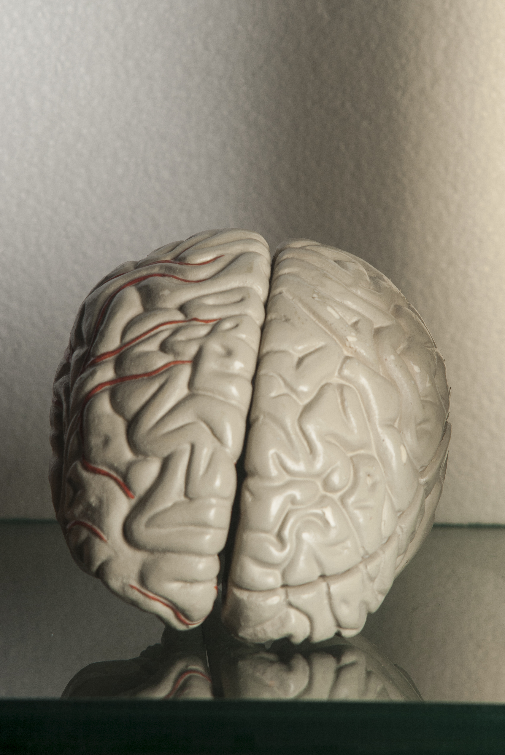
Talk to the Body:
Science-backed communication strategies that use sensory input to improve learning outcomes
Help! I feel
under stimulated…
Heidi Forssell LaGrasta
Heidi.lagrasta@maxiv.lu.se
This Photo is licensed under CC BY-SA
Notes:
Who am I?
Outreach officer, but also: event coordinator, teacher, improv troupe member, parent. I have seen that movement helps learning outcomes.
It makes sense- would a hunter gather learn how to hunt by sitting and learning about spears and mammoths?
Start with 8 count shakedown
Start with balloons and nanoparticles

Slide 2

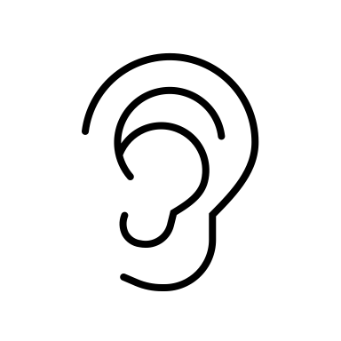


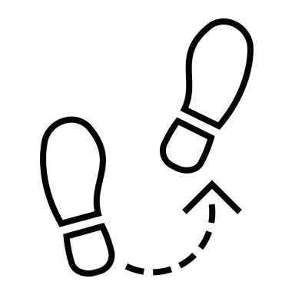

Why Talk to the Body?
Communication techniques that engage with the body are scientifically shown to significantly improve focus, memory, processing speed and executive function in your audience.
Notes:
Easy example: Mirroring clap
We all want our communication to matter. For our audience to pay attention. To remember what we said. We want to make an impact. Yet far too often we treat our audience like floating brains, despite the fact that there is strong evidence that motor movement and cognitive development are linked. It makes sense. Our brains are trapped in our bodies.
Today I will give you some techniques and ways to make small changes in the way we communicate with our audiences can make a big difference in how well they retain the info.

Slide 3
Studies chosen:
Buchele Harris H, Cortina KS, Templin T, Colabianchi N, Chen W. Impact of coordinated-bilateral physical activities on attention and concentration in school-aged children. Biomed Res Int. 2018;2018:2539748. doi:10.1155/2018/2539748. PMID: 29998131; PMCID: PMC5994583.
Heath M, Shukla D. A single bout of aerobic exercise provides an immediate “boost” to cognitive flexibility. Brain Sci. 2019;9(4):87. doi:10.3390/brainsci9040087. PMID: 31003491; PMCID: PMC6523402.
Jha RT, Price S. Embodying science: the role of the body in supporting young children’s meaning making. International Journal of Science Education. 2022;44(10):1659-1679. doi:10.1080/09500693.2022.2089366.
Loprinzi PD, Blough J, Crawford L, Ryu S, Zou L, Li H. The temporal effects of acute exercise on episodic memory function: systematic review with meta-analysis. Brain Sci. 2019;9(4):87. doi:10.3390/brainsci9040087. PMID: 31003491; PMCID: PMC6523402.
Roig M, Nordbrandt S, Geertsen SS, Nielsen JB. The effects of cardiovascular exercise on human memory: a review with meta-analysis. Neurosci Biobehav Rev. 2013;37(8):1645-1666. doi:10.1016/j.neubiorev.2013.06.012.
Shams L, Seitz AR. Benefits of multisensory learning. Trends in Cognitive Sciences. 2008;12(11):411-417. doi:10.1016/j.tics.2008.07.006.
Smyrnis E, Ginns P. Does a drama-inspired ‘mirroring’ exercise enhance mathematical learning? The Educational and Developmental Psychologist. 2016;33(2):178-186. doi:10.1017/edp.2016.17.
Thomas M. The effect of different movement exercises on cognitive and motor abilities. Advances in Physical Education. 2012;2:172-178. doi:10.4236/ape.2012.24030.
Yan J, Wang Y, Chen AG, Ma DJ. Empirical study of the impact of various school-term physical activity of moderate intensity on the executive function of children in their preadolescence. J Sport Sci. 2014.
Zhou Y, Tolmie A. Associations between gross and fine motor skills, physical activity, executive function, and academic achievement: longitudinal findings from the UK Millennium Cohort Study. Brain Sci. 2024;14(2):121. doi:10.3390/brainsci14020121.
Looked at studies across all age ranges
Examined both acute and long-term interventions
Included meta studies
Notes:
Things I noticed as a teacher, as an event planner, as a speaker. Caveats: Some conflicting studies regarding efficacy
In a meta analysis of 50 studies, acute exercise was shown to have a positive effect on short term memory. The effects of cardiovascular exercise on human memory: A review with meta-analysis
Marc Roig ª ^{b} ^{c}, Sasja Nordbrandt ^{b} ^{c}, Svend Sparre Geertsen ^{b} ^{c}, Jens Bo Nielsen ^{b} ^{c}
The brain science and study results show that multisensory learning and movement produce better focus, better attention and better retention
Some studies problematic measurement tools or too small sample sizes. Improves executive function but not always cognitive flexibility

Slide 4
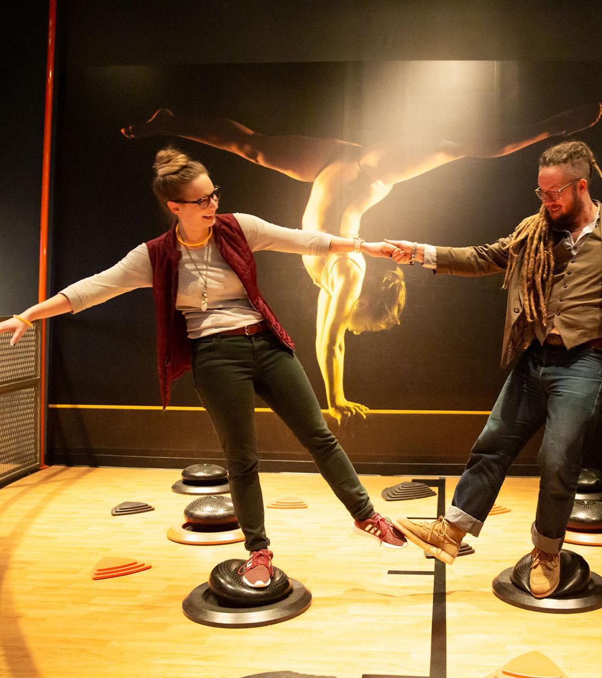
Strategies:
Level 1: Just move!
Level 2: Fine & gross motor movements
Level 3: Multi-modal strategies
Bonus: Online strategies
Notes:
Add breaks and moving around
Reference the body
Use Open skills
Gross motor versus fine motor
Reciprocal movement (mirroring) and behavior matching.
Bisensory learning
Cross meridian bilateral coordination , balancing
Science Museum of minnesota

Slide 5
LEVEL 1: JUsT MOVE!
Add physical movement breaks before and after
acute exercise are effective in enhancing long-term memory function
Notes:
Studied on 21 year olds. Acute (short bursts) but not too aerobic. Lower intensity walking brisk walking pace, as if they were late to class 15 minutes before .
higher-intensity exercise has recently been shown to more favorably influence episodic memory function, enhancing synaptic plasticity in the hippocampus
30 minutes three times a week
Easy example: 8 Count Shake Down
meta-analysis demonstrates that acute exercise occurring during early memory consolidation (d = 0.47, 95% CI: 0.28, 0.67; p < 0.001) and during late memory consolidation (d = 1.05, 95% CI: 0.32, 1.78; p = 0.005) enhanced episodic memory function.
The Temporal Effects of Acute Exercise on Episodic Memory Function: Systematic Review with Meta-Analysis Paul D Loprinzi ^{1,*}, Jeremiah Blough ¹, Lindsay Crawford ¹, Seungho Ryu ¹, Liye Zou ², Hong Li ^{3,4,}

Slide 6
Level 2: Fine & Gross
Motor Movement
Gross motor general cognitive ability
Fine motor working memory improvement
Notes:
Gross motor skills refer to the controlling of large body movements that involve large muscle groups, including core stability and posture e.g. pushing, pulling, rolling, crawling, walking and sitting still. Fine motor skills refer to physical skills that involve small muscles and hand-eye coordination.
Associations between Gross and Fine Motor Skills, Physical Activity, Executive Function, and Academic Achievement: Longitudinal Findings from the UK Millennium Cohort Study
by Yuxi Zhou andAndrew Tolmie
*

Slide 7
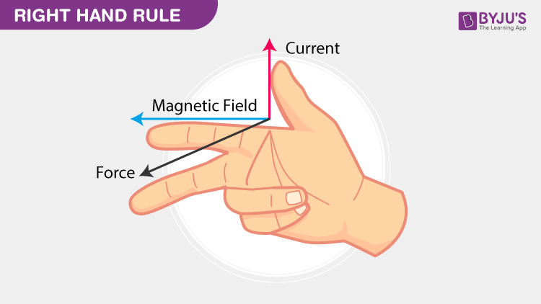
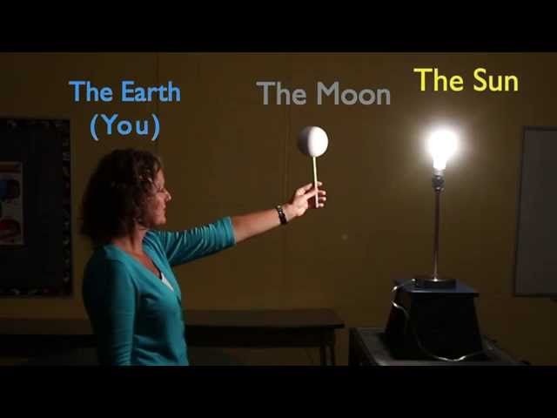
Fine and GROSS Motor Examples
https://www.jpl.nasa.gov/edu/resources/lesson-plan/moon-phases/
https://byjus.com/physics/lorentz-force/
Notes:
Gross motor- big movement. Scale it up!
Fine motor- hand eye coordination
Lorentz force, From the above figure, it is understood that the magnetic force is perpendicular to both the magnetic field and charge velocity.
Doesn’t have to be specific to demonstrating a concept. Also can vote with your feet, stand up if, etc. Can make it sequential (escape rooms)

Slide 8
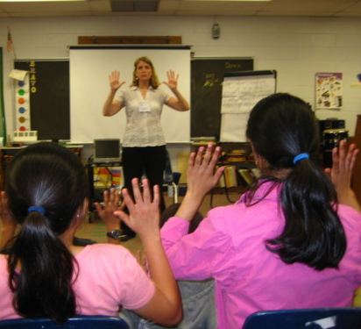
WAYS of MOVING
Open vs. closed helps with cognitive flexibility and executive function
Mirroring improved working memory
Cross meridian improves attention span and concentration
Notes:
1. Use Open skills not closed for executive function benefits. (Open skill refers to the skill of performing motor tasks in an unpredictable environment; closed skill refers to the skill of performing motor tasks in a stable environment. Open would be unpredictable and affected by environment. Open is playing basketball, closed is shooting hoops)
Open skills more valuable than closed skills Open helps with EF, closed helps more with cognitive flexibility. Open may provide more value overall.
Sustained closed skills exercise promotes cerebral neovascularization, increases cerebral blood flow, and activates inhibitory control-related brain areas [69, 70]. However, open skills exercise that combines environmental enrichment, interpersonal interaction, and motor coordination is more likely to promote neurogenesis and synaptic neogenesis, and promote increased activation in brain regions associated with attention control and working memory [17, 69, 71].
2. Mirroring Reciprocal movement (mirroring) and behavior matching. Why do we kiss and shake hands. Coordinating your movement with your audience increases memory. Smyrnis E, Ginns P. Does a Drama-Inspired ‘Mirroring’ Exercise Enhance Mathematical Learning? The Educational and Developmental Psychologist. 2016;33(2):178-186. doi:10.1017/edp.2016.17 showed that it improved working memory
Examples:
. Mirroring clap: The leader held their hands together in front of them as if they were to clap. The follower was instructed to clap at the same time as the leader. Switching from the leader to the follower followed this.
Space counting: First, the experimenter began as the leader and the other as the mirror. The leader drew numbers using his/her index finger from 1 to 9 while the mirroring participant mirrored the leader with their index finger. After this was complete, they swapped roles.
Morning routine: From the previous activity, the experimenter leader improvised their morning routines (i.e., brushing their teeth, eating breakfast, washing their hair, waking up) while the mirroring participant mirrored the image. The experimenter encouraged participants to use their entire body.
Magnifying: The experimenter performed small incremental movement while the mirroring participant magnified that movement. An example could be a small clap by the leader causes the mirroring participant to clap more loudly.
Cross Meridian:
Buchele Harris et al. (2018): This research examined the impact of coordinated-bilateral physical activities on attention and concentration in school-aged children. Activities that involve crossing the midline, such as coordinated-bilateral movements, were found to significantly improve attention span and concentration performance².
Subtypes:
symmetrical coordination
asymmetrical coordination
dominant/non-dominant coordination

Slide 9
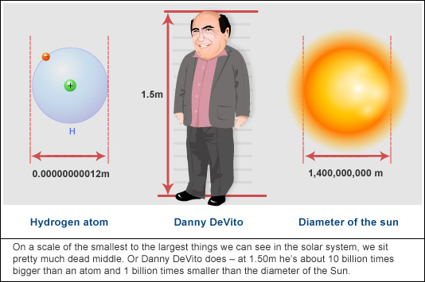
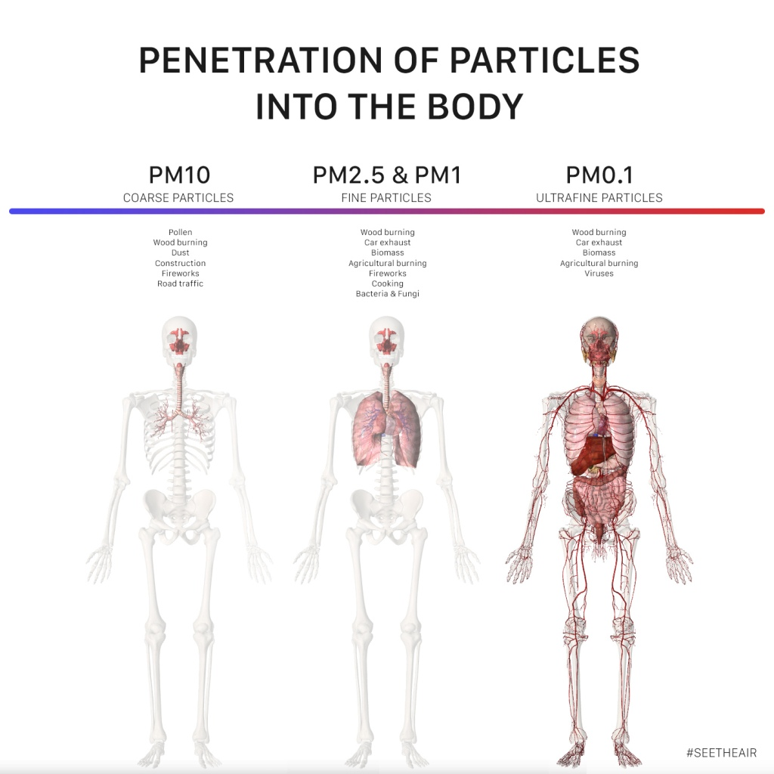
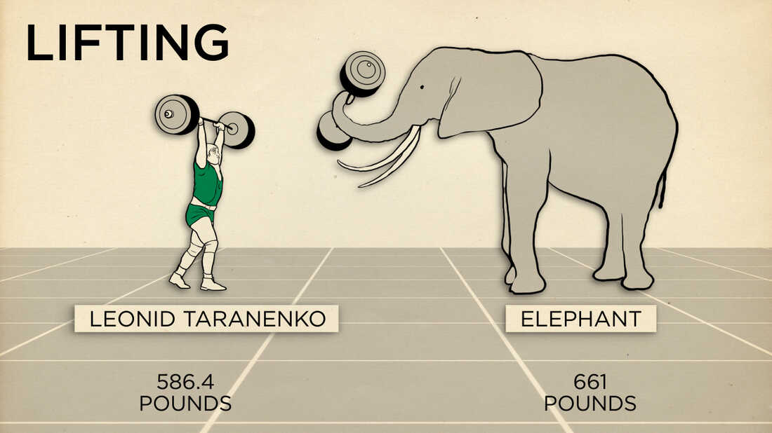
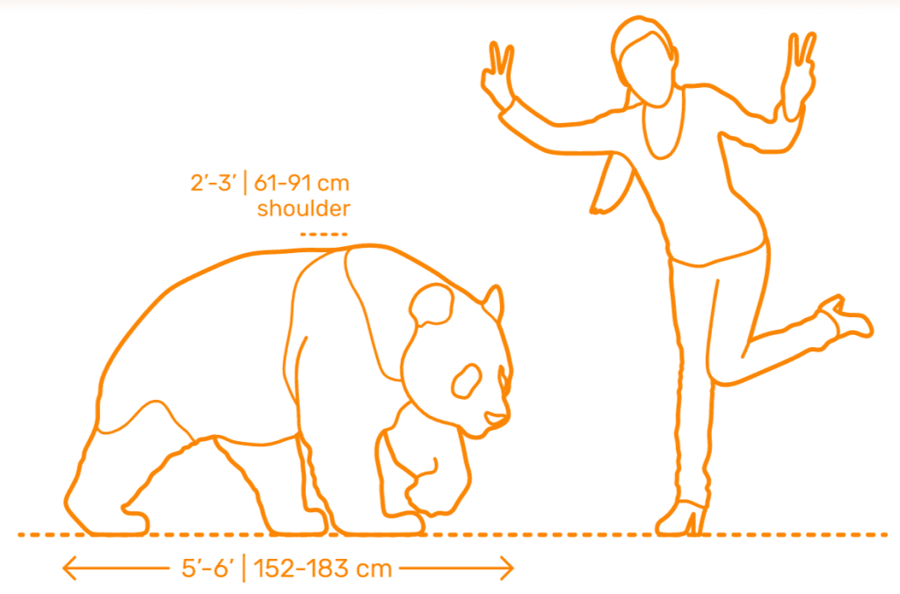
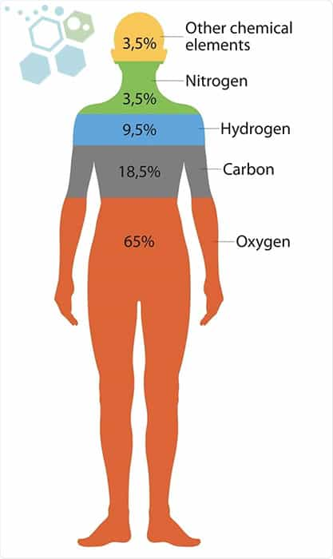
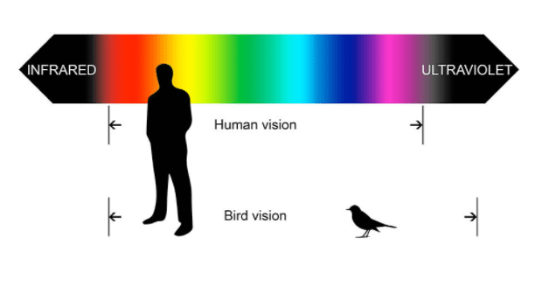
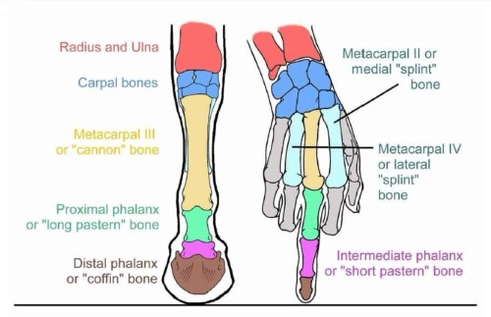
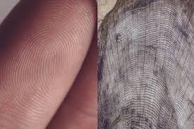
Notes:
https://pandathings.com/learn-about-the-giant-panda/how-big-are-giant-pandas/
https://stemcellthailand.org/common-elements-human-body-composition/
https://seetheair.org/2021/03/01/penetration-of-particles-into-the-human-body/
https://www.abc.net.au/science/articles/2010/03/30/2859247.htm
https://howitsee.com/what-colors-can-birds-see/

Slide 10
Cross meridian subtypes
symmetrical coordination
asymmetrical coordination
dominant/non-dominant coordination
Notes:
crossing the midline increases the myelin coating the nerves across the corpus callosum in the brain and makes accessing information faster (increases cognition)
Symmetrical example
Asymmetrical

Slide 11
Level 3: Multi tasking
Bisensory
Multimodal
Reinforces and improves memory
Notes:
Level 3: Multi-tasking!
Reinforces and improves memory
Bisensory- two or more of the 5 senses
Mutimodal- share the same info in tow different ways Opportunities for cross disciplinary collaborations

Slide 12
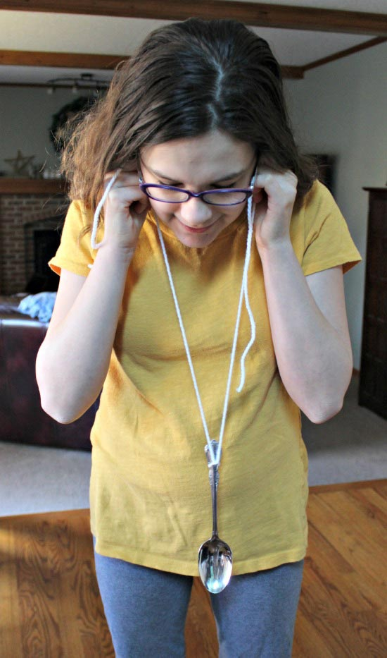
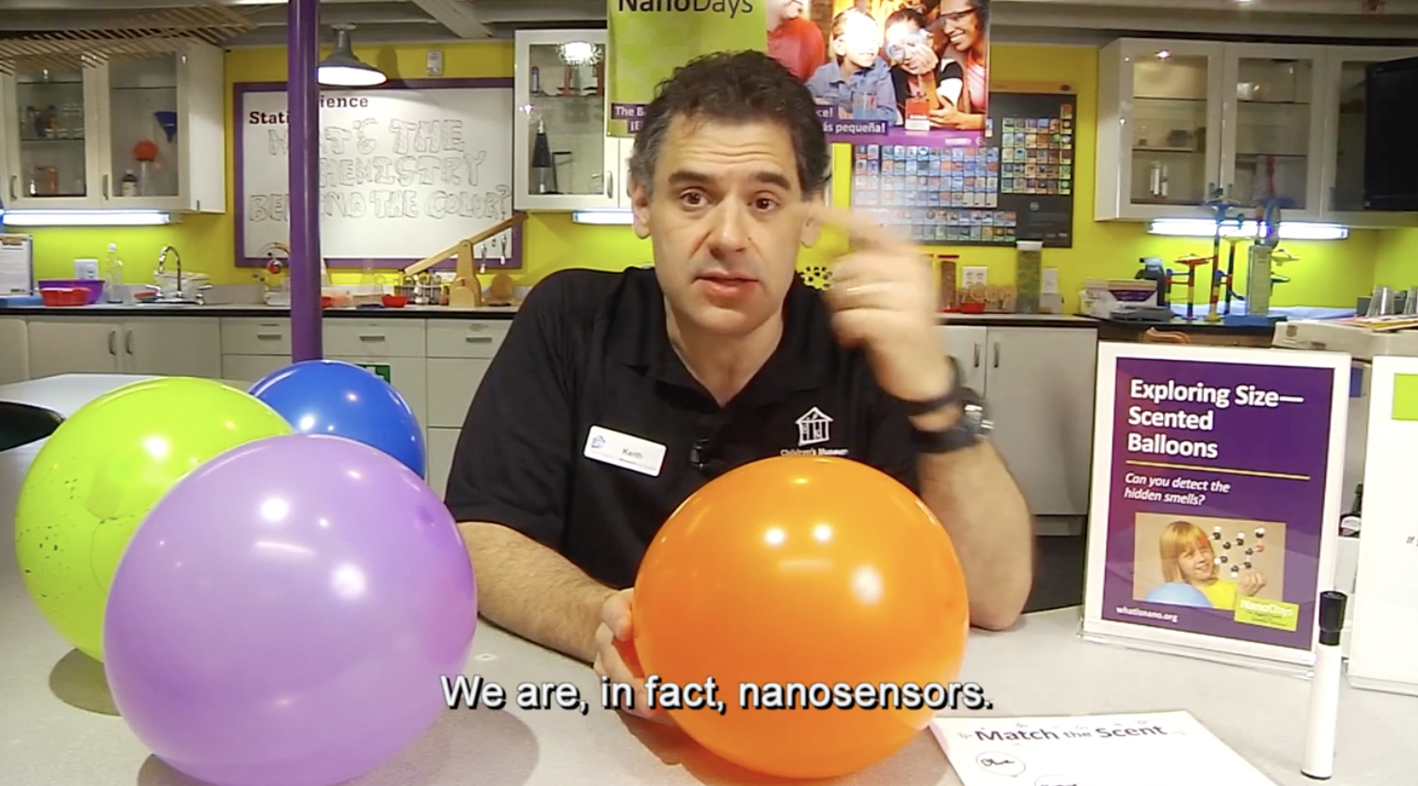
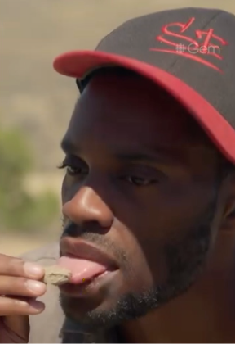
BISENSORY Examples
1. https://www.kcedventures.com/the-science-of-sound-waves-an-awesome-experiment-for-kids/
2. https://www.nisenet.org/catalog/programs/exploring_size_scented_balloons
3. Secrets of the Jurassic Dinosaurs with Anthony Morgan, 2023
Notes:
Taste, touch, sight, sound, smell
Touch-3d printed models of proteins
Taste Eat chalk, lick fossils, feel wind speed
Smell-sort Nanoparticle in balloons
haptic feedback in video games

Slide 13
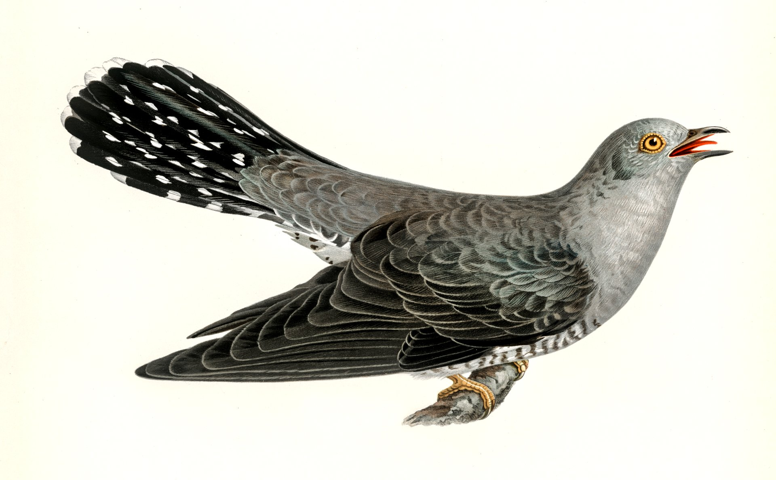

MultiMODAL Example
Notes:
Learn faster, improve concentration and attention
cuculus canorus
Could Incorporate movement too
Spanish teacher using hand motions with accents. i.e. increíble
Shams & Seitz (2008): This study specifically focuses on the benefits of multisensory learning, which is a form of multimodal learning. It highlights how integrating multiple sensory modalities (e.g., visual, auditory) can enhance learning outcomes more effectively than unisensory training. For example, combining auditory and visual stimuli can reduce the number of sessions required to reach learning asymptote by up to 60% compared to visual-only training¹.
Thomas Jha & Price (2022): This study on embodied learning emphasizes the role of the body in supporting young children’s meaning-making. It suggests that incorporating physical activities (kinesthetic learning) along with traditional learning methods can enhance understanding and retention of scientific concepts².
Buchele Harris et al. (2018): This research examined the impact of coordinated-bilateral physical activities on attention and concentration in school-aged children. The study supports the idea that combining physical activities (kinesthetic learning) with cognitive tasks can improve attention and concentration, which are key components of multimodal learning³.

Slide 14

BONUS!
Keeping your digital audience engaged through movement
Encourage participation
Use fine motor mirroring
Try sound recognition
Write and hold up answers
Notes:
Reinforcing,
Different types of learners
Writing asymmetric meridian coordination

Slide 15
In COnclusion
Move before, during and after
Move in big and small ways
Make it novel
Engage multiple senses
Heidi Forssell LaGrasta
Heidi.lagrasta@maxiv.lu.se
Notes:
Hope that it was helpful to reframe your mindset, cooperate with rather than ignore our bodies. More engaging, more memorable, more fun.
Time for more?
Vote with your feet

