Slide 1
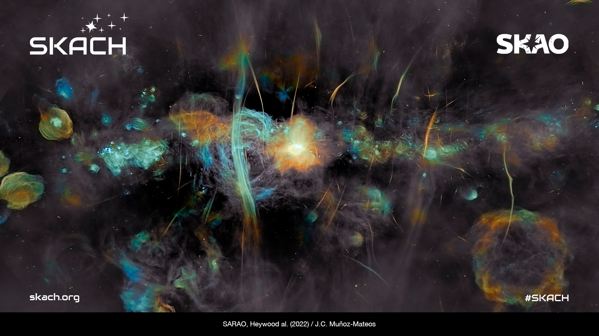
Simulcasting Science
Communicating Science through Podcasts in Today’s Increasingly Competitive Market
PAERI 2024

Slide 2




The Square Kilometre Array Switzerland
SKACH is the Swiss arm of the Square Kilometre Array Observatory
Consortium of ten universities/institutes
Members cover the key language areas of Switzerland: German, French and Italian
Radio Cosmos

Slide 3
Podcast Pop Quiz!
How many podcasts exist globally?
Answer: 5 million
How many podcast episodes exist globally?
Answer: More than 70 million
How many podcast listeners worldwide?
Answer: in 2024 the number hit 500 million
Image Credit: Astrovinch

Slide 4
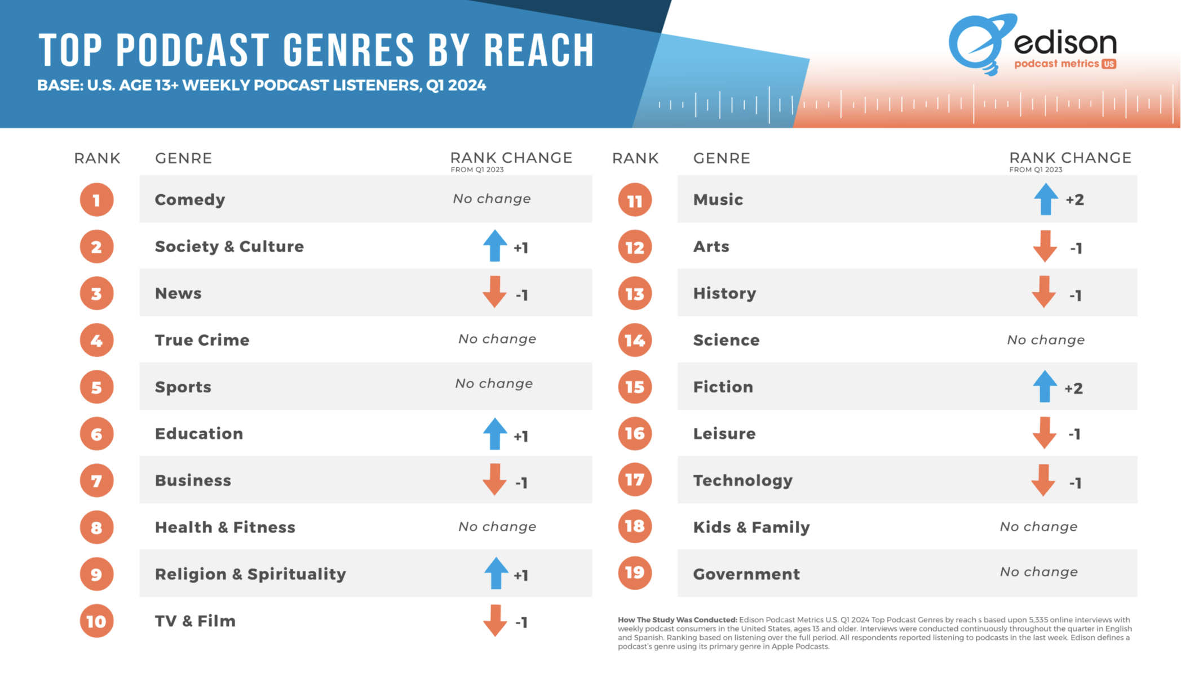
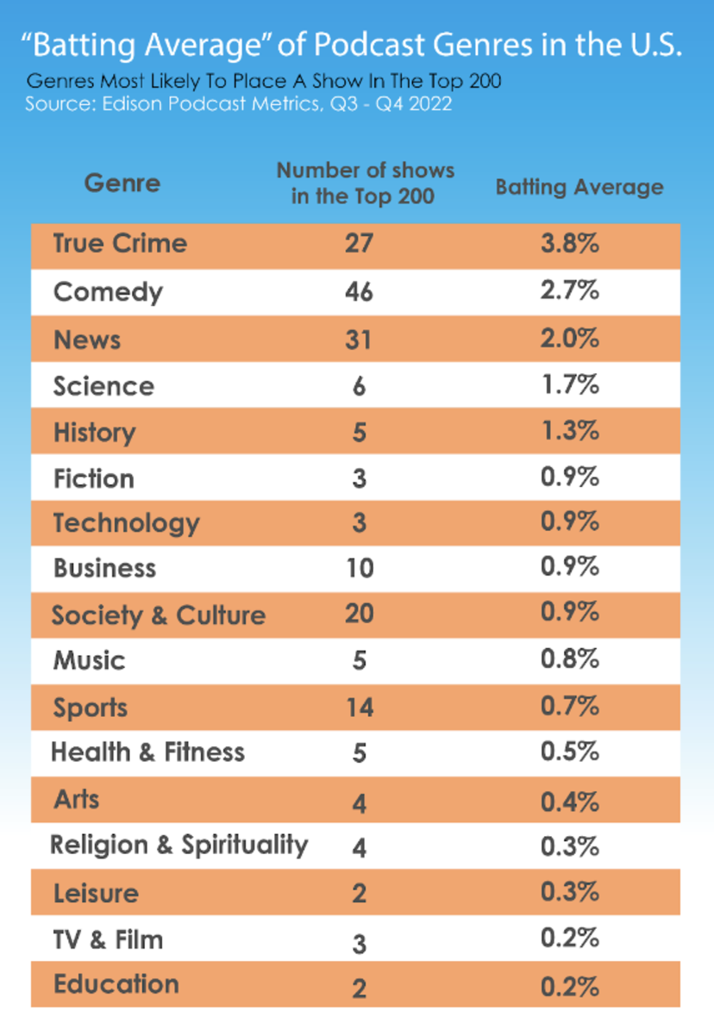
Some Science Podcasting Numbers
Notes:
In some market research science comes under the umbrella of Society and Culture or Education so using some metrics may overall rank higher than #14 in terms of genre popularity. Either way, science does not rank that highly. The batting average metric, also by Edison Research, is an interesting side metric. The batting average is calculated by dividing the number of shows in each genre that make it into the top 200 by the number of shows in each genre that make the top 20-thousand. So looked at in these terms genres like science and history have less competition in the charts but good batting averages.

Slide 5
To podcast or not? And in French?
Opportunities:
Exponentially growing communications medium with half a billion listeners and growing
Decentralized - direct to the audience
‘Dialogue with society’ - ability to create cross platform social media content to make create two-way conversations
‘Batting average’ for science podcasts presents an interesting opening to push the boundaries
Language:
English language science podcasts well established, including in astronomy
Initial funding was for French language, despite German being the most dominant language in Switzerland
Already large interest from German and Italian speaking colleagues

Slide 6


Radio Cosmos
  Four x 30 minute episodes
  French language
  Launch January 2025
  Distribution on all key podcast platforms: Spotify, Apple, Pocket Casts, Over Cast
  Extensive marketing strategy
Notes:
We received 5000 Francs from the Swiss Society for Astrophysics and Astronomy last fall/winter
We received 5000 euro from the IAU Office for Astronomy Outreach this past spring
We have contracted with a production company in Geneva to get started
Mark Sargent would host

Slide 7
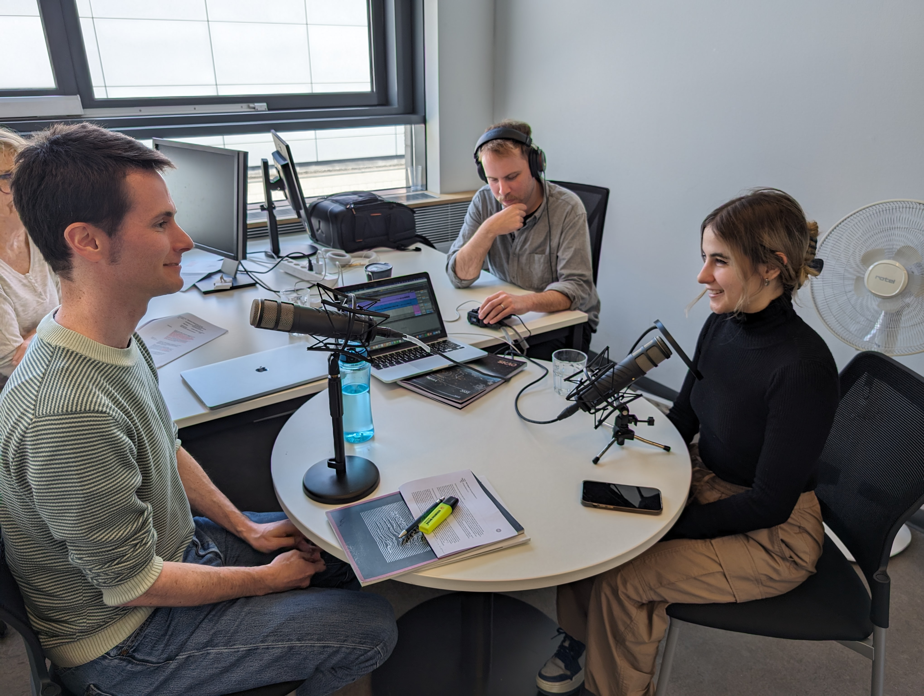
Podcast Planning and Production
Identified hosts
Determined episode topics
Confirmed interviewees
Established production timetable and scoped out appropriate recording facilities
Marketing plan
Creation of all marketing content

Slide 8
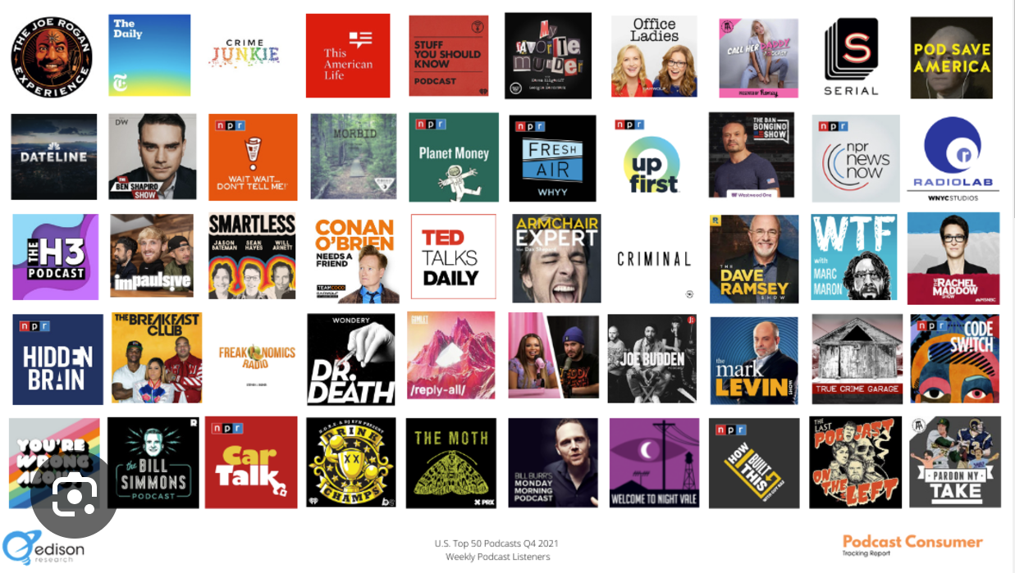
Maximizing Listenership
Notes:
Spotify and Google rank podcasts based on a combination of the total number of followers and recent unique listeners.

Slide 9

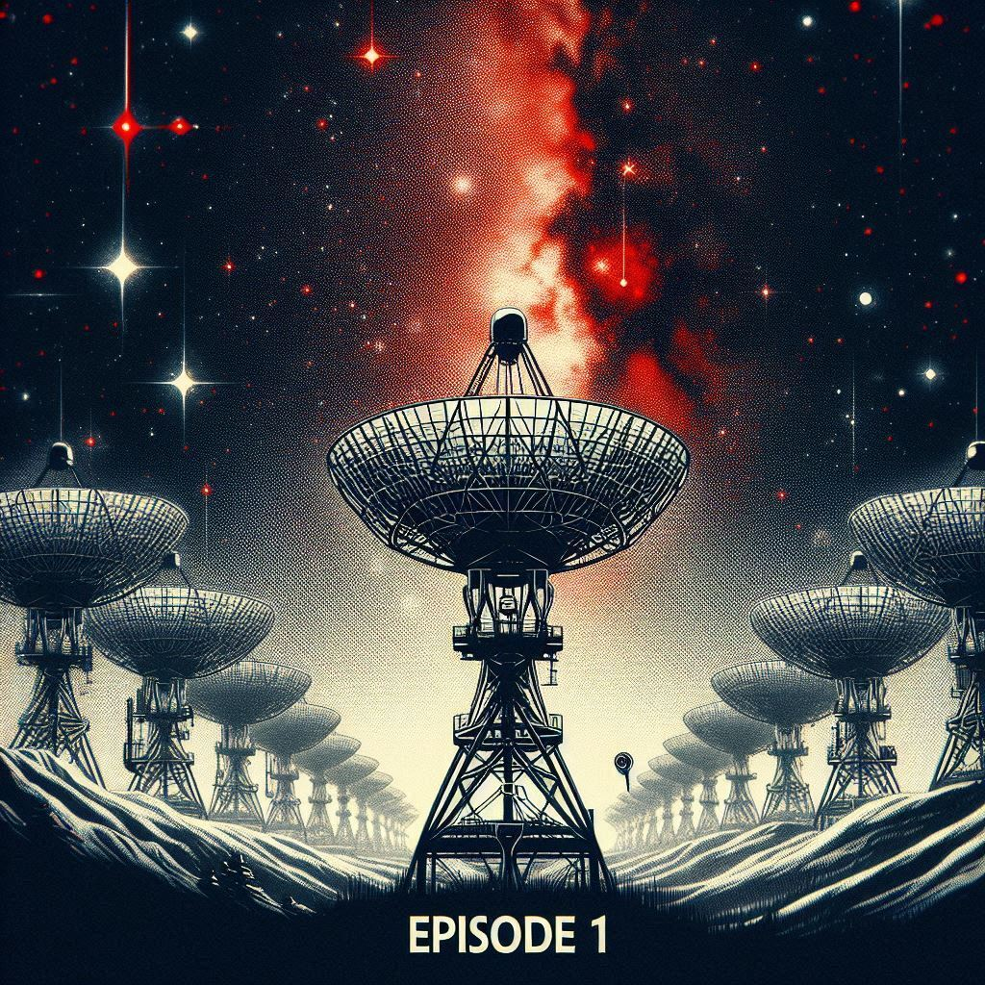


Marketing to Drive Listenership
The podcasts themselves:
Clear episode titles that ‘say what they do on the tin’
Relevant keywords in the title and episode descriptions
Detailed episode descriptions
Appropriate tags and categories to the overall podcast and each episode
Podcast Cover Art: Don’t Underestimate it’s Importance
Notes:
Podcast Cover Art
Don’t underestimate the relevance of your podcast cover art either. It’s the first thing potential listeners see and it can significantly affect their decision to hit play or not. High-quality, eye-catching artwork can make listeners curious and encourage them to check out your podcast.

Slide 10

Marketing to Drive Listenership
A comprehensive marketing campaign:
Content and instructions to SKACH’s 10 partner institutions
Working with SKAO HQ and SKA teams in France, Canada and other French speaking territories
Marketing content and instructions for hosts and contributors/interviewees to spread awareness
Working with the universities in Switzerland for on campus promotion

Slide 11

Conclusion
CHECKLIST
Determine if a podcast is right for you – objectives, audience, content, language
Identify hosts
Determine episode topics
Confirm interviewees
Establish production timetable and scope out appropriate recording facilities
Marketing plan
Creation of all marketing content
Marketing Campaign

Slide 12
THANK-YOU!
QUESTIONS?
PAERI 2024

