Slide 1
Engagement with a dream: Designing a public engagement strategy for a facility with no science (yet!)
Jo Lewis
Communications and Public Engagement

Slide 2
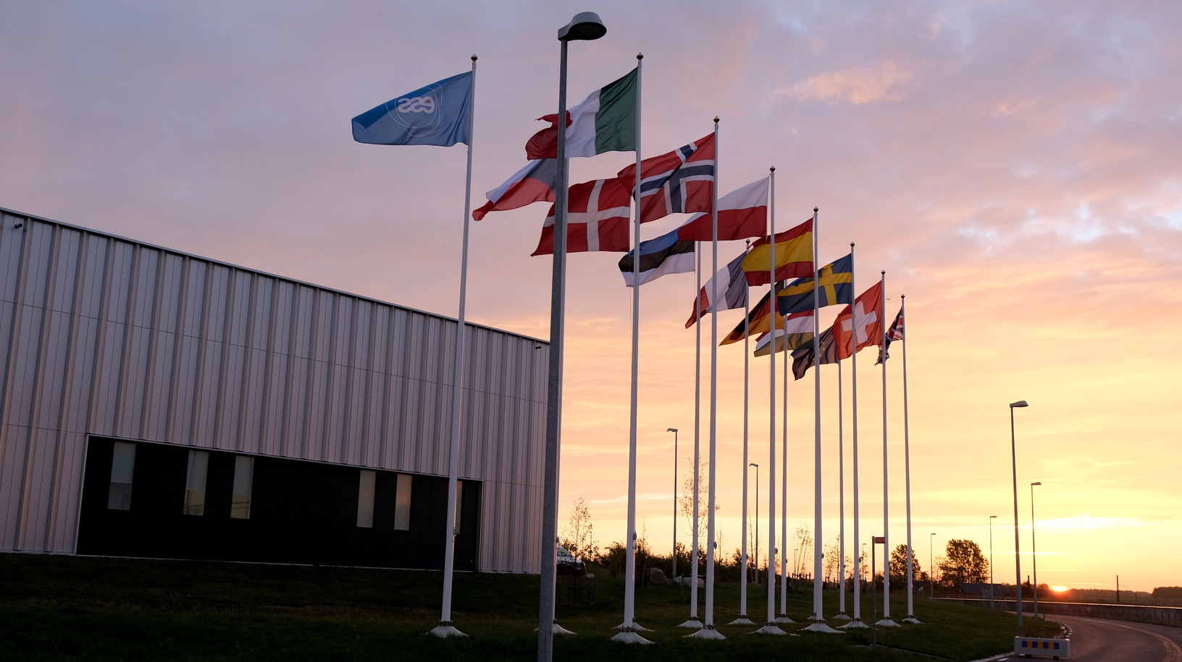
What is ESS?
1

Slide 3
A European Organisation for Science
Host States: Sweden and Denmark
Member States:
Czech Republic, Denmark, Estonia, France, Germany, Hungary, Italy, Norway, Poland, Spain, Sweden, Switzerland and the United Kingdom

Slide 4
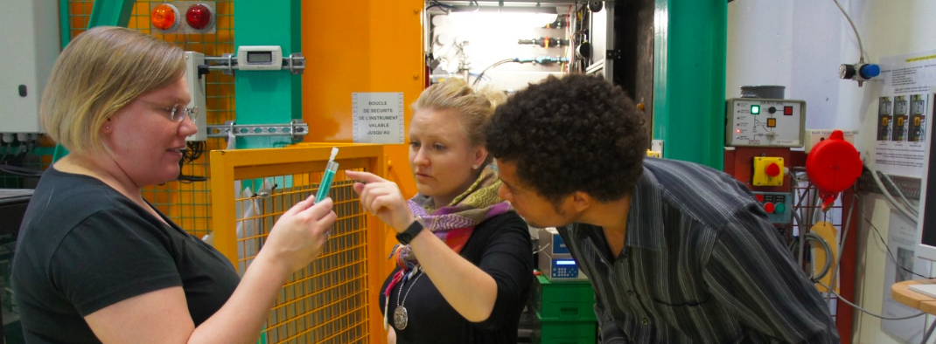
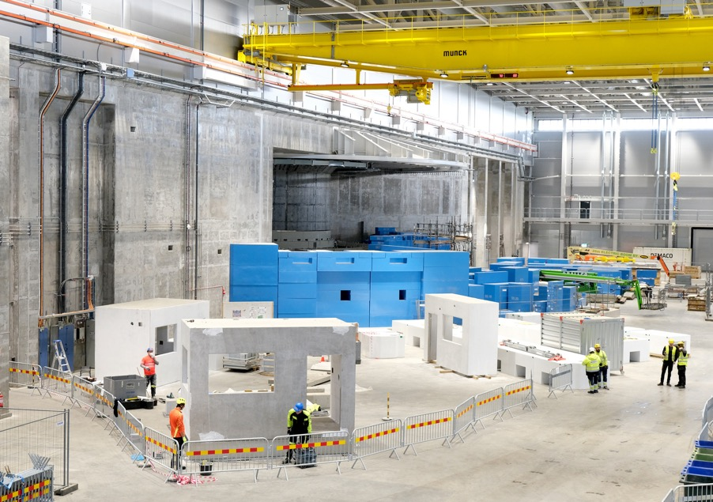
Europe’s future neutron source for research
An neutron source
A user facility with 2000 users per year
ESFRI Landmark Project
Still under construction
Construction costs €1.84 billion

Slide 5
Research areas
Chemistry of Materials,
Magnetic & Electronic Phenomena
Engineering Materials, Fast Neutron Applications,
Geosciences, Archeology & Heritage Conservation
Life Science, Soft Condensed Matter
Particle Physics
Notes:
Rework, without numbers, yes small images, no multi+shapes

Slide 6
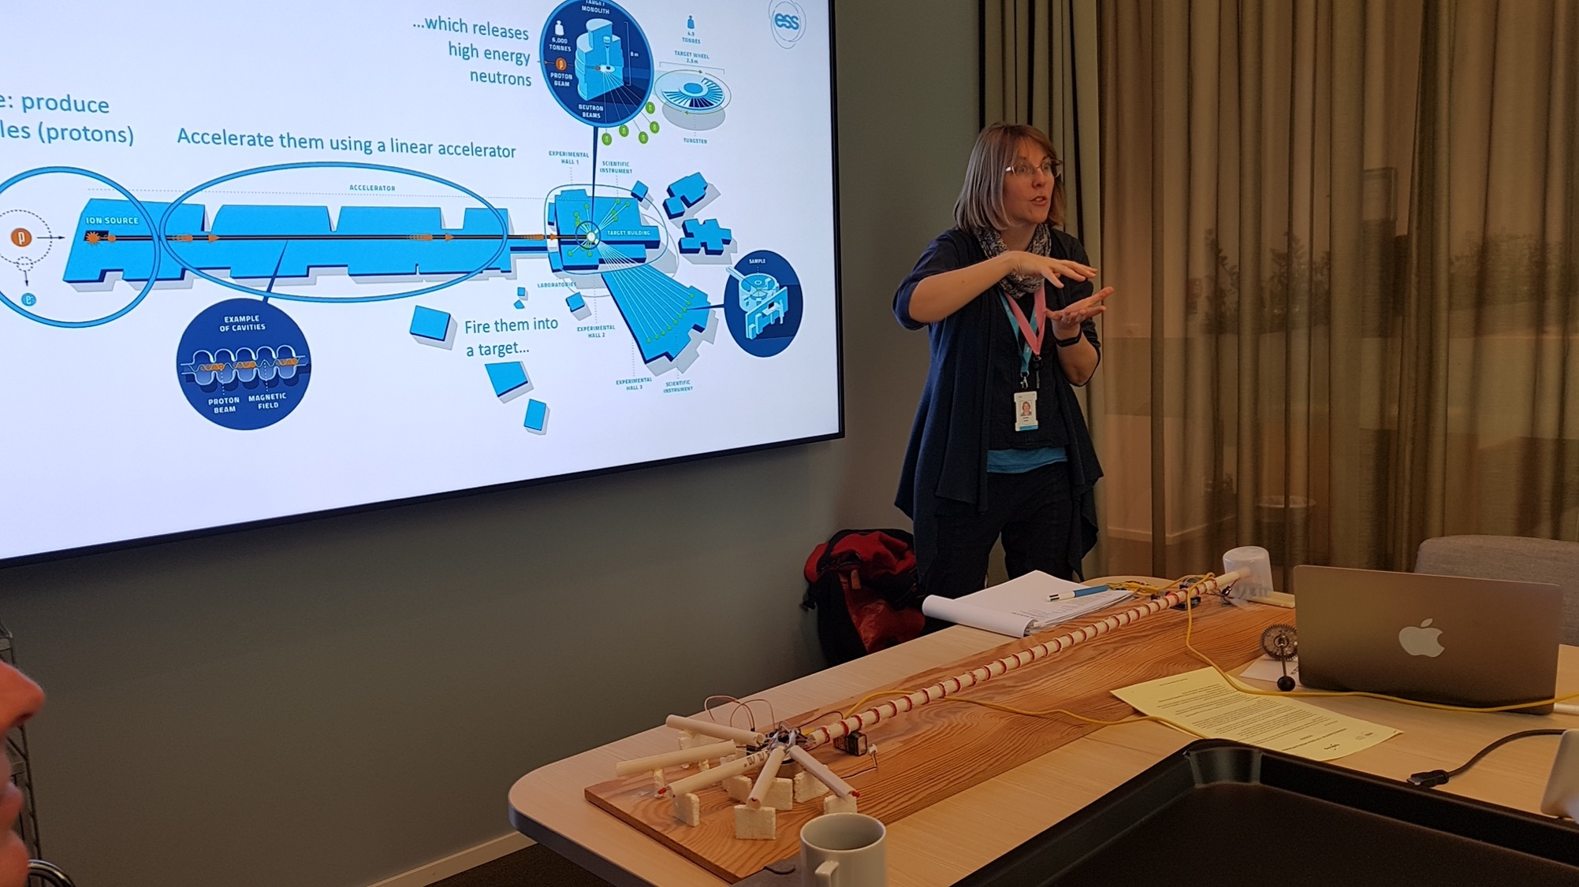
We are already implementing our
Public Engagement strategy
2

Slide 7
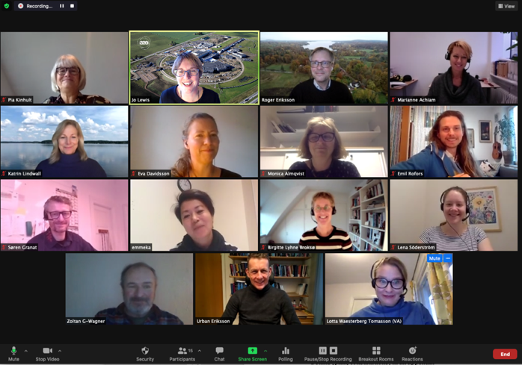
Mission
To be a trusted collaboration partner
on major science engagement projects,
sharing ideas about ESS’s contribution to 21st century research
with people all over Europe
Notes:
As well as being firmly anchored in internal ESS agendas and priorities… . …the strategy was written with input and robust debate from the newly-formed External Advisory Group for Learning and Engagement, EAGLE…
…and is aligned with other actors in our ecosystem of research, industry and education.
By engaging with people across Sweden, Denmark and our member states now we can begin on our public engagement mission:

Slide 8
This strategy covers from 2021 until
First Science
Notes:
… a period of small-scale testing with a wider ambition in mind, paving the way for engagement that reaches further, wider and deeper in the future
We will build up all activities, trialling them in the host states Sweden and Denmark and then disseminating to our member states

Slide 9
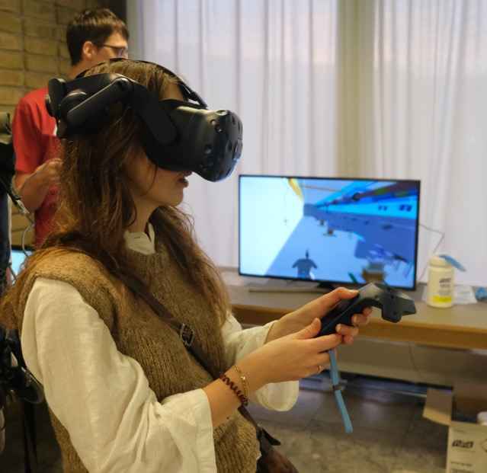
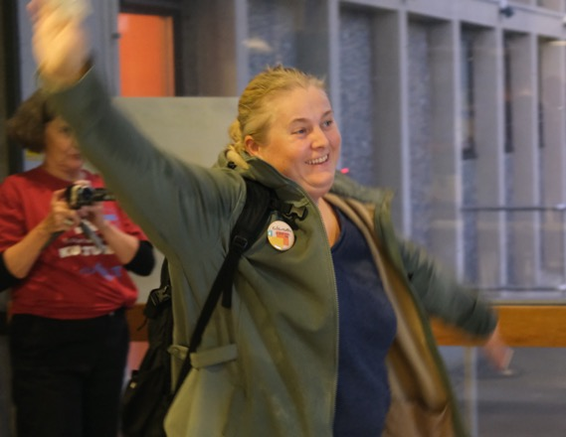
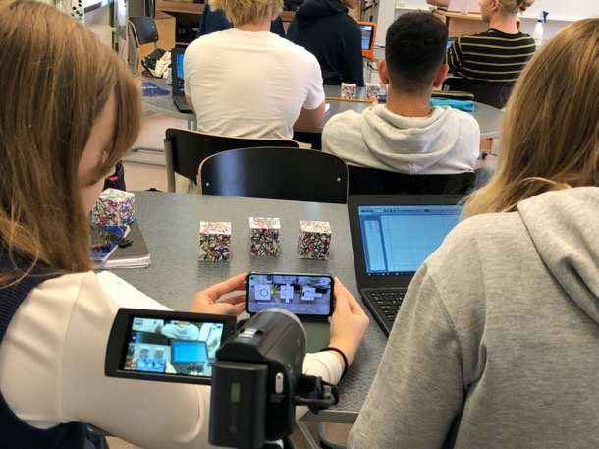
Why engage the public at this time?
Bring people along a journey
Build a sense of trust, ownership and support
Inspire a generation of scientists, engineers and future users
Notes:
ESS will design and create activities that bring people along a journey…
… building a sense of trust, ownership and support for the role of ESS in addressing societal challenges…
…and inspiring a generation of scientists, engineers and future users with the critical thinking and questioning skills to participate in 21st century research.

Slide 10
An engagement journey
One-way Communication
Dialogue and Listening
Interest
Participation and Co-creation
Trust
Low awareness
Disassociation
Inspiration
Excitement
Ownership
Support
Notes:
We will use evaluation to demonstrate that our interventions play a positive role in moving all audiences along an engagement journey

Slide 11
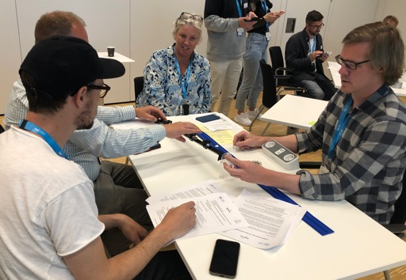
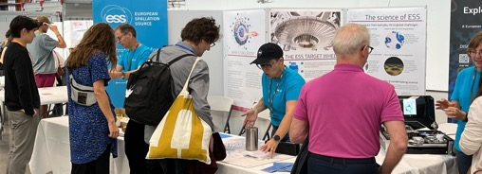
What are the key strategic priorities?
Inspire 11-19 year olds in science and STEM subjects
Empower educators to use contemporary research in their teaching
Create cultural interactions between public and research
Collaborate with key regional, national and international partners
Develop processes for implementation within ESS

Slide 12
ESS Public Engagement
Achievements 2020-2024 (Audiences over time)
EU-funded online course with 1200 teacher participants

Slide 13
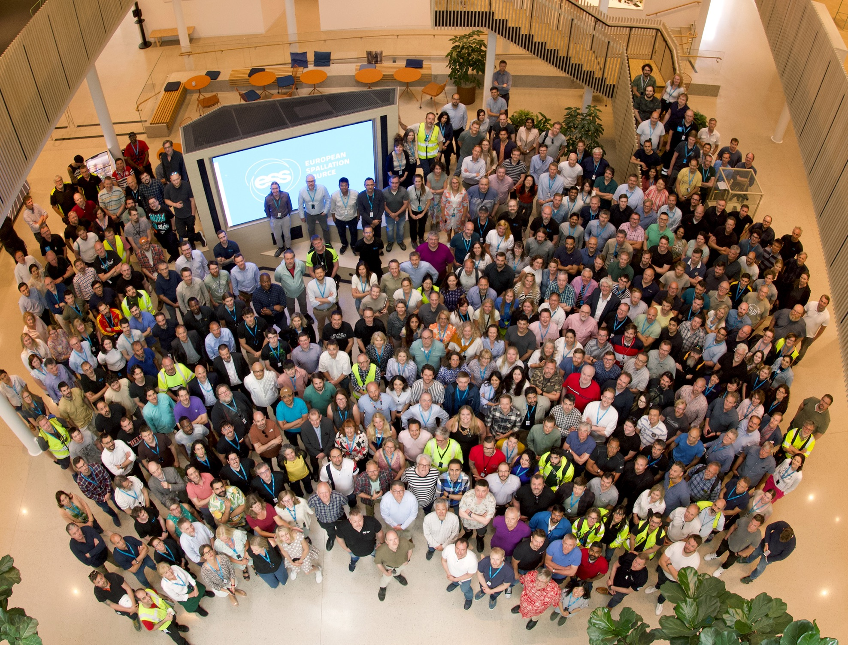
Case Study:
Collaboration with key engagement partners
3

Slide 14
Collaboration to reach new audiences
Goal: Use RI unique assets to help address a challenge highlighted by partners
Challenge: Support teachers to
Bring to life topics like forces, magnetism, electromagnetic spectrum, atomic structure
Increase their knowledge of contemporary research to make it relevant and exciting
Stimulate students’ skills:
Analytical and critical thinking
Collaboration and communication
Active participation
RI assets:
Existing online materials for training non-specialists
People with skills and knowledge about the science and technical aspects
Case studies of real people using high tech to address real-world problems
Notes:
To be a trusted collaboration partner
on major science engagement projects,
sharing ideas about ESS’s contribution to 21st century research
with people all over Europe
Erasmus+ Grant 2022-2024 250.000 Euro

Slide 15
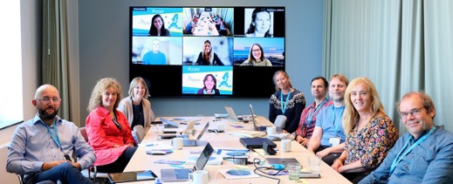
Accelerating Teaching
Massive Open Online Course (MOOC)
https://bit.ly/AT_MOOC23

Slide 16
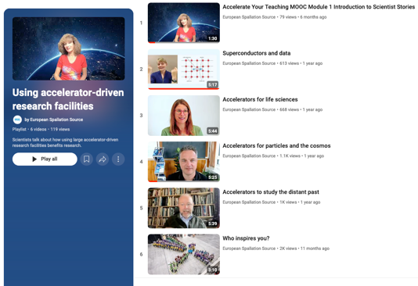
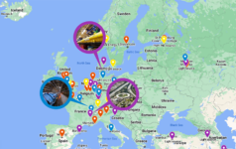
Pedagogical tools
Videos of Scientist Stories
Classroom game: Race to Space
Lesson plans

Slide 17
Evaluation
I'm a Biology teacher. I will use particle accelerators at my lessons: Imaging devices, enzyme crystallography, renewable energy and many more topic are related with my lessons.
2211 people registered 75 countries
1293 participated
314 completed the MOOC
58% engagement rate
24% completion rate
First 4 weeks
1
3
At first I was afraid of not being able to complete the course because it was related to Physics. But every module I enjoyed more!
7
1
2
3
59
16
67
114
Powered by Bing @GeoNames, Microsoft, OpenStreetMap, TomTom
Notes:
Participant = completed at least one unit of the course (in any module)
Completer = explored all the sections of the MOOC and did all the activities. INCLUDING DESIGNING AND UPLOADING THEIR OWN CURRICULUM-LINKED LESSON PLAN OR LEARNING SCENARIO
** The course engagement rate is calculated by dividing the number of participants who completed at least one section of the course by the total number of people who registered to the course.
*** The course completion rate is calculated by dividing the total number of participants who completed at least one section of the MOOC) by the total number of participants that completed the course.

Slide 18
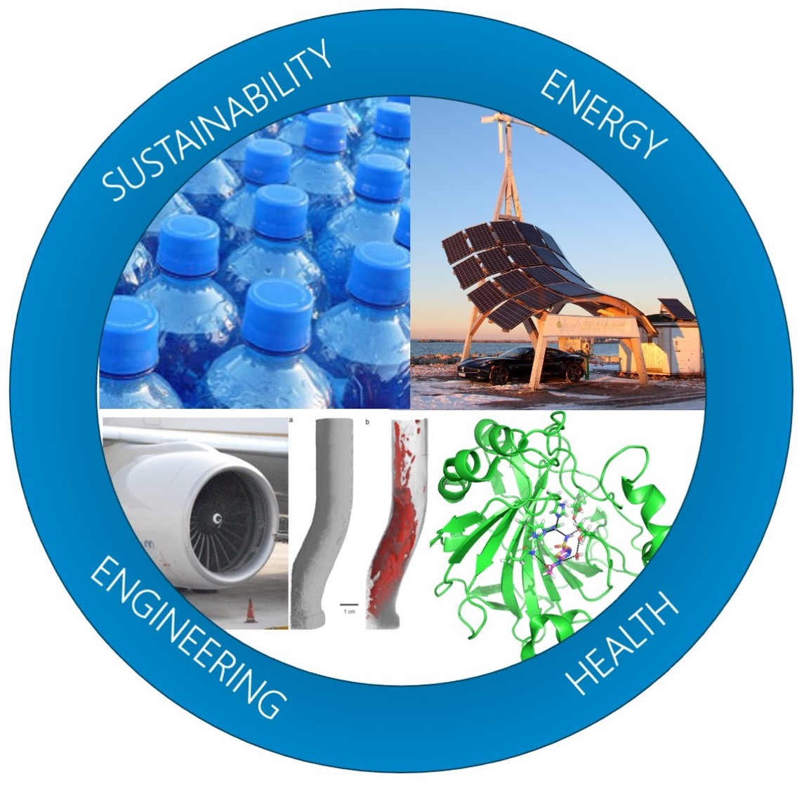
Case Study:
Developing new processes within ESS
4

Slide 19
Developing new processes within ESS
Goal: Pilot a large-scale on-site visit that engages a public audience
RI assets:
Many hands-on activities developed with other projects
People with skills and knowledge about the science and technical aspects
Desire to show workplace to their friends and families
Challenge: Site undergoing large-scale installations
Safety and security issues of the site
Timing: must not interfere with larger project plan
Event on a weekend
Staff motivation and engagement
Notes:
Reception, office support, cleaning not usually available at the weekend

Slide 20
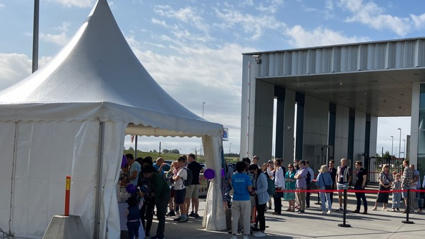
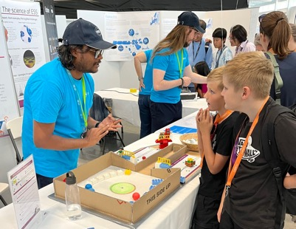
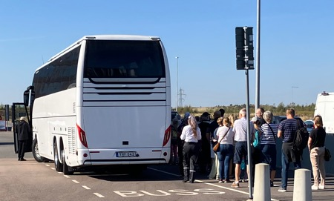
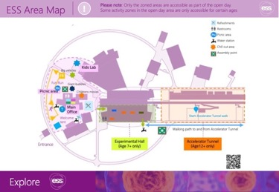
Three High-Impact Events
Saturday 24 August
Friends and Family event
1100 people (of whom 800 were public)
Saturday 21 September
Lund Culture Night
Two events:
ESS stand at MAX IV
750 people
mostly families with kids
Bus tours round ESS
500 people
Mostly adults

Slide 21
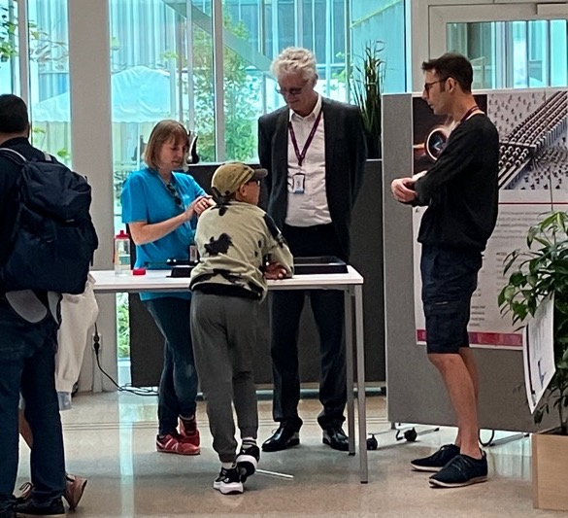
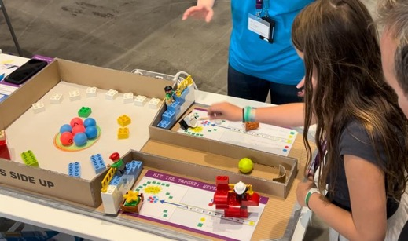
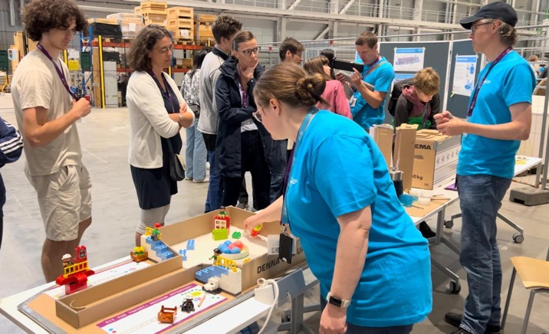
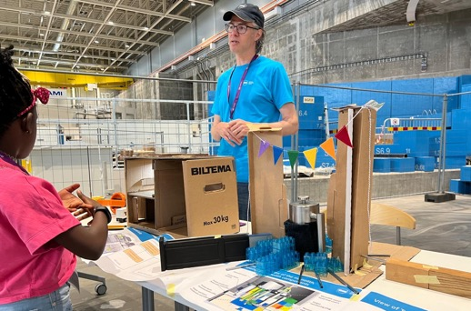
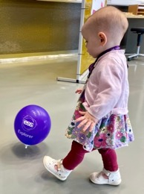
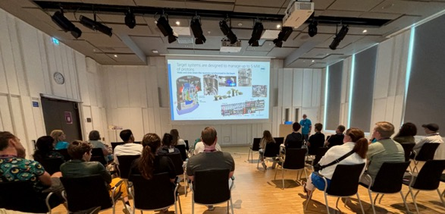
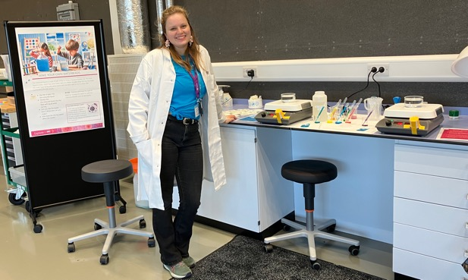
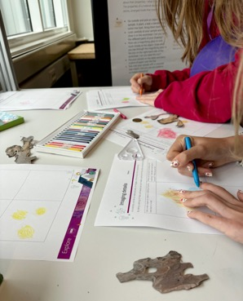
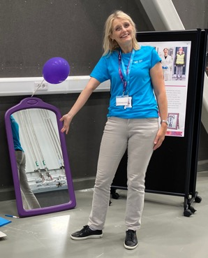
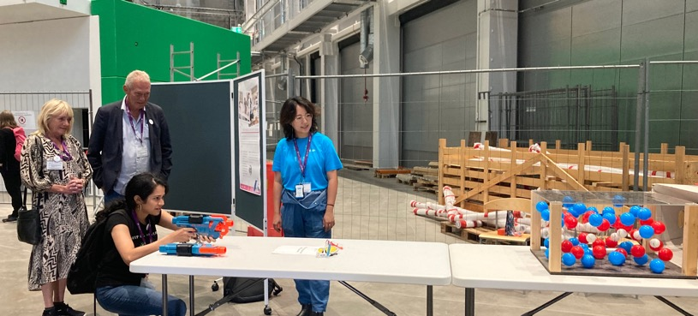
Notes:
Anecdote
Show the spider cranes on site on a carpark
But installations were happening the following week and the carpark was needed to have a large tent for construction materials
Could not put tables, large security fencing into the instrument hall until the day and had to remove on the day so installations could continue 6am on Monday morning
BUT also had a 40m laboratory with no equipment in it yet that we used for all the under 10 year olds with dressing up, materials projects, access to magnifying glasses, and make your own water beads

Slide 22
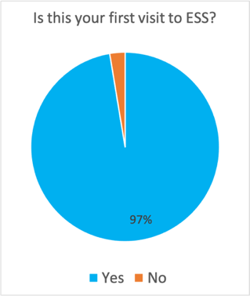
Evaluation
Friends and Family day
Inputs: 46k Euro ; 110 staff volunteers, 7 paid security staff
Outputs: Branded materials, learning materials, training materials
Reach: 800 public, 324 staff
Outcomes: Increase in trust, pride and support of ESS
Lund Culture Night
Inputs: 1.5k Euro; 10 staff volunteers, 7 paid security staff
Outputs: *Branded materials, learning materials, training materials
Reach: 1250 public
Outcomes: Increase in awareness, knowledge and interest in ESS
My family and I are so impressed both with ESS and the event.
So proud to have been a part of it.
*Re-used from Friends and Family day
Notes:
Return on investment
Many materials will be used at many future events

Slide 23
New Processes developed
Establish steering group and working groups
Delegate and trust key tasks to working groups
Set key deadlines, with flexibility for vacation period
Allocate top-line budget, and monitor spending against plans
Align with steering group
1. Trust-based task delegation with strong steering group
Strong Project team
Event booking Software
Training materials
Evaluation tools
Notes:
Productivity
Accountability
Transparency
Value for money
Project team:
Sponsors at director level
Project manager
Strong steering group with agency to make decisions
Software to manage large-scale event bookings
Training materials for staff on public engagement
Evaluation tools for volunteer and for visitor feedback

Slide 24
OUTCOMES: What was the effect?
When at ESS,
I feel like I am a part of the future.
AMAZING! Very glad we got to bring our family! THANK YOU!
What I love about ESS is that it is all about experiments and excitement. I love the place, it is big and lovely and I am looking forward to be working at ESS. Thank you. Nesma, age 12
It was a lot of fun! It was interesting to see the exhibits about the science and walk along the accelerator tunnel. The food and drink were much appreciated, and it was very well organised.
I have never been to such a big scientific facility - spellbound!

Slide 25
Questions and discussion Joanna.Lewis@ess.eu ess.eu/explore
Notes:
With image meatballs blue
Add safe slide at the end

Slide 26
What next?
5

Slide 27
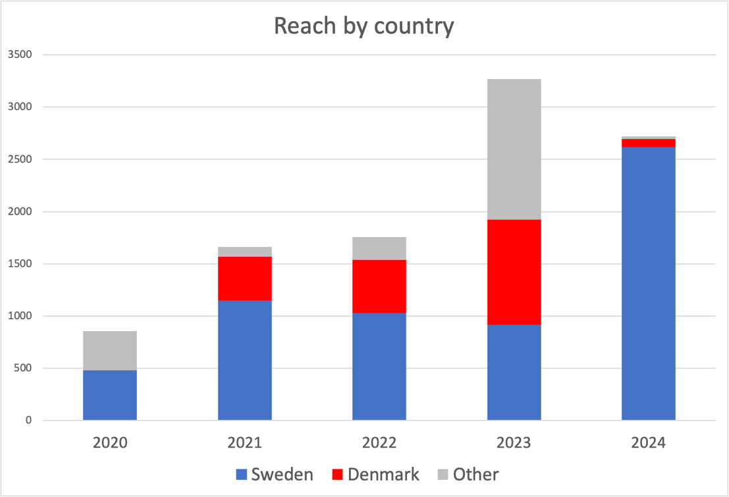
Key goals for 2025
Redress the balance of work with Denmark
Reach beyond our region to other parts of Sweden
Identify collaborations to help embed ESS in school learning

Slide 28
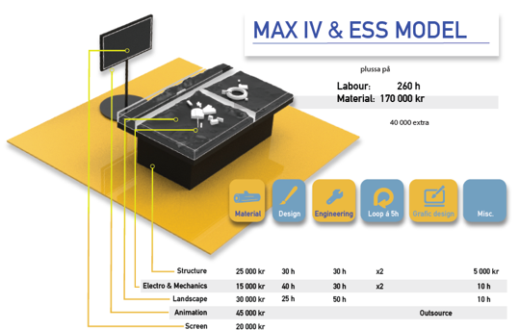
Plans for 2025 and beyond
Public and school stream in a large science conference
Culture nights in both Lund and Copenhagen
Initiate a touring exhibition about ESS and MAX IV
Embed ESS into the Danish school curriculum
Start planning a (real!) open day for ESS inauguration

Slide 29
Specific interventions for Public and schools
High-quality tailored communications
Low awareness
Low trust/ non-belief
Doubt / confusion
Interest, Inspiration, Excitement
Trust, Ownership & support
Disassociation
Position on Engagement journey
Provide teaching resources including training for less confident teachers
Seek schools to collaborate on developing new activities
Provide cross-cultural platform for ESS people and non-scientists to engage in meaningful conversation
Participate in Culture Night Provide engaging information in public spaces
Exhibitions about ESS in museums or public spaces
Participate in Researchers Night
Seek feedback from teachers on their needs
Provide virtual or physical tours for groups with Q&A
Example interventions by ESS
Next steps for audience
Tell others
Share
Like
Watch a video
Try an activity
Visit ESS website
Participate in discussion
Ask a question
Recommend a visit or tailored experience
Participate in a project or activity with ESS
Partner with ESS on a project
Share and disseminate ESS work
Initiate conversations with new partners about ESS on our behalf

