Slide 1
Users, owners, funders, friends: The challenges of overlapping audiences in the age of weaponised social media
Terry O’Connor
PAERI’24
29 November 2024

Slide 2
Objective
Encourage resilience in stakeholder (audience) planning
Starting principles
All communication / engagement should be two-way
Engagement effort should be prioritised to the ‘virtuous cycle’
This is a workshop
Open discussion
Share experiences even if you don’t think they’re relevant to others

Slide 3
Resilient engagement
There are real organisational benefits in understanding our audiences / stakeholders
Enables better management decisions & strengthens the impact of our work
Analysis is especially important with multiple, overlapping groups of ‘stakeholders’
National funders, local officials, staff, users, suppliers, community groups etc
Understanding the special nature of RIs helps create stronger and supportive networks
Especially important when ‘batteries not included’ is increasingly an issue

Slide 4
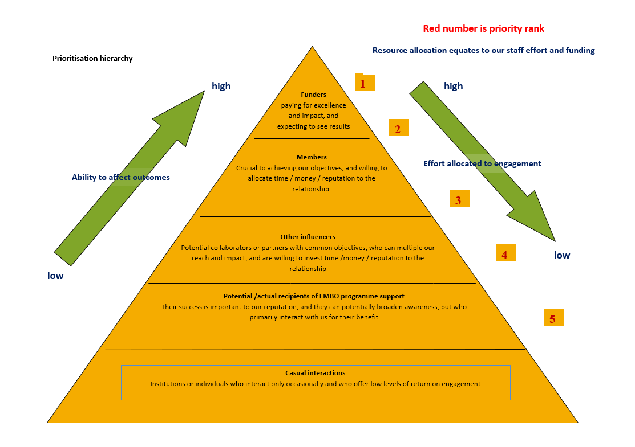
Audience Engagement

Slide 5
Pyramid or Matrix?
The Pyramid
It’s presented as a linear relationship for clarity in decision making
Who, with whom, when etc
Matrix
Reality is more complex and confusing
Everything everywhere all at once
Can lead to the loudest getting the most attention even if they’re the least influential

Slide 6
The pyramid dilemma
We operate in a matrix world
We can’t and shouldn’t ignore any audience
But there is a hierarchy & some stakeholders can shut us down
We must engage with them to meet their information needs
Eg, funders expect us to do – and be seen to do – more than ‘excellent science’
Houston, we have a problem
Weaponised social media is creating new power centres that influence decision-makers

Slide 7
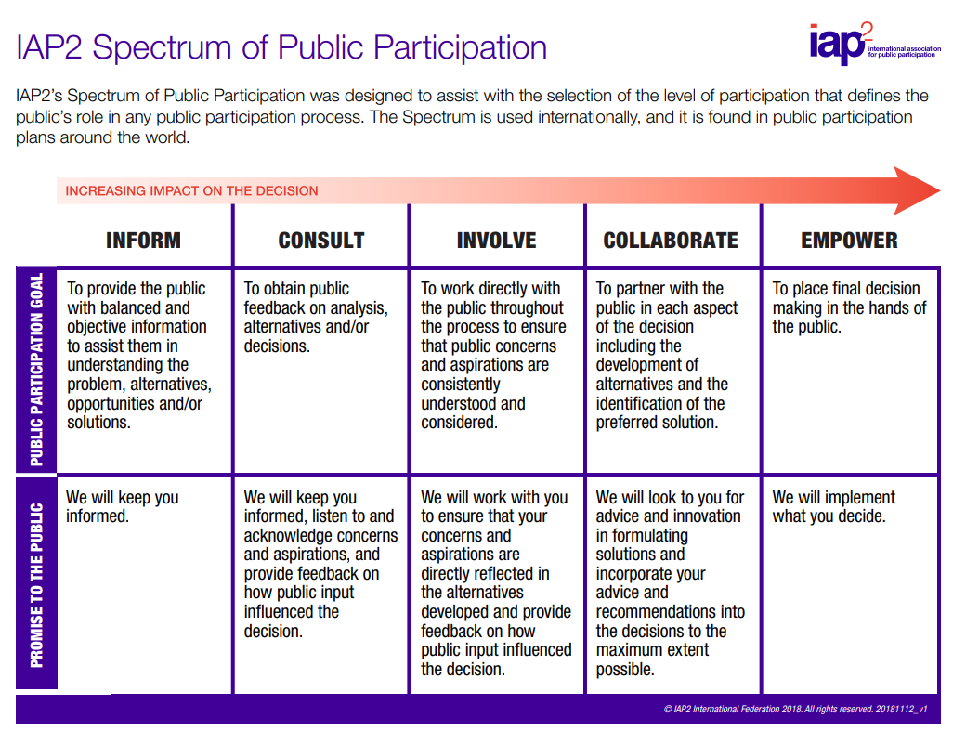
Good news
We do have potential allies in the ‘info wars’ to whom decision makers also listen
Local communities
We live, shop and our kids attend schools there
Directly affected special interest groups
Schools, community groups etc
Others
Local elected officials, media etc
Do we ‘inform’ or just tell?

Slide 8
Why it matters

Slide 9
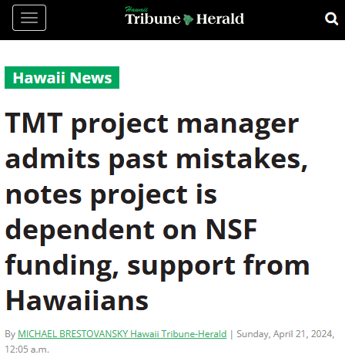
Why it matters

Slide 10
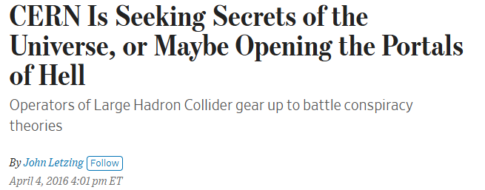
Why it matters

Slide 11
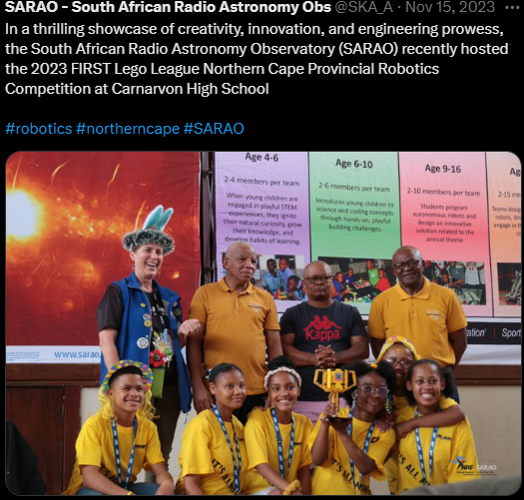
Why it matters

Slide 12
Your experiences
Do you agree?
Who are your allies?
What special factors affect your audience engagement?
What techniques do you use to ensure resilience?

