Slide 1
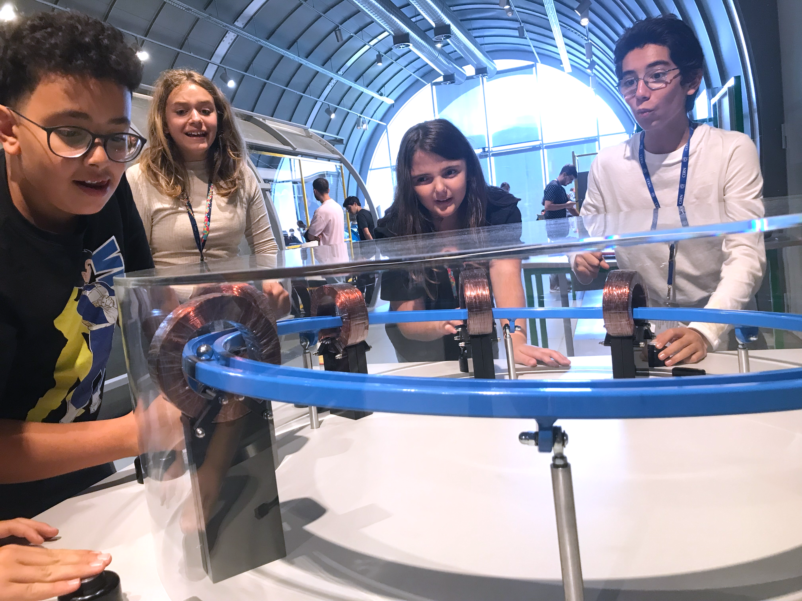
Introducing Science Gateway
PAERI conference, 28th November 2024 - Emma Sanders, Head of exhibitions, CERN

Slide 2
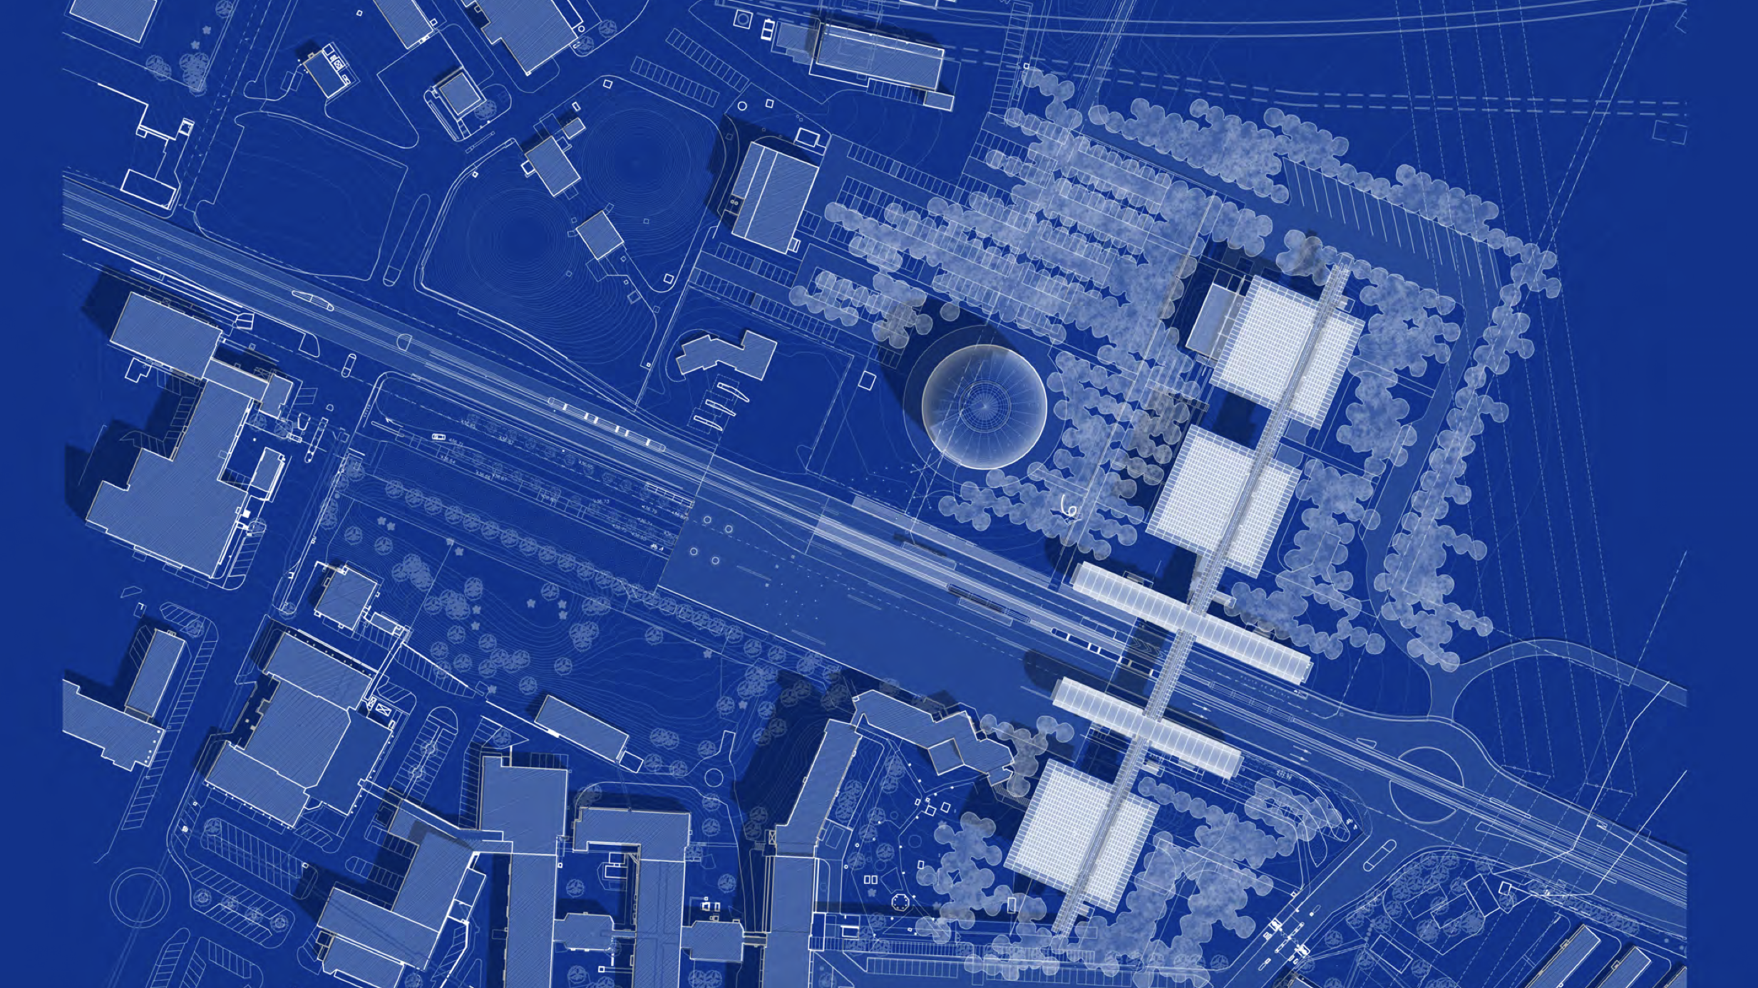
From blueprint in 2019…

Slide 3
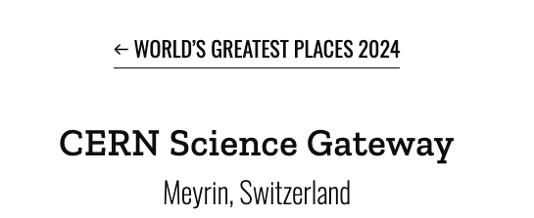
…to reality in 2023
Notes:
1 year on 400’000 visitors

Slide 5
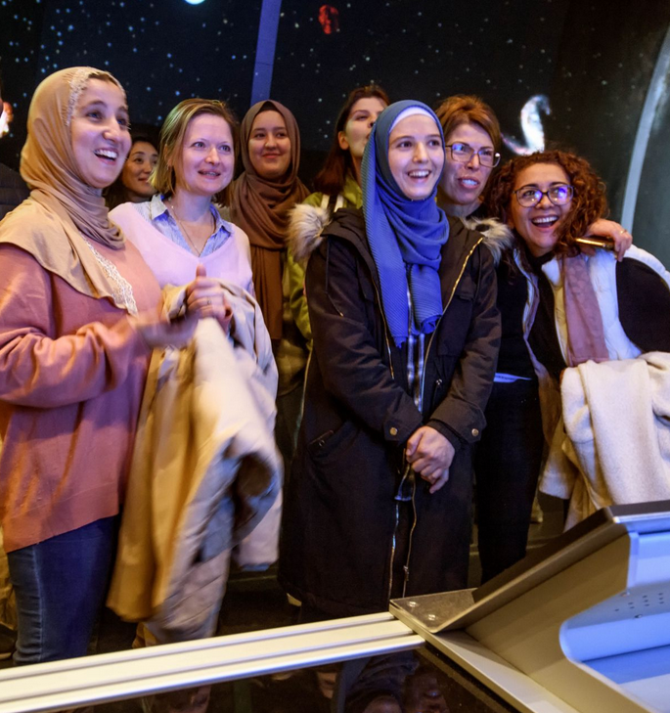
Our Goals
Enable a diverse audience across all sectors of the public to engage with the science, the discoveries, the technologies and the people working at CERN
Inspire the next generation to explore a career in science and technology
Empower visitors of all ages to make sense of the science that shapes their lives
Conserve and display the heritage of big science, the objects and stories that transmit the tremendous human endeavour in a tangible way.
Build ties across CERN Member States and beyond, encouraging co-creation with other museums, science centres, cultural centres and education networks.
Notes:
OPTIONAL

Slide 6
How did we get there? 8 key ingredients

Slide 7
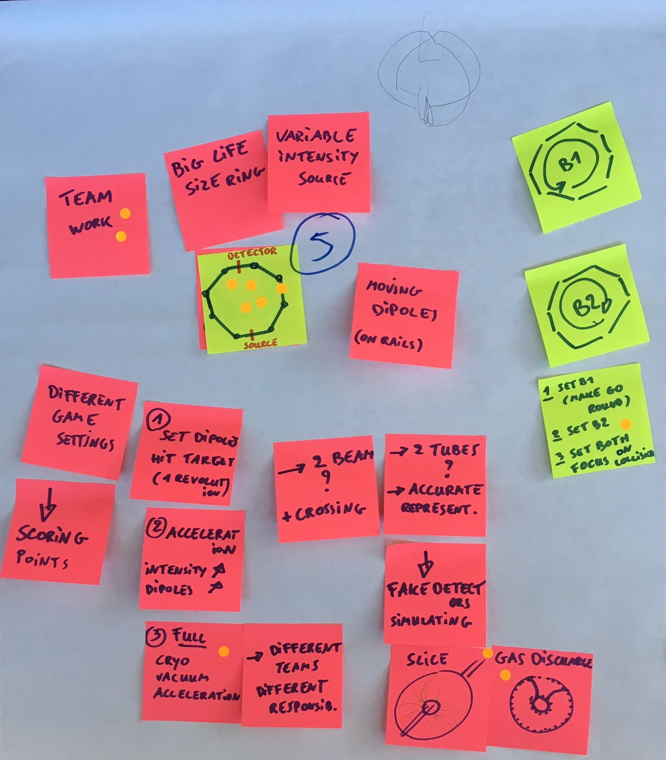
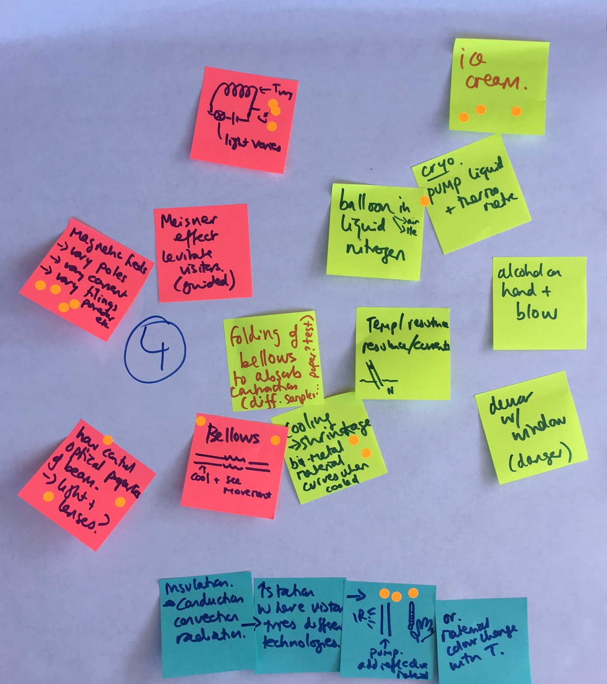
1. Give your scientists plenty of post-its

Slide 8
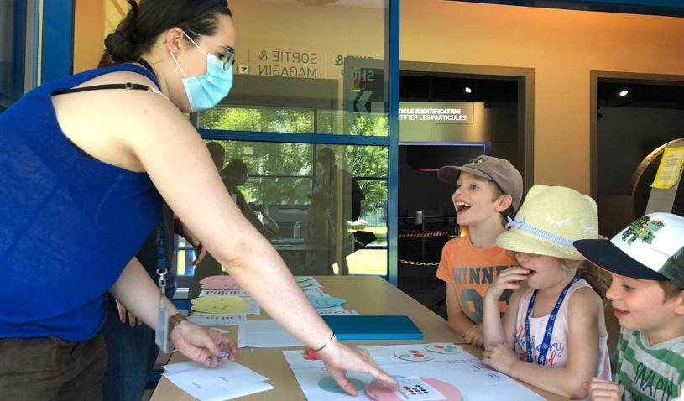
2. Interact with your audience groups

Slide 9
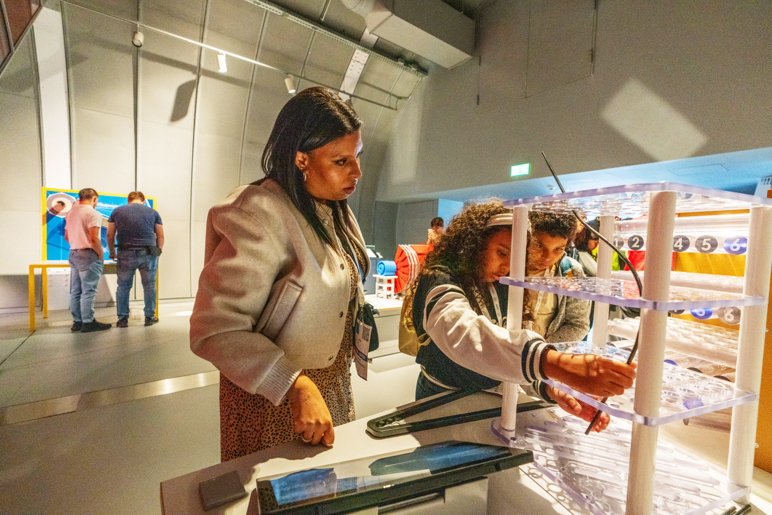
3. Put hands-on experimentation centre stage

Slide 10
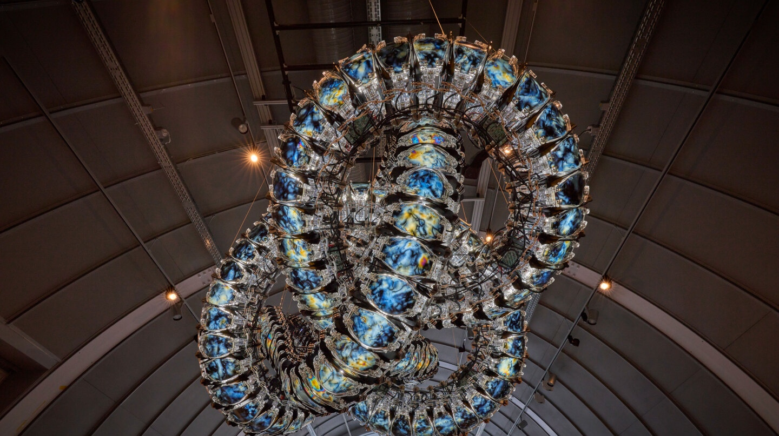
4. Vary the experiences, create rhythm

Slide 11
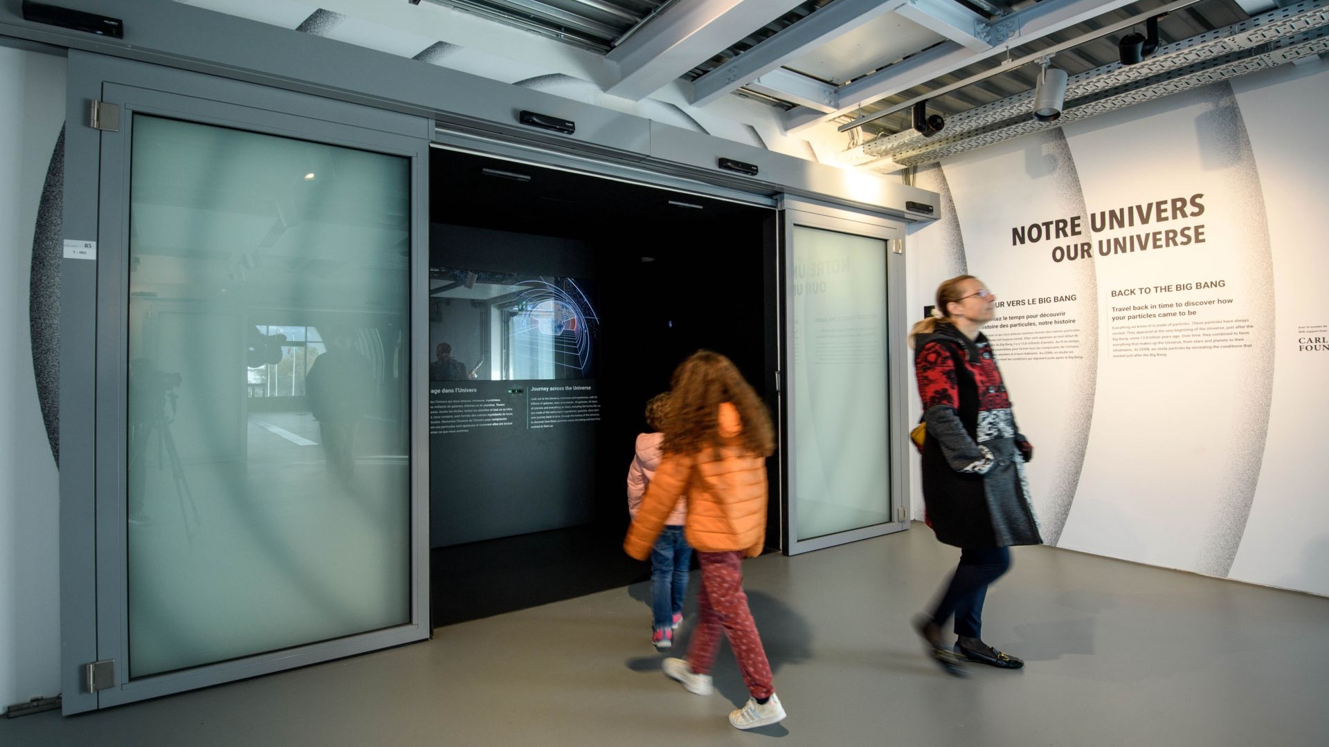
5. Tell human-centred stories
Travel back in time to
discover how your
particles came to be
Notes:
Travel back in time to discover how your particles came to be
On screens / guides / and you in all this? / you are made of particles

Slide 12
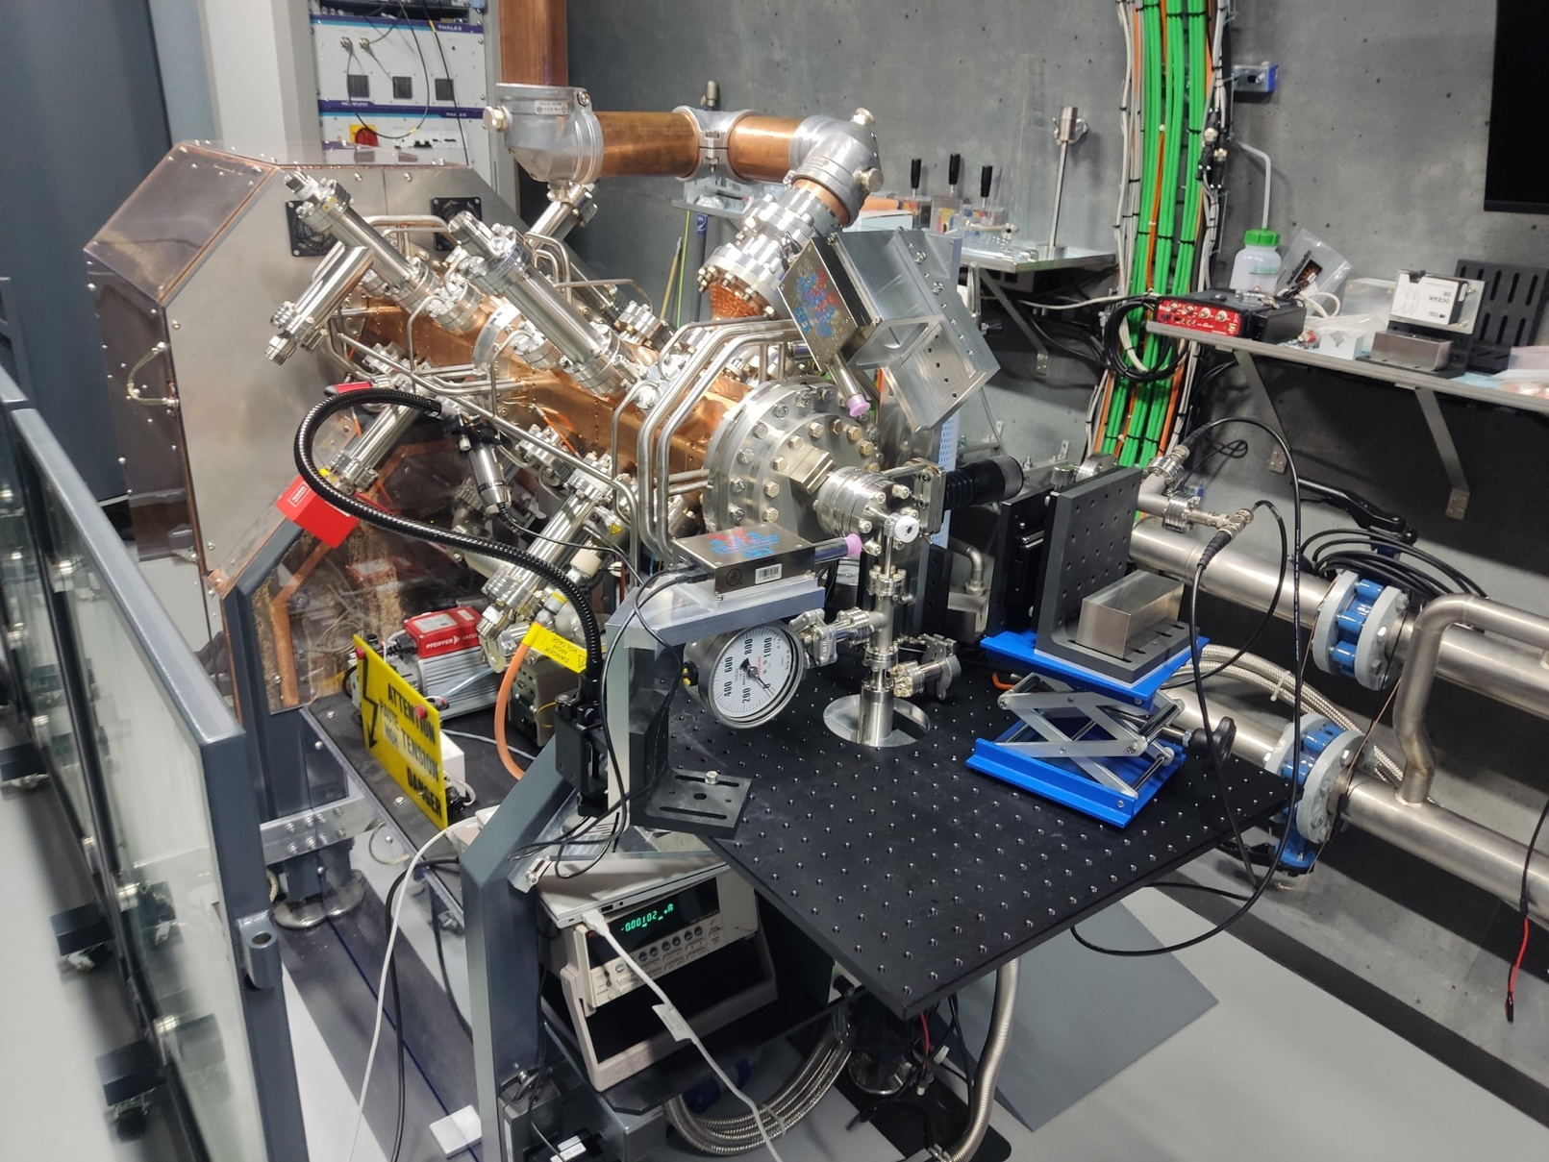
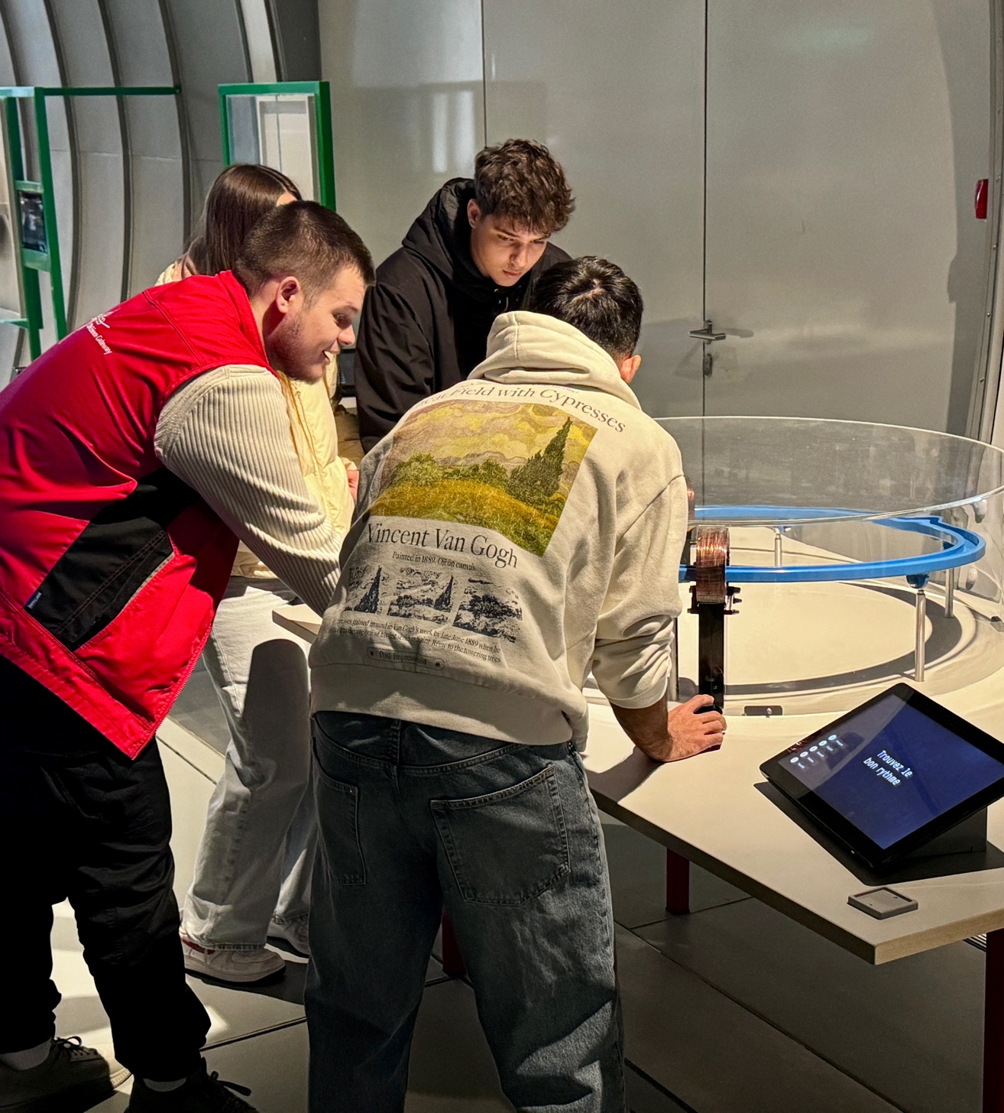
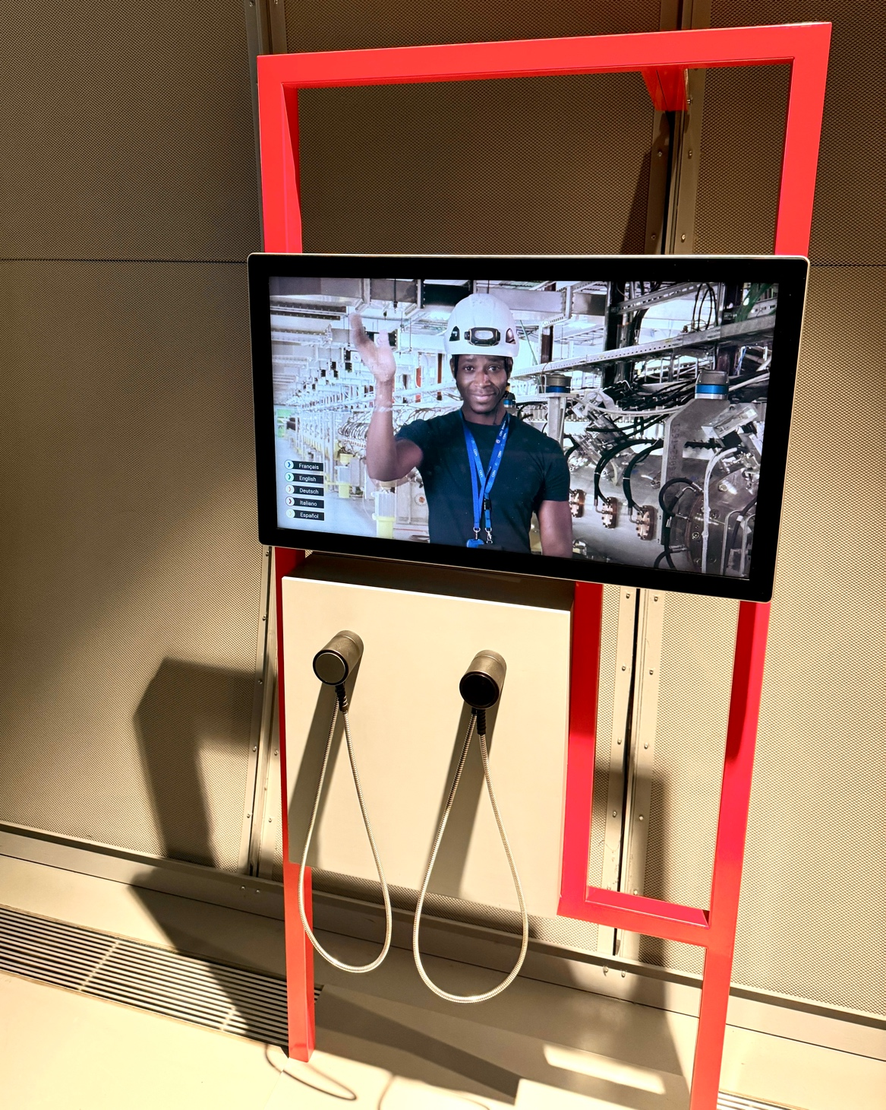
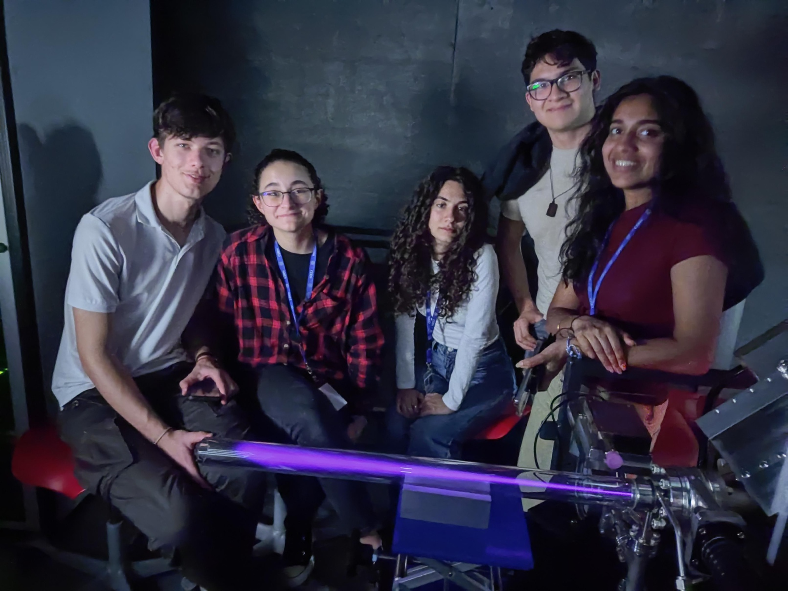
6. Make it authentic
Notes:
Guides are CERN members or students

Slide 13
7. Accessible is better for everyone

Slide 14
8. Make it fun!

Slide 15
Inspiration book – sharing content with others
exhibitions.team@cern.ch

Slide 16
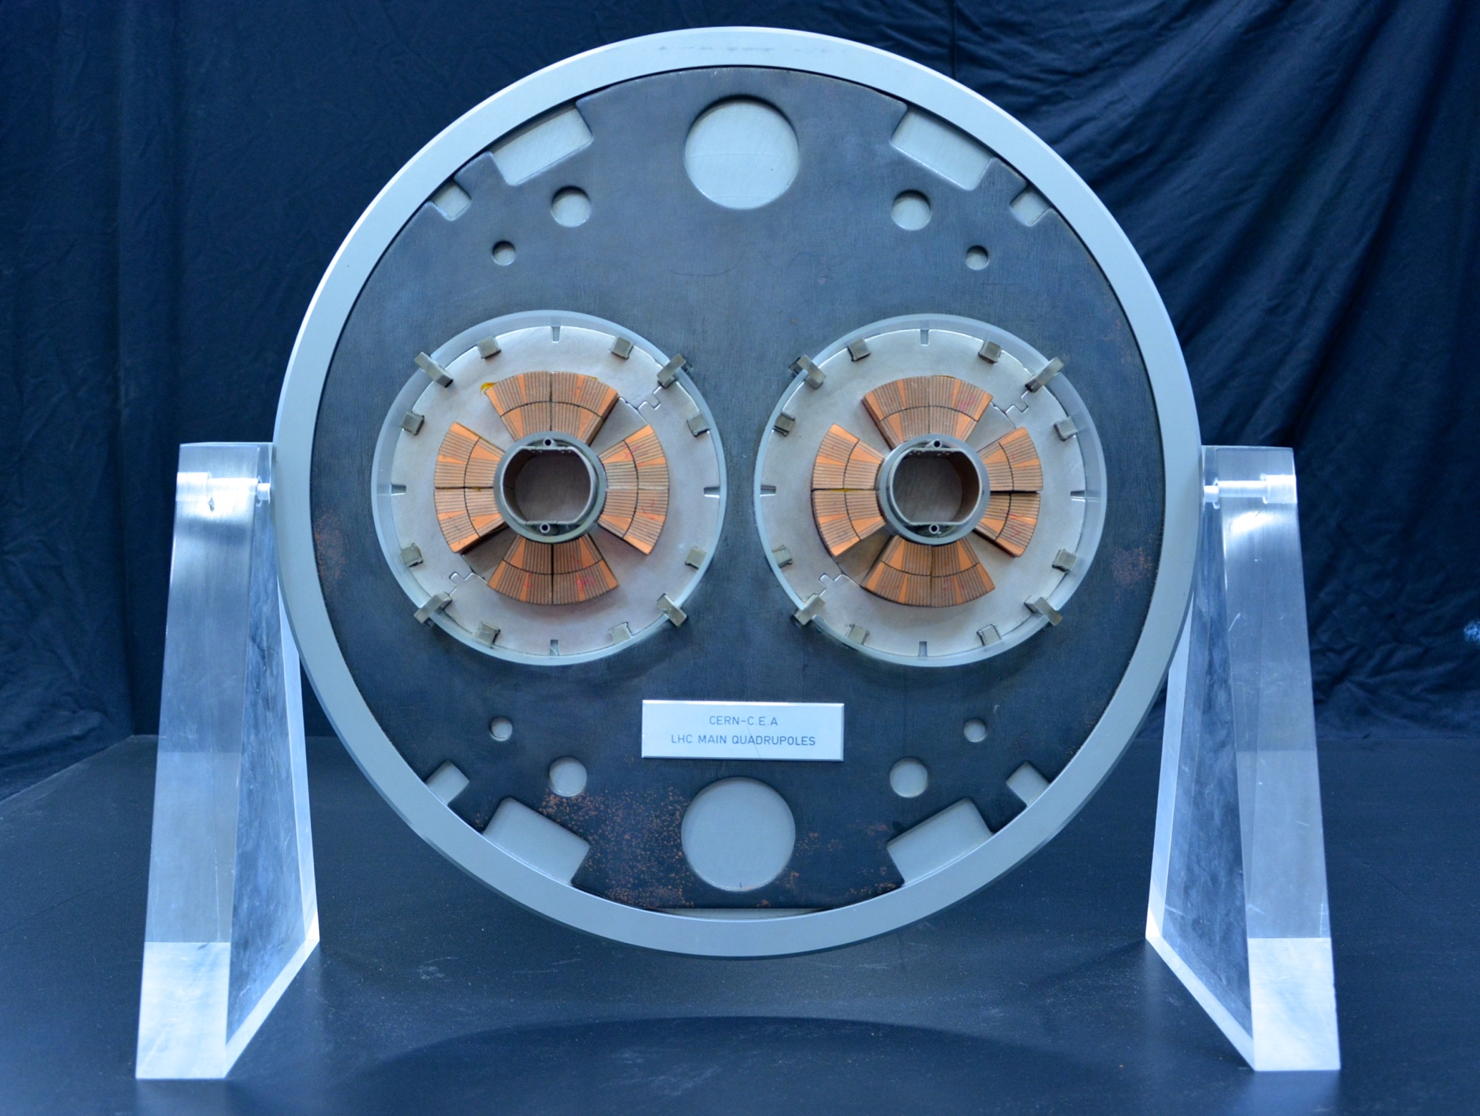
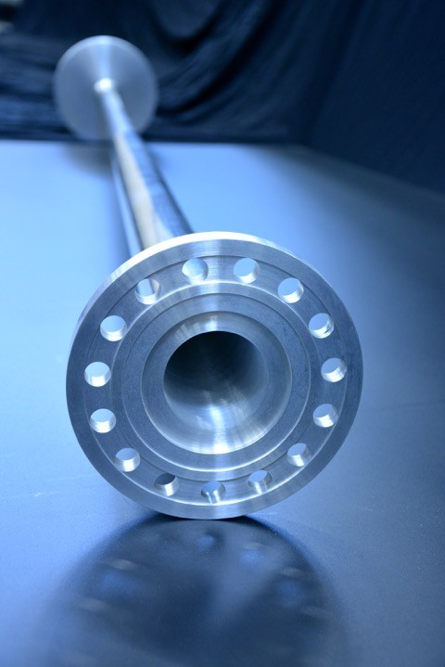
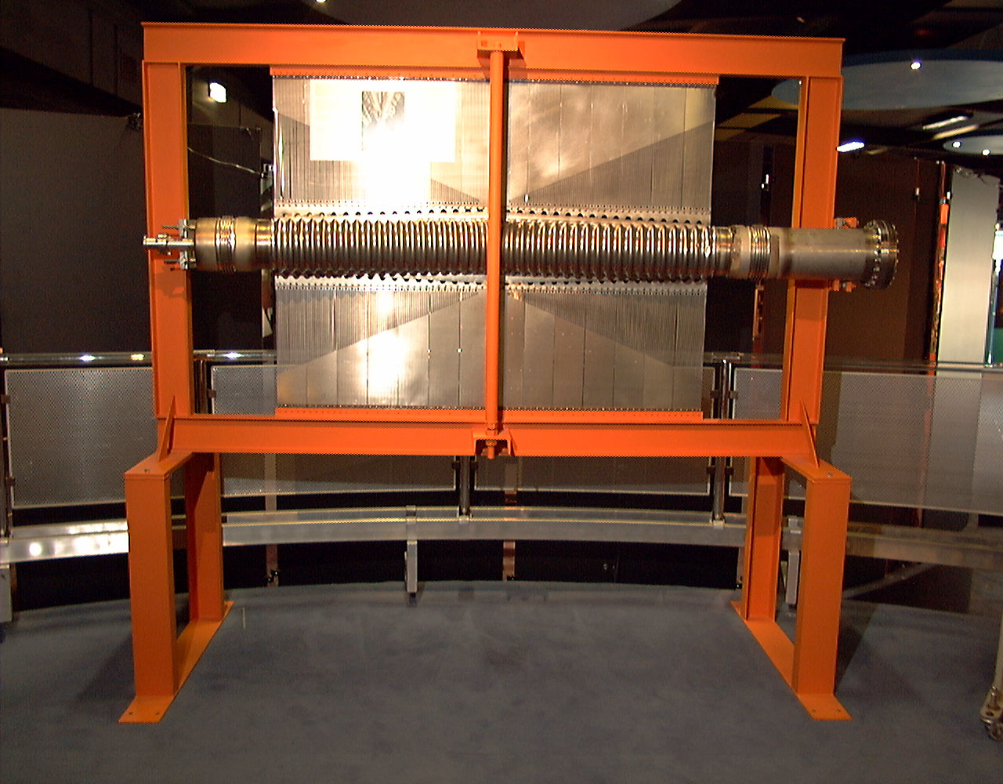
Heritage object collection for loan

