Slide 1
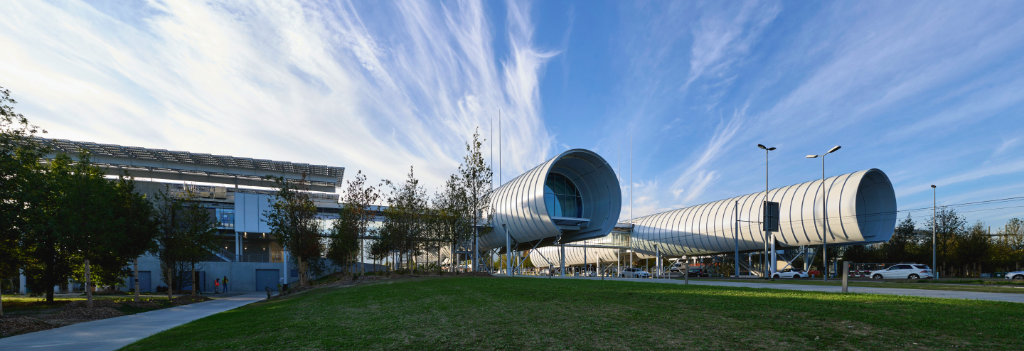

Science Gateway exhibitions an audience research from a social science perspective
Jimmy Clerc
PAERI, 28th November 2024

Slide 2
Introduction
The exhibition team conducted evaluation research in three stages :
  Frontend evaluation
    Interviews with teachers from primary schools
    Testing challenging topics with tourists
  Formative evaluation
    Prototype testing in primary schools
    Testing tactile content
  Summative evaluation
    Surveys
    Visitor tracking

Slide 3
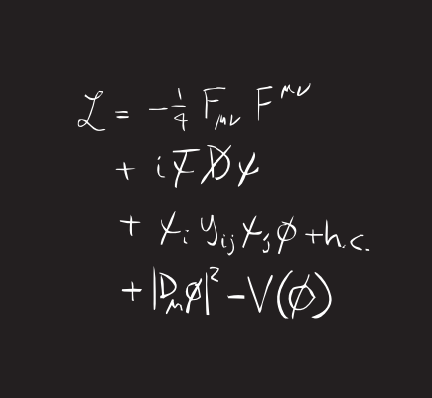
Frontend evaluation
Interviews with teachers from primary schools
  Methodology
    Interviews with teachers in primary schools
  Goals
    Identify motives, barriers, and needs for visiting CERN
  Main findings
    Teacher’s interests & motivation > the link to the curriculum
    Concerns about unadapted and unengaging content
    Time constraints (visit and transport)

Slide 4
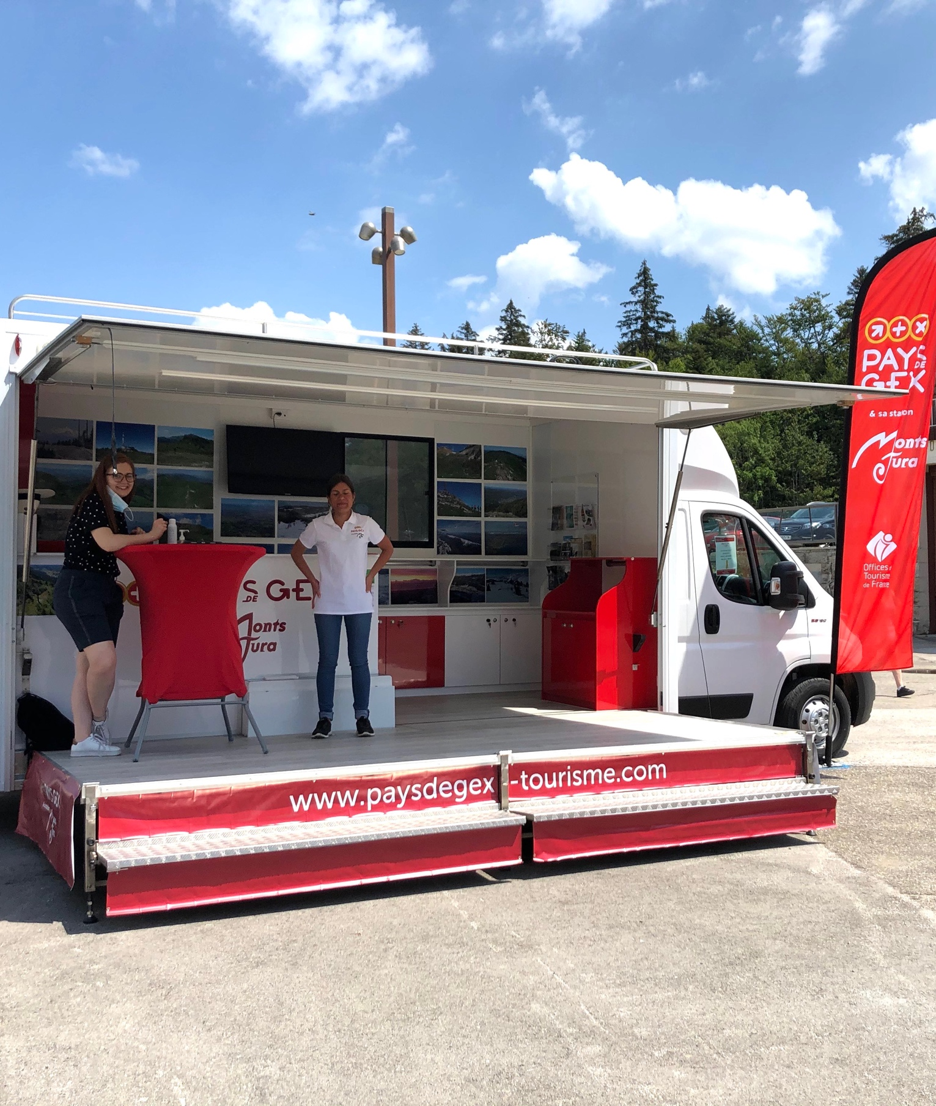
Frontend evaluation
Testing vocabulary and interest in challenging topics with tourists
  Methodology
    Interviews with tourists
    Testing exhibit prototypes
  Goals
    Understand dealing with challenging topics
    Broaden CERN’s visitor audience

Slide 5
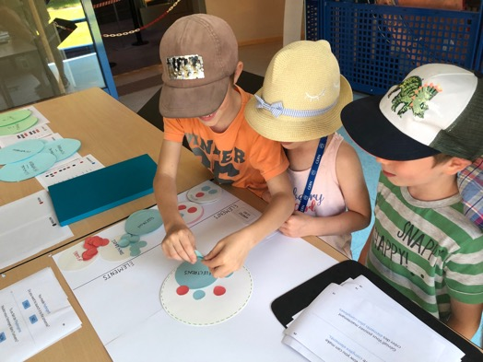
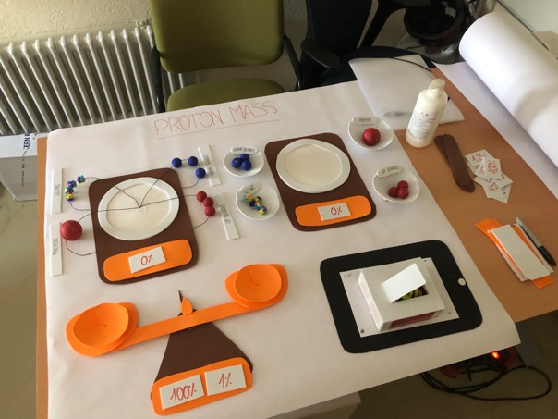
Formative evaluation
Prototype testing in primary schools
  Methodology
    Paper prototypes testing
  Goals
    Evaluating content accessibility for primary school children

Slide 6
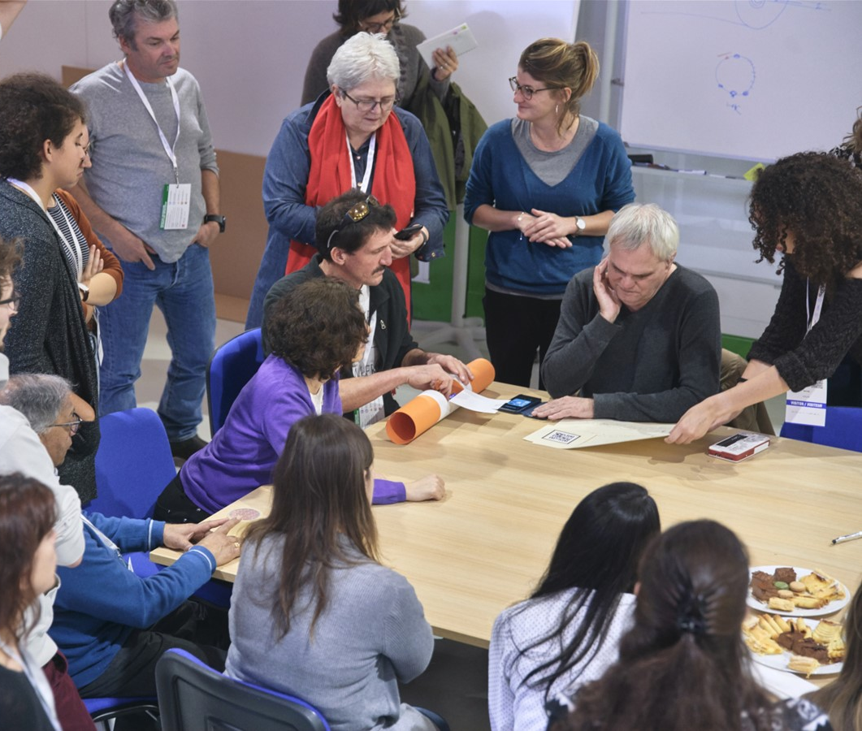
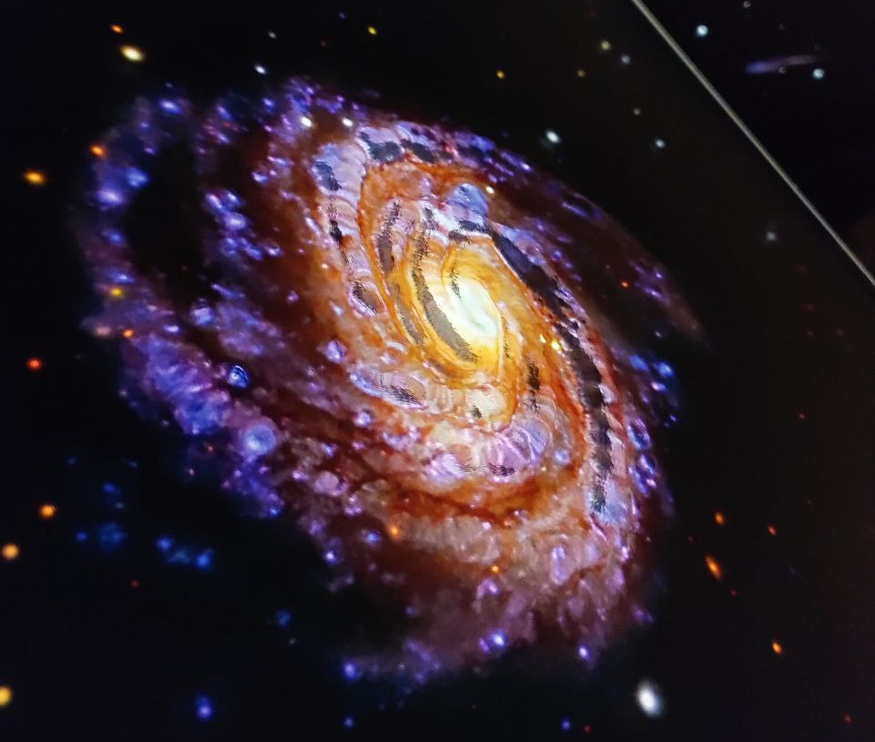
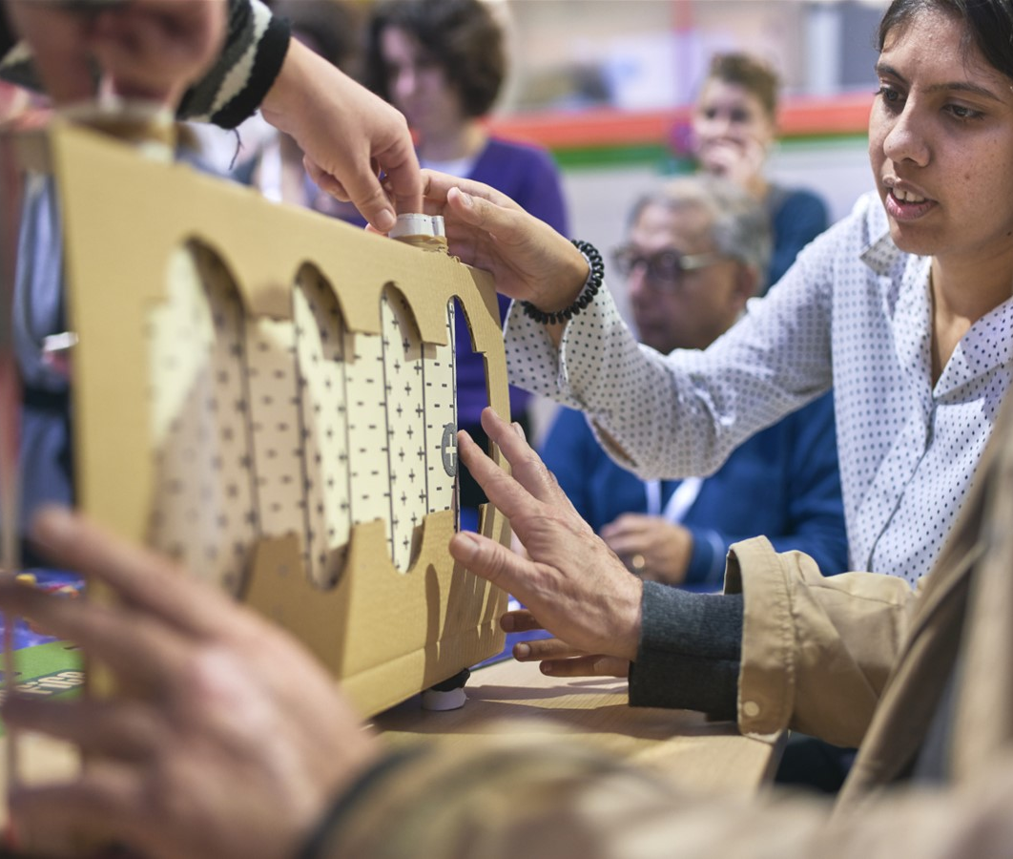
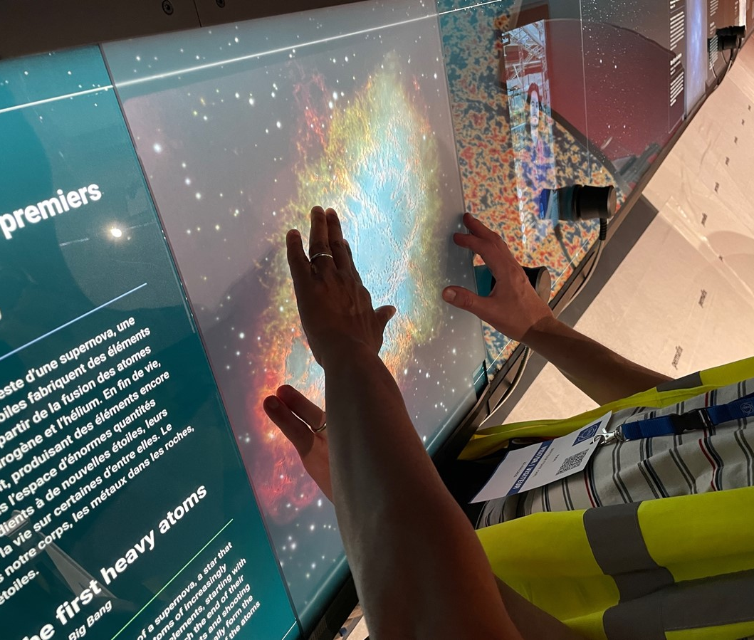
Formative evaluation
Testing tactile content
  Methodology
    Testing tactile content with swelling paper and paper
    prototypes with associations for blind and visual
    impaired people (ABA, Culture accessible)
  Goal
    Improve content and physical accessibility for
    blind and visual impaired people
What did we get out of it?
Provide tactile content, audio descriptions, subtitles and
easy access in wheelchair in Science Gateway exhibitions

Slide 7
Summative evaluation
Goals of the evaluation is to address
  Audience diversity and accessibility
    Do exhibitions attract diverse audiences?
  Visitor experience
    What emotions do visitors experience?
  Inspiring young generations
    Do young visitors consider science careers?
  Engage visitors with science
    Does interest in science increase after visits?
Design of the evaluation
  Mixed methods : survey, tracking, data from visit service, observations, discussions
  Complementary methods for reliable results
Notes:
Main goals of Science Gateway
Enable a diverse audience across all sectors of the public to engage with the science, the discoveries, the technologies and the people working at CERN
Inspire the next generation to explore a career in science and technology.
Empower visitors of all ages to make sense of the science that shapes their lives
Convey the importance and relevance of fundamental science in bringing nations together through peaceful collaboration and driving innovation.
Conserve and display the heritage of big science, the objects and stories that transmit the tremendous human endeavour in a tangible way.
Build ties across CERN Member States and beyond, encouraging co-creation with other museums, science centres and education networks.

Slide 8
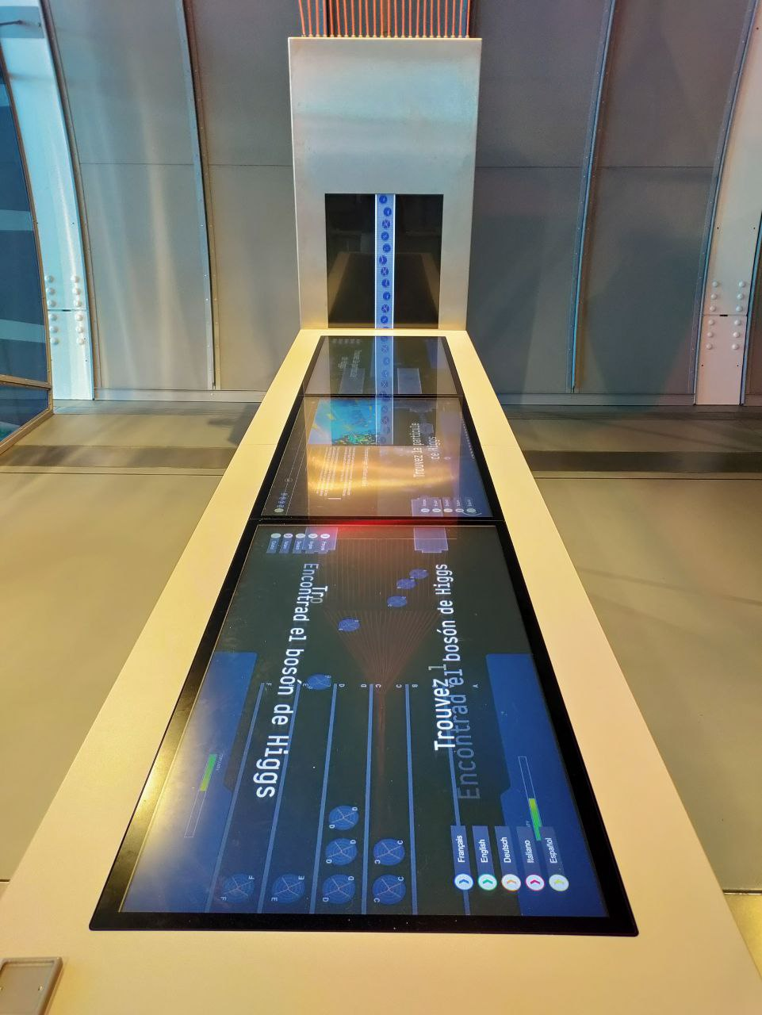
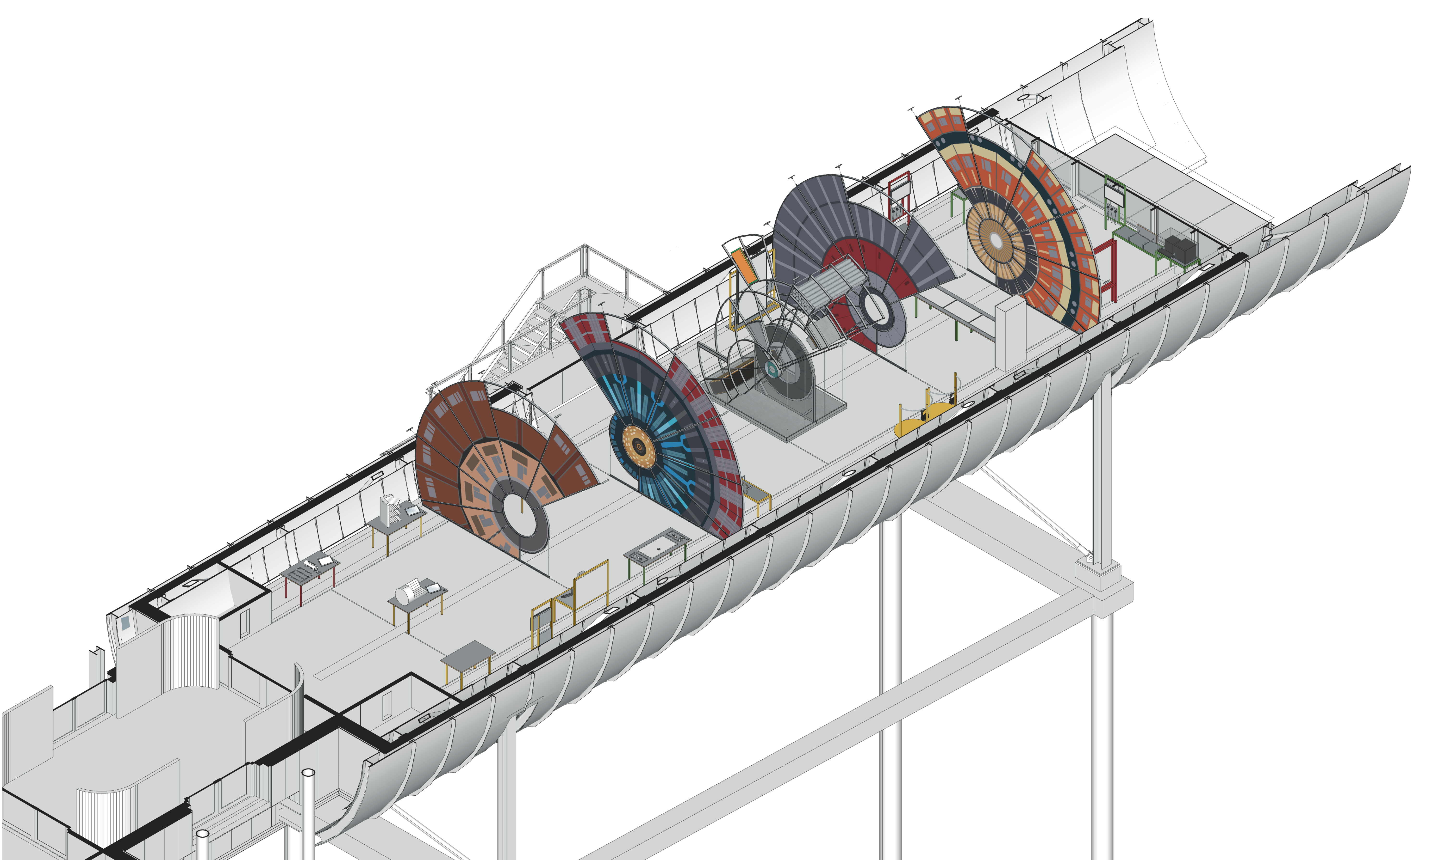
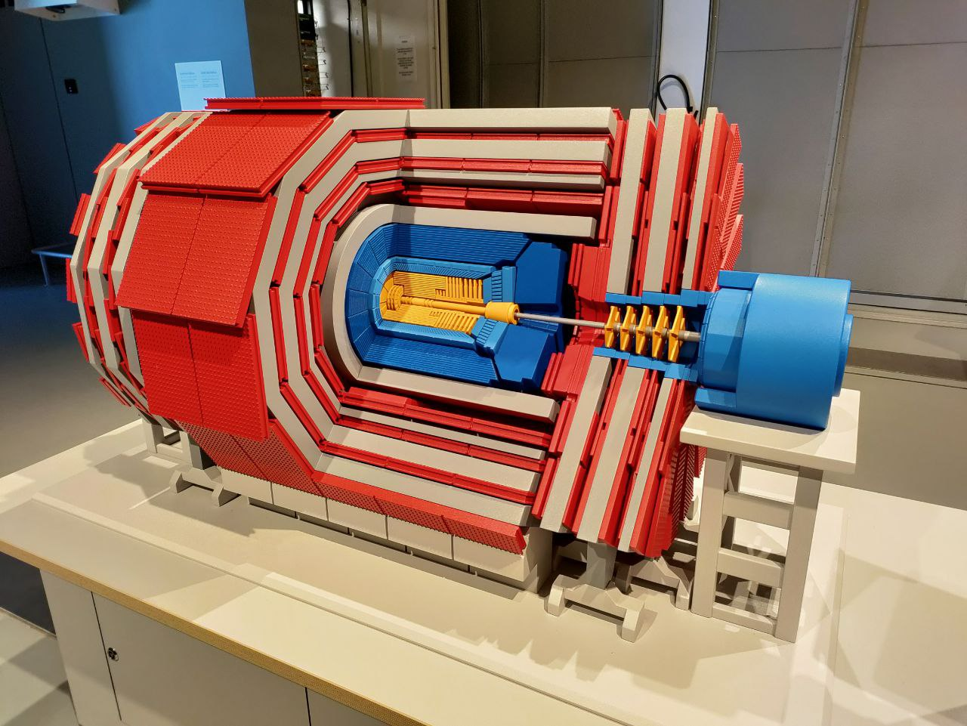
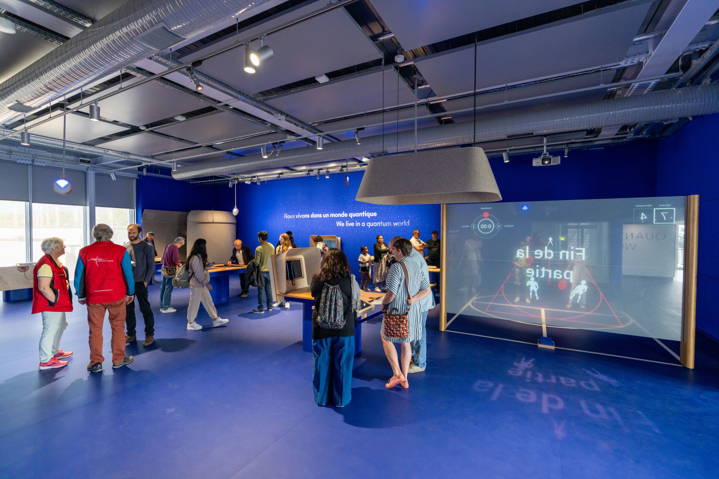
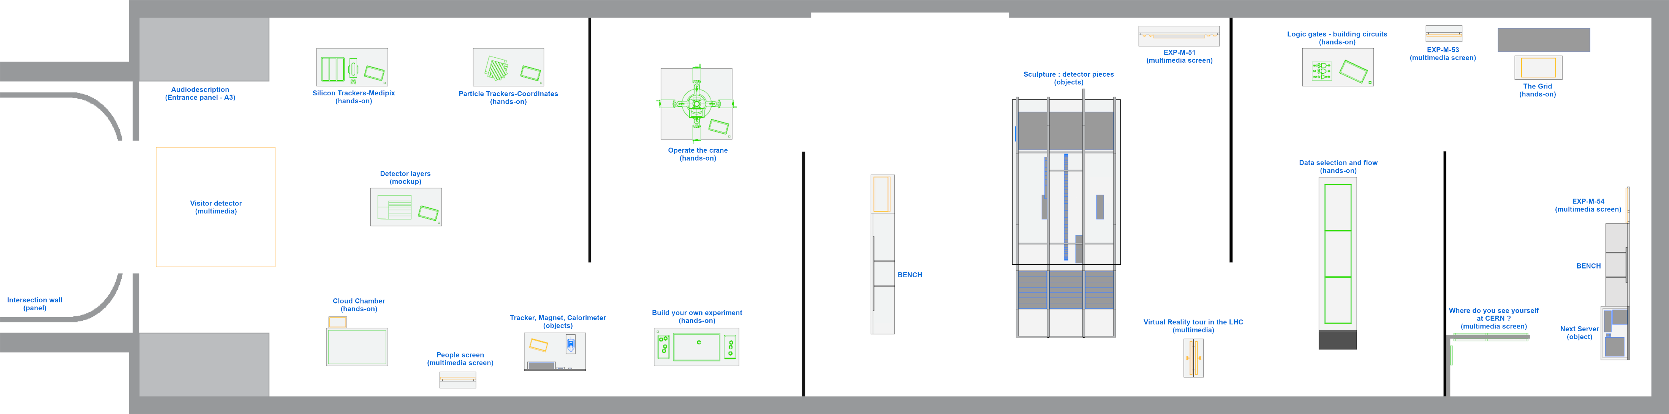
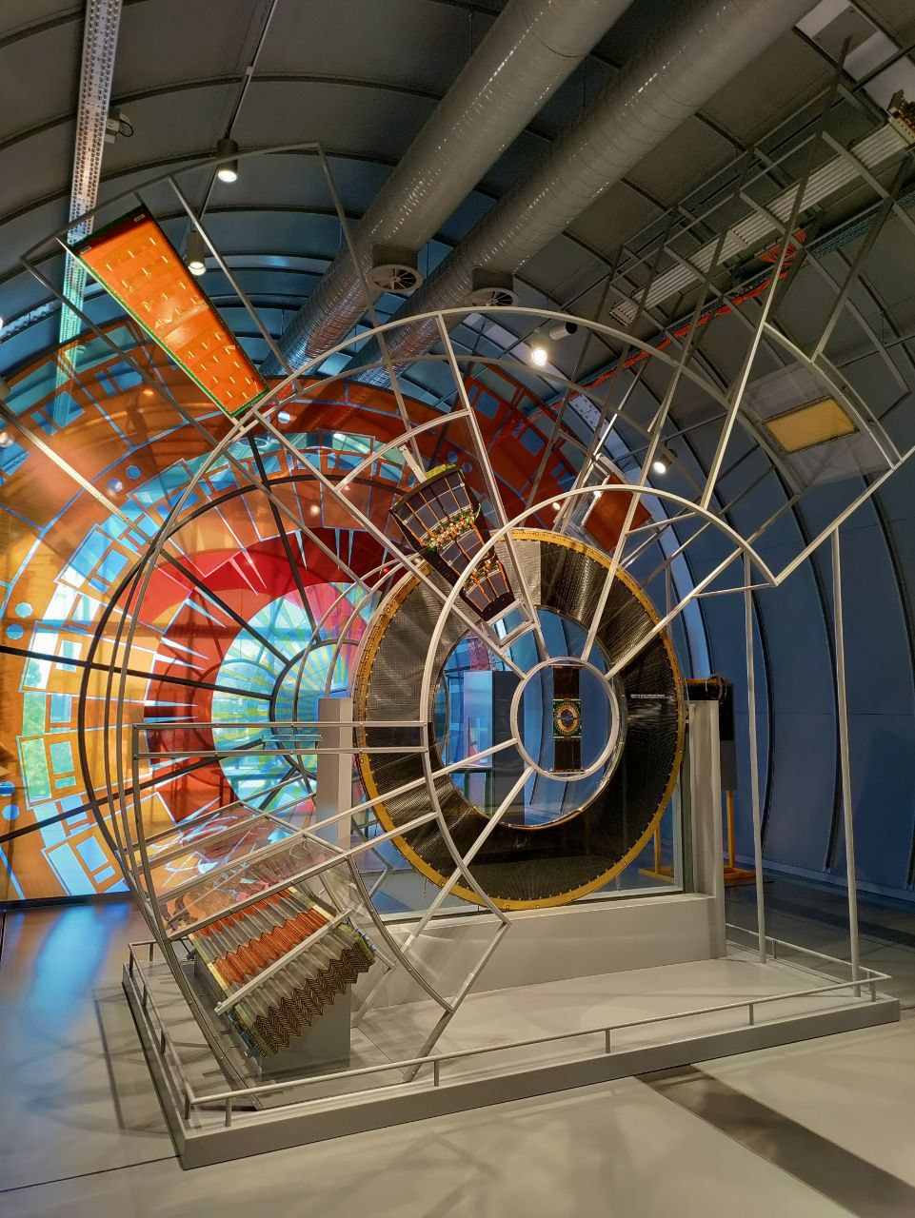
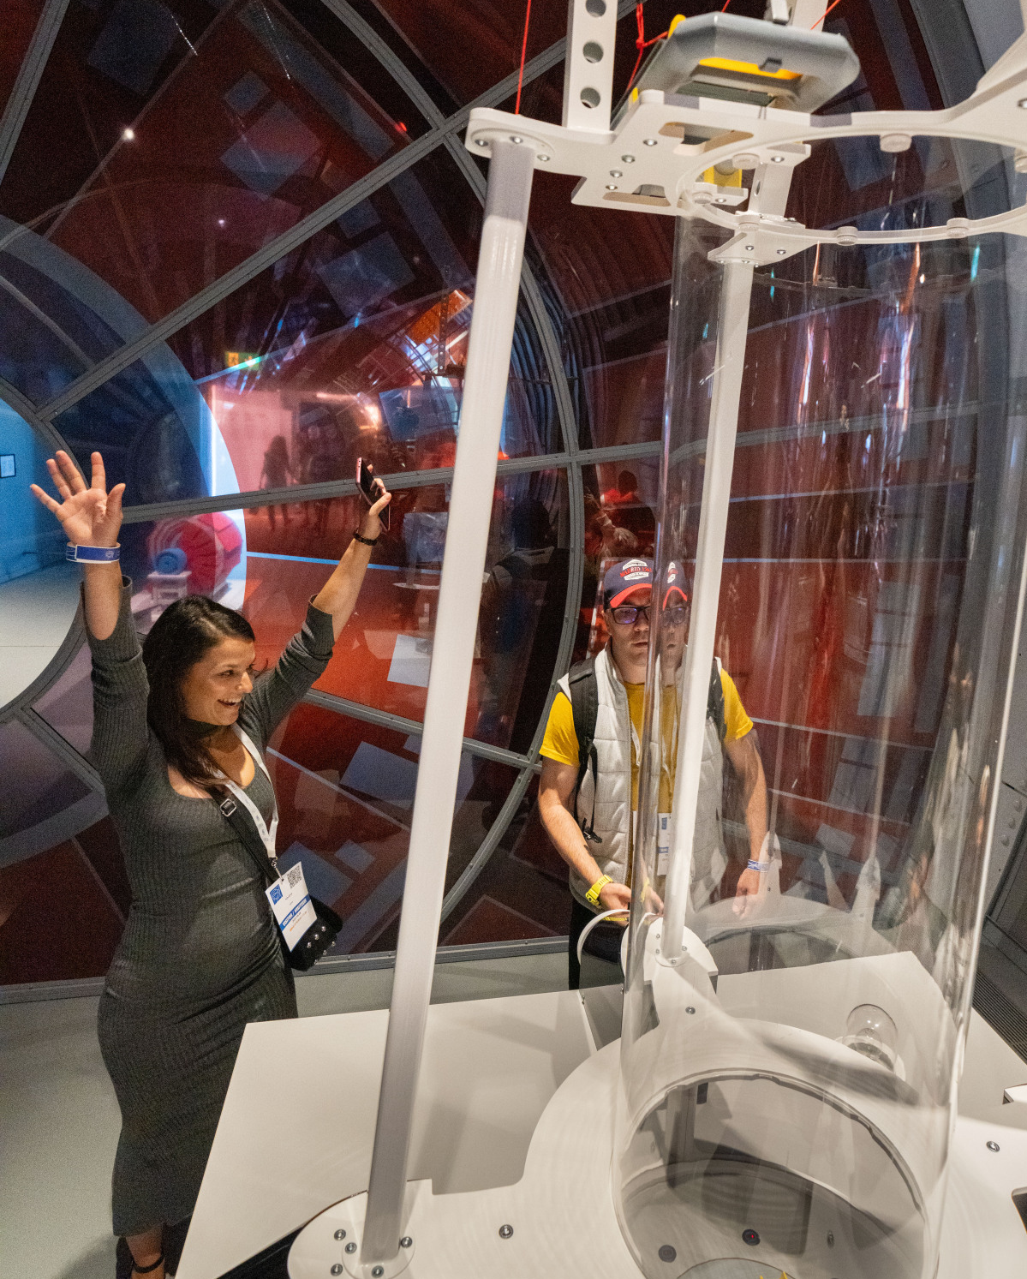
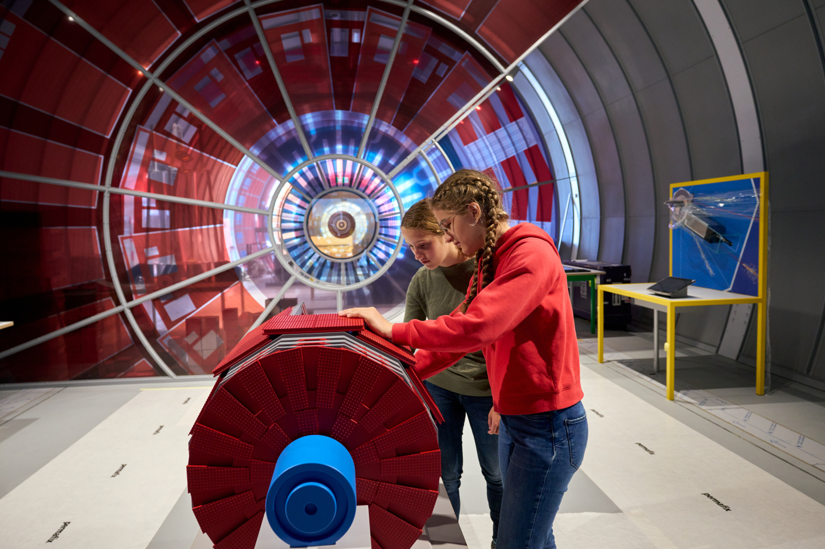
How do we evaluate ?
Collide exhibition
Survey for Science Gateway visitors
  30 questions (~ 8 min) about visitors’ :
    Expectations
    Emotions
    Experience
  Data collection at the end of the exhibits
Tracking
  Following visitor paths in exhibition
    Measuring stop, order of stops, time spent at the exhibits
  Identifying popular activities and potential bottlenecks
Entrance

Slide 9
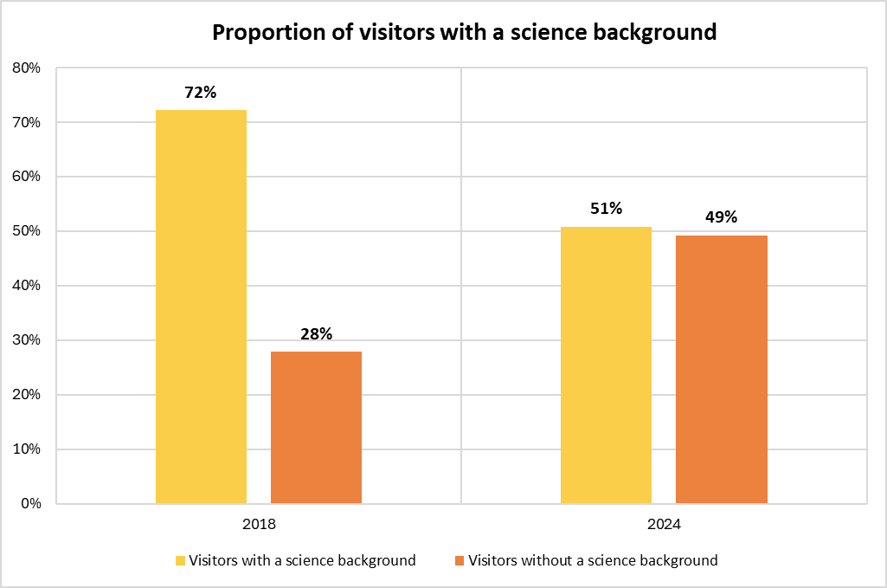
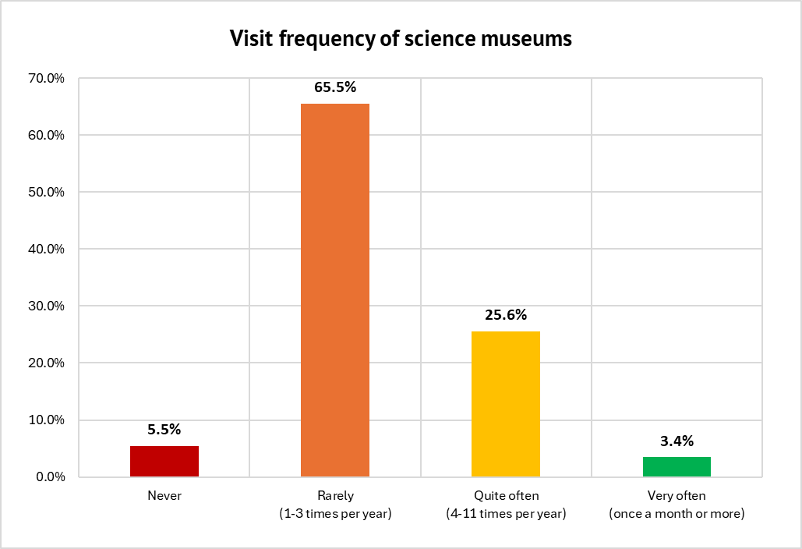
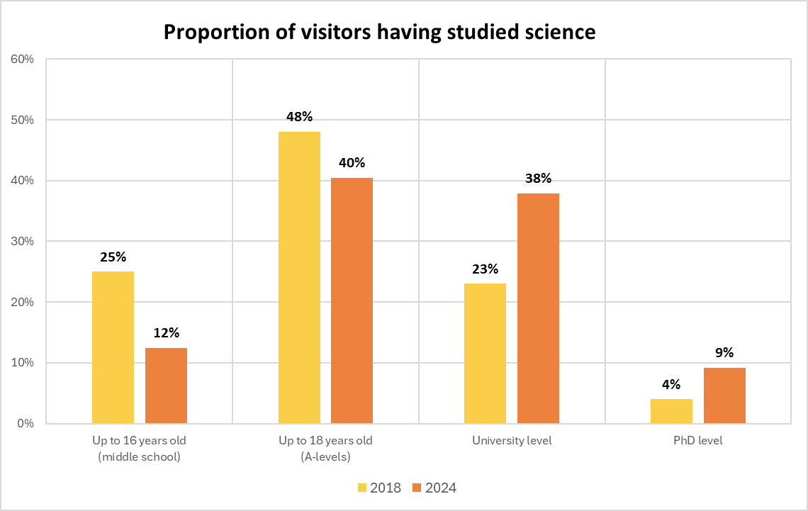
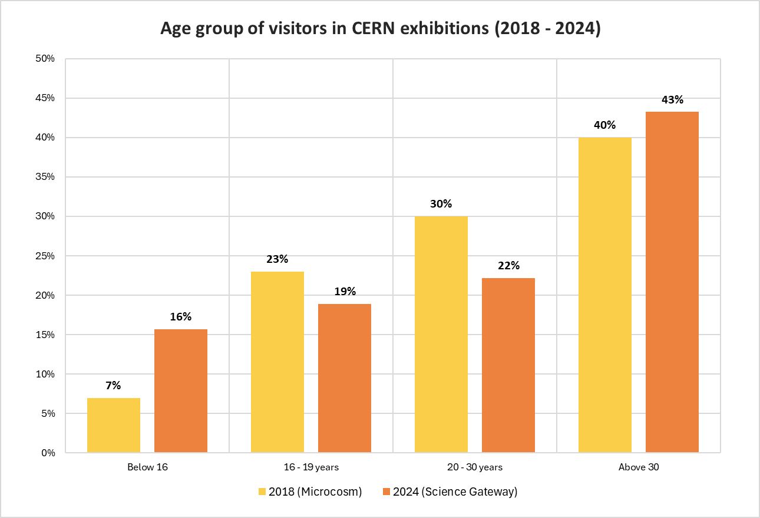
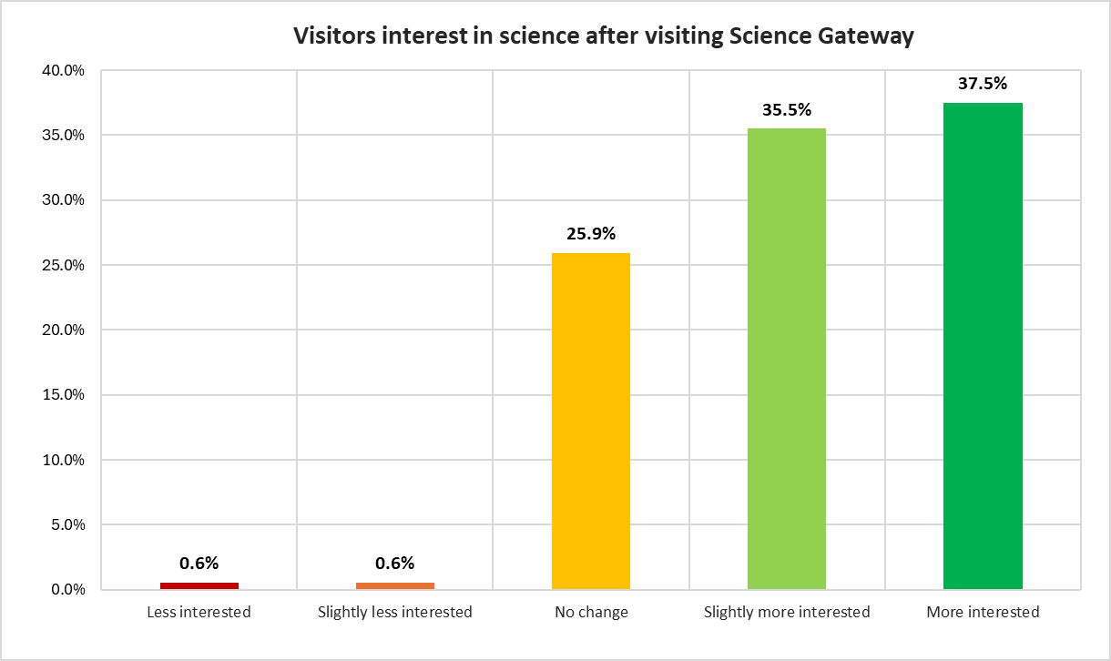
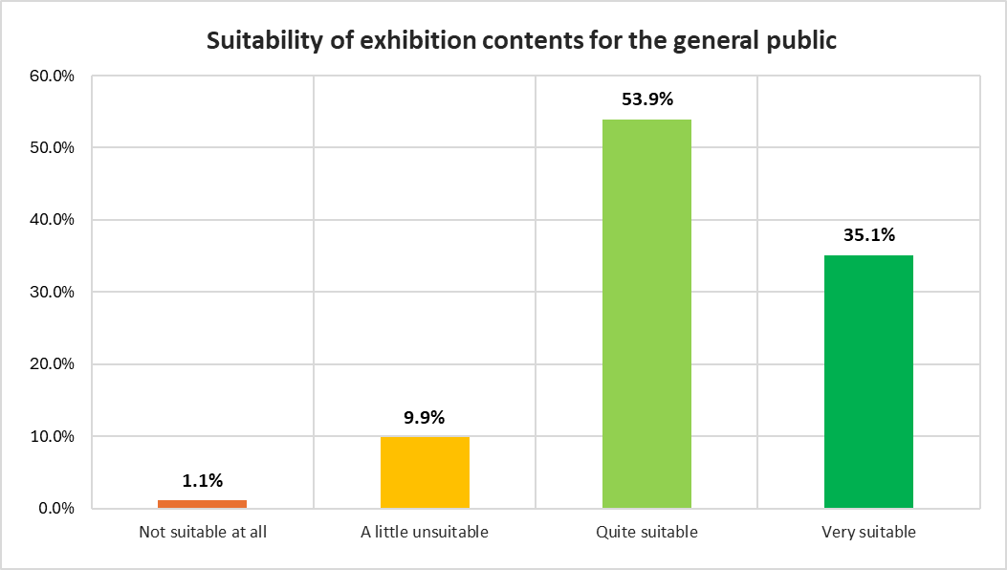
Who visit the exhibitions ?
New public audiences
  Younger visitors
  Half of visitors have not a science background
  Most of visitors come rarely to science museums (1 to 3 times a year)
Engaging visitors with science
  Visitors consider exhibition content suitable for the general public
  Visitors are more interest in science after their visit

Slide 10
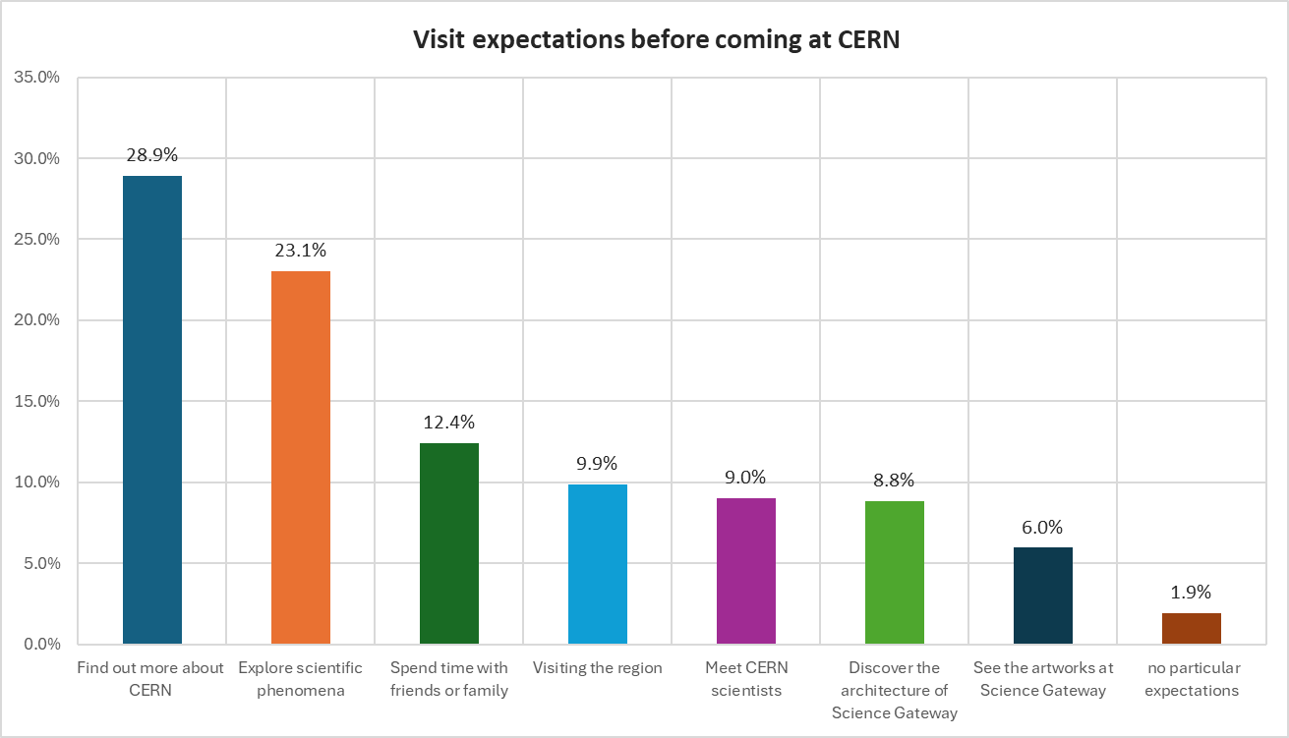
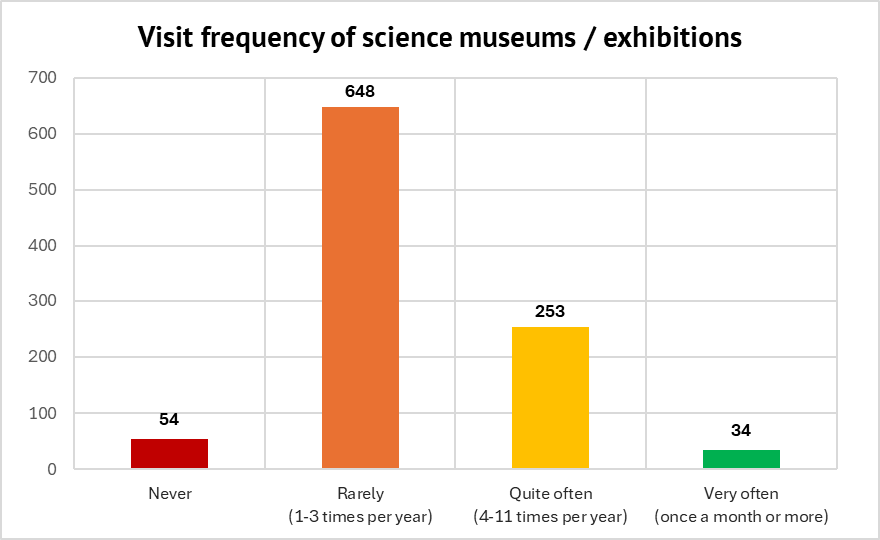
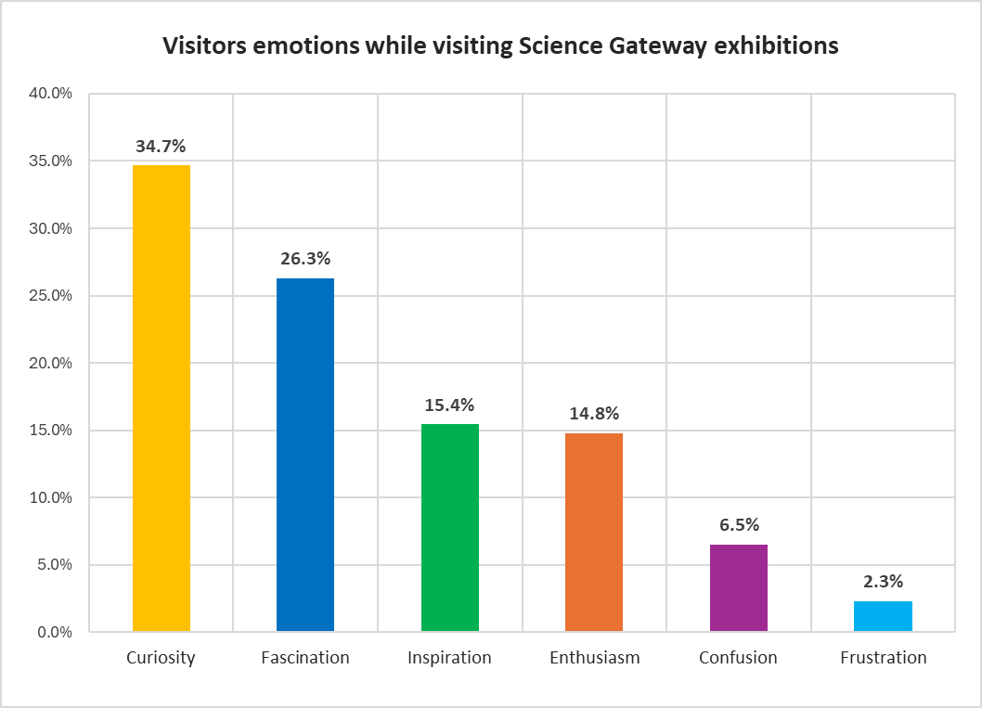
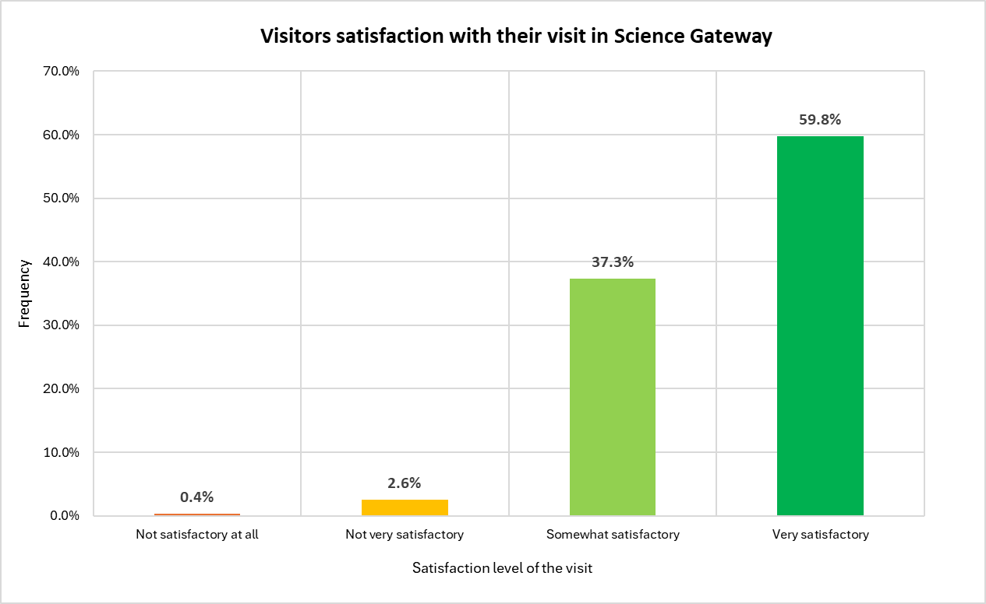
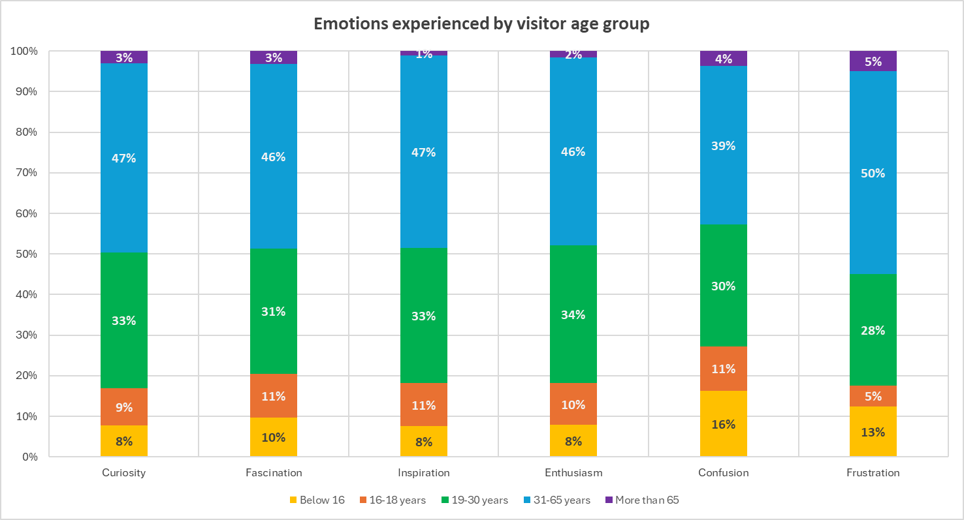
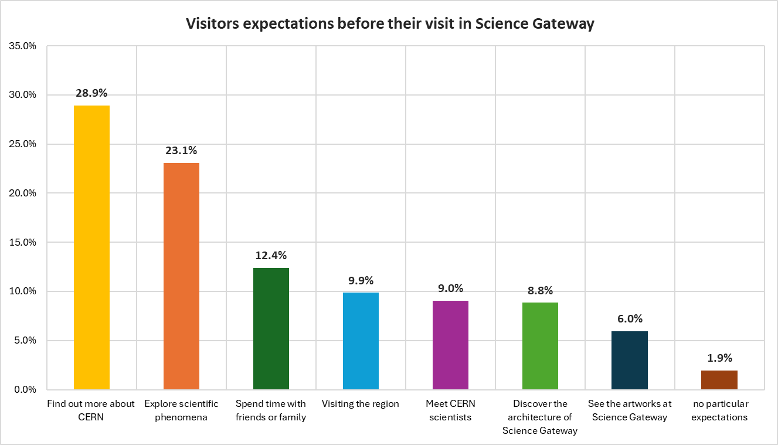
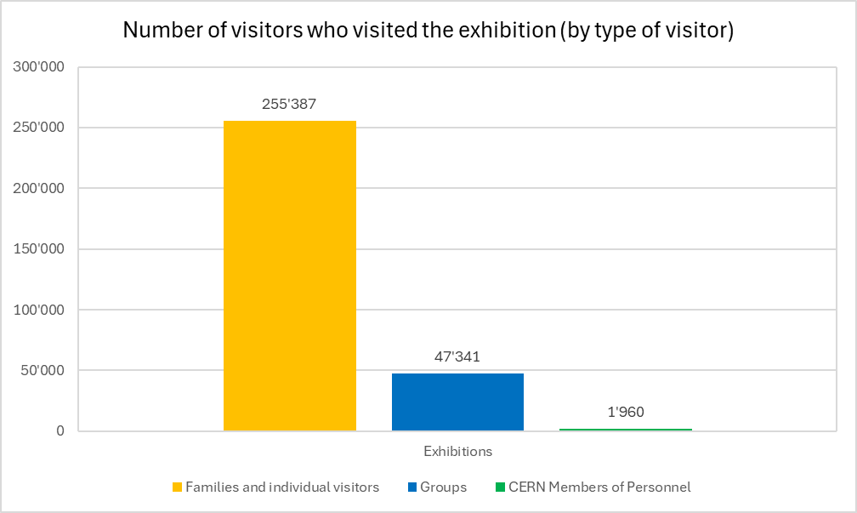
What do visitors experience and feel ?
Visit expectations vs. experience
  Most of the visitors expect to :
    Find out more about CERN
    Explore scientific phenomena
    Spend time with friends or family
  High percentage of visitors satisfied with their visit
What do visitors feel ?
  Visitors feel curious, fascinated and inspired by the exhibition
“Science Gateway exhibitions are like the Disneyland of physics”
Notes:
Parler des familles qui viennent visiter le Portail de la Science afin de s’amuser → expectations meet visit experience

Slide 11
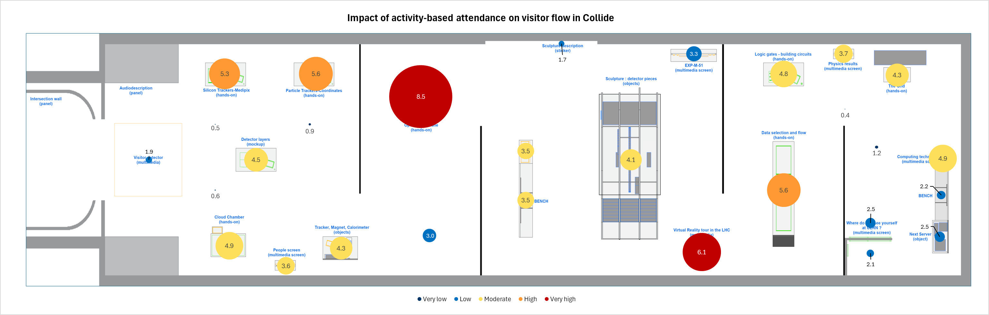
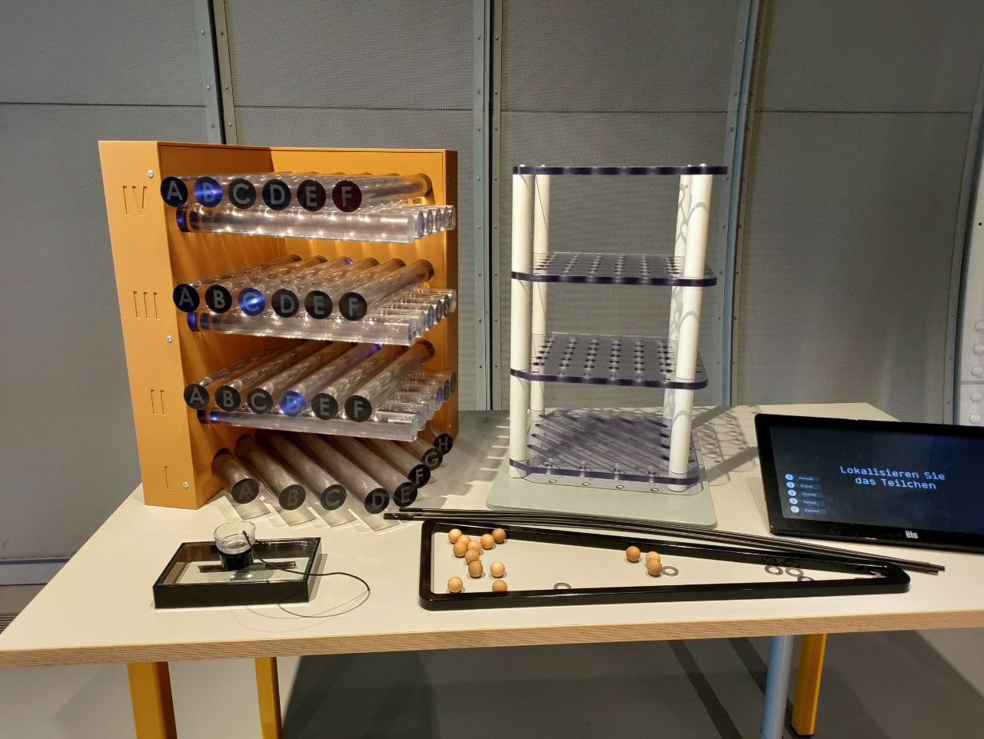
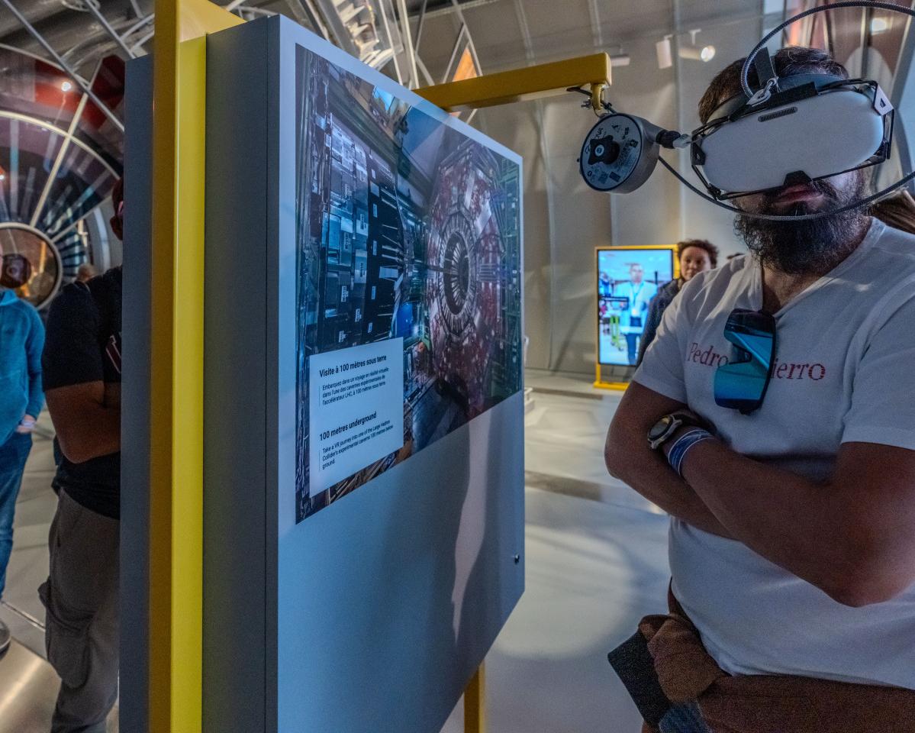
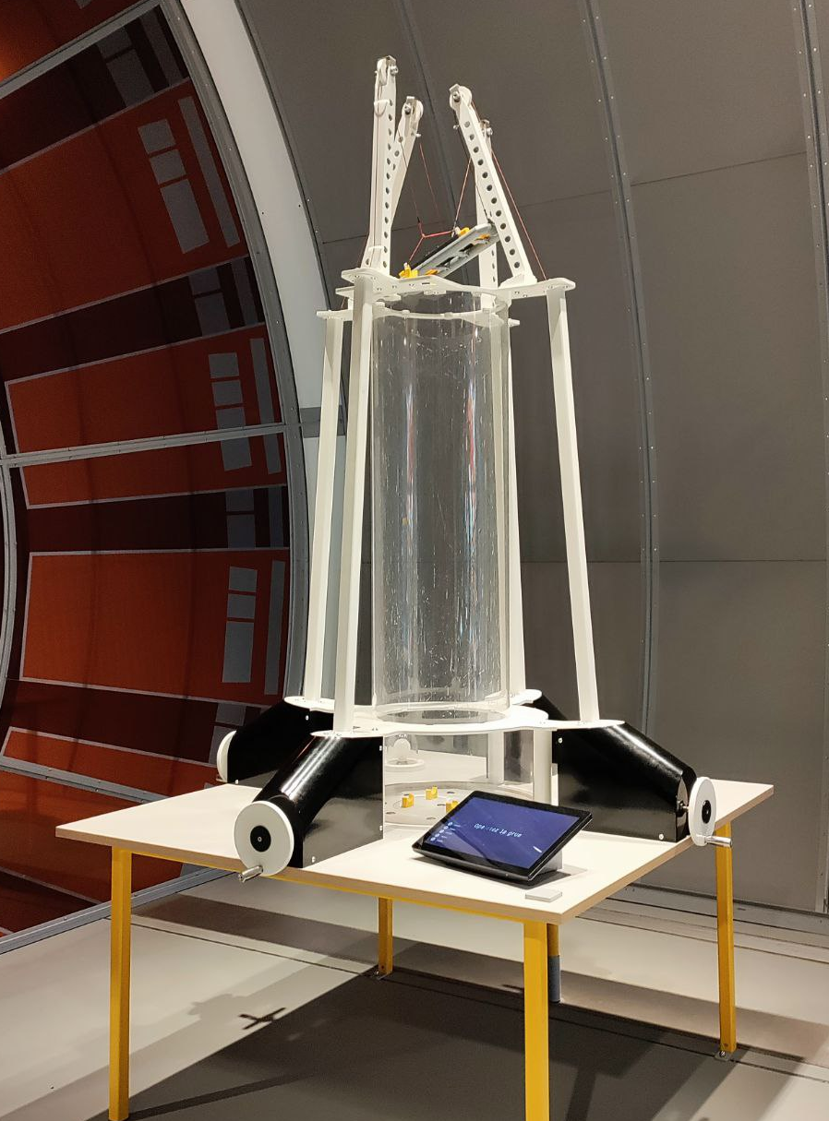
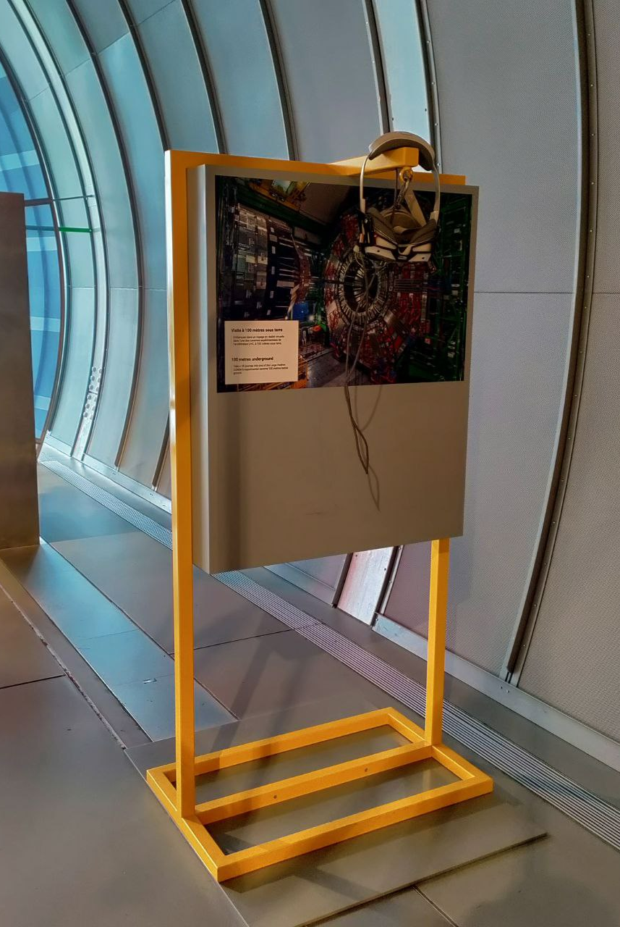
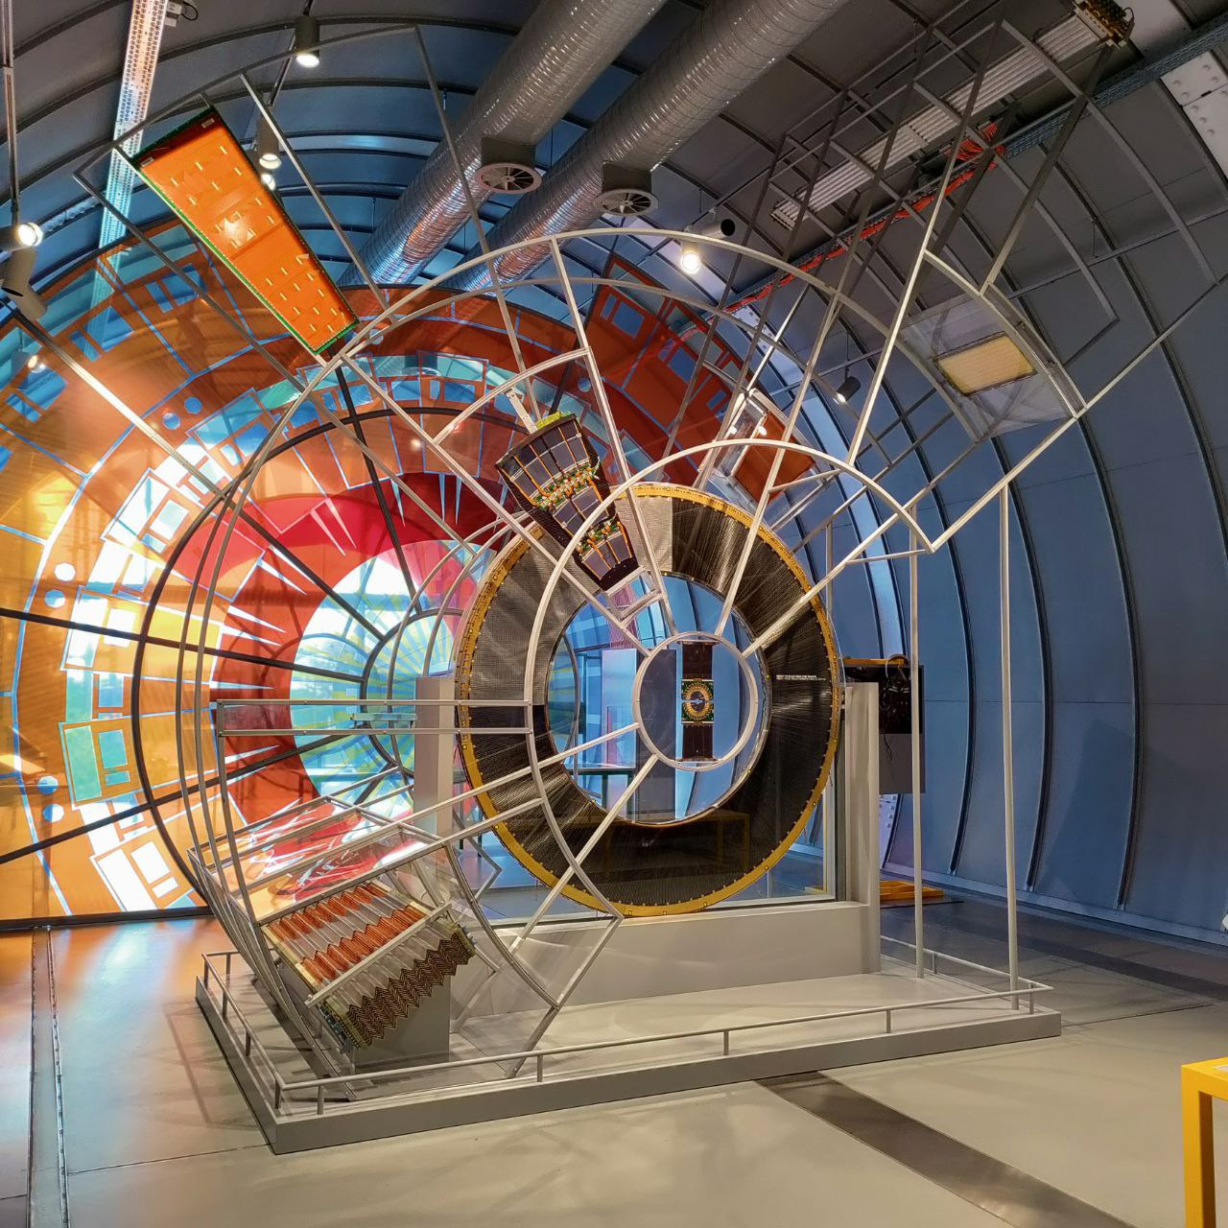
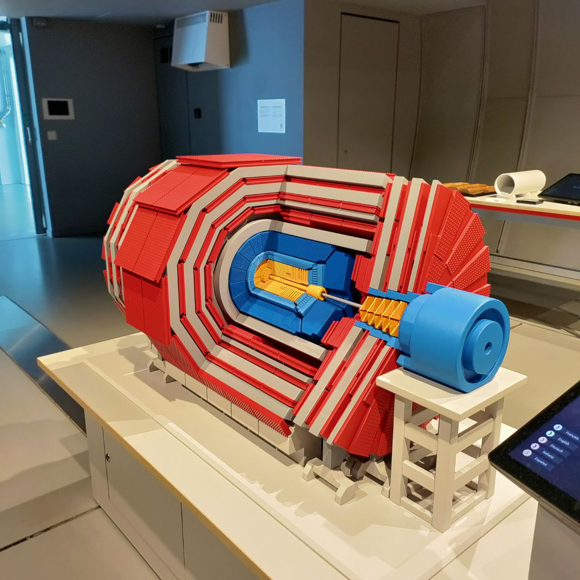
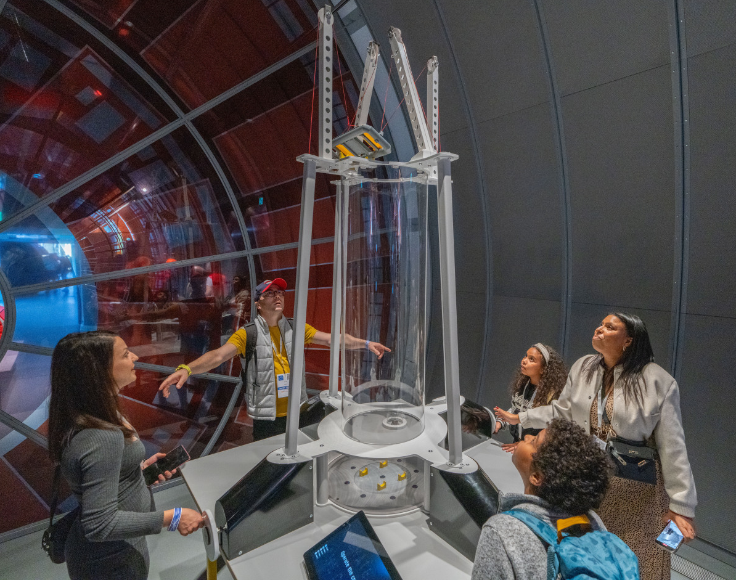
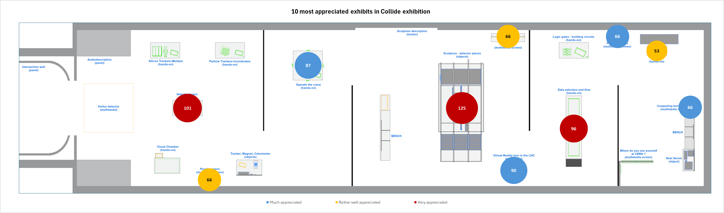
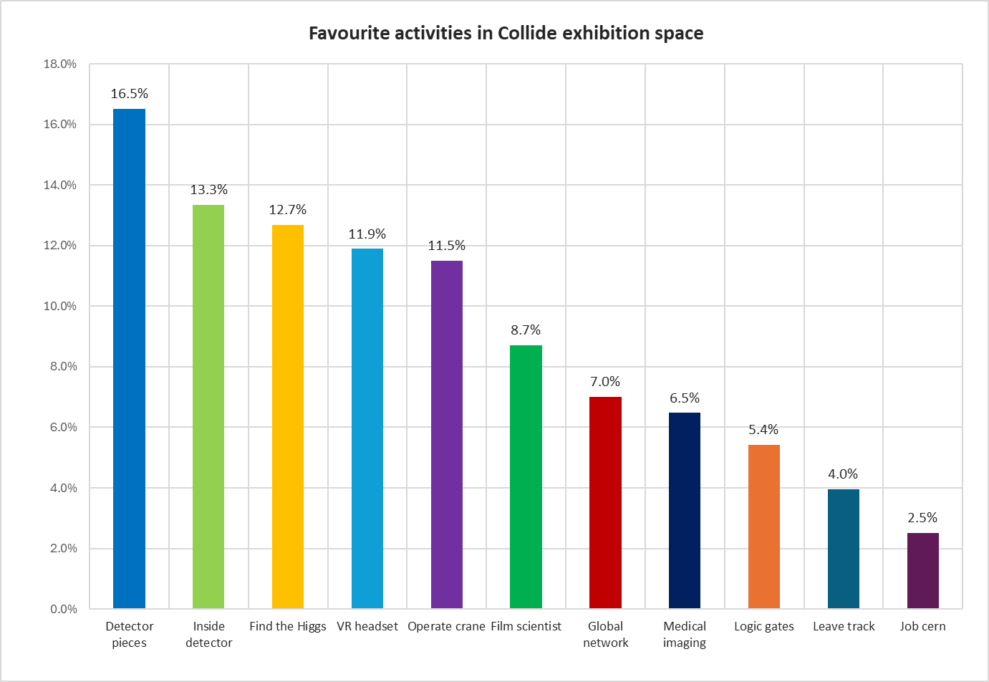
What do visitors appreciate most ?
Most frequented exhibits are not always the most appreciated
Which exhibits are the most frequented?
  Visitor flow is focused around two exhibits :
    Operate the crane
    VR headset
But…
  Visitors particularly appreciate :
    Authentic objects (detector pieces)
    Tactile objects (Inside a detector)
    Interactive games (Find the Higgs)
    Immersive experience (VR headset)
    Hands-on exhibits (Operate the crane)
Operate the crane
VR headset

Slide 12
New paths to explore...
Ongoing analysis
Survey for Science Gateway guides
Observation data analysis (and triangulation with surveys and tracking)
Evaluation process
Continuity in the evaluation process (frontend, formative and summative evaluation)
  Using previous evaluation results to enhance exhibitions
  Mixed methods for a comprehensive analysis and reliable results
What changed?
New demonstrations introduced to improve guide-public interactions.
Identification of a bottleneck in visitor flow and readjustment of the exhibition space

Slide 13
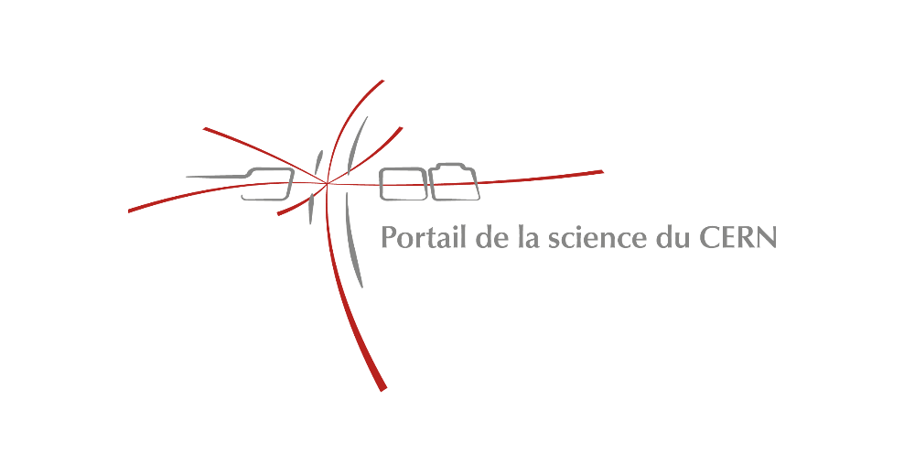

Thank you for your attention !

