Slide 1
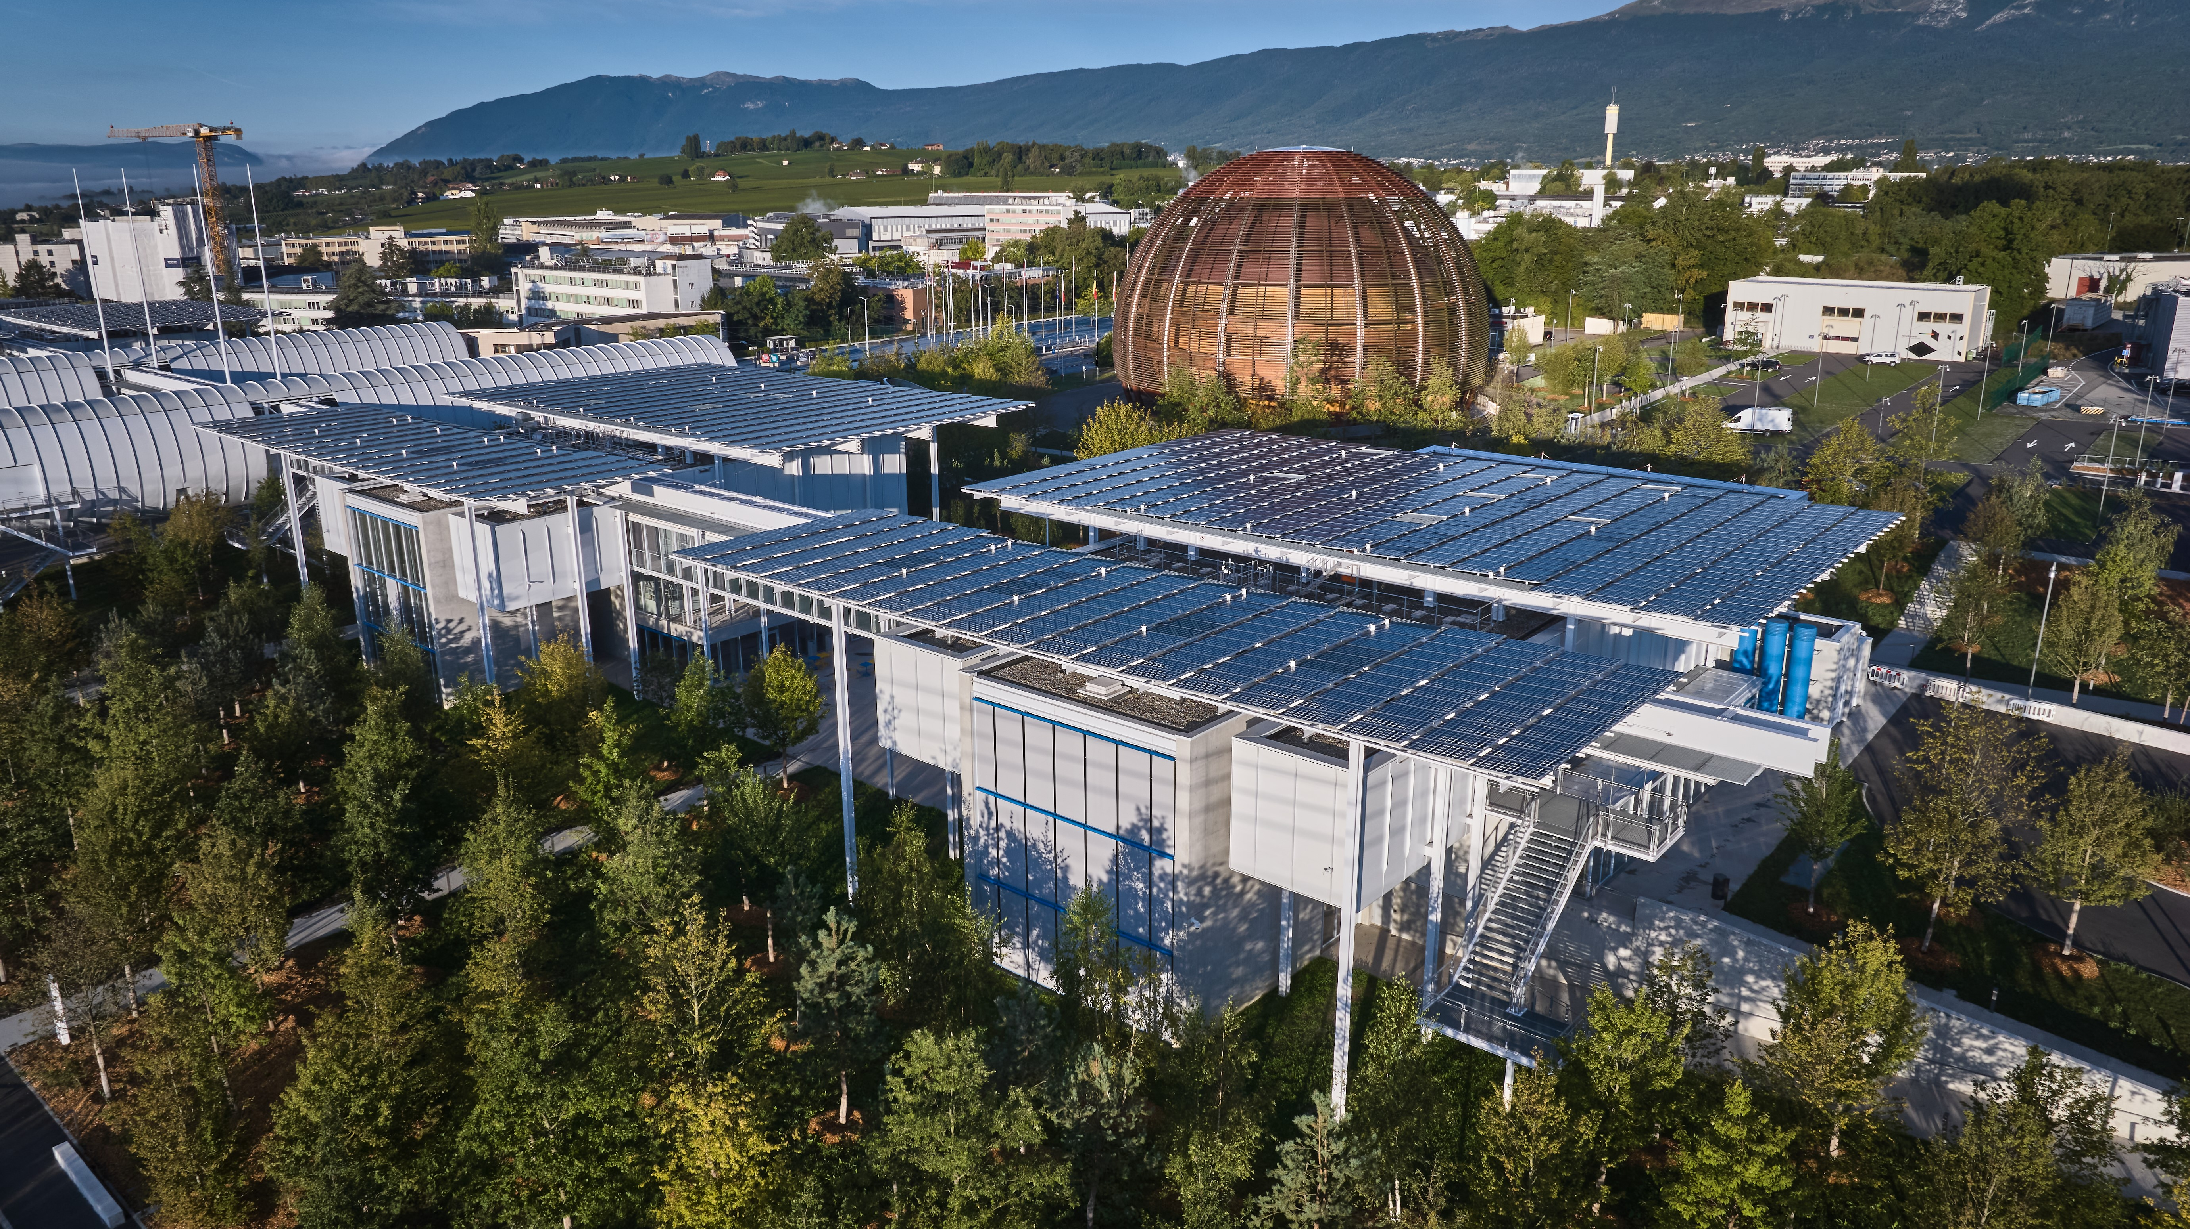
Communicating Science Gateway
Kate Kahle
28 November 2024
Notes:
With CERN Science Gateway built, equipped with excellent exhibitions and animated with fascinating science shows and lab workshops, now comes the task of generating and maintaining excitement both internally and externally.
This is the role of the digital, media and editorial teams to craft and disseminate communication products. So how did we build momentum ahead of the inauguration? How did we motivate the CERN community to volunteer as CERN guides? What was put in place for the inauguration itself? How have we used our internal newsletter, website and social media channels to inform and engage? And finally, how does CERN Science Gateway fit with CERN’s strategic priorities and communication strategy?
CERN’s strategic priorities include delivering world-class scientific results and knowledge, increasing return to Member and Associate Member States and strengthening CERN’s impact on society. These priorities underpin CERN’s communication strategy, which encompasses internal and external communications and builds on decades of well-established and successful communications, education and outreach programmes.
This presentation will provide examples of what was communicated, the underlying strategy and the results obtained.

Slide 2
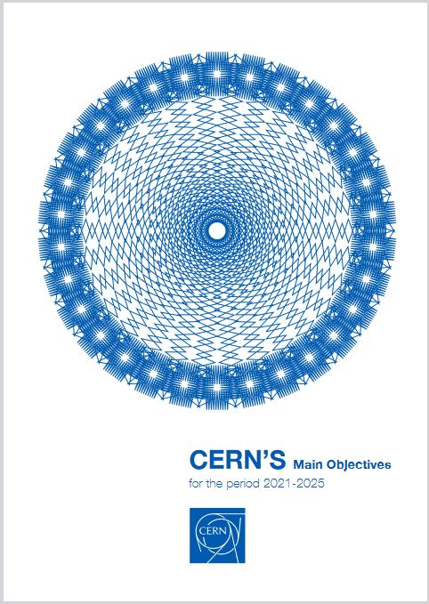
CERN’s Main Objectives 2021–2025
CERN management has identified three top-level objectives for 2021–2025:
• To deliver world-class scientific results and knowledge;
• To increase the return to Member and Associate Member States in several areas;
• To strengthen CERN’s impact on society.

Slide 3
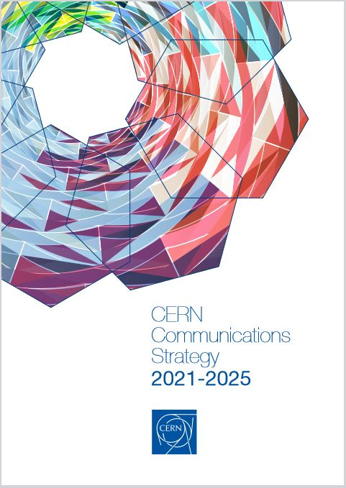
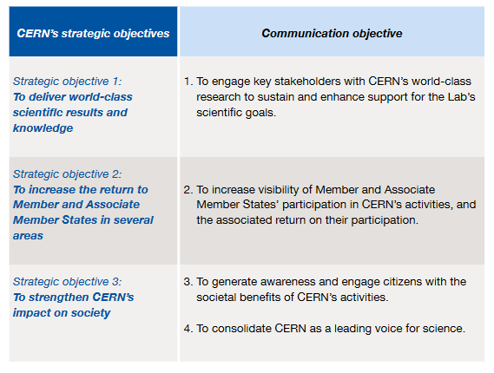
CERN Communications Strategy 2021–2025

Slide 4
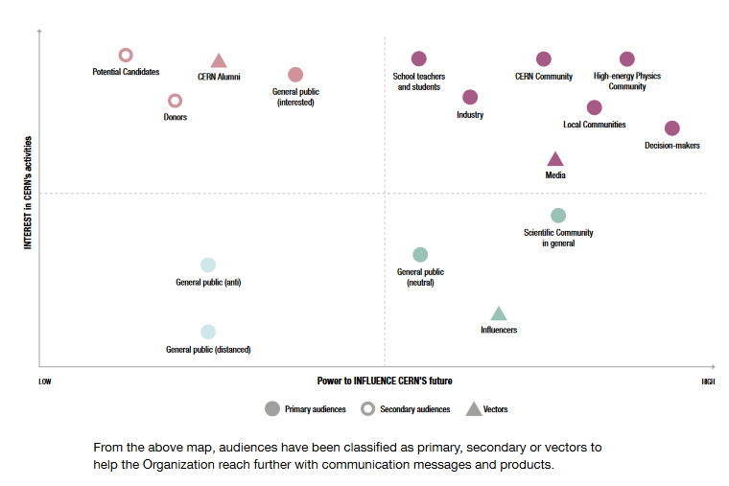
CERN Communications Strategy 2021–2025

Slide 5
~3000 staff
+12,000 worldwide particle physicists
+2000 students and graduates

Slide 6
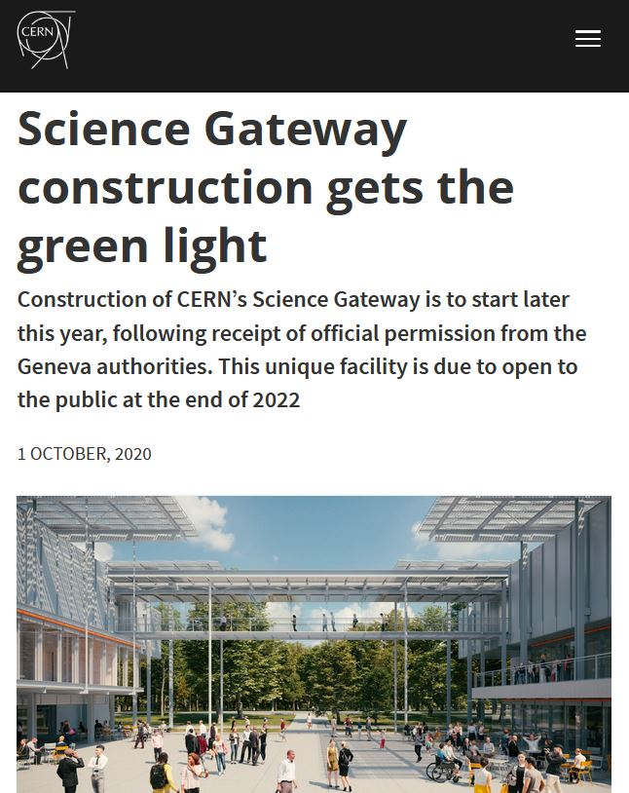
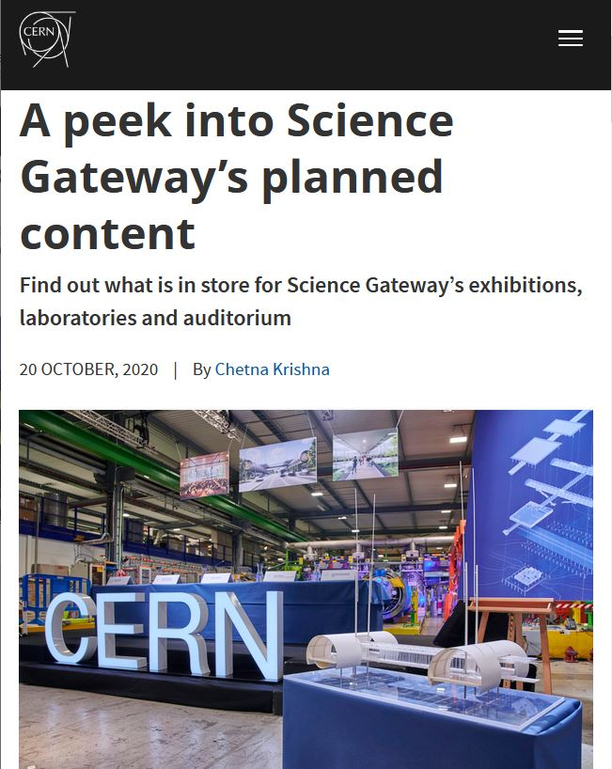
Building momentum from 2020 onwards

Slide 7
Building momentum internally…

Slide 8
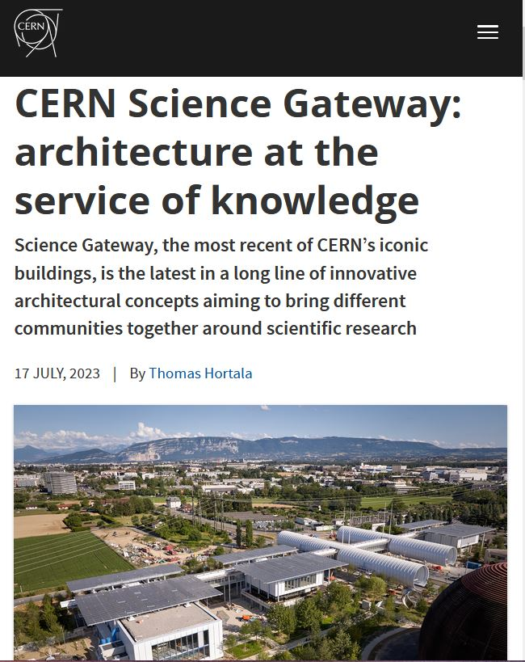
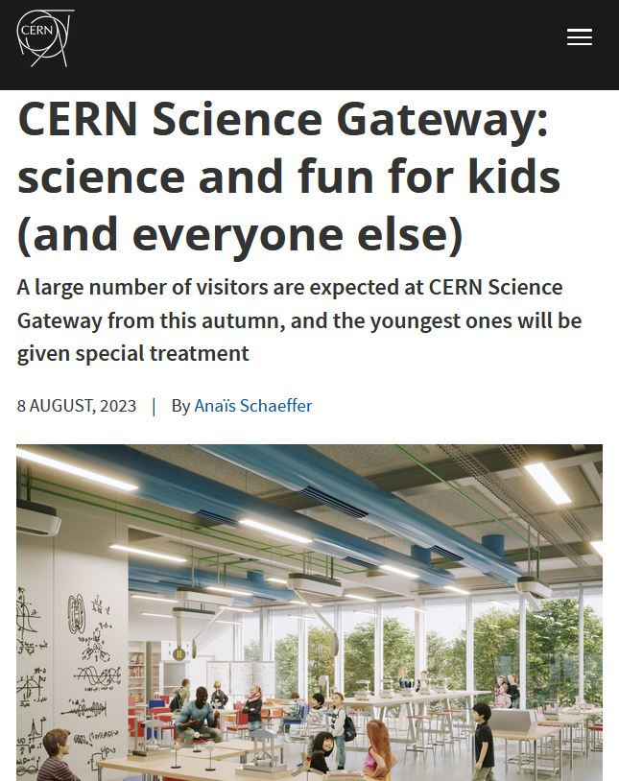
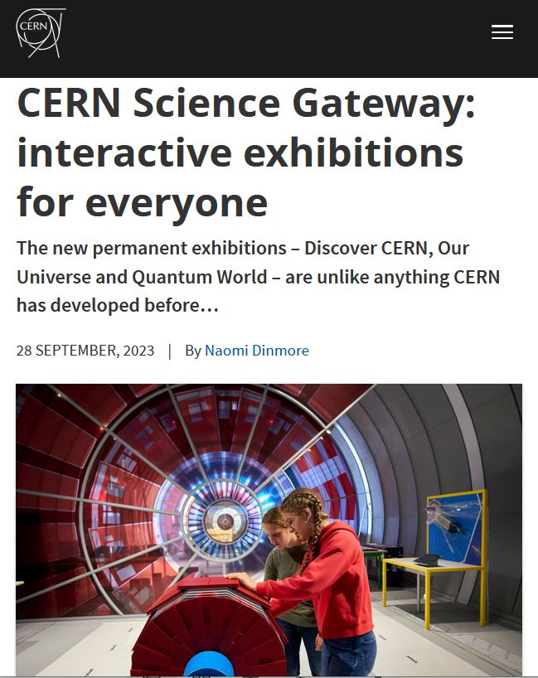
Building momentum internally

Slide 9
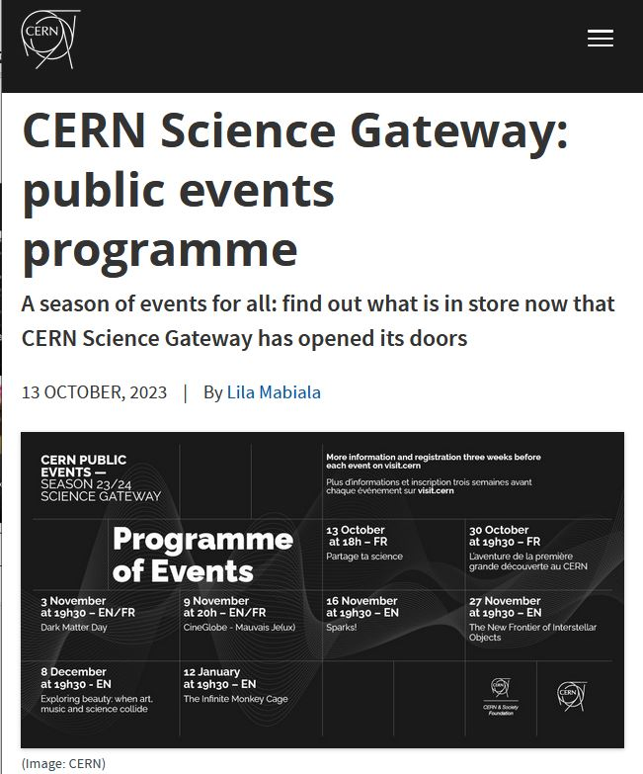
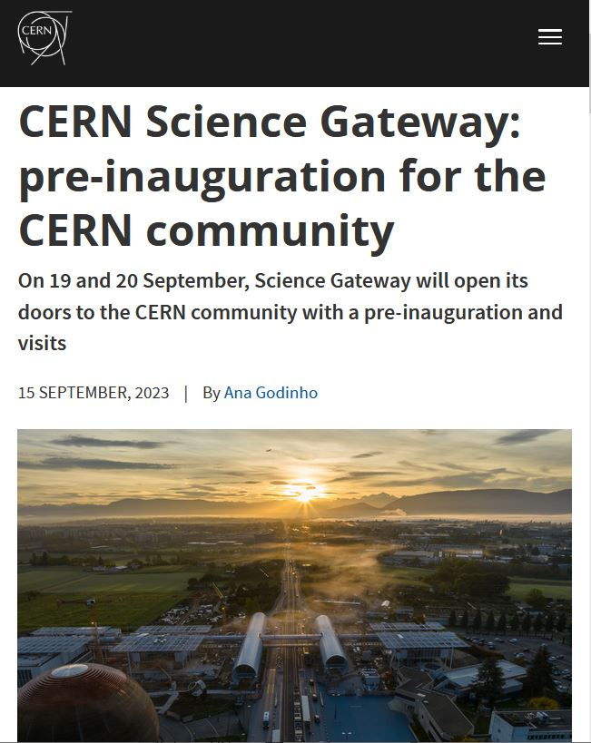
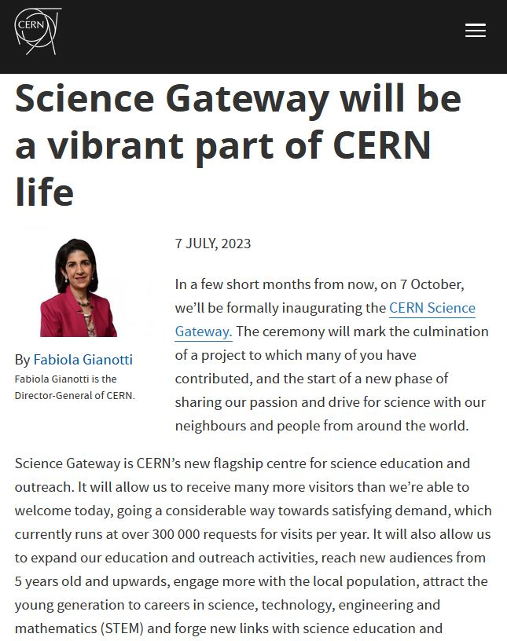
Building momentum internally

Slide 10
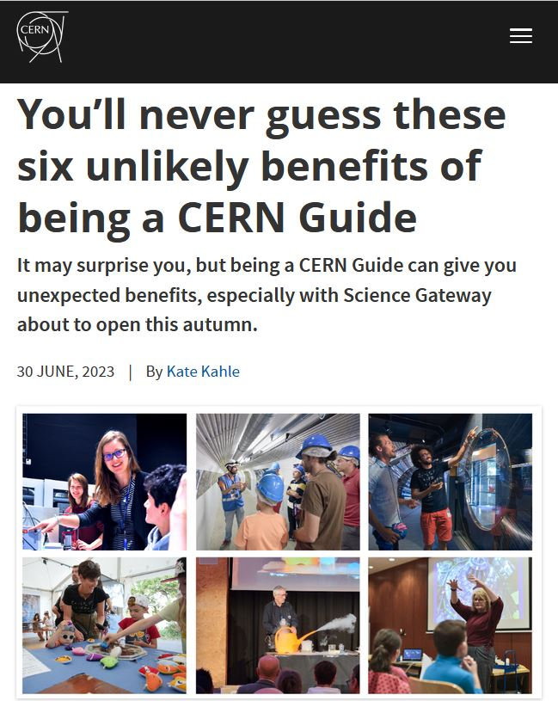
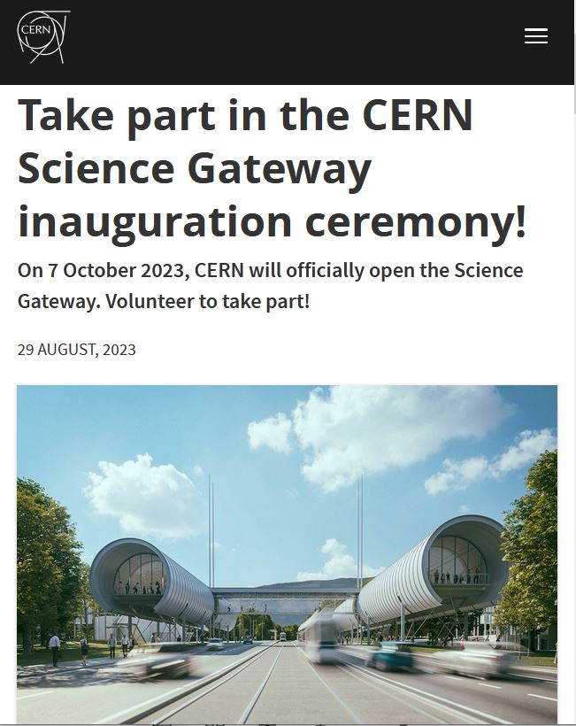
Motivating the CERN community to get involved

Slide 11
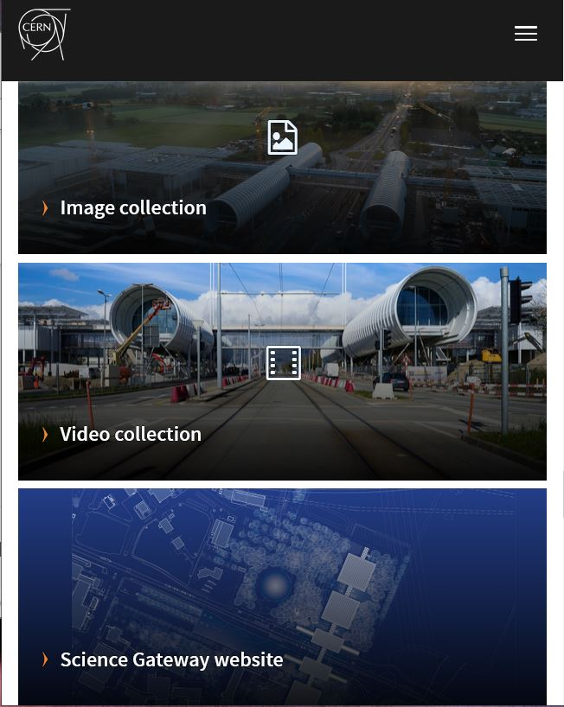
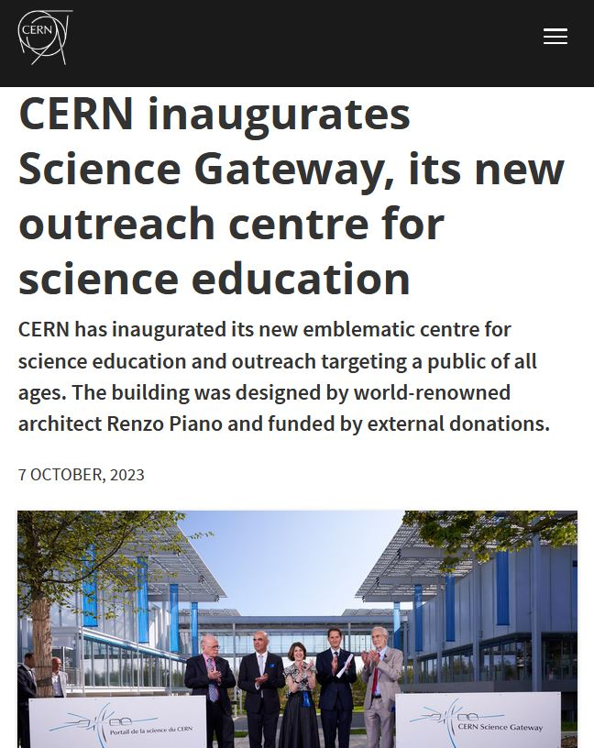
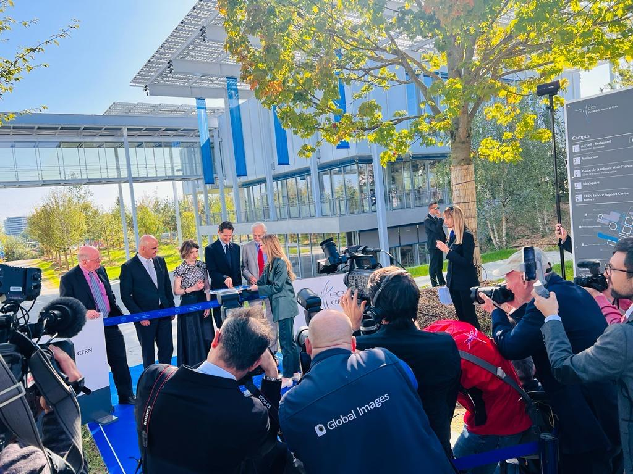
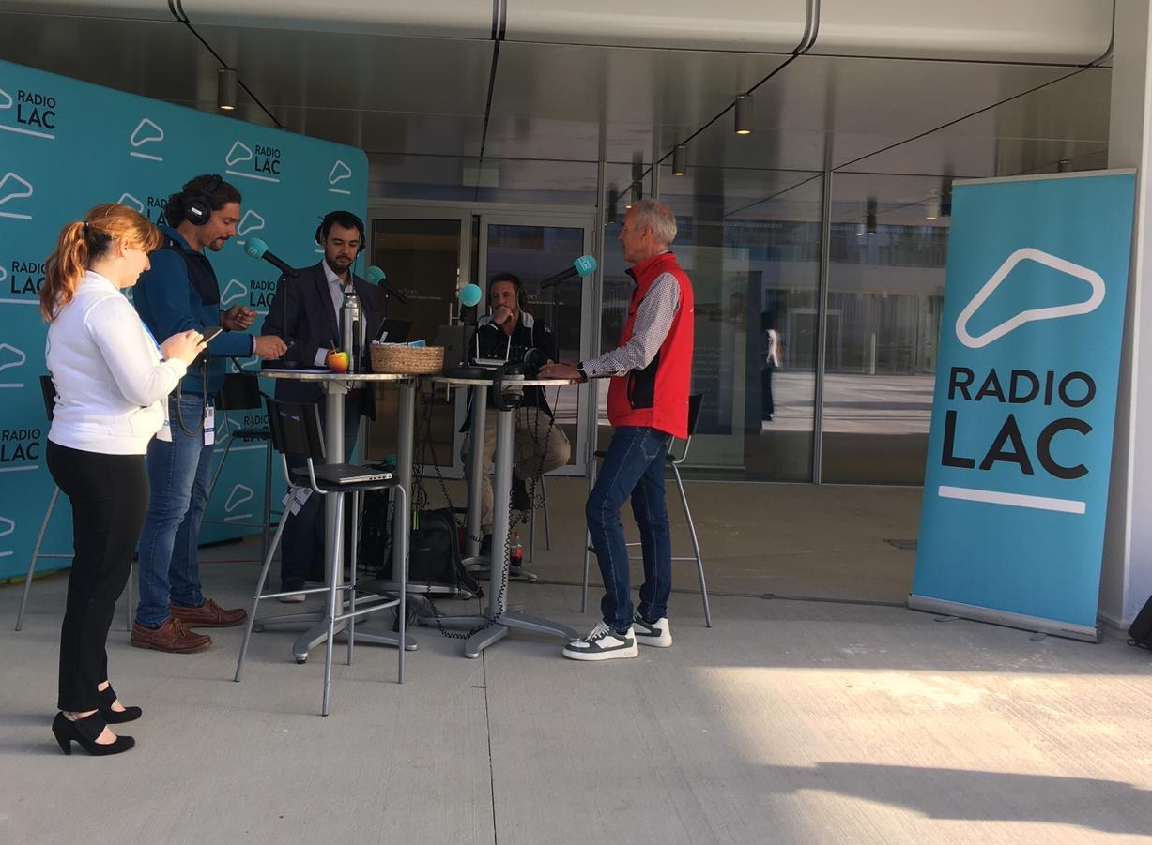
Inauguration media relations
Media pre-visit and digital media kit
+80 journalists on site for inauguration
Radio Lac for public opening

Slide 12
Media coverage (Q4 2023)
Alpha antimatter result + beginning of LHC lead-ion run
Science Gateway inauguration

Slide 13
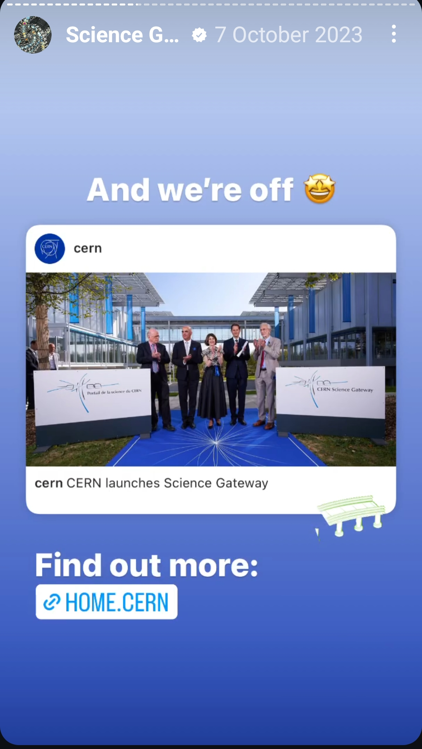
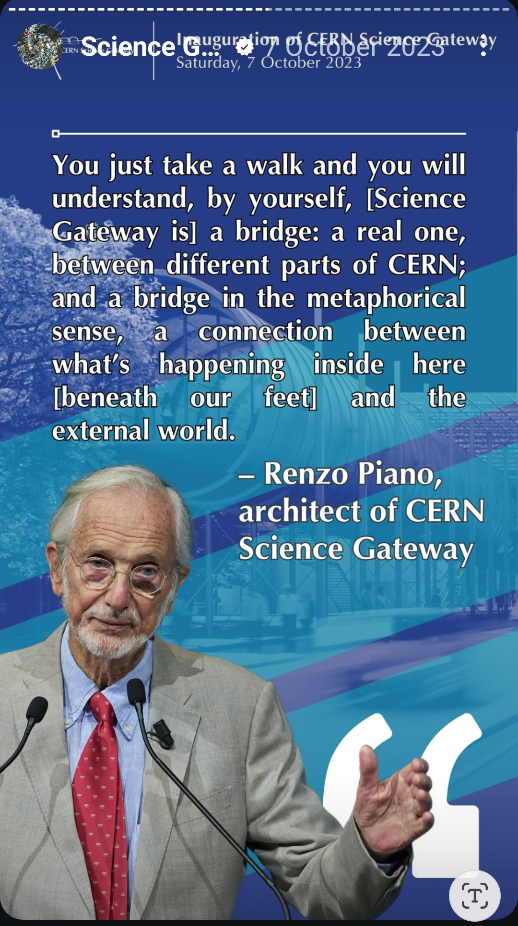
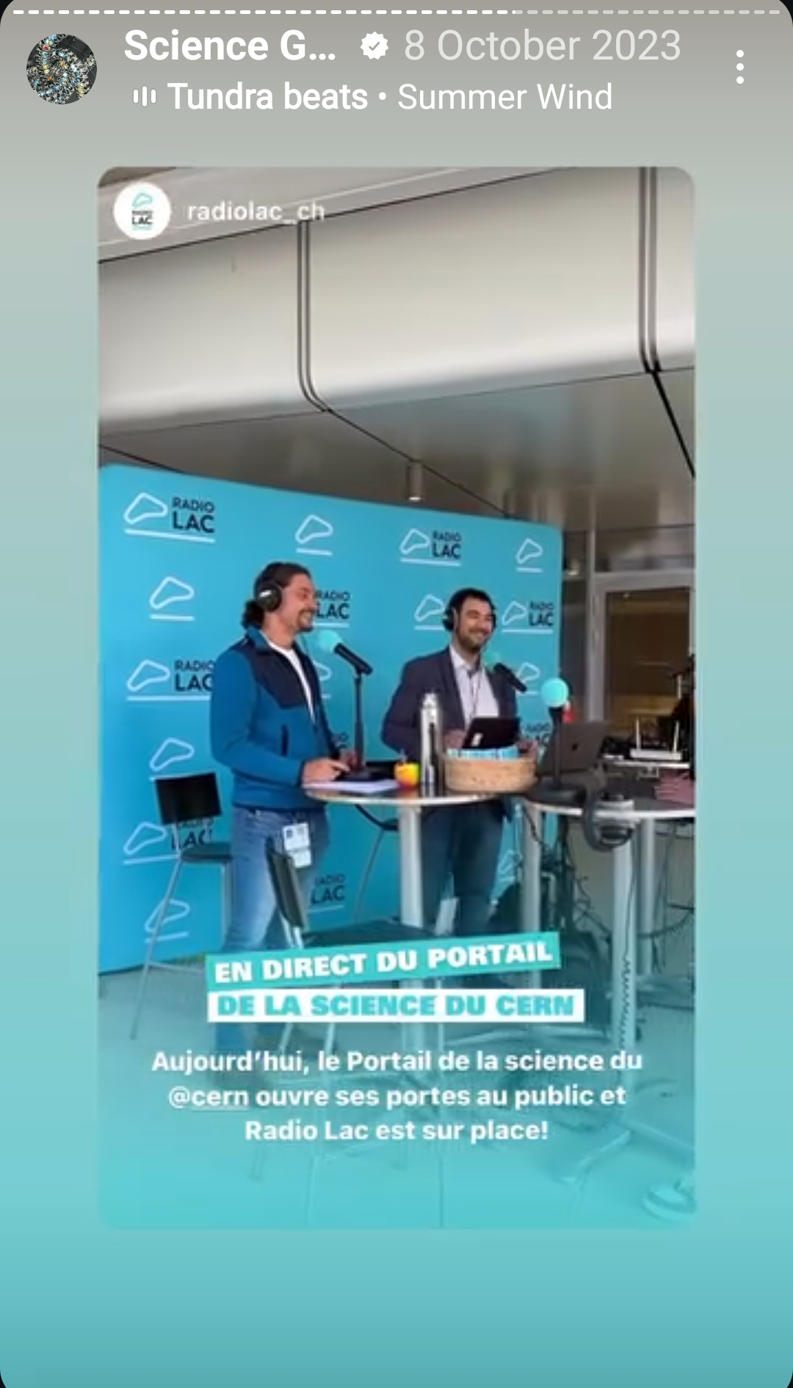
Social media: brand building #CERNScienceGateway

Slide 14
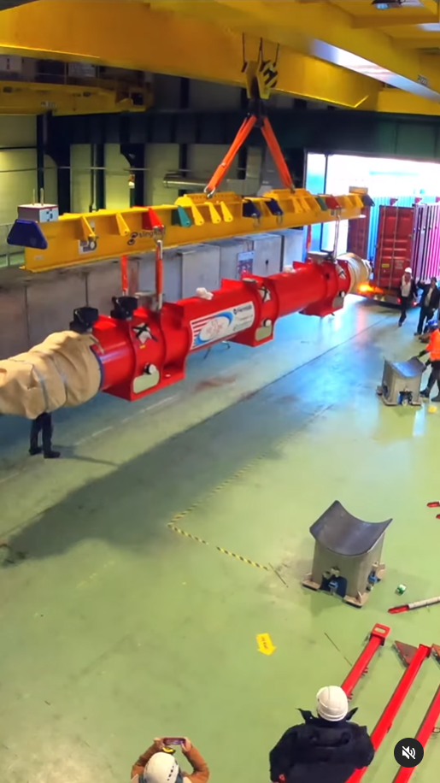
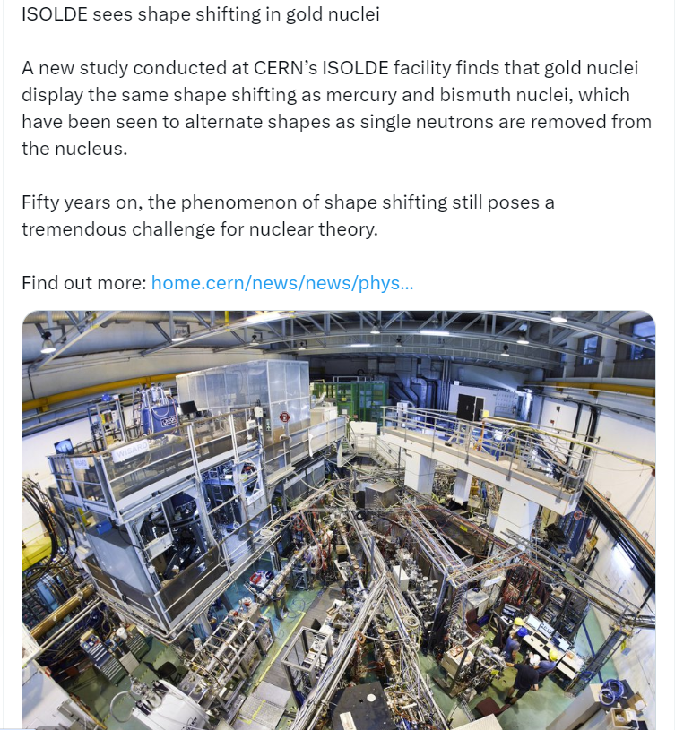
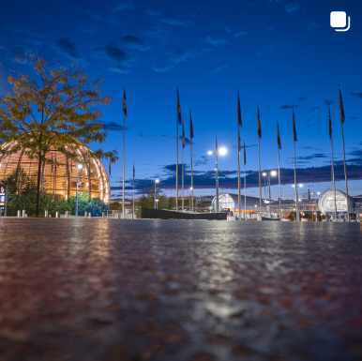
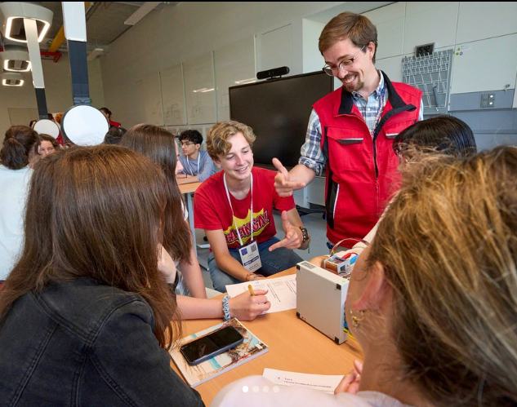
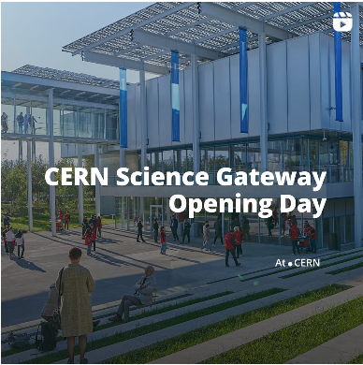
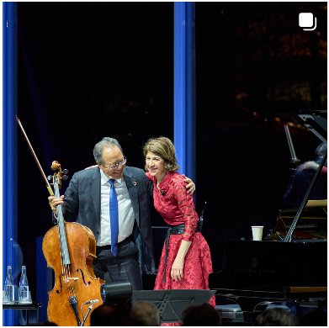
Social media statistics (Q4 2023)
Fermilab cryostat timelapse
#HiLumiLHC
World Science Day for Peace and Development
ISOLDE news
CERN SG Inauguration
Yo-Yo Ma / Music & Physics
World Teachers Day

Slide 15
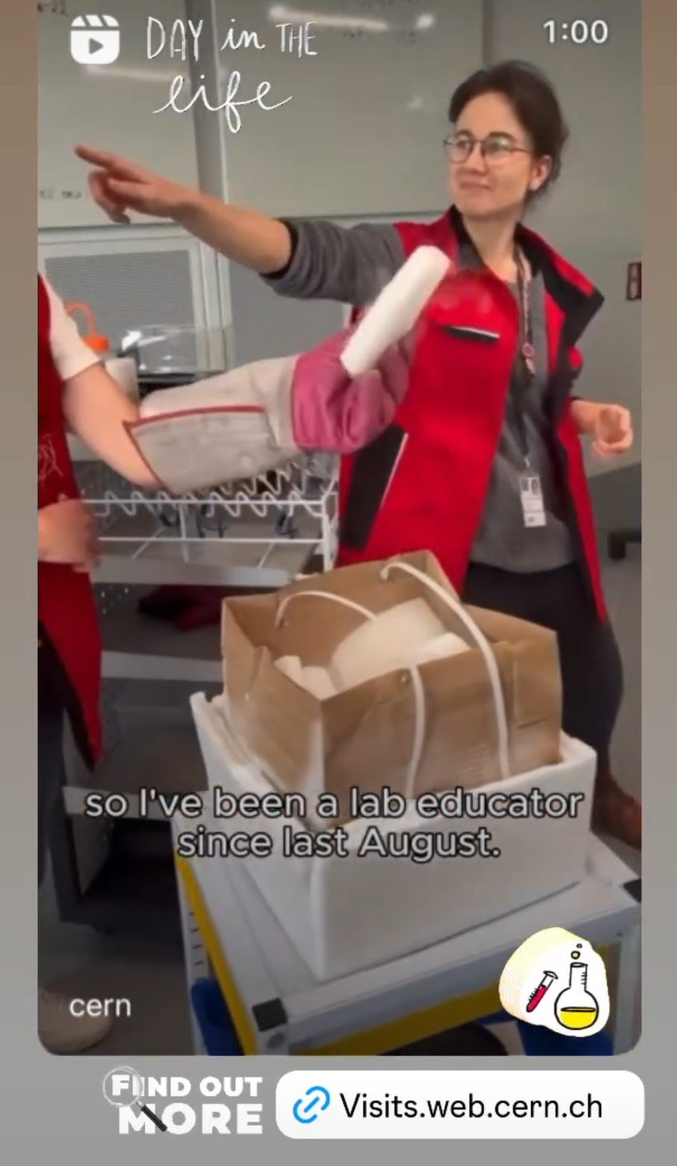
Keeping momentum: internal & external influencers
Notes:
July 2024

Slide 16
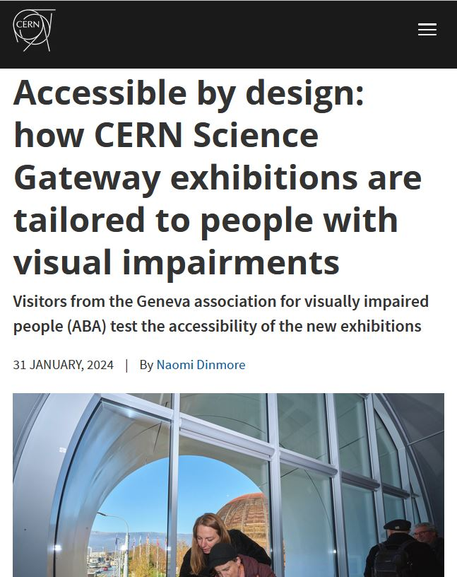
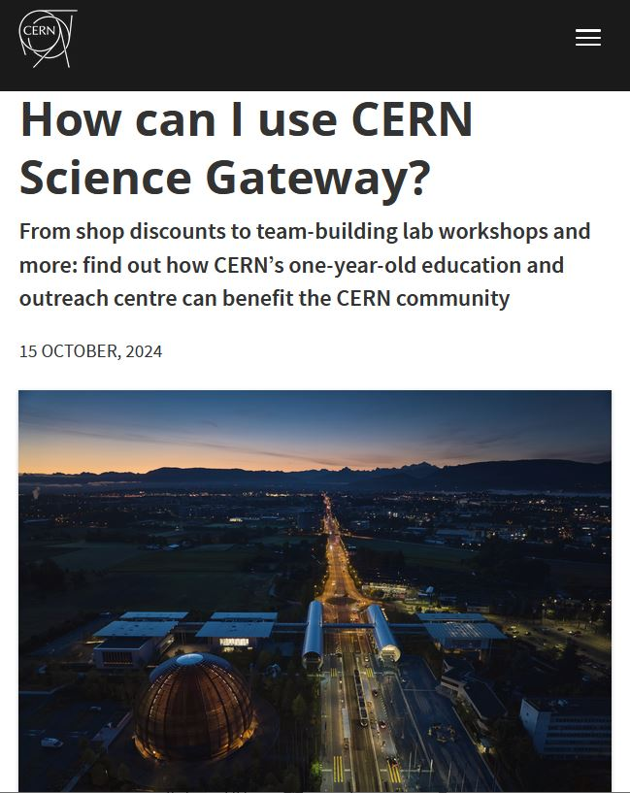
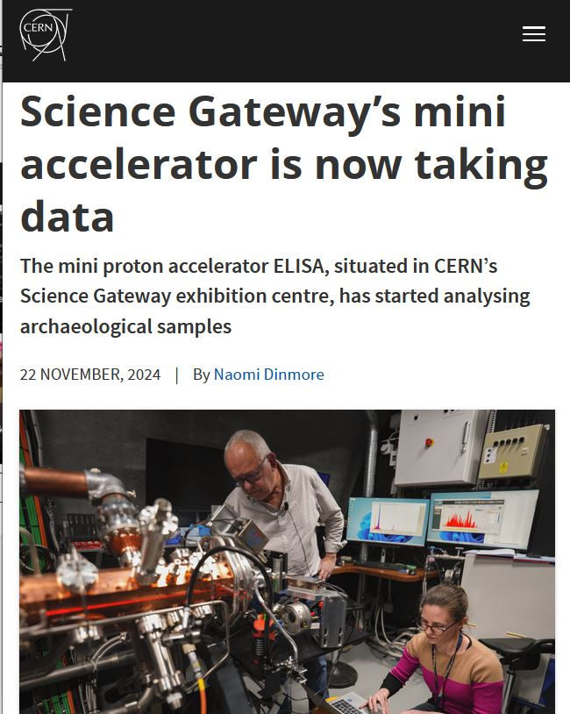
Keeping momentum internally and externally

Slide 17
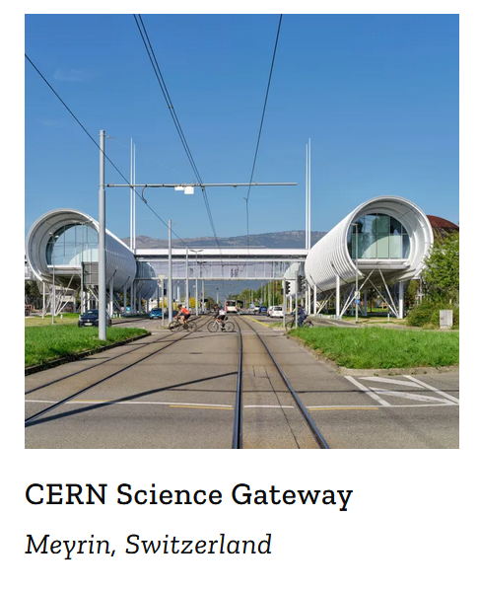

Slide 18
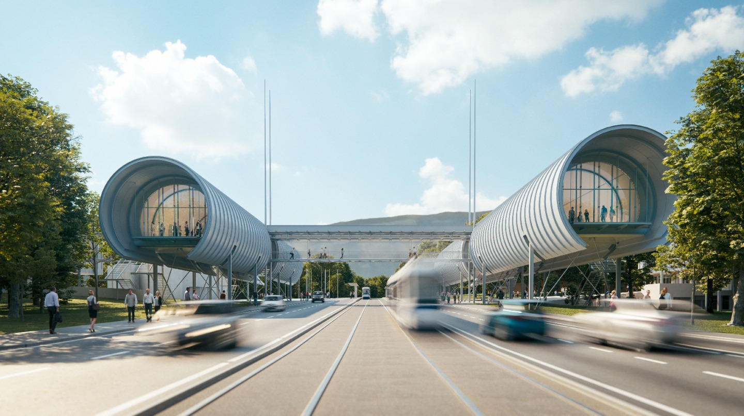
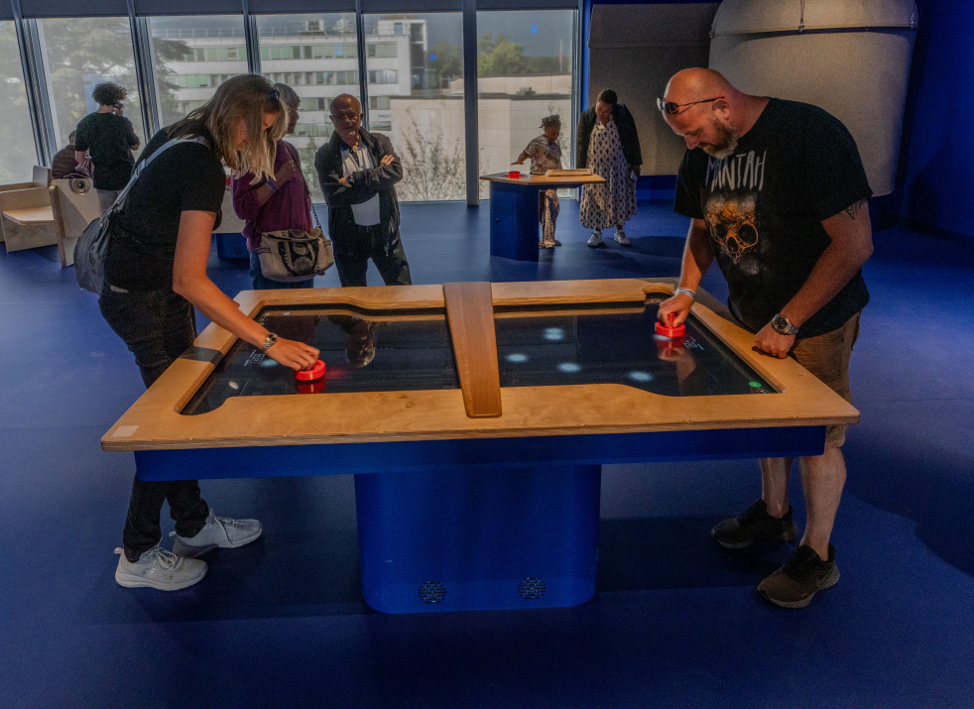
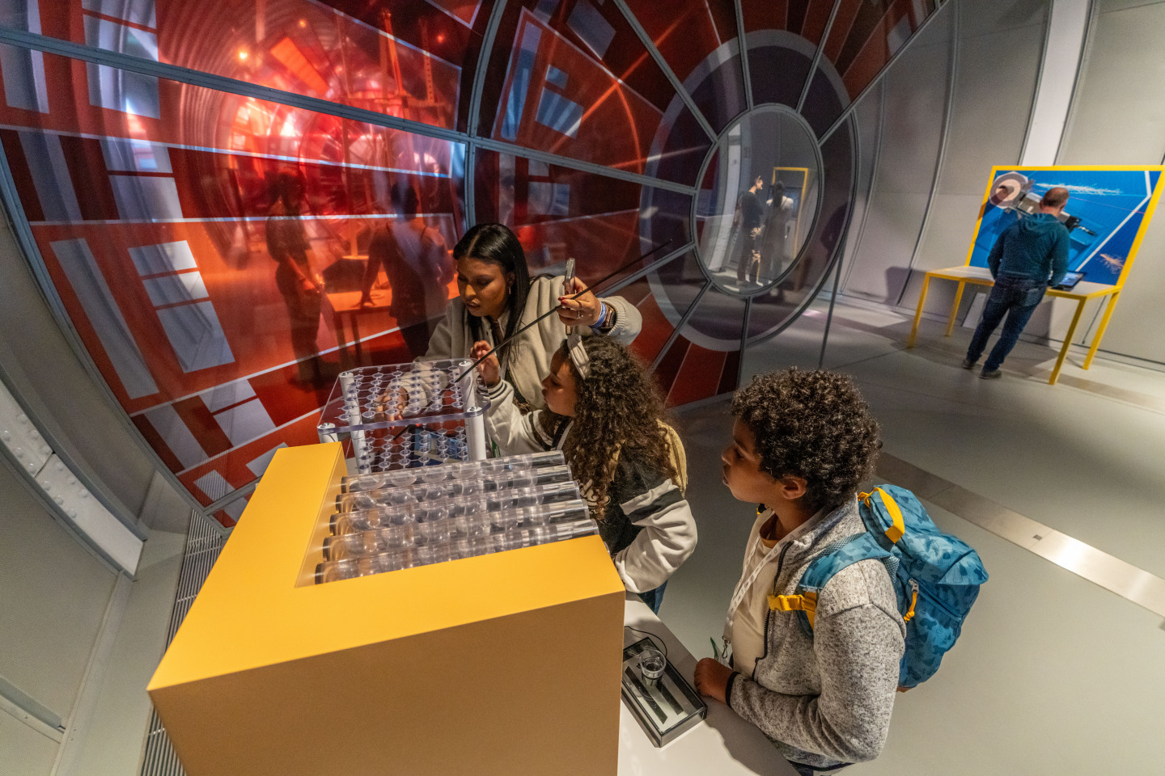
Visit CERN Science Gateway
Free hands-on exhibitions
visit.cern
voisins.cern/fr/schools

