Slide 1
TABASCAL
Trajectory Based RFI Subtraction and Calibration
Chris Finlay (UNIGE)
Bruce Bassett (UCT), Martin Kunz (UNIGE), Nadeem Oozeer (SARAO)

Slide 2
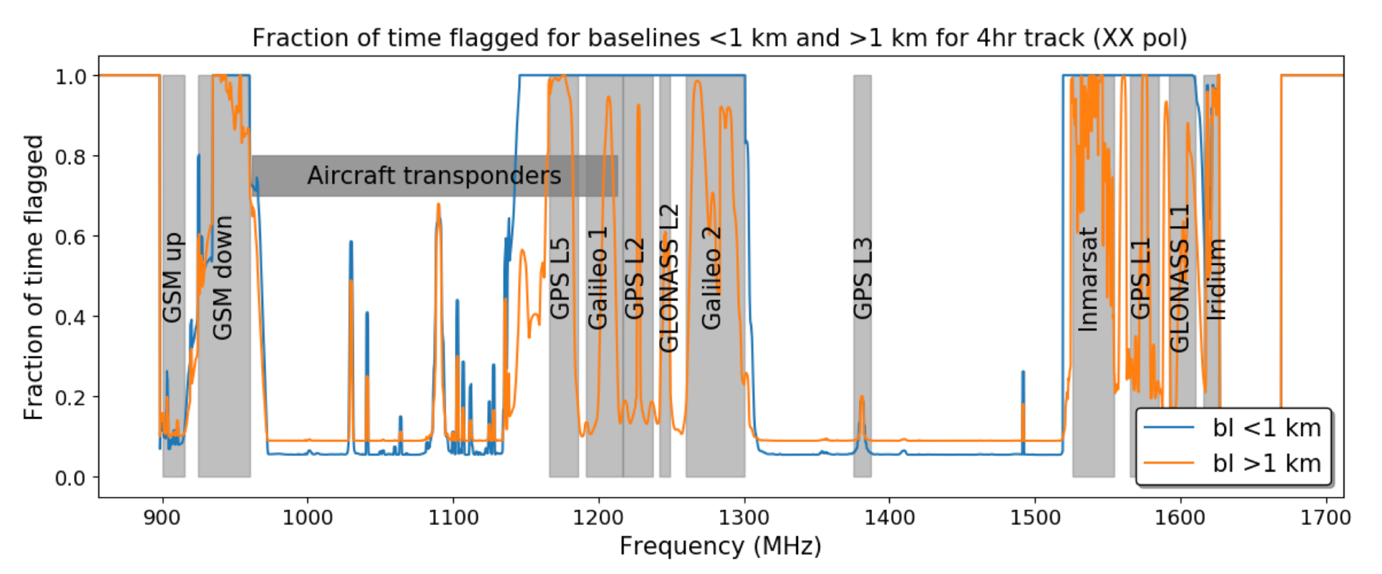
Radio Frequency Interference (RFI) - Motivation
30 % of the MeerKAT (SKA-Mid) L-band is contaminated.
Much of it is (reasonably) predictable
MeerKAT cost $ 330 M $ 100 M is being wasted.

Slide 3
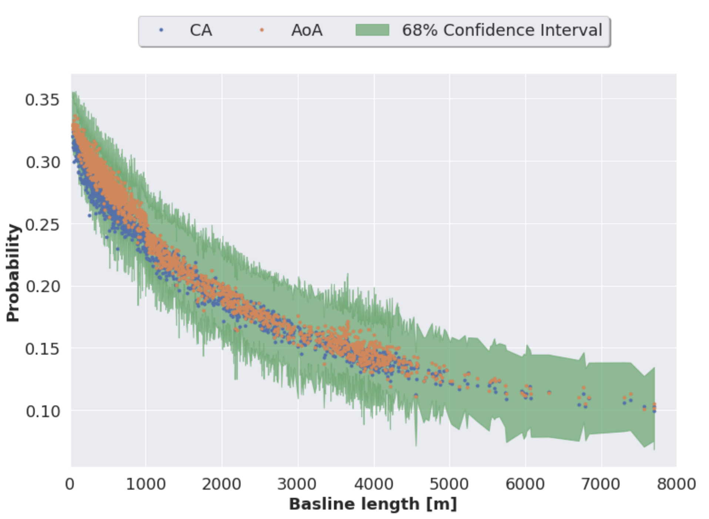
Baseline Dependence of RFI
RFI is stronger on shorter baselines due to fringe-washing.
RFI flagging of archival MeerKAT data
Sihlangu et al 2020

Slide 4
TABASCAL
Goals
Replace RFI flagging with RFI subtraction
Recover astronomical visibilities
Fit into the current data reduction workflow - 1GC then 2GC (self-cal) and beyond.
Ideas
Use RFI trajectories to help estimate their visibility contribution.
Estimate antenna gains by using prior information.
Use baseline dependent smoothness of astronomical visibilities to help with estimation.

Slide 5
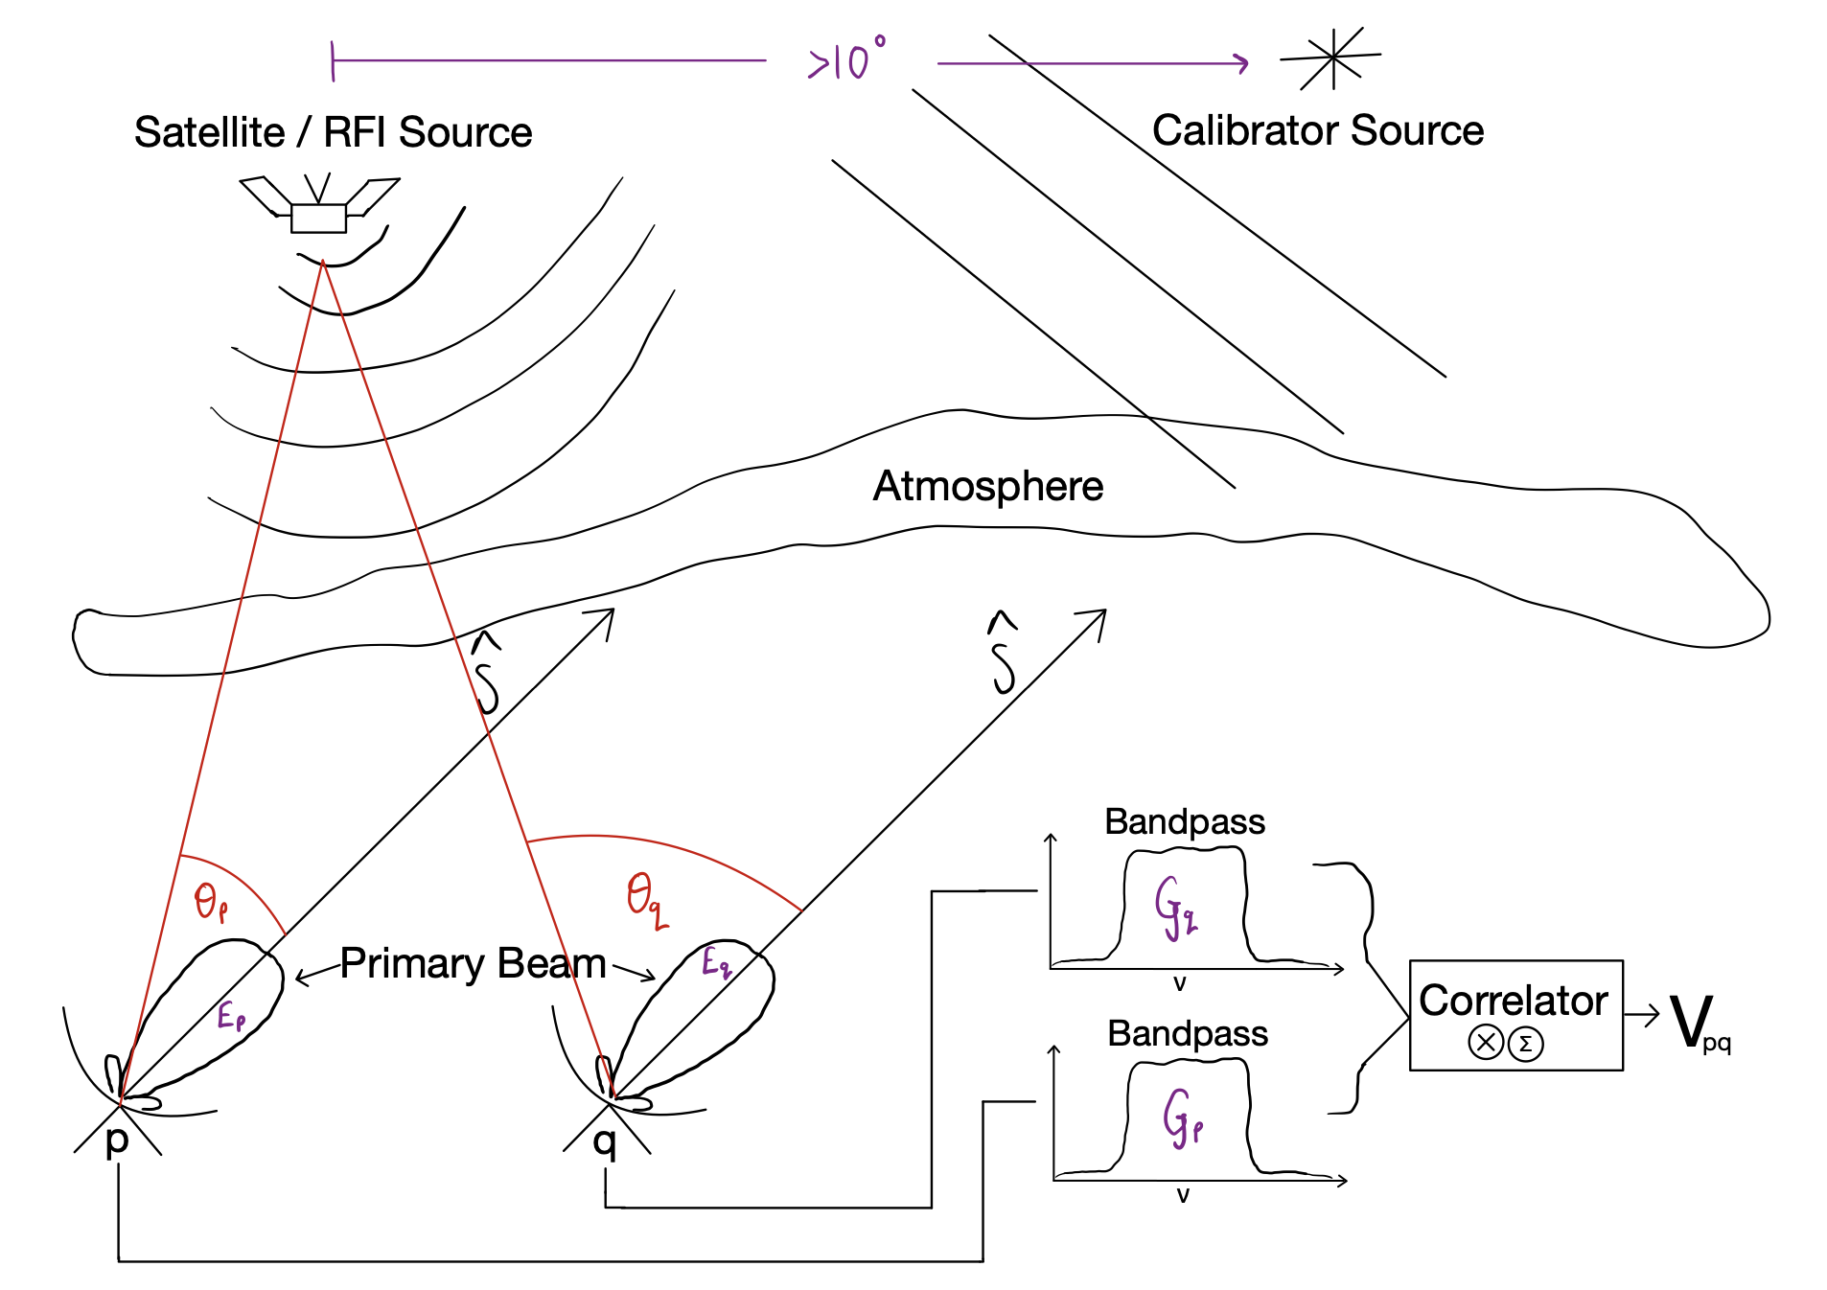
Data Simulations
Features
Satellite and Ground-based RFI sources
Correlator averaging (Fringe loss)
Time & direction dependent gains
Fast JAX implementation for CPU, GPU & TPU
Scalable with Dask to multiple GPUs
https://github.com/chrisfinlay/tabascal

Slide 6
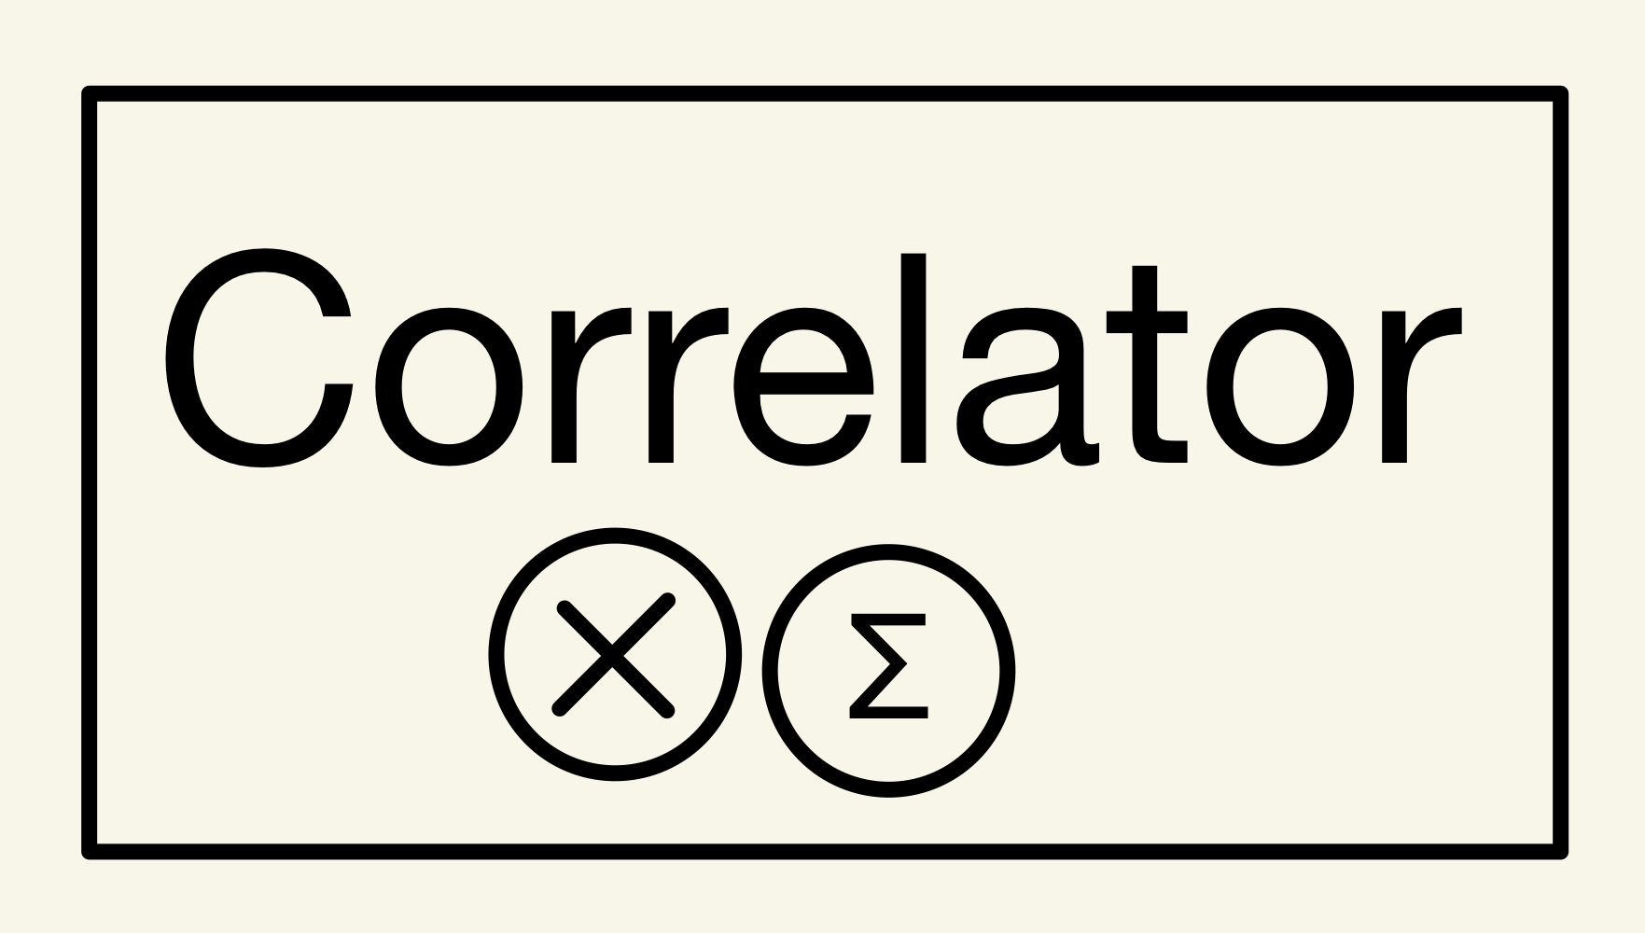
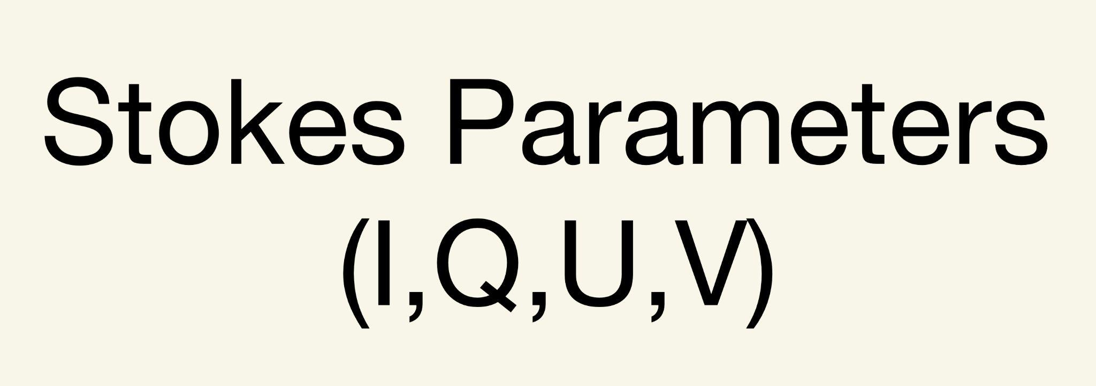
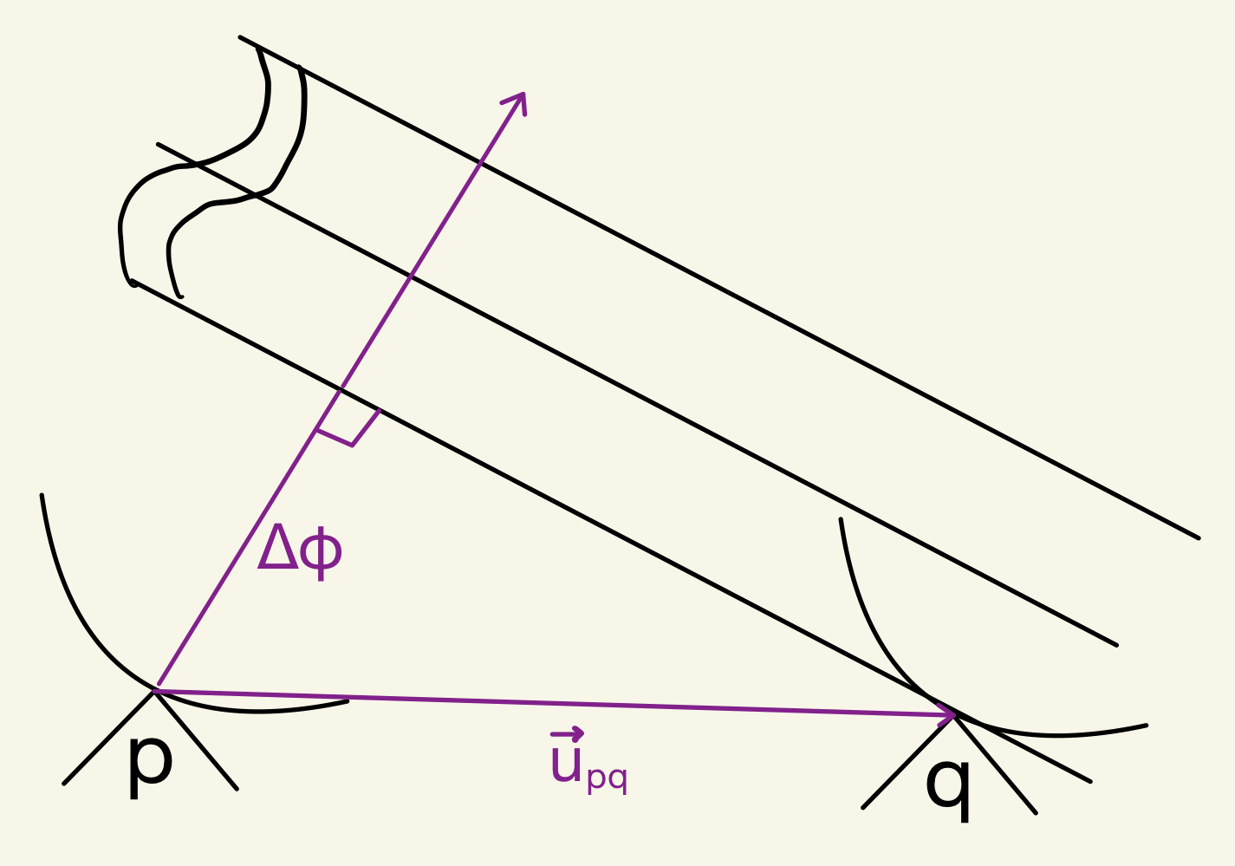
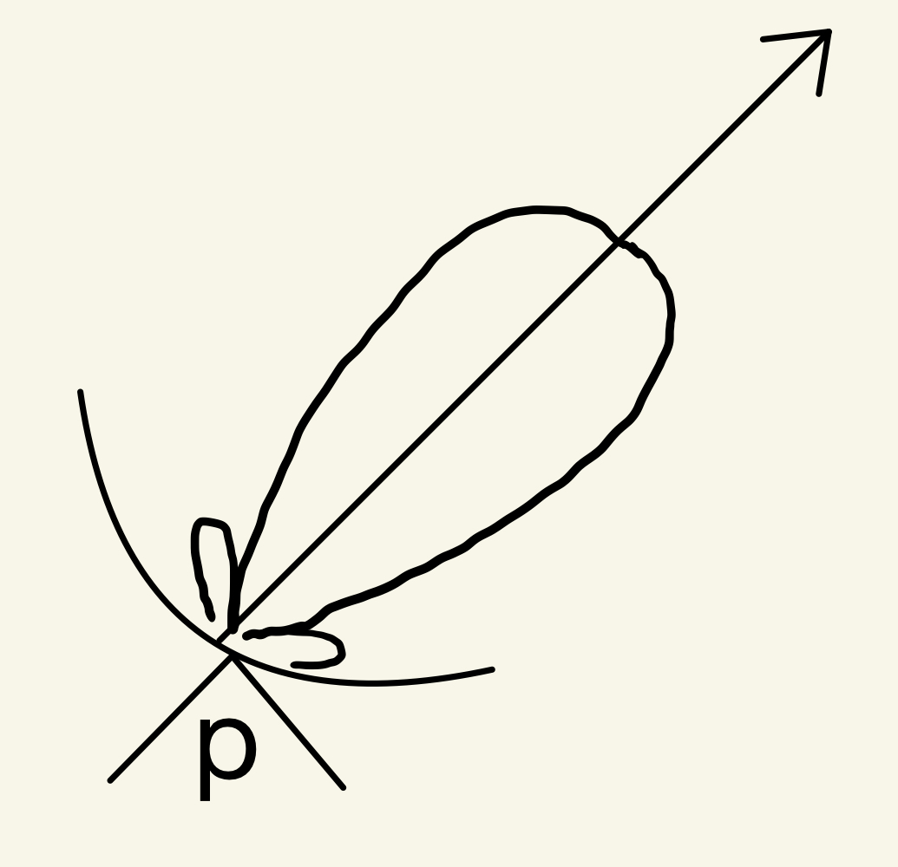
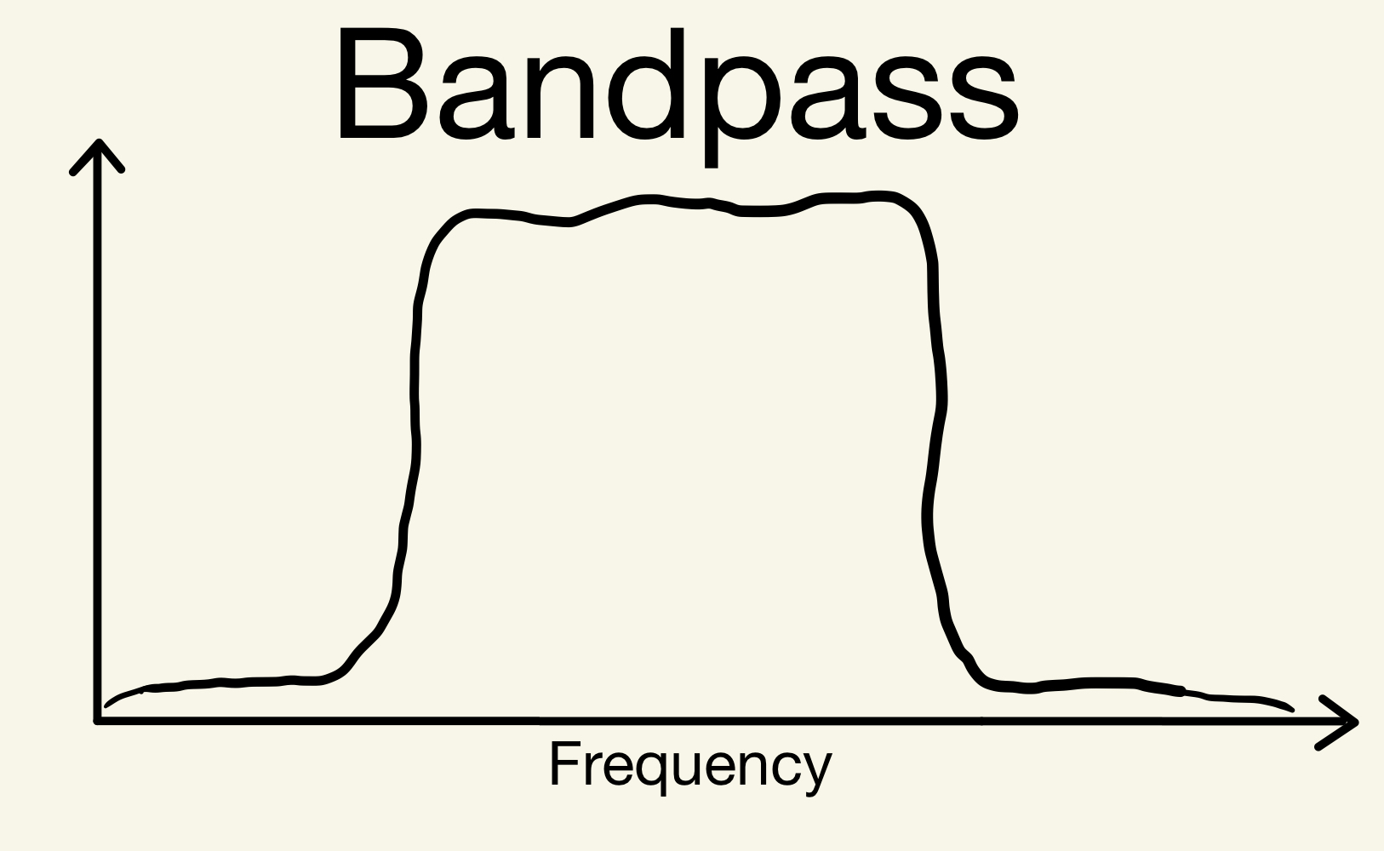
Radio Interferometry Measurement Equation (RIME)
Correlator-like Averaging
Brightness Matrix
Phase Delay
Visibility
Direction Independent Effects
Direction Dependent Effects

Slide 7
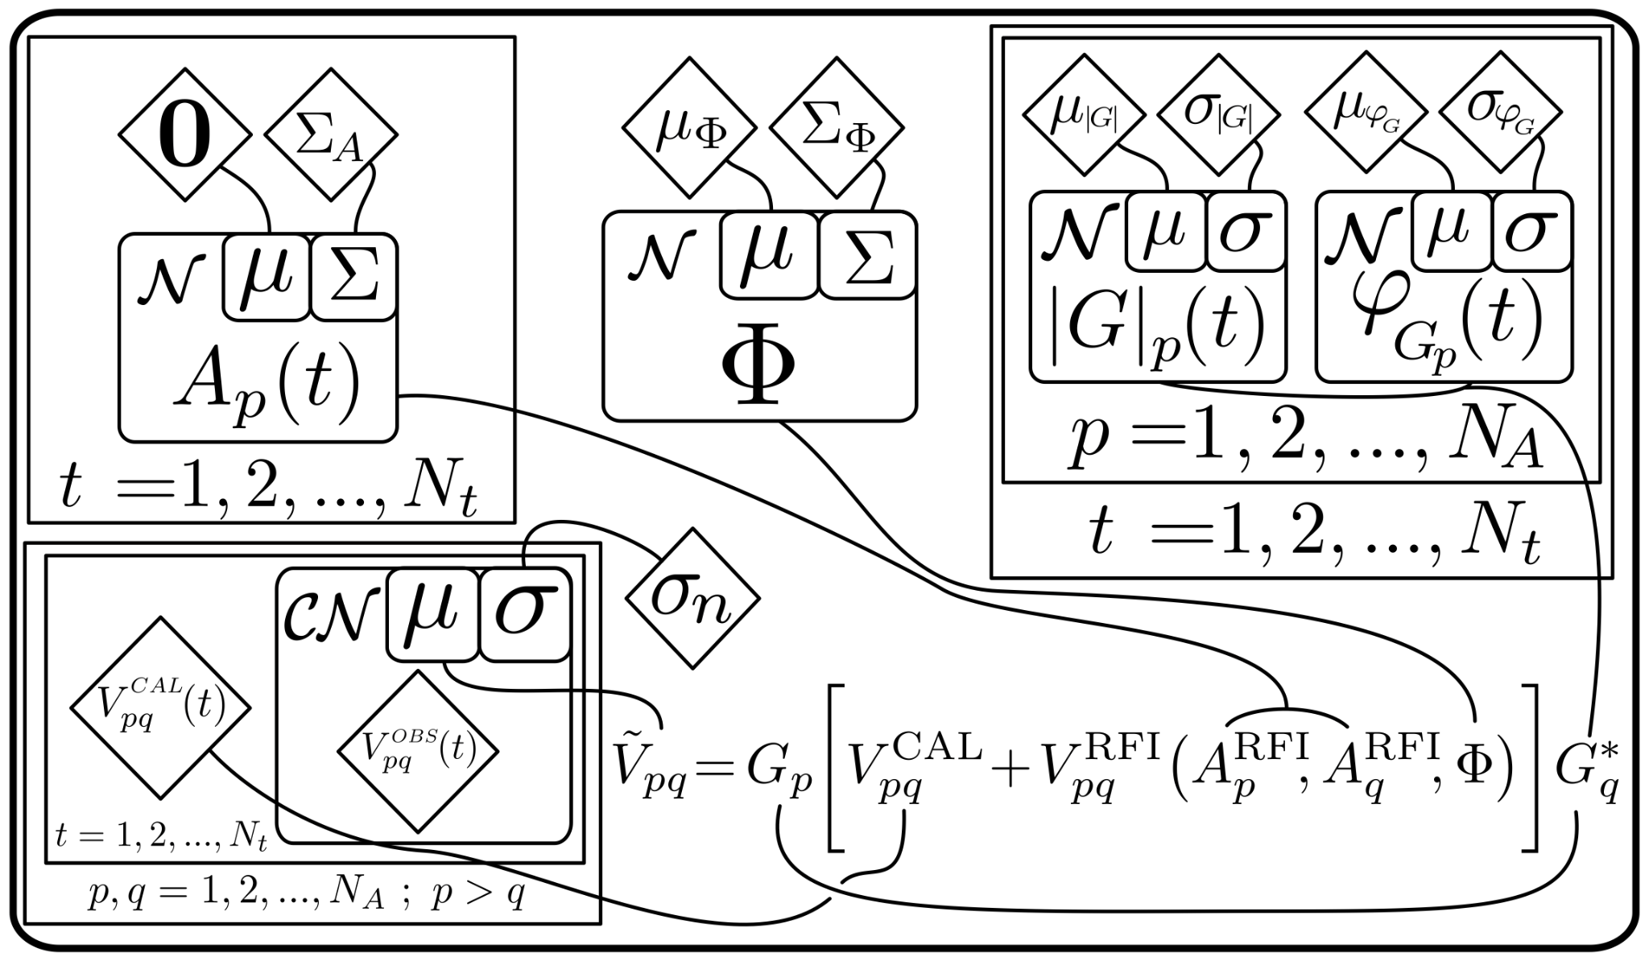
TABASCAL I
(Calibration Observation)
DOI:10.1093/mnras/stad1979
Prior
RFI Signal
RFI Trajectory
Antenna Gains
Jointly estimate RFI signal/trajectory and antenna gains.
Bayesian model to reliably estimate parameter errors.
Likelihood
Forward Model

Slide 8
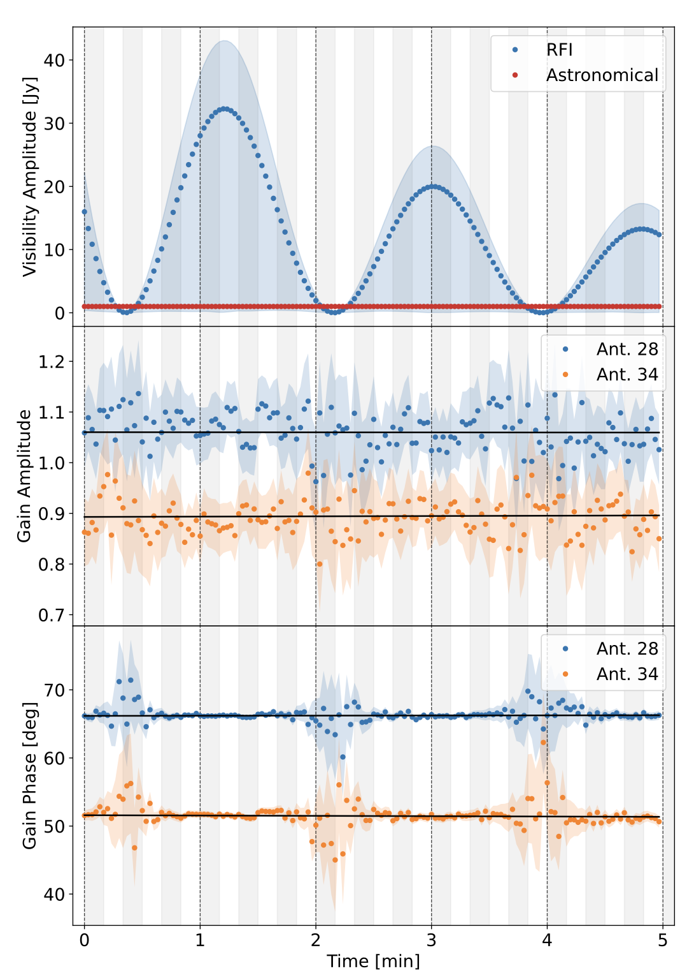
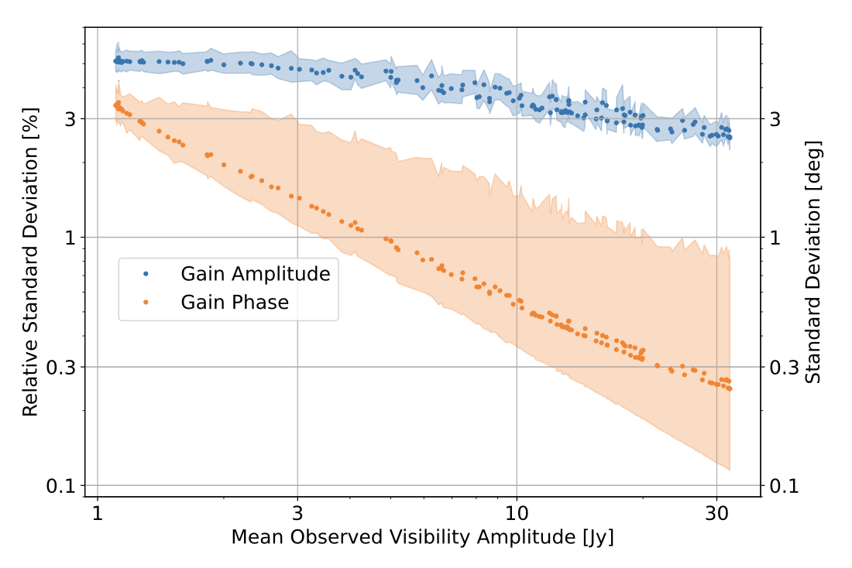
TABASCAL I

Slide 9
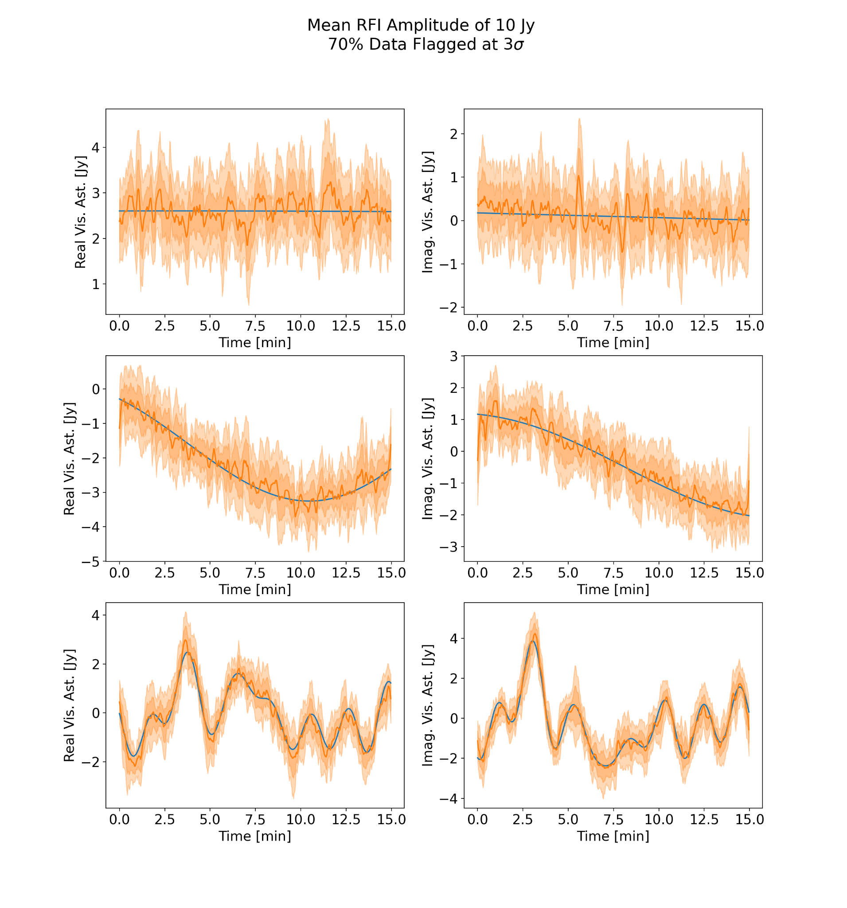
TABASCAL II
(Target Observation)
Use TABASCAL I estimates as a prior for TABASCAL II.
Use Wiener filter to enforce smoothness by defining the power spectrum (in time) of the signal.

Slide 10
TABASCAL II - Scalable Uncertainty Estimation
Sample the posterior covariance with chosen accuracy/performance trade-off.
TABASCAL uses a combination of autodiff, implicit definition of FIM and MVP, and conjugate gradient.

Slide 11
Conclusion
TABASCAL II can subtract RFI recover astronomical visibilities.
At the expense of more computation
Stronger RFI is possible
Multiple RFI sources are possible
Uncertainty estimates with accuracy/speed trade-off
Ongoing Work
Test the limits of TABASCAL
Testing SKA-Low experimental station

