Slide 1
Bringing Self-Supervised Learning to Radio Galaxy Surveys: A Novel Approach with MeerKAT MGCLS
E. Lastufka
M. Audard, O. Bait, M. Dessauges-Zavadsky, M. Drozdova, T. Holotyak, V. Kinakh, D. Piras, O. Taran, D. Schaerer, S. Voloshynovskiy

Slide 2
Self-supervised learning is crucial for training foundation models
Train
Evaluate
Data (images)
SSL network
Morphology classification
Similarity search
Redshift prediction
Anomaly detection
Hayat et al 2021

Slide 3
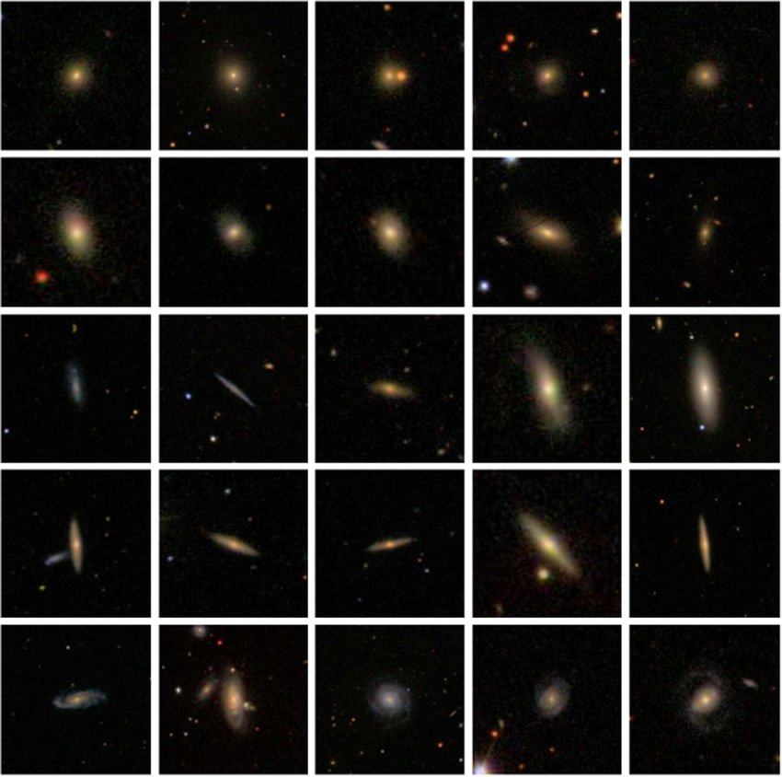
What is a foundation model
3
Galaxy Zoo SDSS (scales vary)
Train
Evaluate
Data (images)
SSL network
Morphology classification
Similarity search
Redshift prediction
Anomaly detection
Notes:
Figure: https://link.springer.com/article/10.1007/s10509-019-3540-1 Zhu et al 2019
424x424 pixel
GZ2 Scaled to 0.02*petroR90_r arcsec per pixel

Slide 4
Current foundation models in astronomy
Regime | Work | Dataset | Network
Optical | Hayat et al 2021 | Galaxy Zoo 2 (SDSS) | MoCo v2, Resnet50
Optical | Mohale & Lochner 2023 | Galaxy Zoo DECaLS | BYOL, Resnet50
Radio | Slijepcevic et al 2023 | Radio Galaxy Zoo | BYOL, Resnet18
Radio | Andrianomena & Tang 2023 | Radio Galaxy Zoo | VDVAE, SimCLR BYOL, SimSiam Resnet34

Slide 5
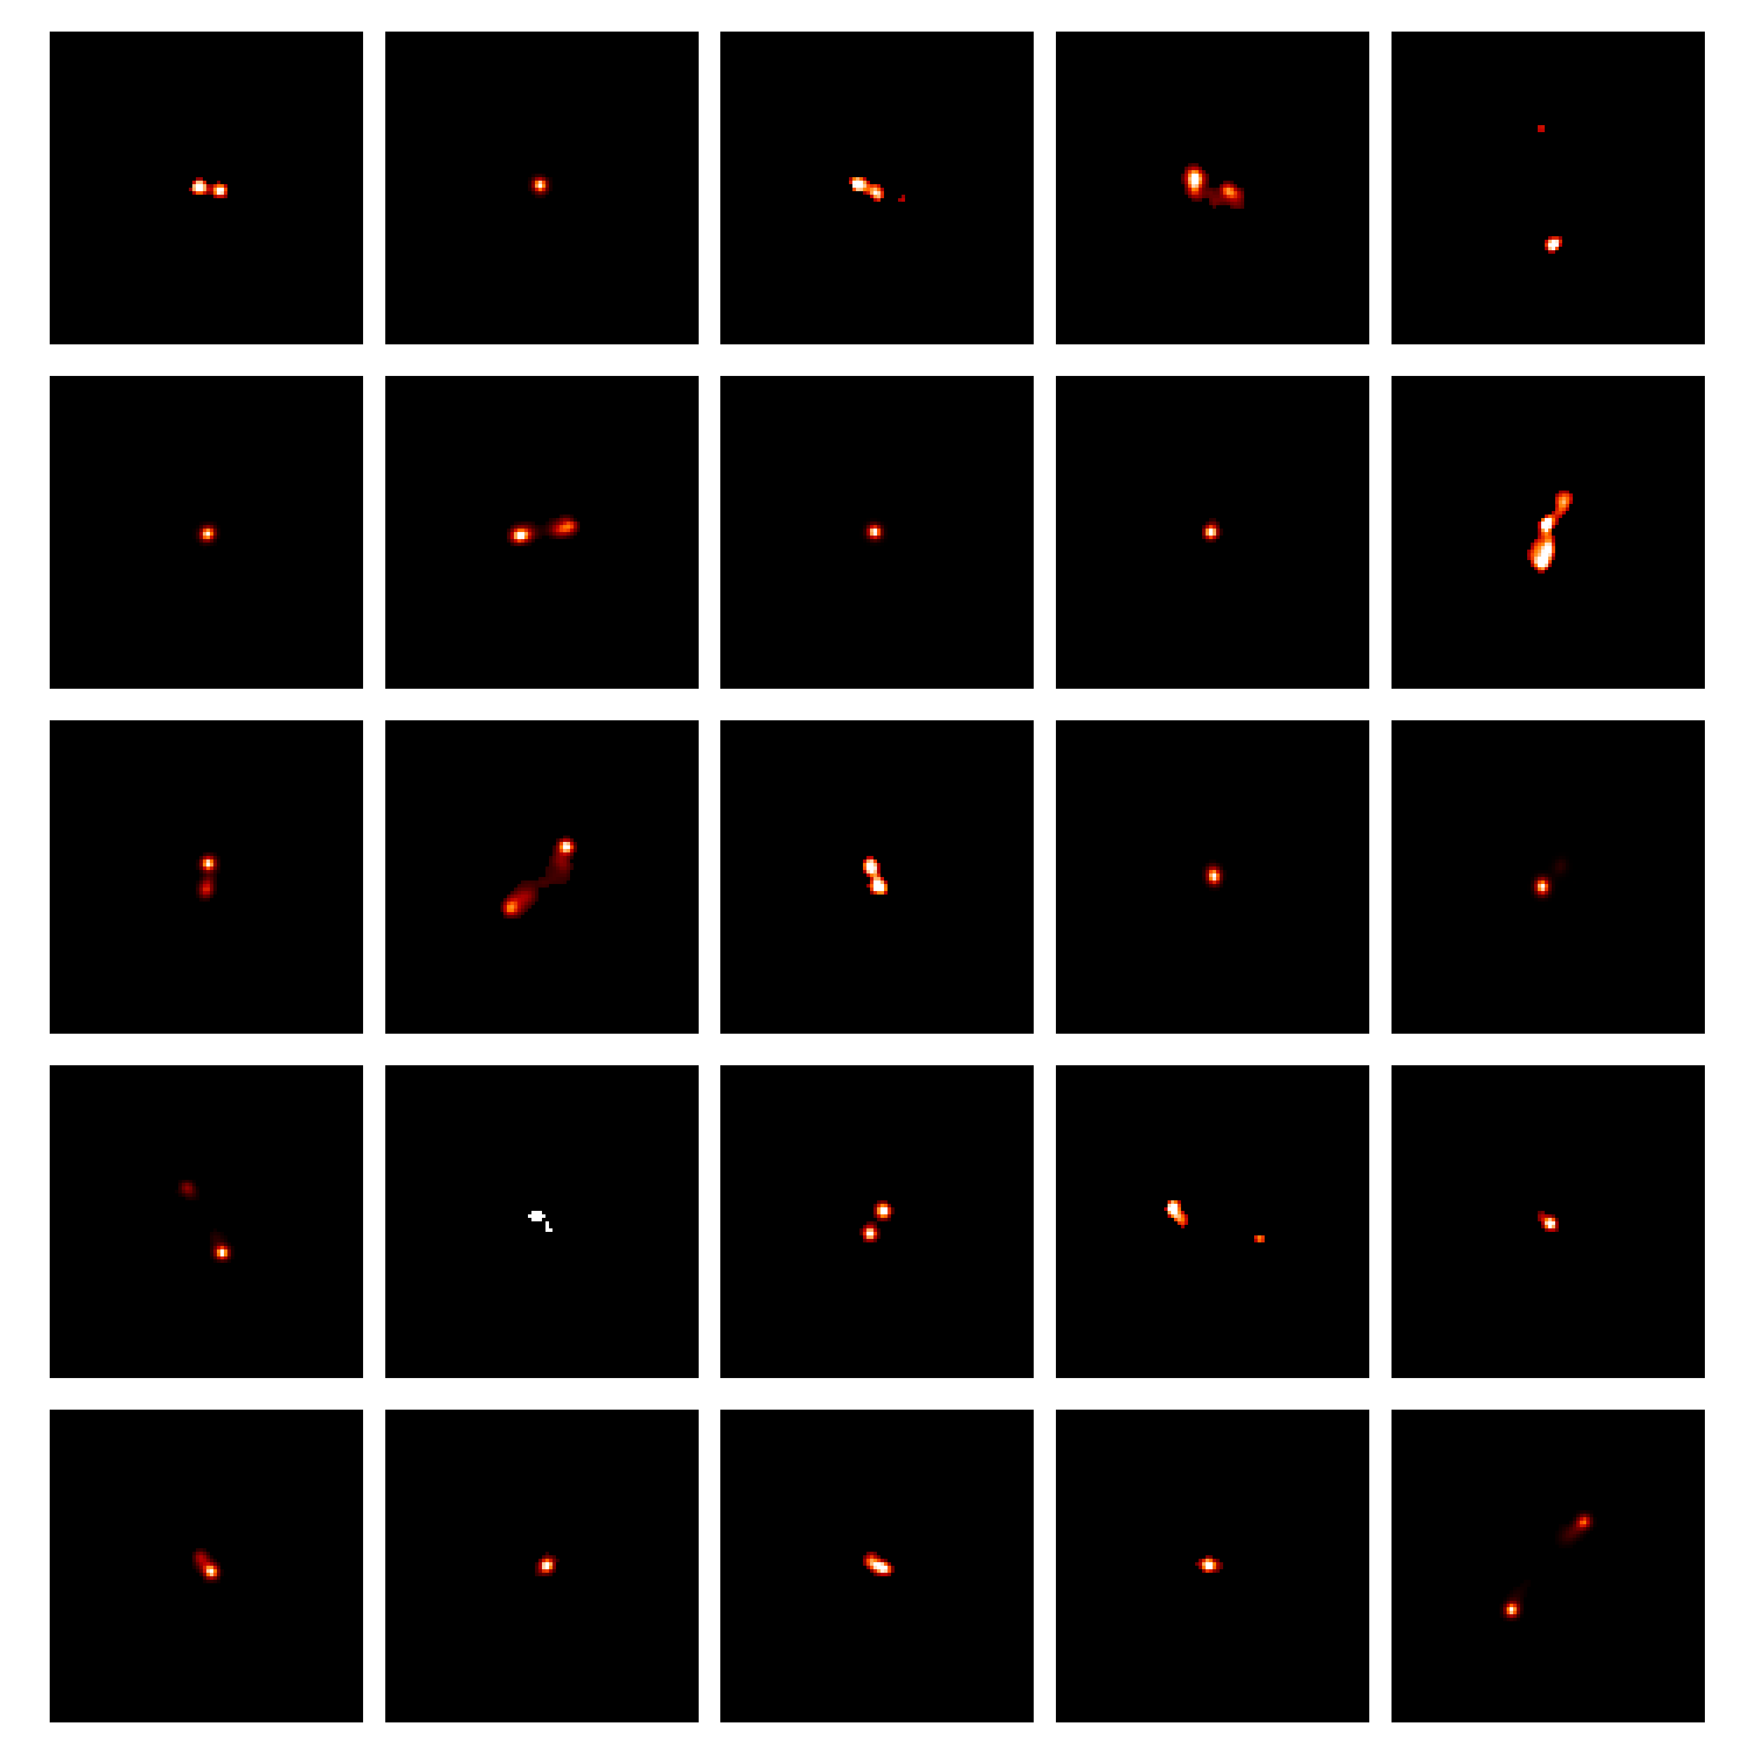
Galaxy Zoo SDSS (scales vary)
180”
Radio Galaxy Zoo (VLA)

Slide 6
MeerKAT L-band

Slide 7
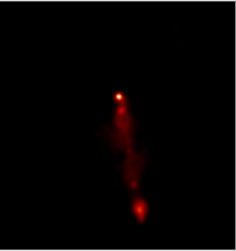
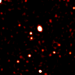
Can we train multi-purpose foundation models with pipeline data?

Slide 8
MeerKAT observations of 115 galactic clusters
Wide-field 1.2 degree images
~20,000 crops of pixel size 256 x 256
Continuum CLEAN images
Notes:
MGCLS crop size about 5 arcmin

Slide 9
Knowledge distillation with no labels: DINO

Slide 10
Can SSL create representations that characterize source-rich MeerKAT data?
Train
Evaluate
Data (continuum CLEAN images)
SSL network (DINO)
Source catalogs
Compact source count
MIGHTEE and MiraBest hand-labelled
morphologyclassification

Slide 11
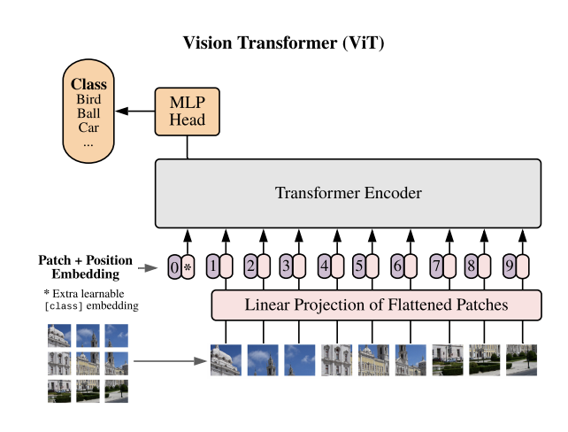
Backbone networks
Notes:
Image sourcehttps://www.google.com/url?sa=i&url=https%3A%2F%2Ftowardsdatascience.com%2Fthe-annotated-resnet-50-a6c536034758&psig=AOvVaw1Sba2c8EJxtmXISlLZPXZu&ust=1705417884381000&source=images&cd=vfe&opi=89978449&ved=0CBUQjhxqFwoTCMDCs_PW34MDFQAAAAAdAAAAABAD
Vit source: https://paperswithcode.com/method/vision-transformer

Slide 12
Visualizing emerging properties: what does the network see?
Head 1
Head 2
Attention mechanism of Vision Transformers allows us to inspect which features in an image are important to different attention heads
Our model has 6 attention heads
Image 1
Image 2
Lastufka et al. 2024

Slide 13
Evaluation: compact source count prediction
Data
Label
24
Labels are from compact source catalog (pyBDSF)
Task: predict source count with image as input
Metric: mean squared error (MSE), the lower the better
35
Notes:
Mention no fine-tuning was done

Slide 14
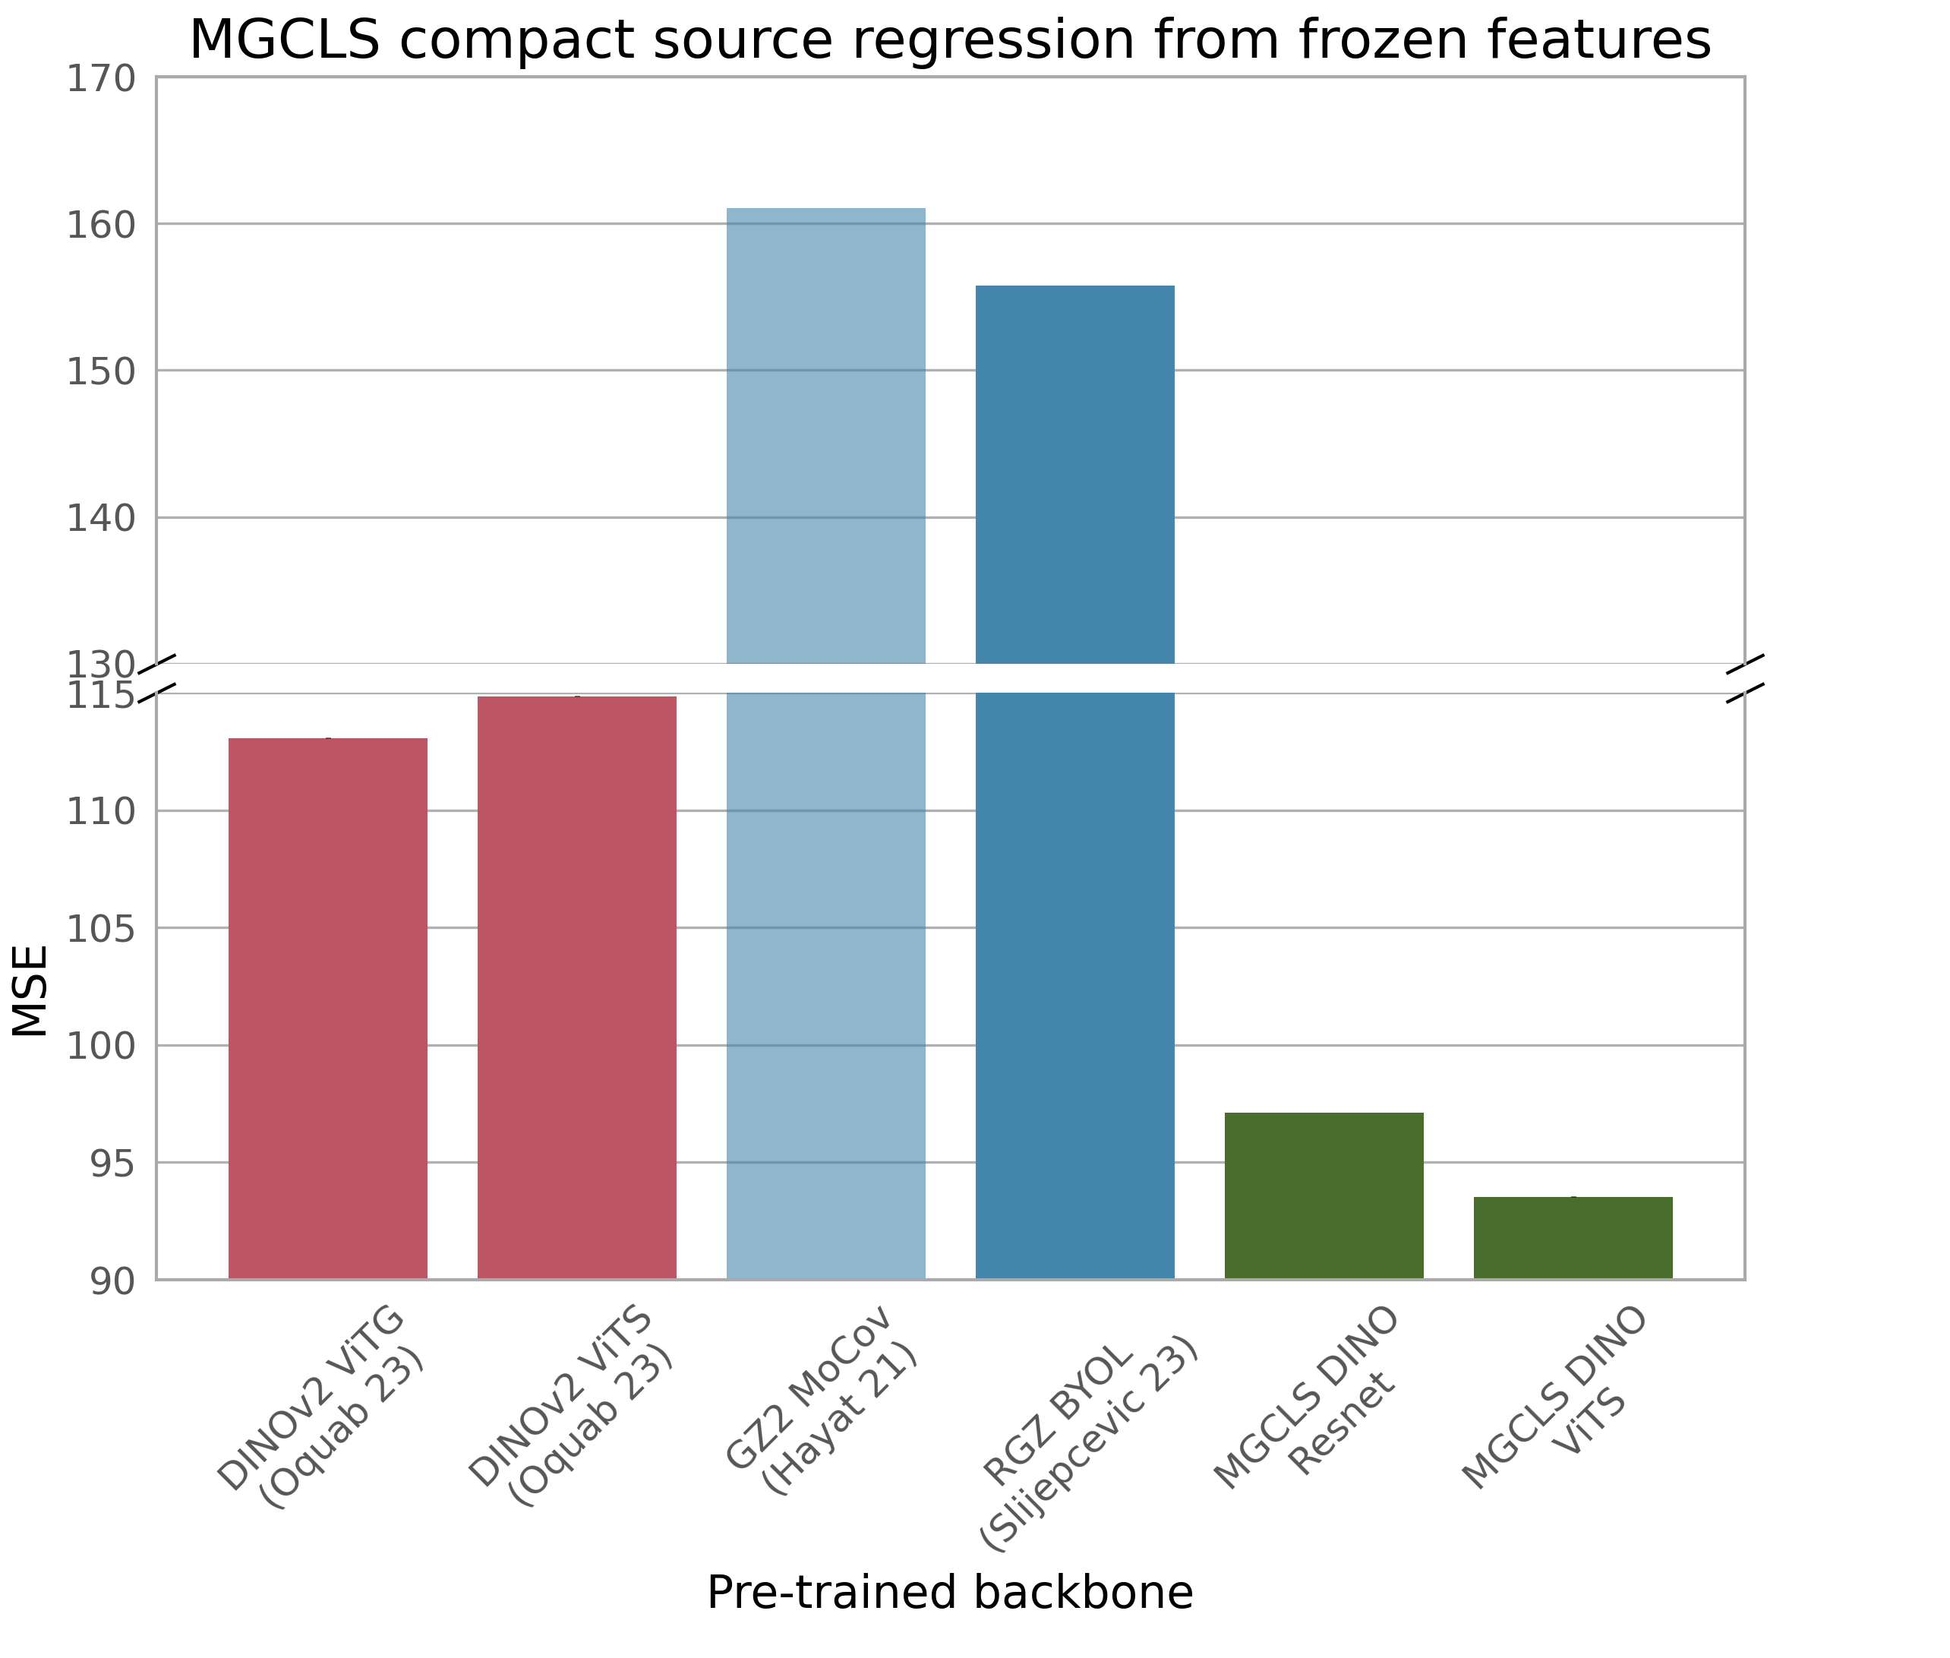
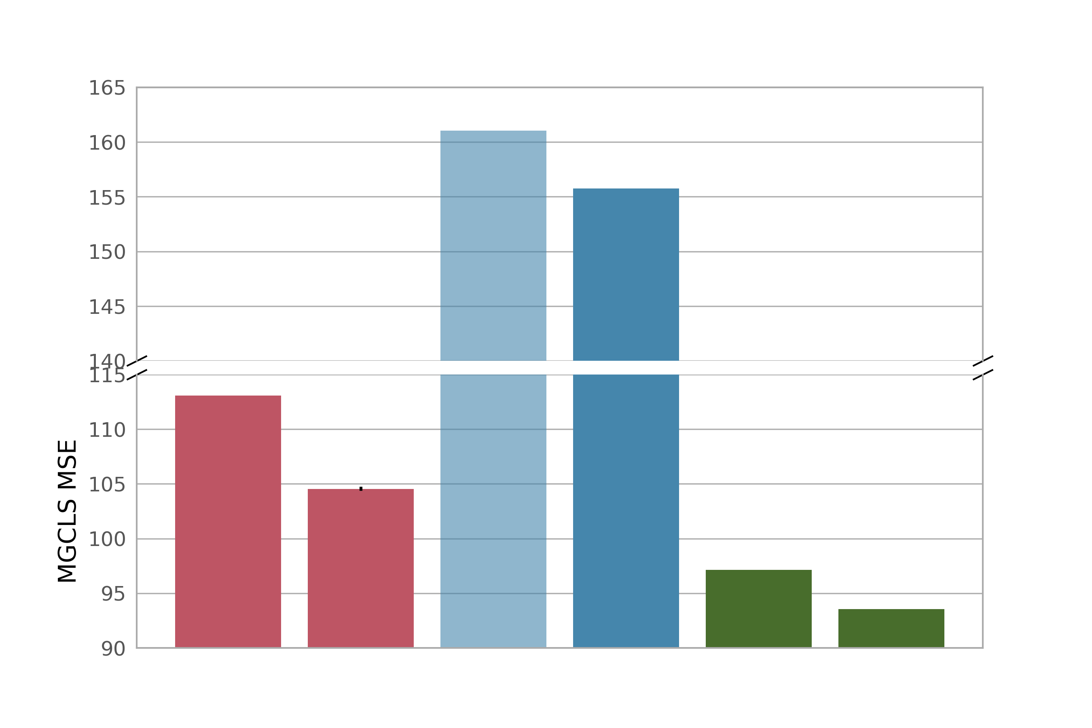
Evaluation: compact source count prediction
Training data
Web images
Optical galaxies
Radio galaxies
Multi-source radio
Lastufka et al. 2024

Slide 15
Evaluation: compact source count prediction
Training data
Web images
Optical galaxies
Radio galaxies
Multi-source radio
Backbones trained on curated, single-galaxy images cannot perform this task!
Lastufka et al. 2024

Slide 16
Evaluation: compact source count prediction
Training data
Web images
Optical galaxies
Radio galaxies
Multi-source radio
Domain-specific training data is best for this task
Lastufka et al. 2024

Slide 17
Can the network do more than one thing?

Slide 18
Evaluation: FRI/FRII galaxy morphology classification
Data
Label
FRI
Public MiraBest dataset from VLA images
Metric: Test set error (1-accuracy), lower is better
FRII

Slide 19
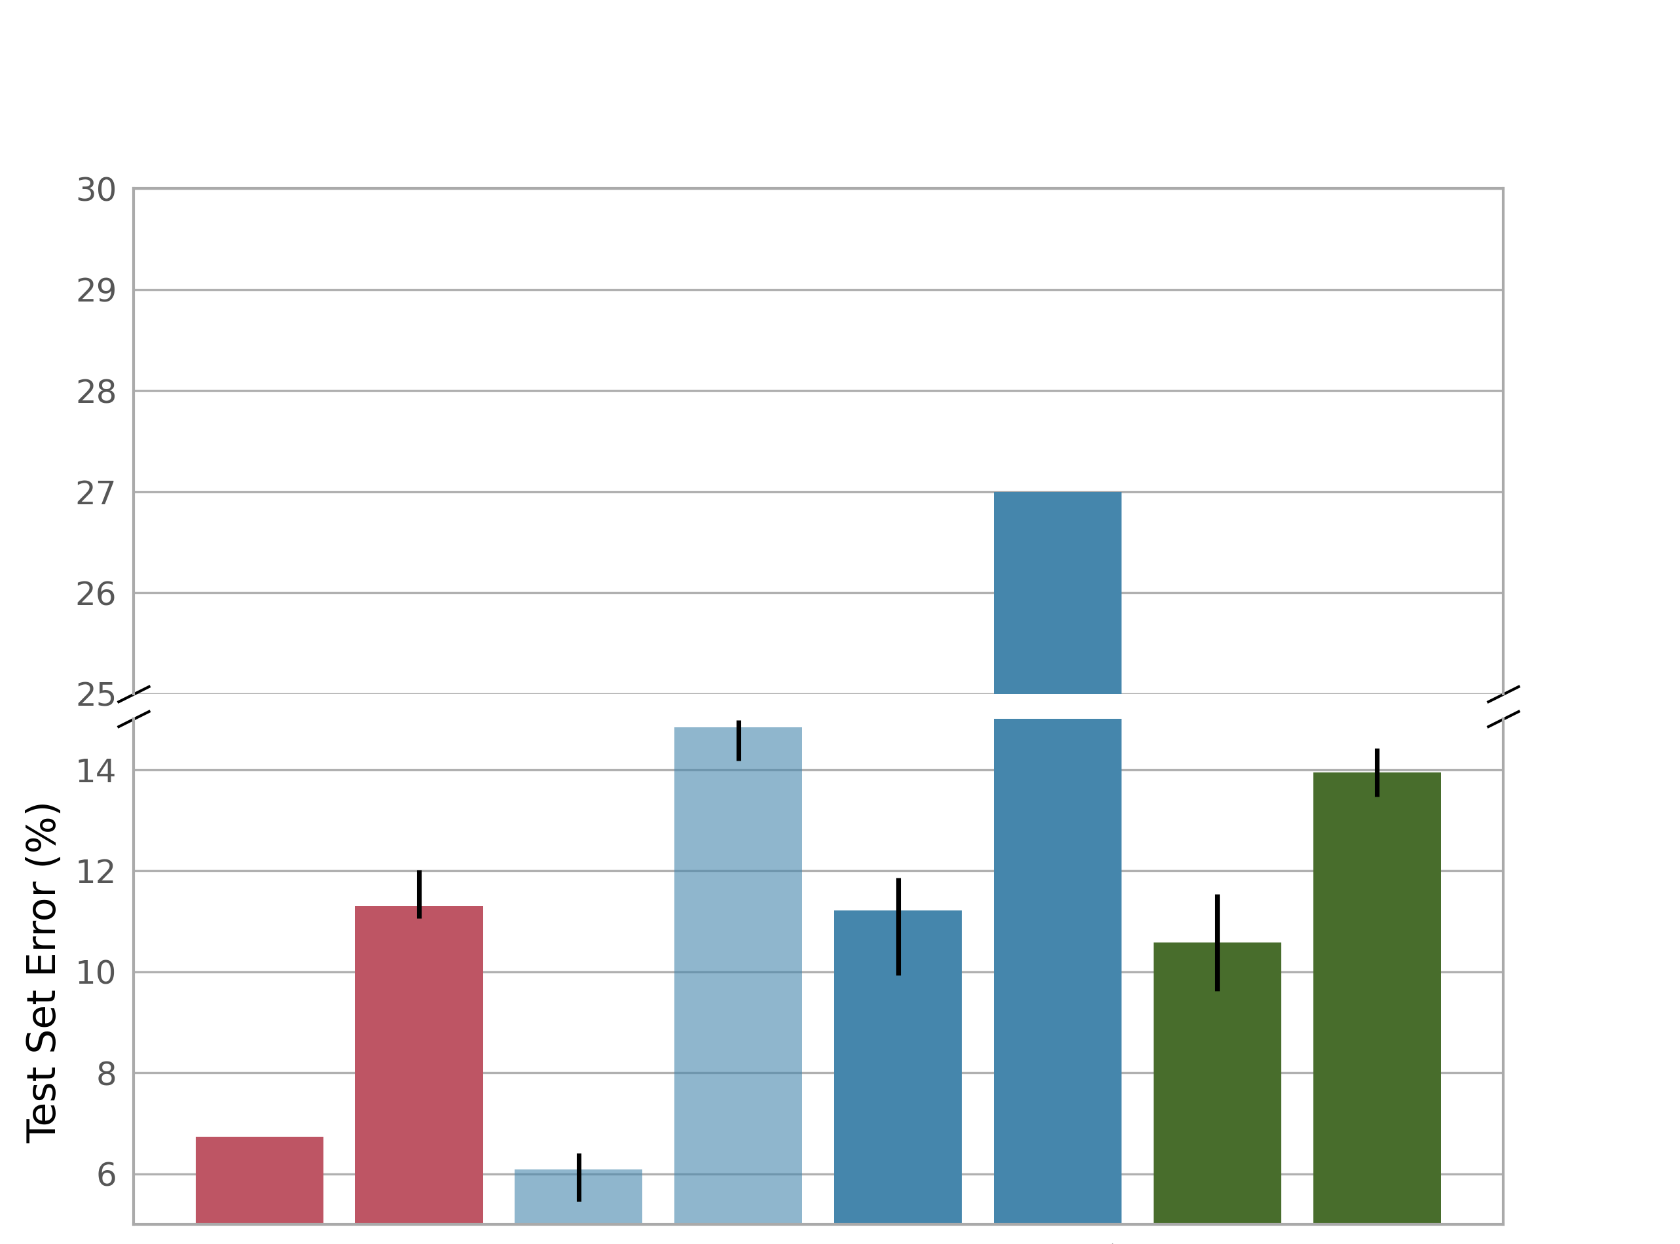
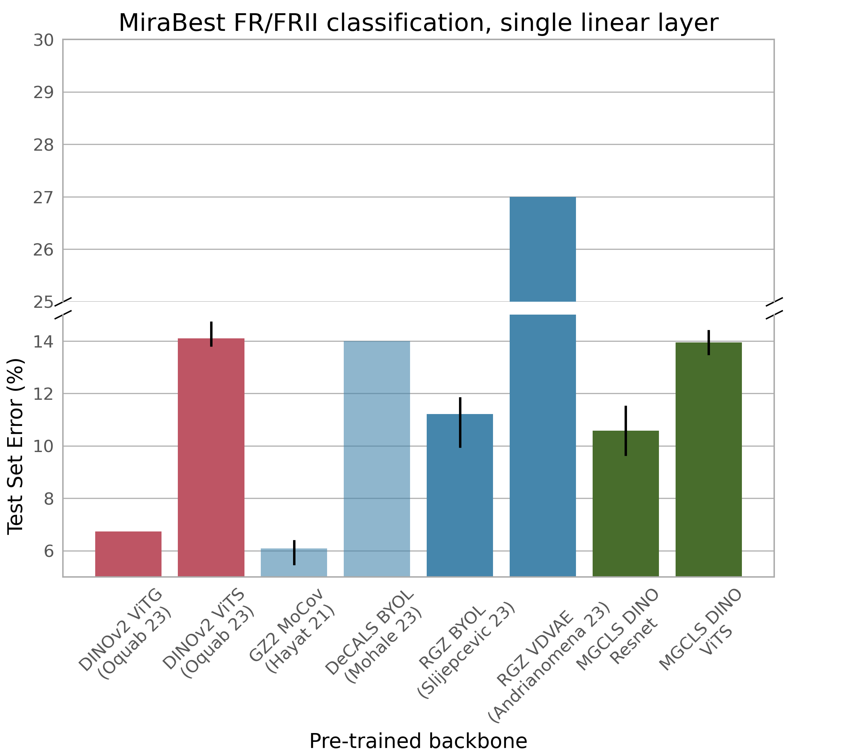
Evaluation: FRI/FRII galaxy morphology classification
Training data
Web images
Optical galaxies
Radio galaxies
Multi-source radio
Lastufka et al. 2024

Slide 20
Evaluation: FRI/FRII galaxy morphology classification
Training data
Web images
Optical galaxies
Radio galaxies
Multi-source radio
Big training datasets gives good performance!
142 million
1.2
million
108k
20k
Lastufka et al. 2024

Slide 21
Evaluation: FRI/FRII galaxy morphology classification
Training data
Web images
Optical galaxies
Radio galaxies
Multi-source radio
Big model makes up for lack of domain-specific training data?
Lastufka et al. 2024

Slide 22
Evaluation: FRI/FRII galaxy morphology classification
Training data
Web images
Optical galaxies
Radio galaxies
Multi-source radio
Our model trained on source-rich data can perform as well as academic state-of-the-art trained on highly curated data
Lastufka et al. 2024

Slide 23
Can the network do complex things?

Slide 24
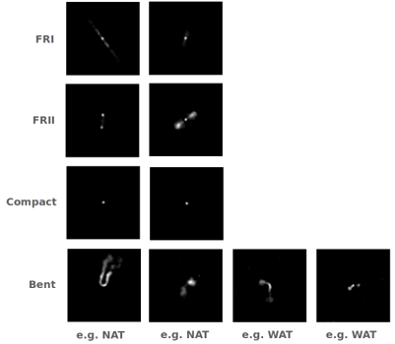
Multi-class morphology classification
RadioGalaxyDataset
VLA images of four morphology classes
Griese et al. 2022

Slide 25
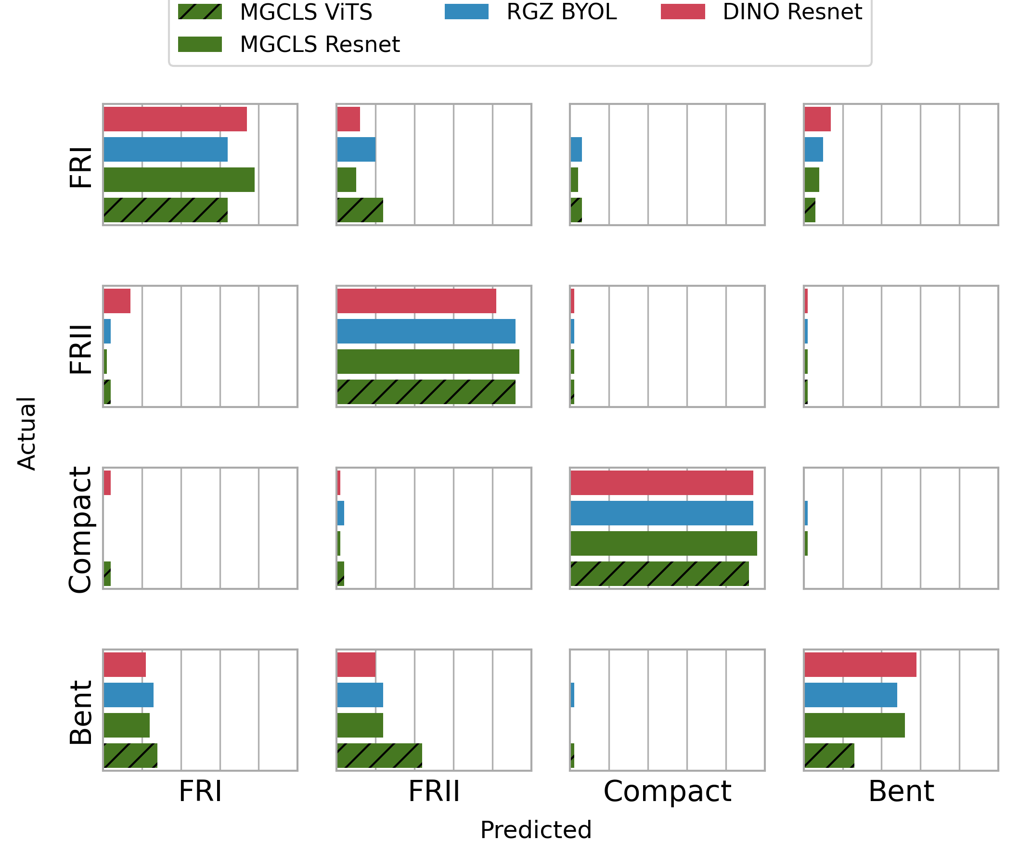
Multi-class morphology classification
With fine-tuning, results are similar for most backbones
Easiest to start with pre-trained weights for common computer vision models
Lastufka et al. 2024

Slide 26
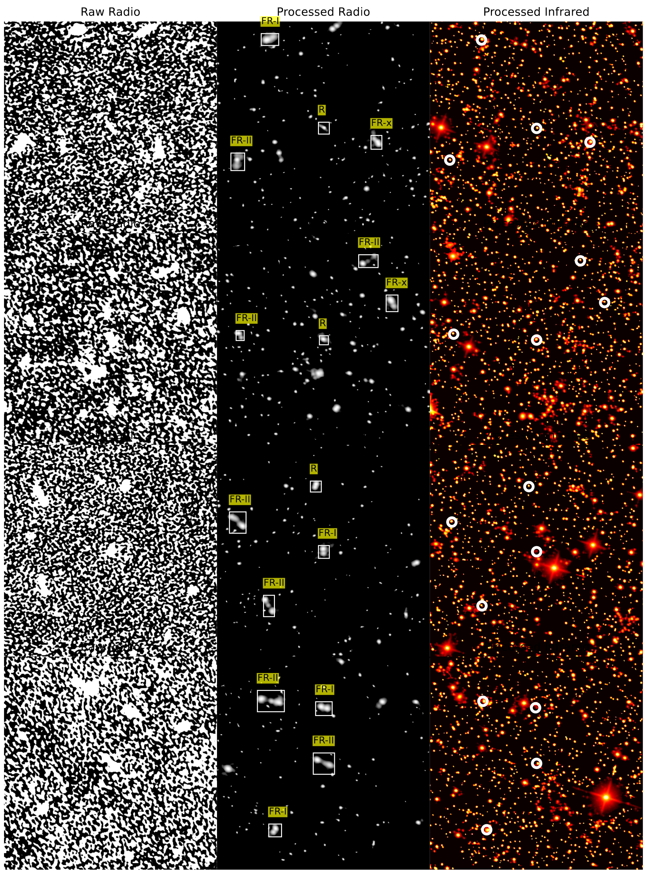
Source detection and segmentation
RadioGalaxyNET
ASKAP + WISE radio/infrared dataset for object detection
Gupta et al. 2023

Slide 27
Future foundation models in astronomy
Training data can come straight from the data processing pipeline!
A mixture of source-rich and single-source?
Evaluated on multiple high-complexity tasks

Slide 28
Extra slides

Slide 29
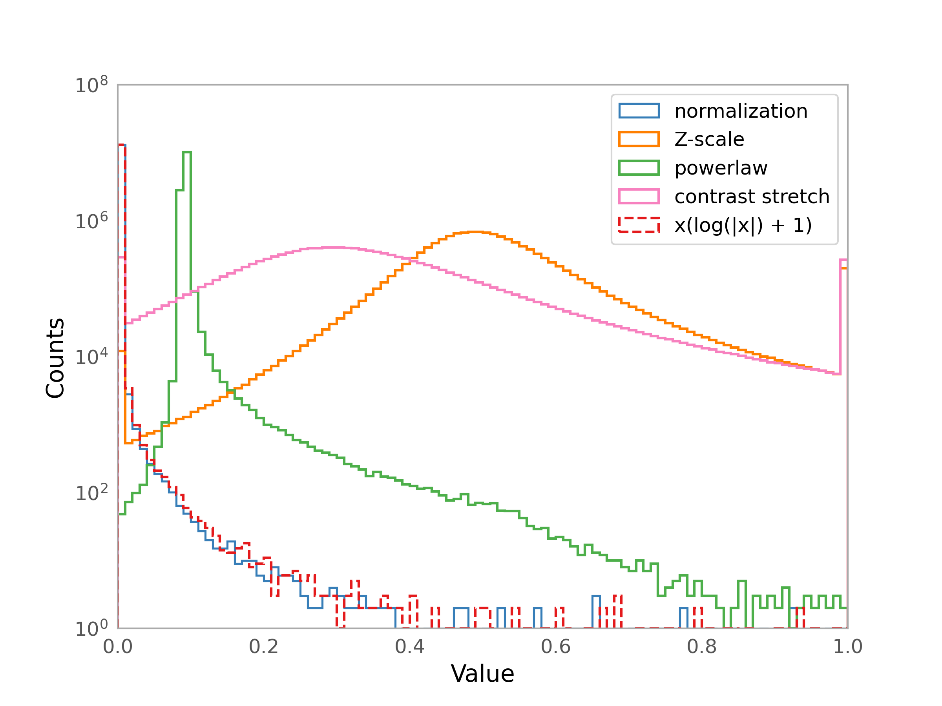
Image Pre-processing

Slide 30
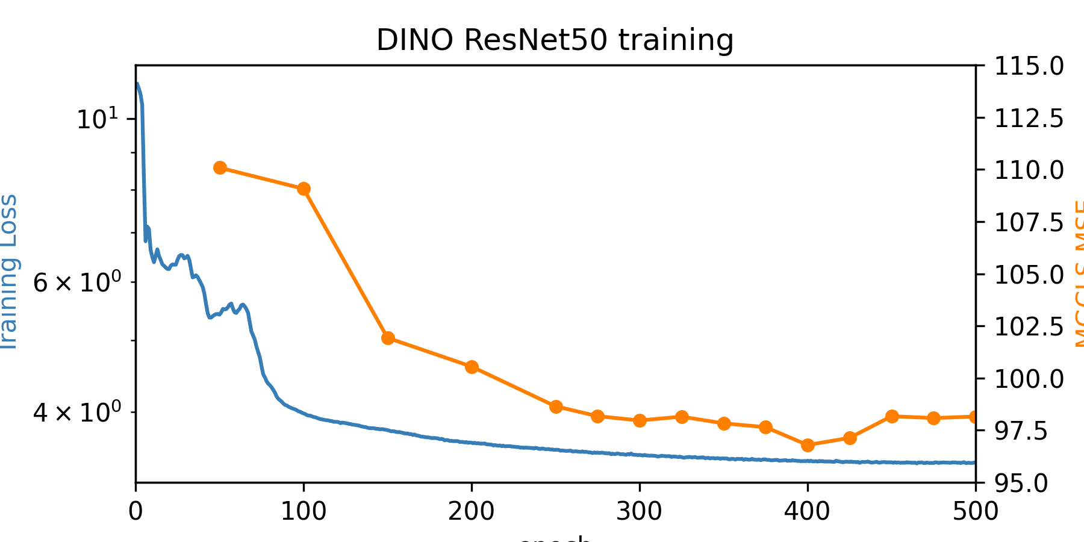
Networks and training
Notes:
Image sourcehttps://www.google.com/url?sa=i&url=https%3A%2F%2Ftowardsdatascience.com%2Fthe-annotated-resnet-50-a6c536034758&psig=AOvVaw1Sba2c8EJxtmXISlLZPXZu&ust=1705417884381000&source=images&cd=vfe&opi=89978449&ved=0CBUQjhxqFwoTCMDCs_PW34MDFQAAAAAdAAAAABAD

