Slide 1
Each Station IS AS Unique as A Snowflake : The Consequences of Assuming Uniformity for EOR Science
AMAN CHOKSHI
NICHOLE BARRY, BART PINDOR
JACK LINE, RACHEL WEBSTER

Slide 2
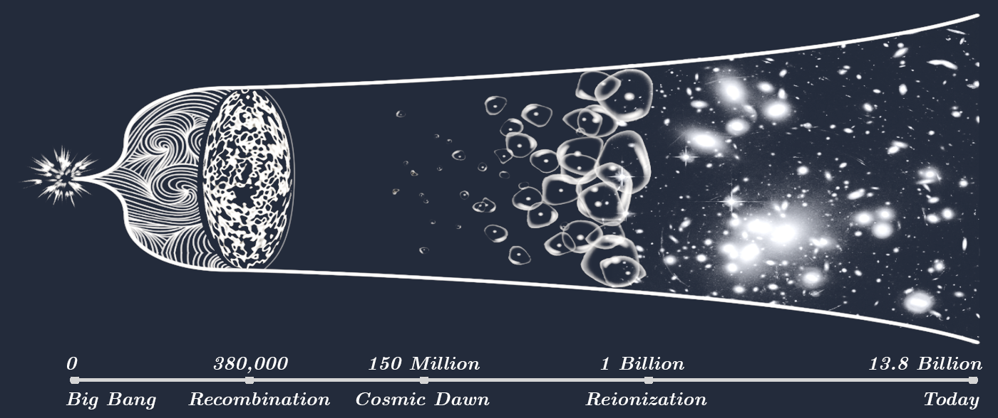
EPOCH OF REIONIZATION

Slide 3
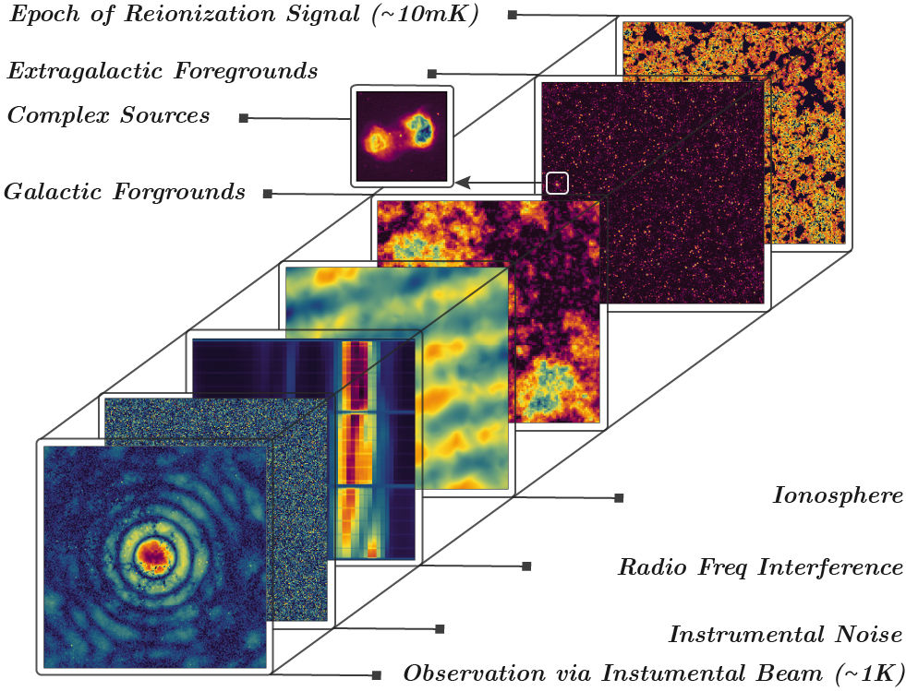
FOREGROUNDS

Slide 4
Foreground – Instrument Systematic Coupling
Spectral characteristics - discriminate EoR vs foregrounds
Massive dynamic range – absolute precision on all levels
Instrumental systematics – beam, bandpass and more
Foreground model – A-team, galactic plane, polarization
Necessitate large and detailed instrumental characterization & simulations

Slide 5
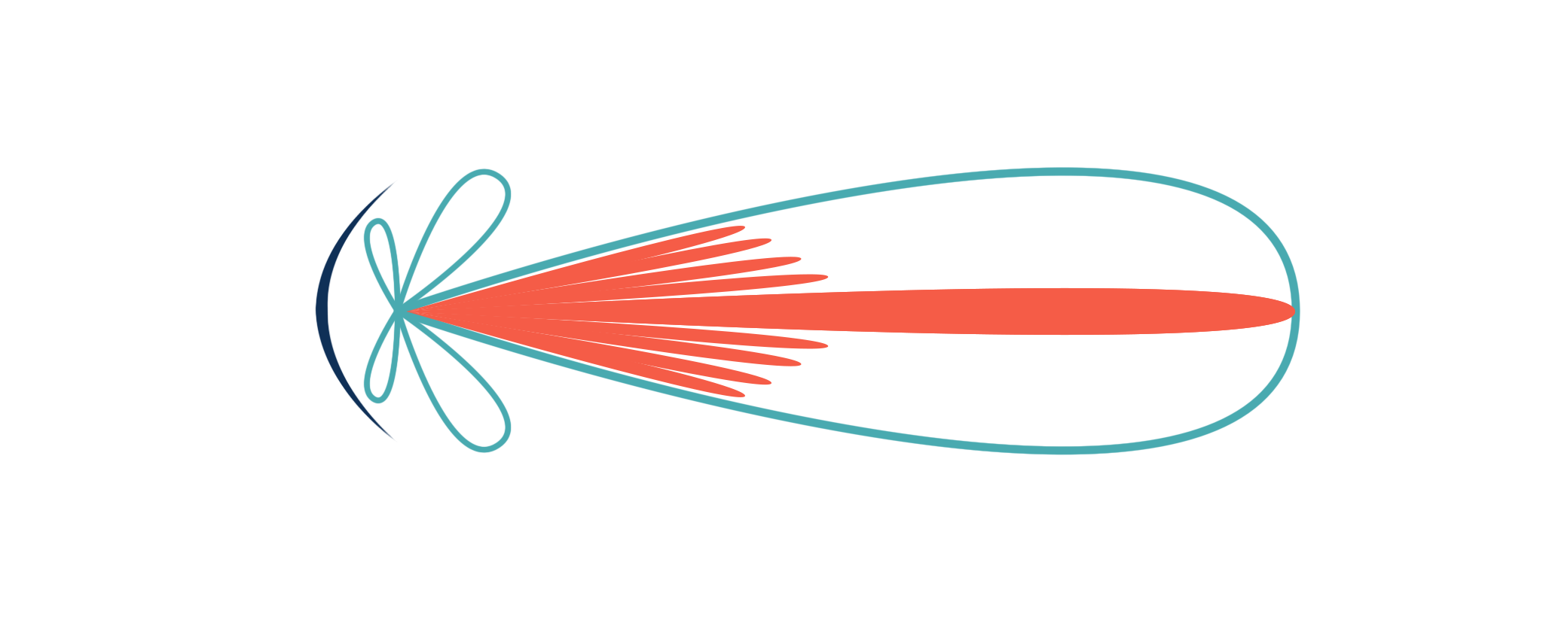
Radio Beams
First Sidelobe
Antenna Radiation
Pattern (Beam)
Primary Beam
Synthesized Beam

Slide 6
Van CITTERT-Zernike Theorem
The mutual coherence function of an infinitely distance source can be used to reconstruct its image
$$V=\iint{A(\hat{s}) I(\hat{s}) e^{−2πi\overset{⃑}{b}∙\hat{s}/λ}}dΩ$$
Sky Intensity
Geometric Phase Term
(Sampled Mode)
Beam Response

Slide 7
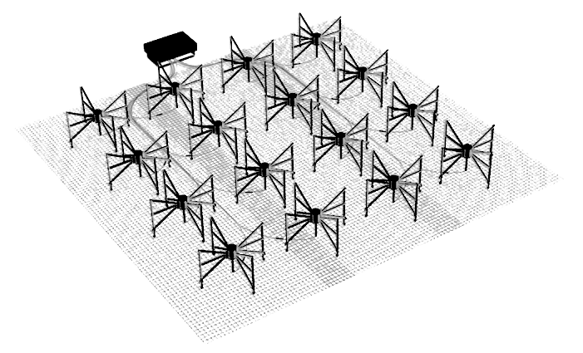
THE MURCHISON WIDEFIELD ARRAY
128 tiles (stations), pseudo-random
4 x 4 array of bow-tie dipoles
Frequency band: 70 – 300 MHz
Field of View at 150 MHz ≈ 25 ° [FWHM]
~ 1 arcminute resolution
[©️ CAASTRO]

Slide 8
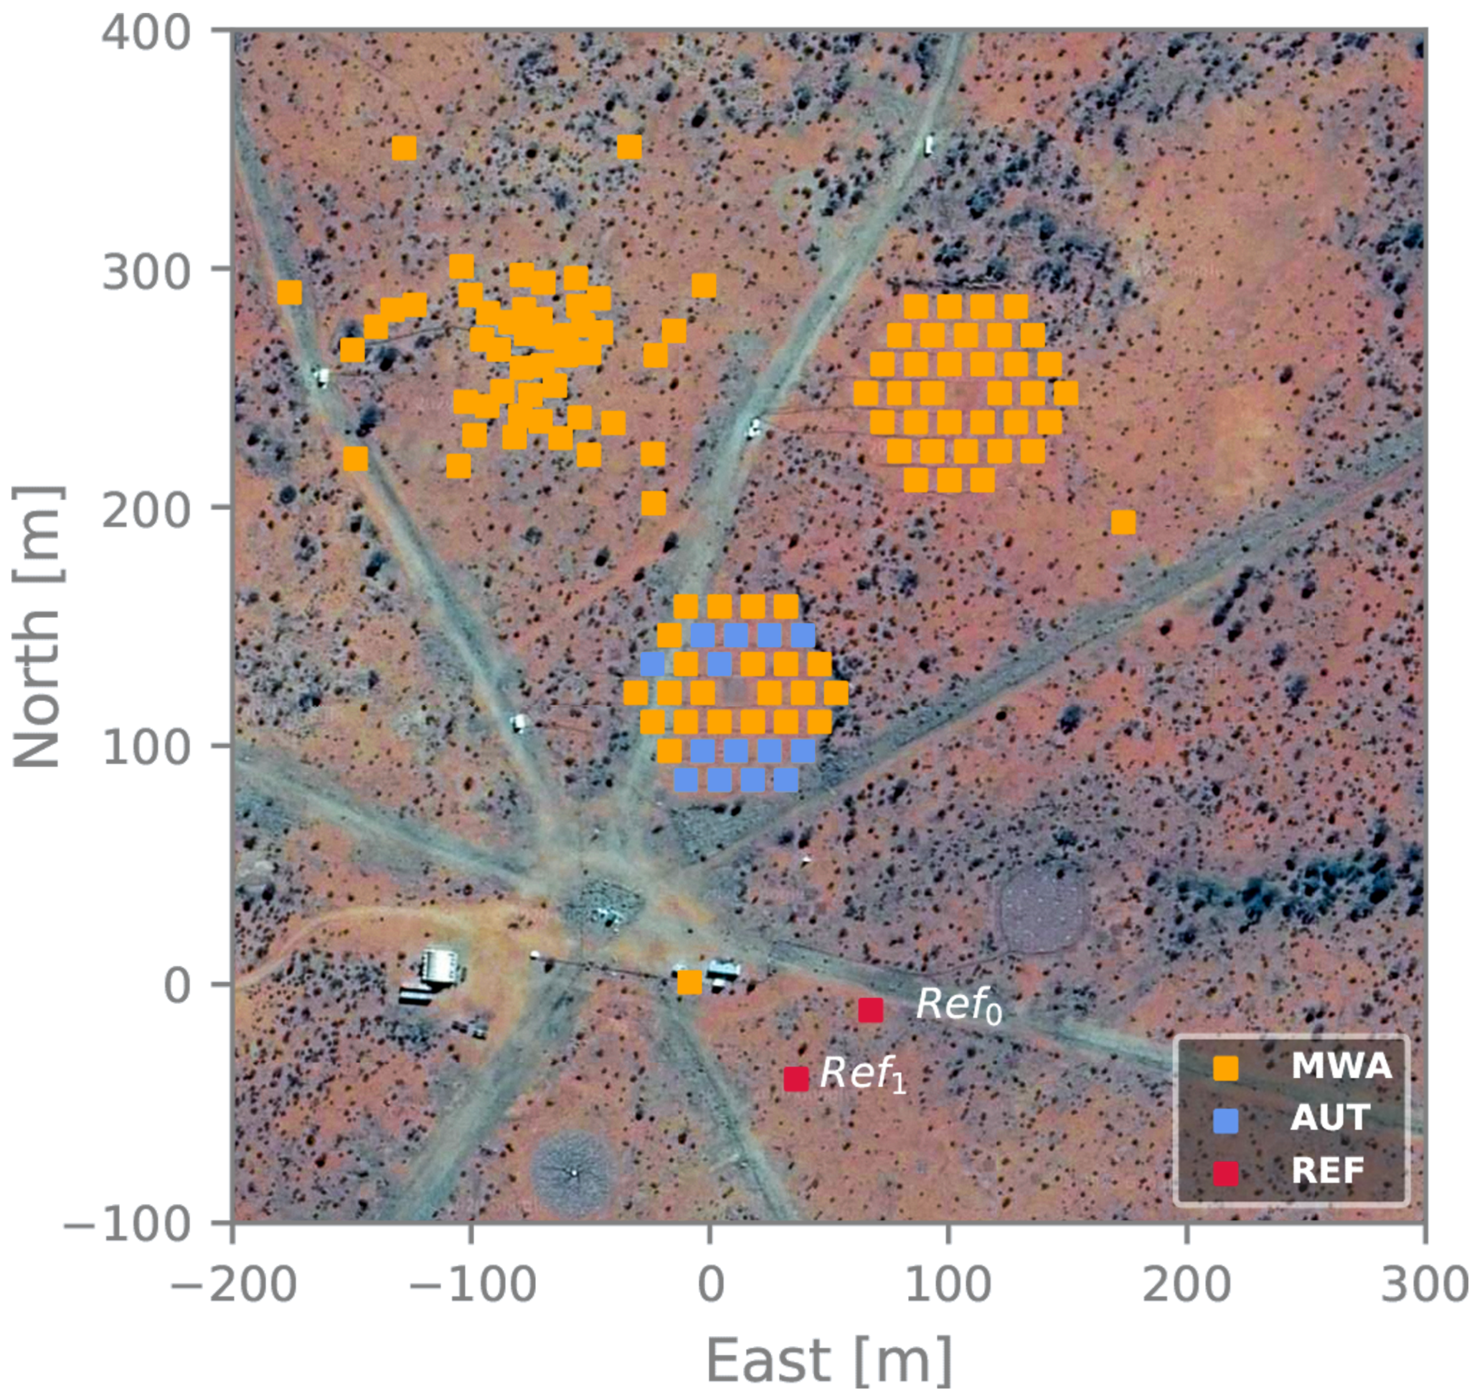
Satellite BEAM EXPERIMENT
Two reference antennas
Record modulation in RF signals
Single dipoles on 5 x 5 m mesh
Each pass probes a cross section
of the beam response
Gradually build up an all sky
beam pattern

Slide 9
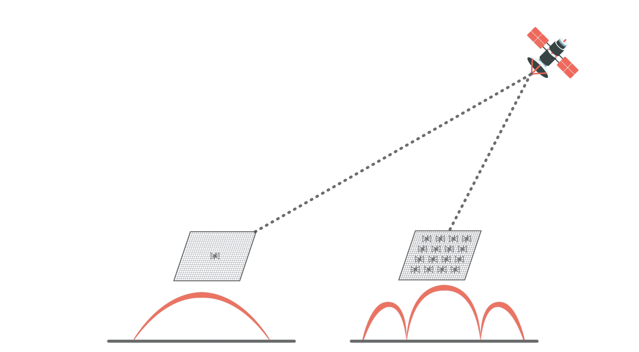
SATELLITE BEAM EXPERIMENT
$${ B}_{AUT }= \frac{P_{AUT}}{P_{ref}}B_{ref}$$
P_{ref} = F. B_{ref}
P_{AUT} = F. B_{AUT}

Slide 10
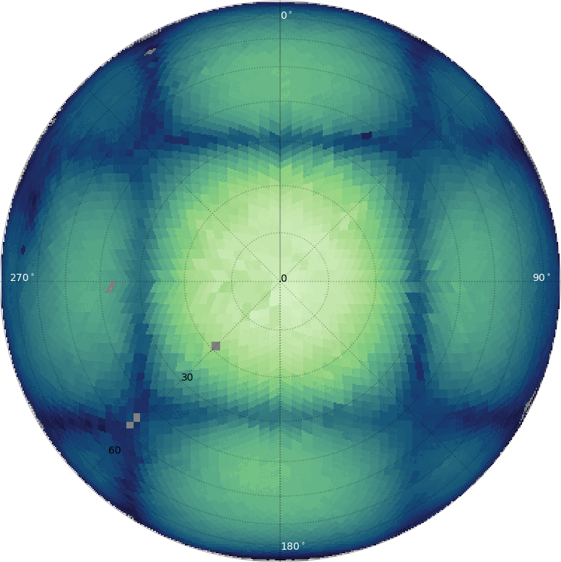
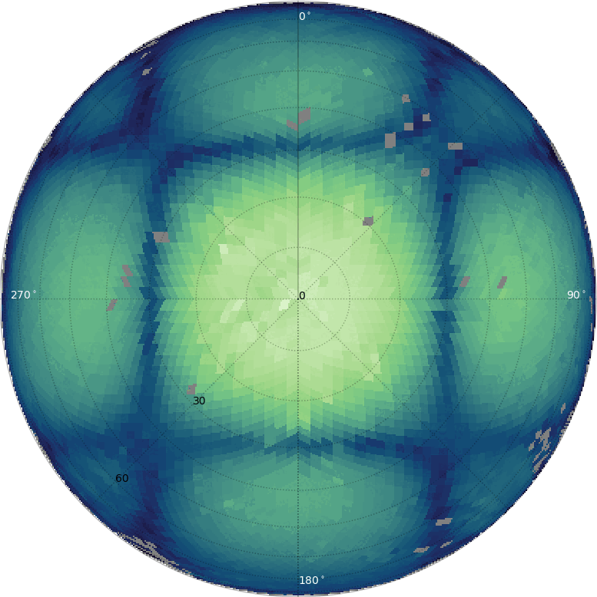
[ MWA Satellite Beam Measurements - Chokshi et al. 2020, 2021 ]

Slide 11
Try it with your Telescope!

Slide 12
Deformed Beam & EoR SCIENCE
Deformed beams encoded within observed data
Perfect beam model used for calibration
Simulate 30,000 complex foreground sources w/ deformed beams
Calibrate with prefect & deformed set of beams
Power spectrum & spectral leakage
Subtract models of brightest sources

Slide 13
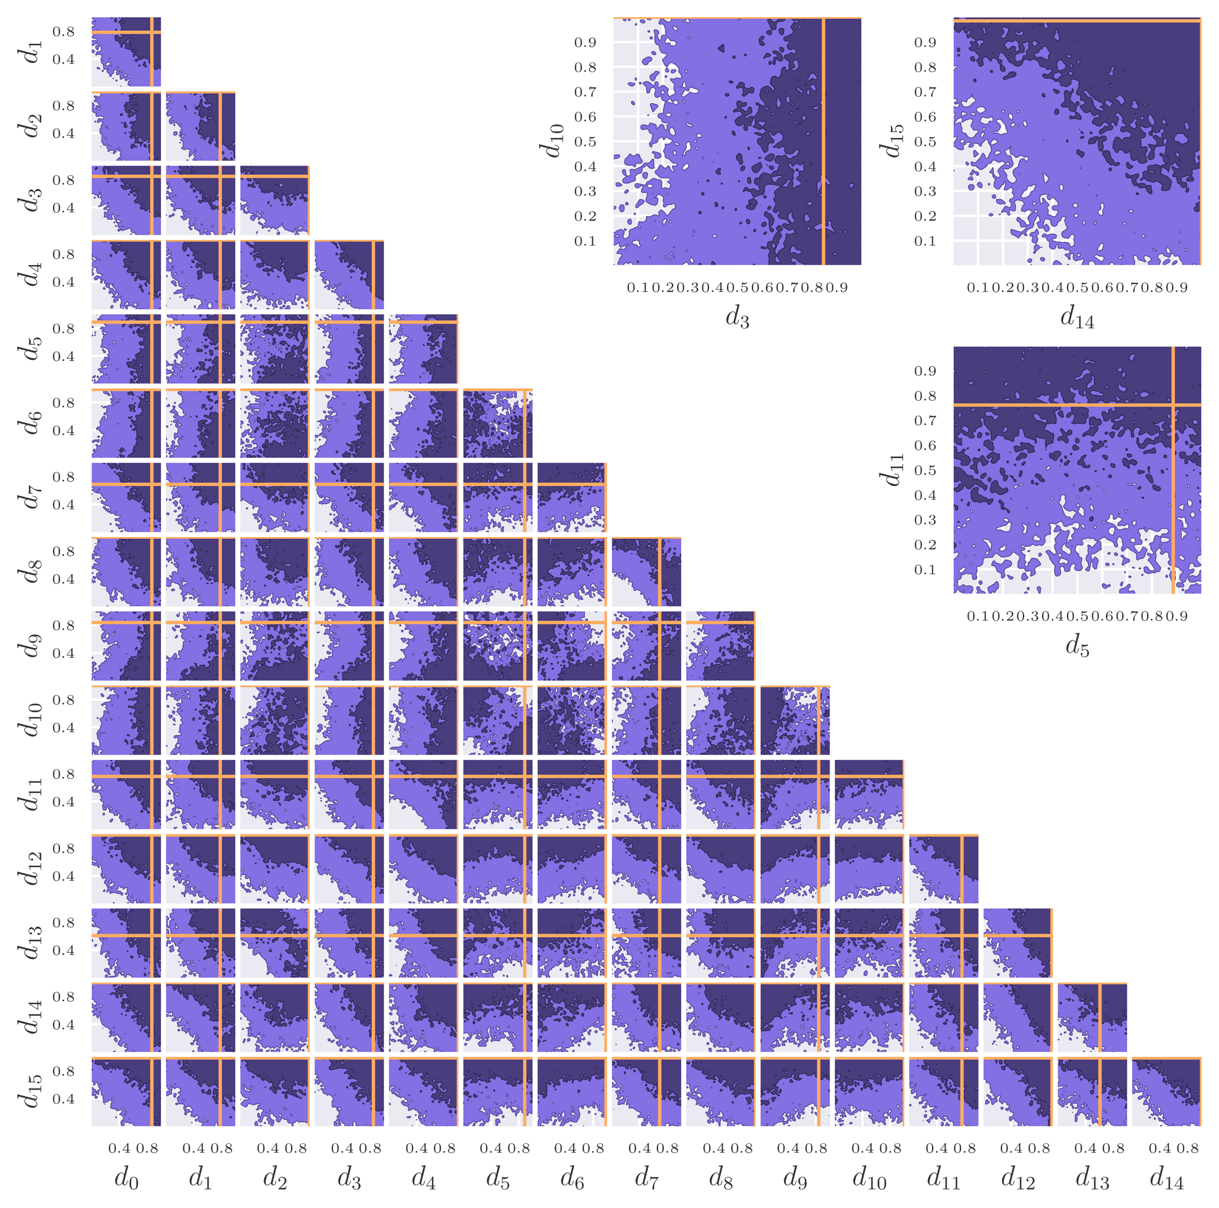
DEFORmED BEAMS
Modulate 16 dipole gain amps
Emulate realistically deformed
MWA beam
Simulation fun

Slide 14
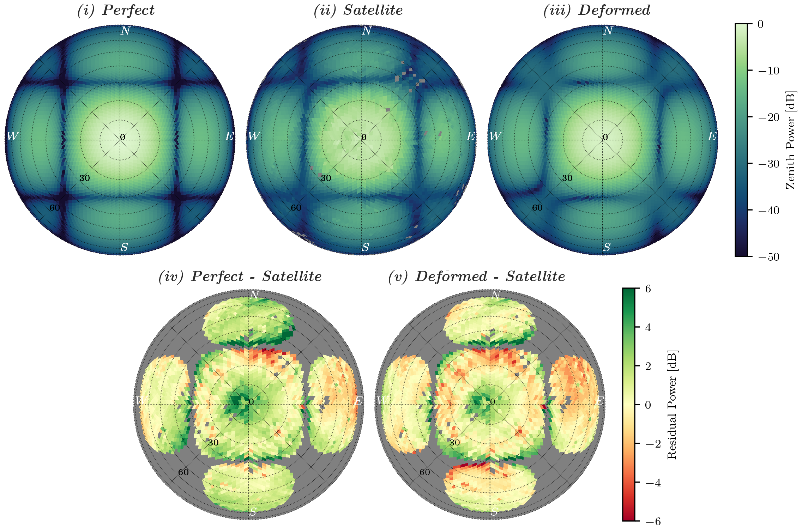

Slide 15
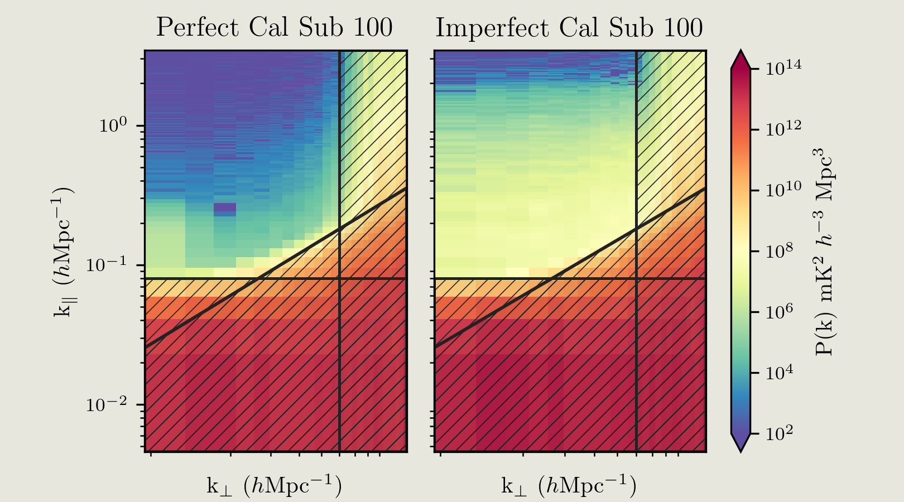
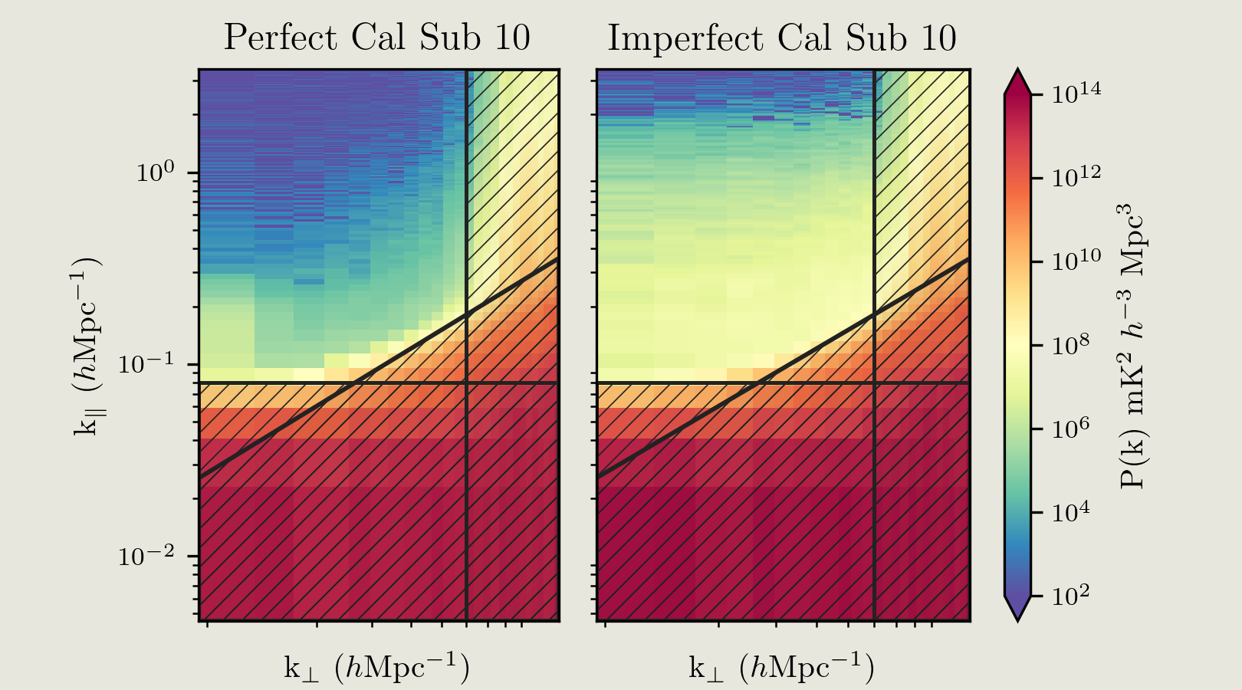
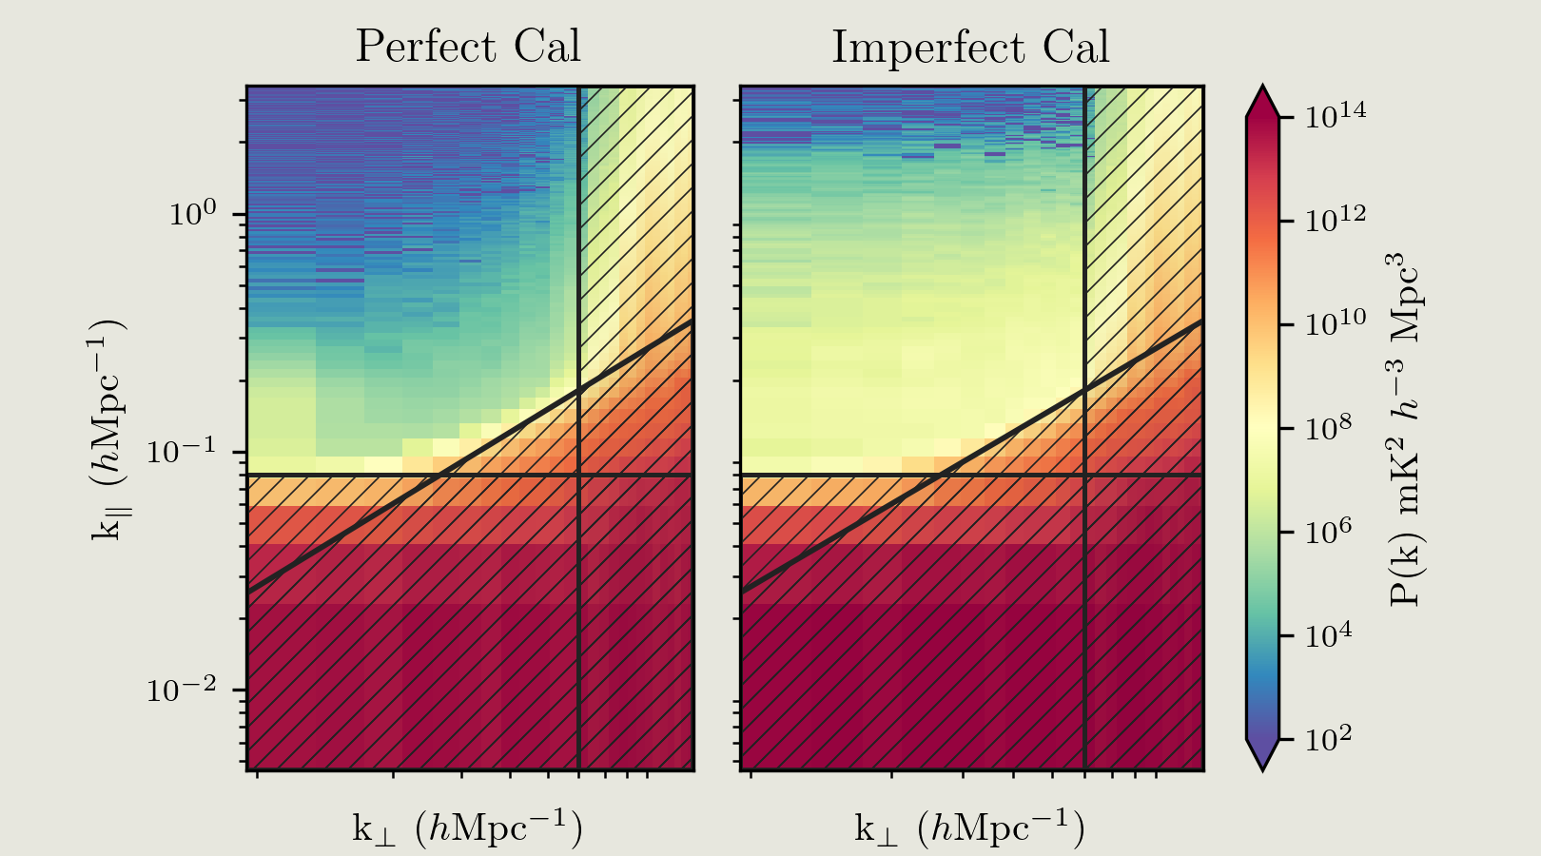
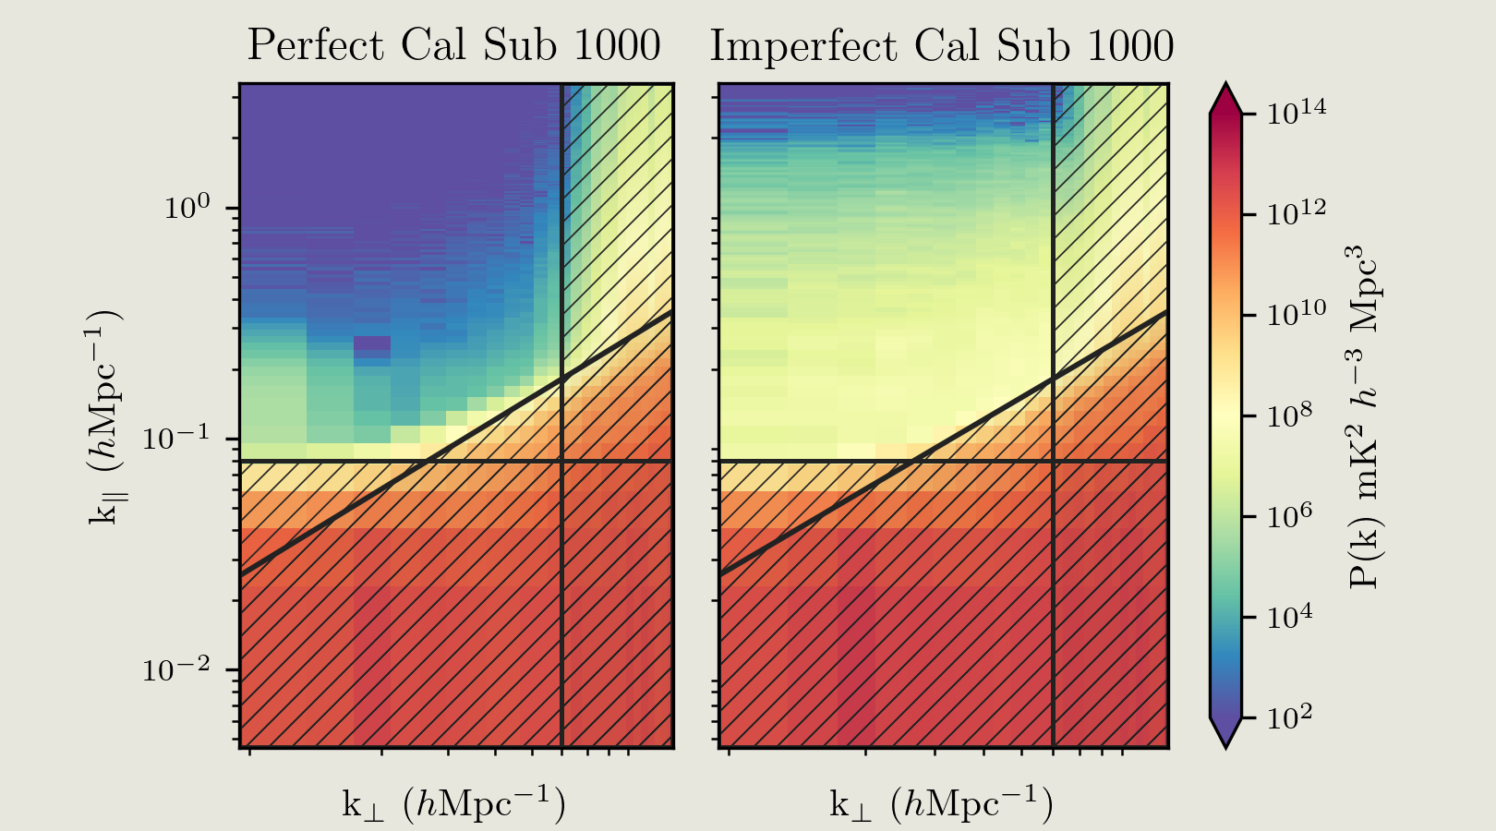
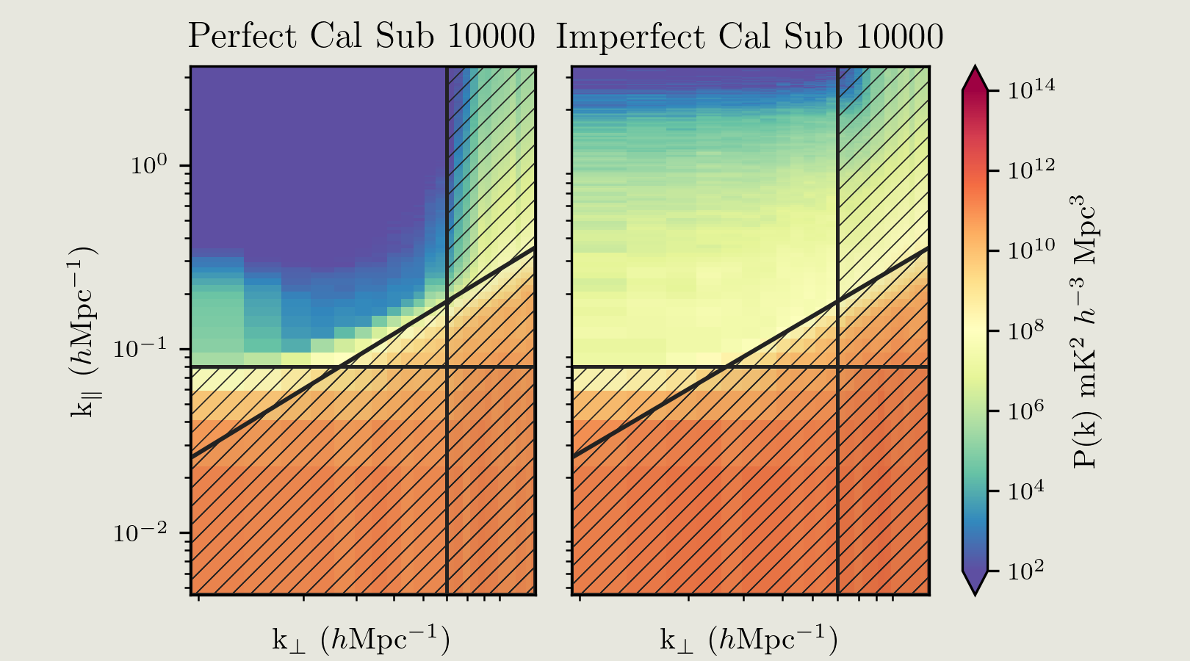

Slide 16
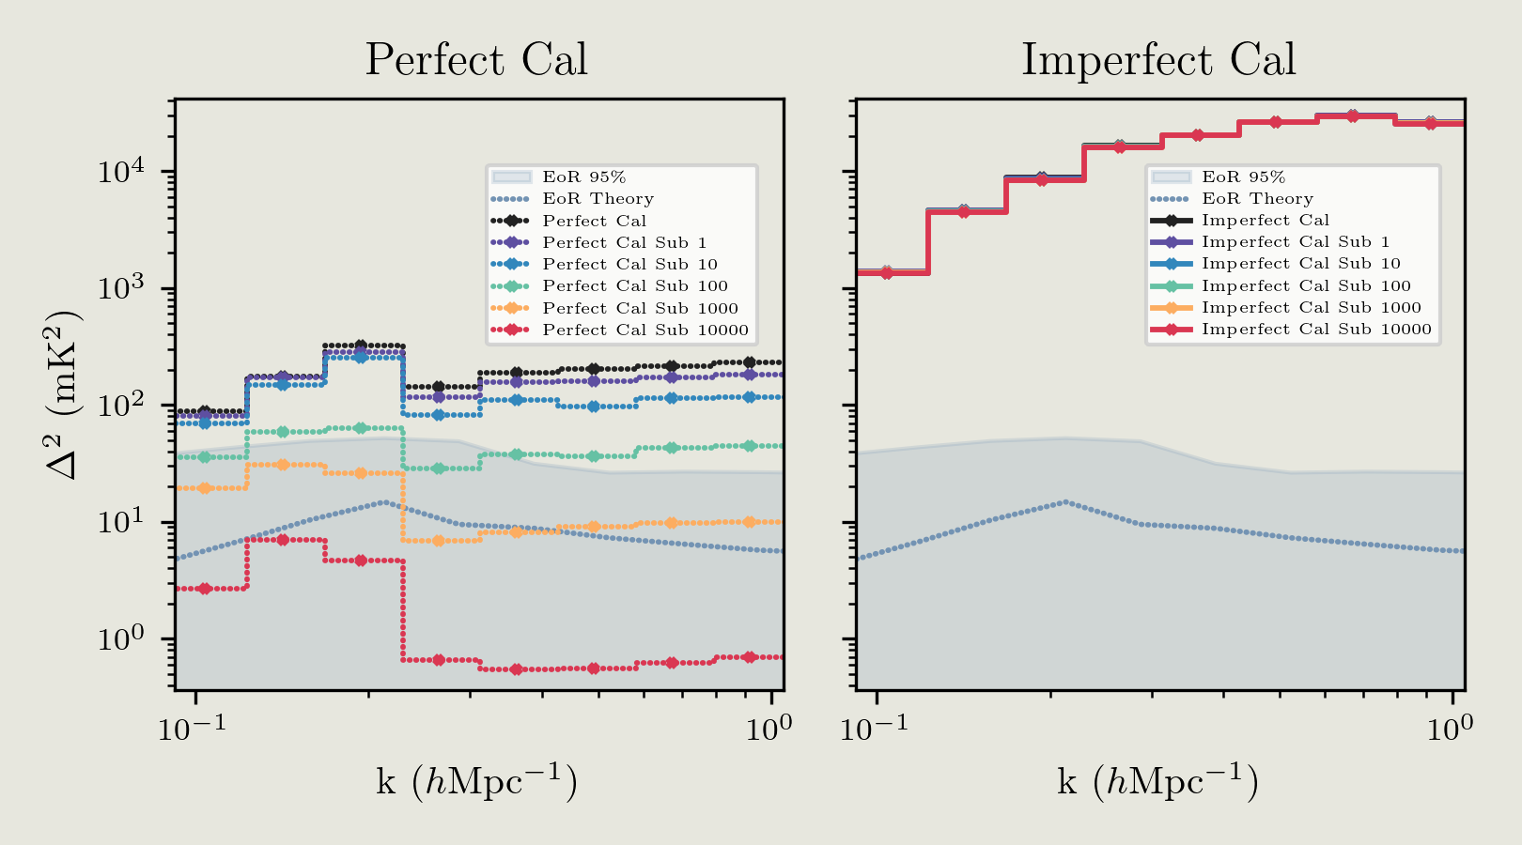
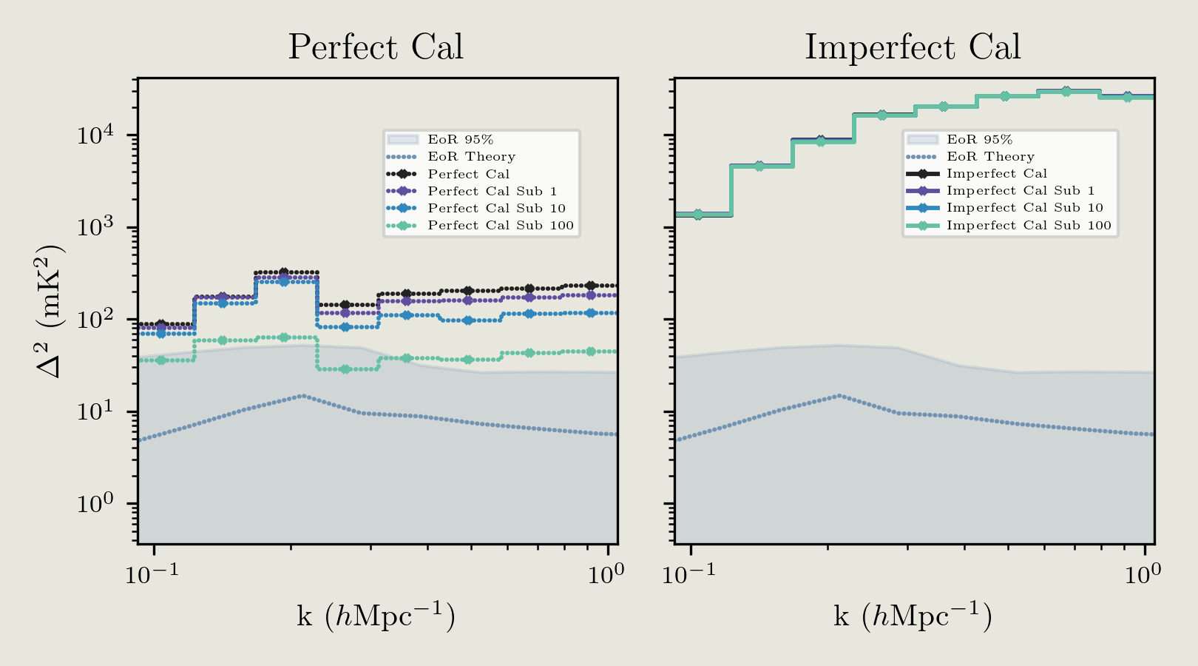
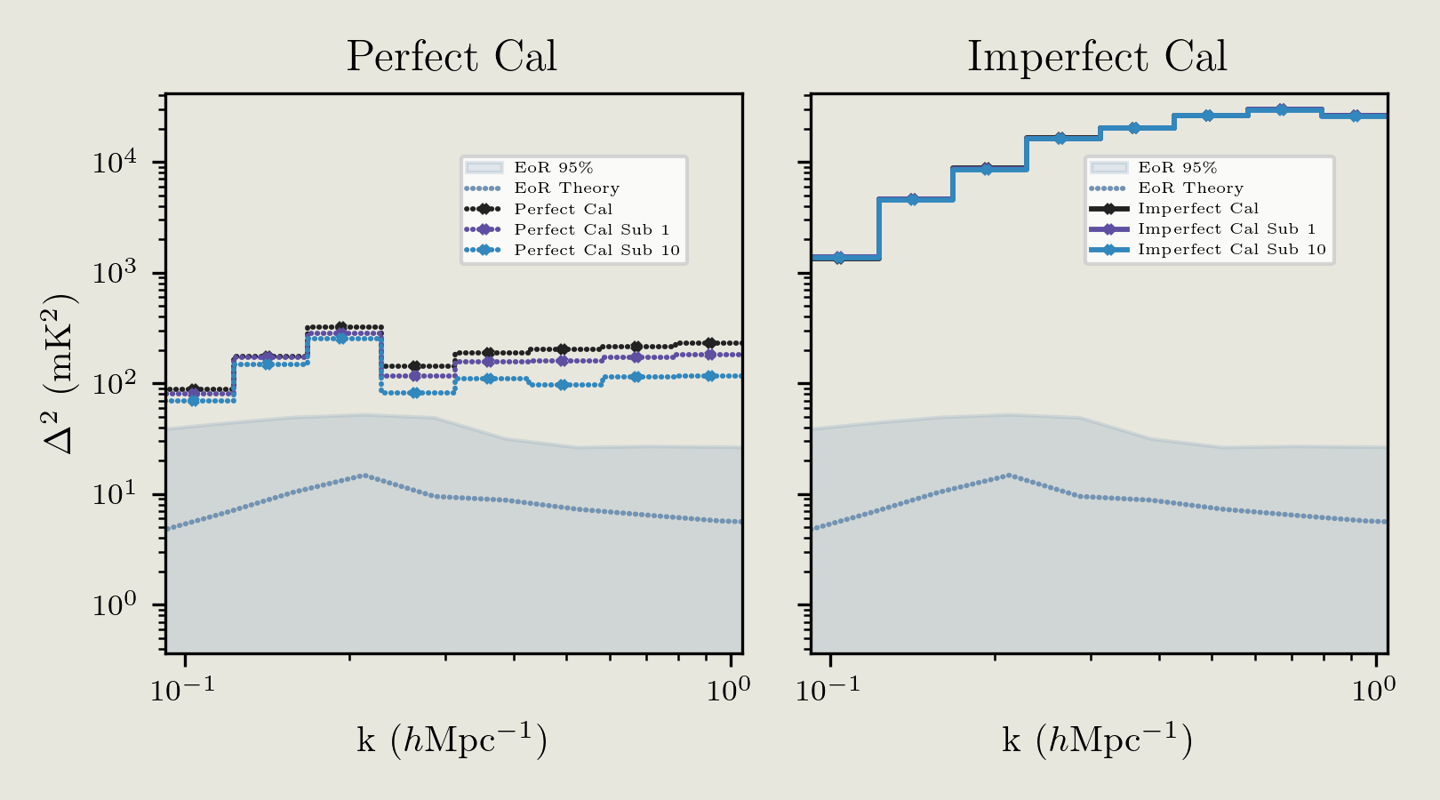
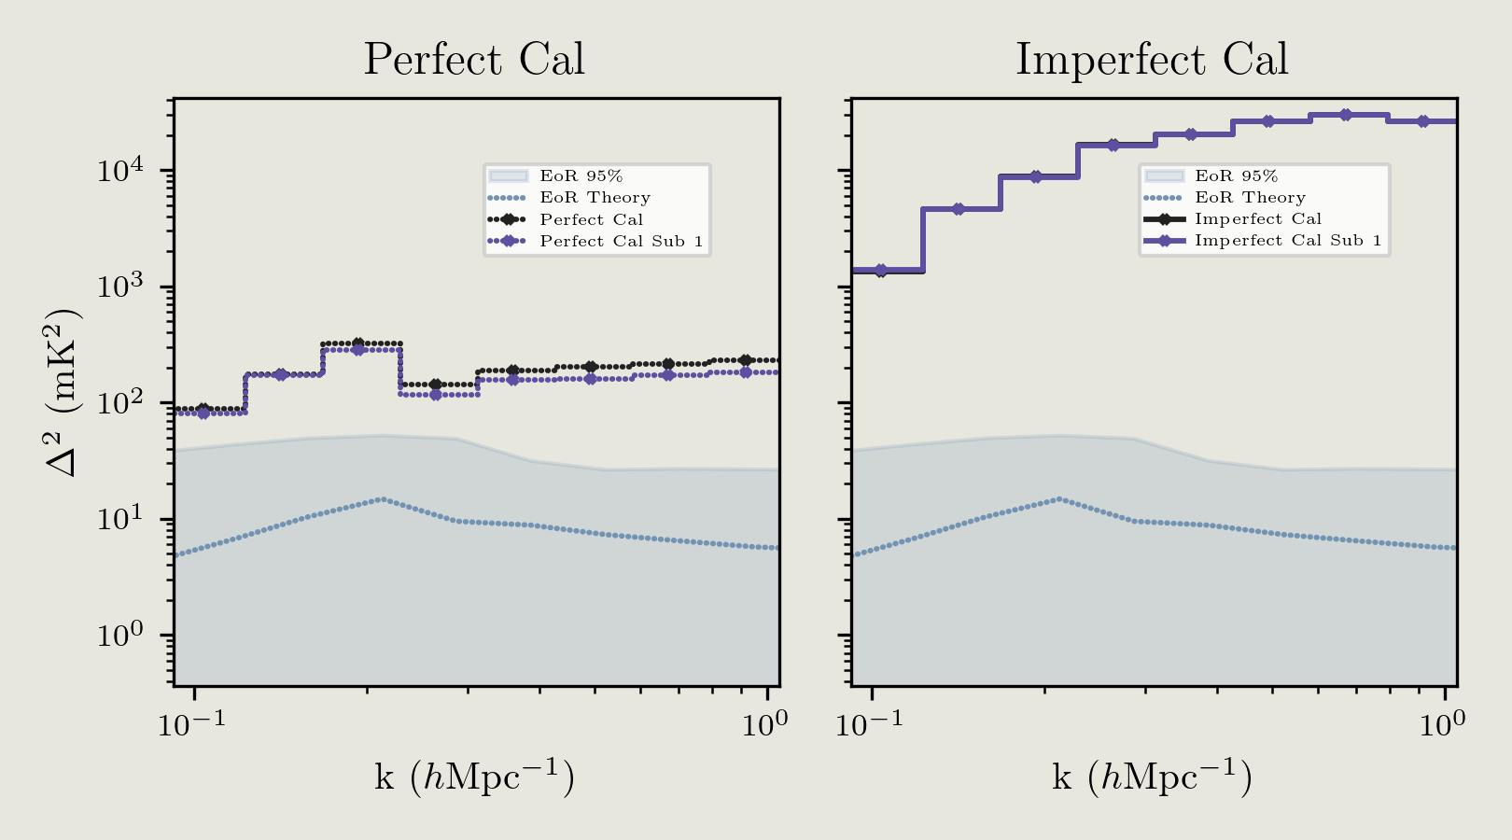
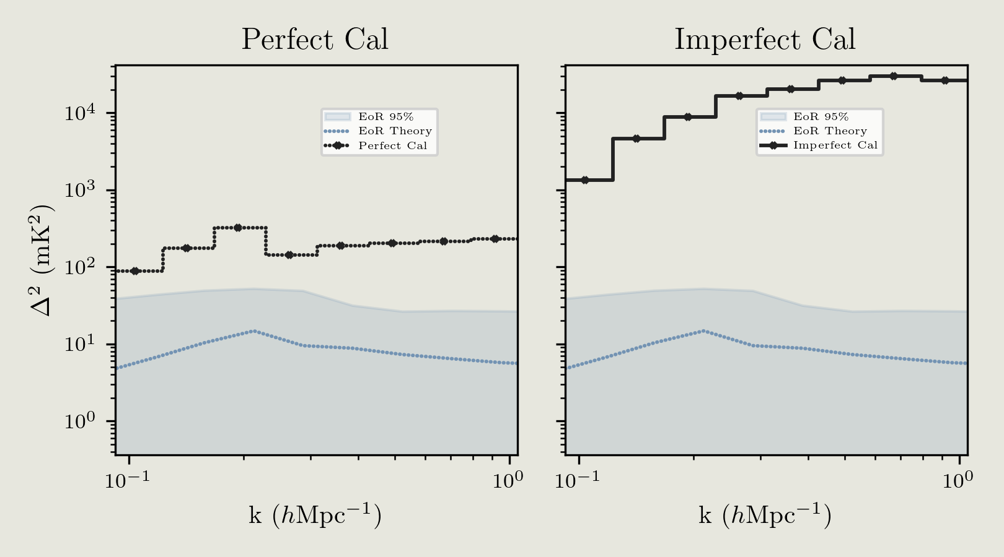
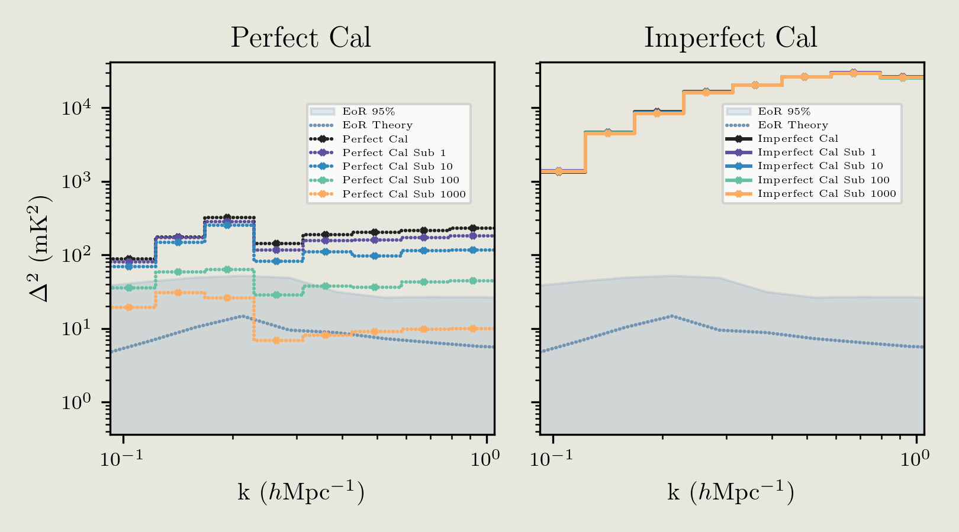

Slide 17
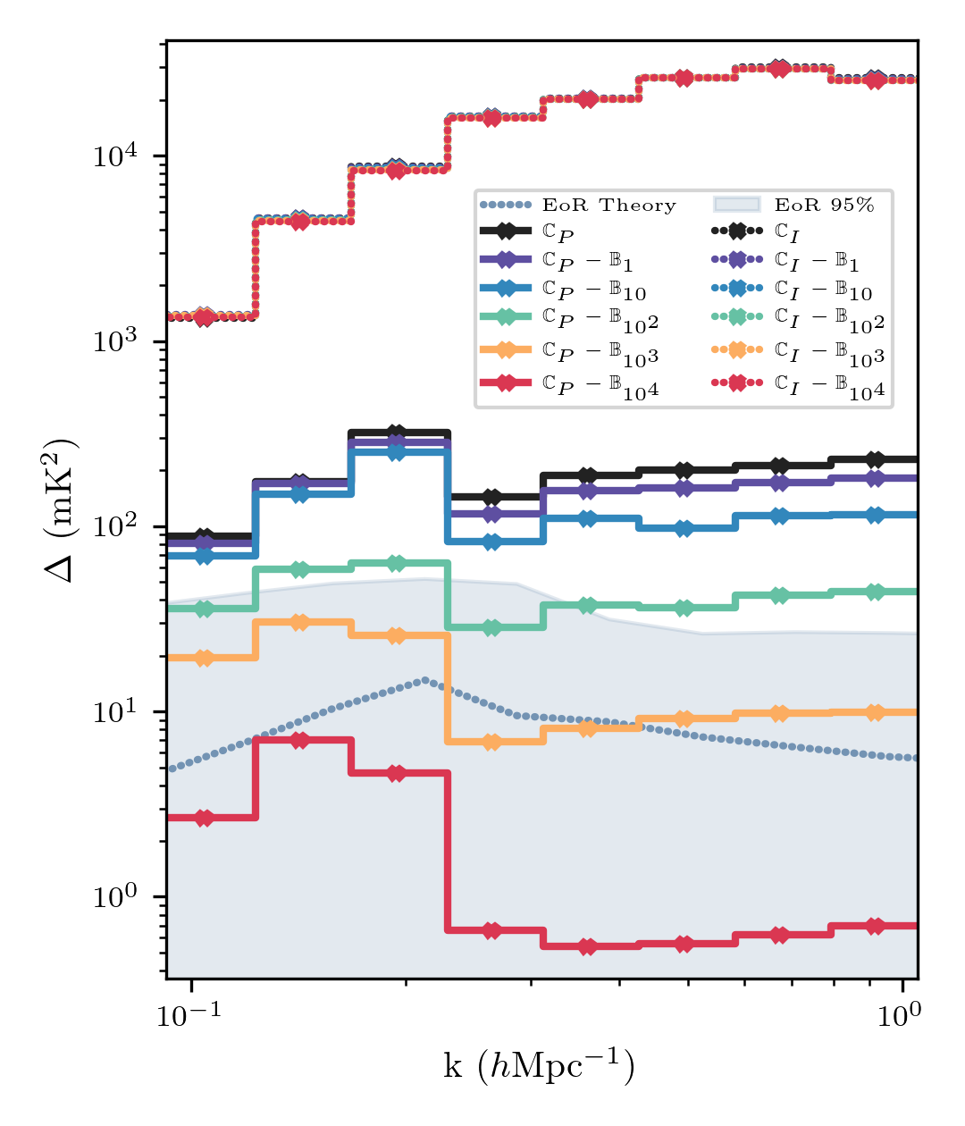
Deformed BEAMS AND THE EoR
Imperfect Calibration
{
Perfect Calibration
Expected EoR Level
[ Chokshi et al. in prep 2024]

Slide 18
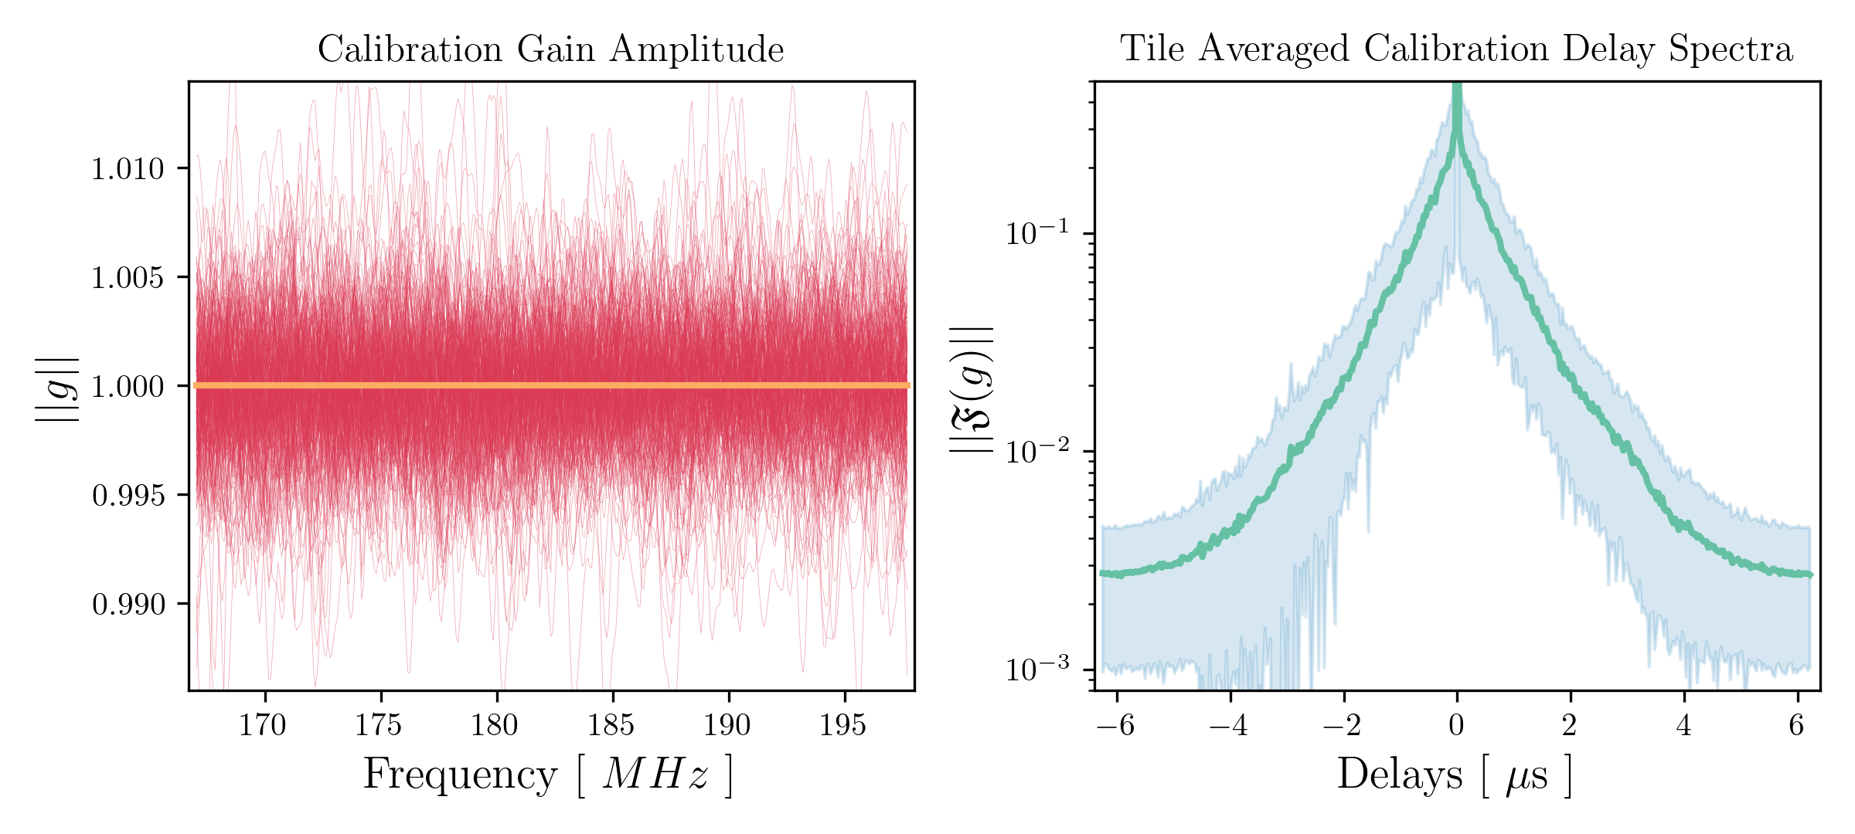
Deformed BEAMS AND Calibration Errors

Slide 19
What does this mean?
At EoR precisions, various faint systematics can dominate a detection
Hope isn’t lost, we need to measure & monitor individual beams
Explore hybrid drone-satellite beam mapping methods
We need to start thinking about it as new telescope start getting built
Chokshi et. al. 2024 (in prep)

Slide 20
THANK YOU
@aman_chokshi

