Slide 1
DARK &
The impact of large satellite
constellations on the
QUIET
SKIES
Anna Bonaldi
Federico Di Vruno

Slide 2
Activity in Low Earth Orbit

Slide 3
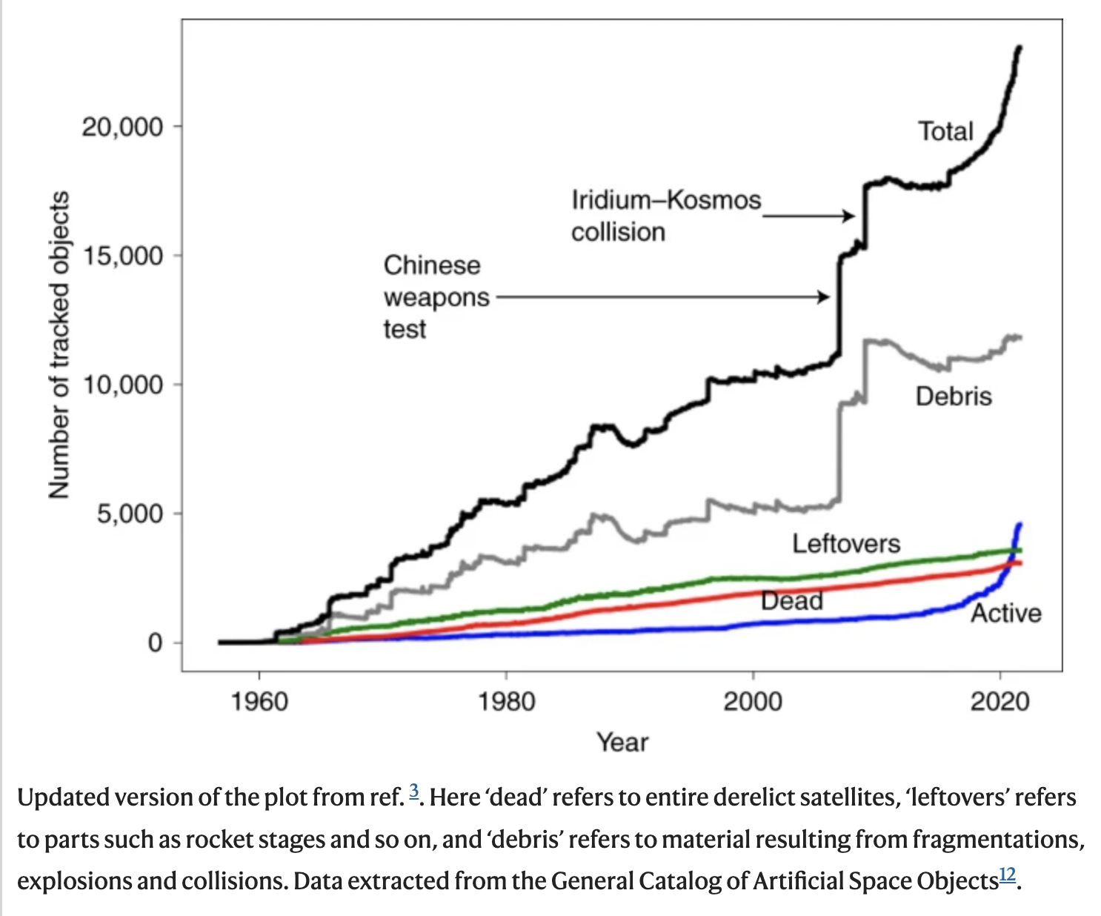
Number of active satellites (1957-2023)
Active satellites in LEO (200 – 2000 km)
1957 October 4: 1
2019 : ~2,200
2022 : ~4,000
2024 : >8,000 (Celestrak)
2030+ : >500,000 (based on filings)
Lawrence et al. 2022 (NatAs, 6,428)
______________________________Mega-constellations

Slide 4
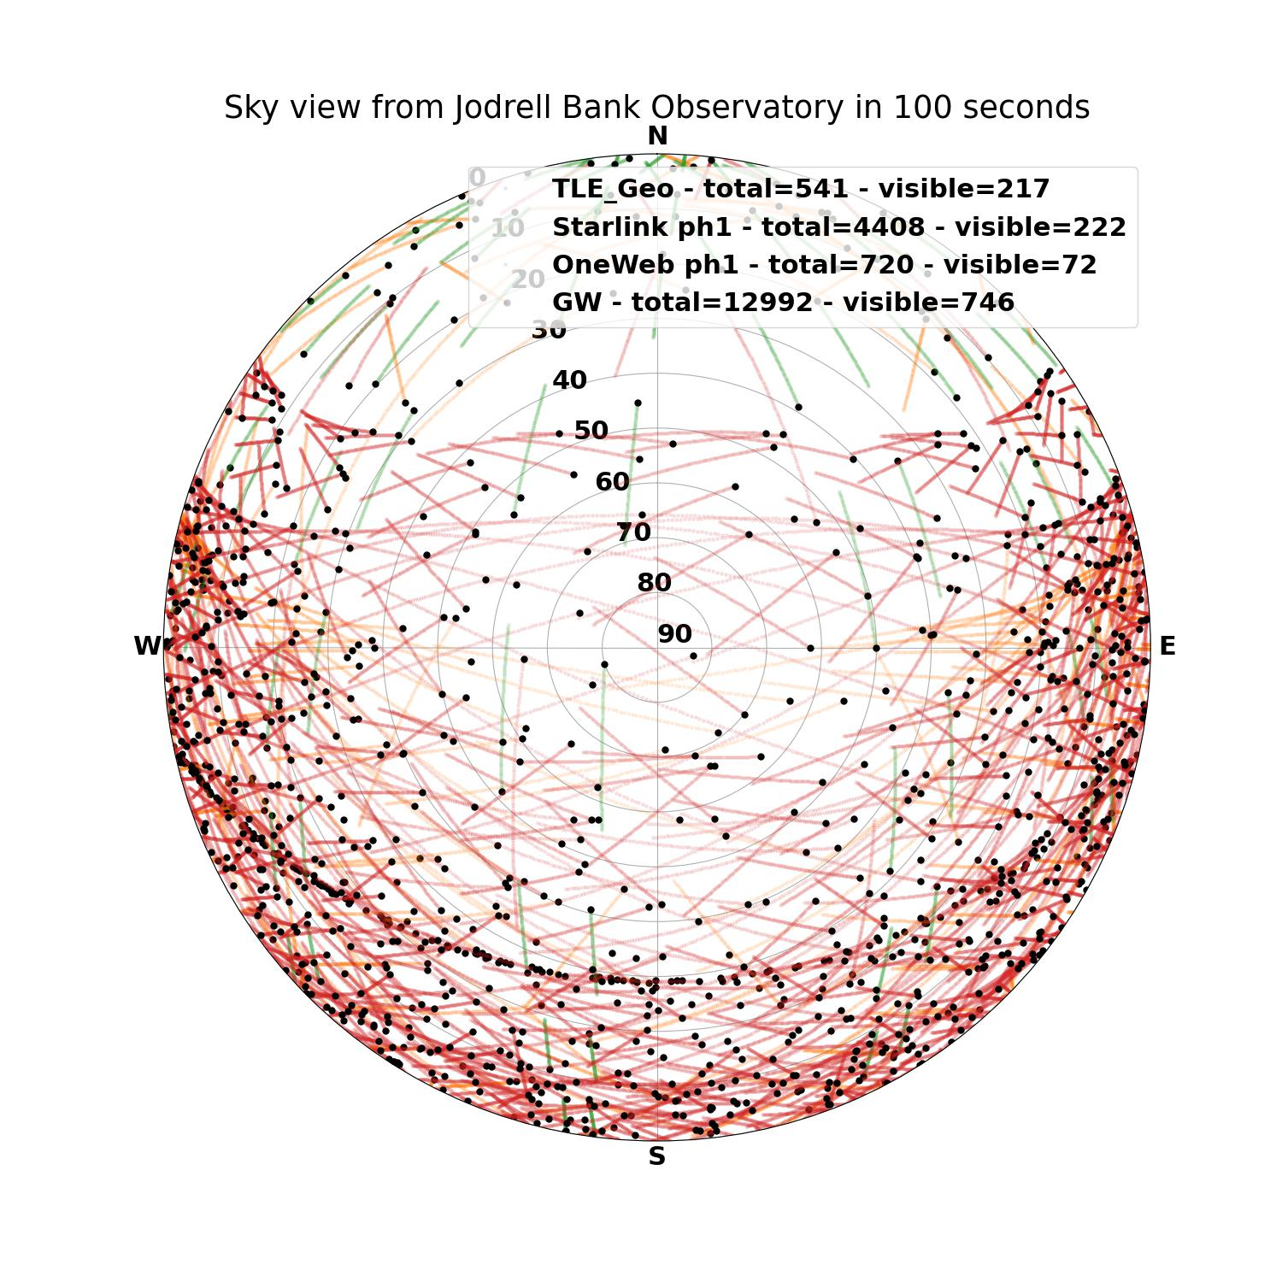
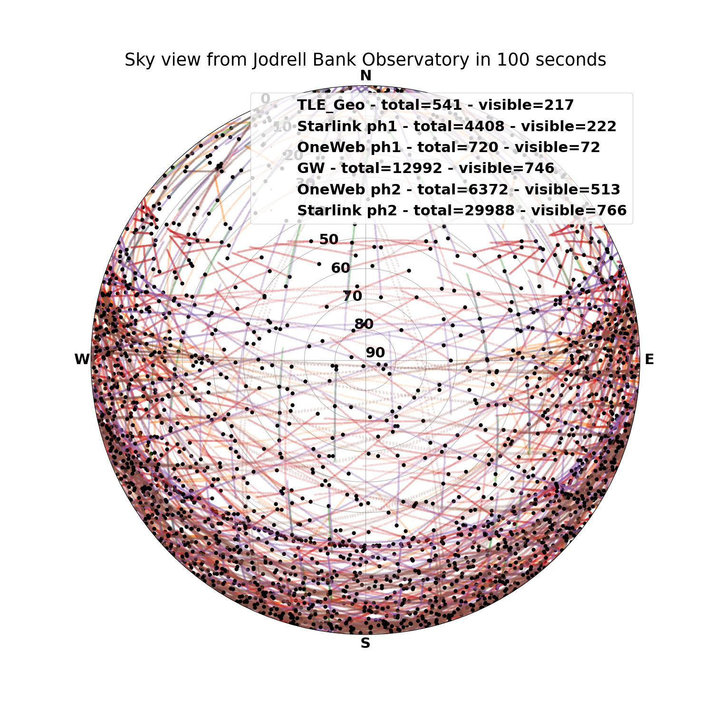
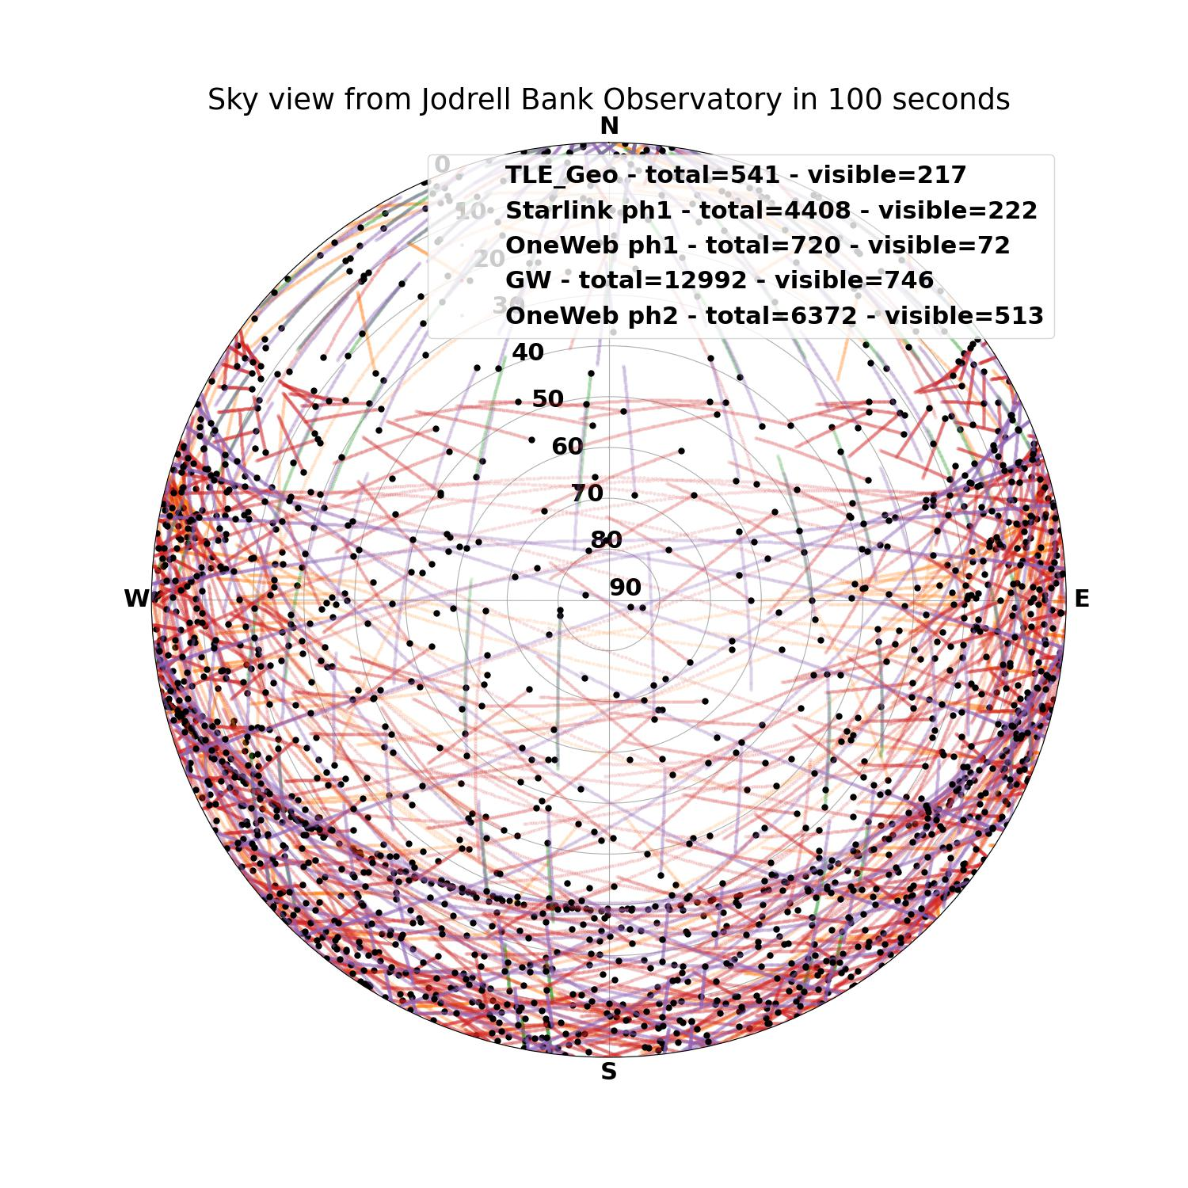
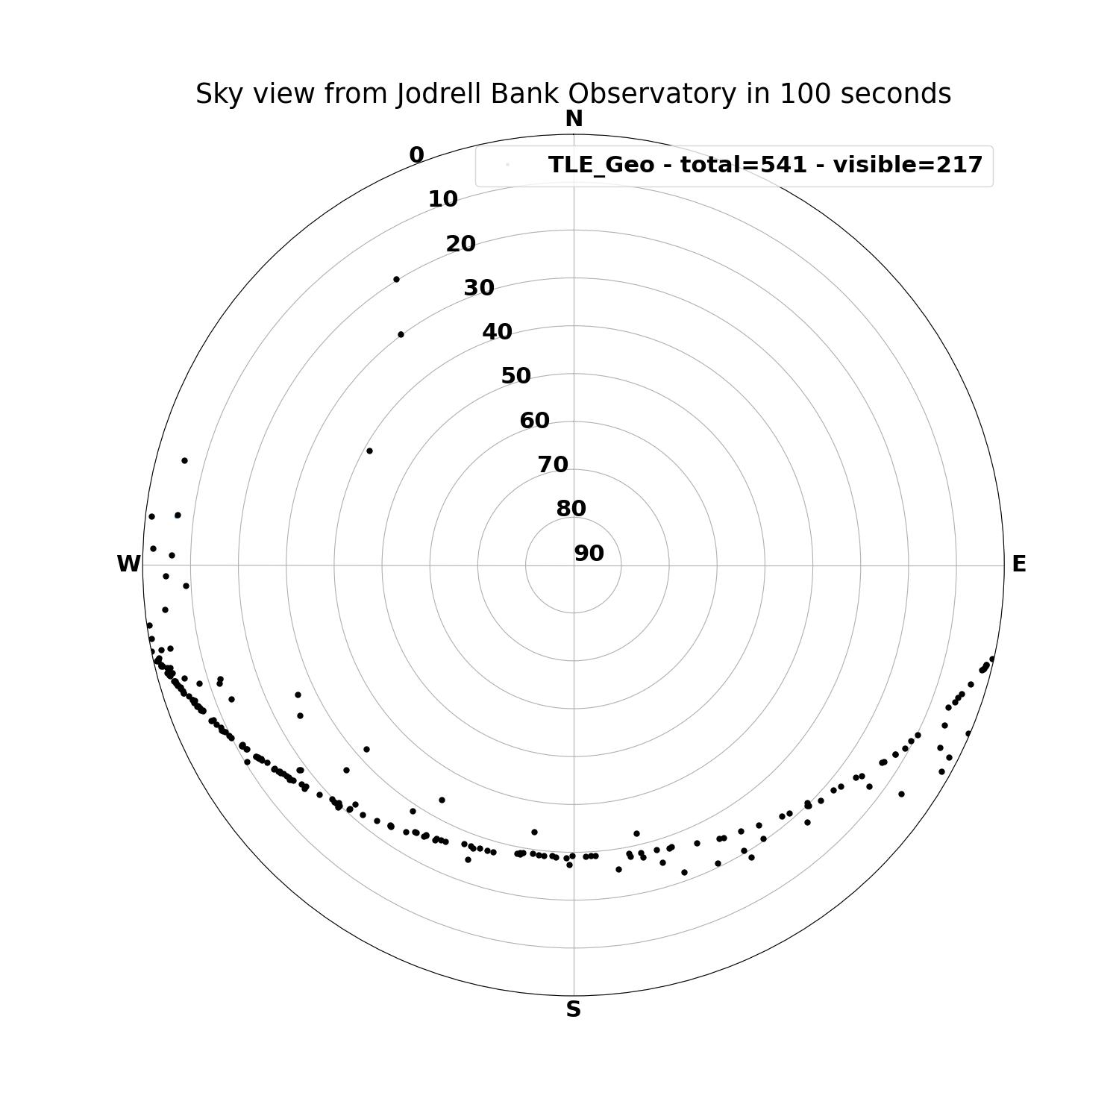
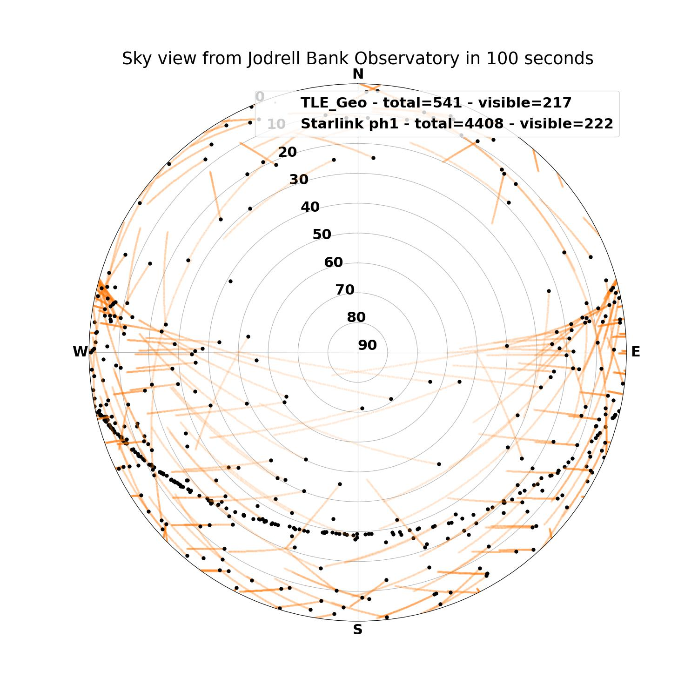
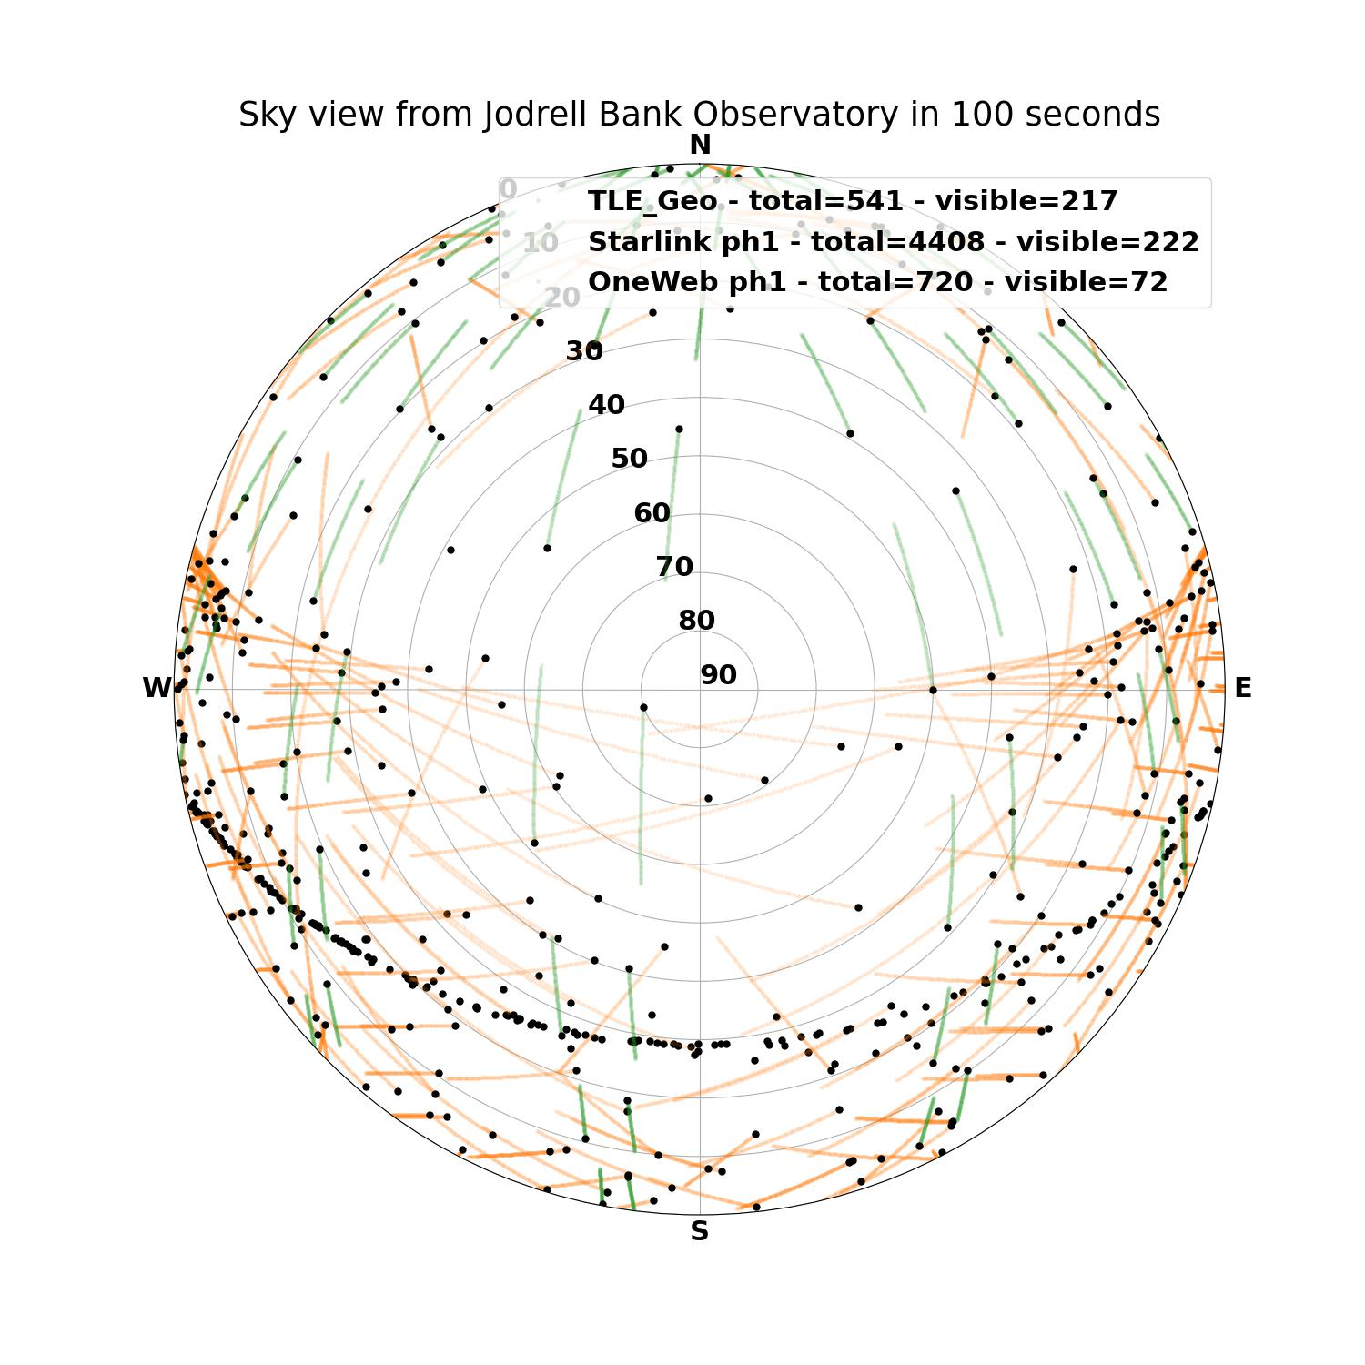
Sky view from Jodrell Bank Observatory Lat = 53 deg 100 seconds
Geostationary orbit
Starlink phase 1
OneWeb phase 1
Guo Wang (p)
OneWeb phase 2 (p)
Starlink phase 2 (p)
Satellites above horizon = 2319
Source: Federico Di Vruno

Slide 5
Effects on the Dark and (radio)Quiet Sky

Slide 6
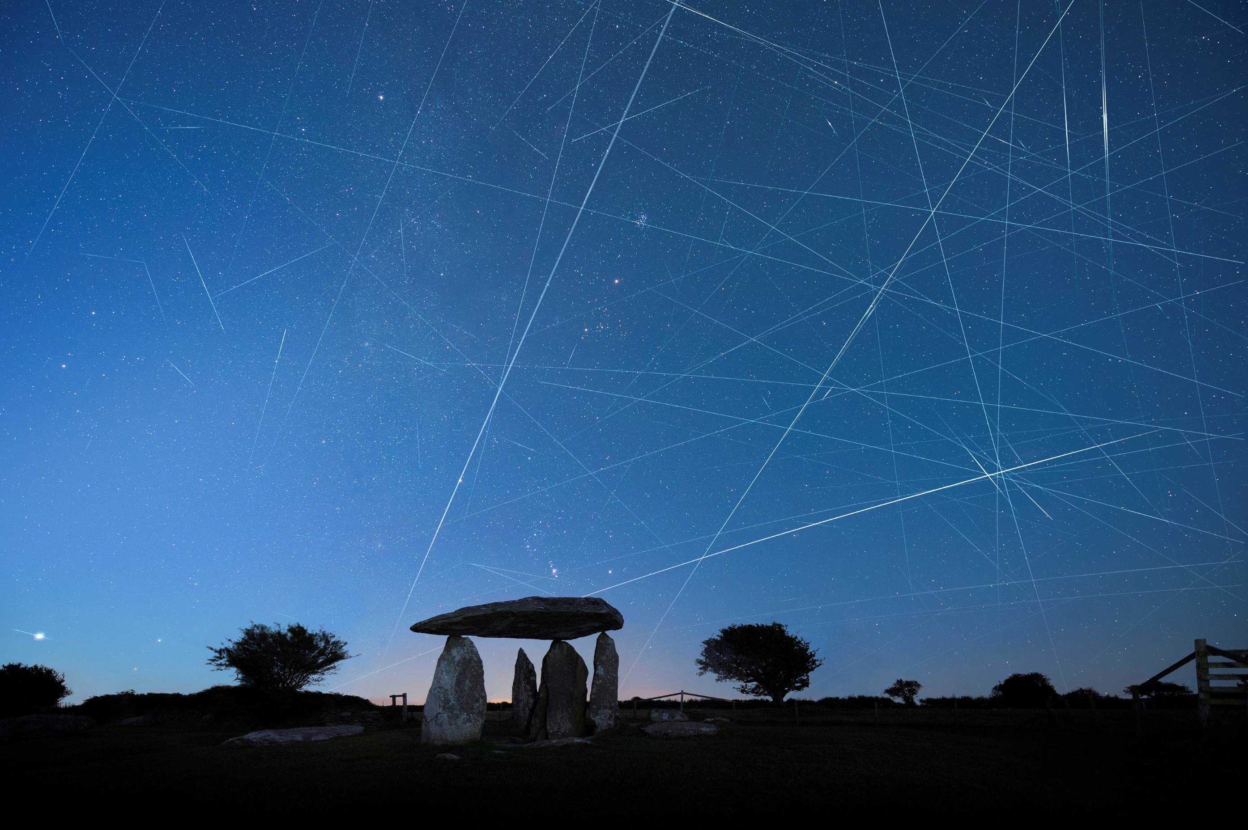
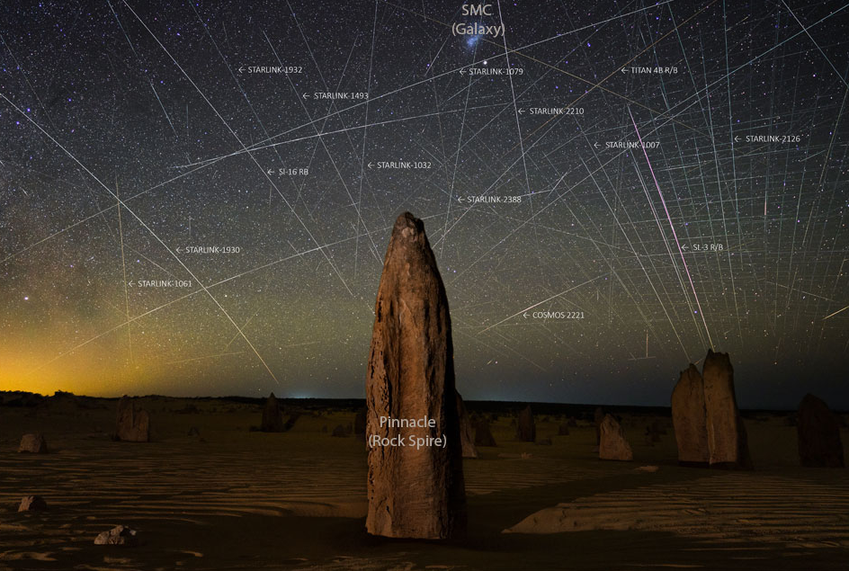
View of the night sky
Credit: @Link4Universe
Source: Max Alexander “Our Fragile Space”
Source: Joshua Rozells

Slide 7
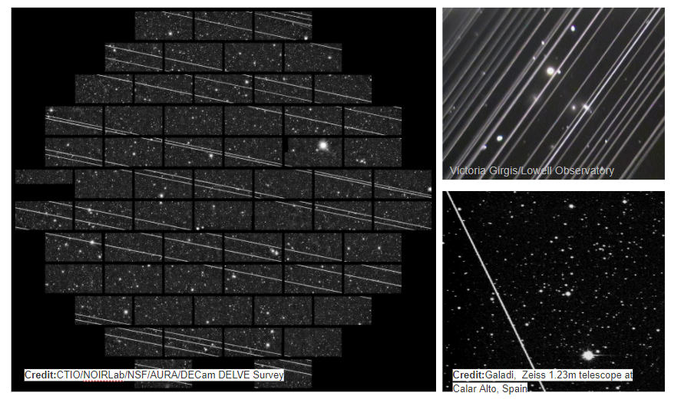
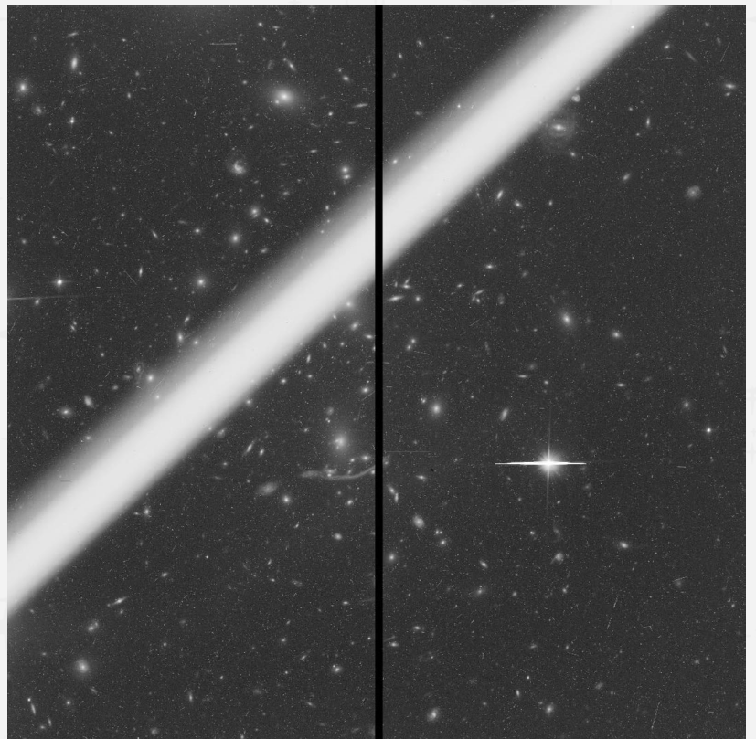
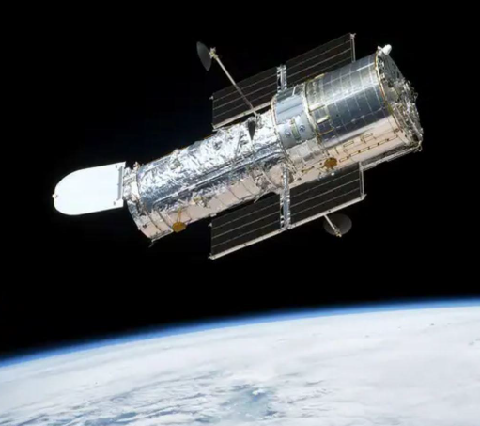
Threats to optical astronomy (Earth and space)

Slide 8
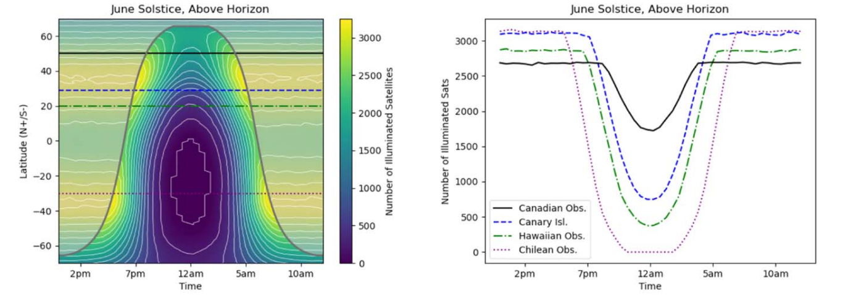
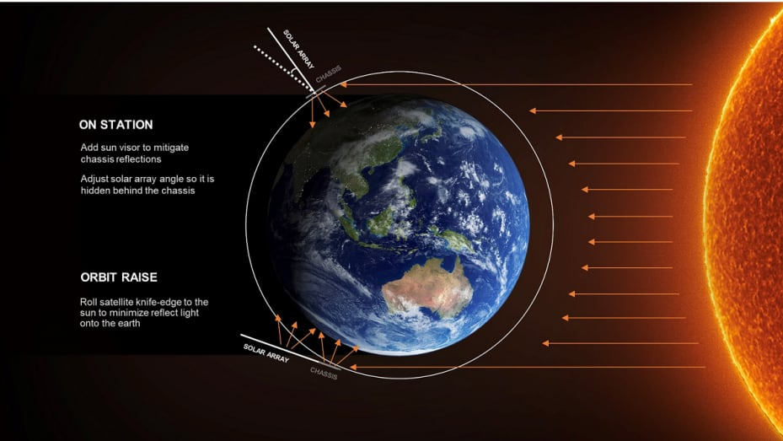
Satellite brightness and visibility
Function of :
Satellite design
Materials
Orbital altitude
Observatory location
Time of year
Visibility of satellites of different constellations (deployed and planned) N = 65000
S. Lawler, A. Boley, H. Rein
https://doi.org/10.3847/1538-3881/ac341b

Slide 9
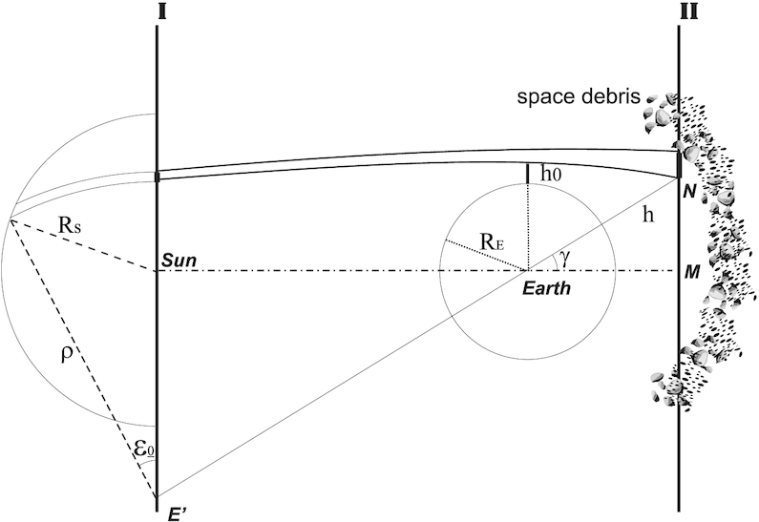
Increase of sky brightness due to space debris
M Kocifaj, F. Kundracik, J. C. Barentine, S. Bara
Mon Not R Astron Soc Lett, Volume 504, Issue 1, June 2021, Pages L40–L44, https://doi.org/10.1093/mnrasl/slab030
The content of this slide may be subject to copyright: please see the slide notes for details.

Slide 10
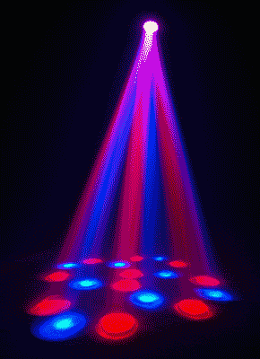
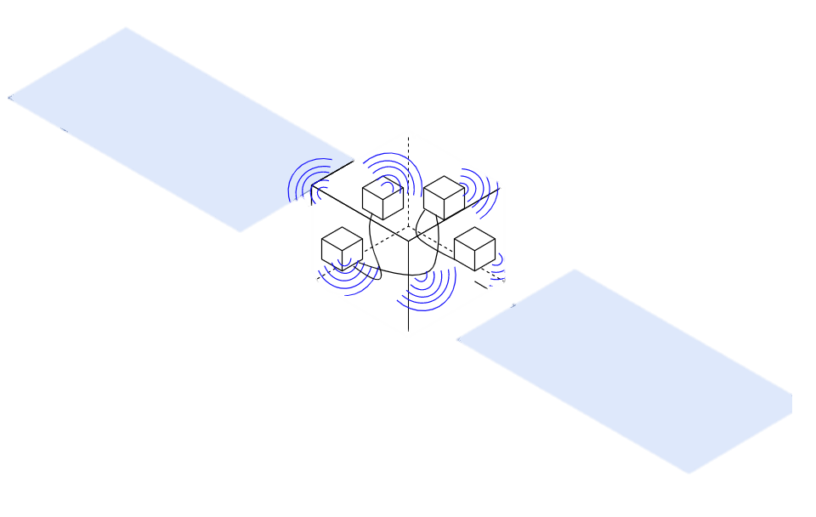
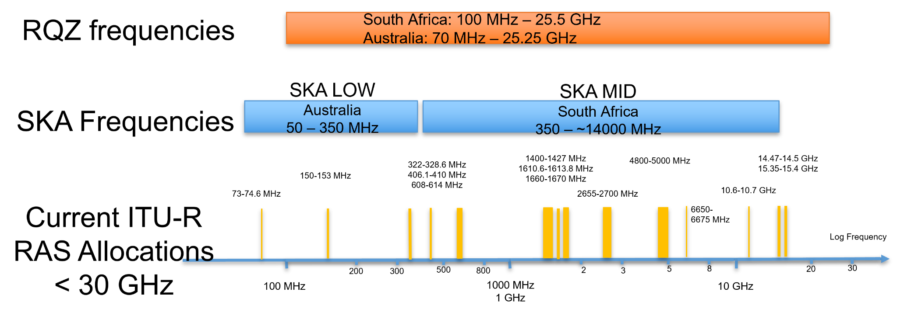
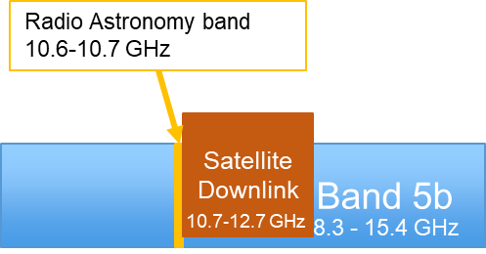
Threats to radio astronomy
Satellite visible 24/7
Main transmissions close to protected bands
Steerable beams, fixed beams
Radio Quiet Zones affected
Many planned frequencies close to protected bands:

Slide 11
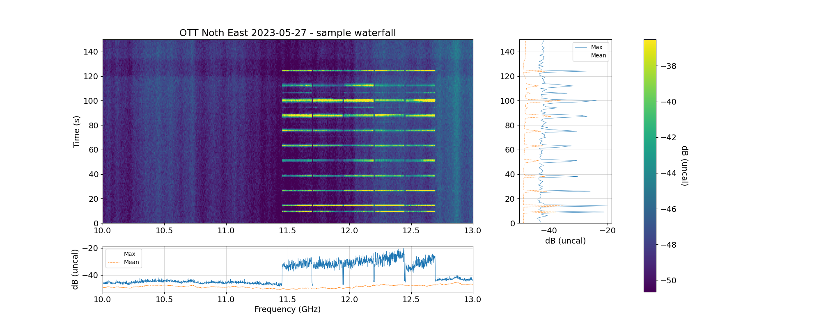
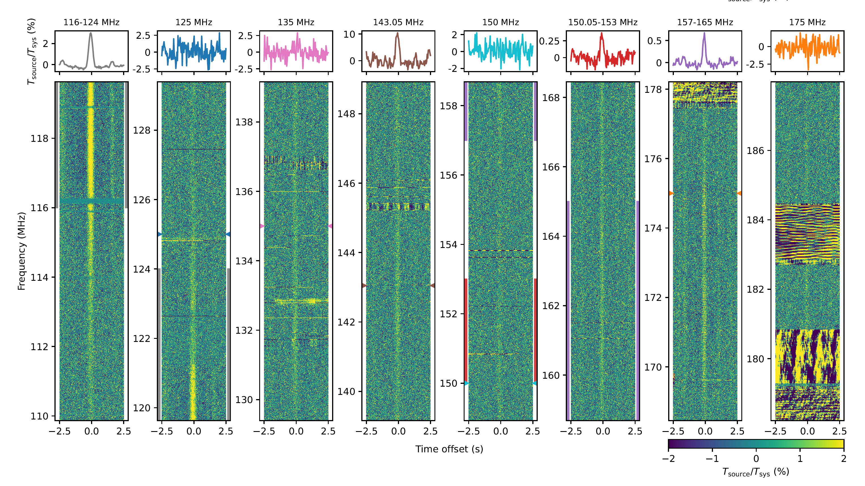
Threats to radio astronomy
Very strong signals in downlink bands (10e6 Jy)
Weak signals in unintended radiation (~10s Jy)
Unintended Electromagnetic Radiation (110 – 180 MHz)
https://www.aanda.org/articles/aa/full_html/2023/08/aa46374-23/aa46374-23.html
Satellite downlinks in Ku band (10.7 – 12.7 GHz)
F. Di Vruno, G. Hovey, Onsala Space Observatory

Slide 12
Possible mitigation measures

Slide 13
On Satellite operator’s side
Minimize the number of satellites
Design satellites with low reflectivity (optical)
Minimize the production of space debris (optical)
Use steerable beams for downlinks (radio)
Minimize the Unintended Electromagnetic Radiation (UEMR)
Share high precision location of the satellites

Slide 14
On astronomy side
Work on software for:
Scheduling (needs good satellite information)
Post processing mitigation
Making receivers more resilient to strong signals (easier said than done)
Possible coordination satellite operator-telescope
Share telescope pointing information to operators

Slide 15
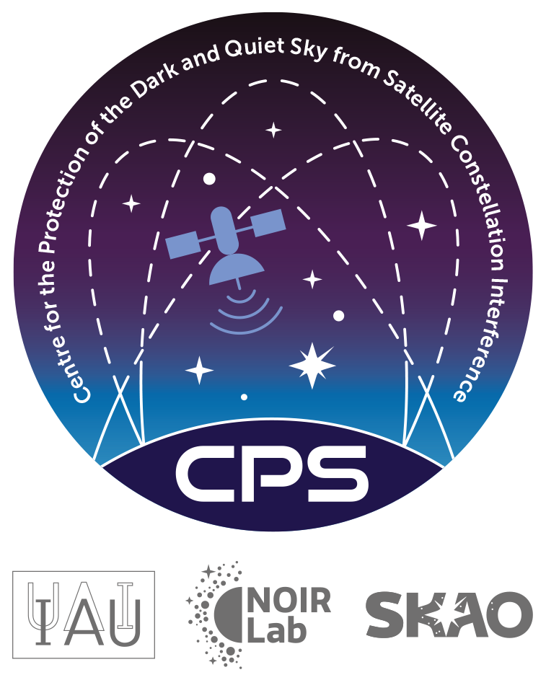
The IAU Centre for the Protection of the Dark and Quiet Sky

Slide 16
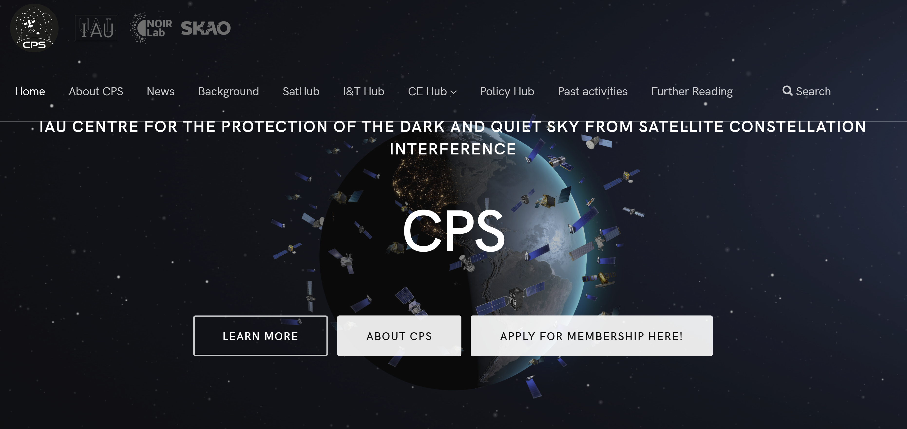
IAU CPS - A brief summary https://cps.iau.org
Coordinate efforts and unify voices
Bringing together different communities
Collect, produce and disseminate information and resources
Open and free products
4 Hubs
> 200 members (astronomers, amateur astro, Astro-photography, communications, policy, etc)

Slide 17
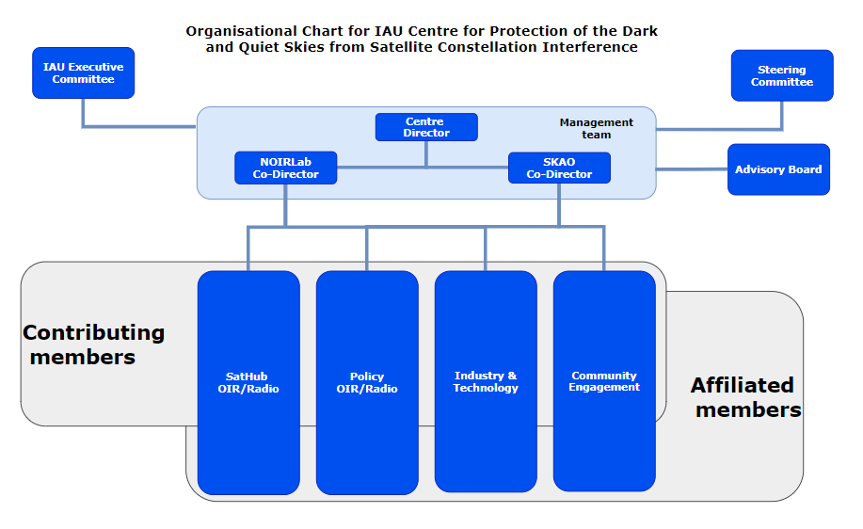
IAU CPS Hubs Activities
Piero Benvenuti
Richard Green (interim)
Connie Walker (NOIRLab)
Federico Di Vruno (SKAO)
Richard Green
Andrew Williams
John Barentine
Jessica Heim
Chris Hofer
Tim Stevenson
Meredith Rawls Mike Peel
Siegfried Eggl

Slide 18
Industry & Technology Hub
Co-leads: Chris Hofer and Tim Stevenson; Advisor: Patricia Cooper
industry@cps.iau.org
Technical Advisory Committee (TAC) with 12 members from Industry
Astronomy Guides programme: open search for astronomers
GSOA published position paper on space sustainability
Briefing to Satellite Industry Association (SIA) in 2023. Planning more briefings in 2024
Promoting test labs for bi-directional reflectivity, observation campaigns in collab with SatHub

Slide 19
Policy Hub
Co-leads: Andy Williams and Aaron Booley
policy@cps.iau.org
Publishing stage of IAU CPS Position Document “an overview of the problem and summary of core position from astronomy community”
Advancing National and International space policy analysis, used as basis for IAU input to the Legal Sub Committee of COPUOS
SSR astronomy module: models developed, need feedback, need resources for the SSR.
Spectrum Management (see ITU developments)
Consolidated set of technical recommendations to be published soon

Slide 20
Sat Hub
Co-leads: Siegfried Eggl, Mike Peel and Meredith Rawls
sathub@cps.iau.org
Published Blue Walker 3 observations paper in Nature
Collecting optical observations of Starlink V2 mini, Amazon Kuiper (2 test satellites, one with optical mitigations).
Planning Infrared observations of ISS and BW3 with James Clerk Maxwell Telescope
Continuing radio observations of Unintended Electromagnetic Radiation (UEMR) with LOFAR and other low frequency telescopes and of satellite downlinks

Slide 21
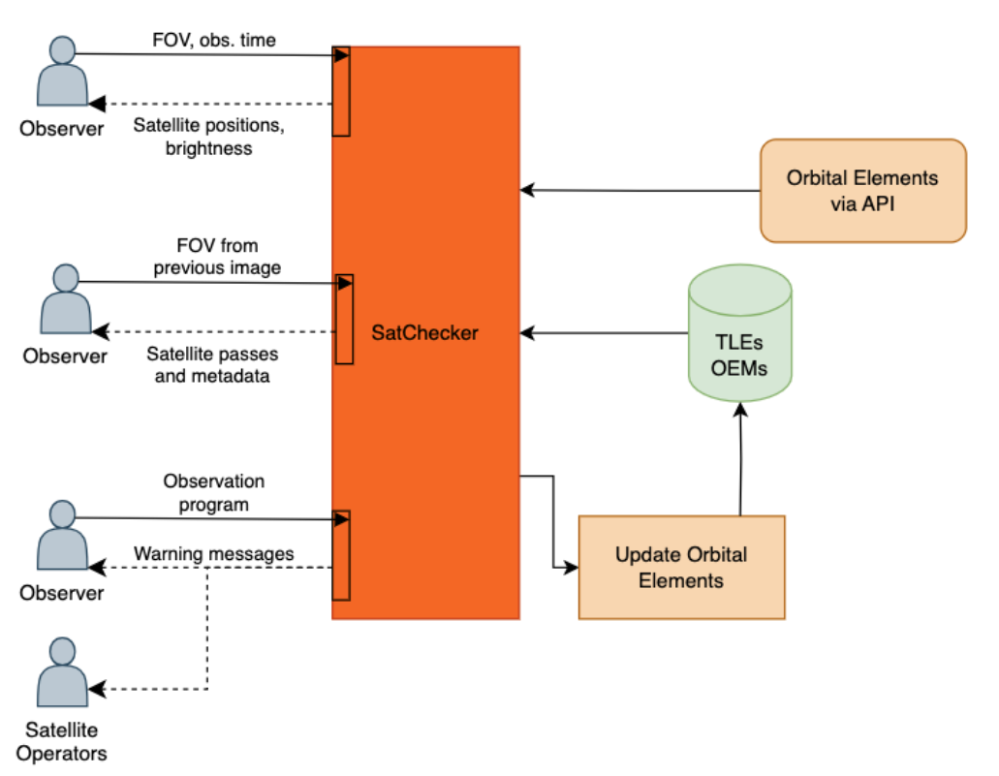
Sat Hub
Co-leads: Siegfried Eggl, Mike Peel and Meredith Rawls
sathub@cps.iau.org
SatChecker available (Beta): http://satchecker.readthedocs.io
Future: Extend SatChecker to forecast all illuminated commercial LEO satellites in the FOV
Credit: Michelle Dadighat, NOIRLab

Slide 22
Community Engagement Hub
Co-leads: John Barentine and Jessica Heim
community-engage@cps.iau.org
Awareness
Produced set of informative videos “SATCONS 101”
Providing factual information to inform the general public
CE Hub is CPS’ bridge to the community of night sky users beyond professional astronomers. It ensures their voices are part of the broader discussion.

Slide 23
Policy actions to protect D&QS

Slide 24
International Telecommunication Union
World Radiocommunication Conference 2023 results
WRC27 Agenda Item for Radio Astronomy on protection of Radio Quiet Zones and Radio Telescopes from Satellite Constellations in LEO
WRC27 Agenda Item to include frequencies above 76 GHz into Resolution 739
WRC27 Agenda item for future development of communications on the cislunar environment
Radiocommunication Assembly results
ITU-R Resolution 74 on sustainable use of radio spectrum and associated orbits
Database of Radio Quiet Zones to be published by ITU-R

Slide 25
International Telecommunication Union
Study Cycle 2024-2027
Working Party 4A:
Resolution 74 on “Space Sustainability”
Agenda Item on “unauthorized operations”
Working Party 7D:
Agenda Item on Radio Quiet Zones and Satellites
Unintentional Electromagnetic Radiation (ongoing report)
List of Radio Quiet Zones

Slide 26
United Nation’s Committee on the Peaceful Uses of Outer Space (UN COPUOS)
Scientific and Technical Subcommittee (STSC)
Group of Friends for the D&QS
Technical Group on Lunar activities
Agenda Item on Dark and Quiet Skies until 2029

Slide 27
Thank you for your kind attention! QUESTIONS? Contact: federico.divruno@cps.iau.org

