Slide 1
SKACH Winter Meeting: Communications Update
Neuchâtel, January 2024

Slide 2
Communication and Outreach, August 2023 – January 2024
Focus:
Strategy development, alignment with SKAO where possible
News
Podcast series
Analysis media assets
Image Credit: Astrovinch

Slide 3
Strategy development, August 2023 – January 2024
Workshop Swiss SKA Days, Zurich
- science, technology, impact relevance
- donors, decision makers, wider scientific community, public
- English and national languages
- non-language communication
Final development stages strategy to share
Image Credit: Astrovinch

Slide 4
News, August 2023 – January 2024

Slide 5
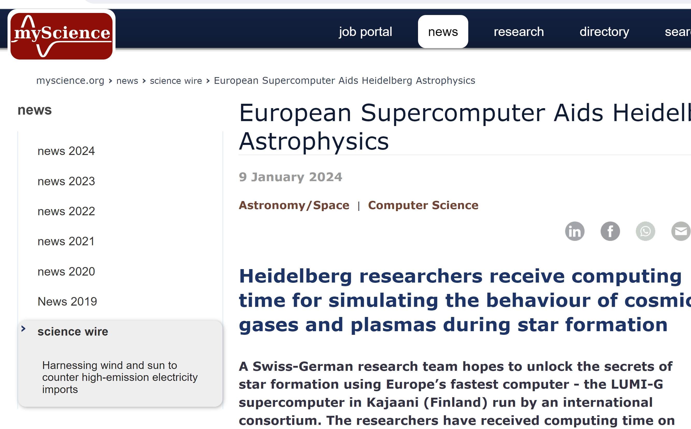
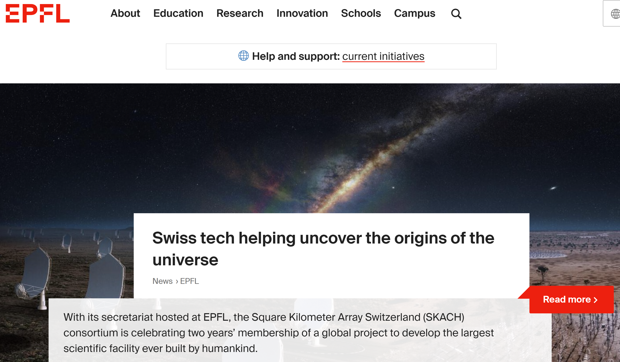
News, August 2023 – January 2024

Slide 6
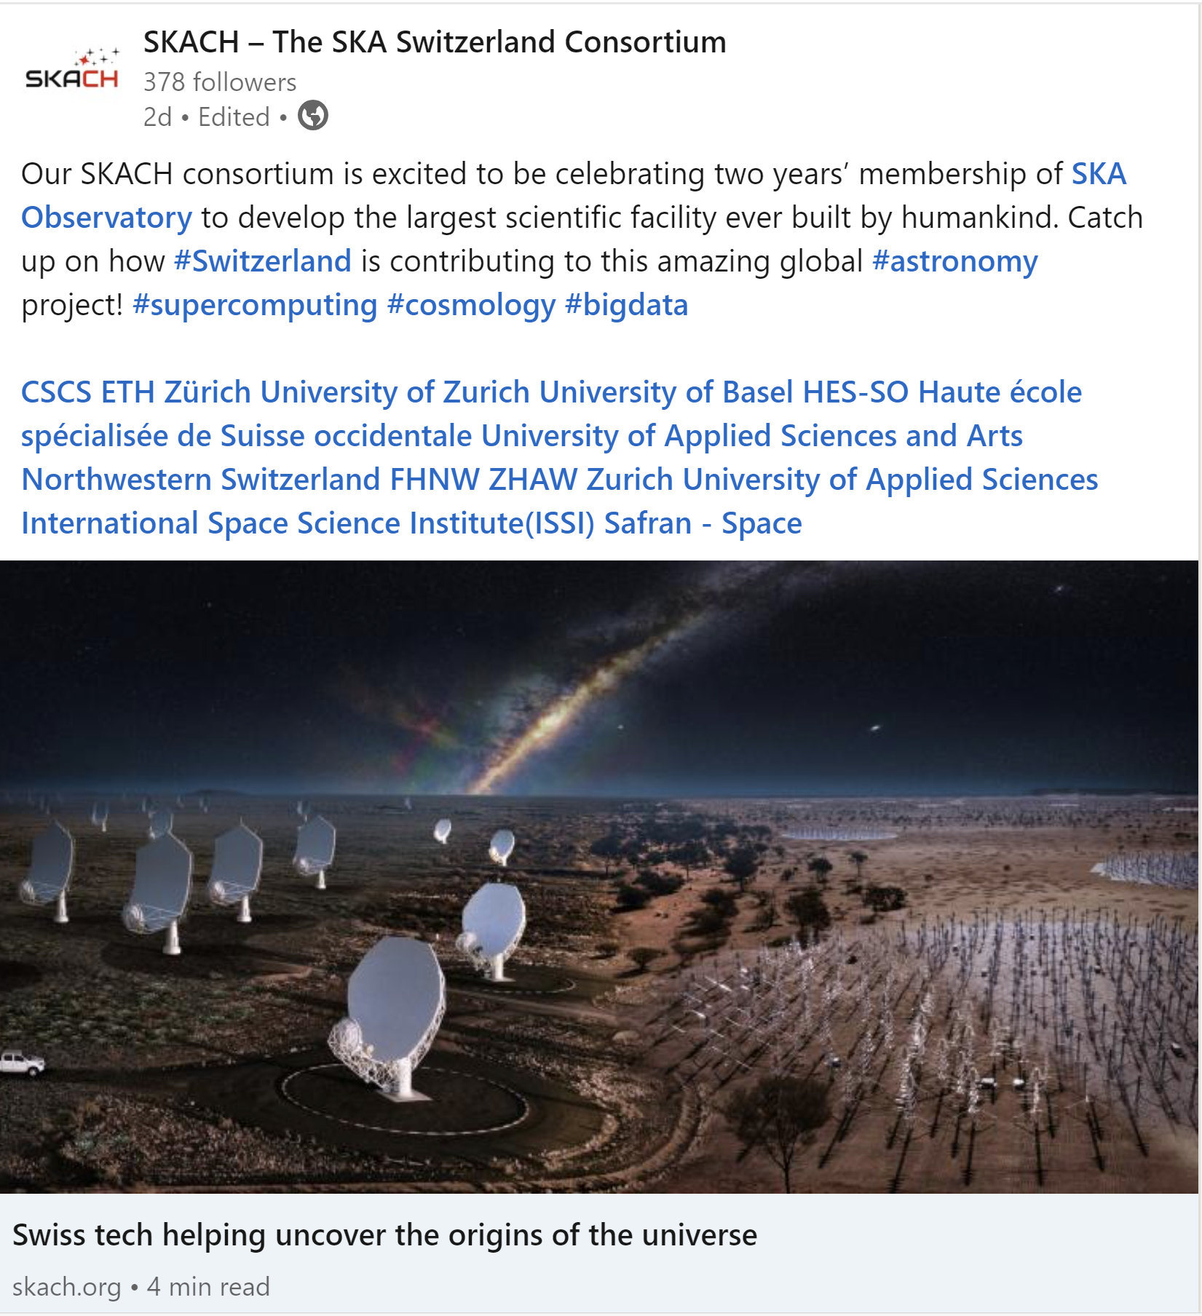
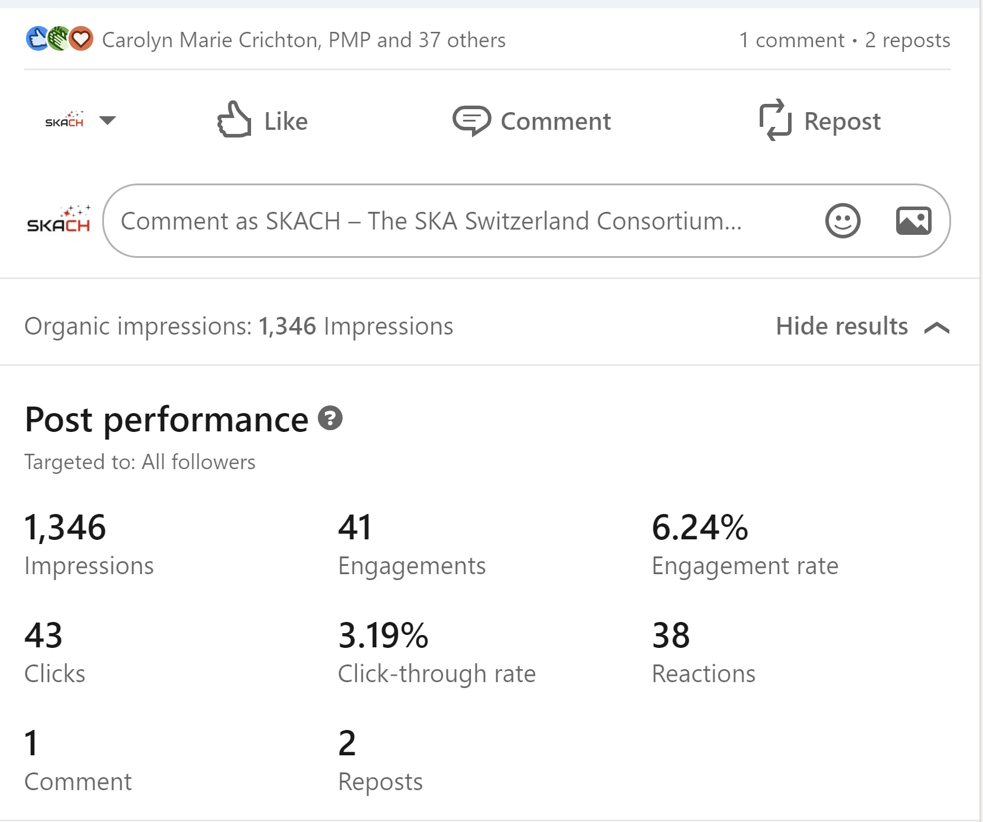
The power of (some) social media

Slide 7
Making Waves Podcast:
Secured funding for a mini-series of 5 episodes
Initially in French, may expand to other languages
Made an offer to a co-host
First two episodes skeleton outline
Notes:
We received 5000 Francs from the Swiss Society for Astrophysics and Astronomy last fall/winter
We received 5000 euro from the IAU Office for Astronomy Outreach this past spring
We have contracted with a production company in Geneva to get started
Mark Sargent would host

Slide 8
Analysis media assets
Images and video SKACH key meetings
Images SKACH board (group and individual)
Images and video and content via SKAO
What we don’t have:
Broader imagery of consortium members work and contributions
Updated SKACH ‘corporate’ video
Branded astronomy 101 content
SKACH Media Kit

Slide 9
Communication and Outreach January 2024 – August 2024
Focus:
Strategy finalization and implementation
News
Podcast series
Website
Progress Report
Development media assets
Image Credit: Astrovinch

Slide 10
Website: SKACH.org
Notes:
we have finally added (almost) everyone in the consortium on the Team page (and use that as a reminder that they should send photos of themselves), that we created an “In the Media page” to highlight media coverage of SKACH, and having an open jobs and a news page that are (somewhat) up-to-date.

Slide 11
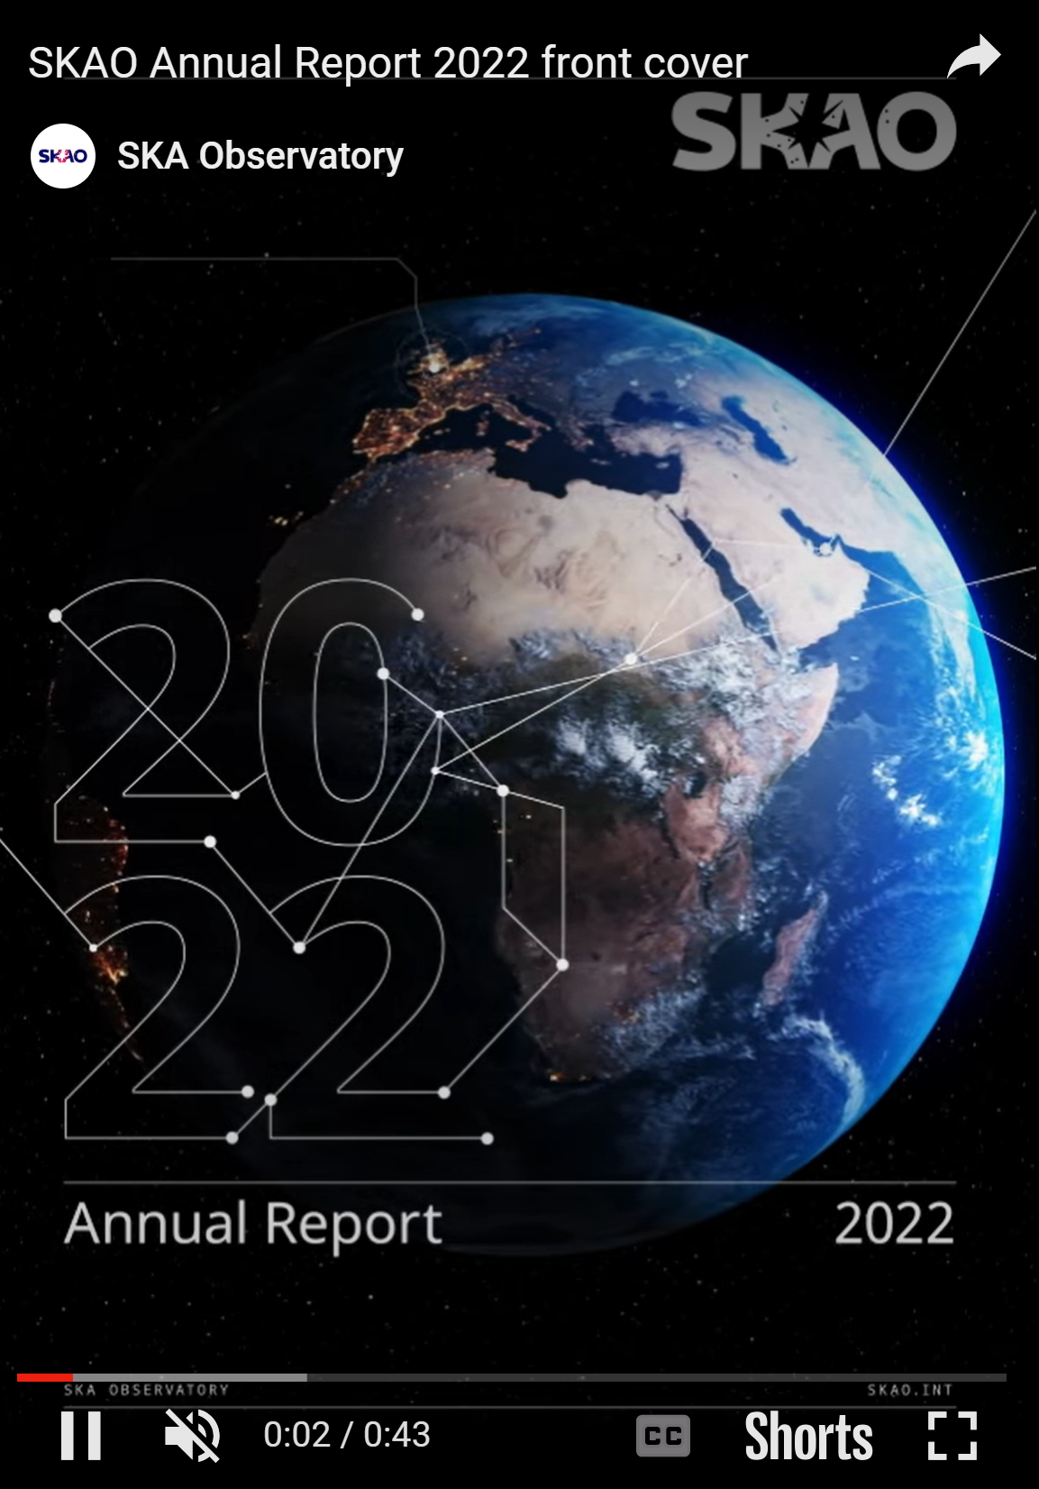
SKACH Progress Report
About 60 pages
Progress on all aspects of SKACH
Skeleton outline complete, full draft shortly
Commissioning articles and updates in February/March
Aim to complete by mid-year

Slide 12
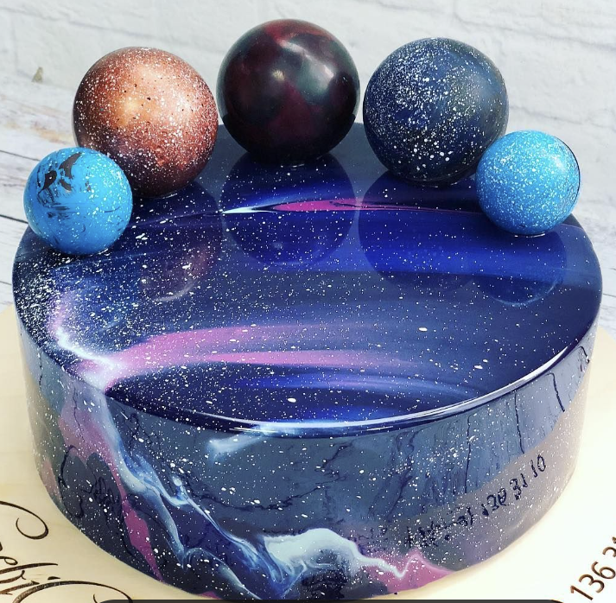
Happy Anniversary SKACH!
Image Credit: SKAO HQ

