Slide 1
Hyper-fast Bayesian inference
with cosmological emulators
Davide Piras (and many others)

Slide 2
But first… let me apologise
Notes:
Present you and work. Mention collaborators. Mention that you are open to questions, and that data science includes ML, etc.

Slide 3
But first… let me apologise
My background is weak lensing
Notes:
Present you and work. Mention collaborators. Mention that you are open to questions, and that data science includes ML, etc.

Slide 4
But first… let me apologise
My background is weak lensing
There will be questions for you…
Notes:
Present you and work. Mention collaborators. Mention that you are open to questions, and that data science includes ML, etc.

Slide 5
But first… let me apologise
My background is weak lensing
There will be questions for you…
… and some jokes in return
Notes:
Present you and work. Mention collaborators. Mention that you are open to questions, and that data science includes ML, etc.

Slide 6
Hyper-fast Bayesian inference
with cosmological emulators
Davide Piras (and many others)

Slide 7
How to get your posterior contours before your PhD is over
Davide Piras (and many others)

Slide 8
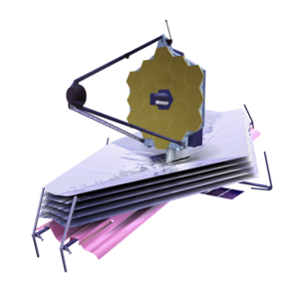
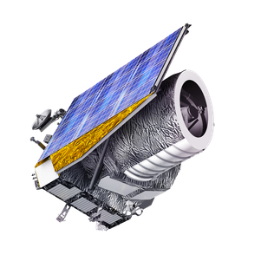
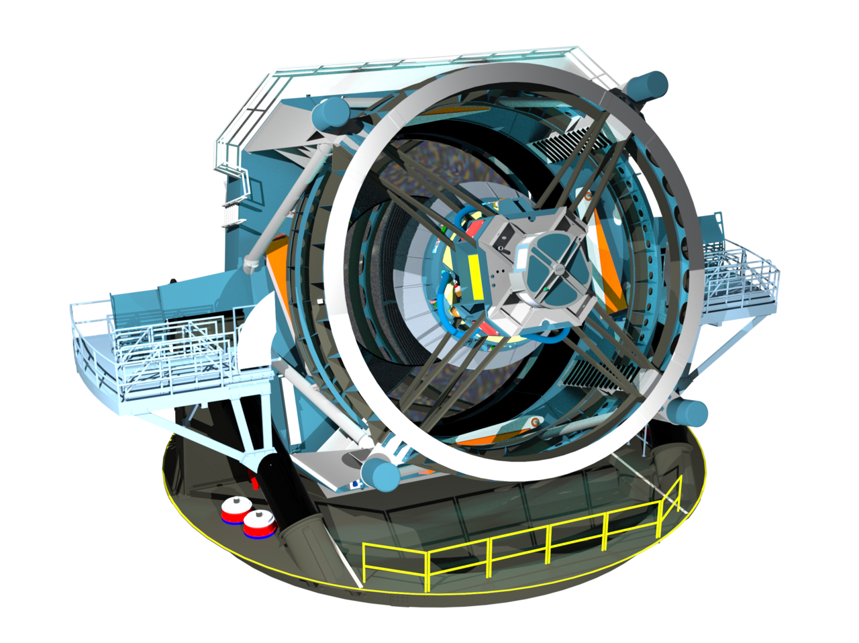
Big data incoming
JWST
Dec 2021
100 TB
Euclid
Jul 2023
700 TB
Vera Rubin Observatory
Jan 2025
500000 TB
Notes:
Present you and work. Mention collaborators. Mention that you are open to questions, and that data science includes ML, etc.

Slide 9
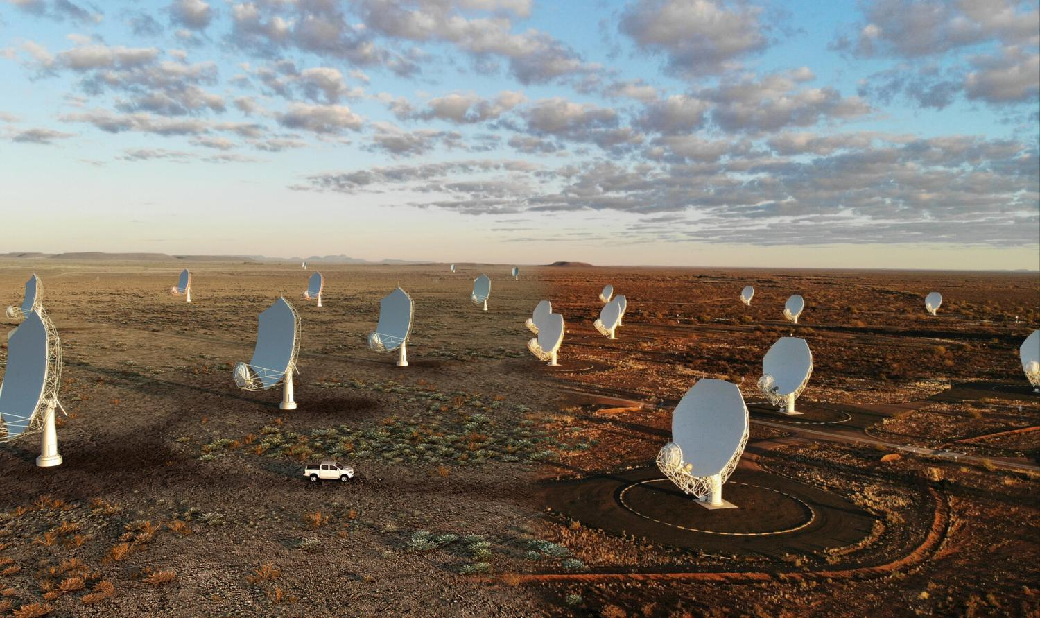
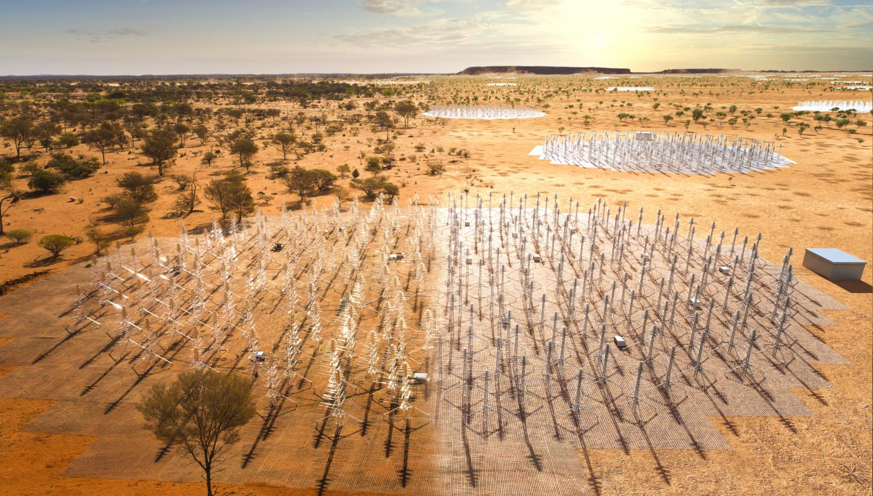
Big data incoming
JWST
Dec 2021
100 TB
Euclid
Jul 2023
700 TB
SKA
2028
40000000000 TB
Vera Rubin Observatory
Jan 2025
500000 TB
Notes:
Present you and work. Mention collaborators. Mention that you are open to questions, and that data science includes ML, etc.

Slide 10
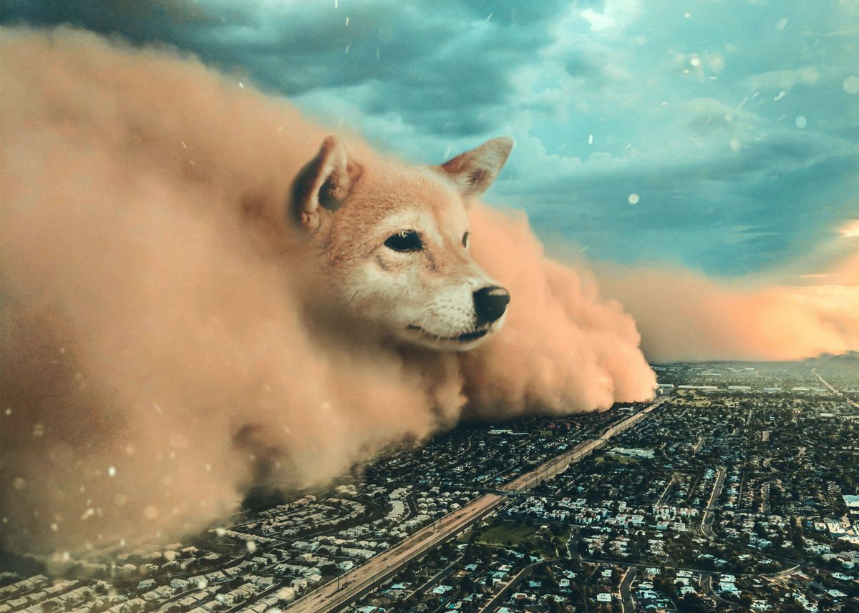
Big data incoming
SKA
Notes:
Present you and work. Mention collaborators. Mention that you are open to questions, and that data science includes ML, etc.

Slide 11
Notes:
Present you and work. Mention collaborators. Mention that you are open to questions, and that data science includes ML, etc.

Slide 12
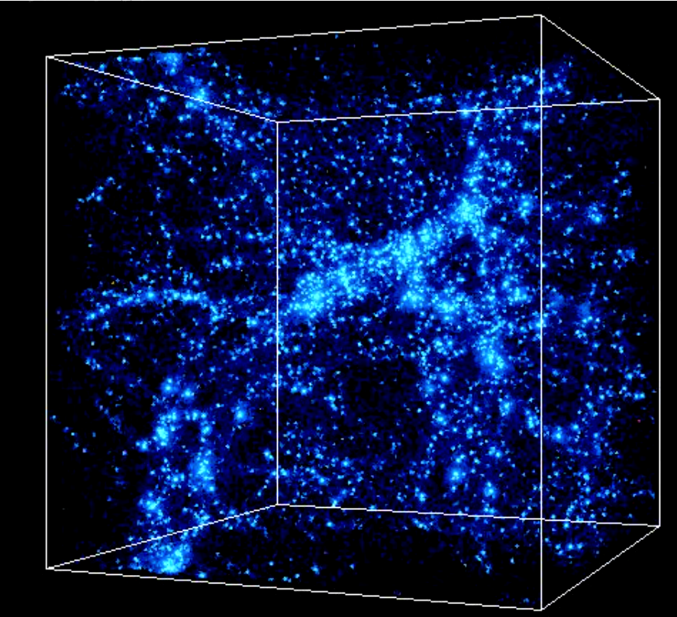
Notes:
Present you and work. Mention collaborators. Mention that you are open to questions, and that data science includes ML, etc.

Slide 13
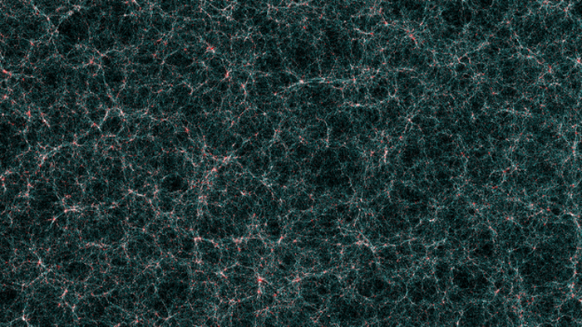
Notes:
Present you and work. Mention collaborators. Mention that you are open to questions, and that data science includes ML, etc.

Slide 14
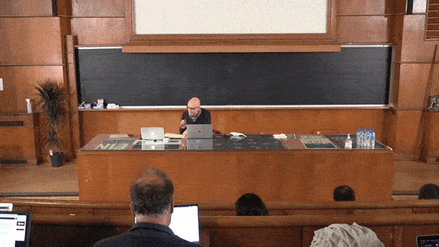
The starting idea
Can we use machine learning
to generate cosmological simulations?
Click here for video

Slide 15
Summarising
Can we use machine learning
to generate cosmological simulations?
No*
*but see talks by Mariia Drozdova and Philipp Denzel

Slide 16
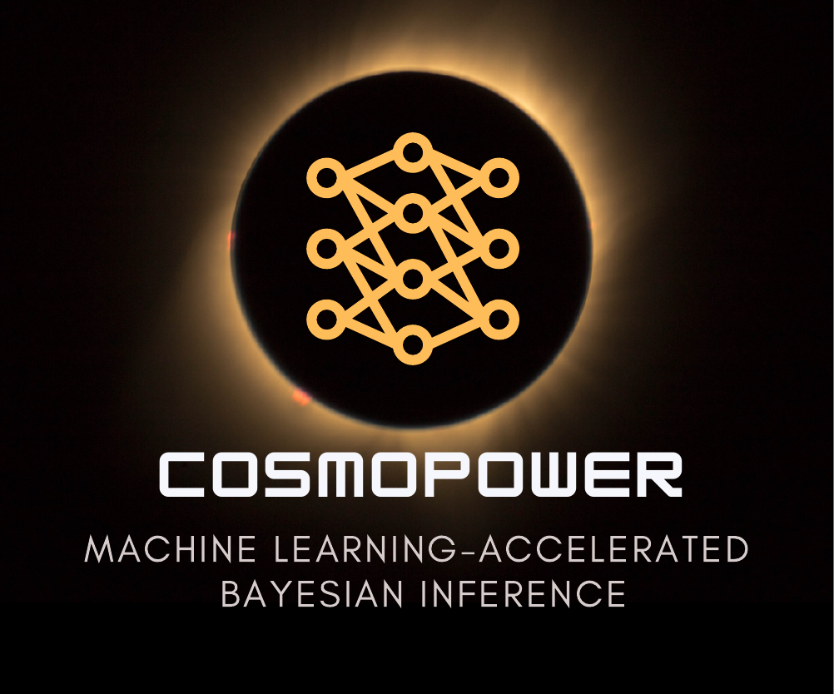
CosmoPower: flexible emulation of cosmological power spectra
Code available
Notes:
Present yourself. You are going to talk about generative methods in Cosmology, as the title suggests. Mention other people that work with you.

Slide 17
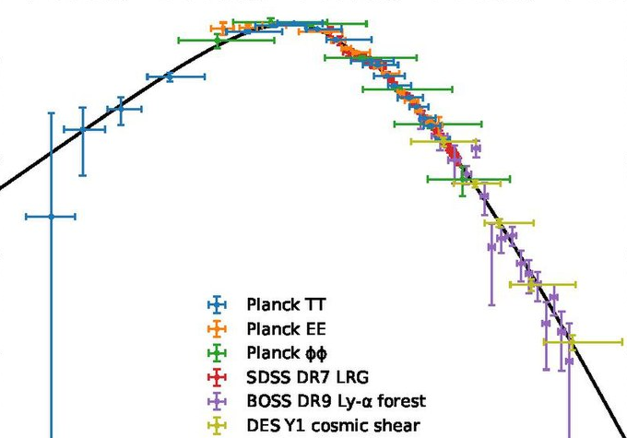
CosmoPower: flexible emulation of cosmological power spectra
DISTILL
Theory
Measurements
Notes:
Present yourself. You are going to talk about generative methods in Cosmology, as the title suggests. Mention other people that work with you.

Slide 18
CosmoPower: flexible emulation of cosmological power spectra
Create labelled training data
(
, ϴ)
Theory
Cosmological parameters
Notes:
Present yourself. You are going to talk about generative methods in Cosmology, as the title suggests. Mention other people that work with you.

Slide 19
CosmoPower: flexible emulation of cosmological power spectra
Create labelled training data
Train model
Theory
simple neural network
ϴ
Notes:
Present yourself. You are going to talk about generative methods in Cosmology, as the title suggests. Mention other people that work with you.

Slide 20
CosmoPower: flexible emulation of cosmological power spectra
Create labelled training data
Train model
Plug trained model into posterior sampler
Notes:
Present yourself. You are going to talk about generative methods in Cosmology, as the title suggests. Mention other people that work with you.

Slide 21
CosmoPower: flexible emulation of cosmological power spectra
Create labelled training data
Train model
Plug trained model into posterior sampler
Metropolis-Hastings NesteD sampling Hamiltonian Monte Carlo
…
Notes:
Present yourself. You are going to talk about generative methods in Cosmology, as the title suggests. Mention other people that work with you.

Slide 22
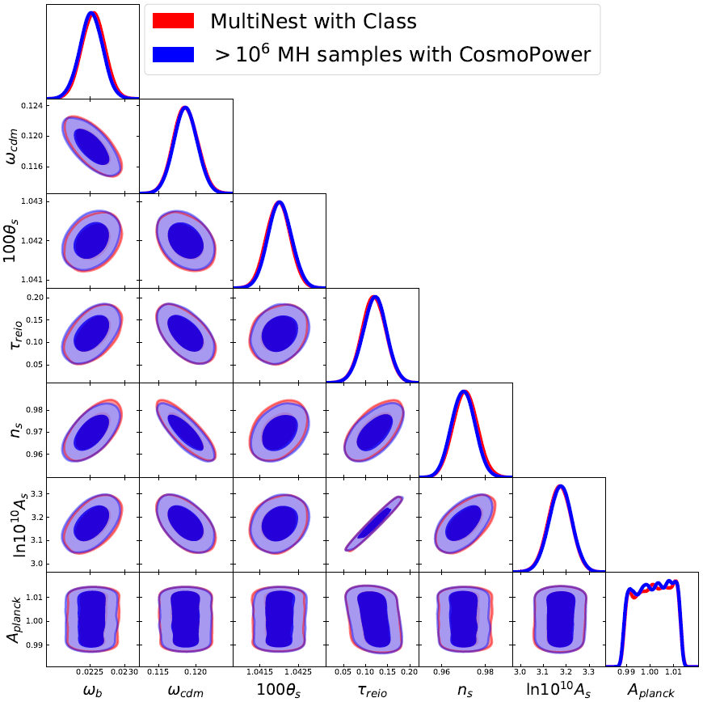
CosmoPower: flexible emulation of cosmological power spectra
Standard analysis (48 cores, few hours)
CosmoPower (1 GPU, 15 seconds)
Planck 2018
Spurio Mancini, Piras et al., MNRAS
Notes:
Present yourself. You are going to talk about generative methods in Cosmology, as the title suggests. Mention other people that work with you.

Slide 23
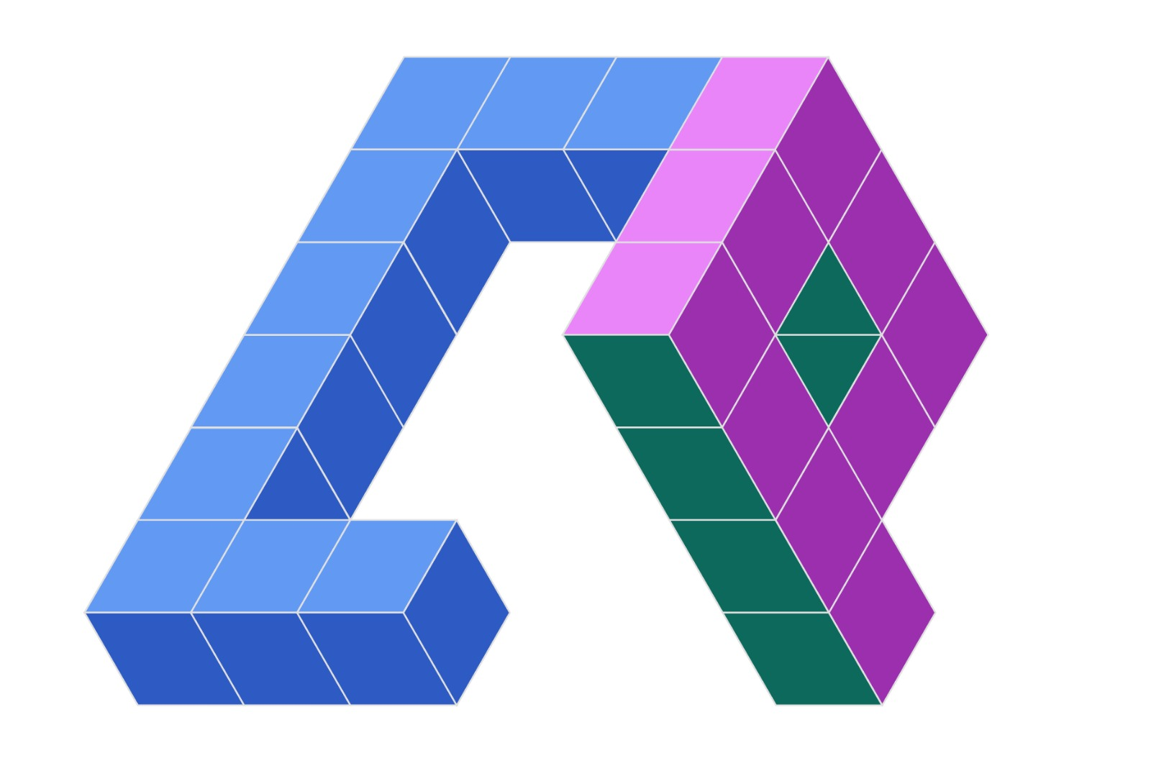
CosmoPower-JAX
JAX implementation of CosmoPower
+
=
Notes:
Present yourself. You are going to talk about generative methods in Cosmology, as the title suggests. Mention other people that work with you.

Slide 24
CosmoPower-JAX
JAX implementation of CosmoPower
+
=
Code available
Notes:
Present yourself. You are going to talk about generative methods in Cosmology, as the title suggests. Mention other people that work with you.

Slide 25
What is JAX?
Latest Google framework for machine learning
Notes:
Present yourself. You are going to talk about generative methods in Cosmology, as the title suggests. Mention other people that work with you.

Slide 26
What is JAX?
Latest Google framework for machine learning
Replaces TensorFlow (?)
Notes:
Present yourself. You are going to talk about generative methods in Cosmology, as the title suggests. Mention other people that work with you.

Slide 27
What is JAX?
Latest Google framework for machine learning
Replaces TensorFlow (?)
Essentially, NumPy on steroids
Notes:
Present yourself. You are going to talk about generative methods in Cosmology, as the title suggests. Mention other people that work with you.

Slide 28
CosmoPower-JAX
JAX implementation of CosmoPower
Allows for fast and automatic differentiation on GPU → can run Hamiltonian Monte Carlo!
Notes:
Present yourself. You are going to talk about generative methods in Cosmology, as the title suggests. Mention other people that work with you.

Slide 29
CosmoPower-JAX
JAX implementation of CosmoPower
Allows for fast and automatic differentiation on GPU → can run Hamiltonian Monte Carlo!
Hamiltonian Monte Carlo relies on DERIVATIVES of the likelihooD
Notes:
Present yourself. You are going to talk about generative methods in Cosmology, as the title suggests. Mention other people that work with you.

Slide 30
CosmoPower-JAX
JAX implementation of CosmoPower
Allows for fast and automatic differentiation on GPU → can run Hamiltonian Monte Carlo!
And avoid finite differences…
Notes:
Present yourself. You are going to talk about generative methods in Cosmology, as the title suggests. Mention other people that work with you.

Slide 31
Next-generation survey analysis in JAX
Notes:
Present yourself. You are going to talk about generative methods in Cosmology, as the title suggests. Mention other people that work with you.

Slide 32
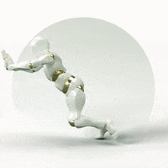
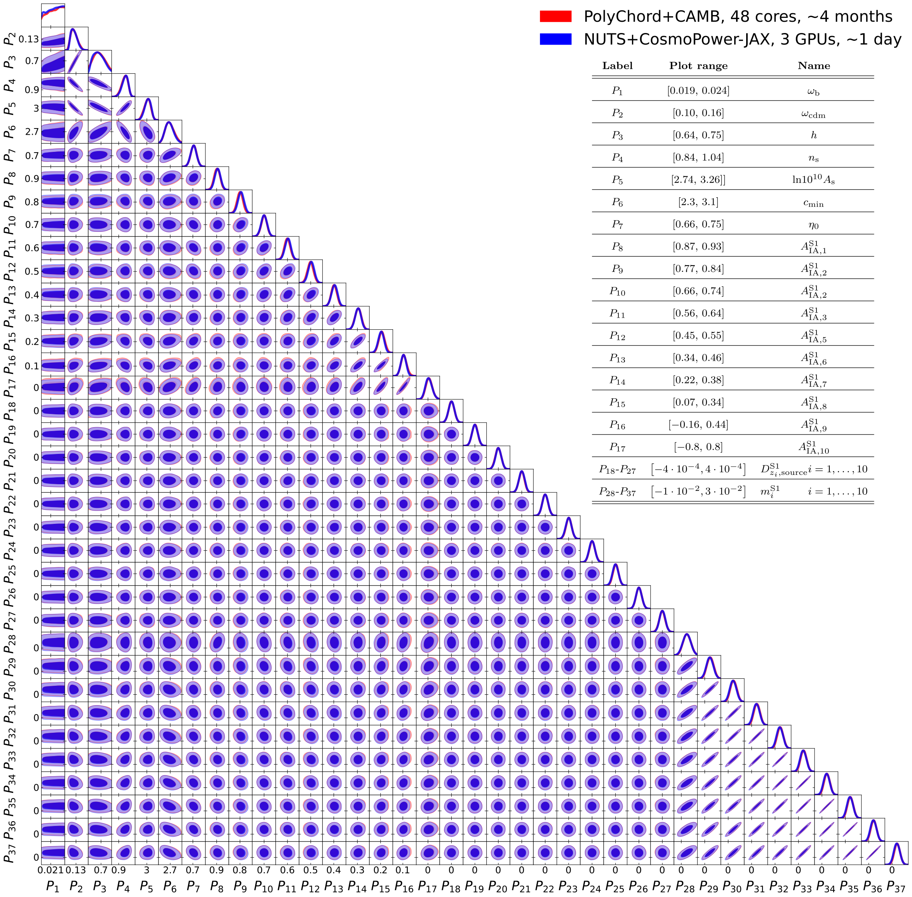
Next-generation survey analysis in JAX
Standard MCMC (48 cores, 4 months)
Hamiltonian MC + JAX emulator (3 GPUs, 1 day)
Cosmological parameters
Standard MCMC (cobaya, 48 cores, 4 months)
Hamiltonian MC (JAX emulator, 3 GPUs, 1 day)
Cosmic shear
(37 parameters)
Intrinsic alignment
Cosmic shear only
(37 parameters)
Redshift shift
Multiplication bias
Notes:
Present yourself. You are going to talk about generative methods in Cosmology, as the title suggests. Mention other people that work with you.

Slide 33
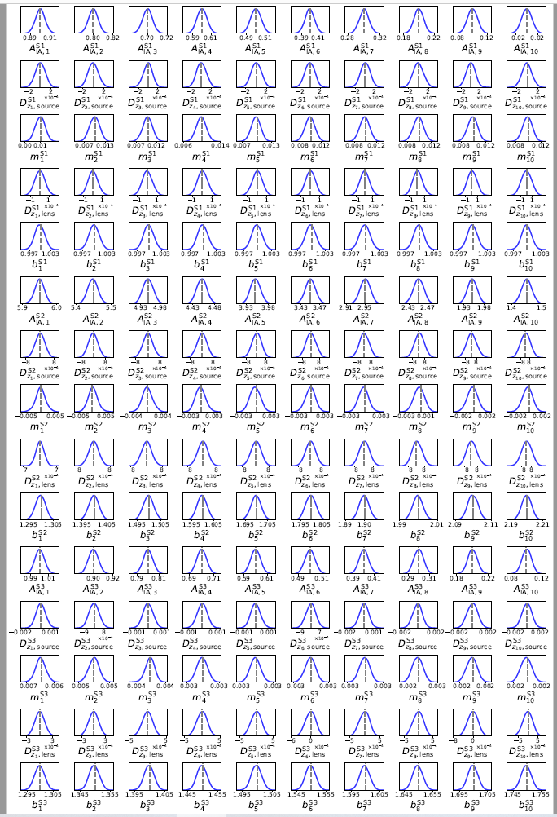
Joint survey analysis in JAX
Standard MCMC (48 cores, about 6 years)
Hamiltonian MC + JAX emulator (3 GPUs, 3 days)
3x(3x2)points statistics analysis: 157 parameters!
Piras & Spurio Mancini, Open Journal of Astrophysics, 2023
Notes:
Present yourself. You are going to talk about generative methods in Cosmology, as the title suggests. Mention other people that work with you.

Slide 34
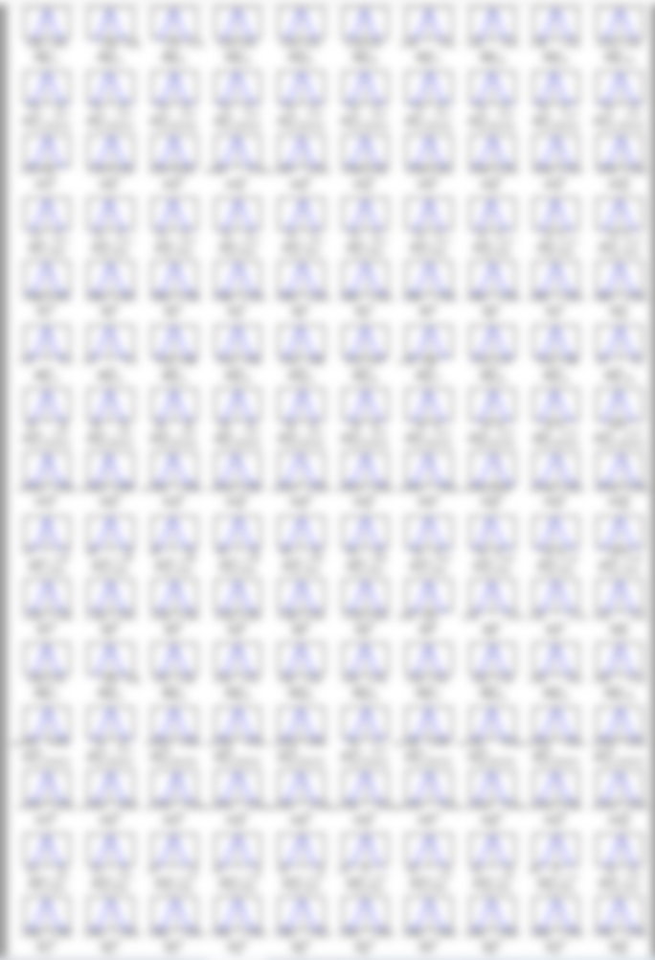
Standard MCMC (48 cores, about 6 years)
Hamiltonian MC + JAX emulator (3 GPUs, 3 days)
Notes:
Present yourself. You are going to talk about generative methods in Cosmology, as the title suggests. Mention other people that work with you.

Slide 35
Standard MCMC (48 cores, about 6 years)
Hamiltonian MC + JAX emulator (3 GPUs, 3 days)
Notes:
Present yourself. You are going to talk about generative methods in Cosmology, as the title suggests. Mention other people that work with you.

Slide 36
Not limited to cosmology!
Slow forward models are ubiquitous
Notes:
Present yourself. You are going to talk about generative methods in Cosmology, as the title suggests. Mention other people that work with you.

Slide 37
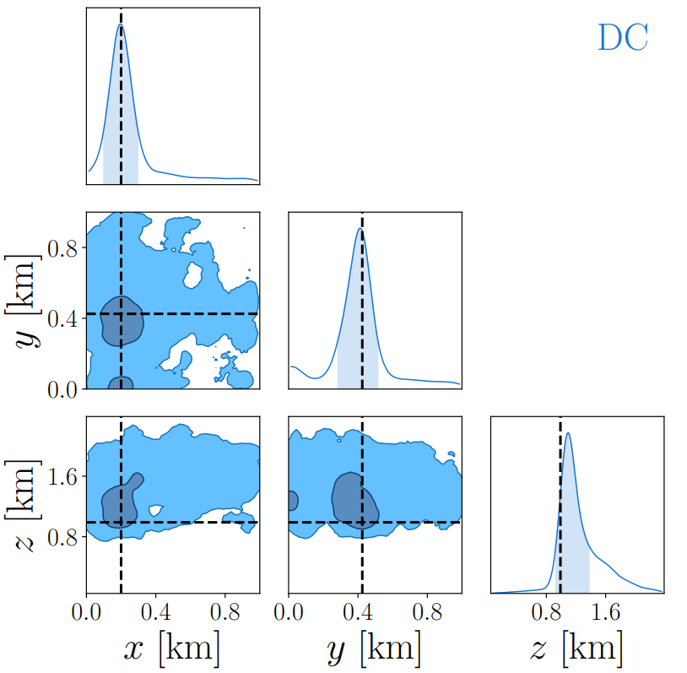
Not limited to cosmology!
Slow forward models are ubiquitous
Example: seismic activity
Piras et al., Geophysics Journal International
Posterior contours of seismic event
coordinates
COORDINATES
Notes:
Present yourself. You are going to talk about generative methods in Cosmology, as the title suggests. Mention other people that work with you.

Slide 38
Conclusions
Machine learning can accelerate forward models, but a lot of work still to do

Slide 39
Conclusions
Machine learning can accelerate forward models, but a lot of work still to do
Are Bayesian analyses performed in the SKA community?

Slide 40
Conclusions
Machine learning can accelerate forward models, but a lot of work still to do
Are Bayesian analyses performed in the SKA community?
And are they fast enough?

Slide 41
Conclusions
Machine learning can accelerate forward models, but a lot of work still to do
Are Bayesian analyses performed in the SKA community?
And are they fast enough?
Happy to talk more!

Slide 42
Extra slides (and memes)

Slide 43
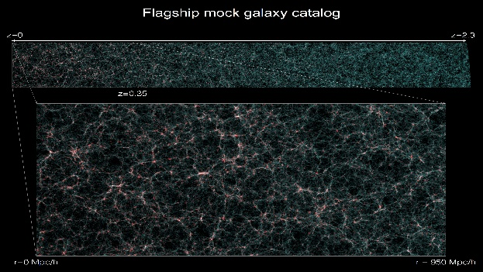
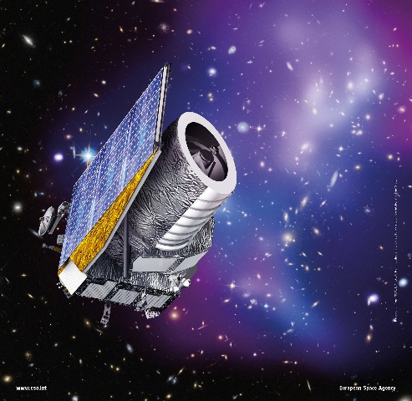
>10³ SIMULATIONS
FLAGSHIP SIMULATION
EUCLID

