Slide 1
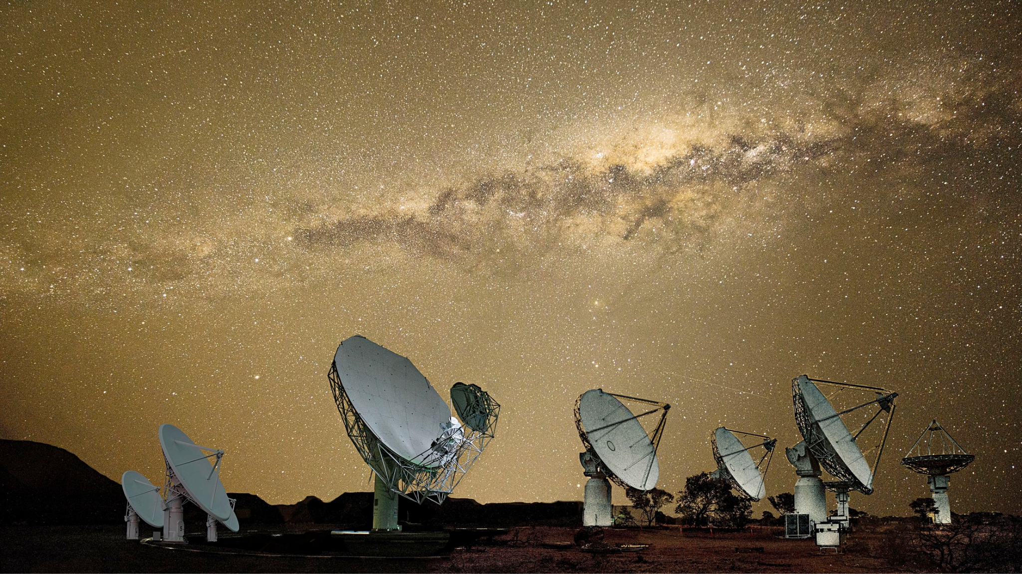
Forward Modeling of 21cm Intensity Mapping:
Updates from ETHZ and FHNW
Luis Fernando Machado Poletti Valle
SKACH Winter Meeting, 22/01/2024
ETH Zürich: Alexandre Refregier, Devin Crichton, John Hennig,
Pascal Hitz, Jennifer Studer, Joel Mayor
FHNW: André Csillaghy, Simon Felix, Rohit Sharma,
Vincenzo Timmel, Lukas Gehrig
Image Credits: https://skach.org/

Slide 2
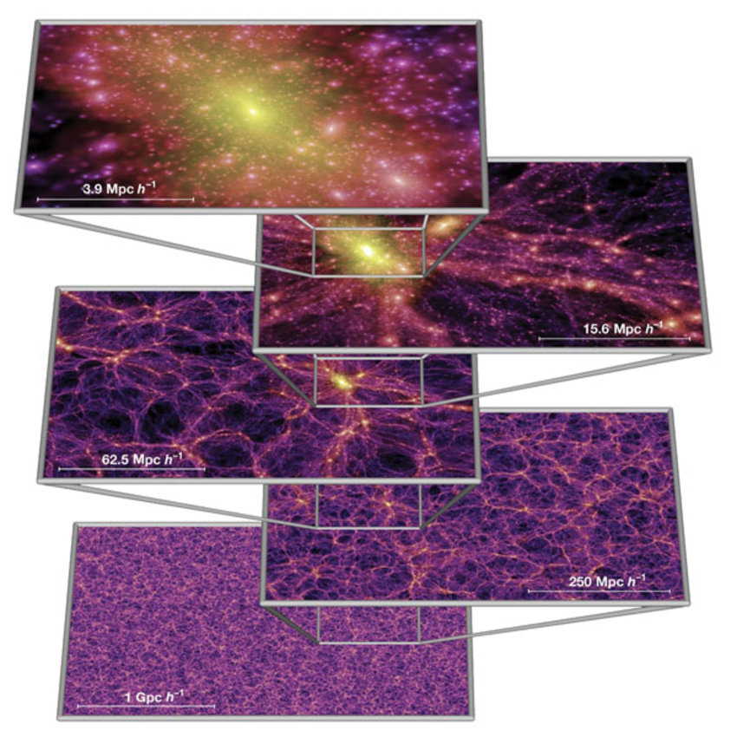
Motivation: Cosmology
Era of precision Cosmology
CMB: Planck
Stage IV Surveys: DESI, LSST, PFS
Nature of Dark Matter and Dark Energy
Promising probe: HI Intensity Mapping
Complement spectroscopic galaxy surveys (z < 2)
Explore Cosmic Dawn / EoR
Our focus: post-EoR IM, for LSS
SKA-Mid, HIRAX
Springel+2005
Notes:
SKA-Mid + HIRAX: each needs different simulated sky areas, so we generate half-sky maps which cover both use cases

Slide 3
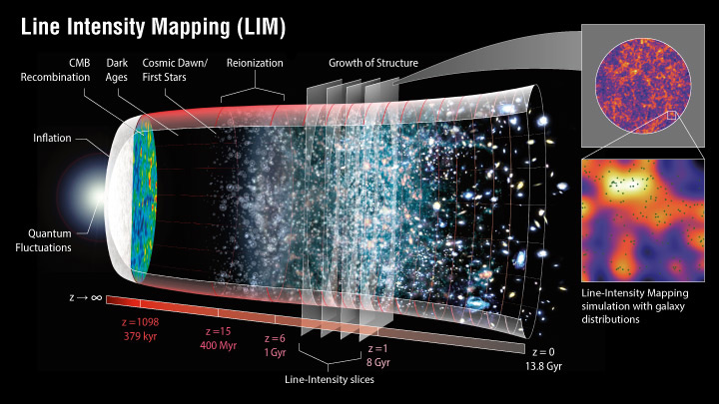
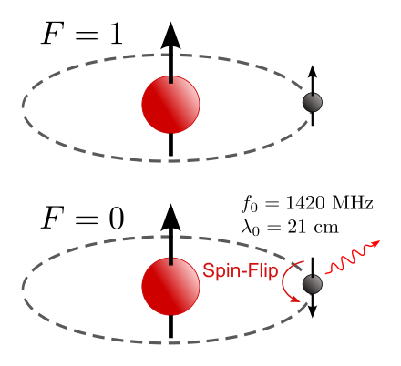
Motivation: HI Intensity Mapping
HI is a biased tracer of DM density fluctuations in post-EoR Universe (z < 6)
HI Intensity Mapping => reconstruct DM density field
Efficient survey: large cosmological volumes with redshift information
High spectral (thus redshift) resolution
https://lambda.gsfc.nasa.gov/education/graphic_history/intensitymapping.html
https://commons.wikimedia.org/w/index.php?curid=5739956

Slide 4
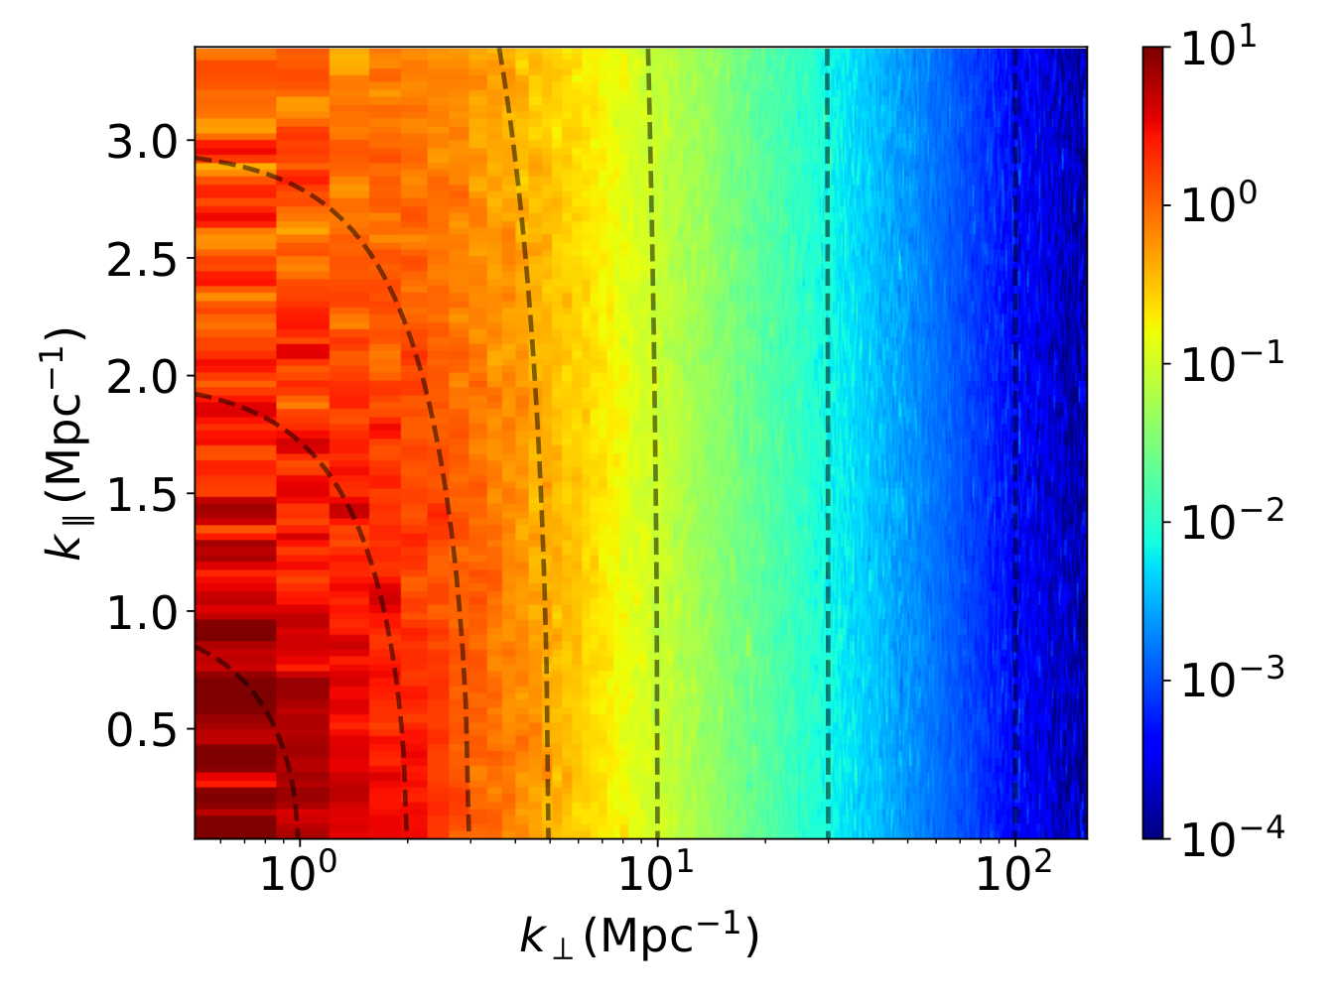
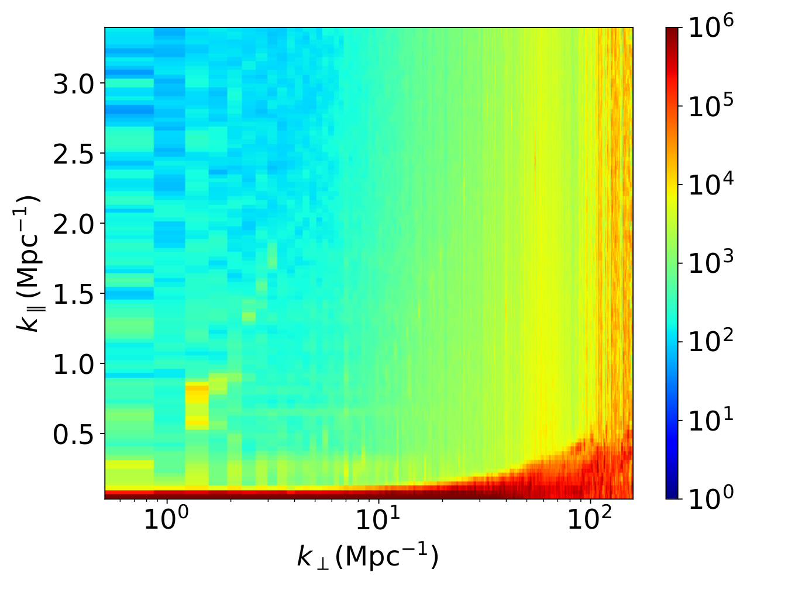
Challenge: Systematics
Sourabh+2021
Systematics (instrument + foregrounds) dominate 21 cm signal
Goal: Forward model pipeline of HI visibilities + images
Notes:
Foregrounds: galactic synchrotron emission, extragalactic emission, point sources
Units of 2D power spectrum: mK^2 * Mpc^3
Right plot: red region == foreground wedge

Slide 5
Forward Modeling Pipeline
1) Sky Model (credit: Pascal Hitz)
Past lightcone of DM halos (PINOCCHIO)
Assign HI to DM halos
(HI-DM mass relation)
3D catalogs of HI sources
(RA, Dec, z, flux)
2) Instrument Simulation
Visibilities
Dirty Images
Primary beam correction
Mosaic

Slide 6
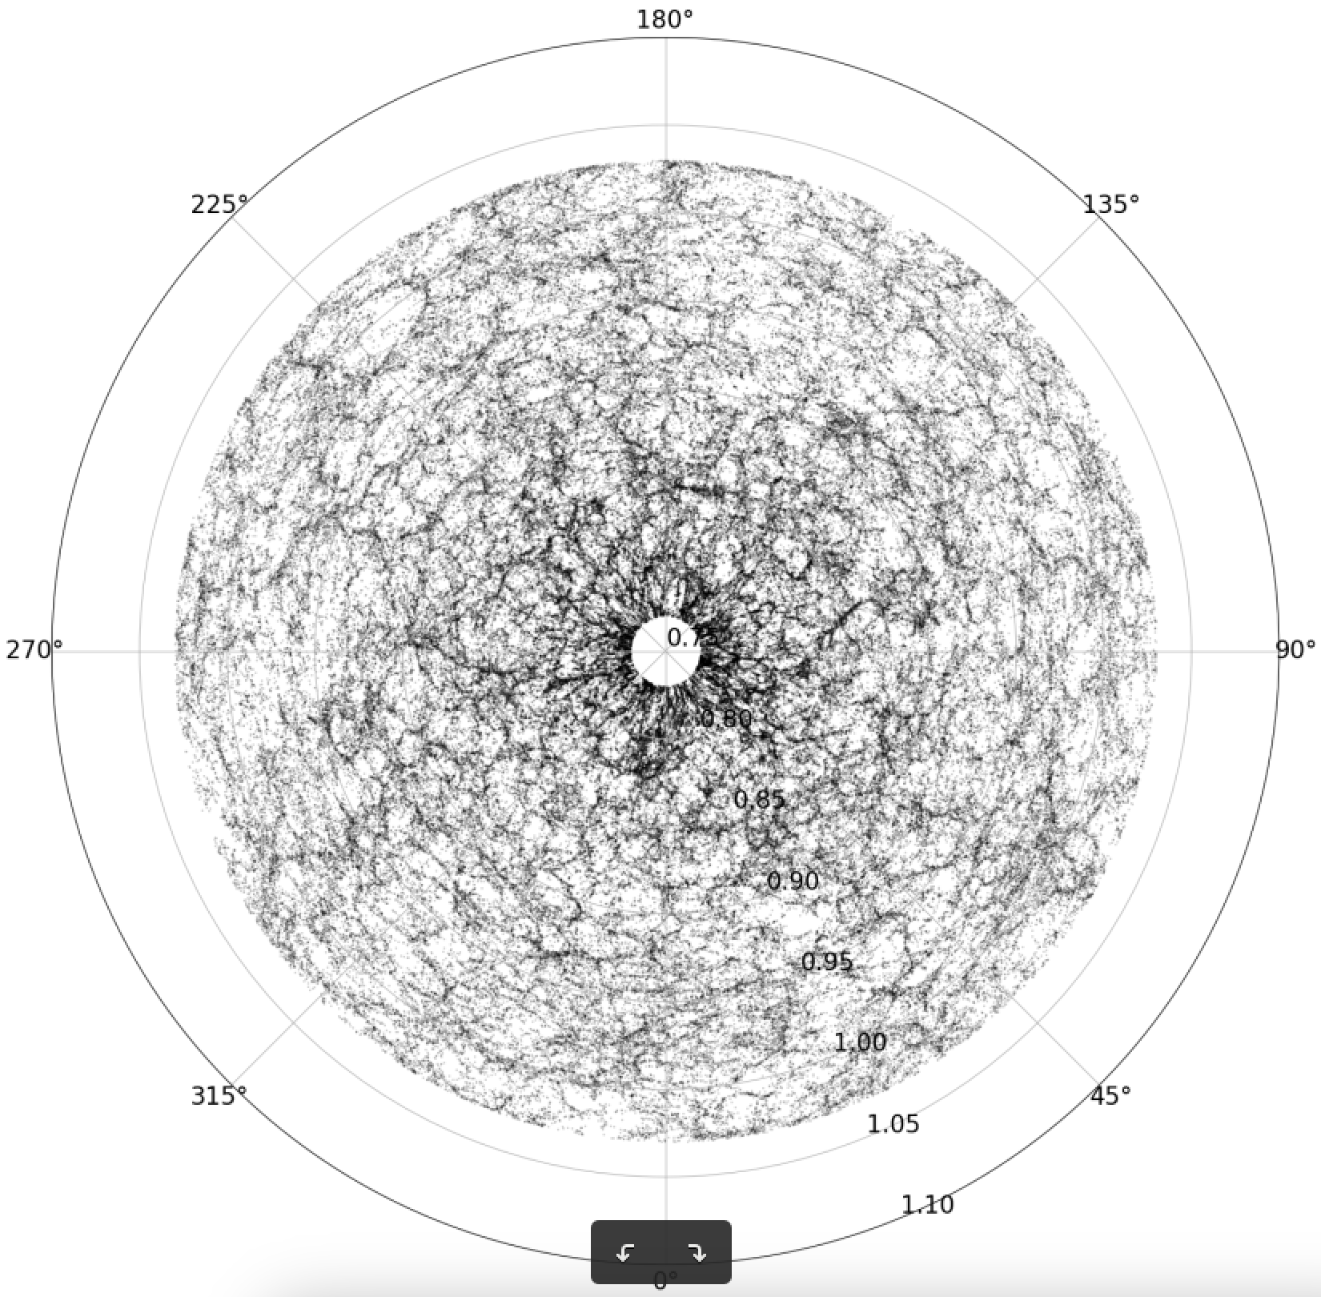
Sky Model: Past Lightcone of DM Halos
PINOCCHIO: approximate DM simulation
Lagrangian Perturbation Theory (LPT)
Faster than NBody
Output: past lightcone catalog of DM halos
Current configuration (Planck18 Cosmology):
2048³ particles
500 Mpc/h boxsize
0.77 < z < 1.03 (21cm: 700 - 800 MHz)
Half-sky opening
Halos: > 10 particles (minimal halo mass: 1.27 * 10¹⁰ Msun/h)
RA
Redshift
Monaco+2002, 2013
Munari+2017
Currently: increasing size/resolution on Piz Daint (John Hennig)
Notes:
BRING UP: synergies with galaxy surveys
-> need simulations with better mass resolution to get galaxies and HI objects to allow for cross-correlations
-> mention “self-consistent” simulations of radio + galaxy survey mocks
Resources: 332 CPU h runtime, 2.75 TB RAM

Slide 7
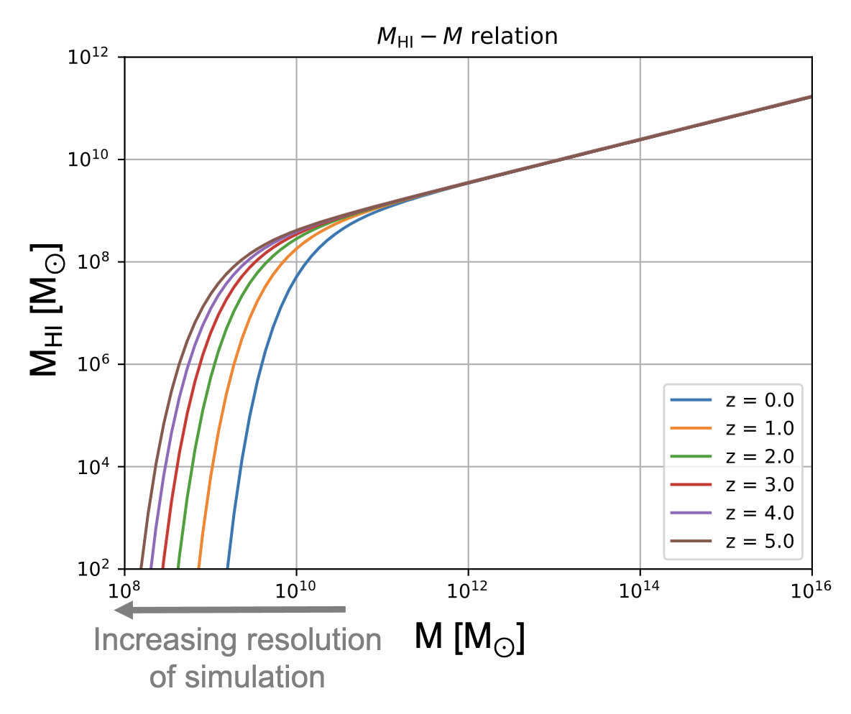
Sky Model: Painting HI with Halo Model
HI-DM Mass relation:
Small halos have significant HI content
Need high resolution to capture most HI mass
Current resolution: missing ~ 15% of HI
Goal: miss a few % of HI mass
Padmanabhan+2017

Slide 8
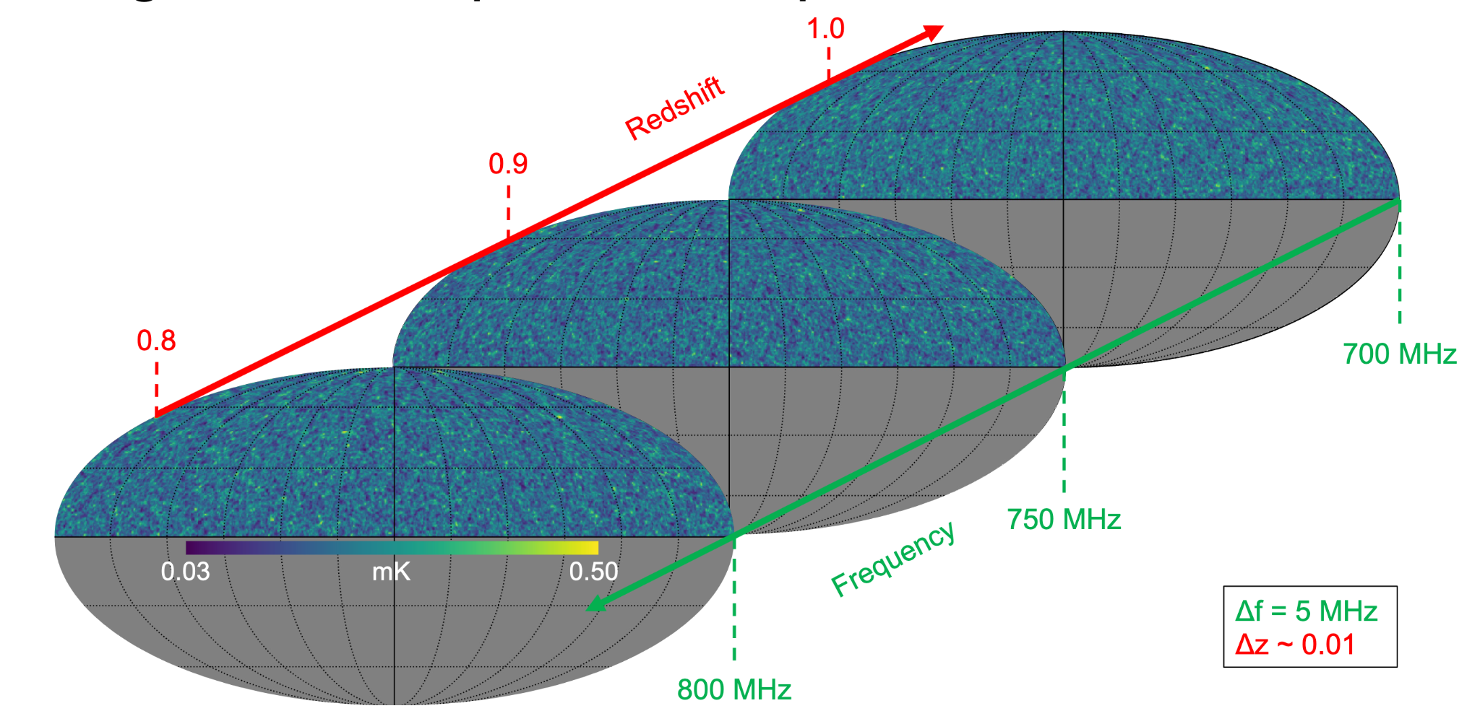
Sky Model: Resulting Catalogs

Slide 9
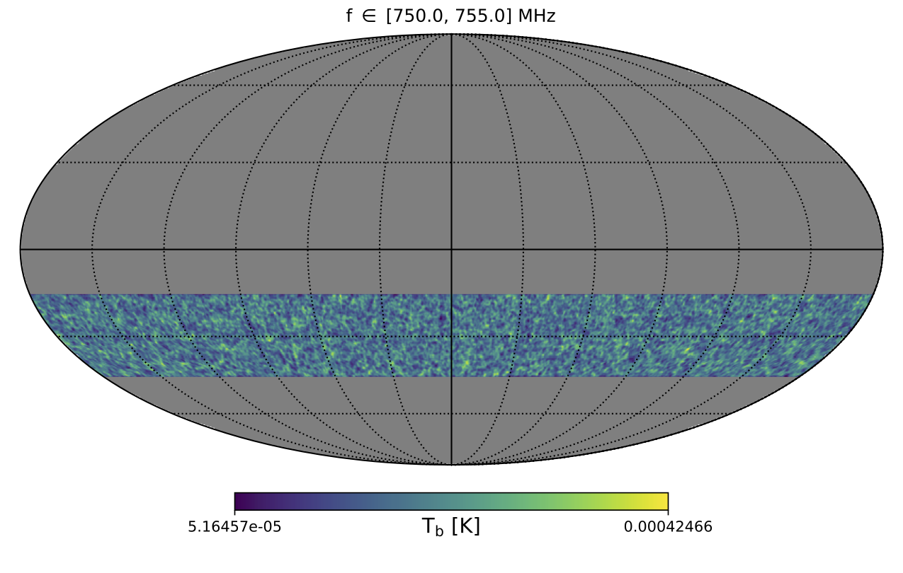
Sky Model: Recent Updates
Latest run:
1 Gpc/h boxsize, 6000³ particles
-15° > Declination > -45°
Custom code for declination stripes
Motivated by HIRAX observations
Minimal halo mass: 6 * 10⁹ Msun/h
Missing 10% of HI mass
Next planned simulation:
1 Gpc/h boxsize, 8000³ particles
Hopefully will succeed within allocated node hours

Slide 10
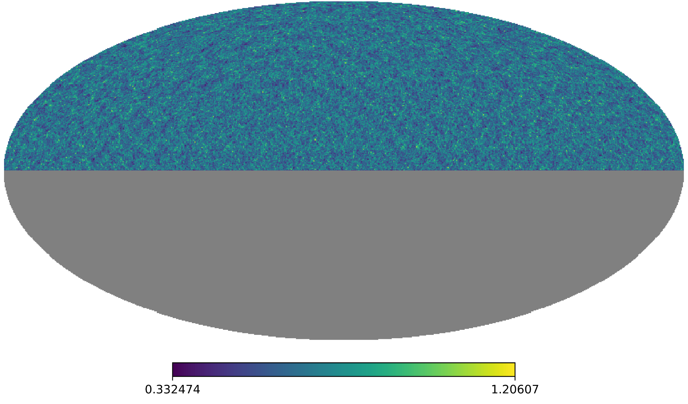
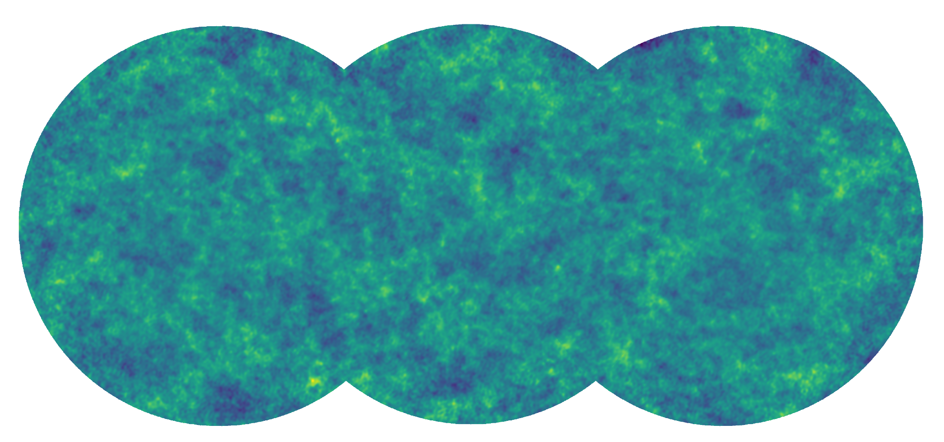
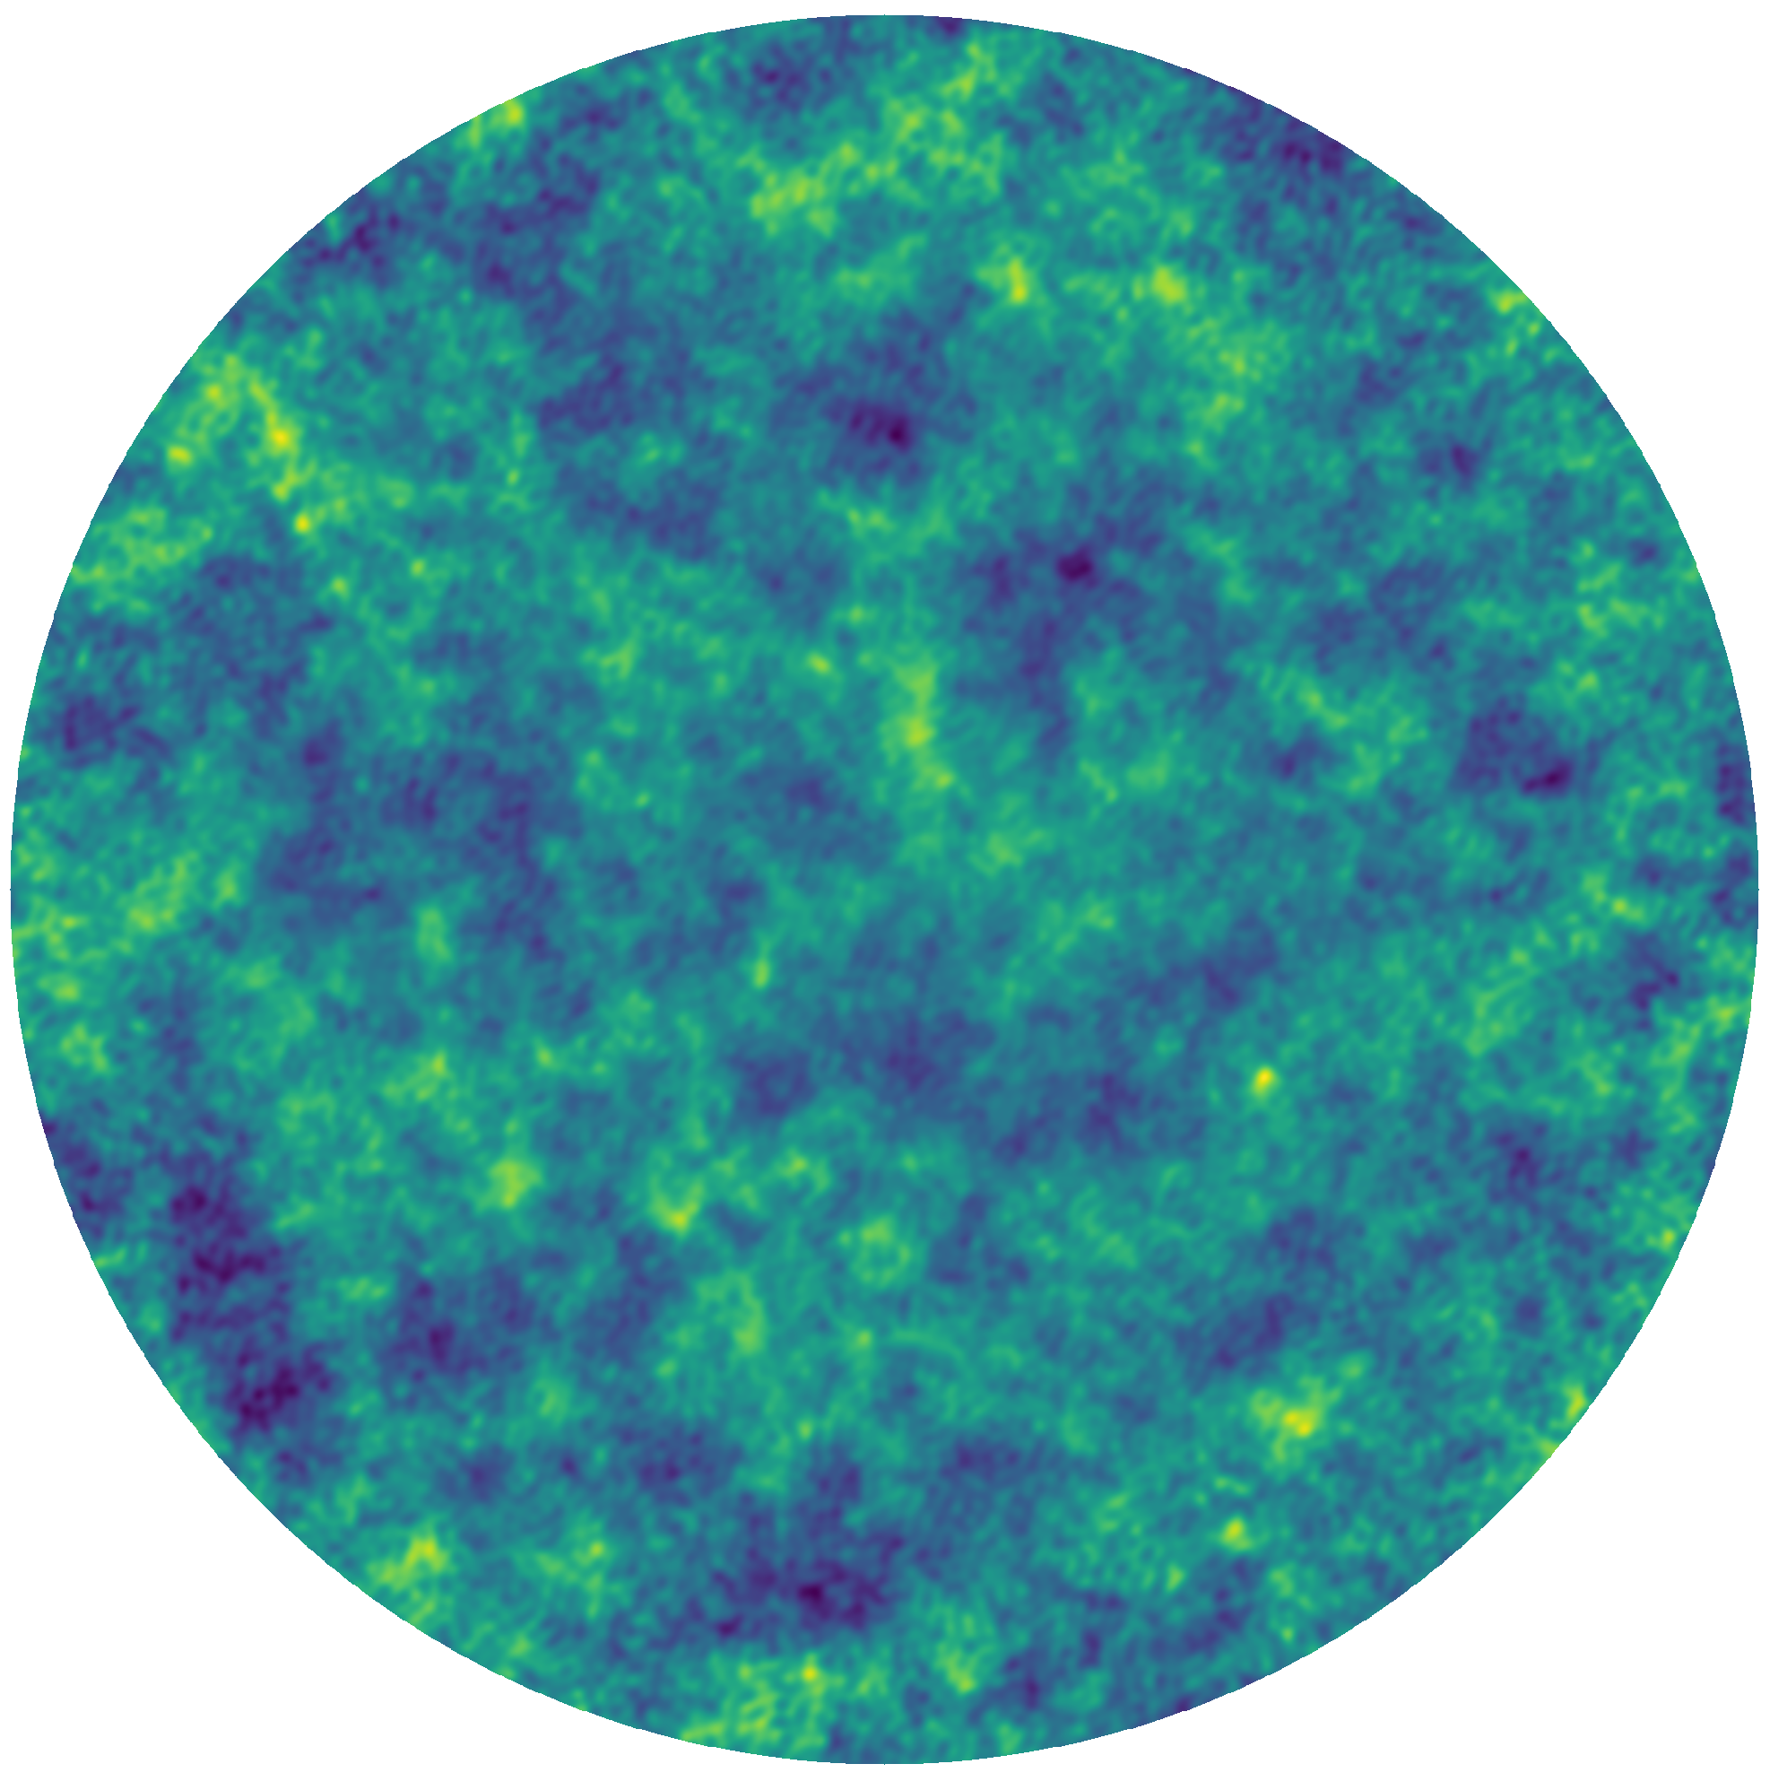
Instrument Simulation with Karabo
Power spectra
Options: OSKAR, RASCIL (WIP)
Input:
HI Source Catalog (RA, Dec, z)
Complex Visibilities
Dirty Images,
PSF
Interferometer
Imager
Choose telescope, frequency channels, time steps, UV distance ranges
Options: OSKAR, RASCIL
Primary Beam Correction
Mosaic of Pointings
Mosaic
Notes:
Input: sky catalog of HI sources, obtained from PINOCCHIO DM halos and a DM-to-HI best-fit (see Pascal’s presentation later today)
Karabo pipeline: choose telescope, apply instrumental effects, compute visibilities and dirty images for each redshift slice
OSKAR: designed for SKA simulations
RASCIL: developed by SKA Science Data Processor (SDP), in active development

Slide 11
Karabo Package (FHNW)
Support for several workflows
Catalog loading + filtering, interferometry, imaging, mosaicking, source detection…
User-friendly abstraction layer on top of OSKAR, RASCIL, Bluebild, PyBDSF
Dask support for HPC via dask-mpi and dask-distributed
Current efforts:
Include RASCIL as interferometry simulator
Improve Dask support
Check out the code: https://github.com/i4Ds/Karabo-Pipeline

Slide 12
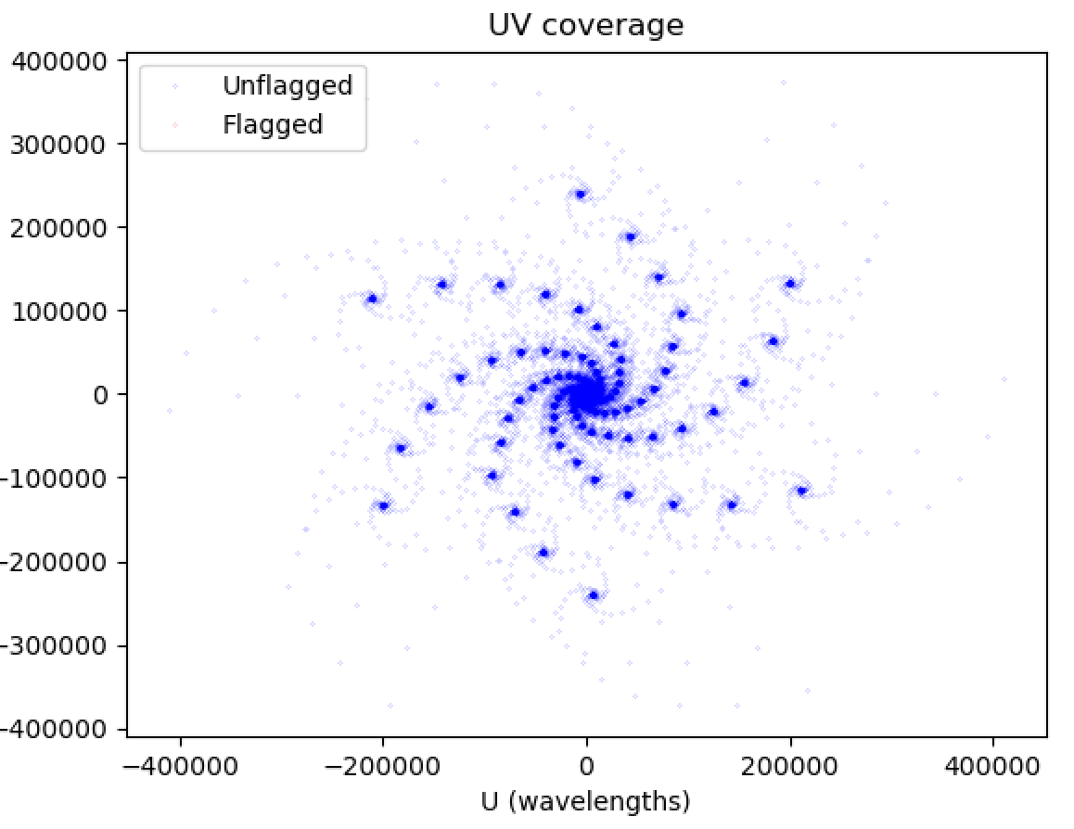
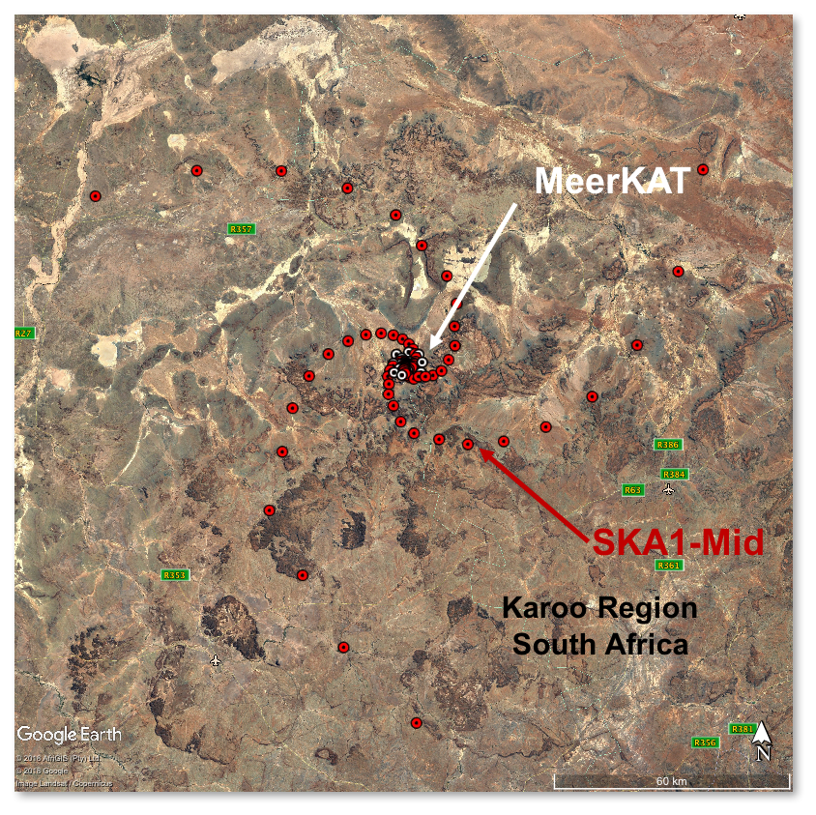
Telescope Configuration: SKA-Mid
Core: 50% of dishes within 2km radius
3 arms out to ~150 km
Frequency: 800 MHz, wavelength: 0.375 m
Credit: SKAO Website

Slide 13
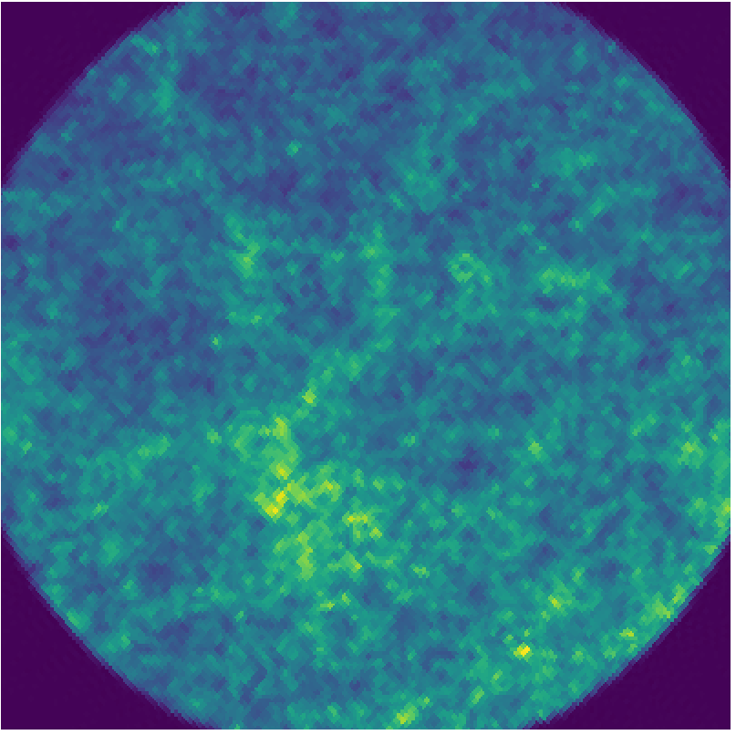
Example: from Sky to Dirty Image
Input Sky Model, projected
(HEALPix flux map with NSIDE = 4096)
Dirty Image, projected, after primary beam correction
2.2°
Pointing Centered at RA, Dec = 20°, -30°
Notes:
Note: here we show a SKA-like pointing. But we can also simulate HIRAX, which explains why we started with half-sky maps in the other slide.
Slice input catalog into redshift bins
Compute visibilities and dirty images for each channel
Apply primary beam correction to each dirty image (more on this later)
Add dirty images together to produce right-hand side

Slide 14
Results: Pointing Mosaics
FWHM of Primary Beam at mid frequency: 1.8°
Summed over 20 frequency channels (700 - 800 MHz, bandwidth = 5 MHz)
2.2°
6°
Notes:
6 nodes, 10 minutes each (1 node hour total) and 10 GB each (60 GB total)
Specs of run:
3 pointings
20 frequency channels (bandwidth = 5 MHz)
4096^2 pixels

Slide 15
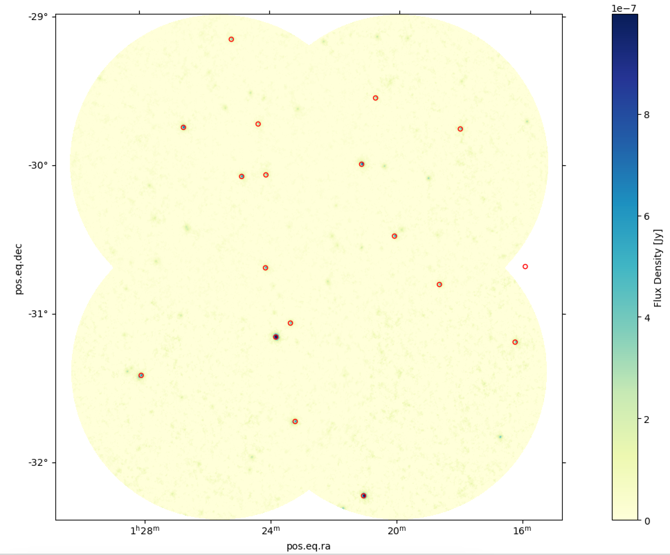
Results: Pointing Mosaics
4 pointings, each diameter = 1°
Bright input sources marked in red
Reproducible using OSKAR or RASCIL as backends
Currently: parallelization of visibility calculation and imaging
Dec
Flux (Jy)
RA

Slide 16
HIRAX: Hydrogen Intensity and Real-time Analysis eXperiment
Interferometric array up to 1024 6m dishes operating at 400-800 MHz
Scalable array built in stages: 2 (qualification), 8, 128, 256 (funded) then expand to 1024 and operate full array for 4 years
SARAO Karoo site co-located with SKAO in South Africa
Dishes stationary and tiltable
15,000 deg2 Neutral Hydrogen survey with redshifts between 0.8 and 2.5

Slide 17
HIRAX Updates

Slide 18
Outlook
Current
Simulate higher resolution catalogs
Integrate RASCIL interferometer simulation into Karabo
Optimize interferometry and imaging code with Dask
Future
Include extended sources + foregrounds
Self-consistent cross-correlation studies (spectroscopic galaxy surveys)
Include deconvolution (e.g., WS-CLEAN) into pipeline
Reach out if you are interested!

Slide 20
Backup Slides

Slide 21
Primary Beam Correction
Final Dirty Image, without primary beam correction
Final Dirty Image, with primary beam correction

Slide 22
Tomography: z slices in HI maps
08.09.2023
‹#›

