Slide 1

2024.03.01

Slide 2
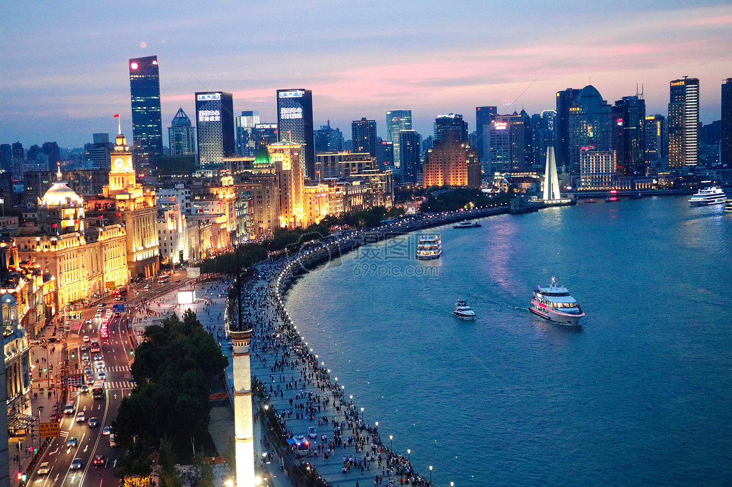
Activities
Thursday 21th March
Banquet
Friday 22nd March
Evening Reception
Saturday 23rd March
Sheshan campus tour
China SKA Regional Centre
TianMa 65m Telescope
Chinese VLBI Network Control Center
Huangpu River Cruise（optional)

Slide 3
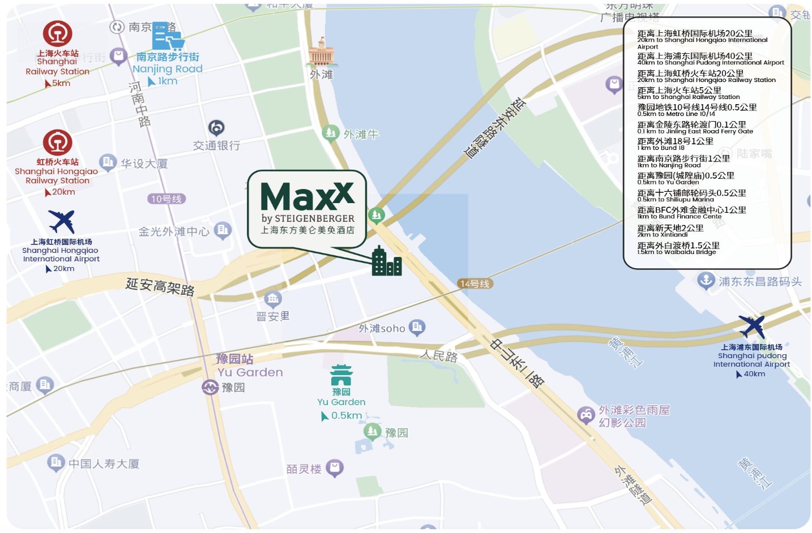
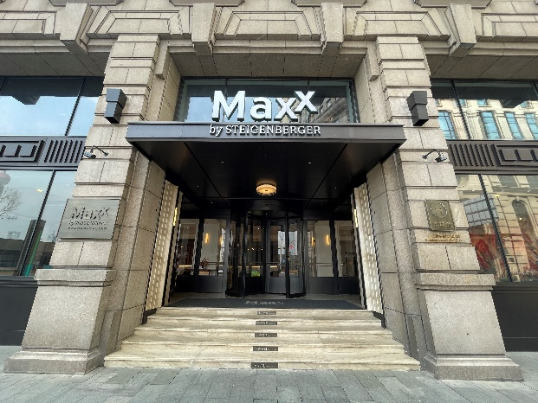
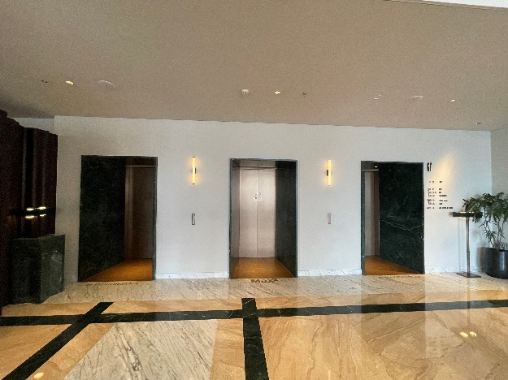
Venue - Maxx by Steigenberger on the Bund Shanghai
No.1 Jinling East Road, Huangpu District, Shanghai. Google Maps

Slide 4
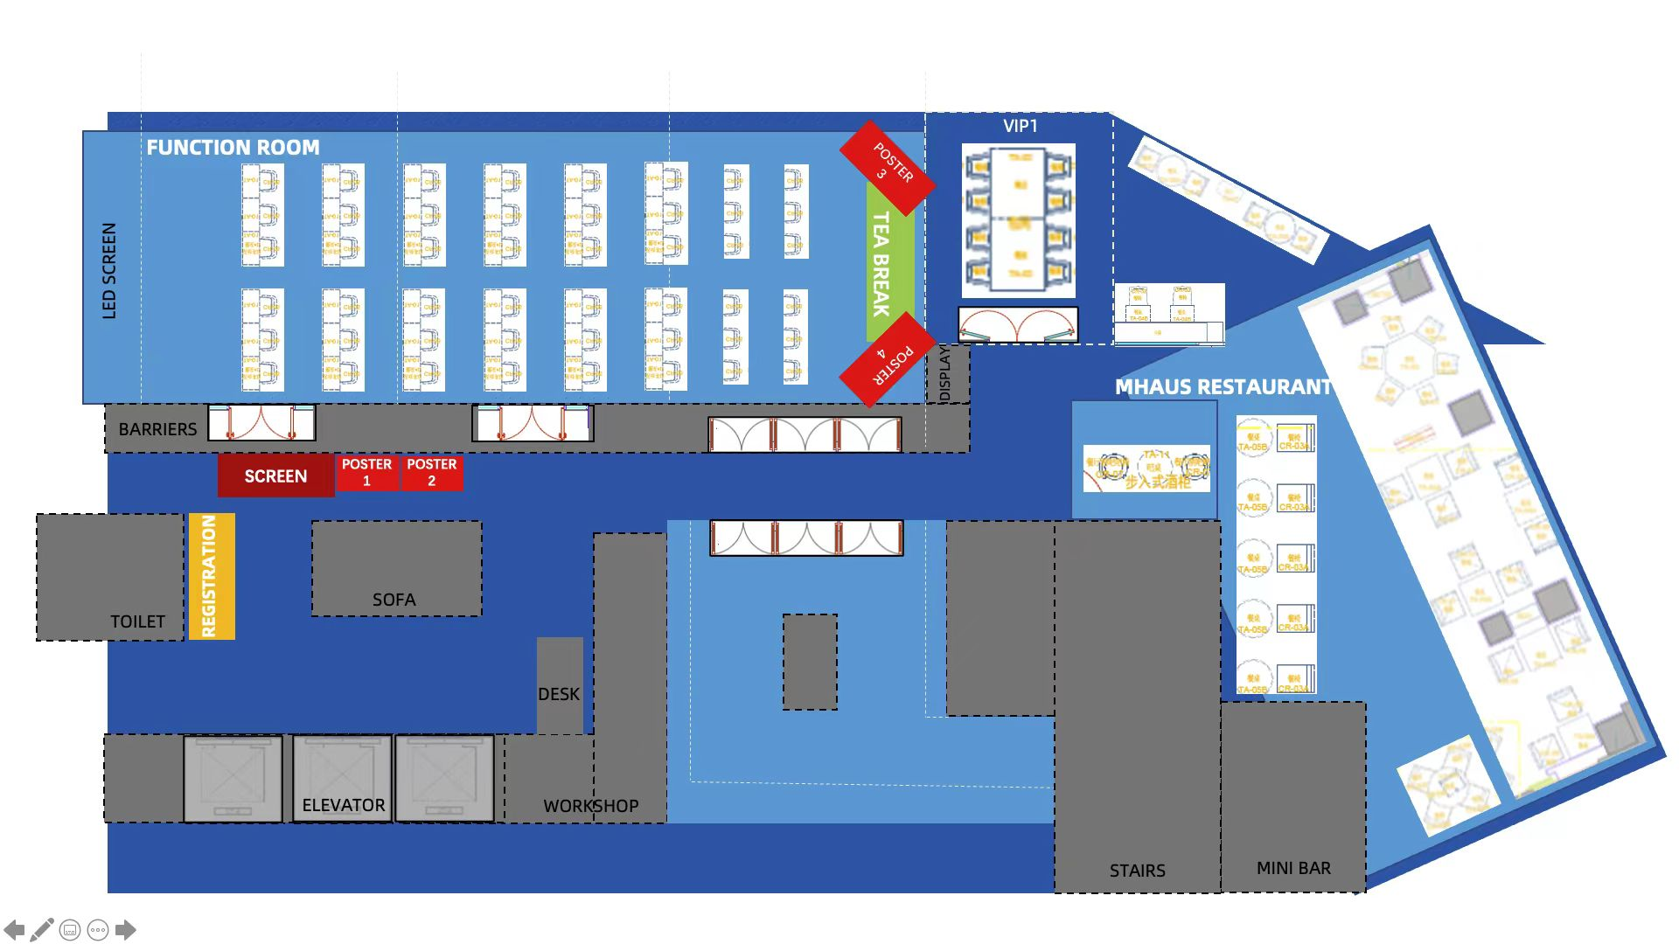
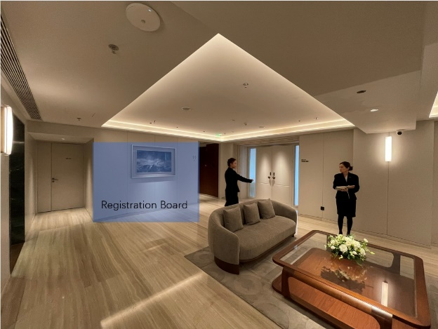
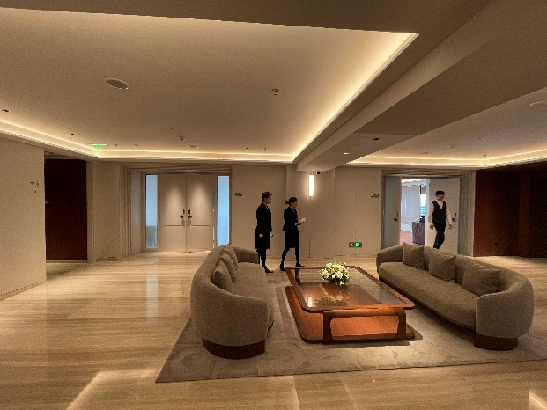
Floorplan

Slide 5
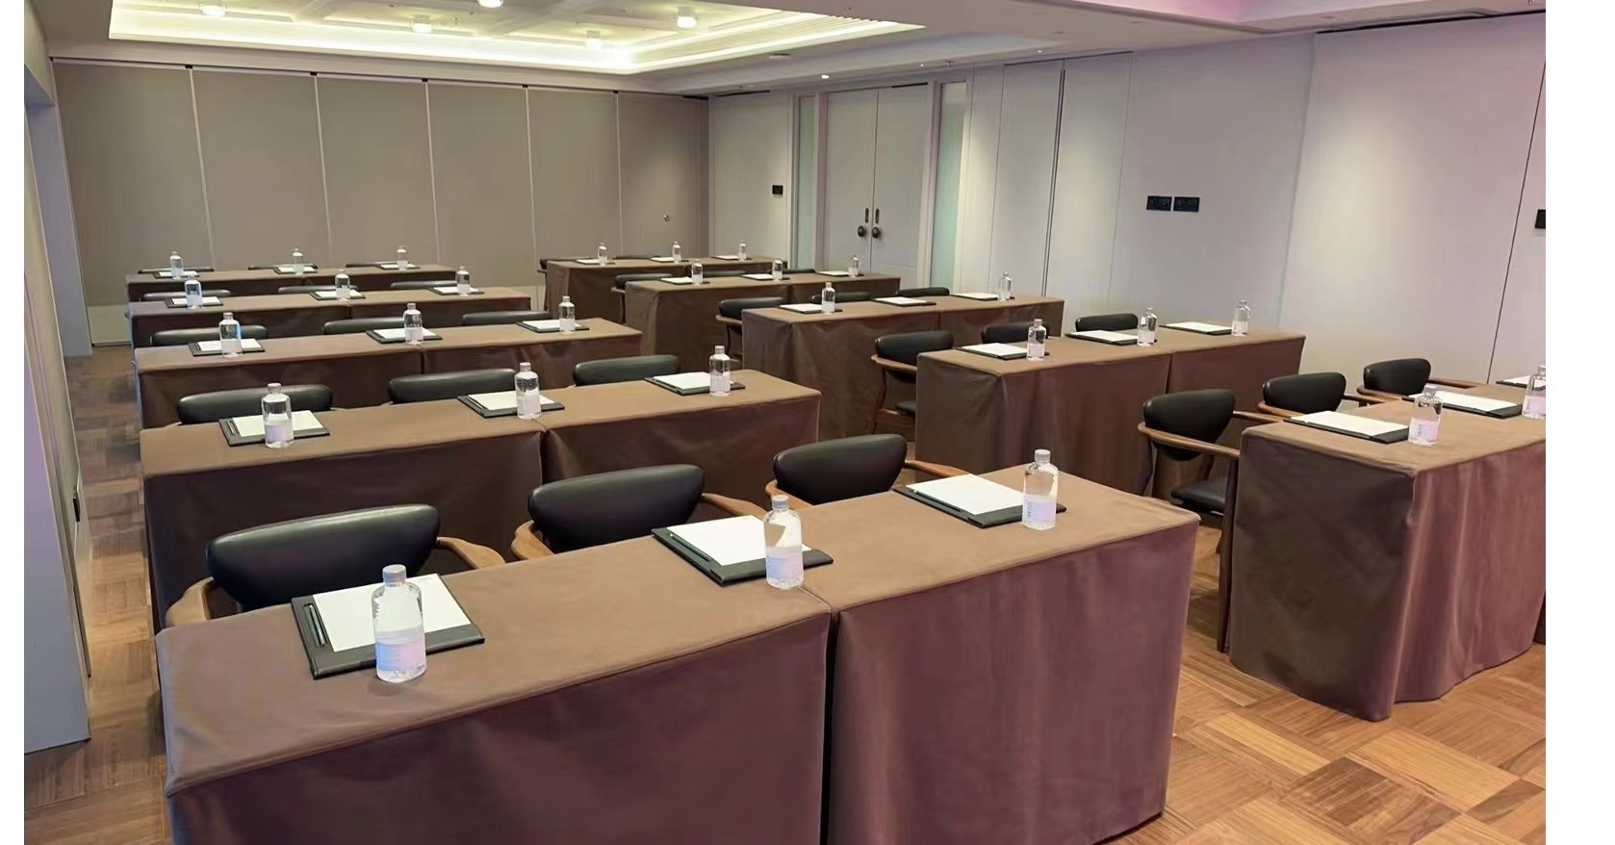
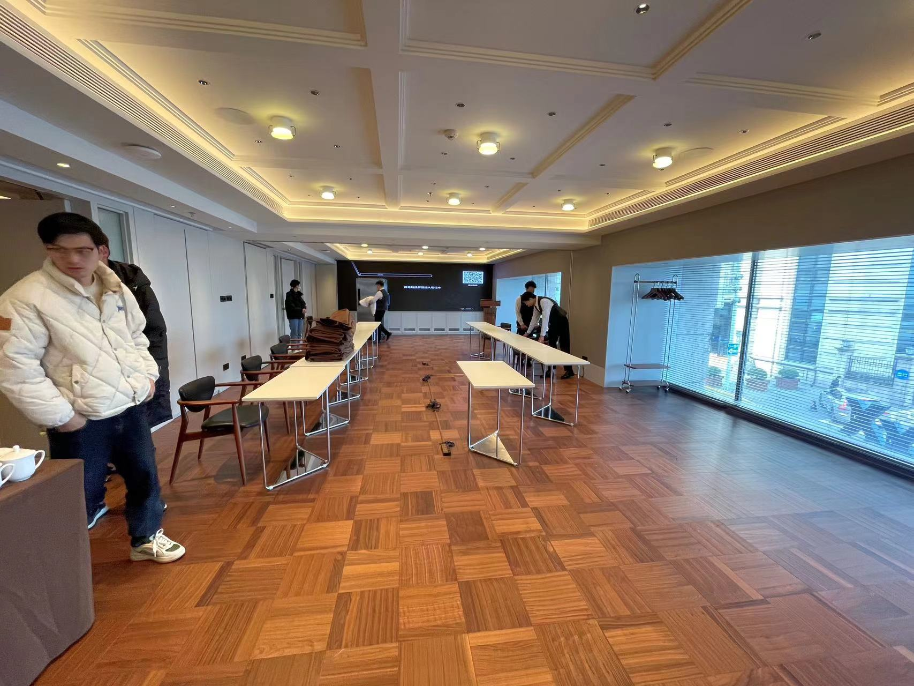
Meeting Room

Slide 6
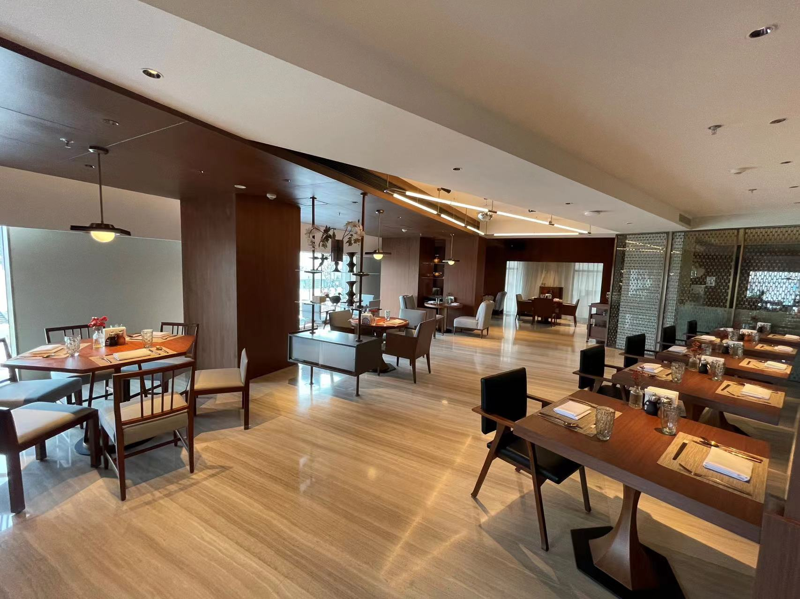
Restaurant

Slide 7
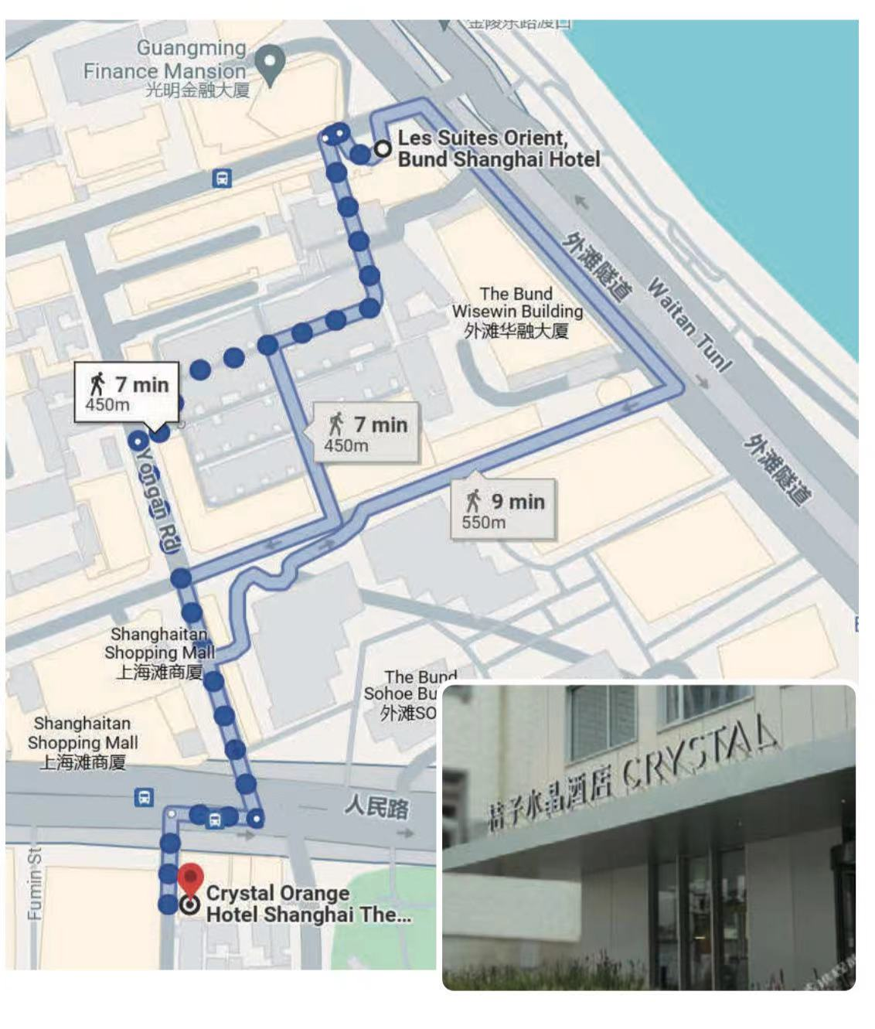
Alternative Hotel
- Orange Crystal (Bund)

Slide 8

TianMa 65m Telescope

Slide 9
China SKA Regional Centre

