Slide 2
Enjoy workshop
We will write a short article for Contact

Slide 3
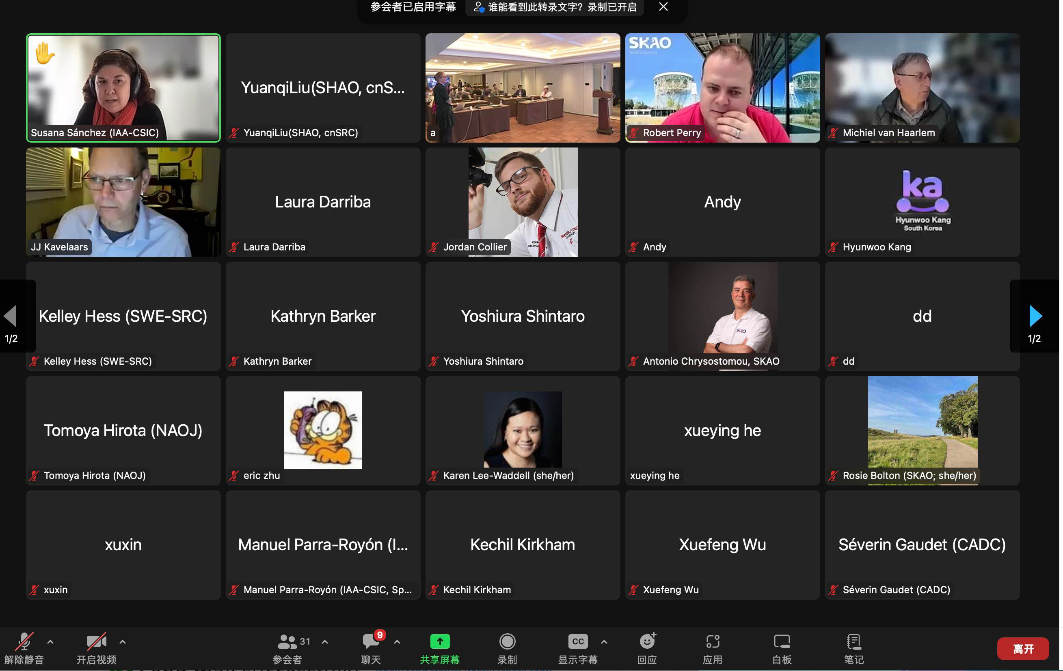
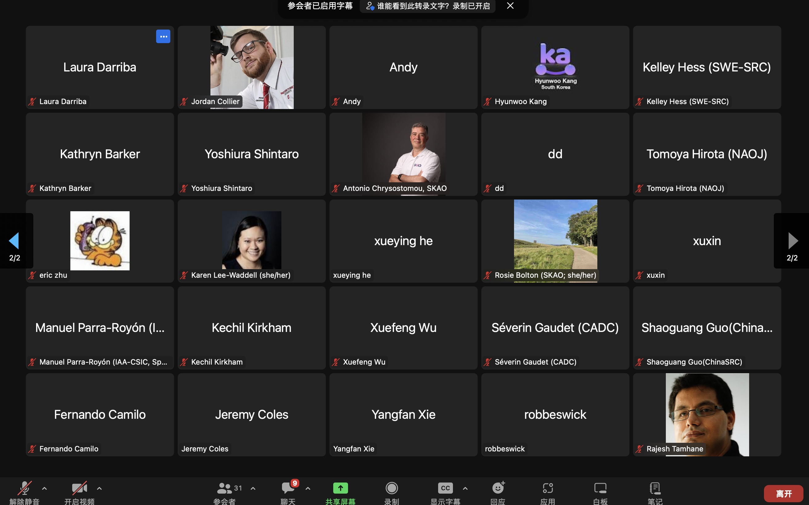
I appreciate so much for online participants, even staying in the middle of the night.

Slide 4
Country | Shanghai | On-line | Total
China | 33 | 3 | 36
UK | 8 | 1 | 9
Netherlands | 2 | 2 | 4
Japan | 2 | 1 | 3
France | 1 | 0 | 1
Switzerland | 1 | 0 | 1
India | 1 | 1 | 2
Australia | 0 | 3 | 3
Spain | 0 | 2 | 2
South Africa | 0 | 2 | 2
Sweden | 0 | 2 | 2
Italy | 0 | 1 | 1
Canada | 0 | 1 | 1
Korea | 0 | 1 | 1
else | 0 | 7 | 7
Total | 48 | 27 | 75

Slide 5
Sessions
>10 sessions
>20 oral presentations
Several poster presentations

Slide 9
feedback
Nice meeting venue
Beautiful view
Good food/banquet/coffee
Create collaborative opportunities
Happy discussion, creative ideas
More feedback/comments/advice, send to me please to help us improve future meeting

Slide 10
Beer Party
Starting from 6pm
Restaurant, same as the lunch place

Slide 11
Thanks to SOC & LOC
Weijia Lv , Shaoguang Guo, Huihua Li, Xiaocong Wu, Zhijun Xu, Yuanqi Liu
Robert Perry, Janneke de Boer
Thanks to advice from Chrysostomou Antonio, Rosie Bolton, Jeremy Coles, Jesus Salgado

