Slide 1
SKACH Consortium Overview
Carolyn Marie Crichton
September 2, 2024

Slide 2
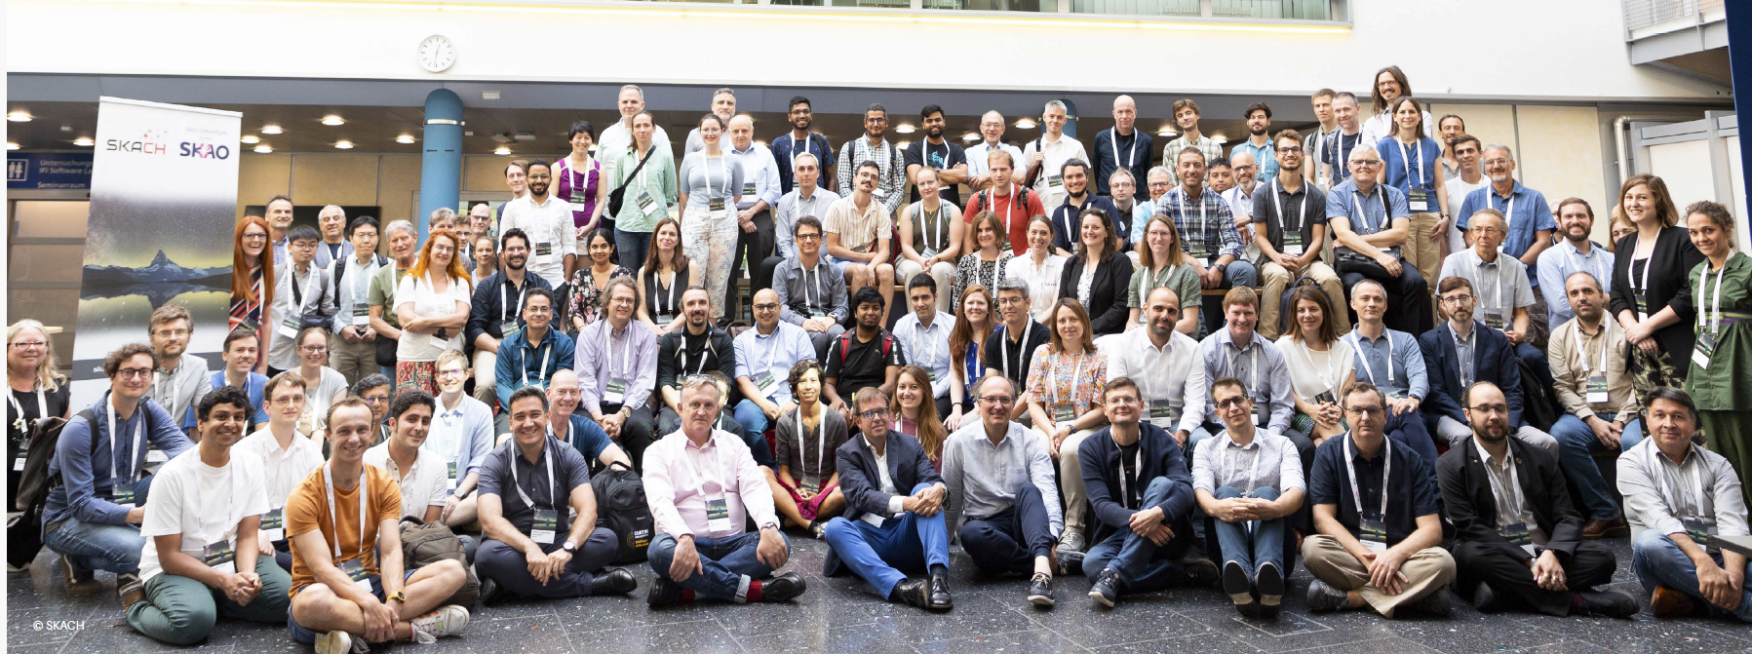
Welcome to New Members!

Slide 3
Vision
Further Swiss leadership in the global radio astronomy community.
Switzerland joined the SKAO on January 19, 2022
SKACH is primarily funded by the State Secretariat for Education, Research and Innovation (SERI). Work within the consortium also leverages funding from external grants such as AstroSignals SINERGIA, SNF Bilateral, PASC, and Horizon Europe.
Mission
Ensure meaningful contributions to the SKAO and SRCs through the development and delivery of cutting-edge Swiss solutions to key science goals, big data research, technology, and services.

Slide 4
Progress of the SKACH Consortium
2021
2022
2023
2024
Year 1:
We started to form as a consortium
Year 2:
We continued to form as a consortium
Year 3:
Reflection and adjustments of consortium structures. We are also using this information to plan for the next round of SERI Funding
Year 4:
We expect to see strongly formed collaborations and results from this first round of consortium funding.
Submitted proposal for SERI to fund the consortium for the SKAO
EPFL signed agreement and received funds from SERI
First meetings of the consortium board
Hiring of personnel began
Switzerland officially joined the SKAO
Monthly meetings of the consortium board
Weekly meetings for the consortium
Consortium branding
Kick-off of SKACH programs and reporting
Attendance to SKAO council
International collaboration
Continuing board and weekly meetings
Increased regular meetings for work packages (simulations, SRCs)
2025 + consortium planning
Increased participation in international groups
Preliminary results
Continuation and adjustment of consortium structures
Final results of the first round of consortium funding
Reflection of SKACH Activities
Preparation for next round of activities

Slide 5
The SKACH Board is comprised of one voting member from each institution & is responsible for managing SKAO related activities.
Chair: Ms. Carolyn Marie Crichton
Co-Chair: Mr. Stefan Kögl
Voting Members
Prof. André Csillaghy (FHNW)
Prof. Alexandre Refregier (ETHZ)
Prof. Daniel Schaerer (UniGe)
Dr. Elena Gavagnin (ZHAW)
Dr. Evelina Breschi (HES-SO)
Prof. Florina Ciorba (UniBas)
Prof. Jean-Paul Kneib (EPFL)
Prof. Lucio Mayer (UZH)
Dr. Mark Sargent (ISSI)
Mr. Pablo Fernandez (CSCS)
Observer: Susanne Wampfler (UniBern)
The SKACH Board. Left to Right: Top: Daniel Schaerer, Jean-Paul Kneib, Florina Ciorba, Evelina Breschi, Elena Gavagnin, Carolyn Marie Crichton Bottom: André Csillaghy, Alexandre Refregier, Stefan Kögl, Lucio Mayer, Pablo Fernandez

Slide 6
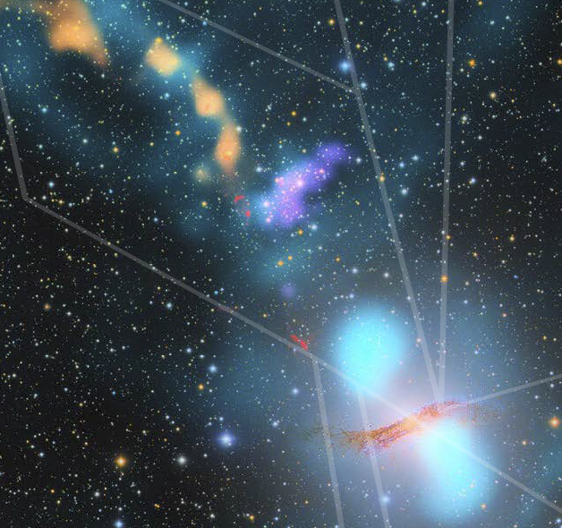
Science
(Astrophysics)
Data Science and Simulations
Computing Platforms
CSCS Provides
Expert Engineering Support
Storage
Computing
One cluster for sandbox environment
Support for SKAO Data Science Challenges
Switzerland has also begun planning for a SRCNET node
Chair:
Victor Holanda (CSCS)
Co-Chair:
Darren Reed (UZH)
Infrastructure
Communications & Outreach
SKAO Working Groups
Extragalactic
Cosmology
Solar, Heliospheric and Ionospheric
Our Galaxy
Science Interests
Intensity Mapping
Cosmic Dawn & Reionization
Extragalactic & Nearby Galaxies
And more…
Chair:
Miroslava Dessauges (UniGe)
Co-Chair:
D. Crichton (ETHZ)
Members are Using
Advances in computational imaging,
Bayesian inference,
Generative models and deep learning
Tools in Development
SPHEXA
Bluebuild
Karabo
SEAMS
And more…
Chair:
Emma Tolley (EPFL)
Co-Chair:
Simon Felix (FHNW)
Development of the Mid-band 6 proof of Concept
Extend the observation frequency range to 15-25 + GHz
Realization of the Elegant Bread Board (EBB)
Chair:
Dominique Bovey (HES-SO)
Co-Chair:
Gilles Feusier (EPFL)
Communications Supports
4-Year Report
Fantasy Basel
Open Days
Cosmos Archeology
Press
Community Interest Articles
Proposal Support
Social Media
Chair:
Tanya Petersen (EPFL)
Co-Chair:
Hamsa Padmanabhan (UniGe)

Slide 8
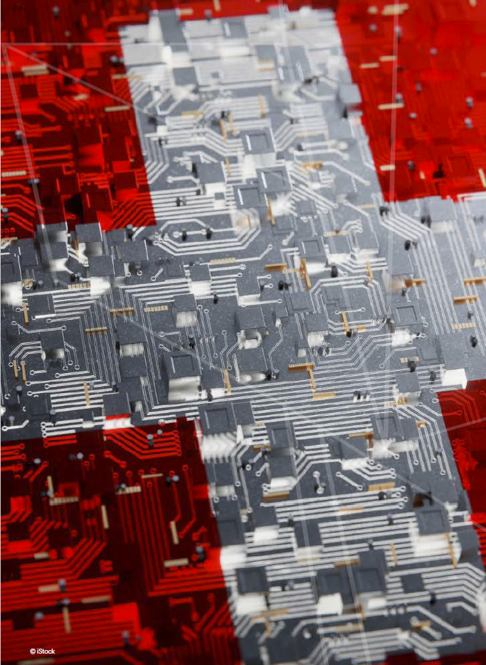
Industrial Return
Observatory Management and Control - Cosylab
Feed Horns - MECHA AG
Atomic Clocks - Safron
Co-design - EPFL SCITAS

Slide 9
Management
SKAO Resource Center (SRC)
Infrastructure
Science
(Astrophysics)
Communications & Outreach
SERI Funding Measures
Management
Administration
Events
Travel
SERI Funding Measures
Data Science
Imaging
HPC Simulations
V0.1 Computing & Infrastructure
FLARE
SRC V1 - Full Swiss SRC Node
PASC
Continued Developments in Computing
CSCS User Lab
Additional Compute and Storage
SDSC
MWA Data
SKAO Pipelines
Innosuisse
Future Development of the Mid-band 6
Horizon Europe
Continued Development of Receiver Capabilities
SSO
Funding for Dark and Quiet Skies Research
Marvis
Receiver Development
SNSF
Focus on precursors (MeerKAT, MWA, LOFAR, HIRAX)
NCCR
Development of coordinated Astrophysics Science pipelines and tools
ERC
Building blocks of galaxies
Star Formation
AGN
Bilateral Grants
HIRAX
MeerKAT
Large Agora
VIRUP
Small Agora
Podcast
Scientainment
Cosmic Play

Slide 10
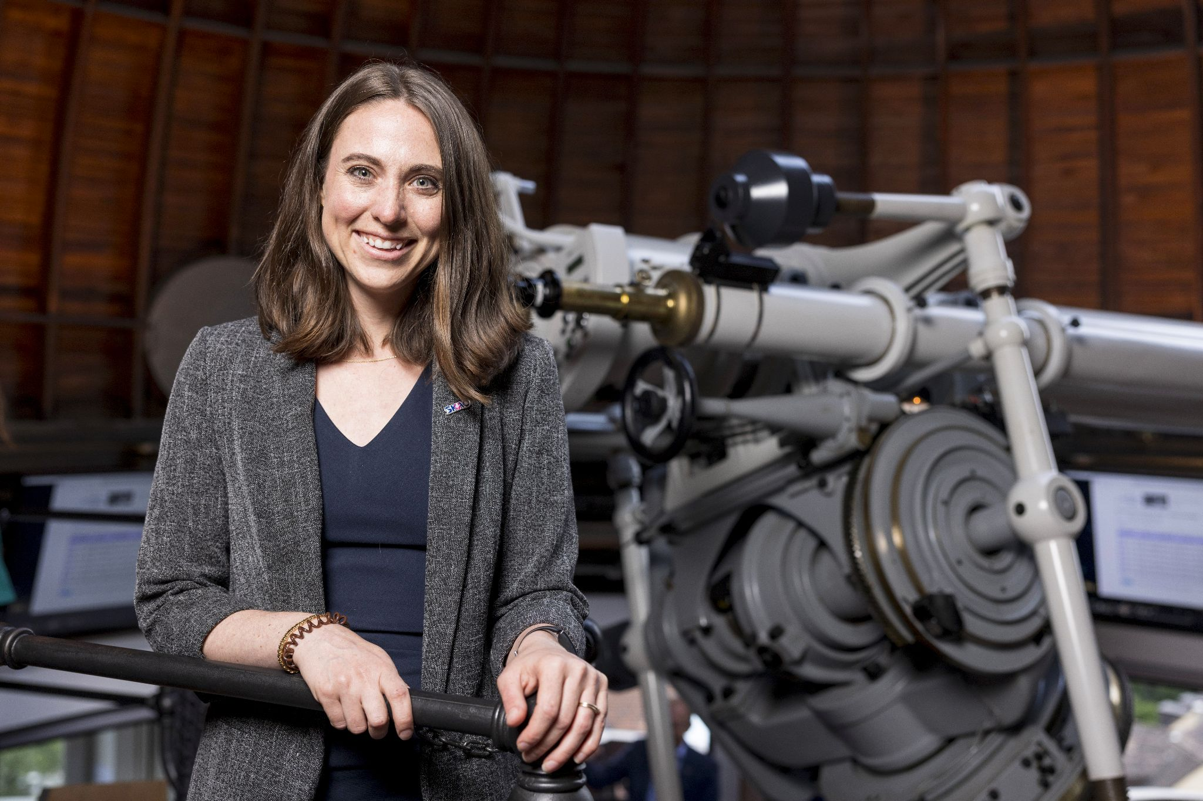
Contact Me:
Carolyn.Crichton@EPFL.ch

