Slide 1
TABASCAL
Trajectory Based RFI Subtraction and Calibration
Chris Finlay (UNIGE)
Martin Kunz (UNIGE), Bruce Bassett (UCT), Nadeem Oozeer (SARAO)

Slide 2
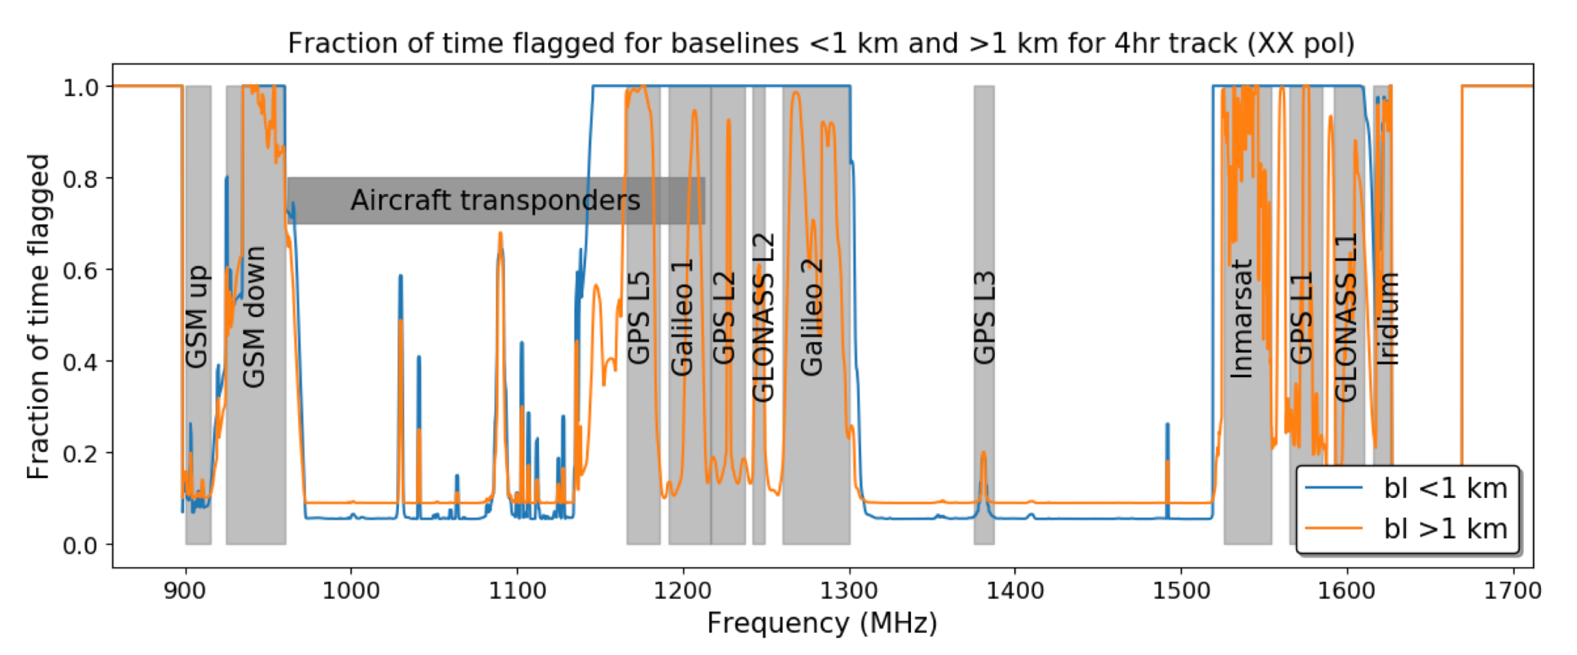
Radio Frequency Interference (RFI) - Motivation
30 % of the MeerKAT (SKA-Mid) L-band is contaminated.
Much of it is (reasonably) predictable
MeerKAT cost $ 330 M $ 100 M is being wasted.

Slide 3
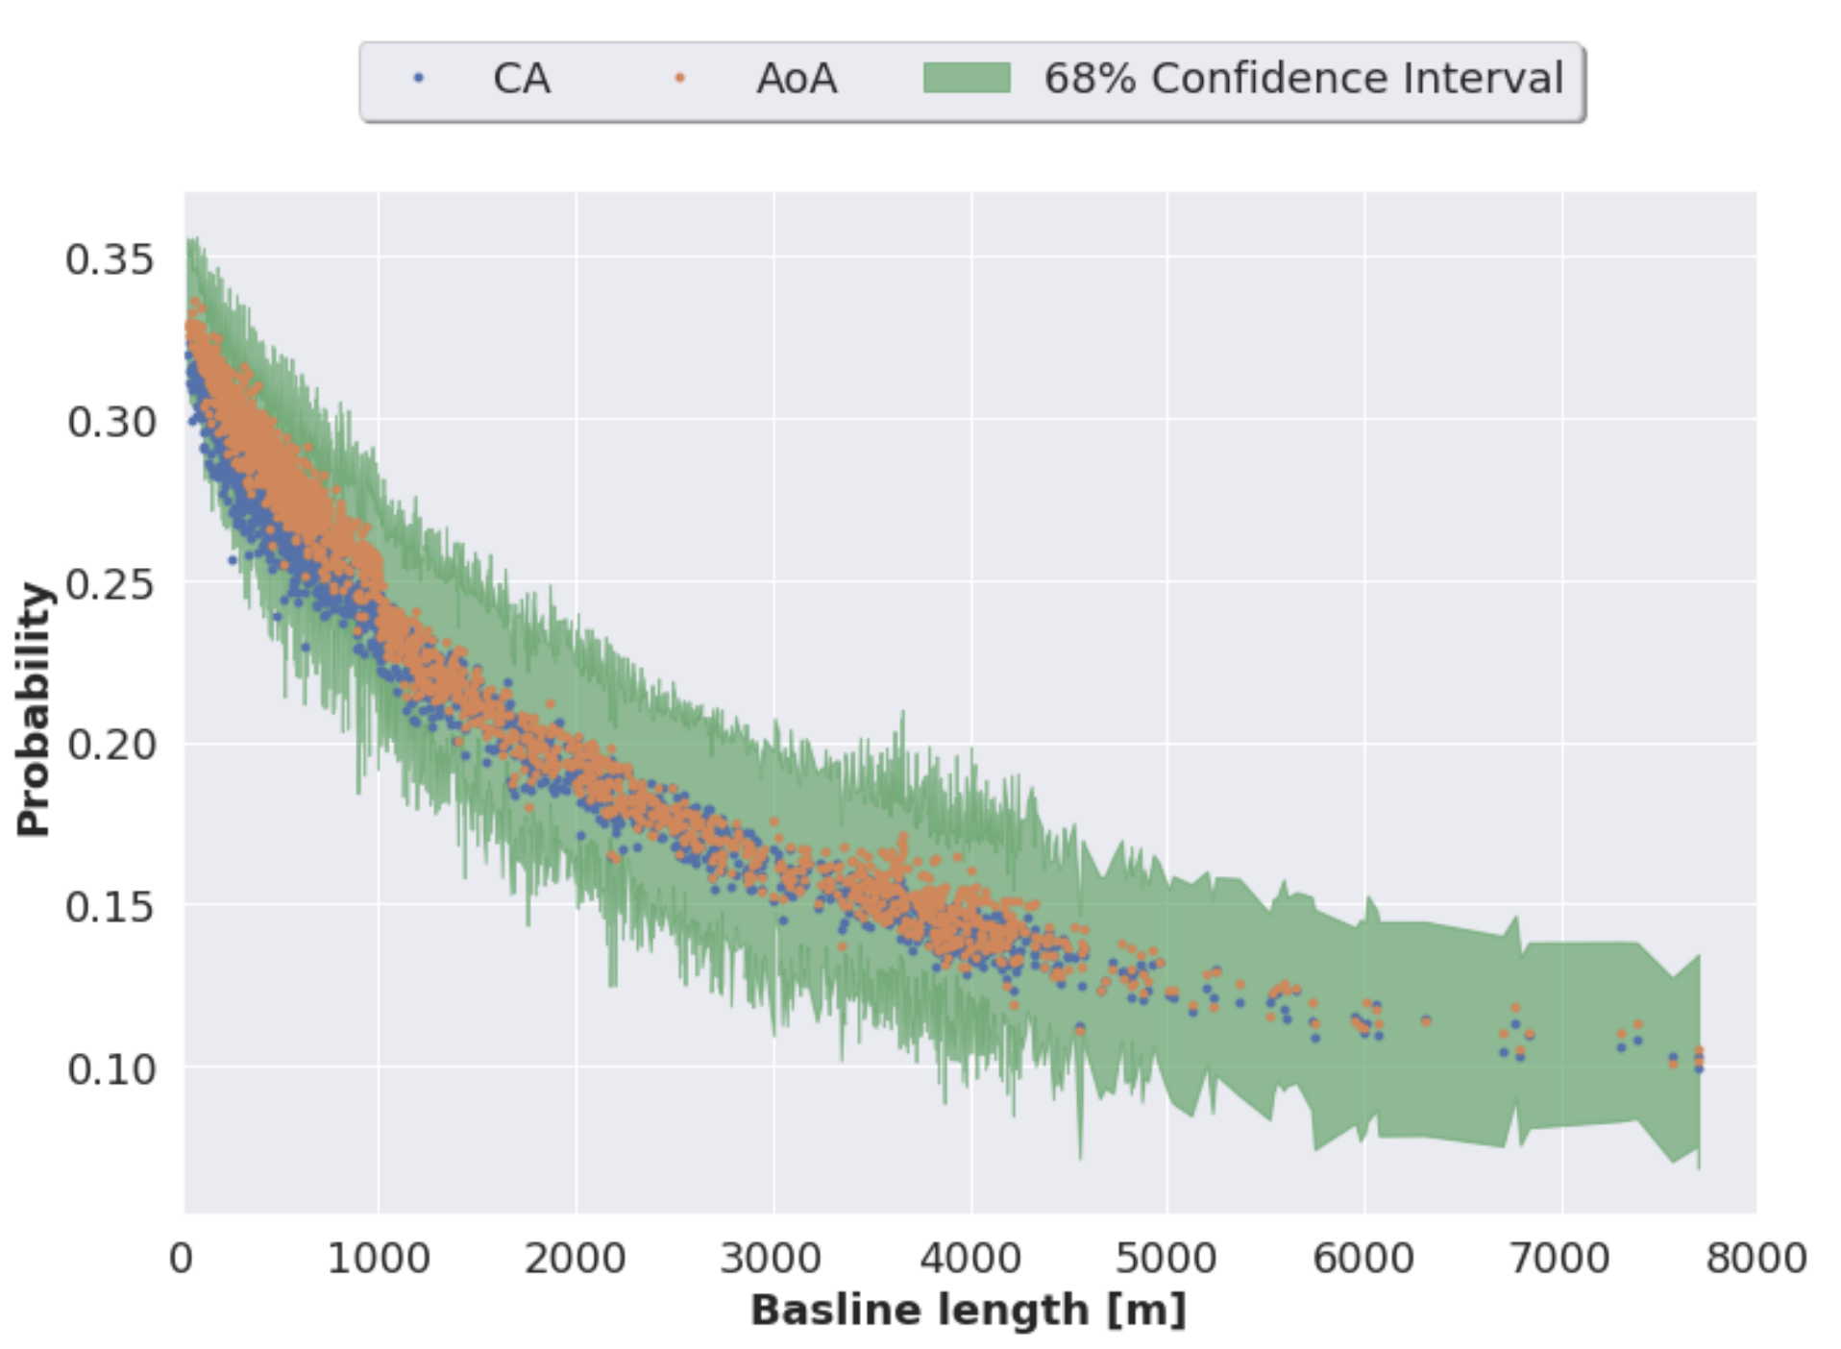
Baseline Dependence of RFI
RFI is stronger on shorter baselines due to fringe-washing.
RFI flagging of archival MeerKAT data
Sihlangu et al 2020

Slide 4
TABASCAL
Goals
Replace RFI flagging with RFI subtraction
Recover astronomical visibilities
Fit into the current data reduction workflow - 1GC then 2GC (self-cal) and beyond.
Ideas
Use RFI trajectories to help estimate their visibility contribution.
Estimate antenna gains by using prior information.
Use baseline dependent smoothness of astronomical visibilities to help with estimation.

Slide 5
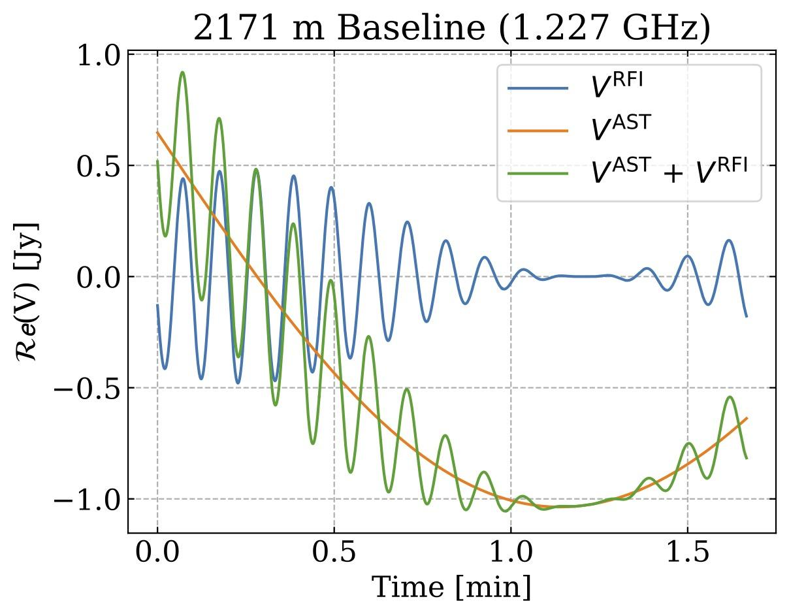
How to distinguish RFI from Signal?
Non-sidereal movement
(does not move with the stars)
High relative time variability
Different for each baseline

Slide 6
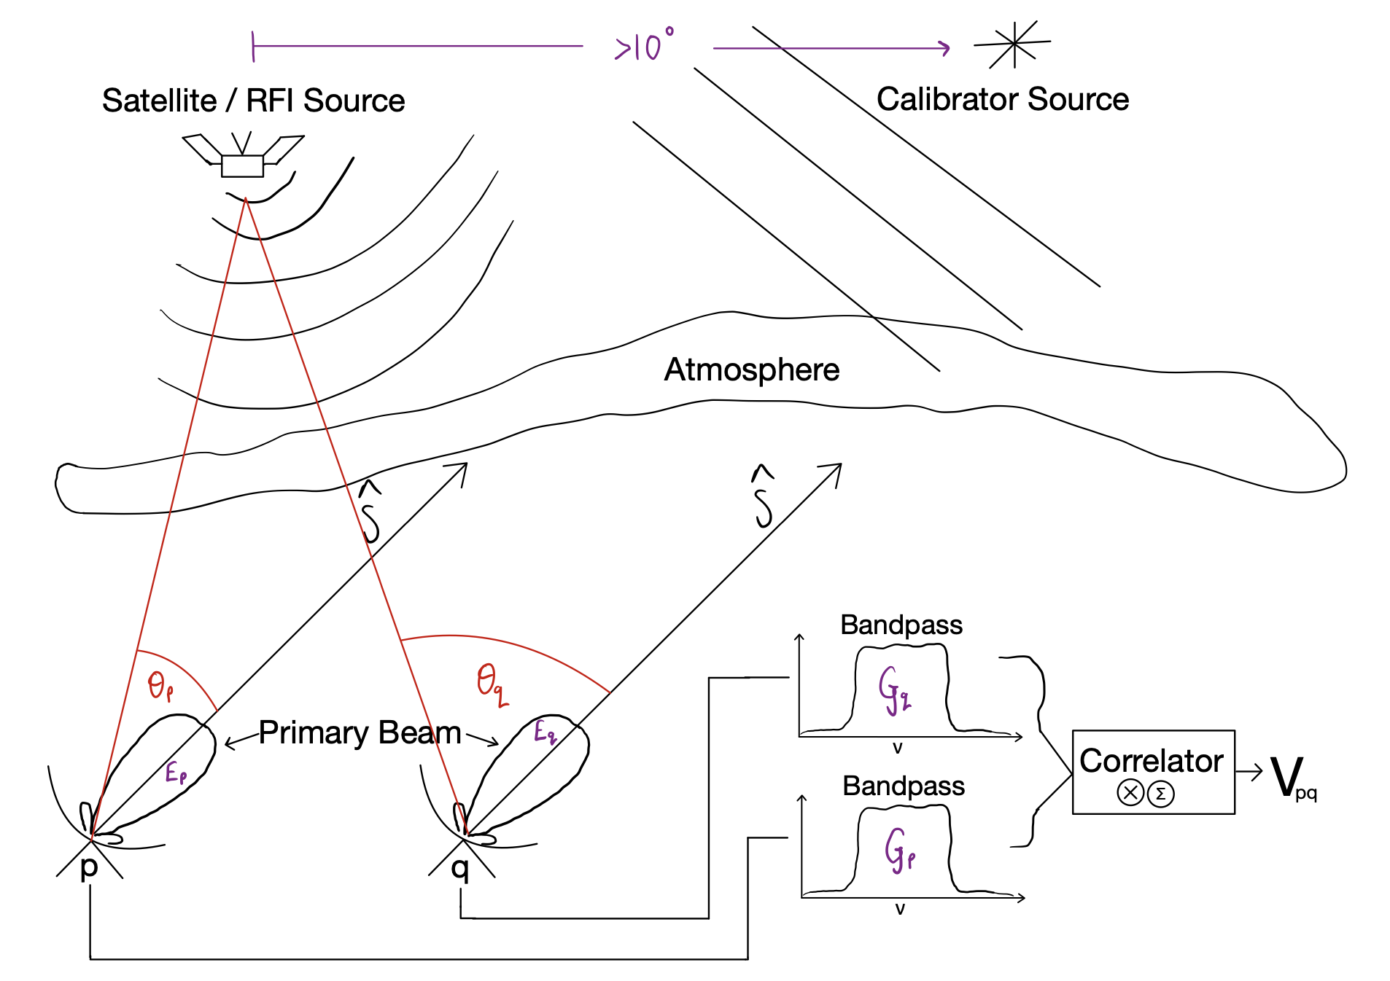
Data Simulations
Features
Satellite and Ground-based RFI sources
Correlator averaging (Fringe loss)
Time & direction dependent gains
Fast JAX implementation for CPU, GPU & TPU
Scalable with Dask to multiple GPUs
https://github.com/chrisfinlay/tabascal

Slide 7
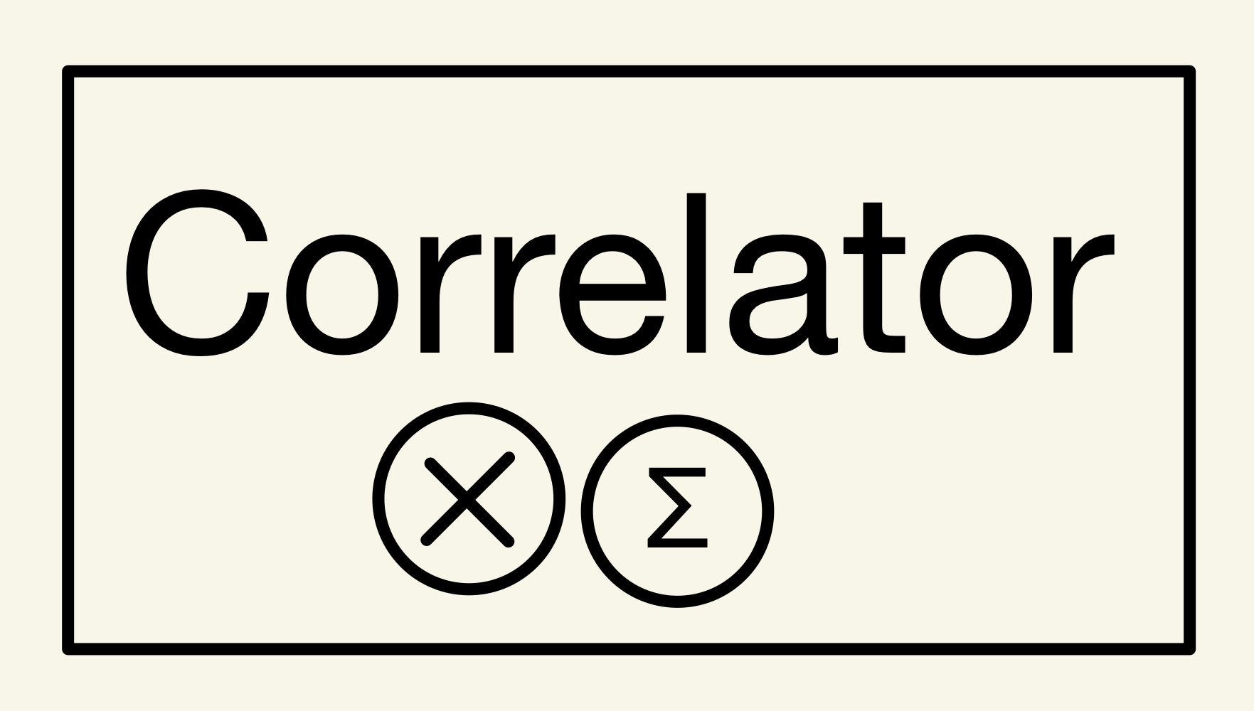
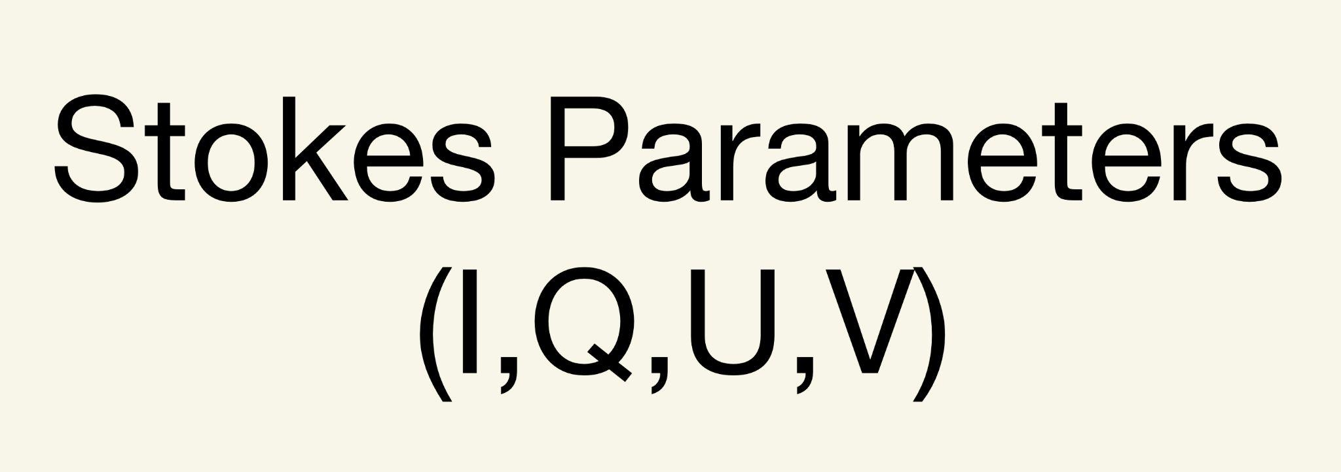
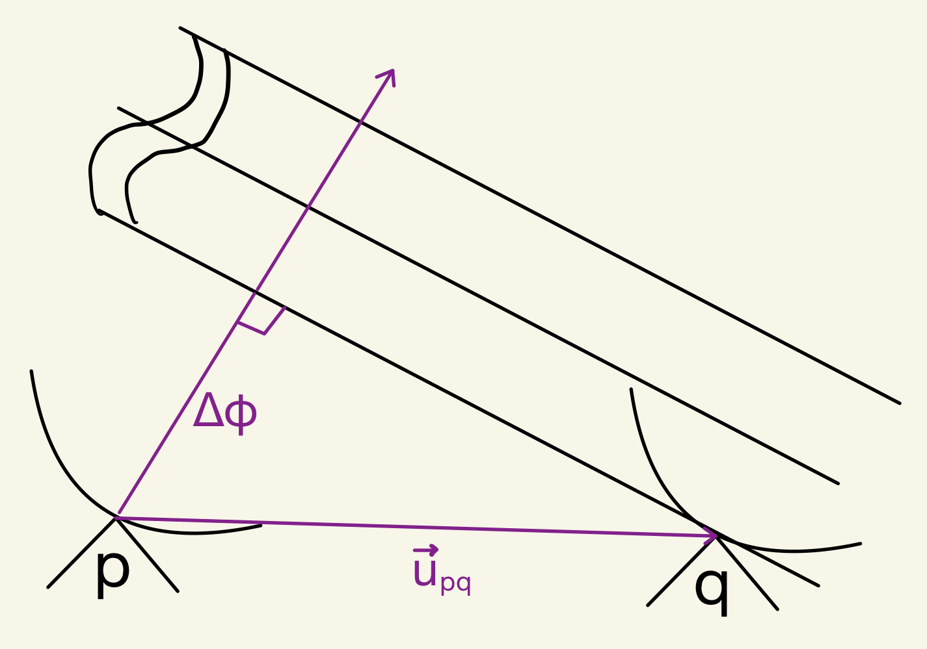
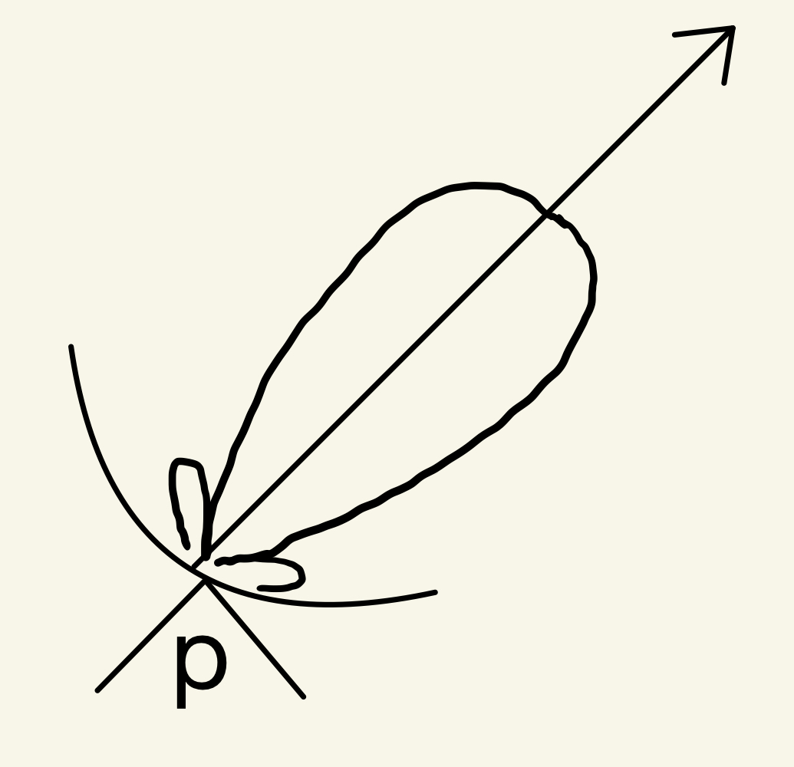
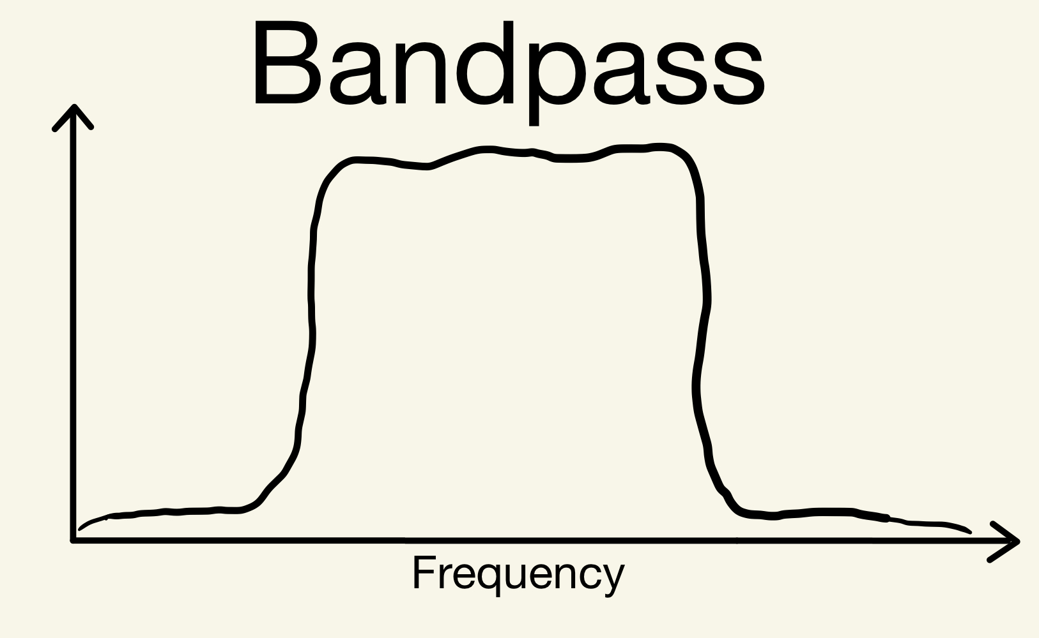
Radio Interferometry Measurement Equation (RIME)
Correlator-like Averaging
Brightness Matrix
Phase Delay
Visibility
Direction Independent Effects
Direction Dependent Effects

Slide 8
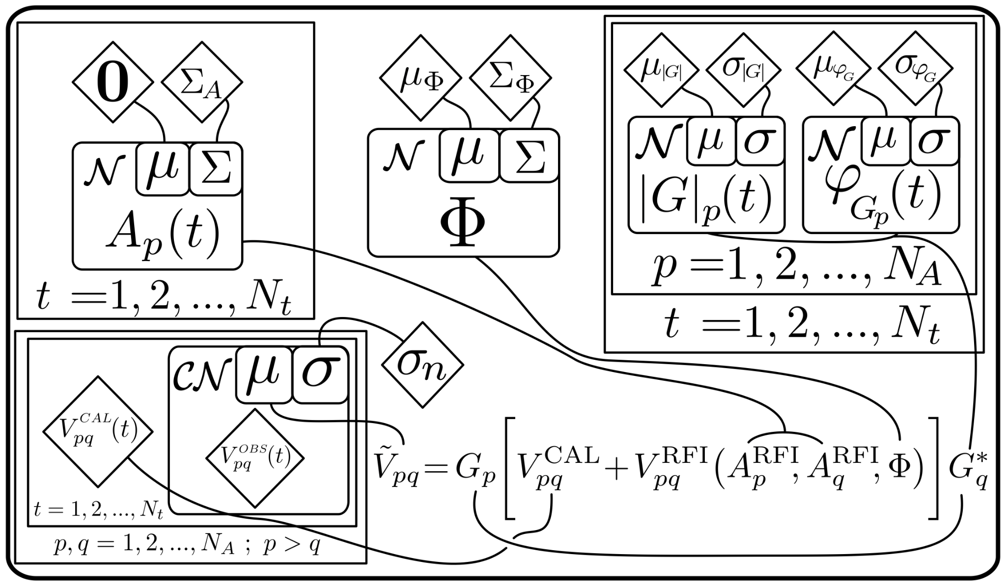
TABASCAL I
(Calibration Observation)
DOI:10.1093/mnras/stad1979
Prior
RFI Signal
RFI Trajectory
Antenna Gains
Jointly estimate RFI signal/trajectory and antenna gains.
Bayesian model to reliably estimate parameter errors.
Likelihood
Forward Model

Slide 9
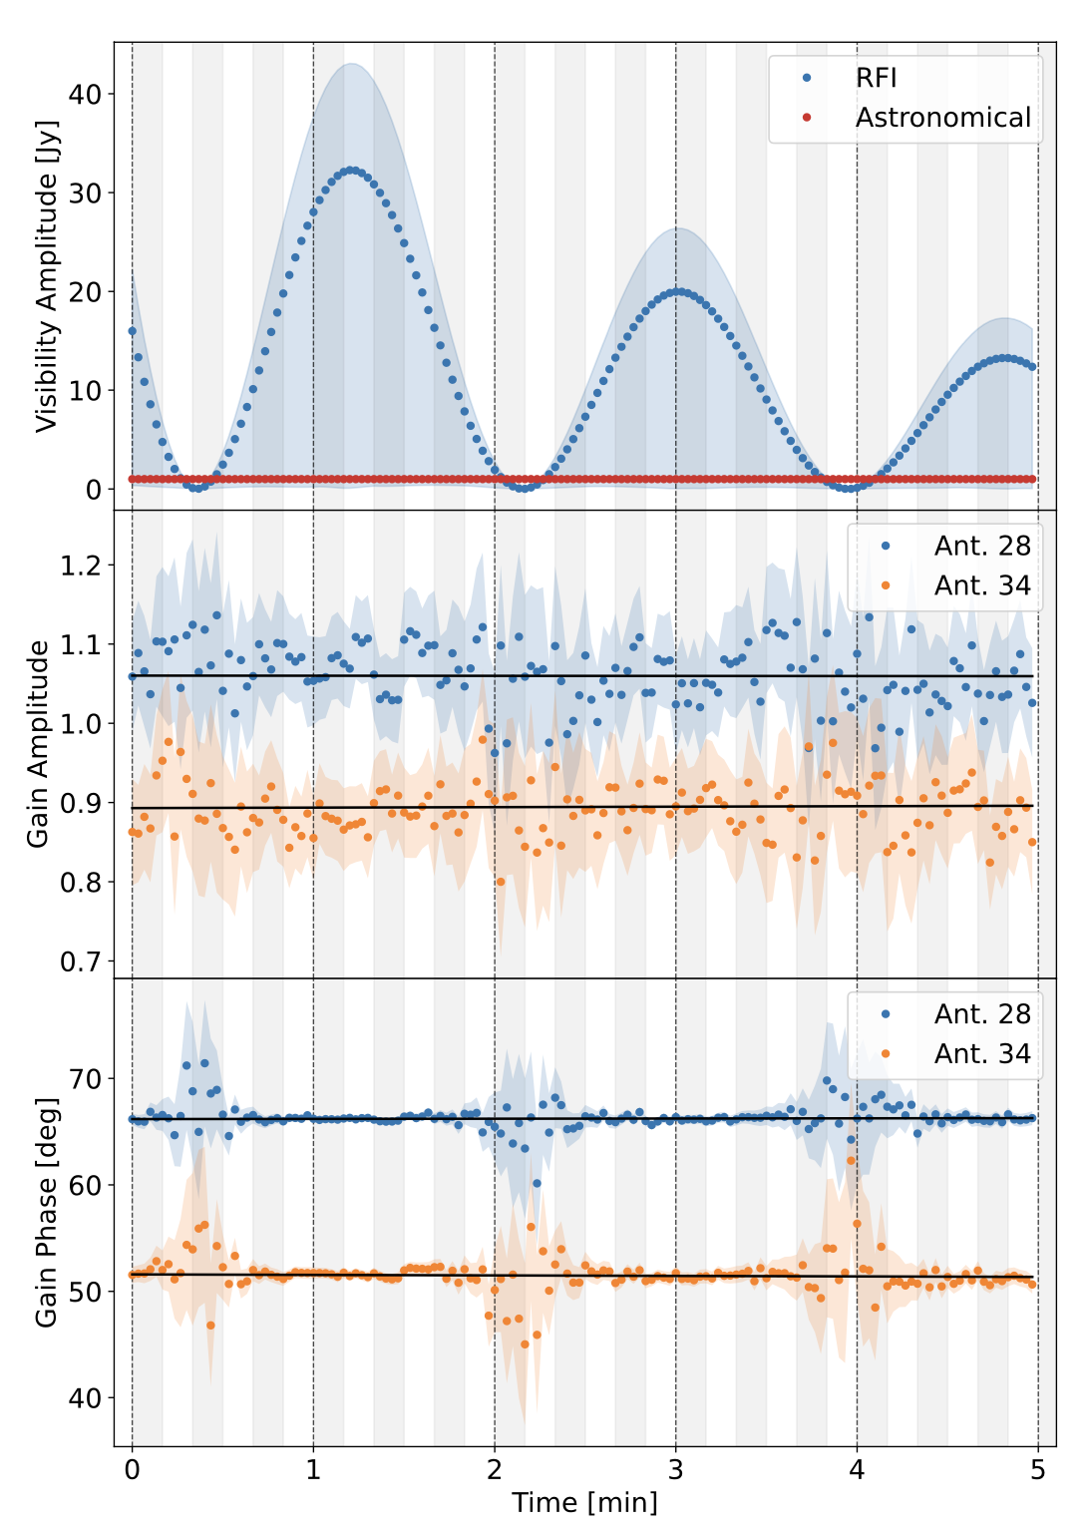
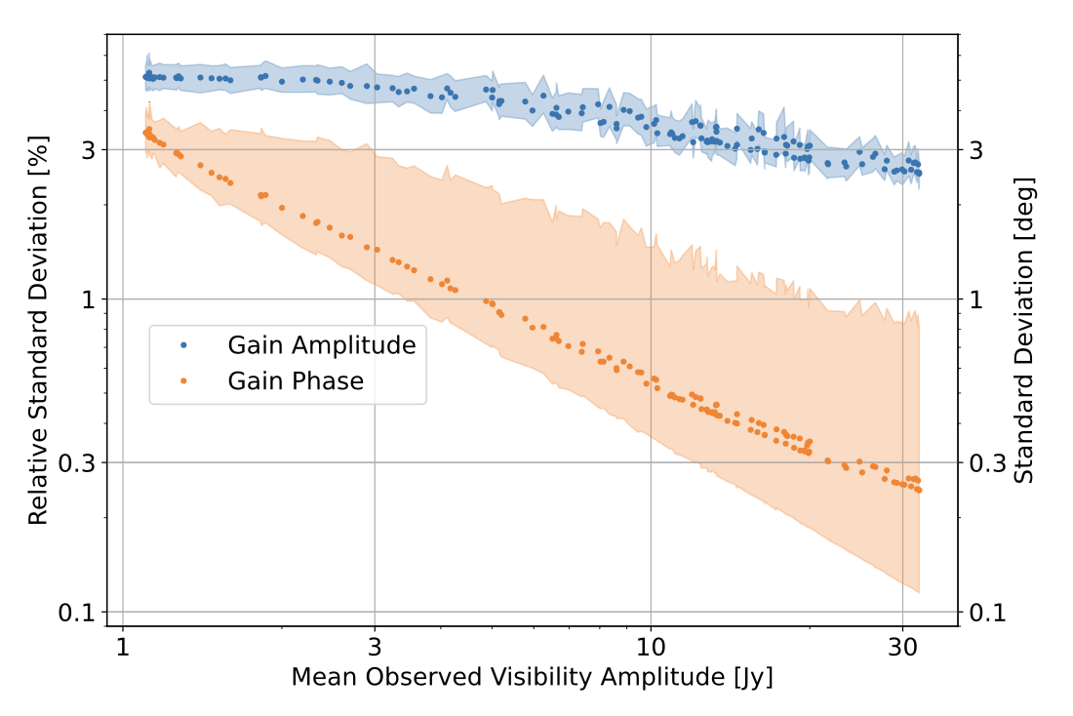
TABASCAL I

Slide 10
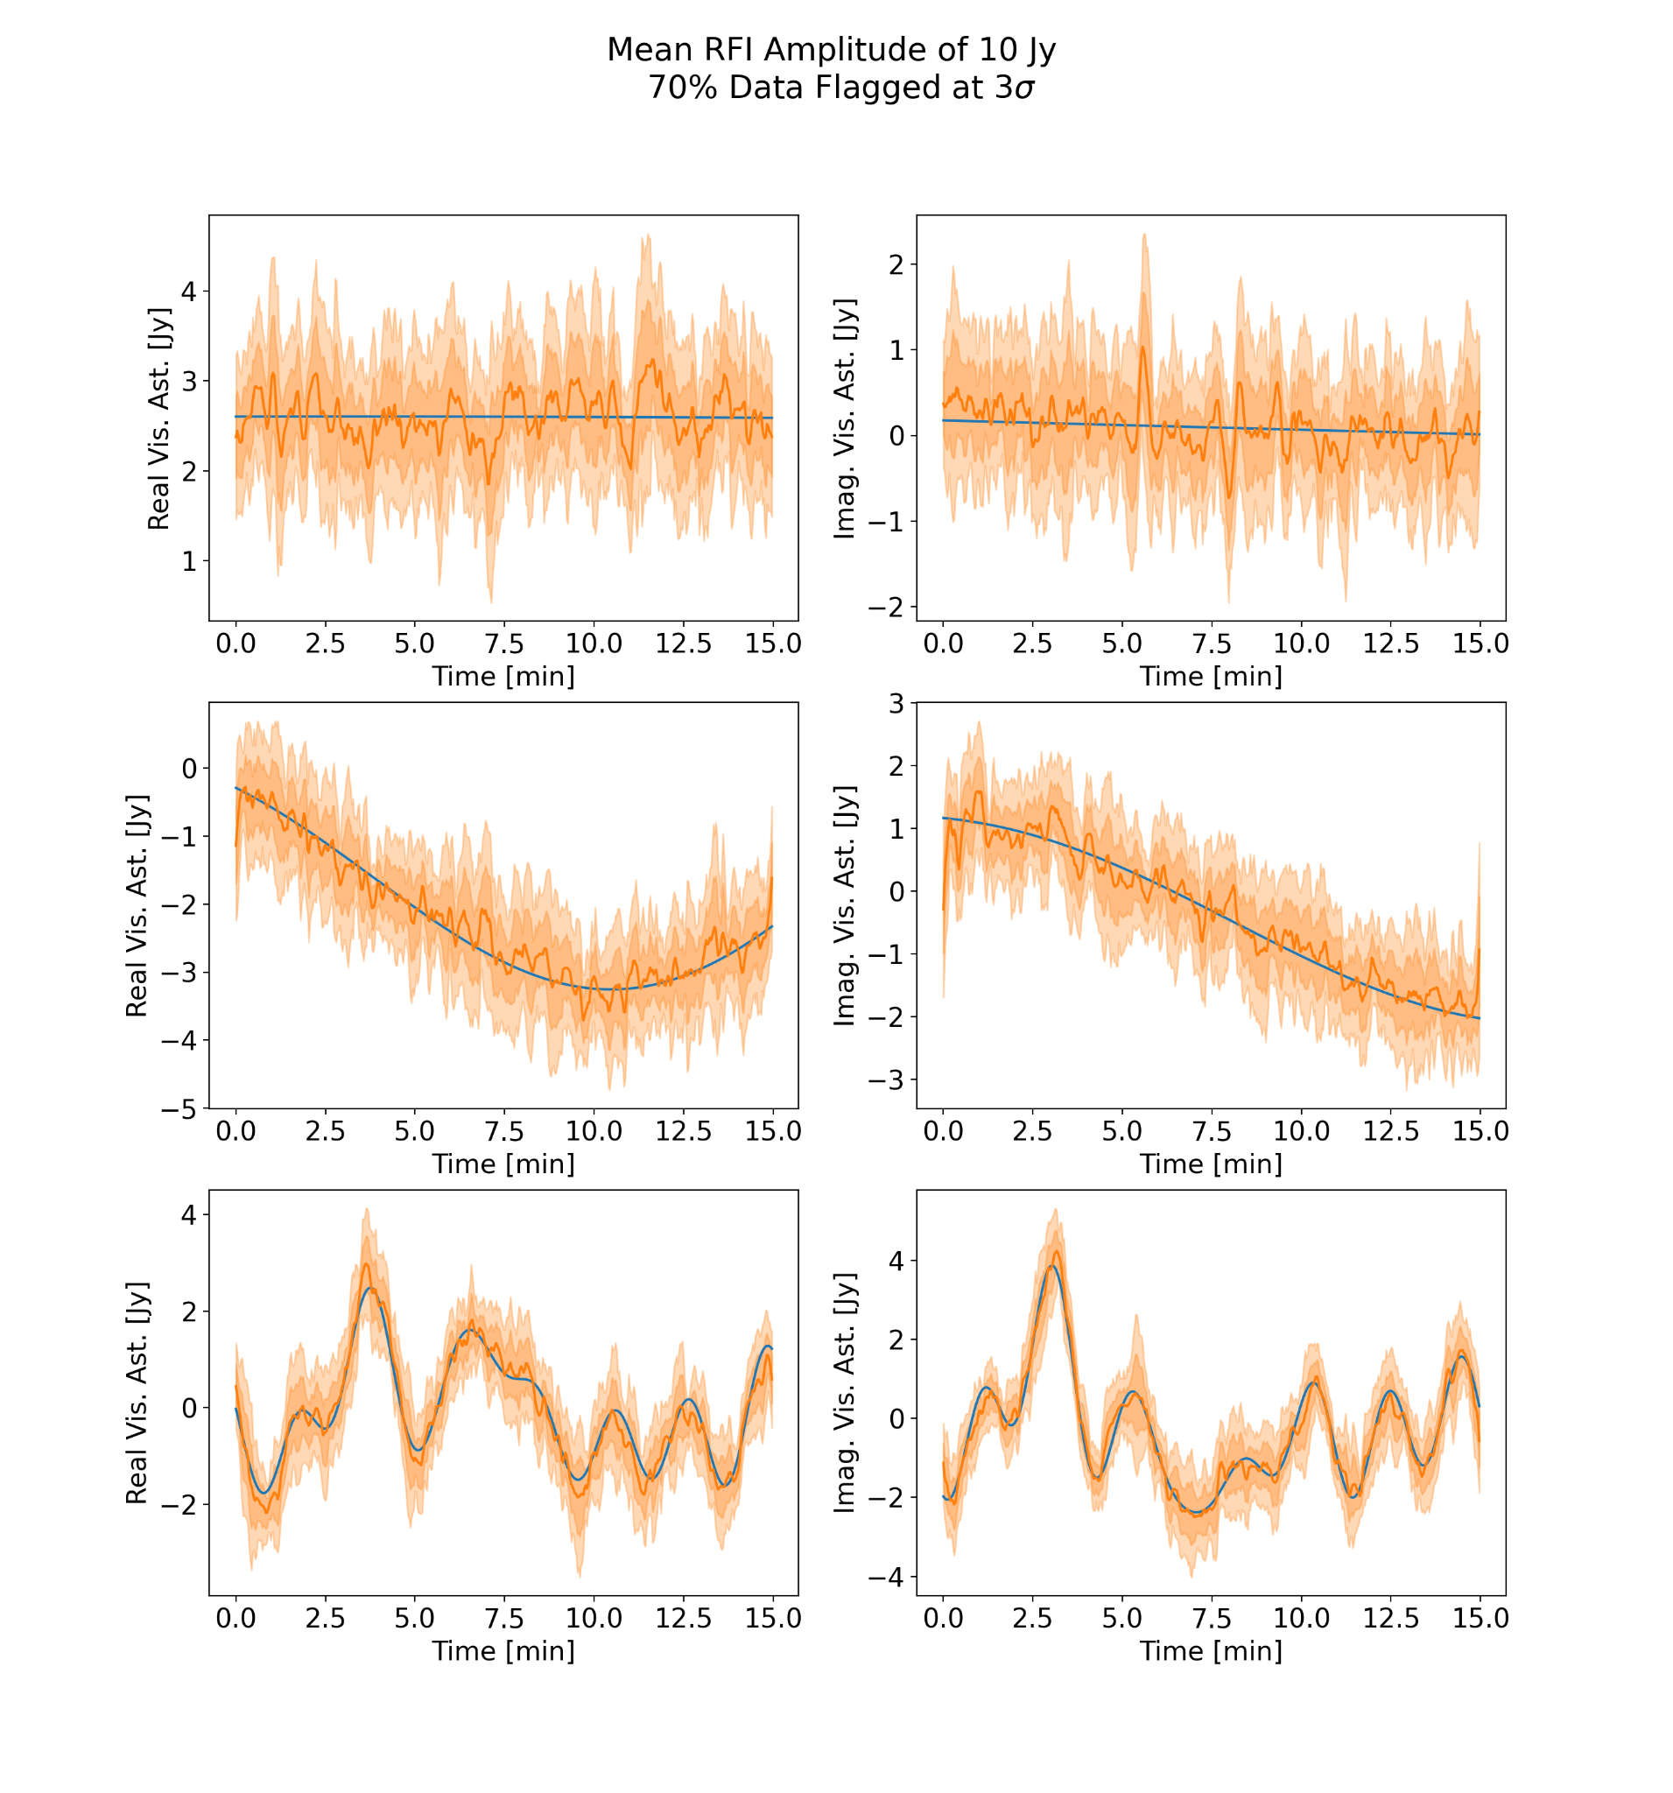
TABASCAL II
(Target Observation)
Use TABASCAL I estimates as a prior for TABASCAL II.
Enforce smoothness by defining Gaussian process covariance.

Slide 11
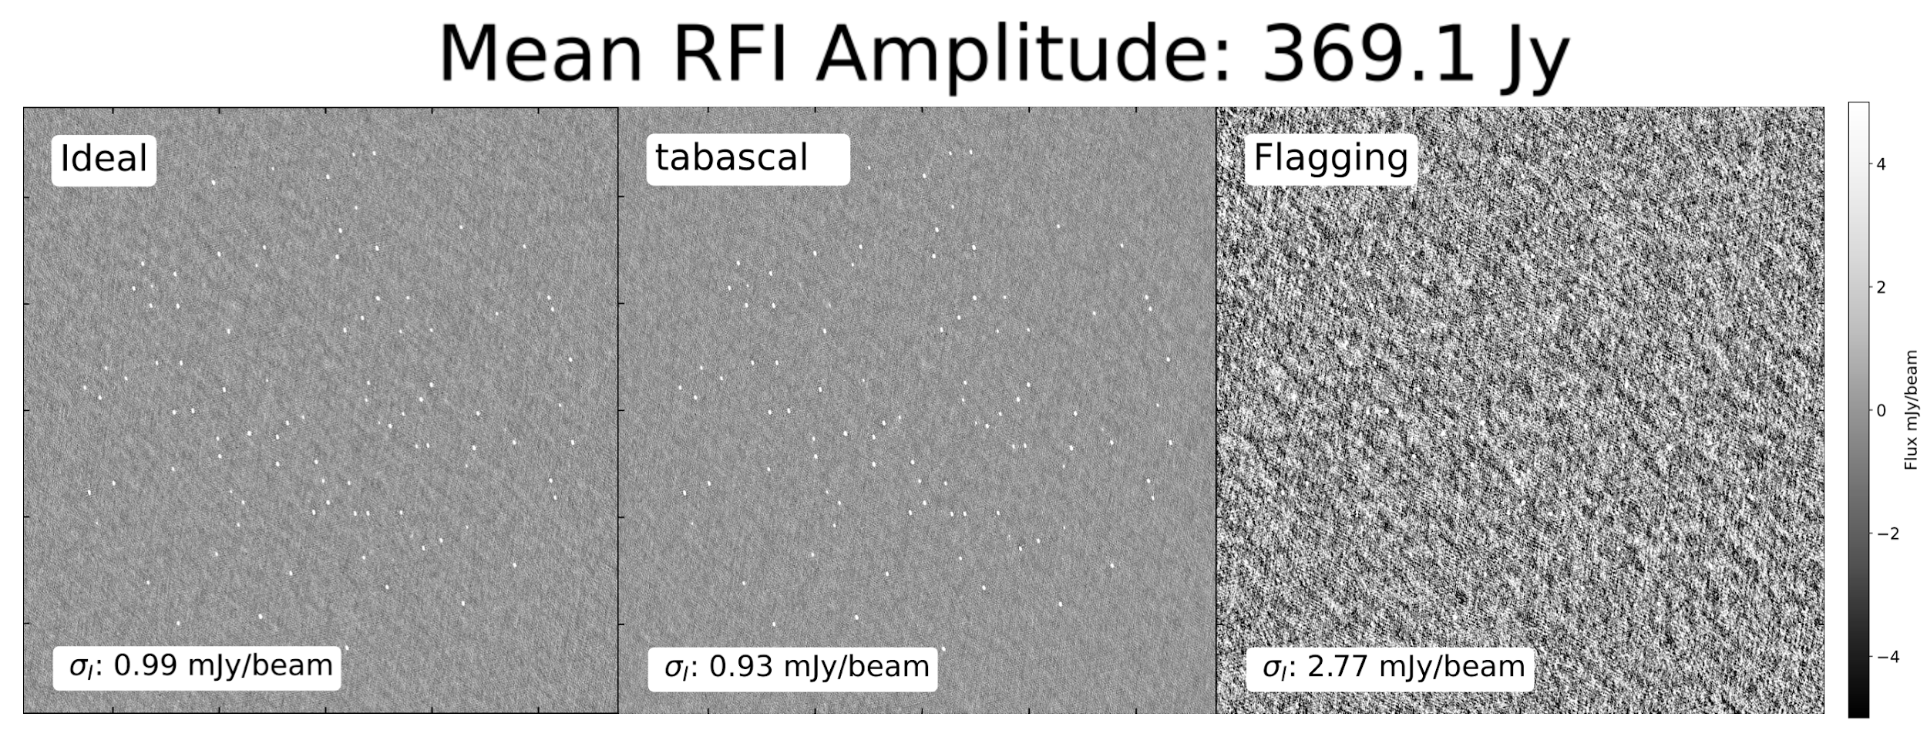
Single Frequency Imaging

Slide 12
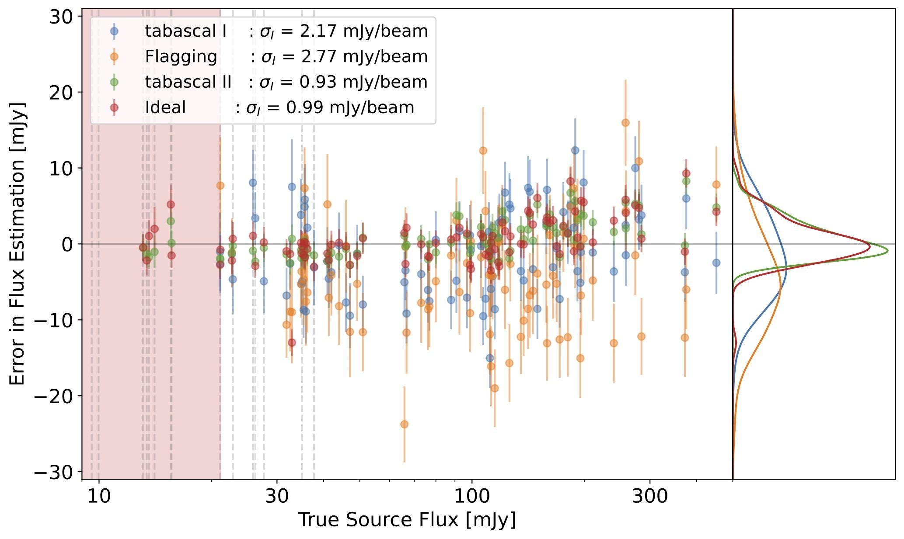
Point Source Recovery

Slide 13
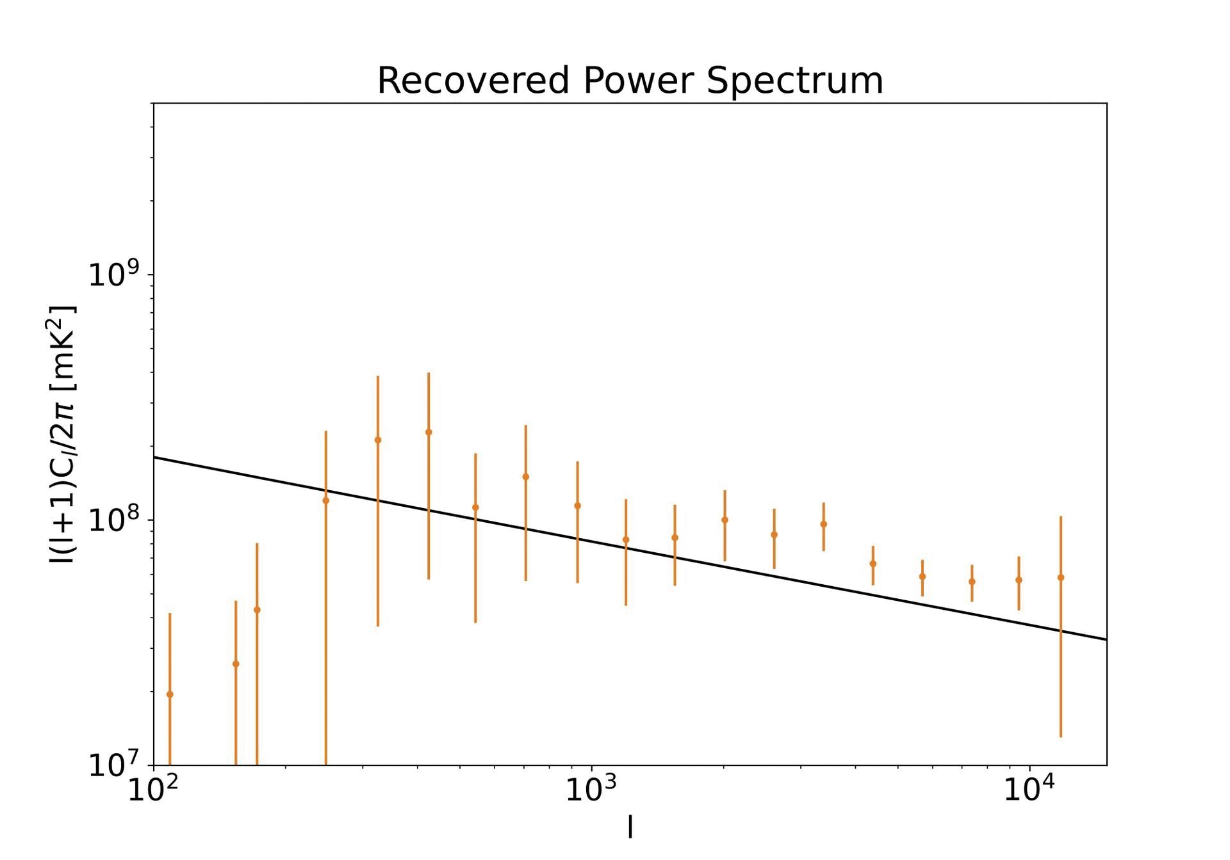
Power Spectrum Recovery
MeerKAT Telescope
Single frequency GPS band
Redshift z = 0.158
80 hours equivalent noise
89 % flagged
1.2 degree FoV

Slide 14
TABASCAL II - Scalable Uncertainty Estimation
Sample the posterior covariance with chosen accuracy/performance trade-off.
TABASCAL uses a combination of autodiff, implicit definition of FIM and MVP, and conjugate gradient.

Slide 15
Future Funding Applications
PASC
Improve the scalability (Up to Tier-0 supercomputers)
Develop a test and benchmark suit
Maybe some imaging things?
Space Sustainability
Test the limits of TABASCAL
Develop auxiliary tools
Calculate a Space Sustainability Rating (SSR) for radio

Slide 16
Conclusion
TABASCAL II can subtract RFI recover astronomical visibilities.
At the expense of more computation
Stronger RFI is possible
Multiple RFI sources are possible
Uncertainty estimates with accuracy/speed trade-off
Ongoing Work
Test the limits of TABASCAL
Testing on real SKA-Low (EDA-2) experimental station data

