Slide 1
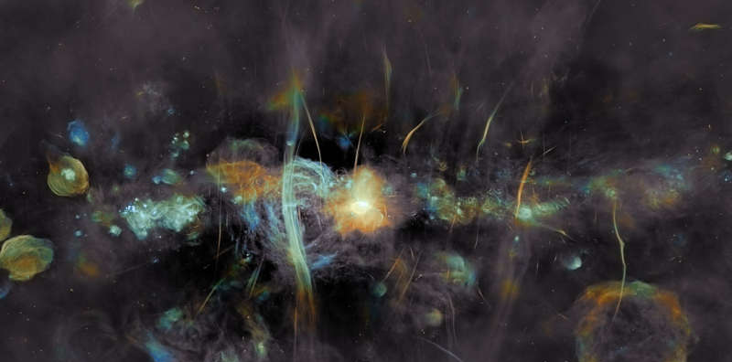

Galactic science with SKAO: the Our Galaxy and Cradle of Life SWGs
Marc Audard (University of Geneva)
Co-chair SWG “Our Galaxy”
SARAO / I. Heywood / J. C. Muñoz-Mateos
Swiss SKA days, 4 September 2024

Slide 2
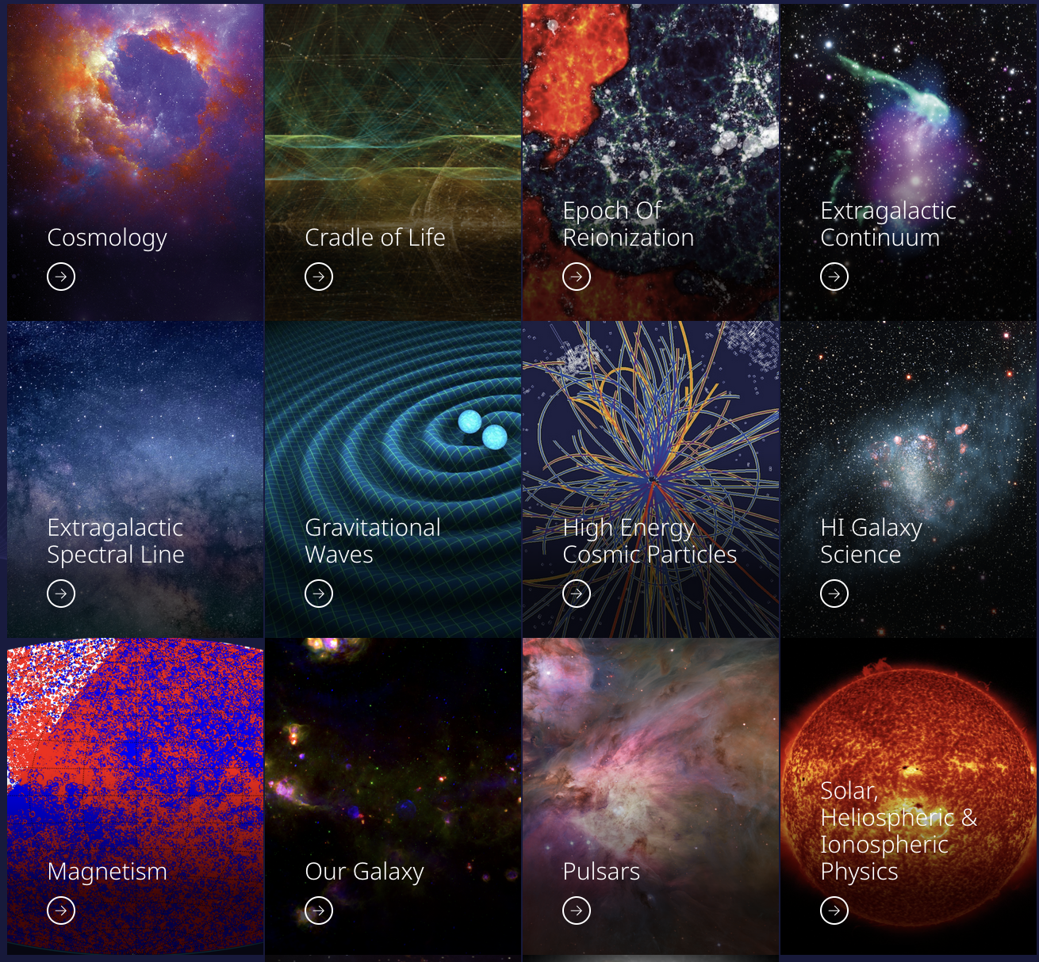
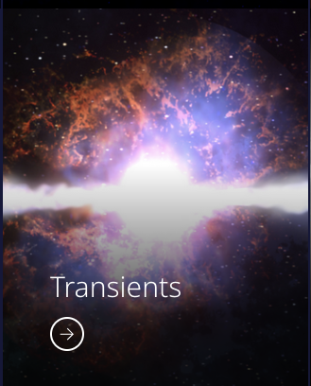
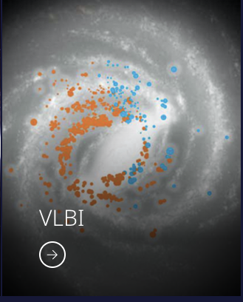
The SKAO Science Working Groups
More than SKAO members, i.e., broader SKAO-interested science broader community
Will not propose KSP projects, but collaborations can help
To join a SWG
Use Google form on the SWG page
https://www.skao.int/en/science-users/science-working-groups
I will focus on these 2 SWGs mainly because of their overlap, especially in star/planet formation

Slide 3
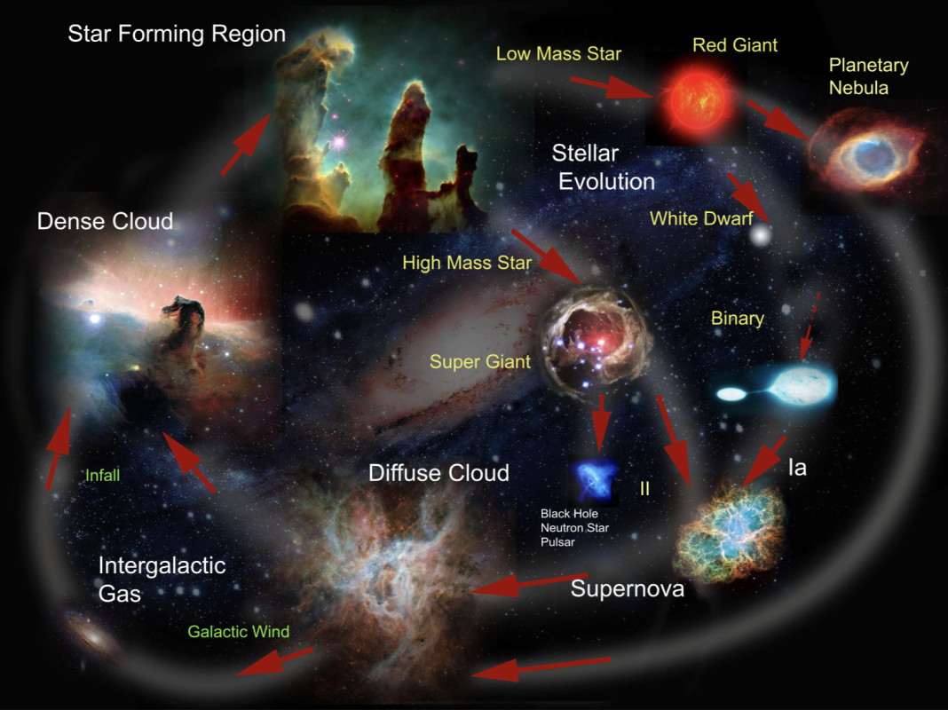
The cycle of matter in our Galaxy
How do stars form, evolve, and die?
What is the role of the interstellar medium?
What is the impact of magnetic fields ?
How do stars interact with their circumstellar matter?
What is the origin of cosmic rays ?
What is the interplay of matter in our Galaxy?
Etc…
adapted from S. Feng’s Ph.D. thesis; DOI: 10.11588/heidok.00018236
https://siyifeng.github.io/teaching.html

Slide 4
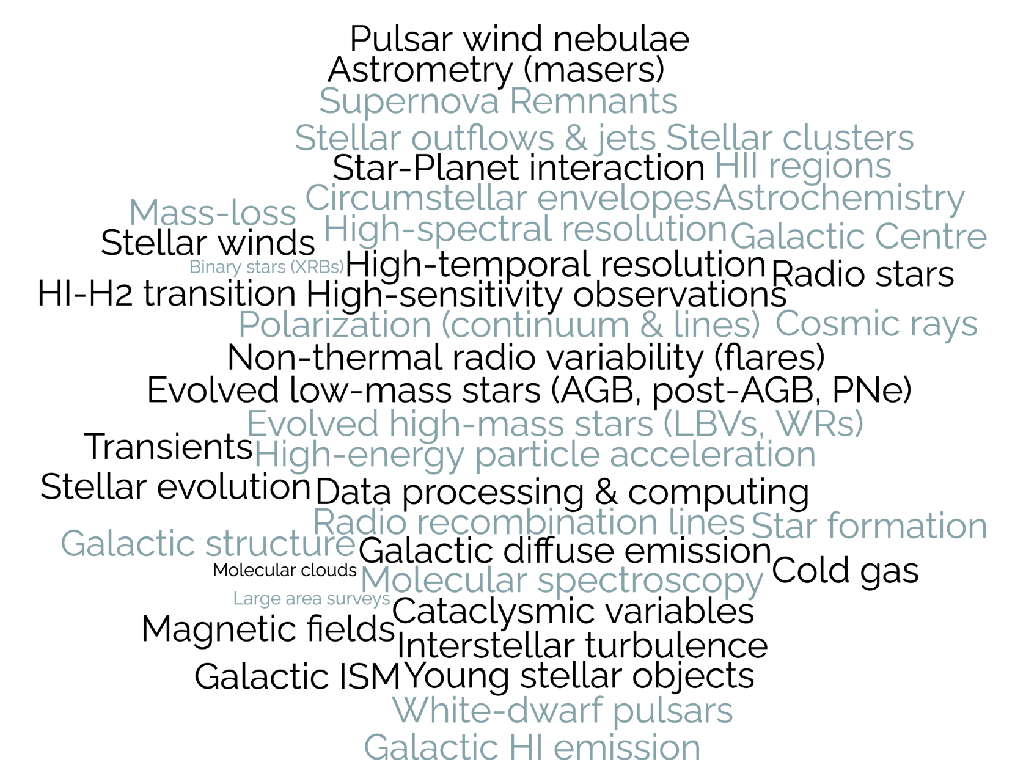
Galactic science for SKAO
From C. Bordiu (2023)

Slide 5
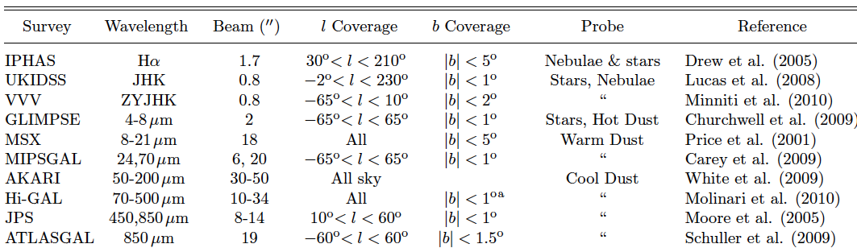
SKAO Galactic Plane Survey
Galactic studies with SKAO will span span scale lengths of 3 orders of magnitude
Complete census of the Galactic sources, and uncover missing objects
A Galactic Plane Survey will provide a high scientific return covering topics of the SKAO SWG “Our Galaxy” and beyond
SKAO provides better sensitivity, sky and frequency coverage, and angular resolution, (see, e.g., Thompson+ 2015; Umana+ 2015), and synergy with other surveys
Possible GPS could be split into narrow spectral and wide continuum surveys
Adapted from Hoare + 2012
See Umana+ 2018
Notes:
From Umana2018:
SKA1_MID-A Generic Survey @ Band 2b (Full BW)
(rms 5μJy/b, 0.8”), ≈8000 hrs, All-sky
SKA1_MID-D Generic Survey @ Band 5 (Full BW)
(rms 6μJy/b, 0.2”), ≈2000 hrs, 480 deg²/GAL

Slide 6
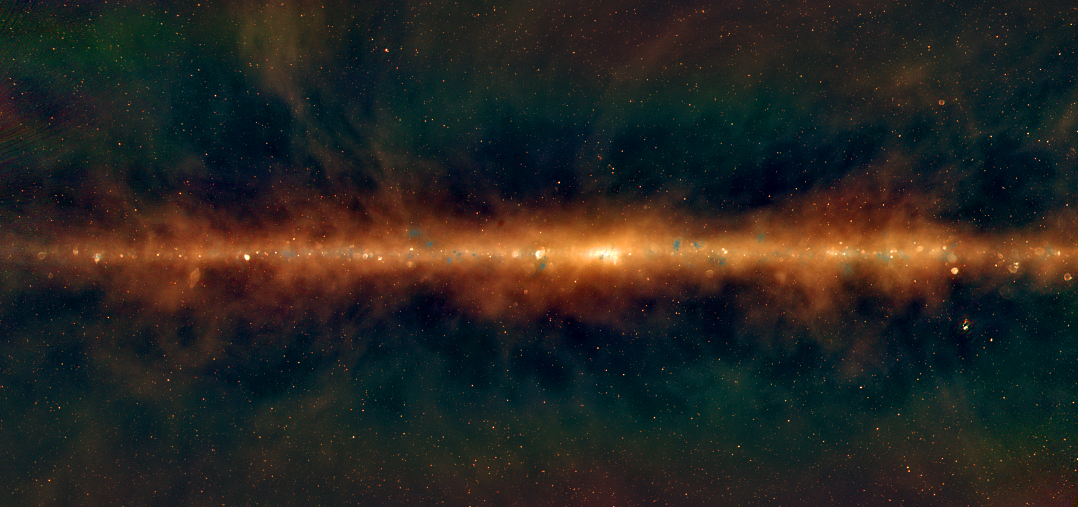
SKAO Galactic Plane Survey
SKA1_MID-A Generic Survey @ Band 2 (Full BW, 0.95-1.76 GHz)
(rms 5μJy/b, 0.8”), ≈8000 hrs, All-sky
SKA1_MID-D Generic Survey @ Band 5ab (Full BW, 4.6-13.8 GHz)
(rms 6μJy/b, 0.2”), ≈2000 hrs, 480 deg²/GAL
Outcome
from KSPs
2015 Meeting
Based on Umana&Rosolwsky 2018
TBD SKA-LOW
MWA map: Hurley-Walker and the GLEAM team
Learn from previous radio surveys (e.g., CORNISH, THOR, GLEAM(-X), SCORPIO, MMB, GLOSTAR, RACS, MMGPS, SMGPS)
These surveys had 2”-20” spatial resolution, 0.1-2 mJy/beam continuum sensitivity, comparable to IR+visible surveys (SMGPS ≈10-20µJy/beam), or limited sky coverage,
SKA1 will have sub-arcsecond angular resolution, large sky coverage, and better sensitivity

Slide 7
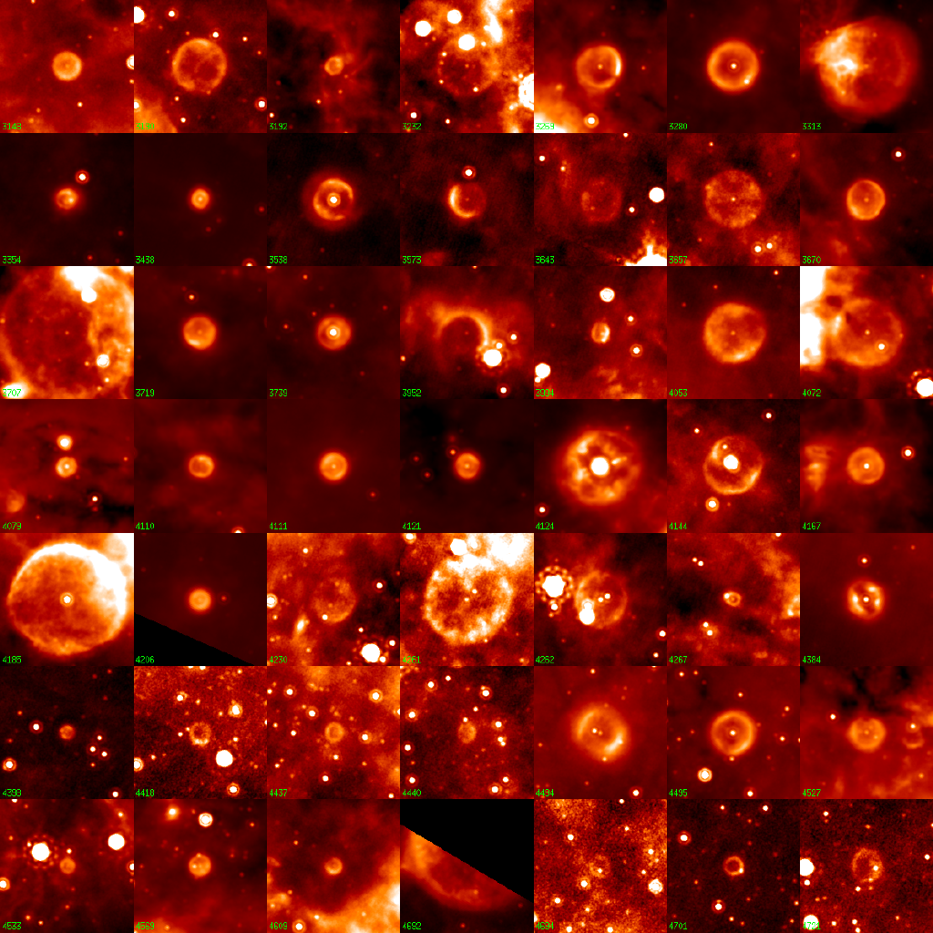
Bubbles in our Galaxy
About 400 “bubbles” found in MIPSGAL (24 µm); Carey et al., 2009, Mizuno et al 2010
Possibly related to late stages of Stellar evolution less than 10% have been identified
Radio observations/IR morphological information to classify the object
  HII vs PN, WR
  HII vs SNR
Radiative recombination lines provide kinematics of ionised gas (Thompson et al. 2015 SKA2014)
Ingallinera et al., 2014; 2016
Bufano et al., 2018
24 μm
Slide from G. Umana & E. Rosolowsky
Credit: Spitzer MIPSGAL Legacy Team

Slide 8
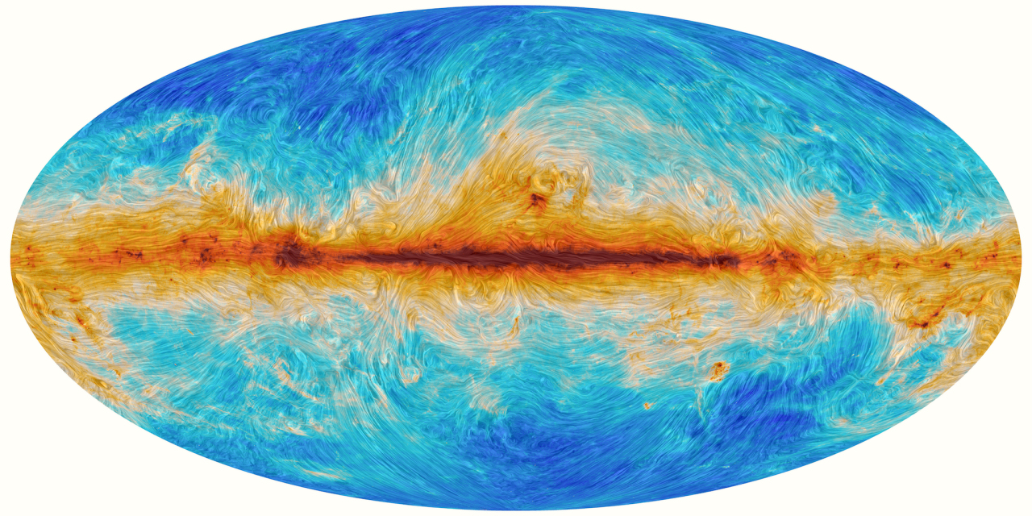
Magnetic fields in star forming regions
SKAO can measure in-situ synchrotron radiation in clouds, generated from cosmic rays penetrating the clouds and gyrating in magnetic fields → unique probe of measuring magnetic fields
Importance for star formation: ambipolar diffusion (strong B) vs turbulence (weak B)
Zeem splitting of HI, OH, and CN → only B_{los} (Crutcher 2012) and polarisation through dust emission, Goldreich-Kylafis or Faraday effects are difficult/weak
Emissivity j_{ν} ~ B², and B ~ n_{H}^{0.6} (Strong et al. 2015) →B ~n_{H}
Flux densities at 1 GHz ≈0.05-10 mJy (Dickinson et al. 2015)
Done by MeerKat (SgrB; Yusef-Zadeh et al. 2024)
Padovani & Galli (2018+2020): Synchrotron in dense cores at low freq!
See Dickinson et al. (2015), SKA 2014
Notes:
The GK effect predicts that, under special conditions, the spectral lines emitted by interstellar molecules should be linearly polarized and the linear polarization vector should reveal the magnetic field direction in the molecular cloud.
If the magnetic sublevels of the J=1 level are equally populated, as it is usually the case, then the line is unpolarized. However, if the magnetic sublevels are unequally populated, then the line is polarized. Goldreich & Kylafis (1981)^{[2]} showed that, if the radiation field (their own plus external) in which the molecules are embedded is anisotropic, then the magnetic sublevels are unequally populated.
his is however not the case as some specific conditions are required for detection. These are that the line optical depth of the molecular cloud should be of order unity and that the radiative rates should be comparable to or larger than the collisional rates.

Slide 9
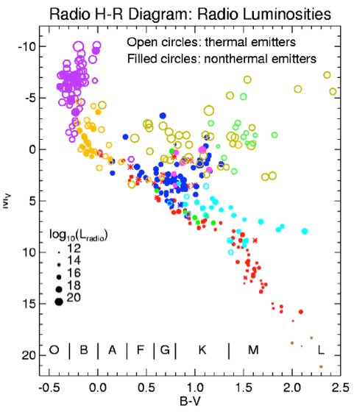
The radio HR diagram
Currently few hundreds detected in radio
Radio probes astrophysical phenomena not detectable by other means:
B field & topology in flare stars, RS CVn binaries
HII region in dust enshrouded sources
Wind-wind interactions
Stellar magnetospheres
Planetary nebulae shaping by jets?
SKA will address current problems of limited sensitivity & selection bias, see Umana+2015
Slide from G. Umana & E. Rosolowsky 2018
Güdel 2002

Slide 10
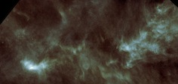
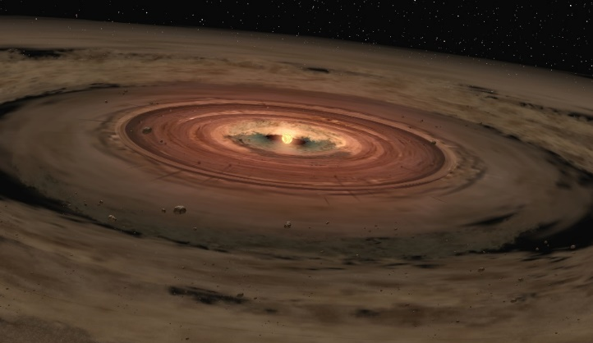
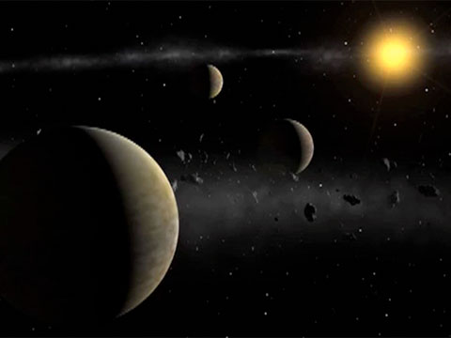
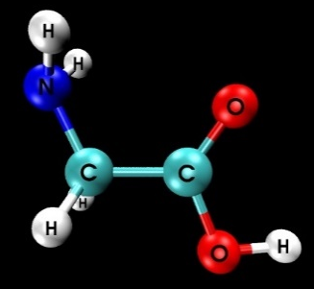
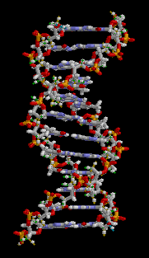
From stars to planets
Molecular clouds
(Pre-stellar Cores)
Planetary systems
Protoplanetary disks
35 mas x 40 mas beam
Complex Organics (COMs)
From SKAO CoL SWG

Slide 11
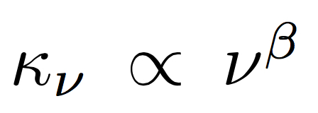
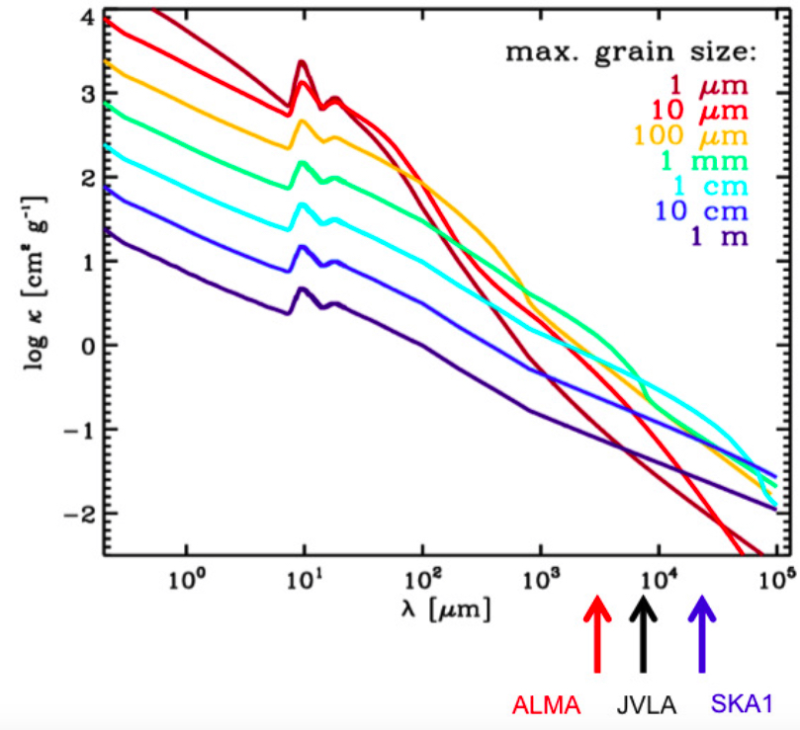
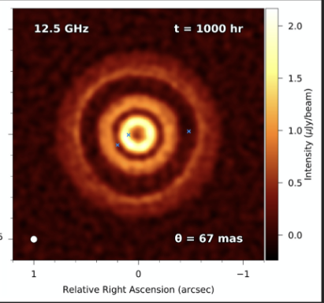
Dust emission in disks
→ measure strength and spectral index
Hoare et al. 2015
Intermediate to high optical depths at mm
ALMA 1.3 mm
@12 GHz
DSHARP (Andrews+ 2018)
matching beams of
40 mas≈4 au radius of
snow line at 100pc
SKAO probes cm-sized dust and will allow measurement of beta across disks

Slide 12
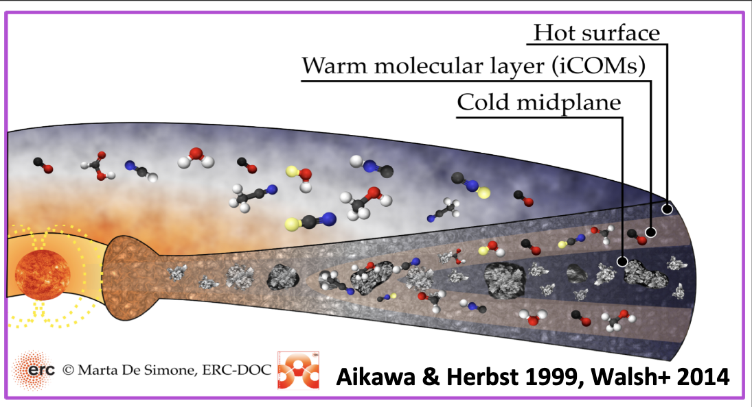
Astrochemistry
Hot surface layer → PDR chemistry
Warm layer → COMs (could be
Cold midplane → freeze-out
Hot corinos in protostars → rich COM vs warm C-chain → poor COM
Ideal for SKA band 5 frequencies
Ceccarelli et al. 2004, 2022, etc.. Codella et al. 2015 (SKA I book)
See S. Wampfler’s talk

Slide 13


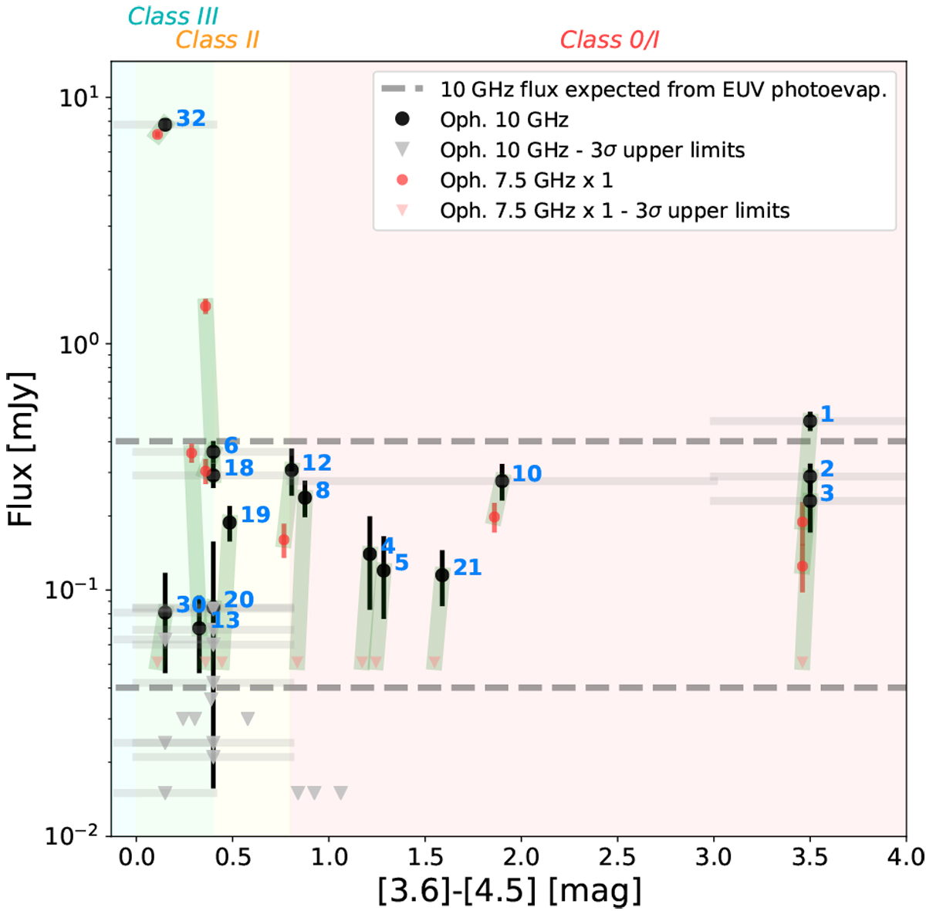
Protoplanetary disk photoevaporation
Disentangling free-free from thermal dust emission
Radio emission from EUV or X-rays:
See Coutens et al. (2019)
Typical photoevaporation models required EUV flux 10⁴¹-10⁴² s⁻¹ to disperse disks
Observations in Oph A cluster show EUV as possible dispersal mechanism in detected objects (but not in non-detected); X-ray photoevaporation not excluded
SKAO’s large FOV and spatial resolution will allow us to cover many sources simultaneously and to separate the contribution from jets/disk
SKAO to potentially detect H recombination lines as well
10⁴² s⁻¹
10⁴¹ s⁻¹

Slide 14
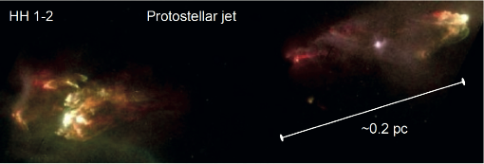
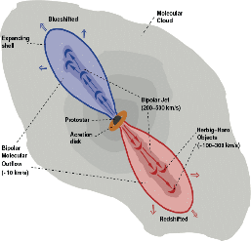
Probing the ionised jets in young stars
Jets detected over large luminosity spectrum
Velocities up to several 100 km/s
Dynamical time scales of months to years
Weak mJy emission
Radio (SKA!) emission traces base emission of collimated, ionized jet
Anglada+ 2015 (SKA I)

Slide 15
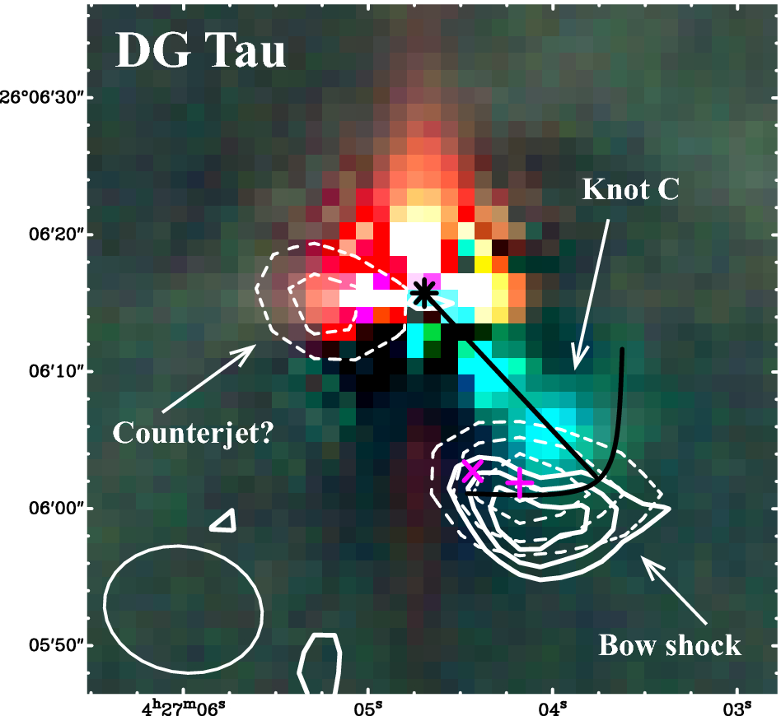
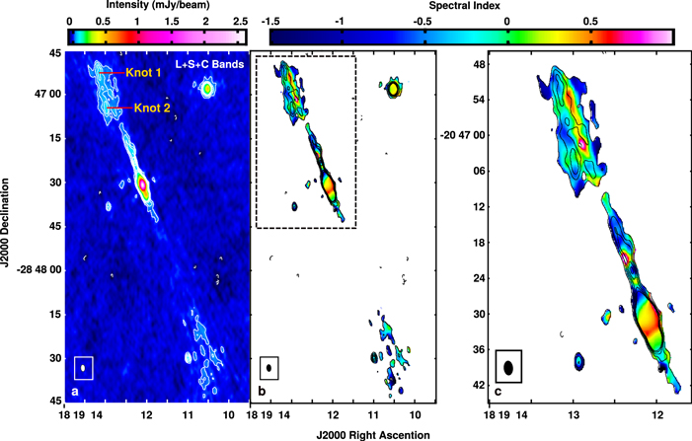
Measuring magnetic fields in jets
GMRT image at 325 MHz (dashed contours) and 610 MHz (solid contours) overlaid on a composite RGB image (I, H𝛼 and [SII]) of the DG Tau jet.
Mostly free-free thermal emission from partially ionized material (Anglada et al. 2018; Reynolds 1986):
non-thermal
thermal
Anglada et al. (2018) and Ainsworth et al. (2014)
Rodríguez-Kamenetzky et al. (2017)
However additional non-thermal emission in knots also detected (negative spectral indices)
Synchrotron emission & polarization (Curiel et al. 1993; Carrasco-Gonzalez et al. 2010)
Direct measurement of magnetic field with SKA

Slide 16
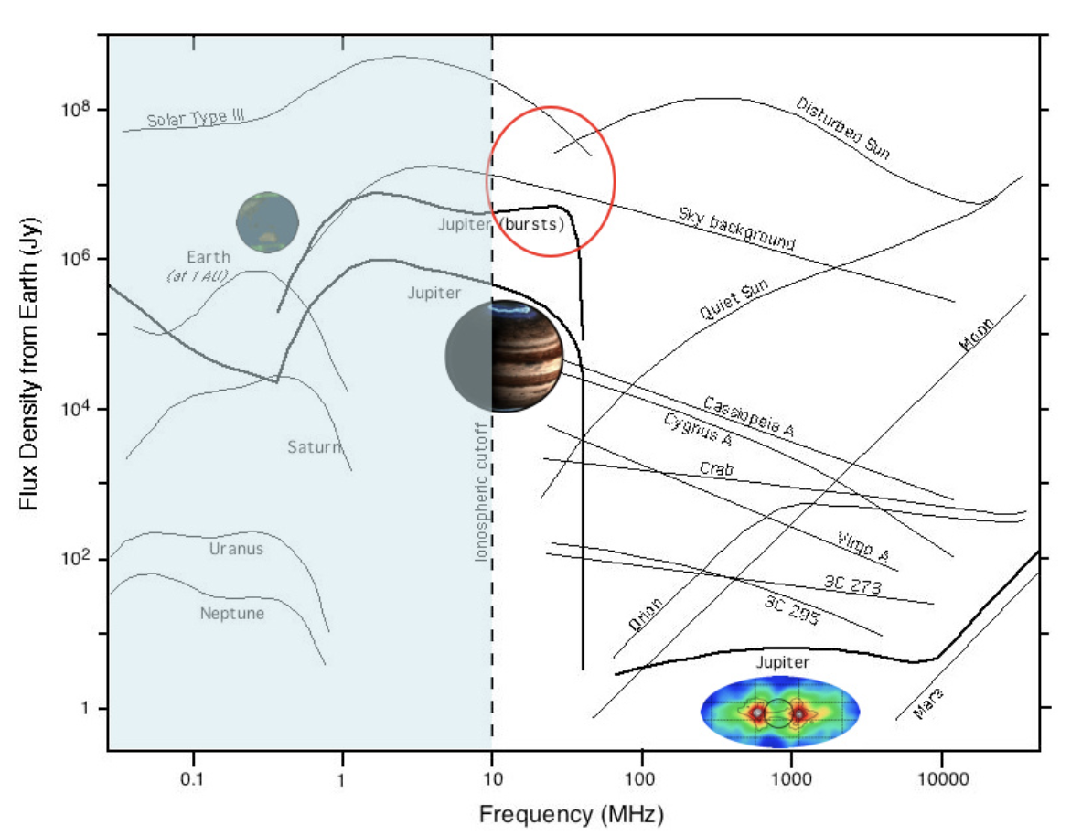
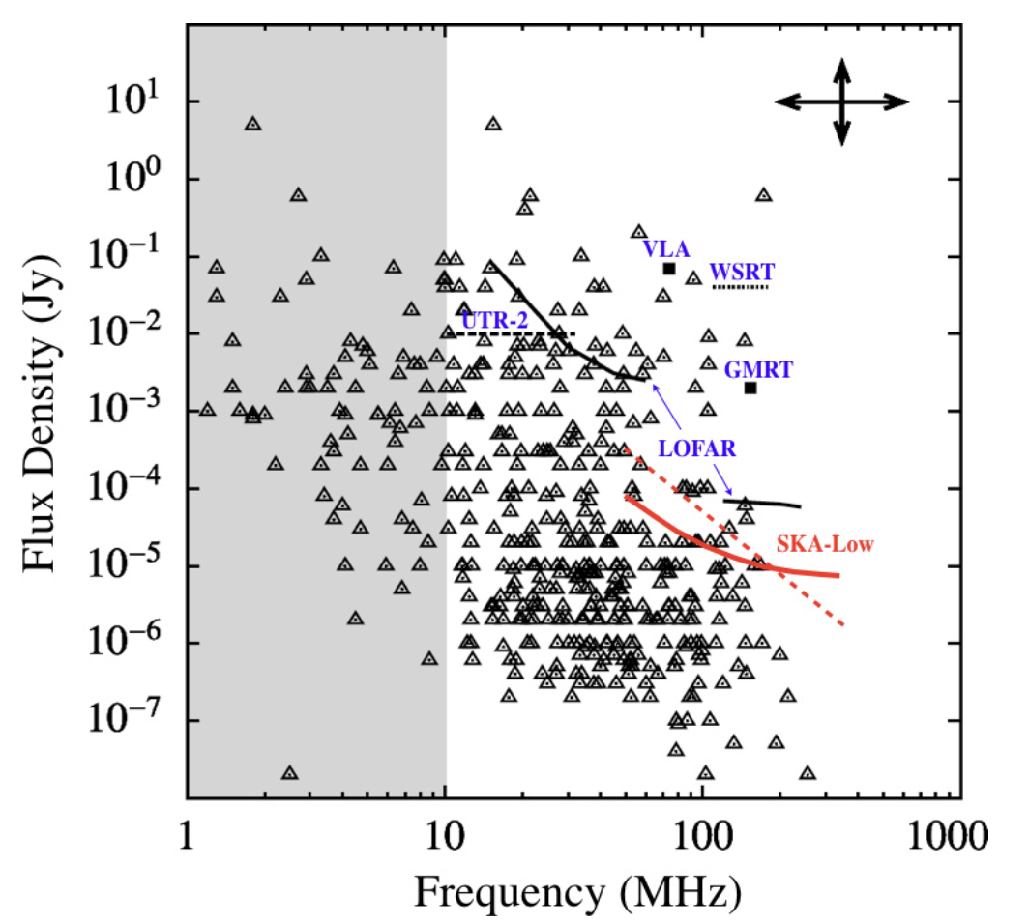
Exoplanetary aurorae
Intense, coherent, circularly polarised emission
Predicted
Jupiter bursts
Exo-magnetospheric physics
Rotation/orbit inclination
From Zarka+ 2015 (SKA I)
Detection up to several pc

Slide 17
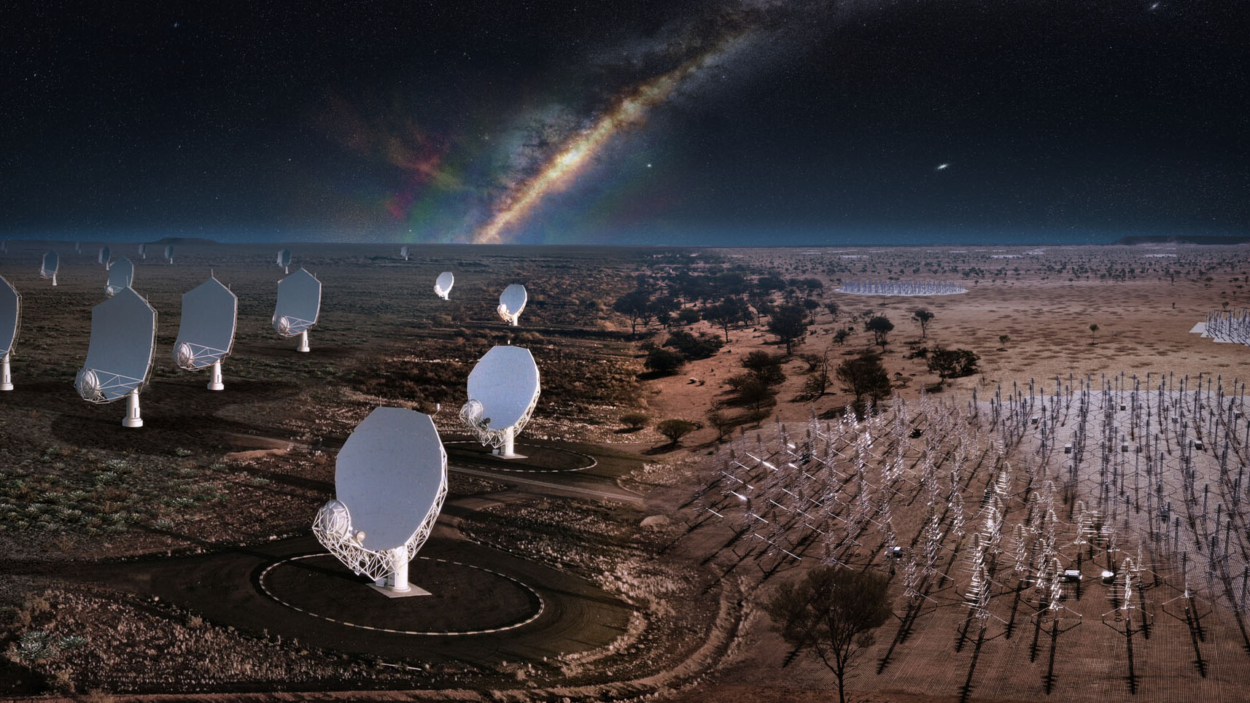
Conclusions
SKAO will contribute to many different science topics in Galactic science
Revisit the 2014 SKA “book” (Advancing Astrophysics with the Square Kilometre Array)
Call was made through the SKAO Science Working Groups and outside (Anna’s talk)
https://www.skao.int/en/science-users/557/advancing-astrophysics-ii-preparing-science-skao
Deadline is September 30
Join SKAO Science Working Groups
And go to Görlitz in June 2025 for the SKAO General Science Meeting

Slide 18


