Slide 1
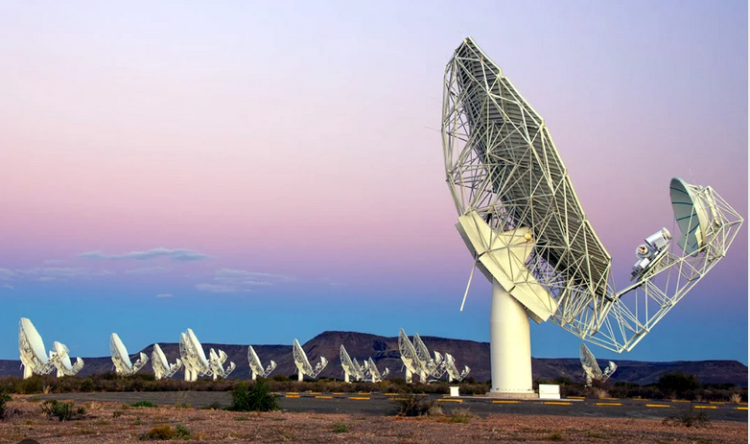
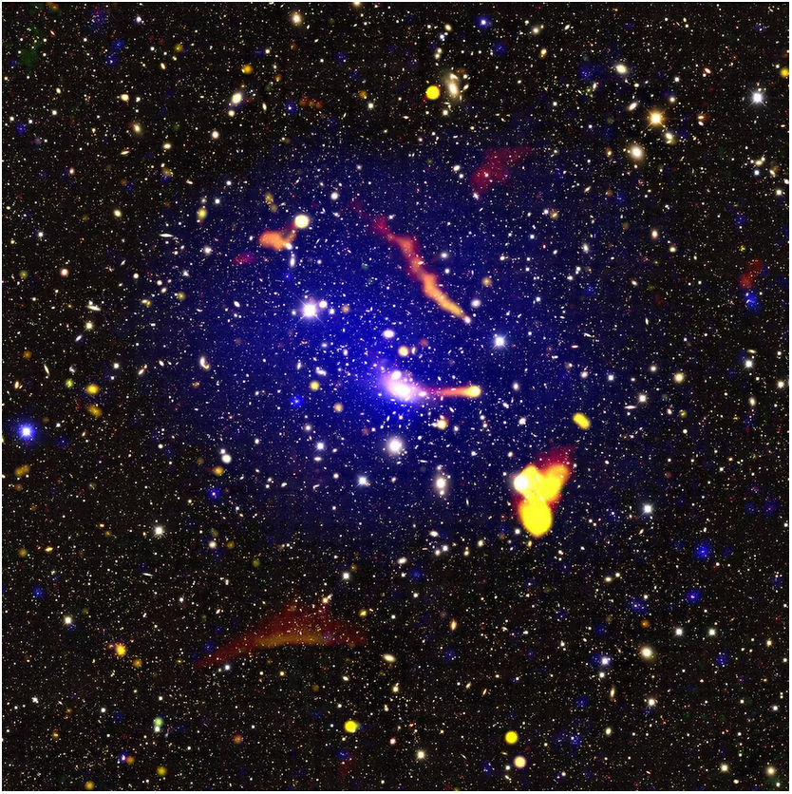
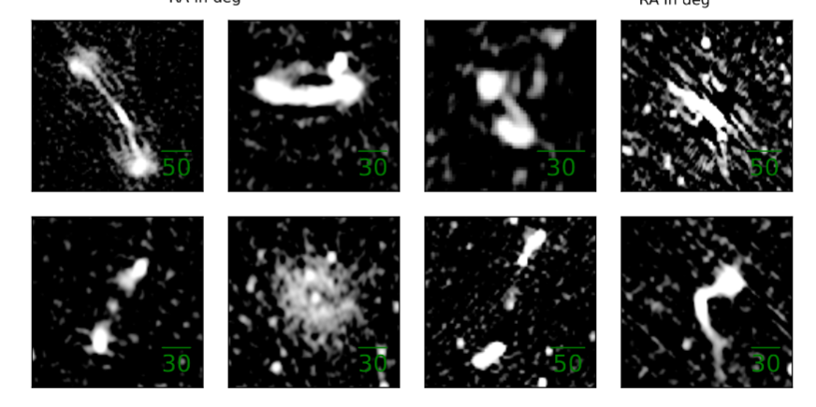
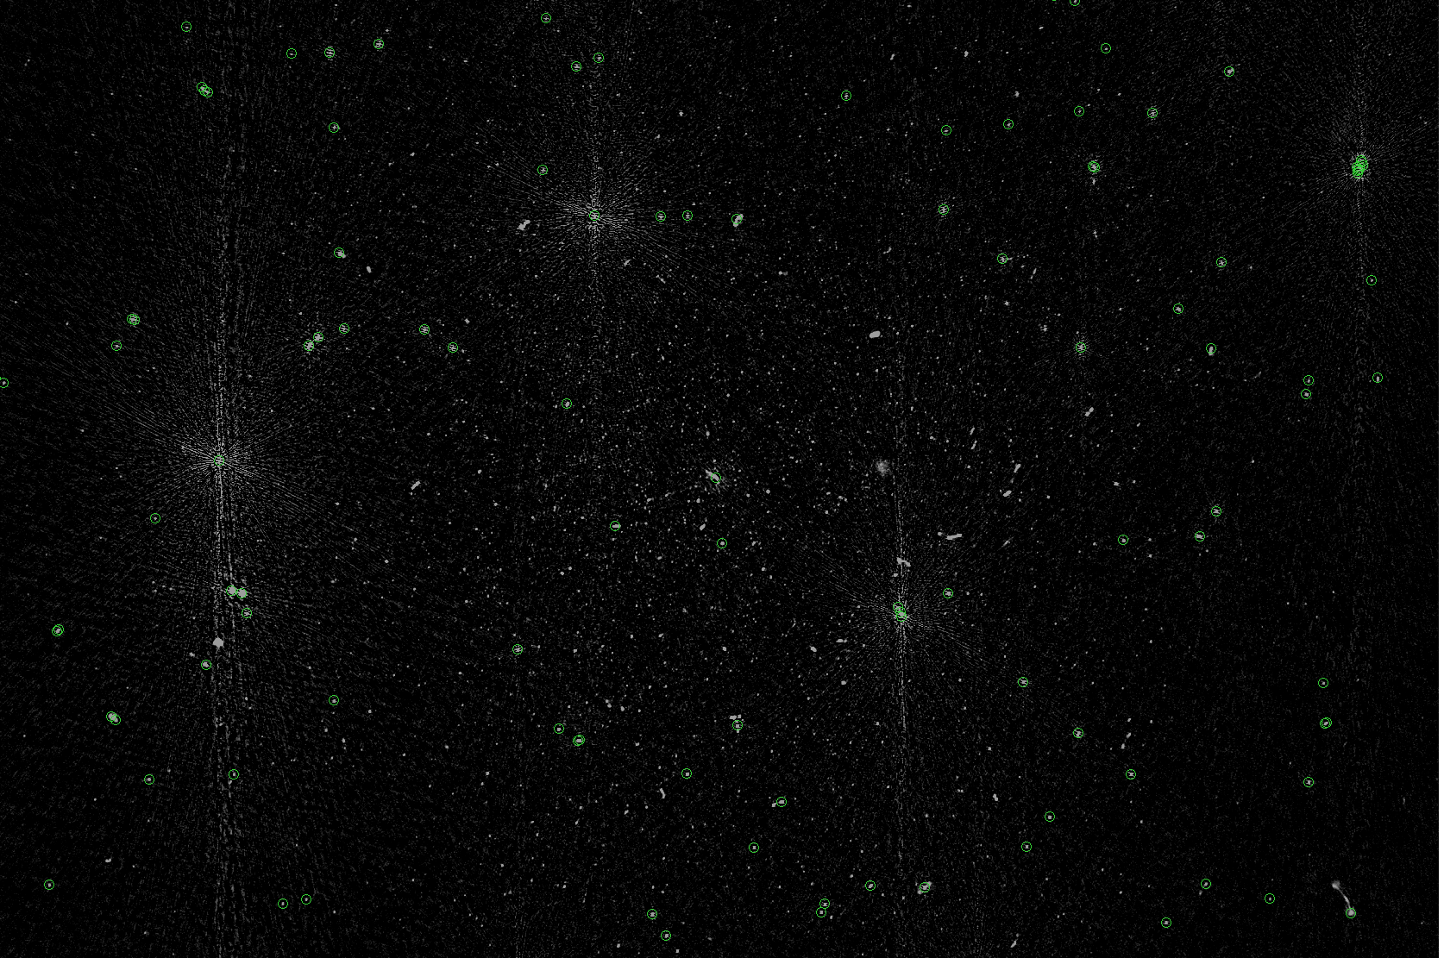
ABELL 2631 MeerKAT Deep source catalog with source counts
Robert Kincaid
Notes:
Today i will be talking about the radio catalog produced by meerkat observations of the A2631 galaxy cluster and the derivation of the radio source counts + corrections.

Slide 2
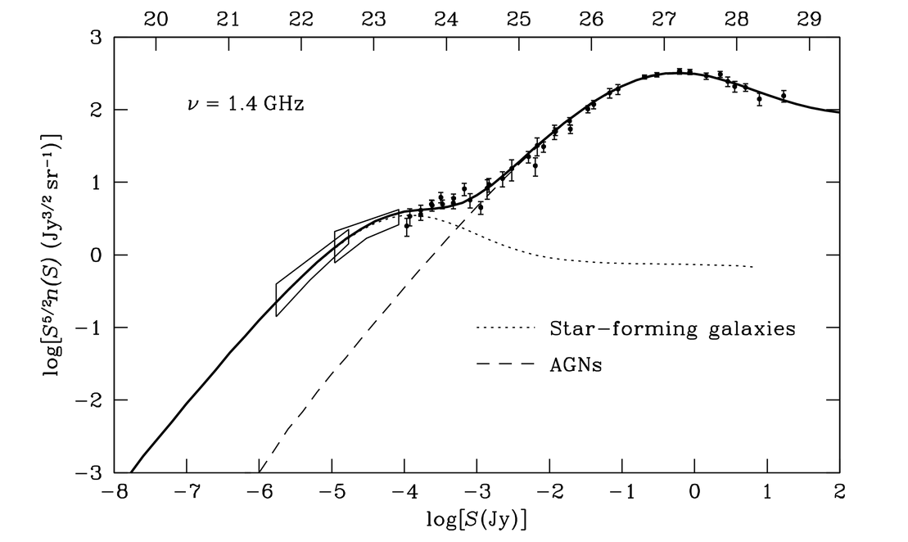
Radio source counts
Curve produced by counts of radio sources per unit area as a function of flux density were one of the earliest cosmological probes.
These curves can tell us the relative populations of galaxy types and cosmological evolution from the luminosity function.
Inflection point ~ 1mJy signalling the emergence of a new population of galaxies.
There is no census on the relative galaxy populations on this faint sub mJy regime where counts show a turn up.
Turn up indicates an increasing dominance of star forming galaxies over AGN at lower lumosities.
Sub mJy inflection point
peak
non-Monotonic decrease
Starburst?
Radio quiet AGN?
Euclidean and static Universe
non-Euclidean and evolving Universe
Spirals?
Constant Comoving source density - > non-evolving sources
Changing comoving source density
Notes:
Curve in general is a superposition of AGN and star forming galaxies. The faint end is of most interest as the relative populations here are not known.

Slide 3
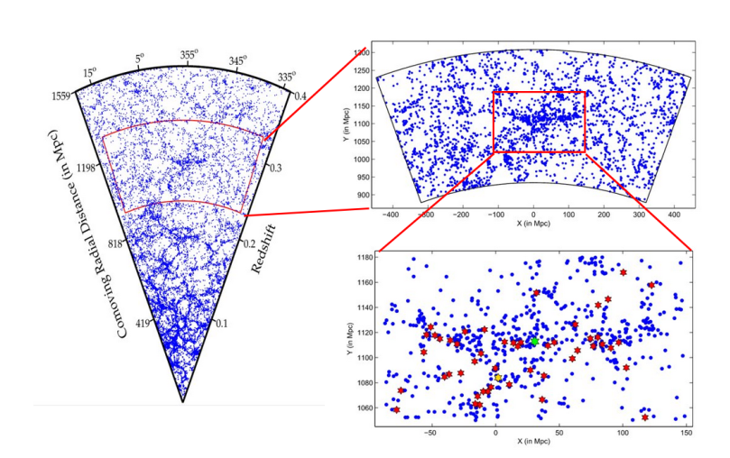
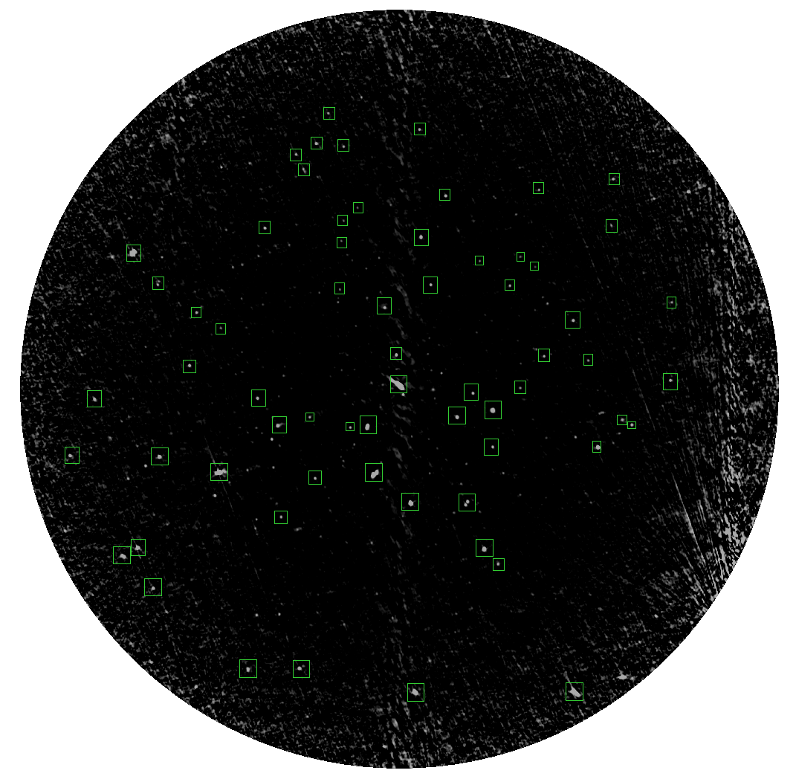
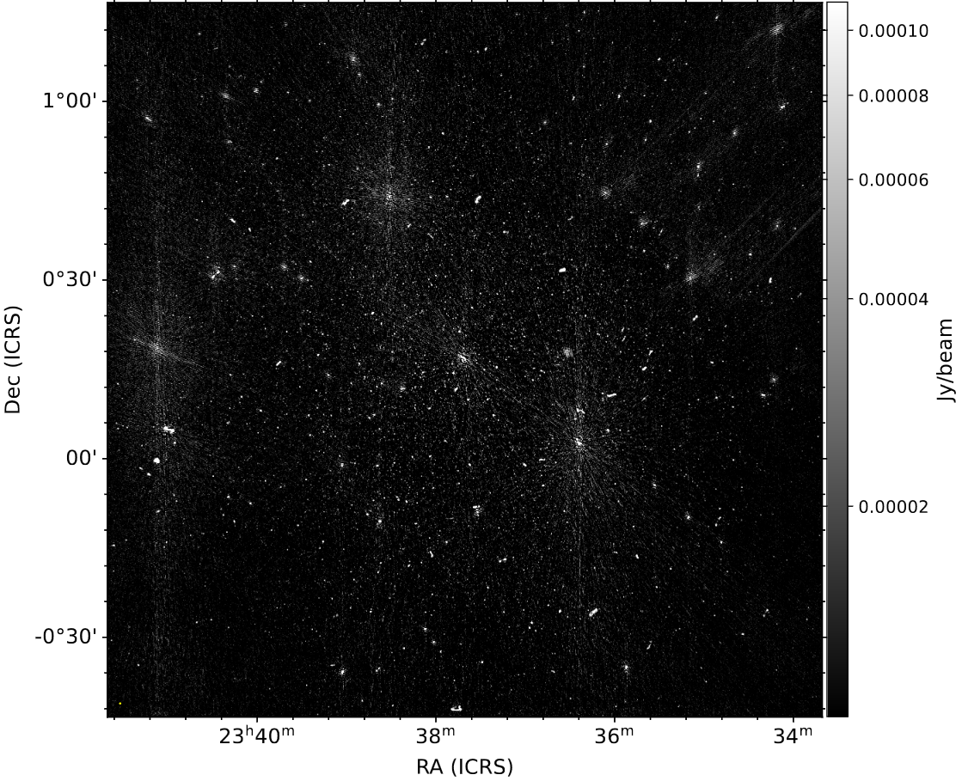
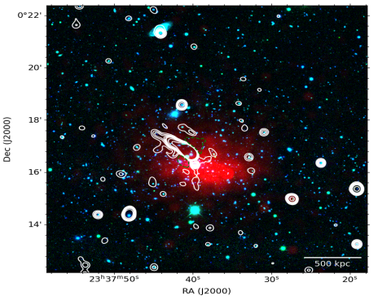
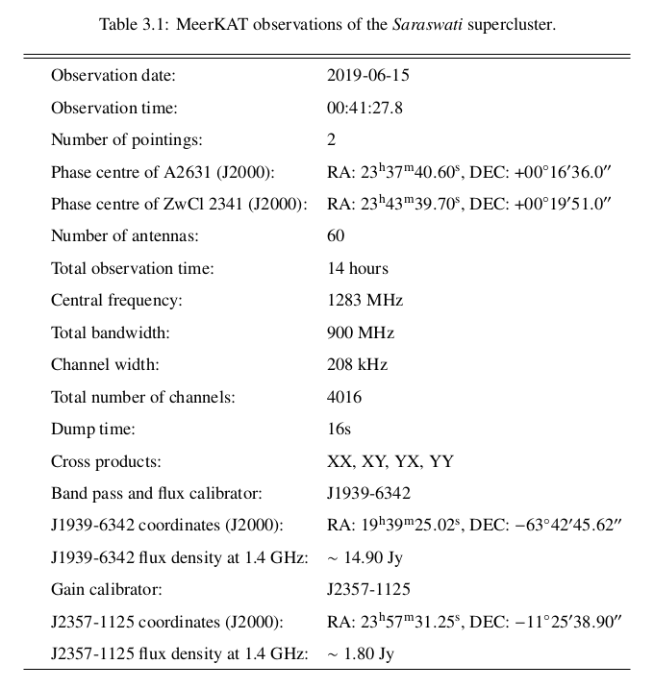
MeerKAT observation of A2631
8 hour observations (4096 channels, 16s int time) of Abell 2631, the largest galaxy cluster residing in the core of the saraswati supercluster (z~0.27).
Resolution of about 8’’ with sensitivity down to 0.01 mJy.
Sample of ~ 3000 radio sources with flux density 15uJy to 10mJy on pb cut image. (Image cut where pb response < 50-60%).
A2631 scenario unclear. Contains bright AGN and disturbed X-ray morphology -> merging galaxy cluster?
One of the most significant density enhancements found at medium-to-high redshifts (z ~ 0.27, universe ~ 10 billion years old).
Is similar to the well-known Shapley and Virgo superclusters.
Primary beam cut ~ 1deg^2

Slide 4
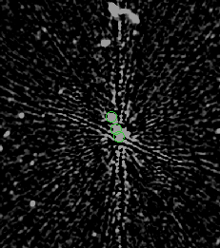
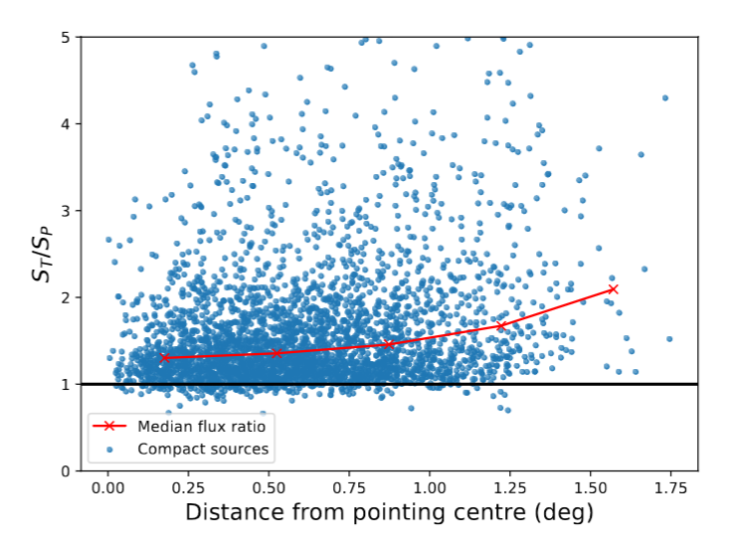
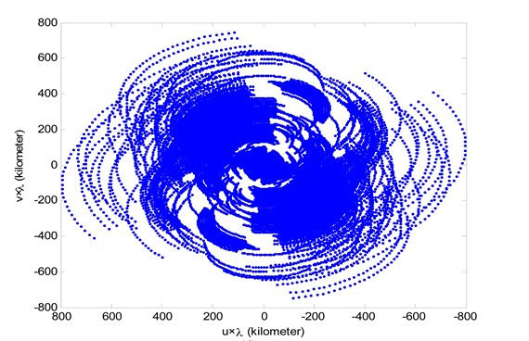
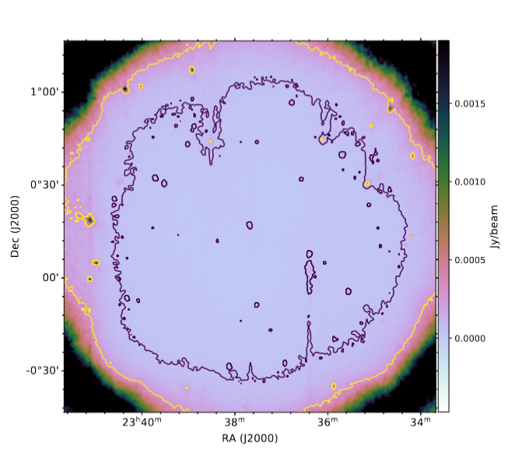
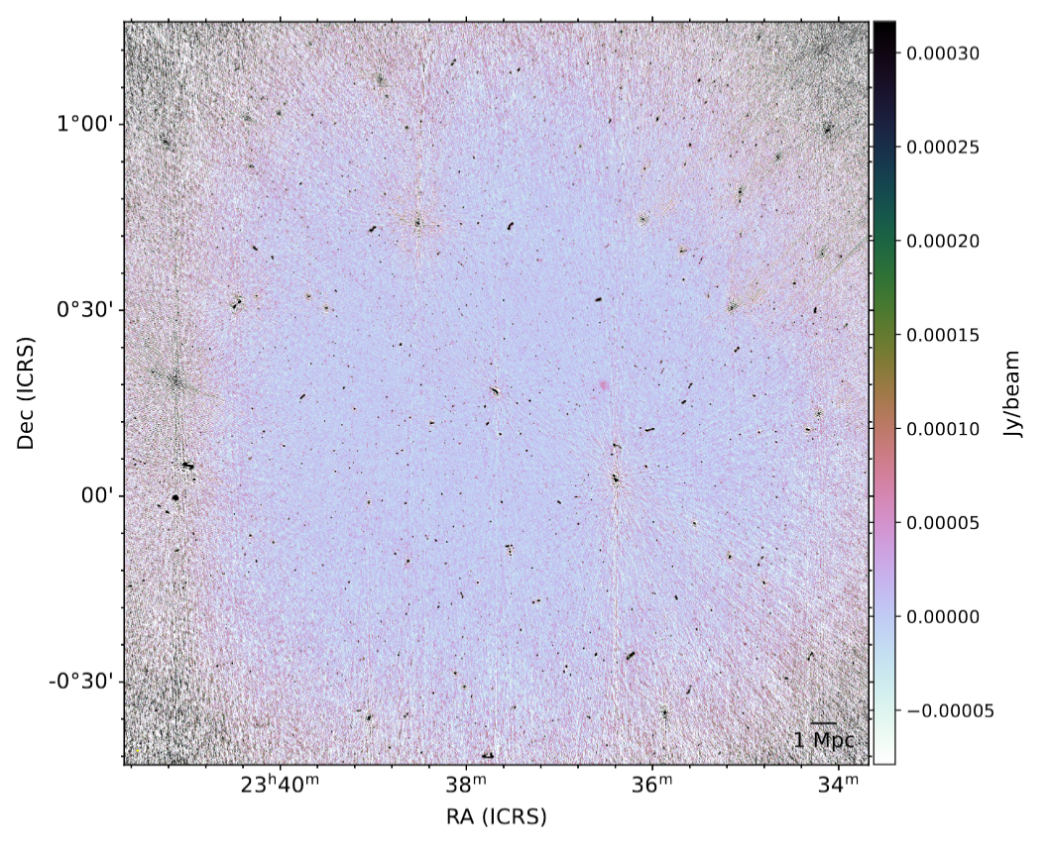
Correcting for the biases introduced from observations
Correction effects
Noise bias
Address the biases introduced from the observation and cataloging process.
Incompleteness results from varying rms levels due to the primary beam and uneven noise distribution.
For correcting incompleteness we need to perform simulations with real source size and flux distribution injected on a residual noise map.
In addition to incompleteness we have various other errors that must be accounted for.
Resolution bias: Preferential non-detection of large sources.
Resolved extended sources can more easily fall below peak threshold while integrated flux does not.
Smearing: Finite bandwidth causes sources further from phase centre to be “smeared”.
Cosmic variance cosmological in origin (non-poisson).
Resolution bias
False detection rate
smearing
Cosmic variance
calibration artifacts
Smearing
Noise inhomogeneity
Notes:
Nature of dark matter coupled with intense inflation caused smaller structures to form first that aggregate over time through merging to form larger structures.
Majority mass components are the filaments whereas majority volume components are the voids.
Left: every node is a merger, largest are superclusters. Others are galaxy clusters, galaxy groups, etc Right: Snapshots of LLS formation.
Small structures first, larger ones later -> superclusters are very young compared to the structures in which they host
CDM travel slow compared to c, cannot escape fluctuations, seeds develop early

Slide 5
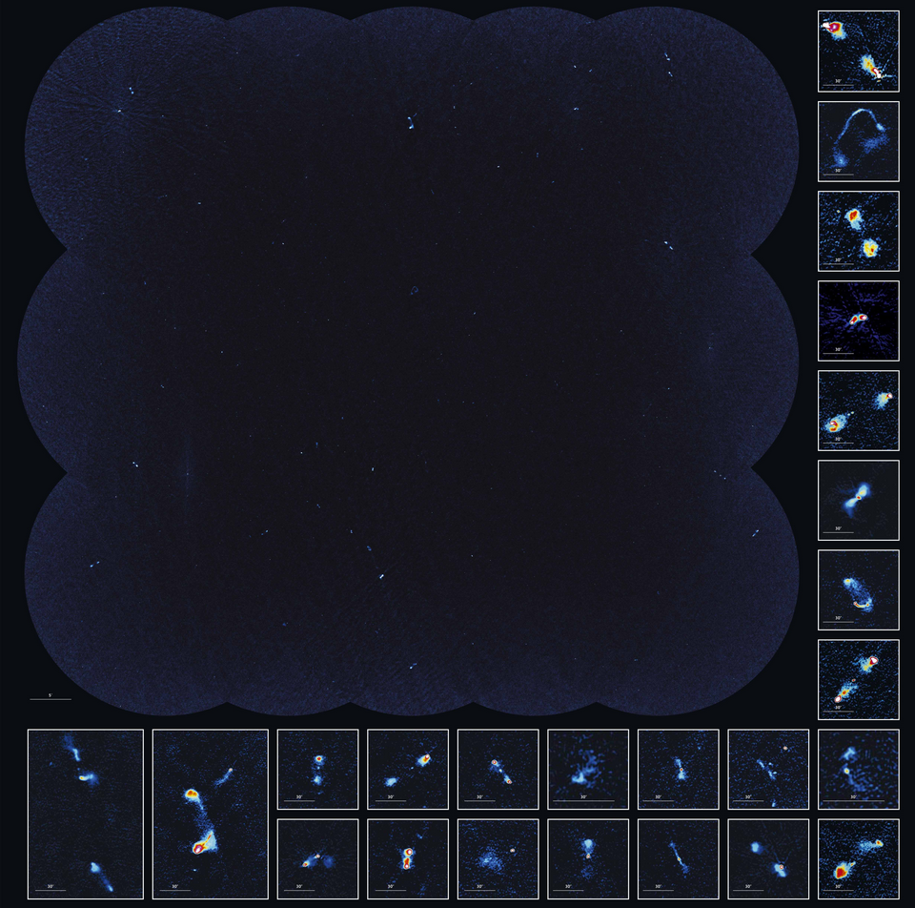
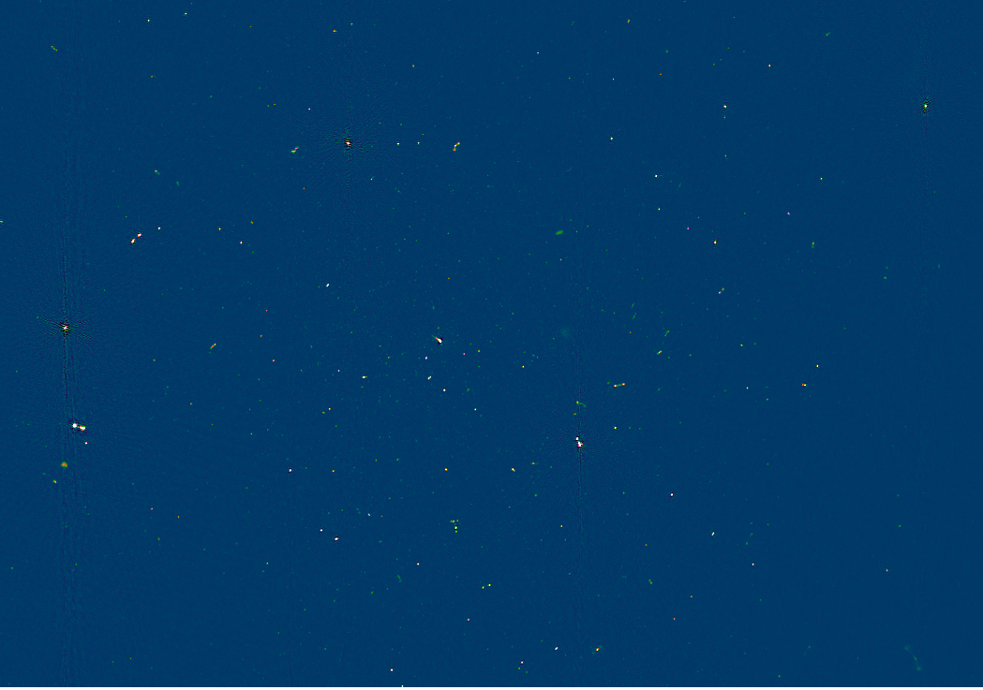
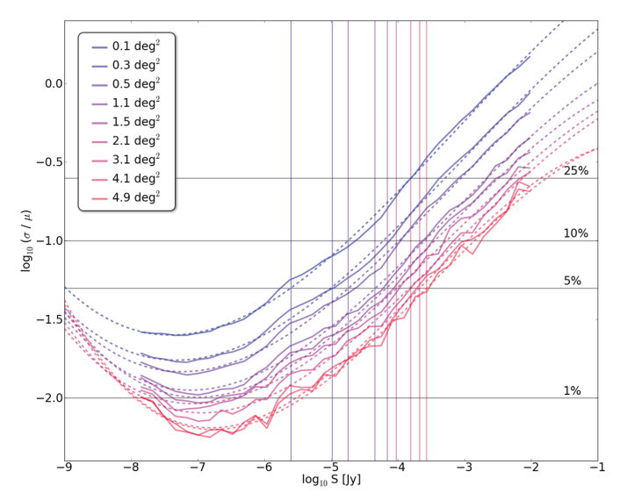
The effect of Cosmic variance on small survey areas
COSMOS
Combined source count data of previous single pointing data show significant scatter at faint end compared to larger survey areas.
At smaller areas the underlying cosmological structure can have a noticeable effect on the radio source properties.
Deeper depths are required for single pointing to achieve the same scatter of that for larger area.
Saraswati core
Survey area
Notes:
Nature of dark matter coupled with intense inflation caused smaller structures to form first that aggregate over time through merging to form larger structures.
Majority mass components are the filaments whereas majority volume components are the voids.
Left: every node is a merger, largest are superclusters. Others are galaxy clusters, galaxy groups, etc Right: Snapshots of LLS formation.
Small structures first, larger ones later -> superclusters are very young compared to the structures in which they host
CDM travel slow compared to c, cannot escape fluctuations, seeds develop early

Slide 6
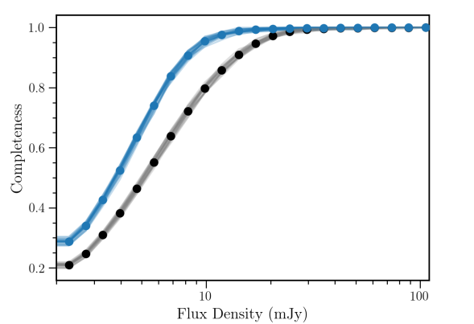
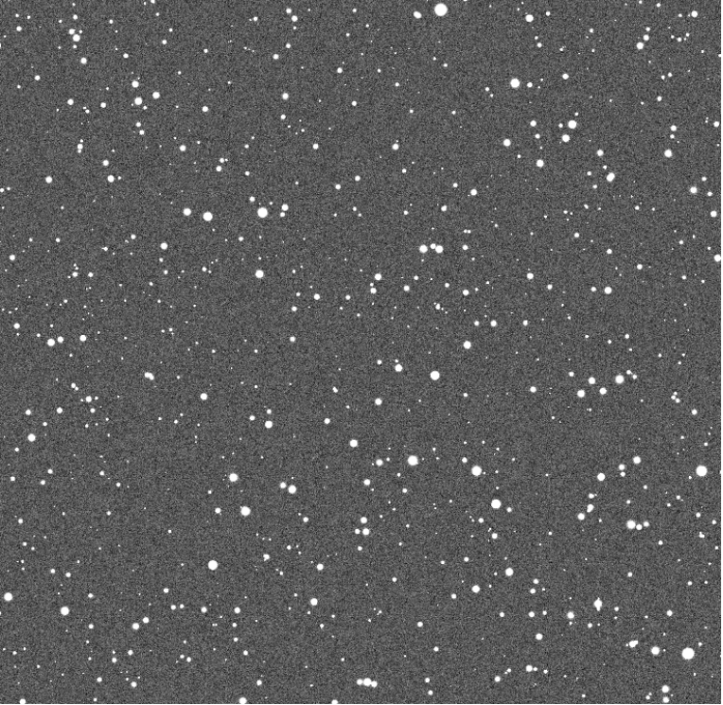
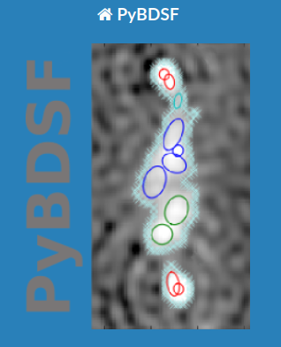
Procedure for deriving the completeness function
One of the resultant products of the CLEAN algorithm is the residual image. After deep cleaning should contain no sources and just noise.
Simulated sources with real flux and source size are injected into the residual image. Source finder used on this simulated image with the same parameters as real image.
PyBDSF source finder software] searches for islands of emissions in which gaussians are subsequently fitted based on peak flux and image noise distribution.
By counting the sources for each bin and computing the ratio: injected_sources/Recovered sources we obtain correction factors per flux density bin.
Injected sources
Injected sources
Completeness ratio
Simulated Image
Recovered sources
WSCLEAN Residual map

Slide 7
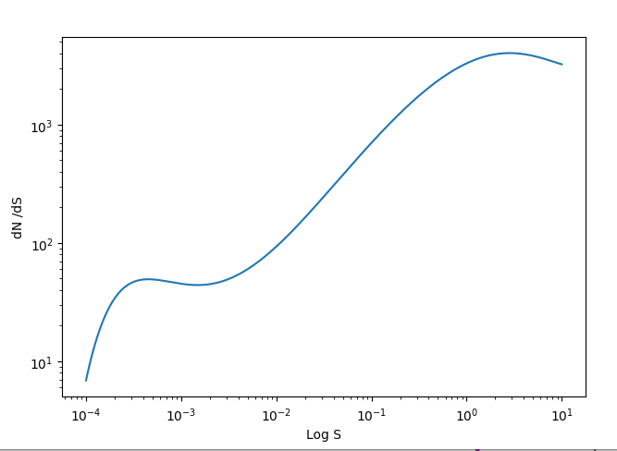
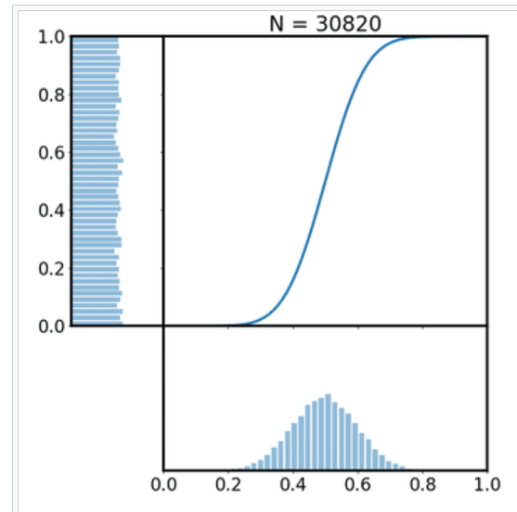
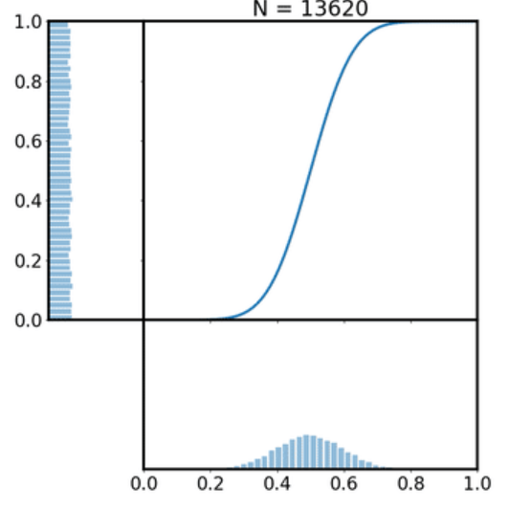
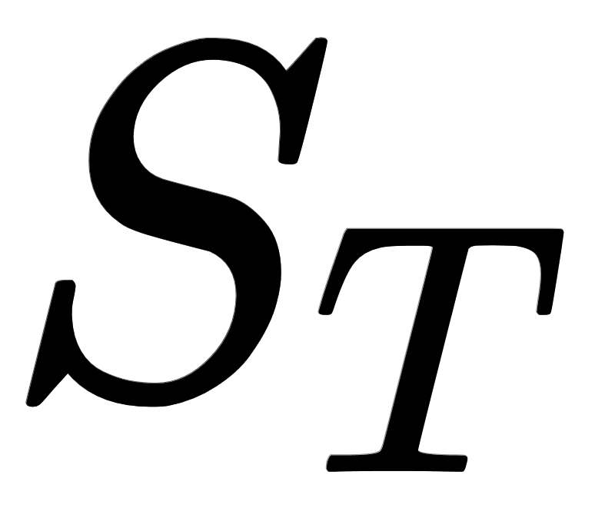
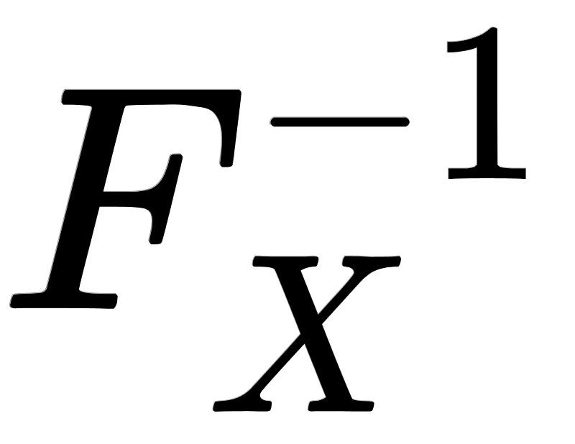
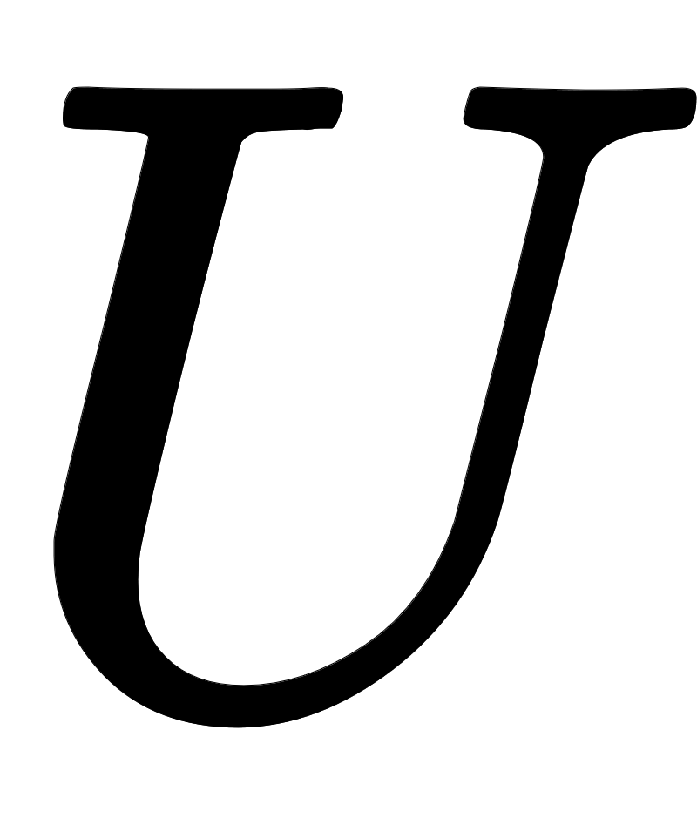
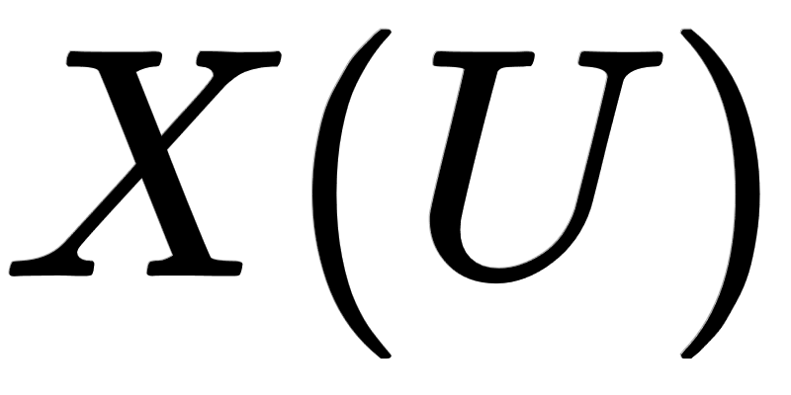
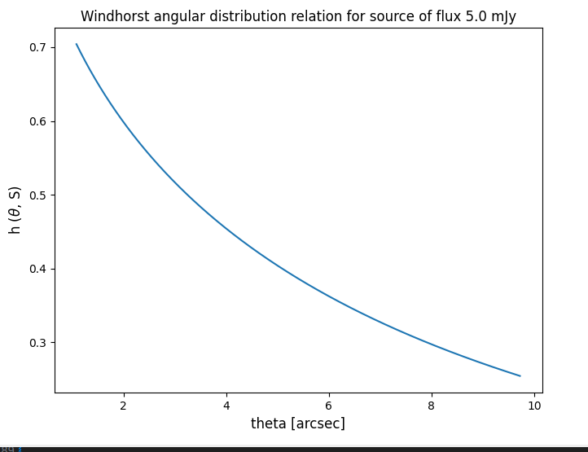
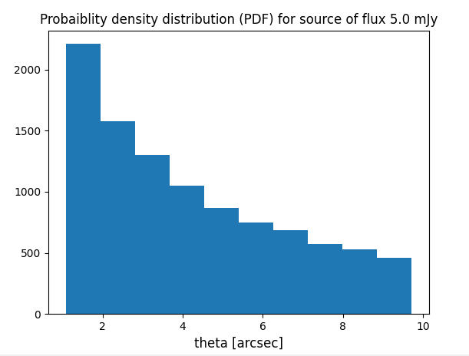
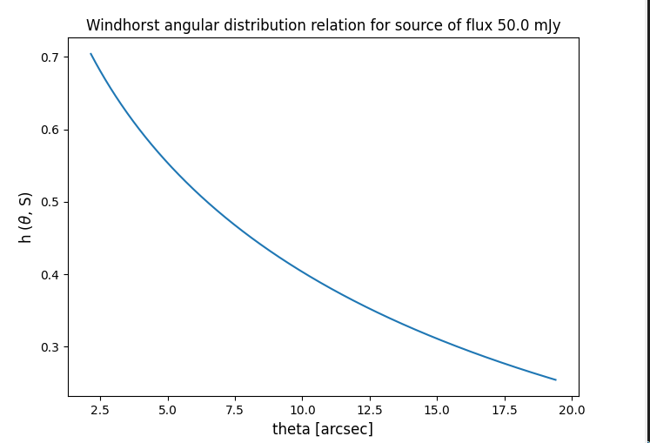
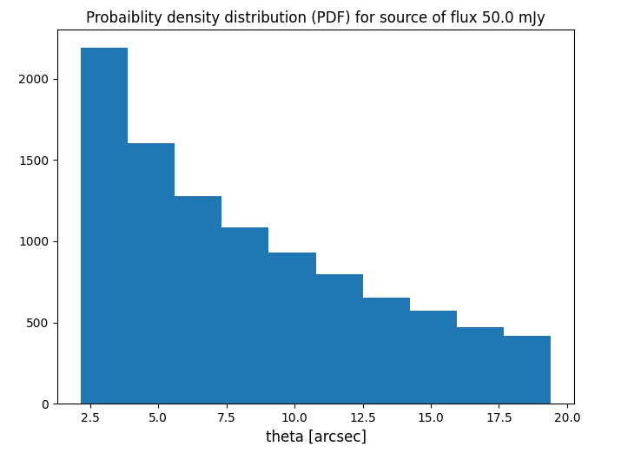
Simulation details: Radio flux and source size selection
Flux selection
Inverse Transfer sampling used to choose from a uniform sample of points from a continuous distribution.
Calculate the Inverse of the cumulative distribution function and then evaluate this function from a normalised uniform sample.
Total sources injected into simulated image determined by integration of source count function.
Source size selection
Windhorst relation most widely used: Empirical integral distribution that shows a decline in angular sizes for fainter sources.
A source of a given flux will have a range of angular sizes to be chosen from.
Larger fluxes will have larger angular sizes and vica versa.
Notes:
Nature of dark matter coupled with intense inflation caused smaller structures to form first that aggregate over time through merging to form larger structures.
Majority mass components are the filaments whereas majority volume components are the voids.
Left: every node is a merger, largest are superclusters. Others are galaxy clusters, galaxy groups, etc Right: Snapshots of LLS formation.
Small structures first, larger ones later -> superclusters are very young compared to the structures in which they host
CDM travel slow compared to c, cannot escape fluctuations, seeds develop early

Slide 8
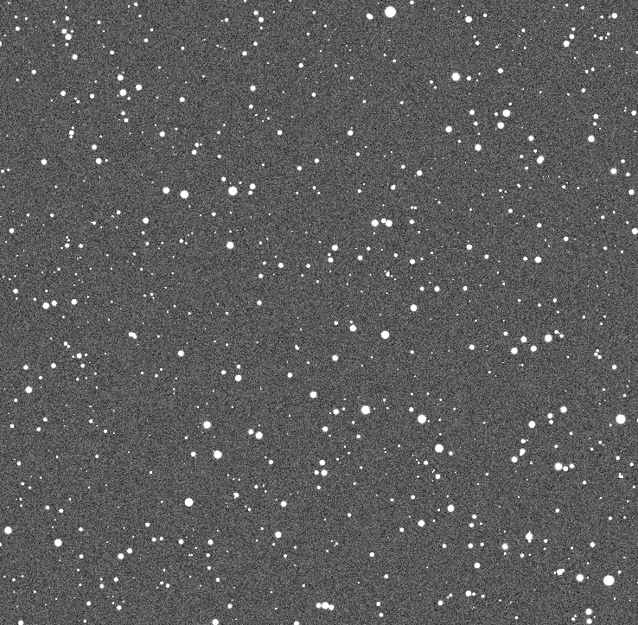
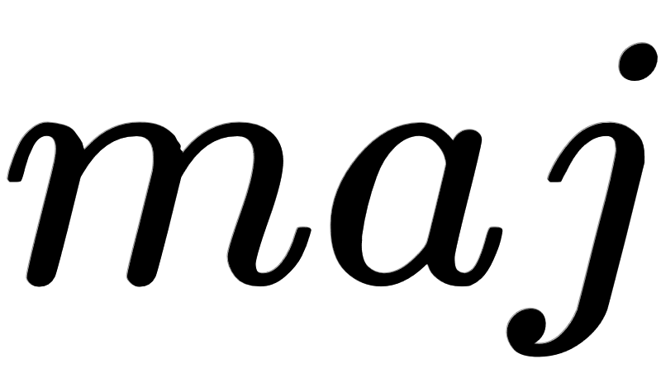
Simulation details: Injection of gaussian sources
We injected circular gaussian sources for simplicity and for each assign a peak flux.
The peak flux must then be spread across the source size for the integrated flux
Source size depends on beam size and true intrinsic size
True size is the source size found from angular source size model such as Windhorst
Notes:
Nature of dark matter coupled with intense inflation caused smaller structures to form first that aggregate over time through merging to form larger structures.
Majority mass components are the filaments whereas majority volume components are the voids.
Left: every node is a merger, largest are superclusters. Others are galaxy clusters, galaxy groups, etc Right: Snapshots of LLS formation.
Small structures first, larger ones later -> superclusters are very young compared to the structures in which they host
CDM travel slow compared to c, cannot escape fluctuations, seeds develop early

Slide 9
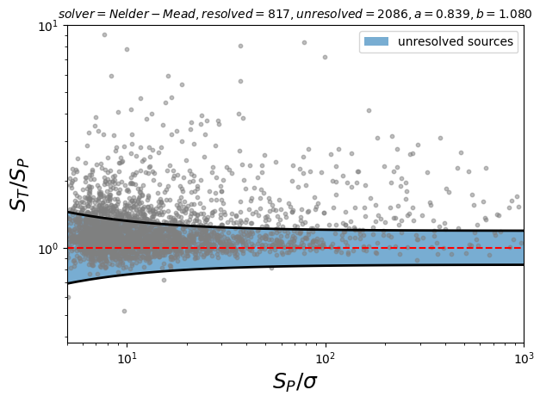
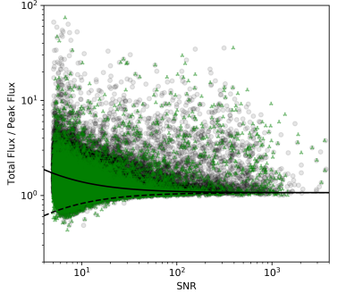
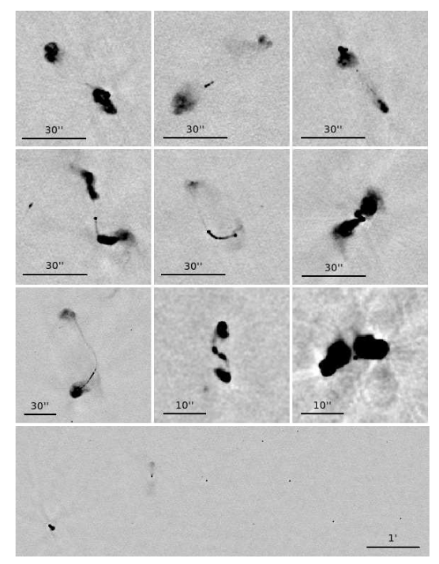
Resolved and unresolved sources
In an ideal image (absence of noise) total flux of a point source is equal to peak flux. For an extended source Total flux > peak flux.
In real images total flux and peak are changed by the noise, smearing, primary beam, noise peaks, etc
Sources with S_T < S_P are affected with errors. Can assume by extension that errors affects sources with S_P > S_T as well.
Can fit a lower envelope for 90%, 95% or 97% of sources S_T < S_P.
resolved
Real catalog
unresolved
Simulated catalog
Notes:
Nature of dark matter coupled with intense inflation caused smaller structures to form first that aggregate over time through merging to form larger structures.
Majority mass components are the filaments whereas majority volume components are the voids.
Left: every node is a merger, largest are superclusters. Others are galaxy clusters, galaxy groups, etc Right: Snapshots of LLS formation.
Small structures first, larger ones later -> superclusters are very young compared to the structures in which they host
CDM travel slow compared to c, cannot escape fluctuations, seeds develop early

Slide 10
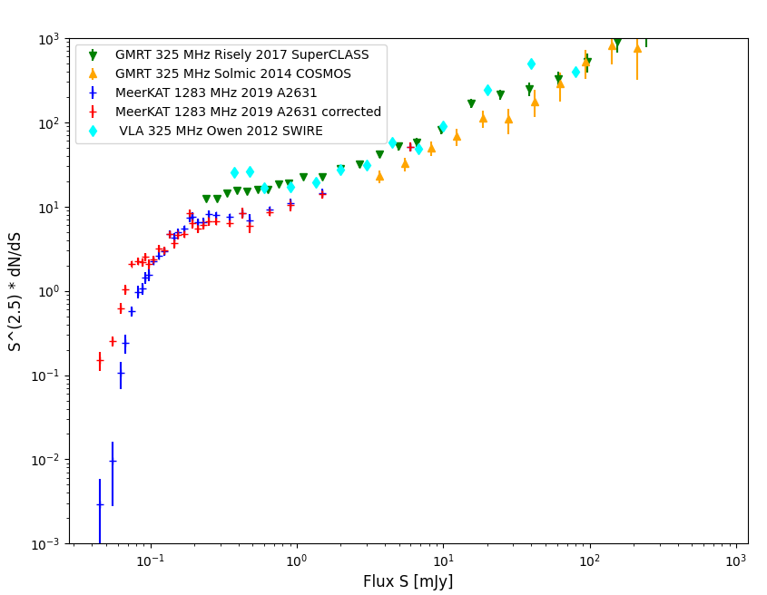
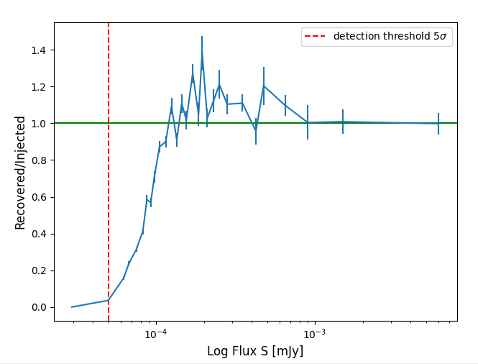
Completeness and source counts
MeerKAT radio source counts compared with Deep observations from GMRT and VLA scaled to 1.4GHz (alpha =-0.7)
GMRT comparable to MeerKAT in terms of sensitivity (~0.03mJy) and resolution (~ 10’’).
GMRT data able to populate the higher luminosities but not deep enough to explore the transition region ~ 1 mJy.
MeerKAT data provide a wealth of uJy - mJy sources allowing us to probe transition region.
Application of 1/completeness shifts sources in the lower bins up while minimal effect on bright sources.
Optical crossmatch required to understand the full nature of sources below the transition zone.
Future SKA and SKA-precursors will be vital to uncover the true nature of radio galaxies in this regime.
Notes:
Nature of dark matter coupled with intense inflation caused smaller structures to form first that aggregate over time through merging to form larger structures.
Majority mass components are the filaments whereas majority volume components are the voids.
Left: every node is a merger, largest are superclusters. Others are galaxy clusters, galaxy groups, etc Right: Snapshots of LLS formation.
Small structures first, larger ones later -> superclusters are very young compared to the structures in which they host
CDM travel slow compared to c, cannot escape fluctuations, seeds develop early

