Slide 1

Accelerating radiative transfer simulations with reinforcement learning
Brandon Panos
Swiss SKA Days,
September 4, 2024
https://brandonlpanos.herokuapp.com/
brandon.panos@fhnw.ch

Slide 2

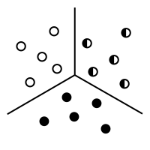

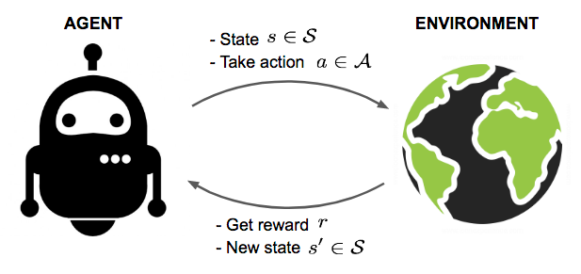

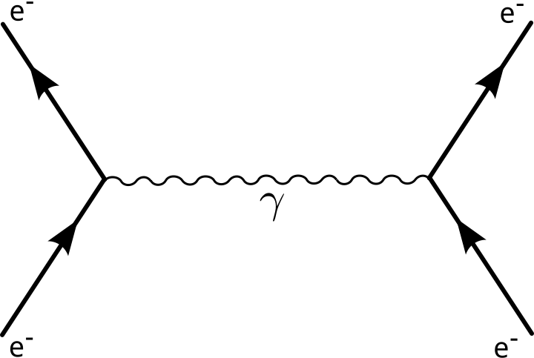
Physics
Machine Learning
Classical Mechanics
Condensed Matter
Supervised learning
Unsupervised learning
y
Radiative Transfer
Electromagnetism
Reinforcement learning
Relativity
High Energy

Slide 3
Physics
Machine Learning
Classical Mechanics
Condensed Matter
Supervised learning
Unsupervised learning
y
Radiative Transfer
Electromagnetism
Reinforcement learning
Relativity
High Energy

Slide 4
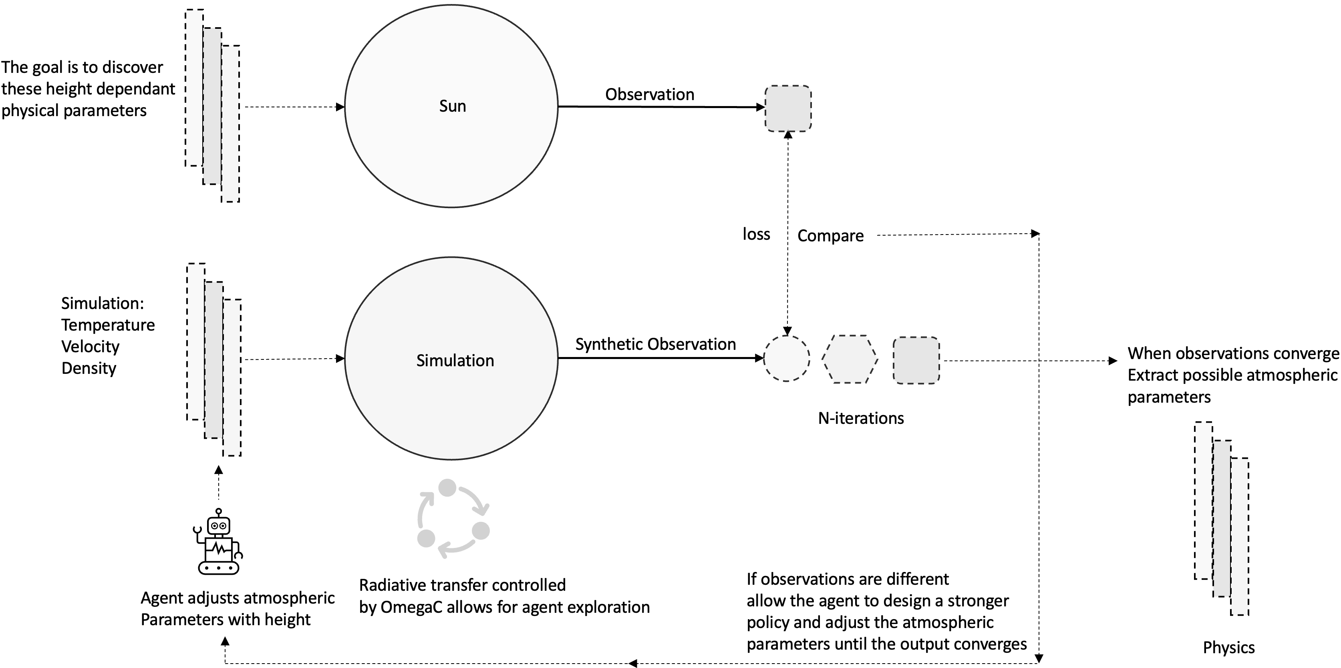
Radiative Transfer (overview)
1
Radiative transfer describes the interaction of radiation and matter
2
This is important for a wide variety of remote sensing observations: Climate modeling, Solar physics, Epoch of Reionization
3
To decode the light we observe we need accurate simulations called inversions
4
This is how inversions work, they are tools for inferring the physics of remotely observed objects
5
One of the most challenging systems to simulate
Leads to unwarranted simplifications that
undermine the validity of the inference
6
Represents one of the biggest computational
bottlenecks that must be removed
7

Slide 5
Radiative Transfer (overview)
1
Radiative transfer describes the interaction of radiation and matter
2
This is important for a wide variety of remote sensing observations: Climate modeling, Solar physics, Epoch of Reionization
3
To decode the light we observe we need accurate simulations called inversions
4
This is how inversions work, they are tools for inferring the physics of remotely observed objects
5
One of the most challenging systems to simulate
Leads to unwarranted simplifications that
undermine the validity of the inference
6
Represents one of the biggest computational
bottlenecks that must be removed
7

Slide 6
Radiative Transfer (overview)
1
Radiative transfer describes the interaction of radiation and matter
2
This is important for a wide variety of remote sensing observations: Climate modeling, Solar physics, Epoch of Reionization
3
To decode the light we observe we need accurate simulations called inversions
4
This is how inversions work, they are tools for inferring the physics of remotely observed objects
5
One of the most challenging systems to simulate
Leads to unwarranted simplifications that
undermine the validity of the inference
6
Represents one of the biggest computational
bottlenecks that must be removed
7

Slide 7
Radiative Transfer (overview)
1
Radiative transfer describes the interaction of radiation and matter
2
This is important for a wide variety of remote sensing observations: Climate modeling, Solar physics, Epoch of Reionization
3
To decode the light we observe we need accurate simulations called inversions
4
This is how inversions work, they are tools for inferring the physics of remotely observed objects
5
One of the most challenging systems to simulate
Leads to unwarranted simplifications that
undermine the validity of the inference
6
Represents one of the biggest computational
bottlenecks that must be removed
7

Slide 8


Radiative Transfer (overview)
1
Radiative transfer describes the interaction of radiation and matter
2
This is important for a wide variety of remote sensing observations: Climate modeling, Solar physics, Epoch of Reionization
3
To decode the light we observe we need accurate simulations called inversions
4
This is how inversions work, they are tools for inferring the physics of remotely observed objects
5
One of the most challenging systems to simulate
Leads to unwarranted simplifications that
undermine the validity of the inference
6
Represents one of the biggest computational
bottlenecks that must be removed
7

Slide 9
Radiative Transfer (overview)

Slide 10
Radiative Transfer (overview)
1
Radiative transfer describes the interaction of radiation and matter
2
This is important for a wide variety of remote sensing observations: Climate modeling, Solar physics, Epoch of Reionization
3
To decode the light we observe we need accurate simulations called inversions
4
This is how inversions work, they are tools for inferring the physics of remotely observed objects
5
One of the most challenging systems to simulate
Leads to unwarranted simplifications that
undermine the validity of the inference
6
Represents one of the biggest computational
bottlenecks that must be removed
7

Slide 11
Radiative Transfer (overview)
1
Radiative transfer describes the interaction of radiation and matter
2
This is important for a wide variety of remote sensing observations: Climate modeling, Solar physics, Epoch of Reionization
3
To decode the light we observe we need accurate simulations called inversions
4
This is how inversions work, they are tools for inferring the physics of remotely observed objects
5
One of the most challenging systems to simulate
Leads to unwarranted simplifications that
undermine the validity of the inference
6
Represents one of the biggest computational
bottlenecks that must be removed
7

Slide 12
Radiative Transfer (overview)
1
Radiative transfer describes the interaction of radiation and matter
2
This is important for a wide variety of remote sensing observations: Climate modeling, Solar physics, Epoch of Reionization
3
To decode the light we observe we need accurate simulations called inversions
4
This is how inversions work, they are tools for inferring the physics of remotely observed objects
5
One of the most challenging systems to simulate
Leads to unwarranted simplifications that
undermine the validity of the inference
6
Represents one of the biggest computational
bottlenecks that must be removed
7

Slide 13
Radiative Transfer (the system and goal)
Radiation field
Atom
New Radiation field
many photons of
different energies
Electrons increase or decrease energy levels
depending on whether the atom absorbs or emits photons
ratio of atoms in excited state vs ground gives level populations
Photon soup is
modified after interaction
Radiation field interacting with
many atoms in a large cube.
Level populations for each point in the
grid are unknown
=
Statistical equilibrium
Goal

Slide 14
Radiative Transfer (the physics)
Radiative transfer equation (energy in and out of ray)
Formal solution (propagate radiation)
Source function (depends on populations)
Mean intensity
=
Statistical equilibrium
Goal

Slide 15


Radiative Transfer (the problem)
Extremely difficult to simulate because….
1
Global
atomic populations far away effect each other
non-linear
2
Cyclic
level densities
determine radiation
field
Radiation field
determines level
densities
Only direct solution = complete linearization
massive matrix
cannot fit into computer

Slide 16
Radiative Transfer (the problem)
Extremely difficult to simulate because….
1
Global
radiative coupling
atomic populations far away effect each other
non-linear
2
Cyclic
level densities
determine radiation
field
Radiation field
determines level
densities
Only direct solution = complete linearization
massive matrix
cannot fit into computer

Slide 17
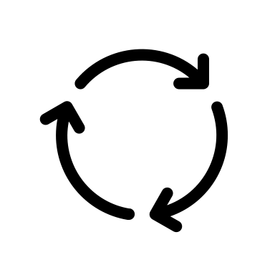
Radiative Transfer (the problem)
Extremely difficult to simulate because….
1
Global
radiative coupling
atomic populations far away effect each other
non-linear
2
Cyclic
level densities
determine radiation
field
Radiation field
determines level
densities
Only direct solution = complete linearization
massive matrix
cannot fit into computer

Slide 18

Radiative Transfer (the problem)
Extremely difficult to simulate because….
1
Global
radiative coupling
atomic populations far away effect each other
non-linear
2
Cyclic
level densities
determine radiation
field
Radiation field
determines level
densities
Direct Solution
Only direct solution = complete linearization
massive matrix
cannot fit into computer

Slide 19
Iterative approach
similar to nature
Radiative Transfer (the physics engine)
Lambda Iteration
Formal transfer equation
lets us propagate the photons
around the atmosphere
1
Initial guess of
level populations
2
Phones generated
by electrons falling
to lower energy levels
Calculate mean radiation
field at each grid point
3
=
Repeat until convergence
levels and radiation field
become stationary
4

Slide 20
Iterative approach
similar to nature
Radiative Transfer (the physics engine)
Lambda Iteration
Formal transfer equation
lets us propagate the photons
around the atmosphere
1
Initial guess of
level populations
2
Phones generated
by electrons falling
to lower energy levels
Calculate mean radiation
field at each grid point
3
=
Repeat until convergence
levels and radiation field
become stationary
4

Slide 21
Iterative approach
similar to nature
Radiative Transfer (the physics engine)
Lambda Iteration
Formal transfer equation
lets us propagate the photons
around the atmosphere
1
Initial guess of
level populations
2
Phones generated
by electrons falling
to lower energy levels
Calculate mean radiation
field at each grid point
3
=
Repeat until convergence
levels and radiation field
become stationary
4

Slide 22
Iterative approach
similar to nature
Radiative Transfer (the physics engine)
Lambda Iteration
Formal transfer equation
lets us propagate the photons
around the atmosphere
1
Initial guess of
level populations
2
Phones generated
by electrons falling
to lower energy levels
Calculate mean radiation
field at each grid point
3
=
Repeat until convergence
levels and radiation field
become stationary
4

Slide 23
Iterative approach
similar to nature
Radiative Transfer (the physics engine)
Lambda Iteration
Formal transfer equation
lets us propagate the photons
around the atmosphere
1
Initial guess of
level populations
2
Phones generated
by electrons falling
to lower energy levels
Calculate mean radiation
field at each grid point
3
=
Repeat until convergence
levels and radiation field
become stationary
4

Slide 24
Iterative approach
similar to nature
Radiative Transfer (the physics engine)
Lambda Iteration
Formal transfer equation
lets us propagate the photons
around the atmosphere
1
Initial guess of
level populations
2
Phones generated
by electrons falling
to lower energy levels
Calculate mean radiation
field at each grid point
3
=
Repeat until convergence
levels and radiation field
become stationary
4

Slide 25

Radiative Transfer (idea)
Can simulate a single propagation and interaction
through the entire atmosphere
Stay still!!
Physics engine
=
Intuition
Our agent manipulates the level populations at each grid point
The physics engine runs a single iteration
If the atmosphere still shows dynamics we have not converged
The agent tries to find the configuration that is a stationary point of the atmosphere

Slide 26
Reinforcement Learning
Grid World
Simplest example is a Grid World
0
1
2
3
4
Agent interacts with environment that is driven by
known or unknown dynamics
5
6
7
8
9
The system’s dynamics dispense an appropriate reward and state transition
based on the agent’s current state and action
10
11
12
13
14
15
16
17
18
19
Agent’s goal is to reach the target green state in as few steps as possible
20
21
22
23
24

Slide 27
Reinforcement Learning
Grid World
Simplest example is a Grid World
0
1
2
3
4
Agent interacts with environment that is driven by
known or unknown dynamics
5
6
7
8
9
The system’s dynamics dispense an appropriate reward and state transition
based on the agent’s current state and action
10
11
12
13
14
15
16
17
18
19
Agent’s goal is to reach the target green state in as few steps as possible
20
21
22
23
24

Slide 28
Reinforcement Learning
Grid World
Simplest example is a Grid World
0
1
2
3
4
Agent interacts with environment that is driven by
known or unknown dynamics
5
6
7
8
9
The system’s dynamics dispense an appropriate reward and state transition
based on the agent’s current state and action
10
11
12
13
14
15
16
17
18
19
Agent’s goal is to reach the target green state in as few steps as possible
20
21
22
23
24

Slide 29
Reinforcement Learning
Grid World
Simplest example is a Grid World
0
1
2
3
4
Agent interacts with environment that is driven by
known or unknown dynamics
5
6
7
8
9
The system’s dynamics dispense an appropriate reward and state transition
based on the agent’s current state and action
10
11
12
13
14
15
16
17
18
19
Agent’s goal is to reach the target green state in as few steps as possible
20
21
22
23
24

Slide 30
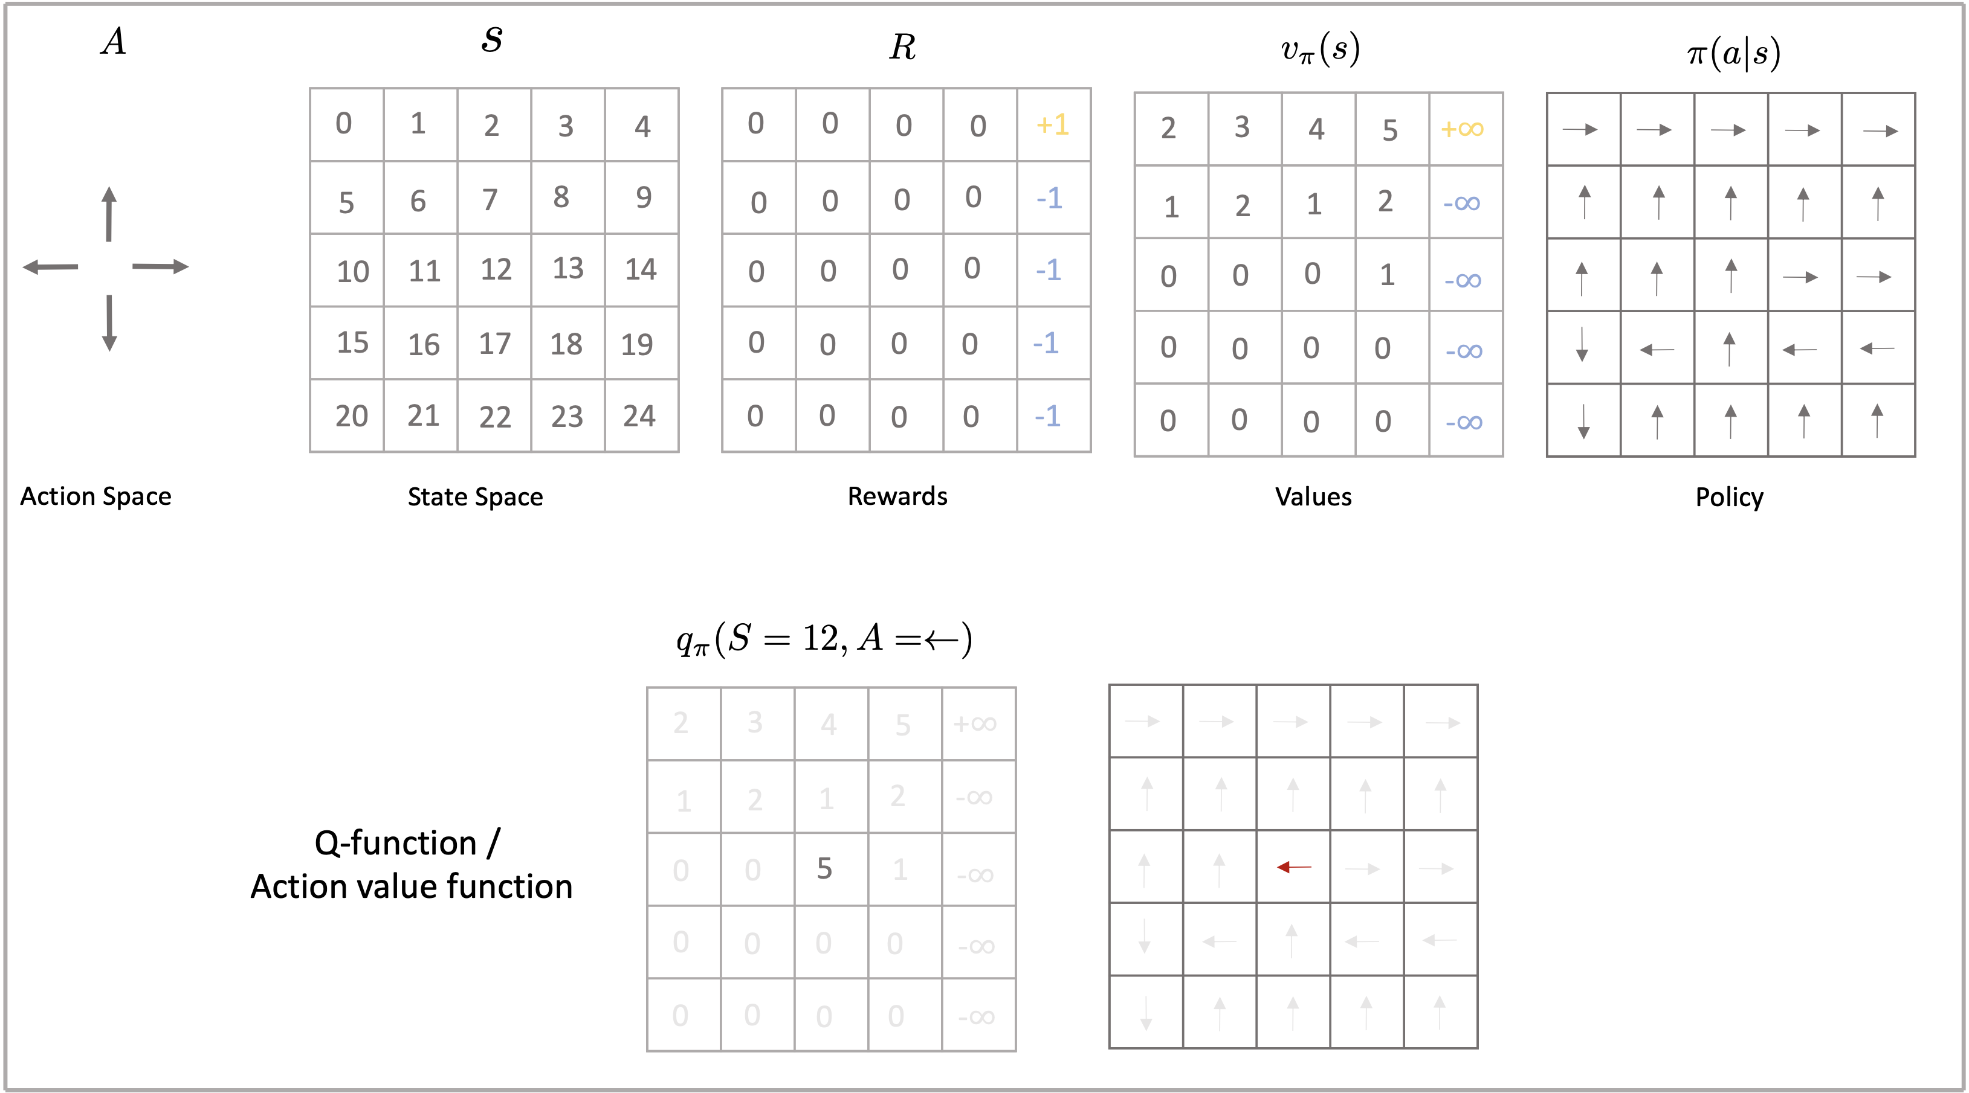
Reinforcement Learning
Components of Reinforcement Learning

Slide 31
Reinforcement Learning
Components of Reinforcement Learning
Our agent can has a discreet action space
up, down, left, right

Slide 32
Reinforcement Learning
Components of Reinforcement Learning
It uses these actions to move
around the state space

Slide 33
Reinforcement Learning
Components of Reinforcement Learning
The system dispenses rewards based on
current state and action

Slide 34
Reinforcement Learning
Components of Reinforcement Learning
Values bake in the long term
consequences of actions

Slide 35
Reinforcement Learning
Components of Reinforcement Learning
A policy is a universal plan of action for
every state that should maximize
the expected returns

Slide 36
Reinforcement Learning
Components of Reinforcement Learning
The systems reward based dynamics
can be fully, partly, or not known,
largely dictating the type of
RL algorithm used

Slide 37
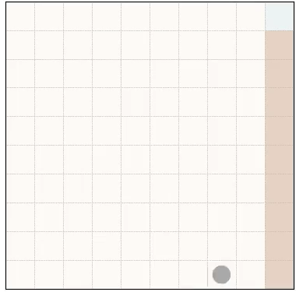
Reinforcement Learning
Grid world example: Mountains Edge
The target state
Stochastic component
in the system dynamics
that models wind and always
gives a chance of moving to
the right no matter the action
Edge = death/cliff
The agent finds a path that balances
tensions beteen speed and safety.
The agent

Slide 38
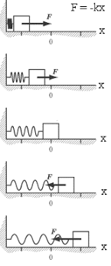
Mapping the spring problem to RL world
Would you please stop
moving!!!
A spring in a vacuum with zero resistance is oscillating.
The agent must apply forces at discreate times such that the
spring reaches equilibrium.

Slide 39
Mapping the spring problem to RL world
State
Continuous positon and velocity vectors
Kinetic and potential
energy is zero. Agent has
Applied forces at time t
Such that the system reaches
equilibrium
Reward
Inversly proportional to energy
Target state
Action Space
Bounded application of continuous force

Slide 40
Mapping the radiative transfer problem to RL world
The systems dynamics are defined by a physics
engine running on the equations of radiative transfer
State
Continuous height dependant variables
Reward
Inversely proportional to rates in and out
Target state
Action Space
Statistical equilibrium
Increase or decrease level populations (continuous)

Slide 41
Mapping the radiative transfer problem to RL world
Radiation field feeds back into atoms
and changes the lvl populations
Agent changes
lvl populations
Physics driven engine provides environment dynamics
PDE generates radiation field
Reward signal
New level populations
from Physics engine
Distance from SE
After many iterations the agent has developed a strategy / policy
to efficiently drive the system into statistical equilibrium
Radiation field feeds back into atoms
and changes the lvl populations
Agent changes
lvl populations
Physics driven engine provides environment dynamics
PDE generates radiation field
Reward signal
New level populations
from Physics engine
Distance from SE

Slide 42

Problem description
Can be cast as a Markov decision process (MDP) since actions are only dependent on the current state
High-dimensional continuous action and state space
Reward dense, the agent receives a reward for every action based on the distance away from statistical equilibrium
Partly observable, although all the atmospheric variables are visible to the model, the model is not aware of the equations of radiative transfer
Candidate solution
Soft-Actor Critic (with memory)
Good for high-dimensional
Good for continuous
Good for reward-dense
Uses entropy term to drive exploration

Slide 43
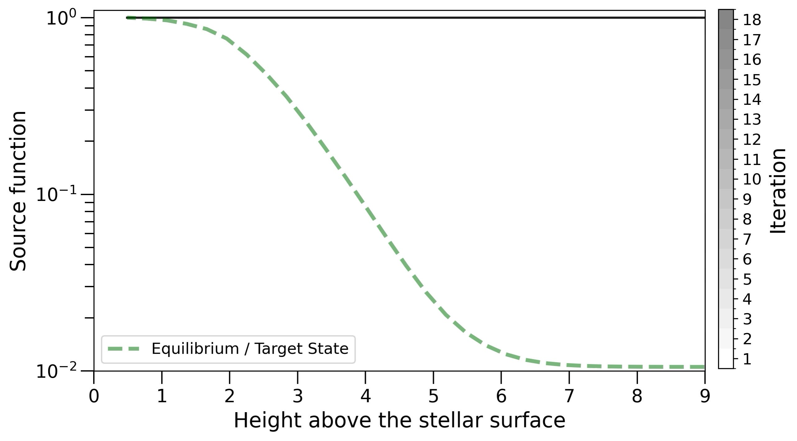
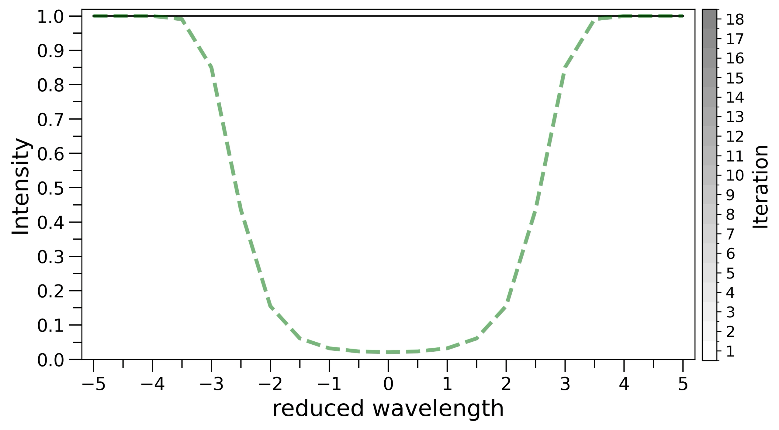
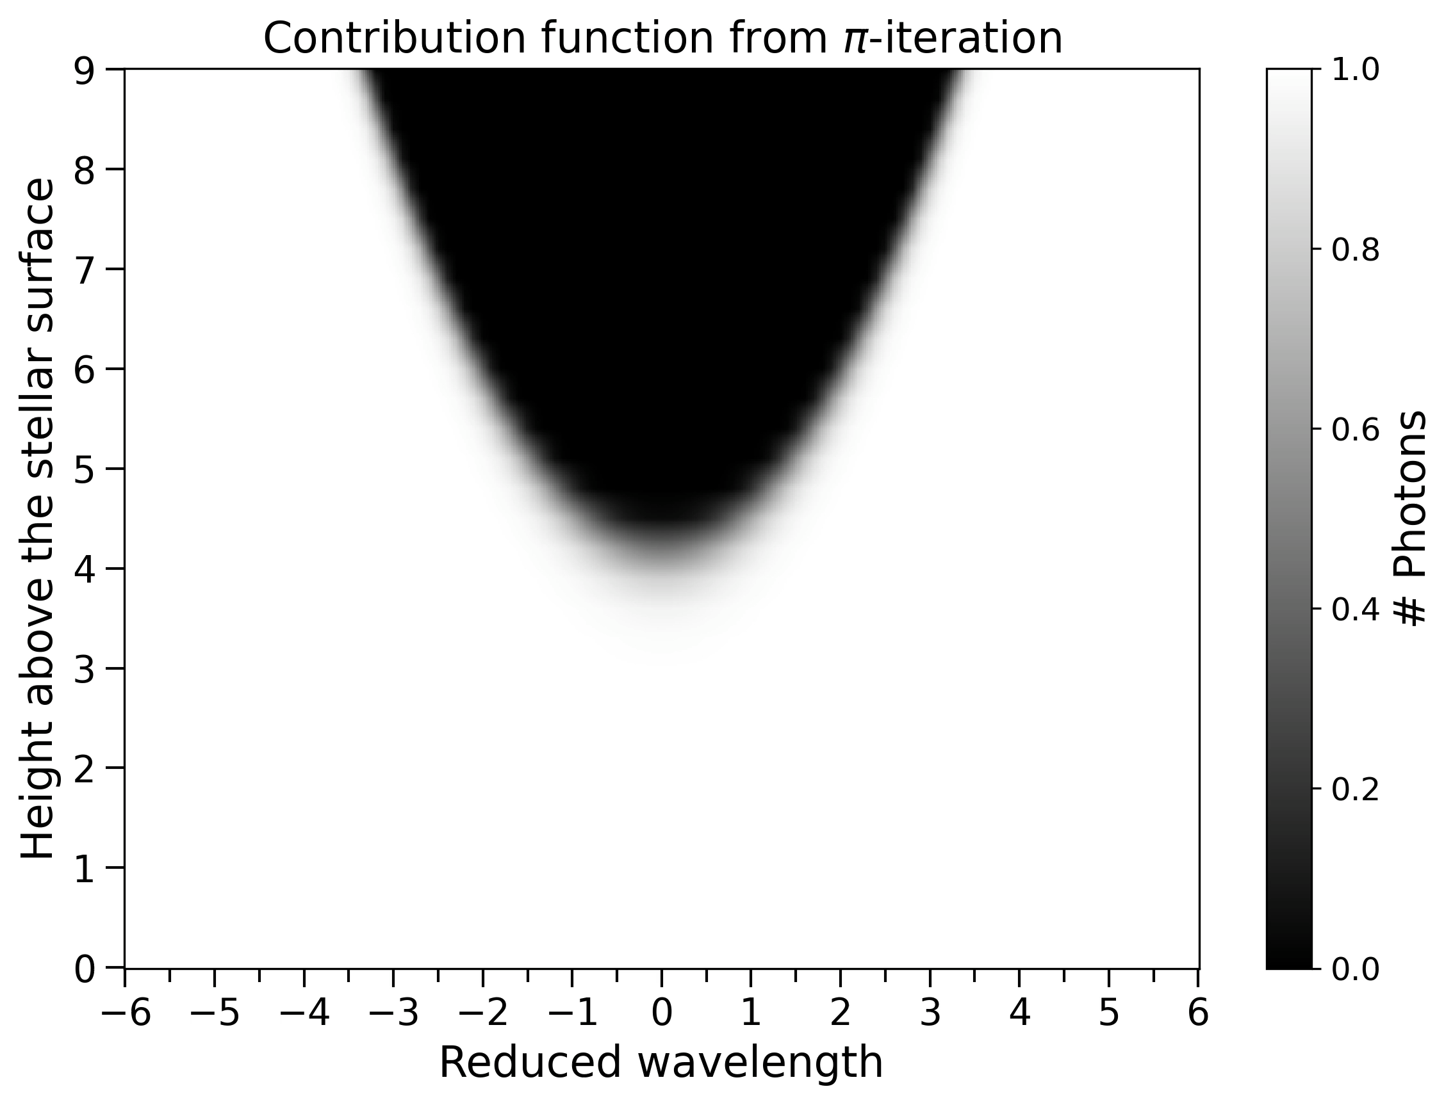
Proof of concept on a simple stellar atmosphere with a single species of two level atom
Where in the atmosphere
are the photons coming from
that make up the spectrum?
Source function domain
Observable spectrum
I am playing with the atmosphere, pulling all the knobs and pushing all the buttons.
When I find the correct configuration that atmosphere remains stationary under the action of the physics engine.

Slide 44
Safe to use
My policy is physics informed
I am not in the business of making artifacts
If I force the system into equilibrium I have found the correct solution, no questions asked
Think of me as a smart optimizer, better than gradient descent, a type of super charged Adam
optimizer that has memories and has learned the problems patterns

Slide 45
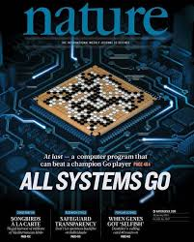
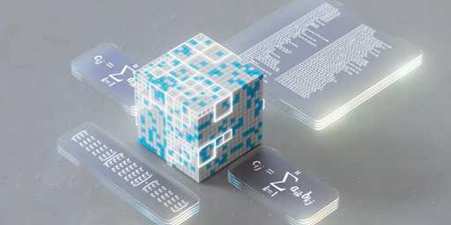
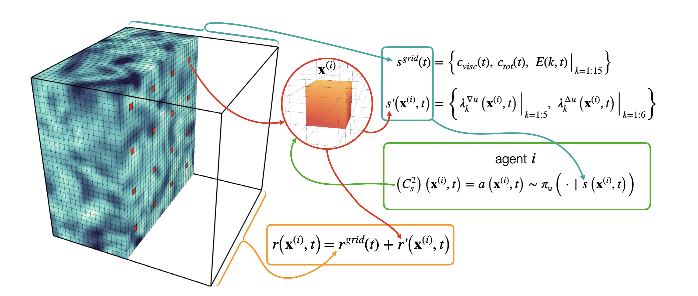
AlphaGo
AlphaTensor
(Silver et al., 2016)
(Fawzi et al., 2022)
Turbulence with MARL
Novati et al,. 2020

