Slide 1
Simulation based inference with radiative hydrodynamics simulations of the Epoch of Reionization
B. Semelin, R. Mériot and D. Cornu
Geneva, Sep 2024

Slide 2
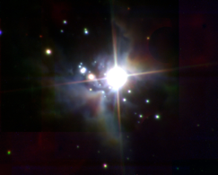
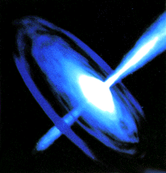
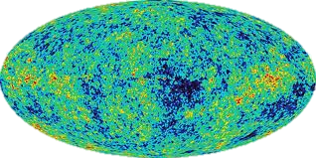
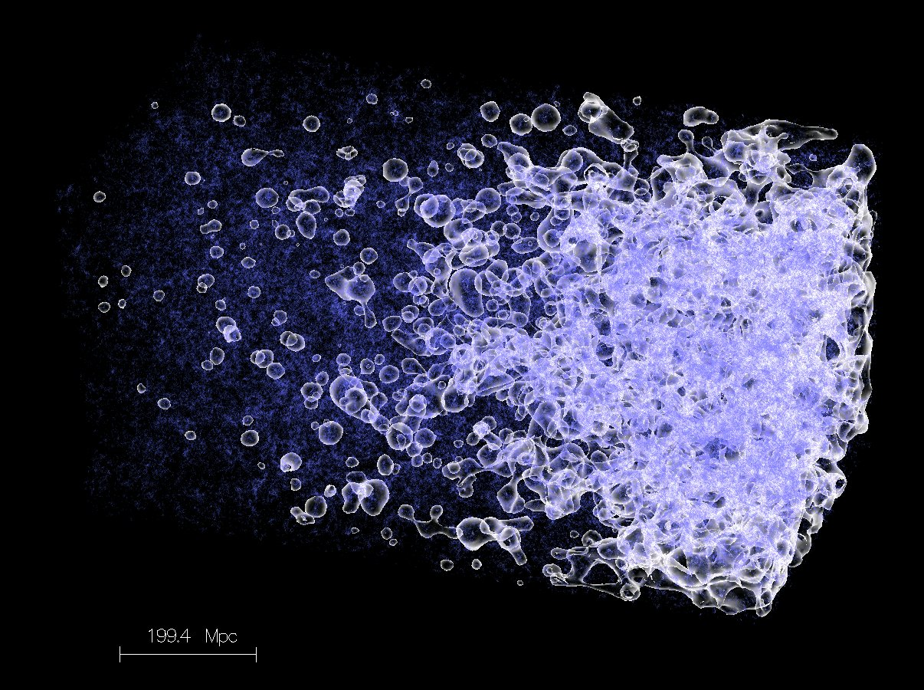
The 21-cm signal during the « Cosmic Dawn »
The first billion years
Massive stars:
Quasars:
z ~ 25 ?
Big
Bang
z=1000
CMB
Dark Ages
Cosmic
Dawn
Epoch of reionization
z = 6
21 cm signal

Slide 3
Complex…or rich ?
Number of
emitting atoms
Intensity
« per » atom
x_{HI}
T_{S}
dv
δ
T_{S}
dr
$$T_{S}^{−1}=\frac{T_{CMB}^{−1}+x_{α}T_{c}^{−1}+x_{c}T_{k}^{−1}}{1+x_{α}+x_{c}}$$
Physical parameters
Galaxy UV
luminosity
f_{esc} ~ M ^{β}
Models (HPC simulations)
Fields
x_{HII}
x_{α}
Galaxy SED
f_{α ,} f_{LW}
Post-processing
21 cm
signal
Star formation rate
𝛕, M_{min}
Inference / inversion
δ,v
T_{K}
Cosmology
H₀, Ω_{m}, etc
X-ray sources
f_{X} , r_{H/S}
?

Slide 4
The LICORICE code
- Dynamics (Treecode + SPH)
- Monte Carlo Ray-Tracing RT: UV and X
- Lyman-alpha 3D RT
- MPI+OpenMP parallelization
HIRRAH-21 simulation (2018):
- 300 Mpc box
- 10¹⁰ particles, > 10⁹ M⦿ , resolution ~ 3 kpc
- 4 x 10¹² photons
- 5 Mh CPU. 4096 MPI domains, 16384 core.
Why run a single large simulation ?
A reference point for validation

Slide 5
Inference with 3D RT simulations?
Bayesian MCMC: > 10⁵ model evaluations => Not with 3D RT!
Possible inference methods:
2) Model inversion with ML (bayesian or not): a few 10³ models
3) Trained ML emulator (a few 10³ models) + MCMC
SBI: ML Density Estimator (a few 10³ models AND implicit likelihood)
=> We need to build a training set with 3D RT simulations!

Slide 6
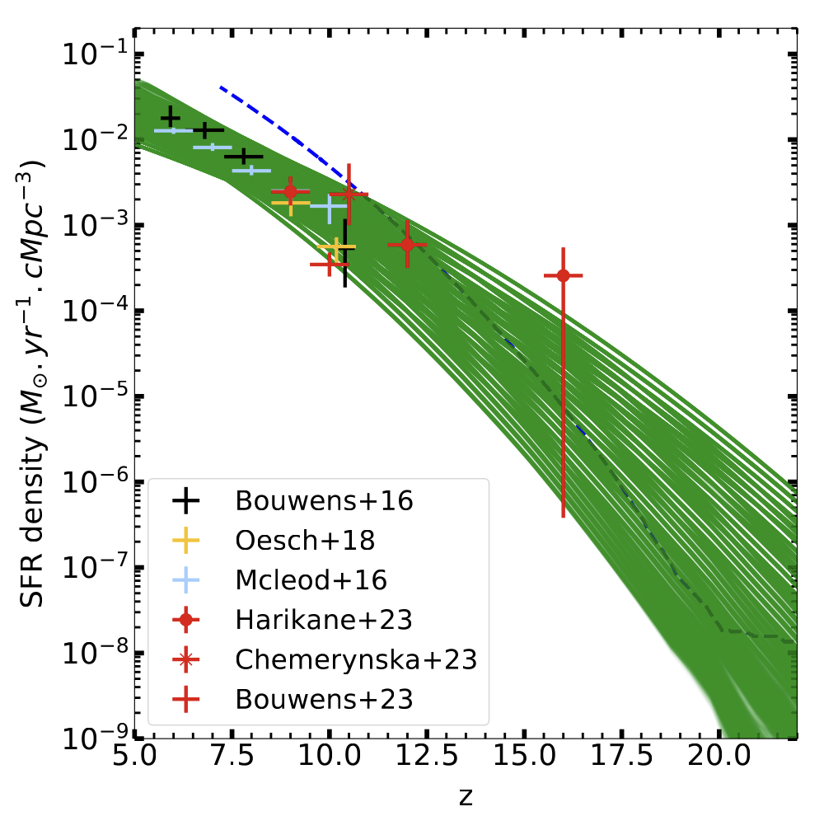
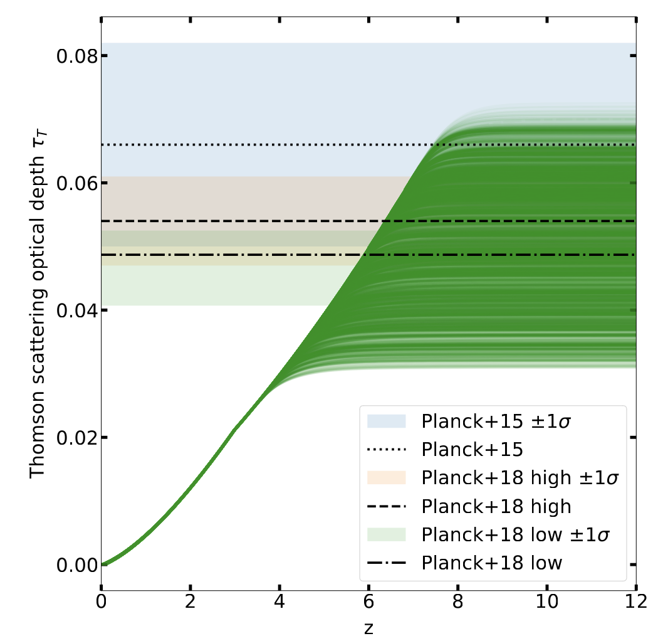
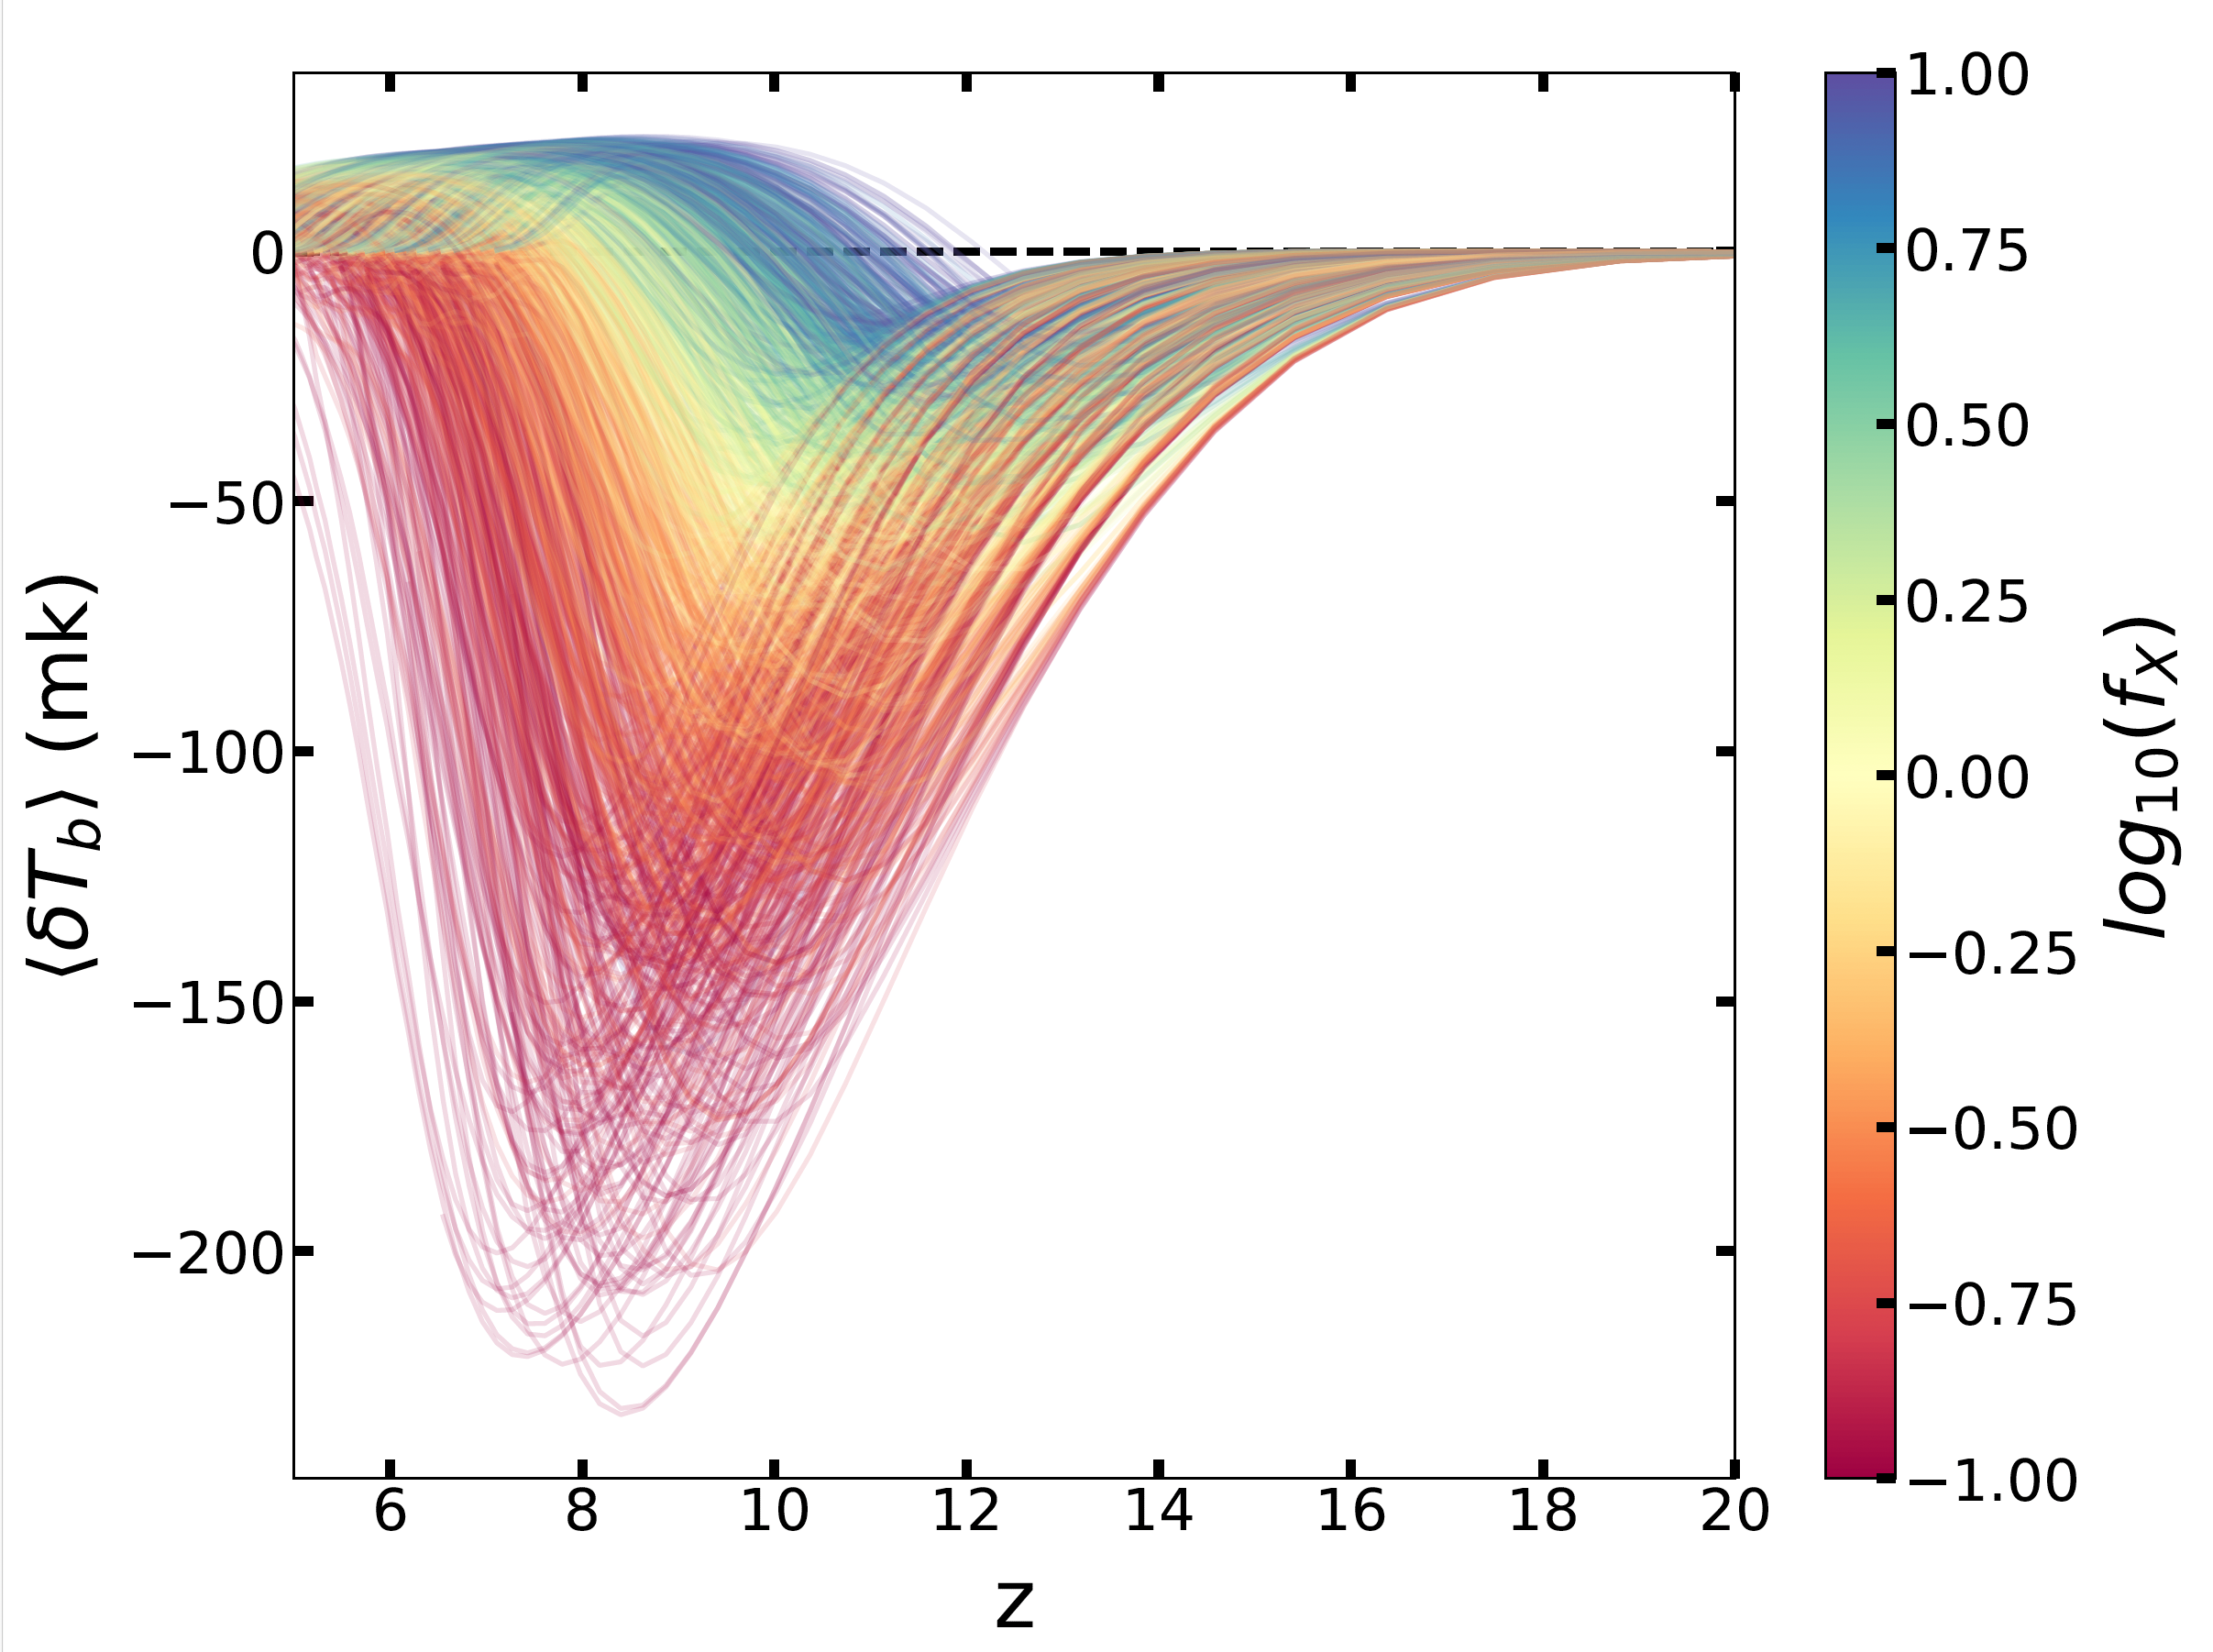
LoReLi II database (Mériot, Semelin and Cornu, in prep, 2024)
10 000 simulations (1.5 Po, 5 Mh CPU)
500 000 21-cm cubes (80 To)
Explore a 5-param space: f_{X}, M_{min}, 𝛕_{SF}, f_{esc ,} and R_{H/S}
Non-hypercubic domain (prior) to account for observational constraints
Mériot et al. (2024)
Mériot et al. (2024)
Mériot et al. (2024)

Slide 7
Principle of Simulation-based inference (SBI)
Baseline 21-cm inference:
- Data = power spectrum
- Assume uncorrelated noise with known variance and mean
=>$P\left( data \right| parameters )$ = analytical gaussian
But correlation exists and 21-cm signal is non gaussian (=> other statistical summaries)
If we can simulate the signal and the noise (yes we can!)
=> One simulation = one draw from $P\left( data \right| parameters )$
=> Train NN to fit $P$ (or the posterior) from a collection of draws (LoReLi II)
=> Use trained NN for very fast MCMC inference

Slide 8
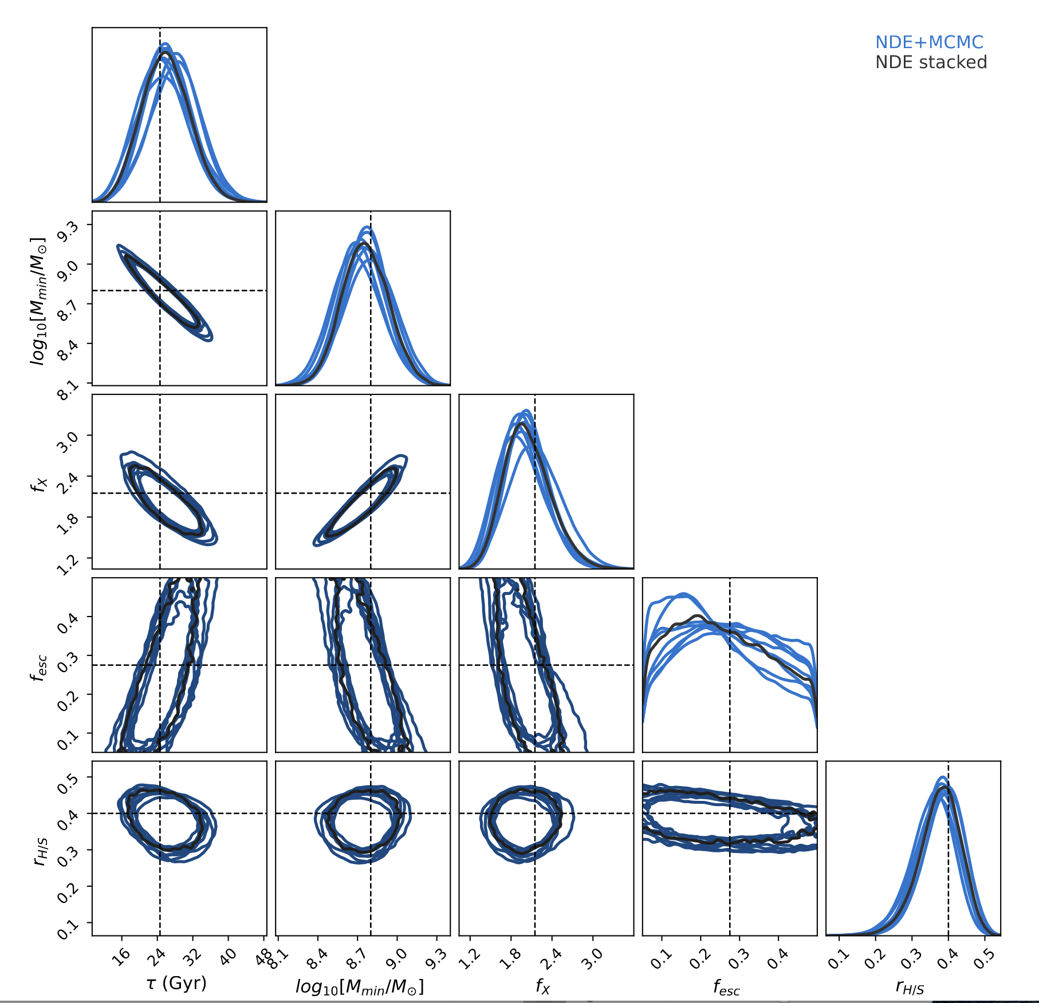
SBI with Loreli II
- Assume 100h SKA thermal noise
- Noiseless mock target signal
=> true params +/- centered
- Train 10 NN to evaluate stability
- Also infer with stacked NNs
Control validity with SBC (~1000 inferences!):
=> Bias < 0.2 𝜎
=> underconfident by ~20%
… a promising approach!

Slide 9
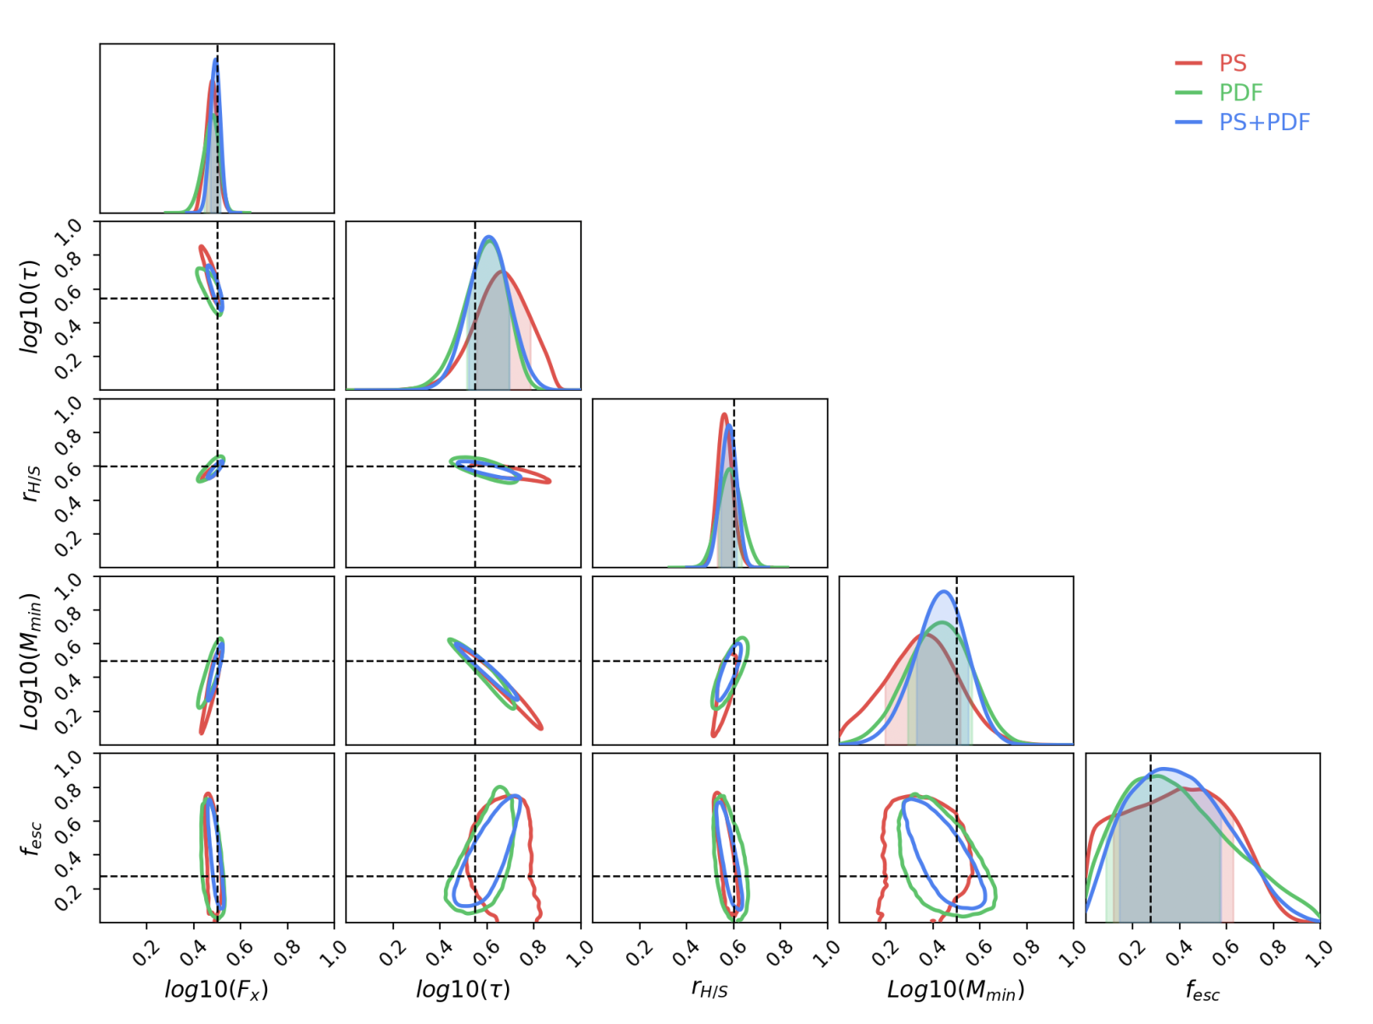
Maximizing information with SBI
Combining several summary statistics (or observables!):
- no analytic form for the likelihood
- not independent => correlations
Example with 21-cm signal:
- Power spectrum + Pixel Distrib Func)
- Fit joint likelihood with NDE
- Train NDE on LoReLi II
- MCMC inference
=> A net gain of information

Slide 10
Thank you!

Slide 11
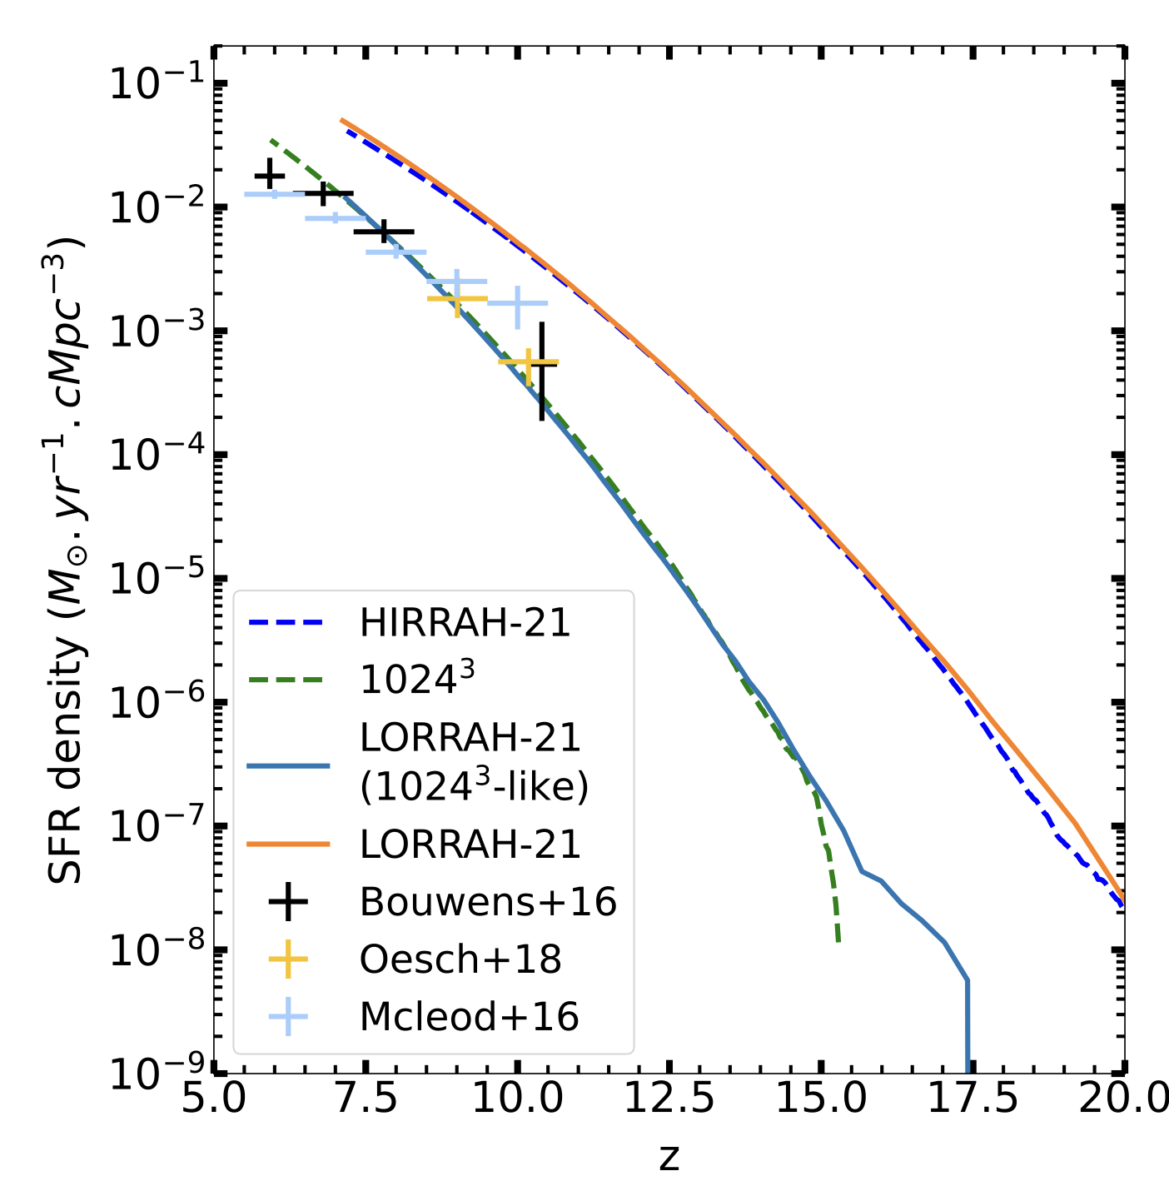
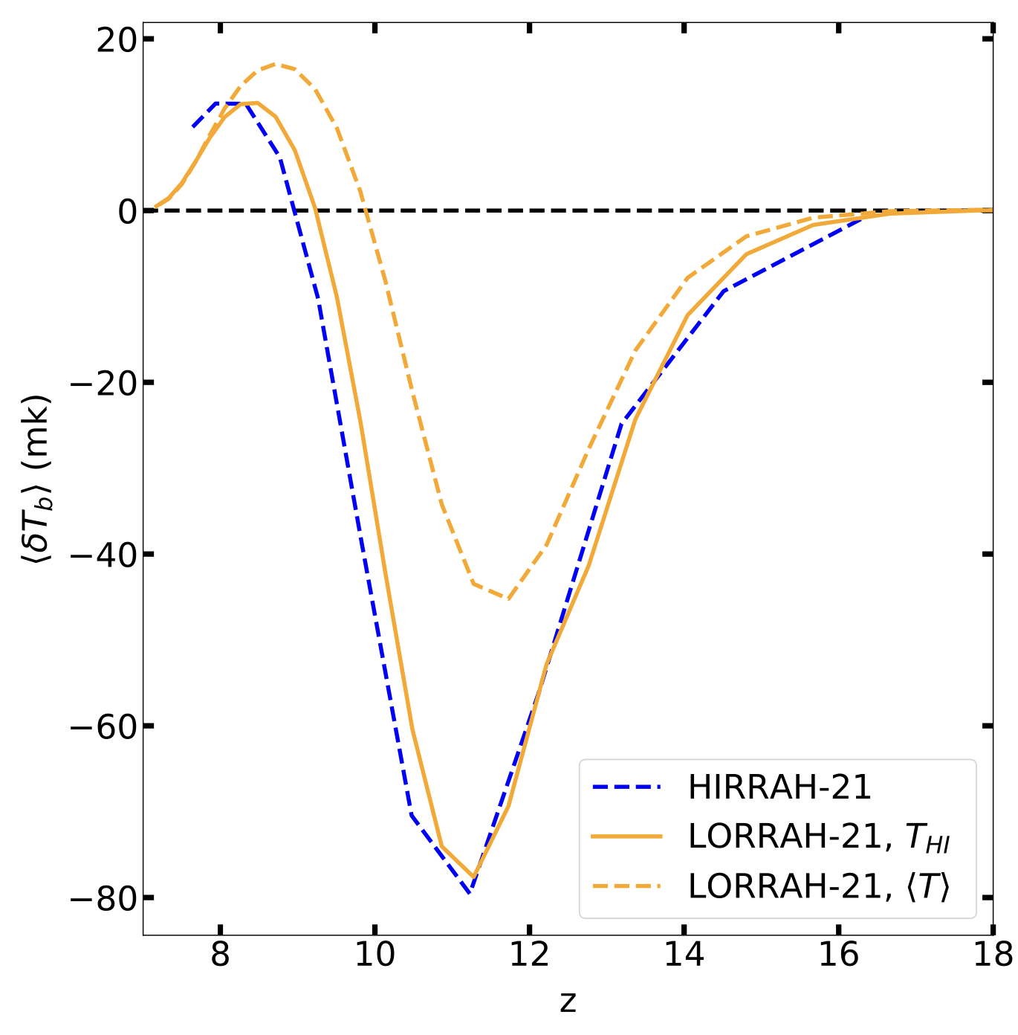
Training set of 3D RT simulations? (Mériot & Semelin 2024)
Doable with 256³ simulations (300 CPU hours per sim)
Algo adapt necessary to match high resolution results
SFR
Resolved halo: >10¹² M⦿
Subresolution needed!
CMF formalism
𝛅T_{b}
2-phase model
for gas particules T_{K}
Good match
1-phase
2-phase
Mériot & Semelin (2024)
Mériot & Semelin (2024)
Details + emulator-based inference in Mériot & Semelin( 2024)

Slide 12
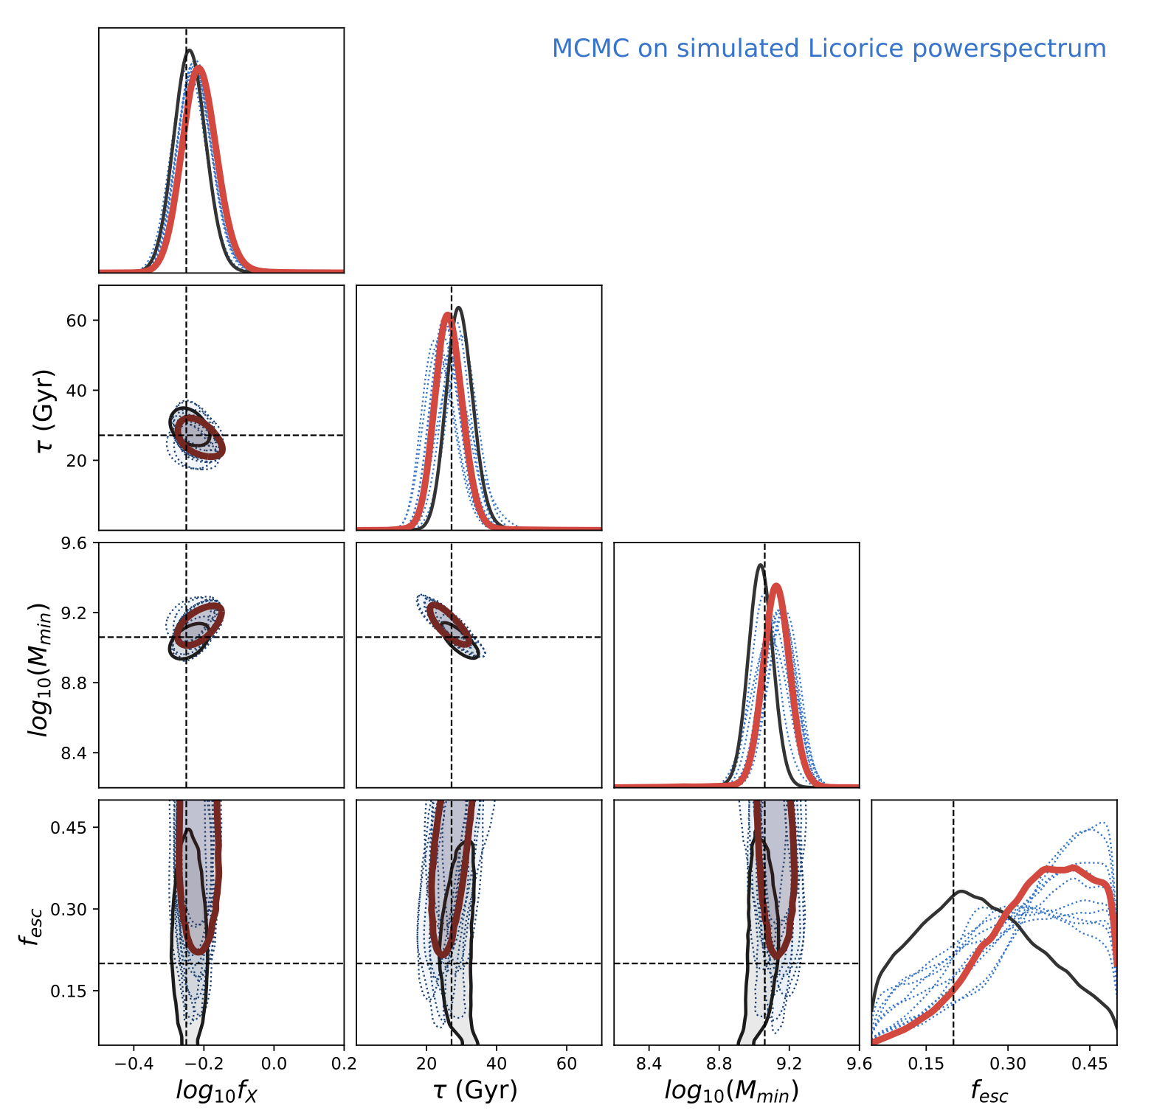
Inference: emulator + MCMC.
LorEMU Network:
- Input layer: k and z
- x3 512-neurons denses layers
- Output: P(k,z)
Trained on LoReLi 1
Target = simulated signal (not in training sample)
100h SKA thermal noise
Cosmic (sample) variance
Training variance
Stacking (averaging) 9 emulators
- with thermal noise
- without therma noise
=> <10% accuracy →

