Slide 1
CSP.LMC on the way to Array Assembly 0.5
Ivana Novak
ivana.novak@cosylab.com

Slide 2
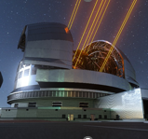
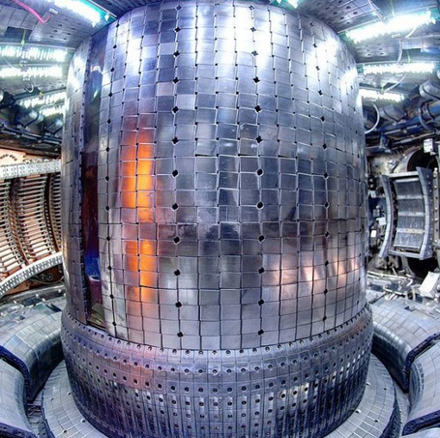
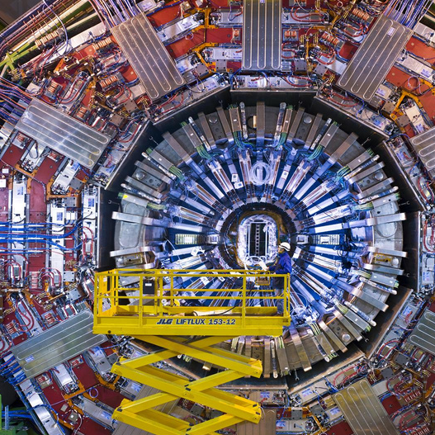
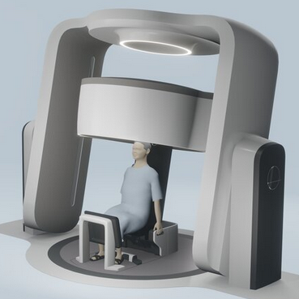
Cosylab’s profile
Company
Powered by Cosylab
The leading provider of turnkey software solutions and electronics for the world's most complex, precise and advanced systems
20+ years of experience
Global team of 300+ highly skilled developers and engineers
Exceptional expertise and innovation
Established processes, ISO certified and IEC compliant
HQ in Europe; subsidiaries worldwide
Cancer therapy systems / Complex medical devices / Particle accelerators / Large telescopes / Fusion reactors / Space industry
Switzerland
Slovenia HQ
Japan
China
United States
References

Slide 3
SKA Events in 2023/2024
2 FTEs within Cream team led by INAF
Funding extension – Cosylab is a software supplier until the end of construction
Reorganization of ARTs
PI21 Planning in Rome, Italy
PI22 Planning in Brugg, Switzerland
PI23 Planning in Pune, India
Visit to GMRT

Slide 4
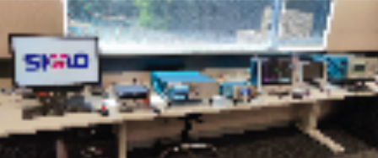
Signal/Observed data
Control & Monitoring data
<< system >>: SKA Observatory Software
Infrastructure Services
Observatory Science Operations (OSO)
Observation Data Archive
Platform Services
Configuration Management
Telescope Monitoring and Control
Engineering Data Archive
Engineering Management System
Synchronzation & Timing
SKA Regional Centre Network
System ITF Test Equipment
MID Telescope
Central Signal Processor (CSP)
Visibilities, Pulsar candidates...
Science Data Processor (SDP)
Dish Monitoring & Control
Digitized, packetised data
Local Monitoring & Control
SDP Monitoring & Control
Observatory Data Products
LOW Telescope
Correlator &
Beamformer
Pulsar Search
SDP Science Workflow & Data Services
Low Array Monitor, Control & Calibration System (MCCS)
Station Beams
VLBI
Pulsar Timing
Real-Time Processing
Batch Processing
Courtesy of Marco Bartolini
Receptors
Analogue Hardware
Digital Hardware
Digital Hardware
Computing Equipment
Data Processing Software
HPC Computing Software
Data Processing Software
Notes:
Nongrouped

Slide 5
Telescope Control System
Signal/Observed data
Control & Monitoring data
<< system >>: SKA Observatory Software
Telescope Monitoring and Control
LOW Telescope
Central Signal Processor (CSP)
Science Data Processor (SDP)
Digitized, packetised data
Local Monitoring & Control
SDP Monitoring & Control
Low Array Monitor, Control & Calibration System (MCCS)
Correlator &
Beamformer
Pulsar Search
Pulsar Candiates
SDP Science Workflow & Data Services
Station Beams
Pulsar Timing
Pulsar Timing Beams
Real-Time Processing
Batch Processing
Low Array Monitor, Control & Calibration System (MCCS)
Visibilities
Receptors
Analogue Hardware
Digital Hardware
Digital Hardware
Computing Equipment
Data Processing Software
HPC Computing Software
Data Processing Software
Observatory Data Products
Notes:
Nongrouped

Slide 6
Low Telescope Control System
Signal/Observed data
Control & Monitoring data
<< system >>: SKA Observatory Software
Telescope Monitoring and Control
LOW Telescope
Central Signal Processor (CSP)
Science Data Processor (SDP)
Digitized, packetised data
Local Monitoring & Control
SDP Monitoring & Control
Low Array Monitor, Control & Calibration System (MCCS)
Correlator &
Beamformer
Pulsar Search
Pulsar Candiates
SDP Science Workflow & Data Services
Station Beams
Pulsar Timing
Pulsar Timing Beams
Real-Time Processing
Batch Processing
Visibilities
Receptors
Analogue Hardware
Digital Hardware
Digital Hardware
Computing Equipment
Data Processing Software
HPC Computing Software
Data Processing Software
Notes:
Nongrouped

Slide 7
Observing State and Comamnds
Telescope Monitoring and Control
Central Signal Processor (CSP)
Digitized, packetised data
Local Monitoring & Control
Correlator &
Beamformer
Pulsar Timing
Station Beams
Pulsar Timing Beams
Visibilities
Signal/Observed data
Control & Monitoring data
Observatory Data Products
Notes:
Nongrouped

Slide 8
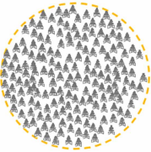
Low Array Assembly 0.5
Signal/Observed data
Control & Monitoring data
<< system >>: SKA Observatory Software
Telescope Monitoring and Control
LOW Telescope
Central Signal Processor (CSP)
Science Data Processor (SDP)
Digitized, packetised data
Local Monitoring & Control
SDP Monitoring & Control
Low Array Monitor, Control & Calibration System (MCCS)
Correlator &
Beamformer
Pulsar Timing
SDP Science Workflow & Data Services
Station Beams
Pulsar Timing Beams
Real-Time Processing
Batch Processing
Visibilities
Receptors
Analogue Hardware
Digital Hardware
Digital Hardware
Computing Equipment
Data Processing Software
HPC Computing Software
Data Processing Software
Observatory Data Products
Notes:
Nongrouped

Slide 9
Integration of CSP LOW: CSP-LMC+CBF+PST
At LOW PSI in Australia
Test with
hardware in the loop
complete real-time signal chain
Performed by Perentie team in LOW demo on 22.8.
With the objective of giving integration teams the ability to configure and execute multiple scans for visibilities and/or PST

Slide 10
CSP.LMC Taranta Dashboard

Slide 11
Steps
Central Signal Processor (CSP)
Steps to produce data
Turn the system on
Assign resources
Configure resources
Start a scan
LMC
Controller
Subarray 1
To-Do
TMC not integrated yet - delay polynomials simulated, CSP.LMC entrypoint
CNIC (SPS)
Some manual steps accessing low level devices directly
CBF
PST
Delay polynomial simulator
Controller
Subarray 1
Beam 1
Processor
Allocator
CNIC
Connector
Observatory Data Products
Notes:
Nongrouped

Slide 12
Integration of CSP LOW: CSP-LMC+CBF+PST - setup
Configuration:
Subarray 1
Station Beam 1
6 Stations - #18, 34, 21 42, 54, 72
1 SPS Channel
#100 for CBF configuration
Frequency = 78,125,000 Hz for PST
PST beam #1
CNIC station source
Time set to 13180 seconds after SKA Epoch (~3 hours 40 minutes)
Station Direction RA: 2h30m00 Dec: -26d49m50
PST beam direction RA: 2h30m00 Dec: -21d49m50
Repeating time gating: 9216 SPS samples on, 9216 off

Slide 13
Assign Resources Command
Central Signal Processor (CSP)
LMC
Controller
Subarray 1
Assign Resources
Delay polynomial simulator
CBF
PST
Controller
Subarray 1
Beam 1
CNIC
Processor
Allocator
Connector
Observatory Data Products
Notes:
Nongrouped

Slide 14
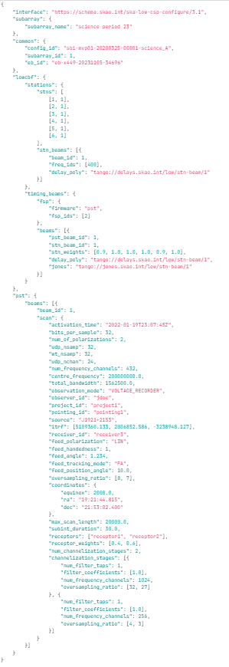
Configure Command
Central Signal Processor (CSP)
LMC
Controller
Subarray 1
Configure
Delay polynomial simulator
CBF
PST
Controller
Subarray 1
Beam 1
CNIC
Processor
Allocator
Connector
Observatory Data Products
Notes:
Nongrouped

Slide 15
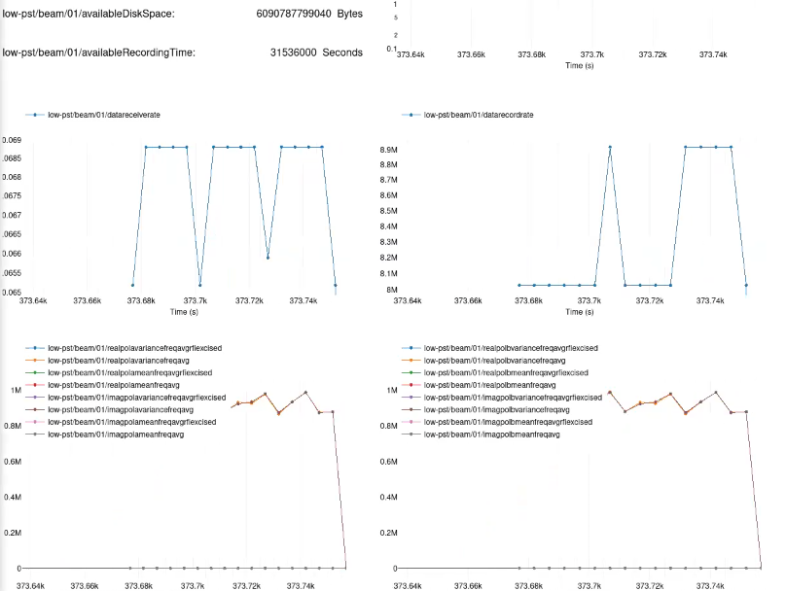
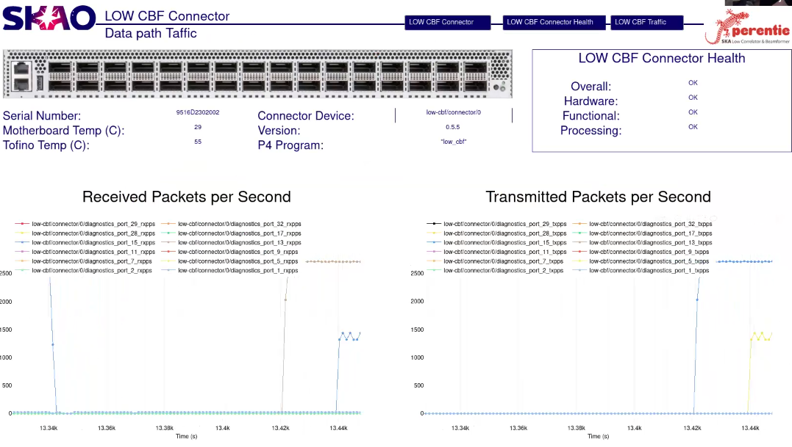
Scan Command
Central Signal Processor (CSP)
LMC
Controller
Subarray 1
Scan
Delay polynomial simulator
CBF
PST
Controller
Subarray 1
Beam 1
CNIC
Processor
Allocator
Connector
Observatory Data Products
Notes:
Nongrouped

Slide 16
CNIC generates data

Slide 17
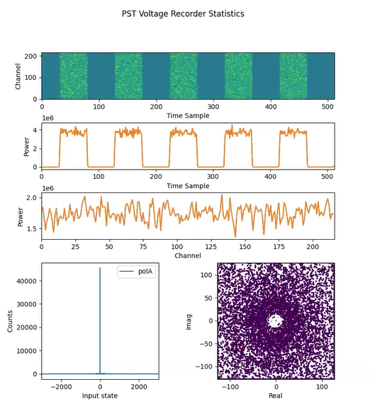
PST receives data

Slide 18
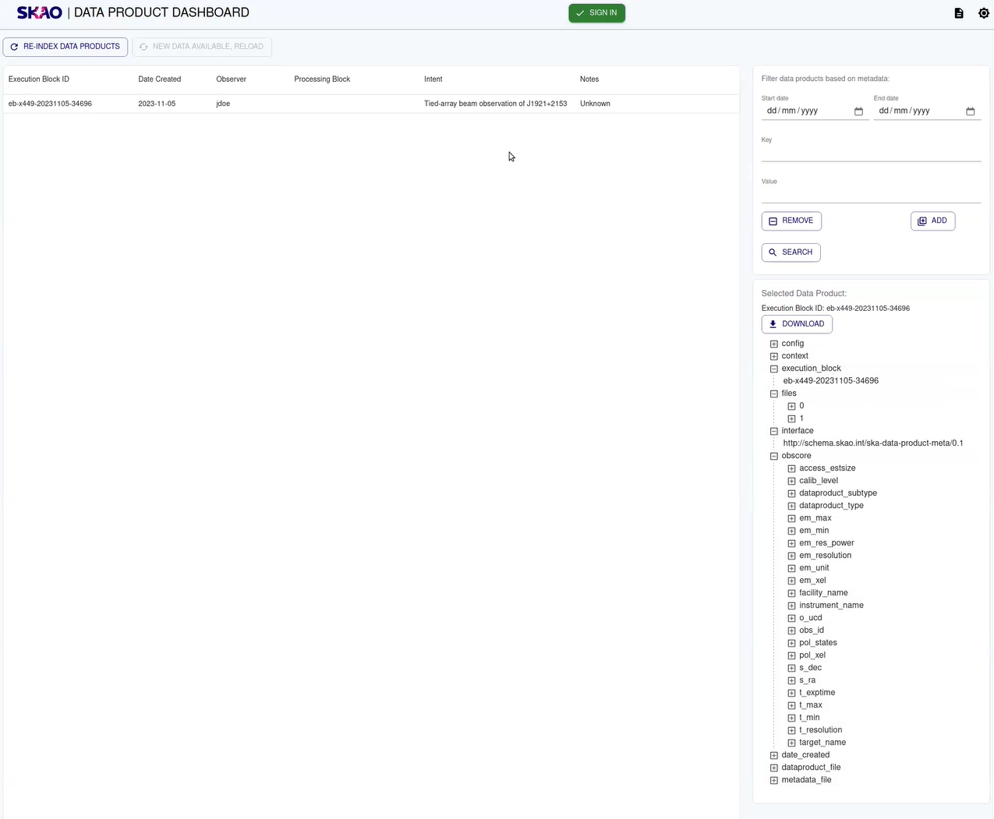
...and stores it!

Slide 19
Next step
Telescope Monitoring and Control
Central Signal Processor (CSP)
LMC
Controller
Subarray 1
Delay polynomial simulator
CBF
PST
Controller
Subarray 1
Beam 1
CNIC
Processor
Allocator
Connector
Observatory Data Products
Notes:
Nongrouped

Slide 20
Other work
development of new functionalities
ensuring continuous compatibility with interfacing systems
pairwise testing with TMC
Monitoring features
MID: integration in MID ITF
HW
With TMC as well
Articles:
ICALEPCS 2023: Strategy and Tools to Test Software in the SKA Project: The CSP.LMC Case
SPIE 2024: Enhancing SKA software testing through data mining strategies

Slide 21
Ivana Novak
Ivana.novak@cosylab.com

