Slide 1
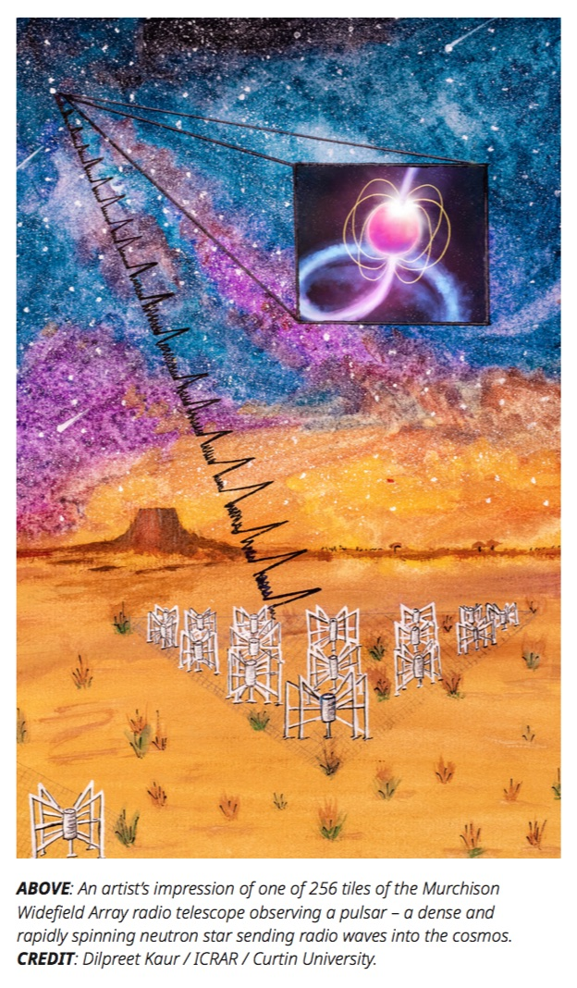
The SMART pulsar survey and its role in the SKA era
Ramesh Bhat
and the SMART collaboration
Swiss SKA Days, Geneva, 2 – 4 September 2024
Notes:
Good morning everyone
Thanks for this opportunity

Slide 2
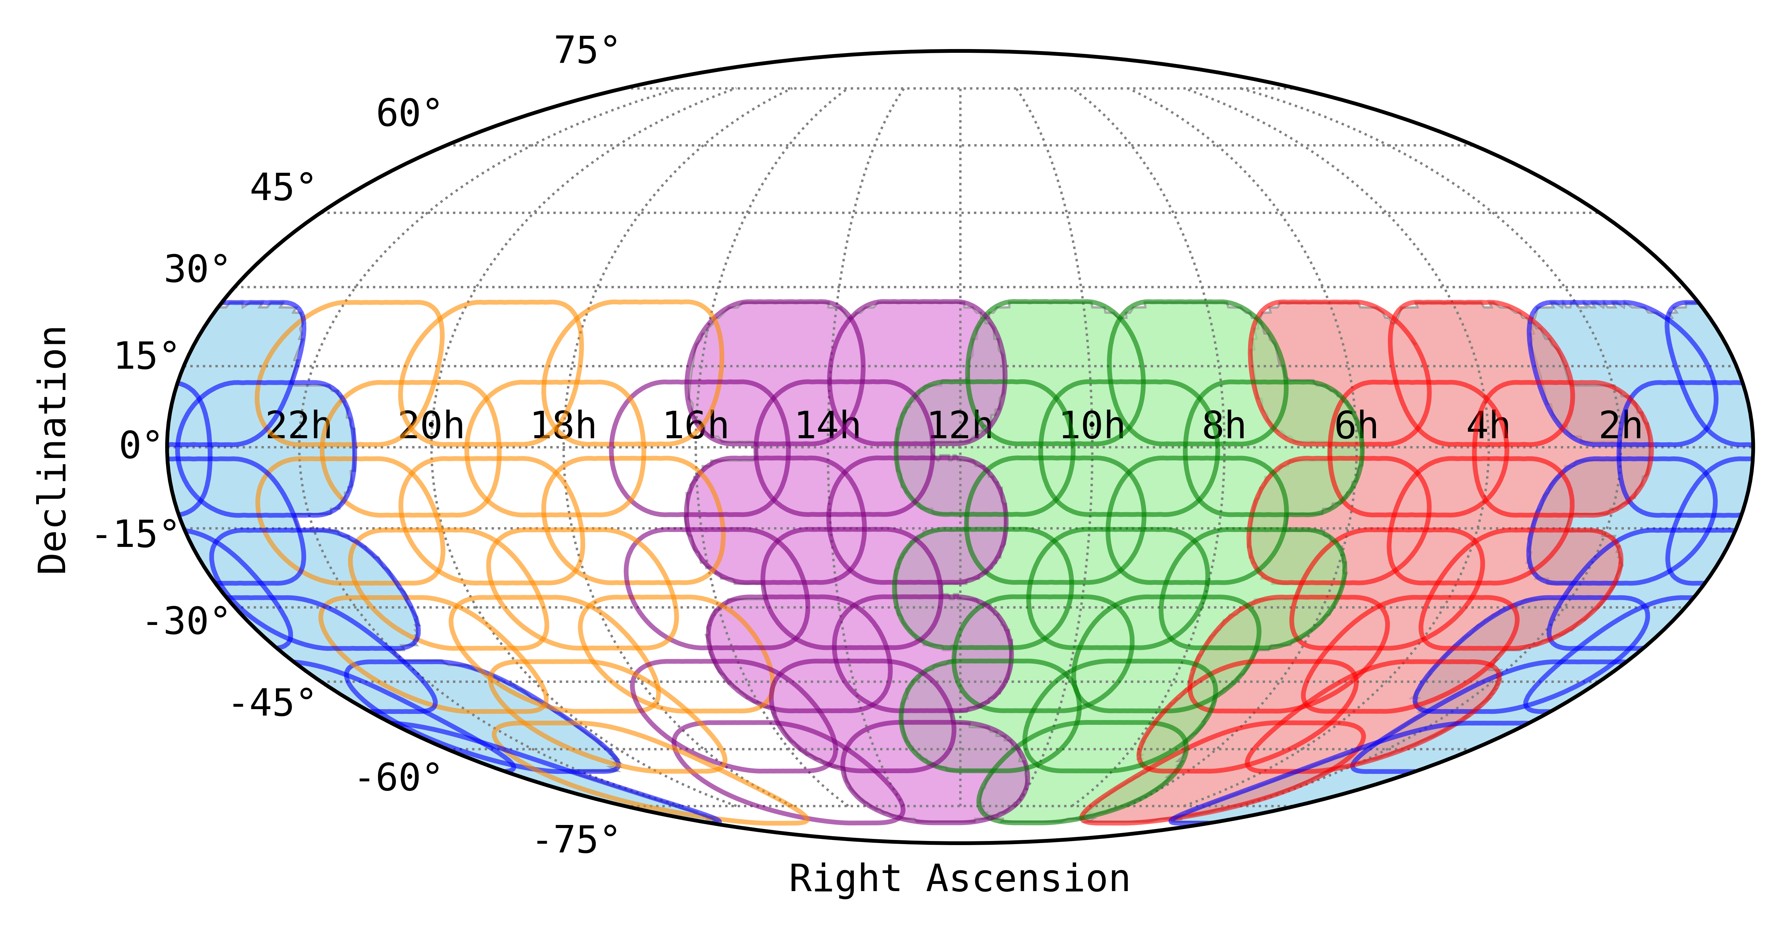
The Southern-sky MWA Rapid Two-metre (SMART) Survey
Exploits the MWA’s large Field of View, the voltage capture system (VCS) capability, and the compact configuration of the Phase 2 array
Large FoV (~610 deg² at 150 MHz) and the VCS for data recording ➔ a survey speed of ~450 deg² hour⁻¹
Compact configuration (128 tiles within ~300 metres) ➔ ~ 2 – 3 orders of magnitude saving in the beamforming cost
First southern-sky pulsar survey in the frequency band of SKA-Low
Frequency band: 140-170 MHz
Recording at 100-μs and 10-kHz resolutions
Long dwell times (4800 second per pointing)
Tied-array beam size ~23 arcminutes
6000-8000 beams per each observation
100 hours to cover the full sky south of +30º
600,000 tied-array beams for the full survey
Large Data rate: 42 – 84 TB per observation
Notes:
The SMART survey is an all-sky pulsar project that exploits several unique advantages of the MWA, like low frequencies, large field of view, compact configuraton after the upgrade, and most imprtantly a capability to record high time resolution voltage data from every single detector – we call it the voltage capture system or VCS. The compant config means orders of magnitude saving in beamforming cost which is incredibly important to make full scale searches tractable with interferometric like this. With the VCS slike system we essentially sample ~ 600 sq deg instantaneously in high time/freq resolution. Still we are talking about 1000s of tied-array / phased array beams per each observation, and that means over a half a million beams to cover the full southern sky. The combination brings astonishingly large survey speed (in terms of data collection) ~ 500 sq deg per hour, and hence Rapid, But that doesn’t undermine the fact that the processing cost are enormous at low frequencies and substantial processing needs for the full search processing.

Slide 3
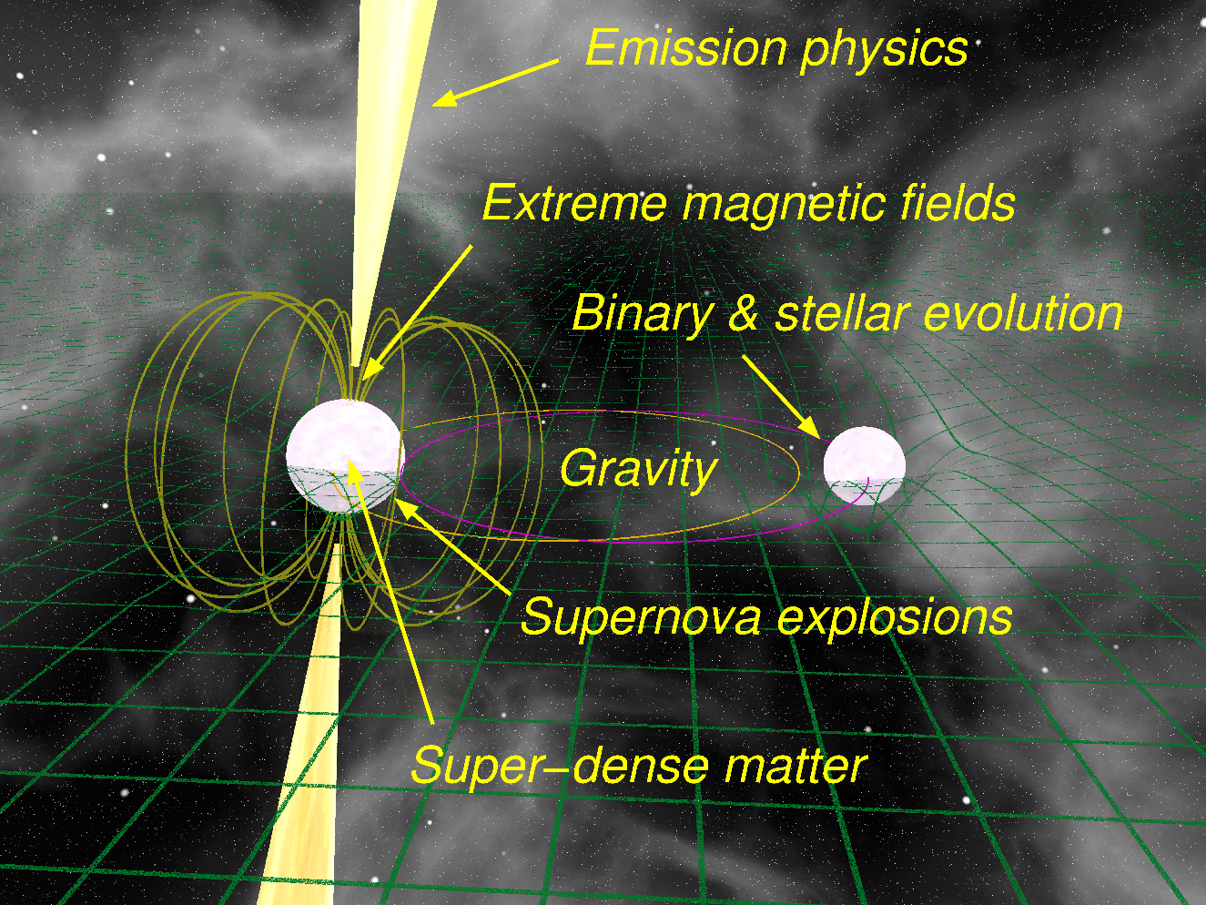
Why search for more pulsars?
Populations
Neutron Stars
Supernovae / Massive Stars
Binaries
Millisecond Pulsars (MSPs)
Exotic Systems
Triple Systems
Double Pulsar
Pulsar-BH
Double Neutron Stars (DNSs)
Clocks
Time Standard
Interstellar Medium
Dispersion
Scattering/Scintillation
Faraday rotation
Extreme Environments
Large B-field
Neutron Star Interior
Tight Binary systems
Fast Spinning
Theories of Gravity
Tests of GR
Tests of Alternatives
Gravitational Waves
Pulsars are laboratories of physics, and tools for physical laboratories
Notes:
Why do we need more pulsars? A shot answer is the shear depth and breadth of science that we can do with these amazing objects – from understanding the supernovae and NS birth rates in the Galaxy to tracing complex stellar evolutionary histories, and from mapping out the magneto-ionic plasma in the galaxy to probing performing exquisite tests of general relativity and theories of gravity using exotic systems like the double pulsar and such relativistic binaries, pulsars are phenomenally wonderful tools for advancing physics. In fact using an array of fast spinning and very stable millisecond pulsars for the detection of very low frequency GWs is tipped as a key science for Phase 1 SKA, and there going to be multiple presentations focused in this topic. To put it plainly, pulsars are excellent laboratories for physics and they make excellent tools for physical laboratories. And it is a key science for SKA

Slide 4
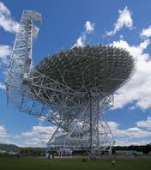
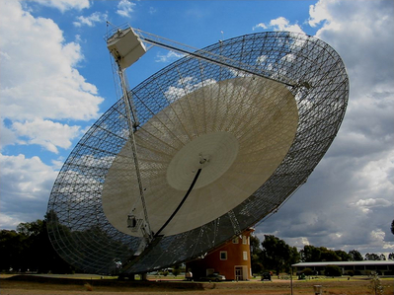
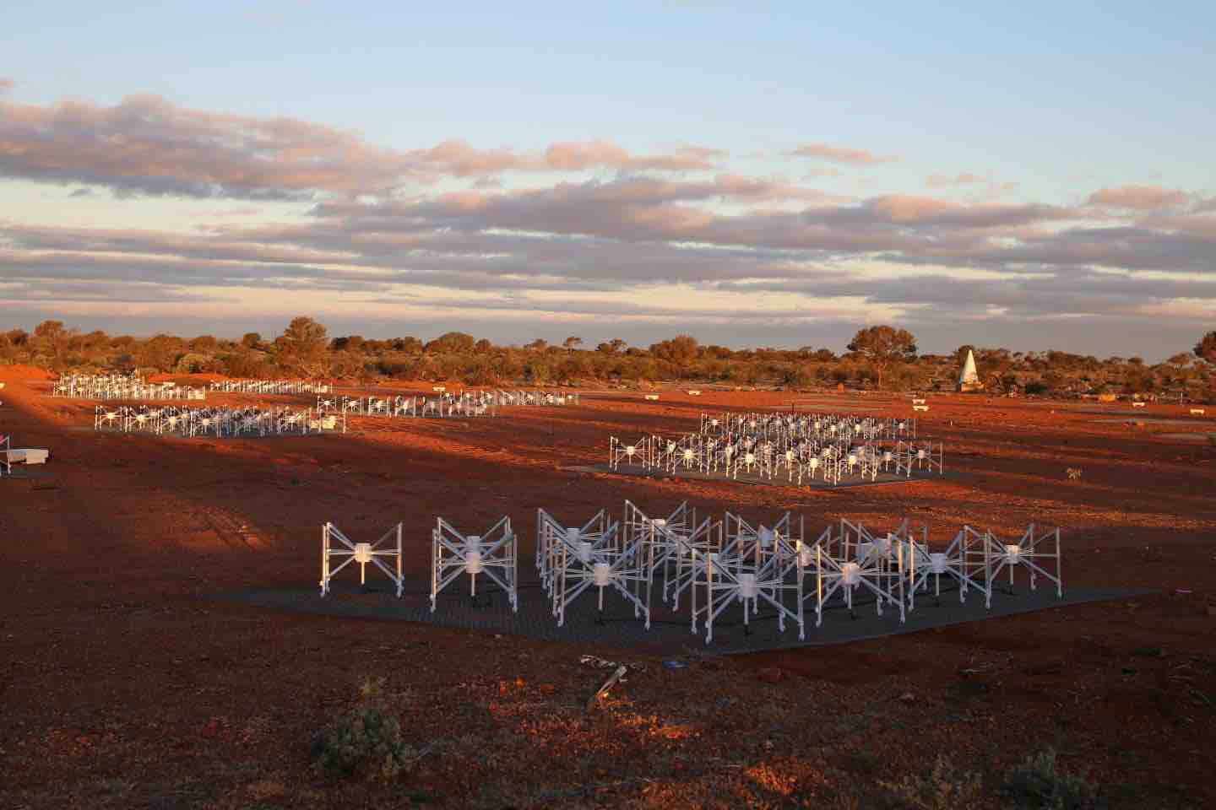
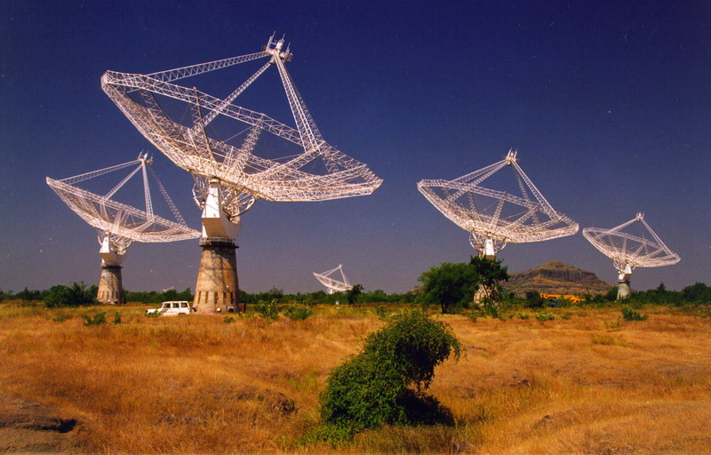
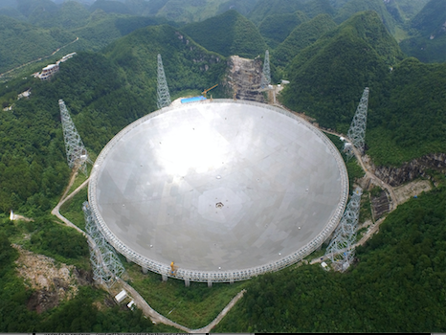
SMART complements all other major surveys
LOFAR (LOTAAS)
GBT (GBNCC)
Murriyang (HTRU)
Sanidas et al. (2019)
Stovall et al. (2014)
Keith et al. (2010)
MWA (SMART)
GMRT (GHRSS)
FAST (GPPS)
Bhat et al. (2023)
Bhattacharyya et al. (2016)
Han et al. (2021)
Notes:
Motivated by the success of LOFAR and GBT surveys
But also nicely complements all other major surveys that are ongoing at the moment

Slide 5
SMART is a survey with SKA precursor
SMART is unique on several counts: e.g. novelty in data recording, and as a reference for surveys planned with SKA-Low
SKA precursor pulsar survey: synergistic overalp with calbration and beamforming methodologies likely relevent for SKA-Low
Reference survey for SKA-Low, providing complete digital record of the southern sky
Voltage-capture mode for data recording (as opposed to filterbank data format of all other surveys) ➔ a multitude of processing (and reprocessing) avenues for follow-ups and confirmation (inc timing/localisation)
3-5 times deeper than previous-generation low-frequency pulsar survey (Parkes 70cm from 1990s), and 2-3 times more sensitive compared to high-latitude Parkes HTRU
Complementarity with ongoing surveys (e.g. LOFAR, GBT, GMRT, FAST) in terms of sky and/or frequency coverages
Search for pulsars (and fast transients) in the new parameter space opened up by the MWA
Map out the pulsar population in the southern sky at the low frequencies
Inform pulsar survey and science prep for the SKA-Low
Notes:
the SMART survey also has a few additional roles or benefits that are worth mentioning. It’s an SKA precursor survey which means higher degree of….
And unlike other past and ongoing surveys we are using the voltage capture mode i..e recording raw unprocessed data (as opposed to...) which means a whole range of processing avenues ....
Away from the plane where propagation effects are no longer limitation, the survey will be several times deeper than previous-generation low freq survey from the 1990s and and a few times more sensitive too….
It also nicely complements…. Importantly, it will also serve as an excellent reference for SKA – Low and will generate a full digital record of the southern sky at low frequencies. ... The main goals are....

Slide 6
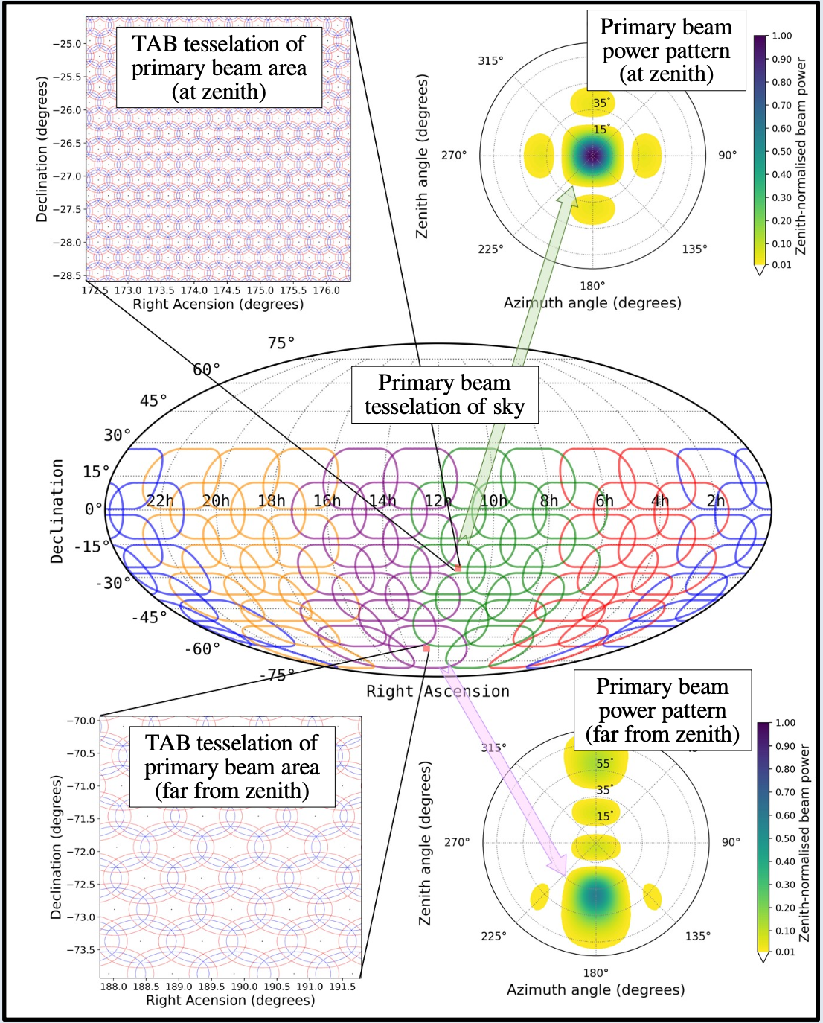
Survey strategy & beamforming
Each SMART observation (~ 610 deg²) is processed to form ~ 6000 to ~ 8000 tied-array (phased-array) beams
Multi-pixel beamformer the front-end workhorse for SMART search pipeline
Bhat et al. (2023), PASA, 40, e020
6
Notes:
8/23/24
6
6
Delving into a bit of technical aspects…
Two important things to note here is the way we tessellate the sky – we essentially do a dense grid to Nyquist sample at a power level higher than half power point even at the high end of the frequency band 140-170 MHz
Secondly, as you can see we have a significant overlap in the survey pointings, which means evey single pointing can play a dual role – both as a discovery observation and potentially for confirmation of pulsars that will be found in adjacent beams – effectively making it like a two –pass survey

Slide 7
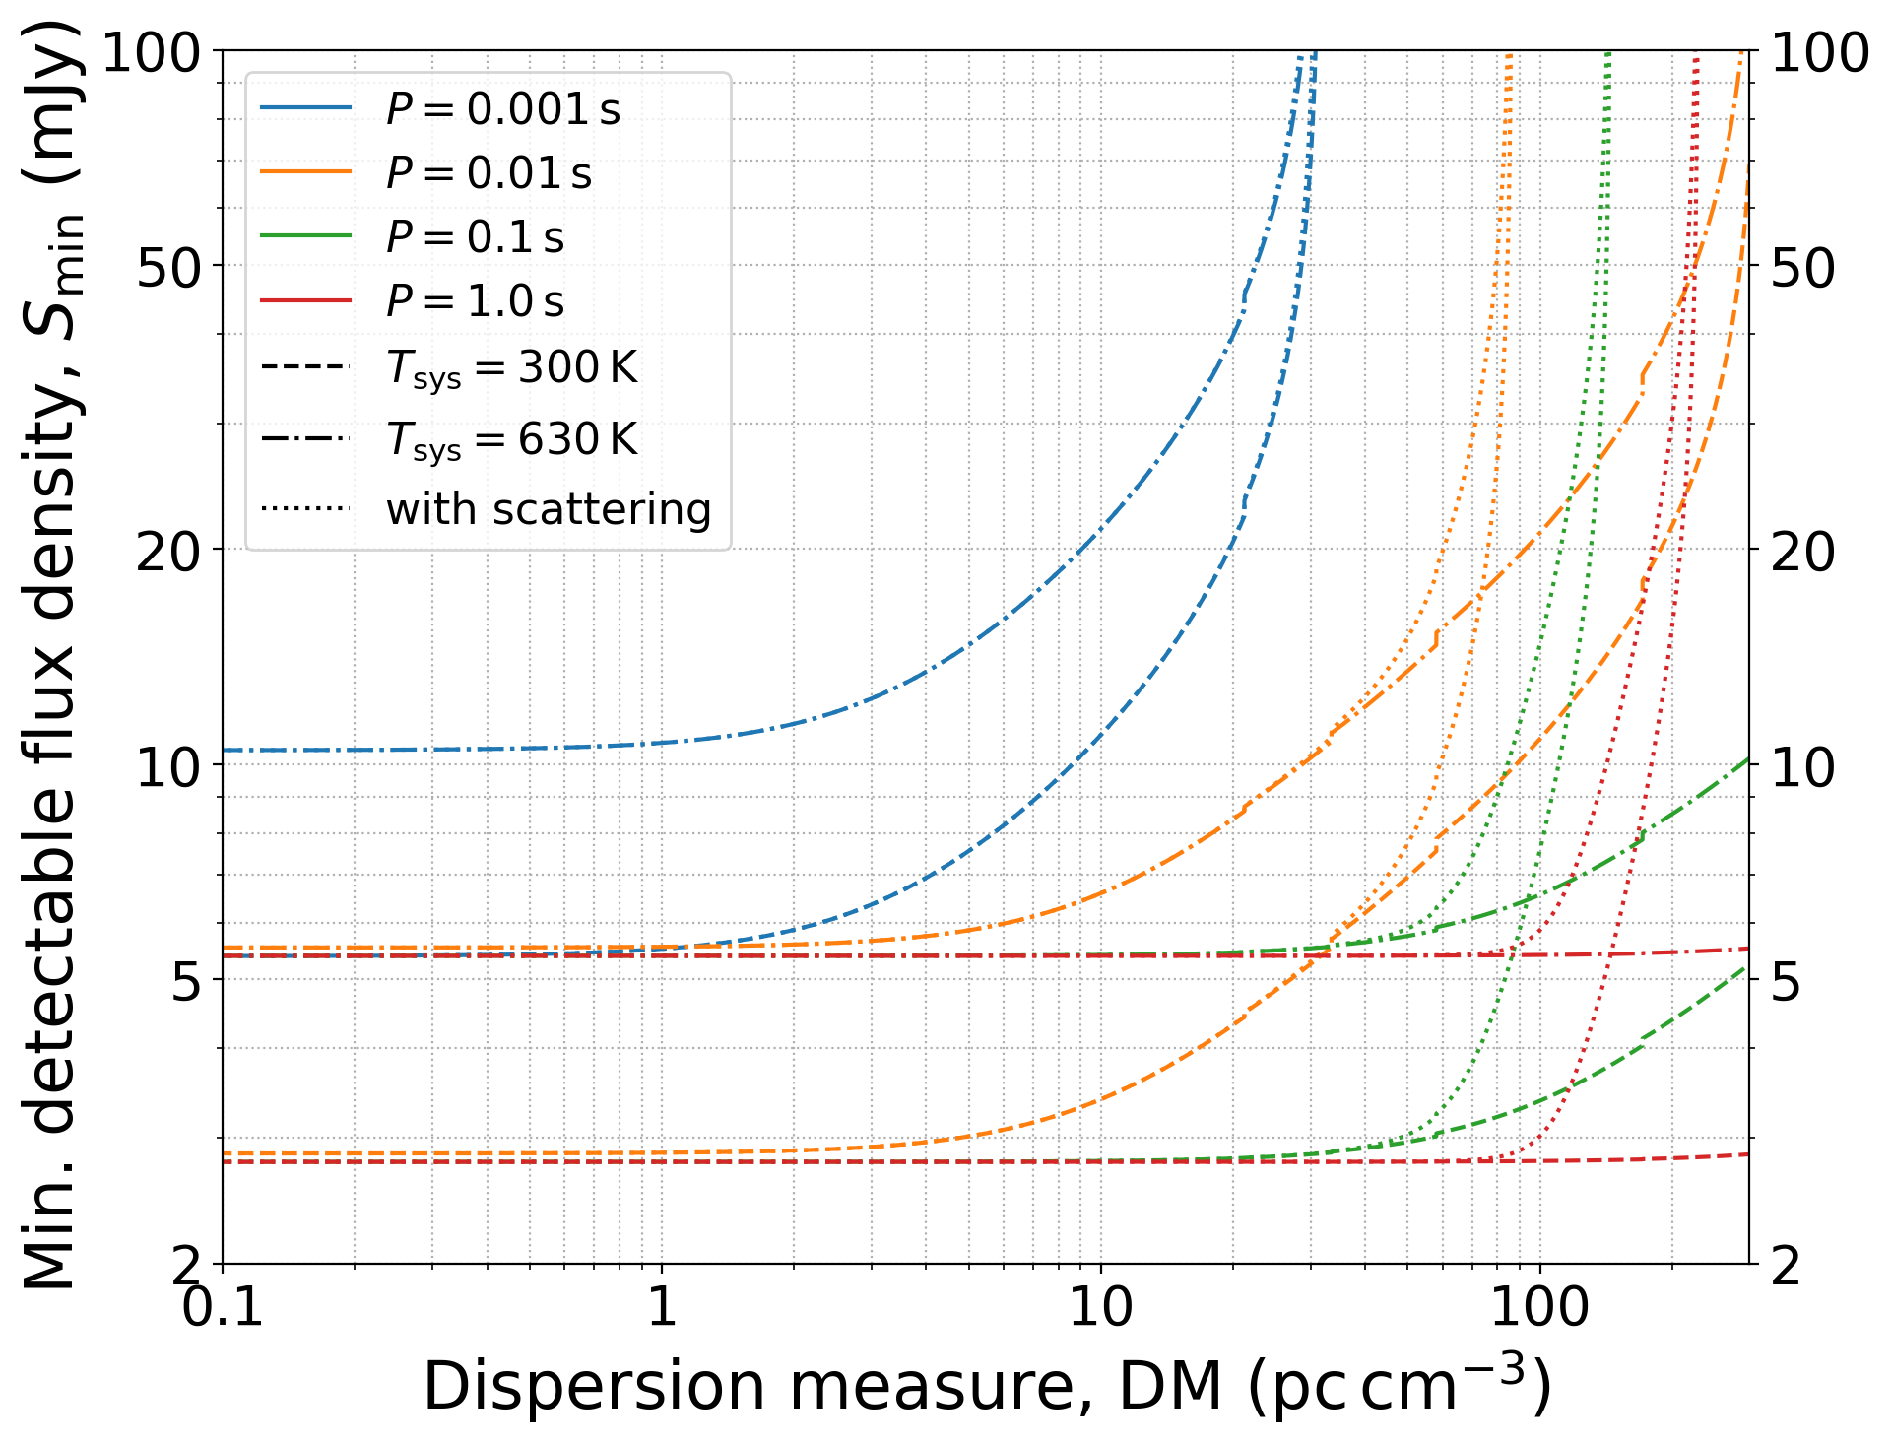
SMART Search sensitivity
For full observation (dwell time = 80 mins, i.e. for the second pass processing)
Approx. 2 x less sensitive compared to LOTAAS (the LOFAR survey)
Scattering is primarily an issue in the Galactic plane and near Galactic Centre
Sensitive down to DM ~ 50 for MSPs and DM ~200 for long-period pulsars
Limiting search sensitivity:
~2-3 mJy for long-period pulsars (P ~ 1 second or longer)
~5-10 mJy for short-period (MSPs) pulsars (P ~ 1- 10 ms)
Notes:
One of the big questions particularly when it comes to searching for pulsars at low frequencies is how far you can see and how deep…
…
The bottomline takeaway is that for long period pulsars we can down to ~2-3 mJy
Acknowledge Jason’s comment to design the survey to make it as comparable in sensitivity…
include the sensitivity formula (from the Bhat et al. paper)?

Slide 8
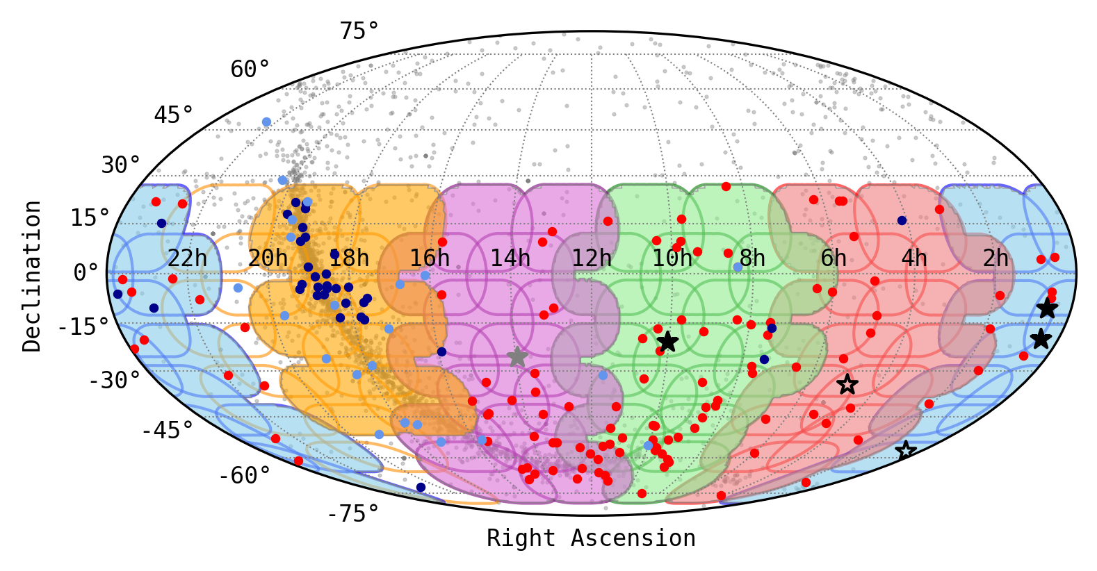
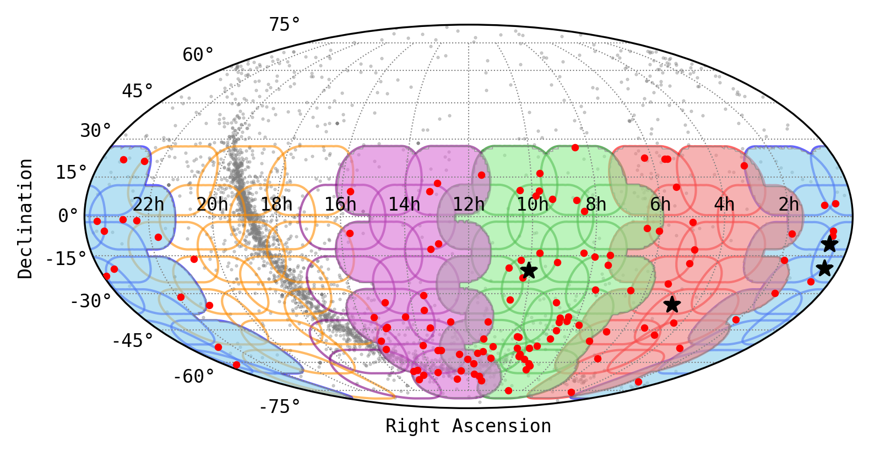
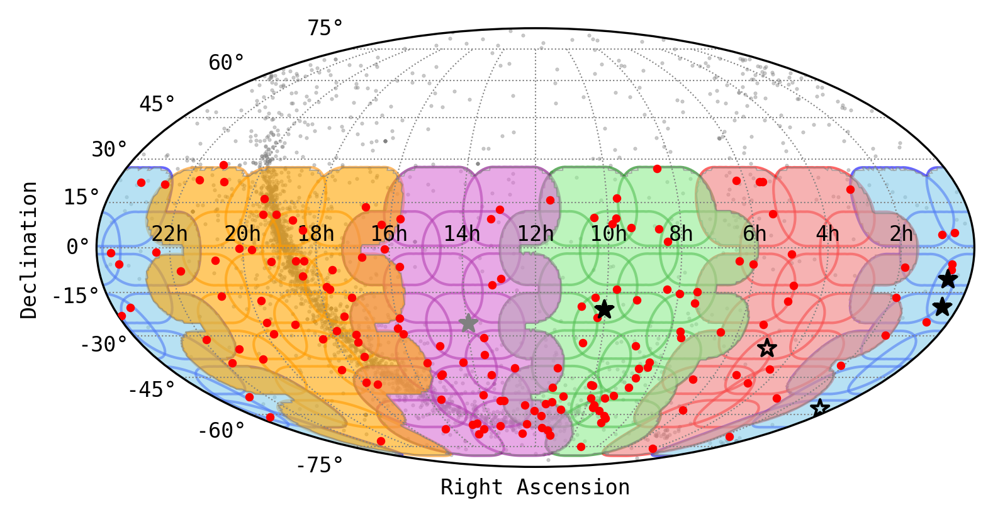
Data Collection & Processing
As of July 2023: 100% sky coverage from ~4.5 semesters of observations
3.9 PB of data
2018B
2019B
2020A
2021A
2023A
2023A
Data collection: 3.9 PB data so far (from 2018 - 2023 observing campaigns)
Full survey: 4.0 PB data, ~585,000 beams to tesselate the sky (dec < +30º)
Filled stars: SMART discoveries/re-discoveries (published in SMART papers)
Unfilled stars : New (unpublished) pulsars (discovered/confirmed in SMART)
Notes:
This was a significant milestone!

Slide 9
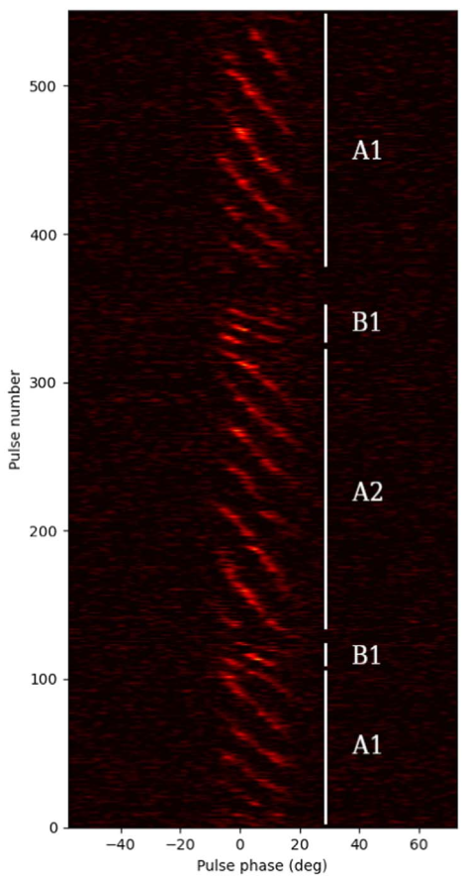
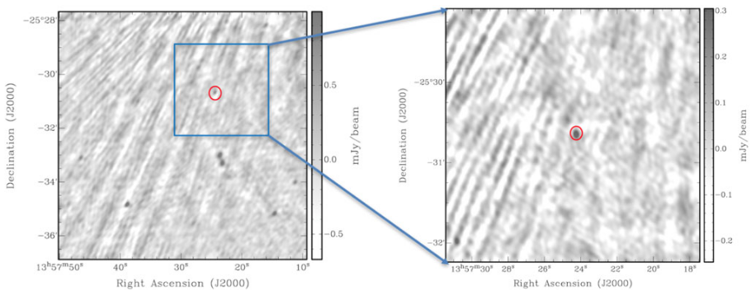
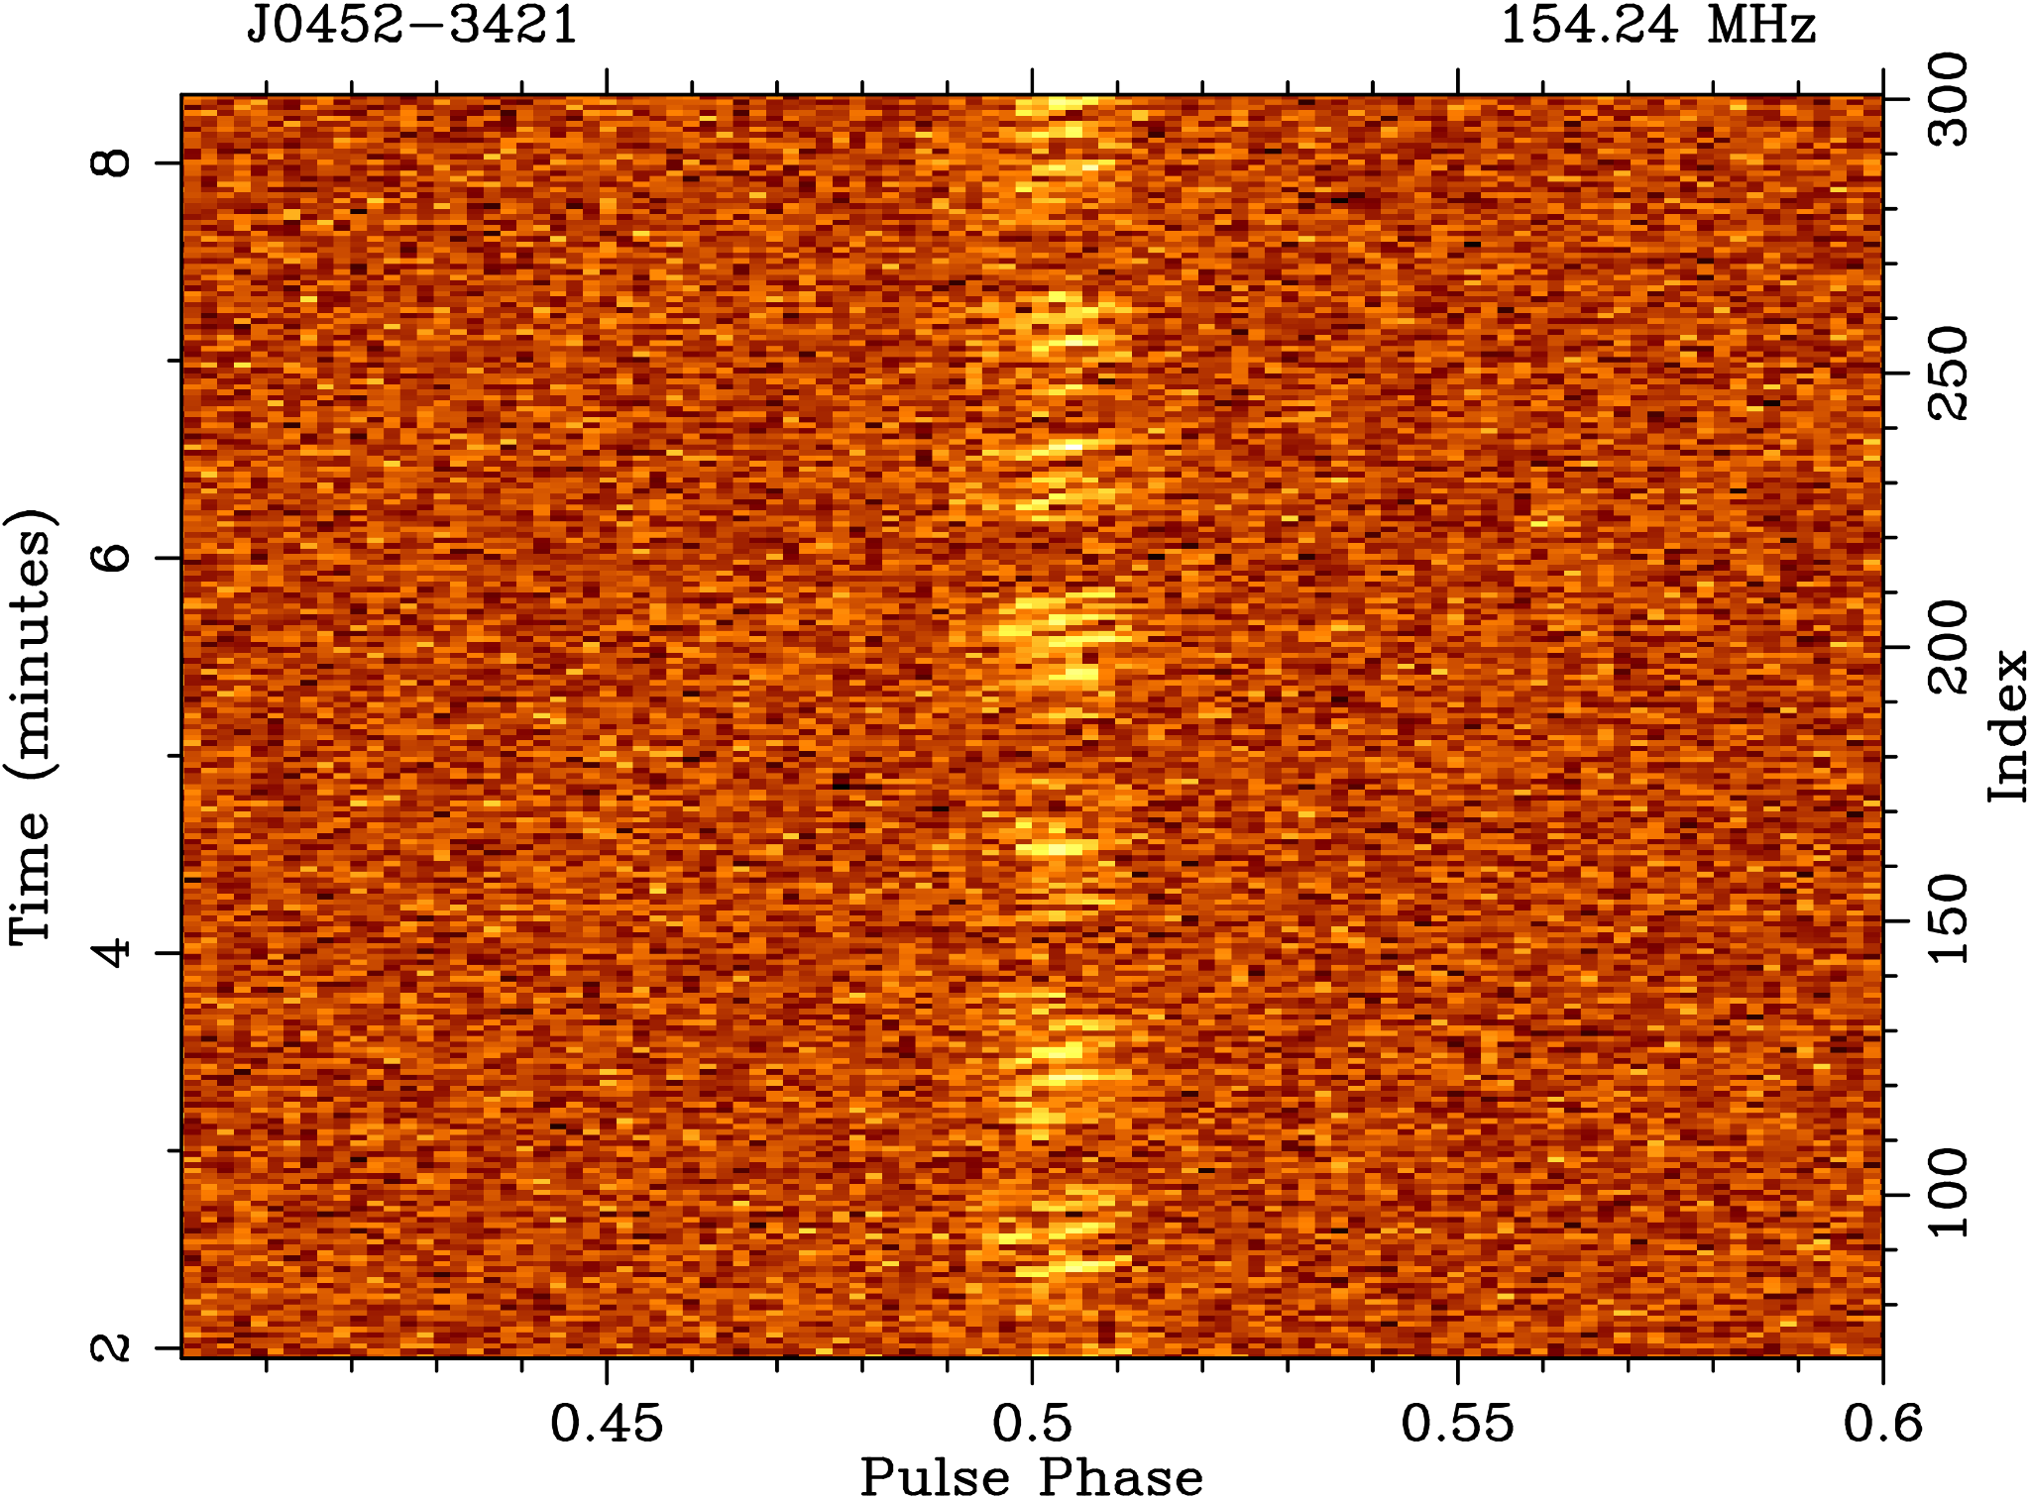
New Pulsars from the First pass
J0036-1033: steep spectrum, low-luminosity, and highly variable by a factor of ~few, high-|b| = interesting scintillation possibilities
(Swainston et al. 2021, ApJL, 911, L26)
J0026-1955: sub-pulse drifting, nulling, high-|b| (McSweeney et al. 2022, ApJ, 933, 210)
J1357-2530: uGMRT imaging localisation based on initial MWA position (Bhat et al. 2023b, PASA, 40, e020)
J0452-3418: subpulse drifting, nulling (Grover et al. 2024a, accepted in ApJ)

Slide 10
Beamforming + Imaging for Localisation
Step #1: from ~10’ to ~10” using a combination of SMART and VCS archival data
Phase 2 compact (~300 m)
Phase 1 (~3 km)
Phase 2 extended (~6 km)
SMART Pulsar #1:
PSR J0036-1033
P = 0.900009 seconds
DM = 23.123 pc cm⁻³
Step #2: Further improvement (~arcsecond level) via uGMRT imaging observations
MWA
GMRT Band 3
GMRT Band 4
Swainston, Bhat, et al. (2021), ApJ, 911:L26; Bhat et al. (2023b), PASA, 40, e020
10
Notes:
8/23/24
10
10

Slide 11
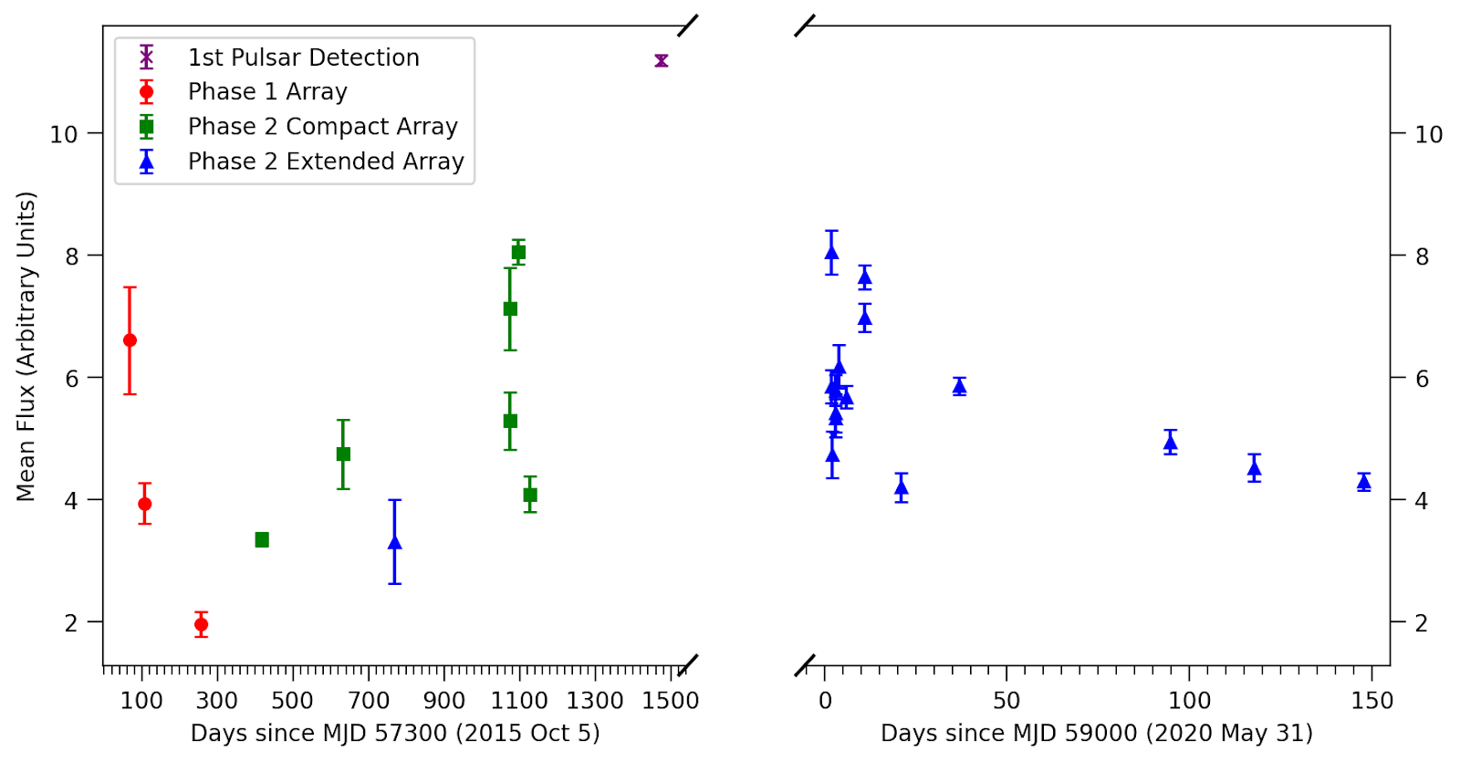
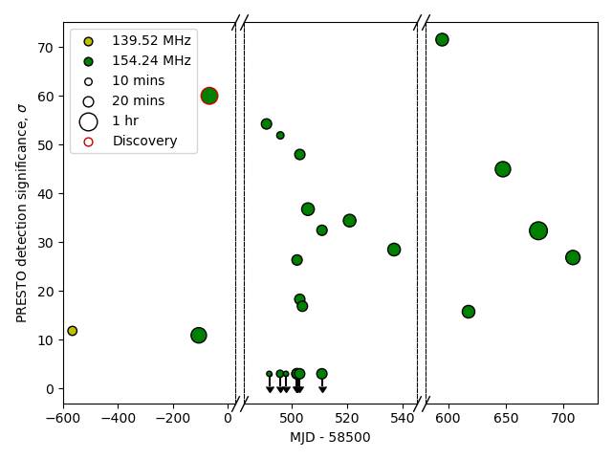
SMART + VCS data for Timing
Swainston, et al. (2021), ApJ, 911:L26
Combination of MWA data (SMART + archival VCS) for full coherent timing solution
P_dot improvement from 7σ (150 days) to 780σ (5.5 year)
Use of the GMRT position for faster convergence of timing
Bhat, et al. (2023), PASA, 40:e020
Similar strategy but this is an “intermittent” pulsar (nulling fraction ~70-80%)
Multiple observations over a ~1.7 year time span, with a P_dot determination at 28σ significance.
11
Notes:
8/23/24
11
11

Slide 12
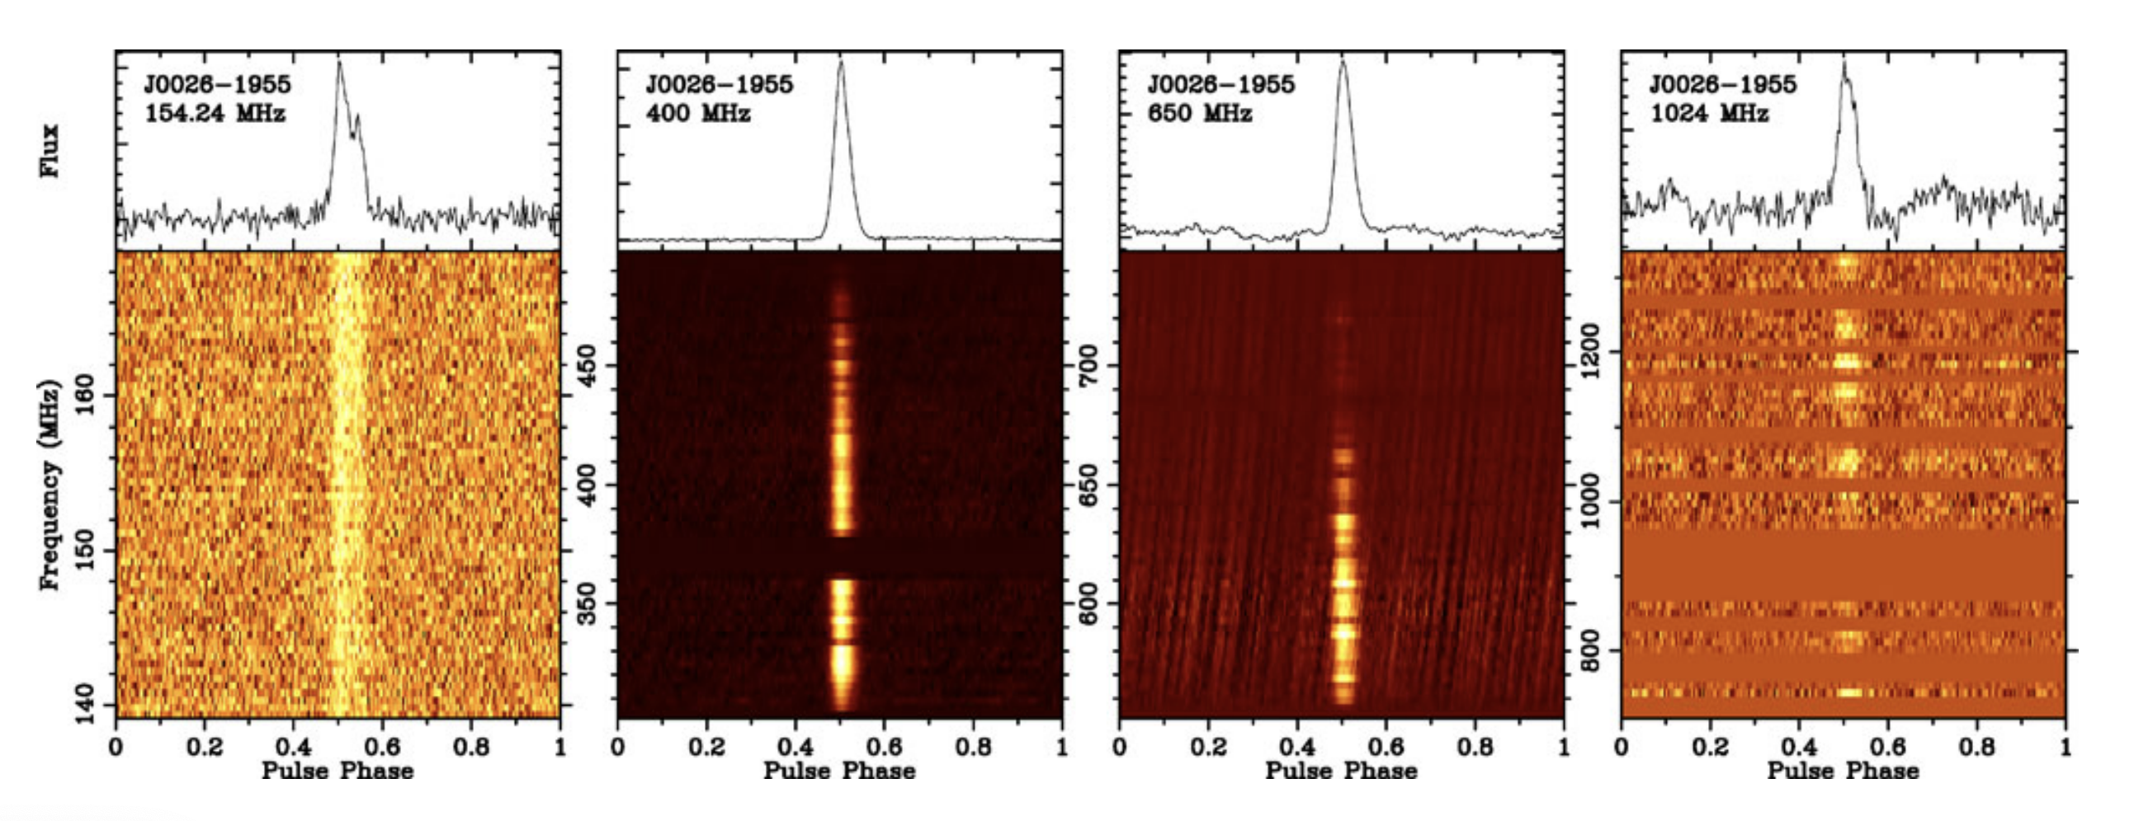
GMRT & Parkes follow-up
MWA (SMART)
GMRT Band 3
GMRT Band 4
Parkes UWL
PSR J0036-1033
PSR J0026-1955
Swainston, et al. (2021), ApJ, 911:L26, Bhat et al. 2023b, PASA, 40, e021
12
Notes:
8/23/24
12
12

Slide 13
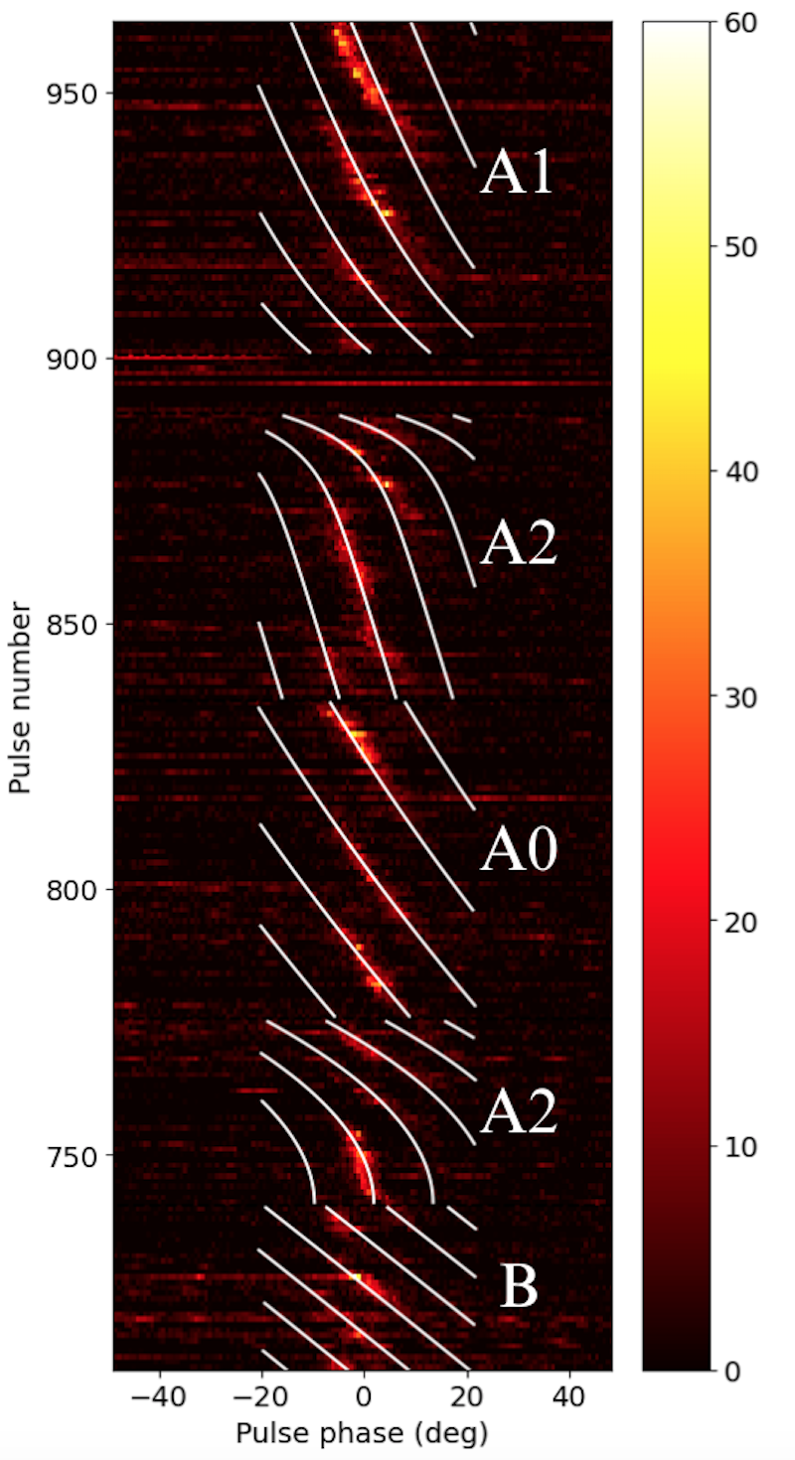
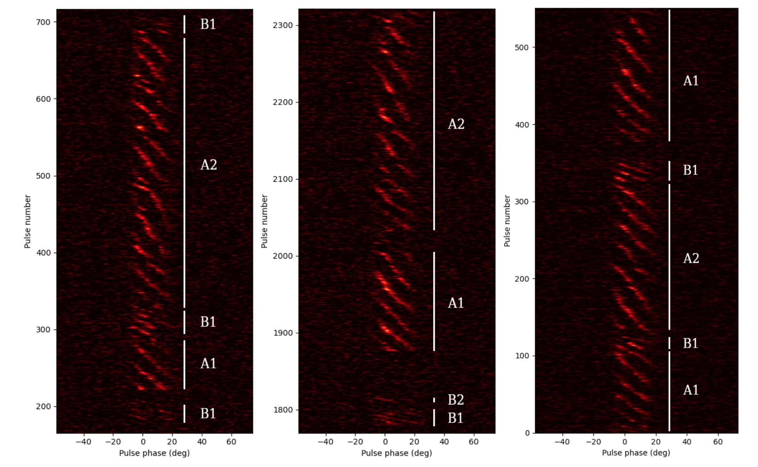
PSR J0026-1955: evolutionary sub-pulse drifting and nulling
GMRT Follow-up
Janagal et al. MNRAS, 524, 2684
Parul Janagal
PhD candidate (IIT, Indore)
A pulsar with unusual sub-pulse drifting (evolutionary and stable drift modes) and a very large nulling fraction (70%)
McSweeney et al. (2022), ApJ, 933, 210
MWA Discovery and Follow-up
13
Sam McSweeney
Notes:
8/23/24
13
13
Keegan’s pulsar - if you’d like a pulsar named after you, pl feel free to line up (and….)
Either an extreme nuller(?) or perhaps a state-switching pulsar….
NF ~ 75% (seen for about 5% of the pulsars that have been studied for....)
Or is there a persistent weak emission?

Slide 14
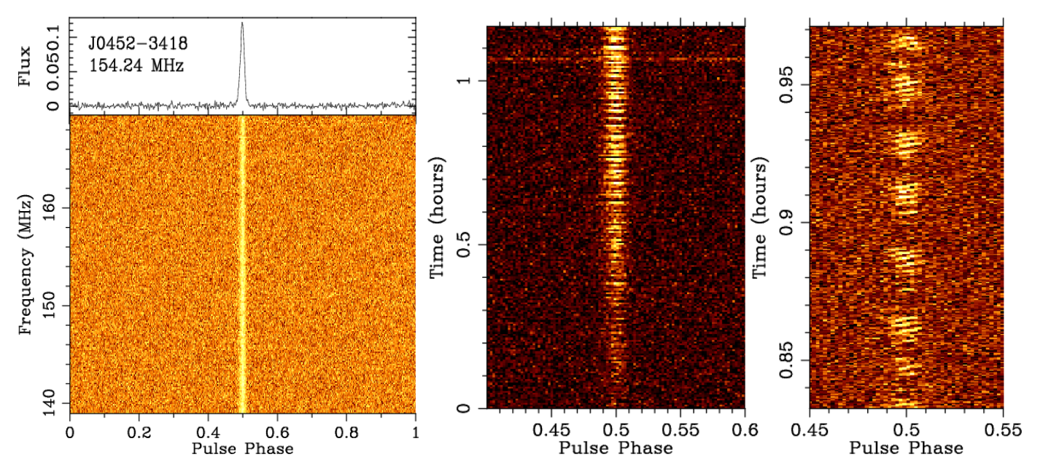
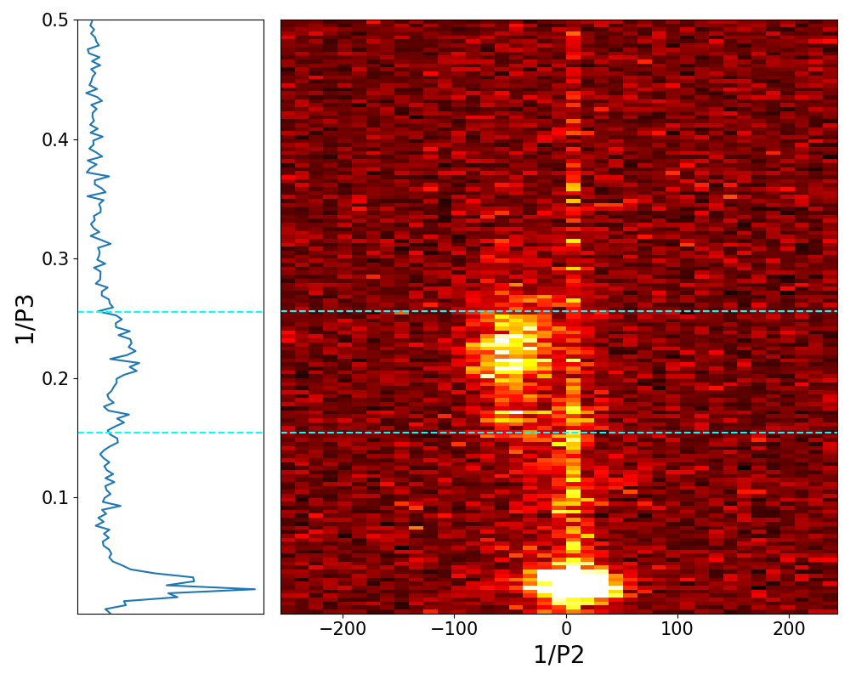
PSR J0452-3418: regular sub-pulse drifting + quasi-periodic nulling
Garvit Grover
PhD candidate (Curtin)
Grover et al. in prep.
Pulsar #5 from the first-pass SMART processing
Period (P₁) = 1.67 seconds
DM = 19.78 pc cm⁻³
Sub-pulse drifting periodicity, P₃ ~ 5 P₁
Quasi-periodic nulling on time scale ~ 45 P₁
Localization (~arcsecond) via uGMRT (Band 3) high-resolution imaging
14
Notes:
8/23/24
14
14
Keegan’s pulsar - if you’d like a pulsar named after you, pl feel free to line up (and….)
Either an extreme nuller(?) or perhaps a state-switching pulsar….
NF ~ 75% (seen for about 5% of the pulsars that have been studied for....)
Or is there a persistent weak emission?

Slide 15
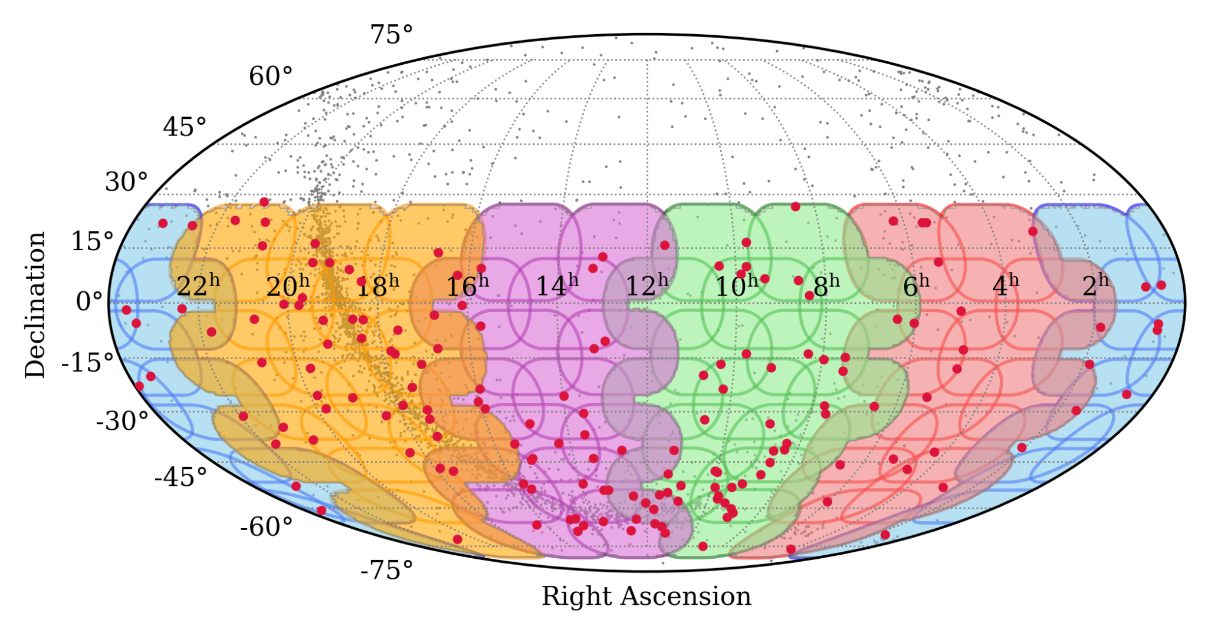
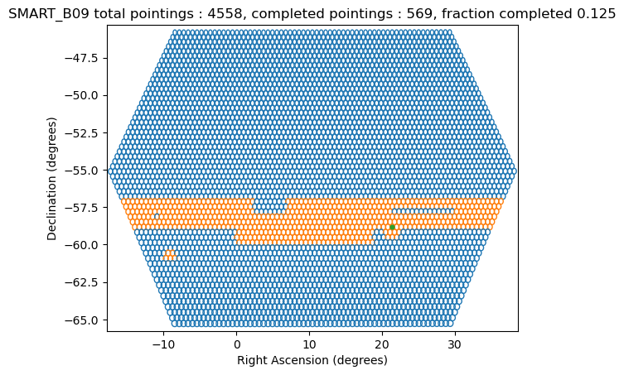
Commencing the “second pass”
More optimal (and efficient) ways of tessellating the sky
Layers of hexagonal rings around the start and end times of SMART drift scans
Working with the FWHM of the MWA tied-array beam (more realistic beam size)
Slide from Chia Min Tan

Slide 16
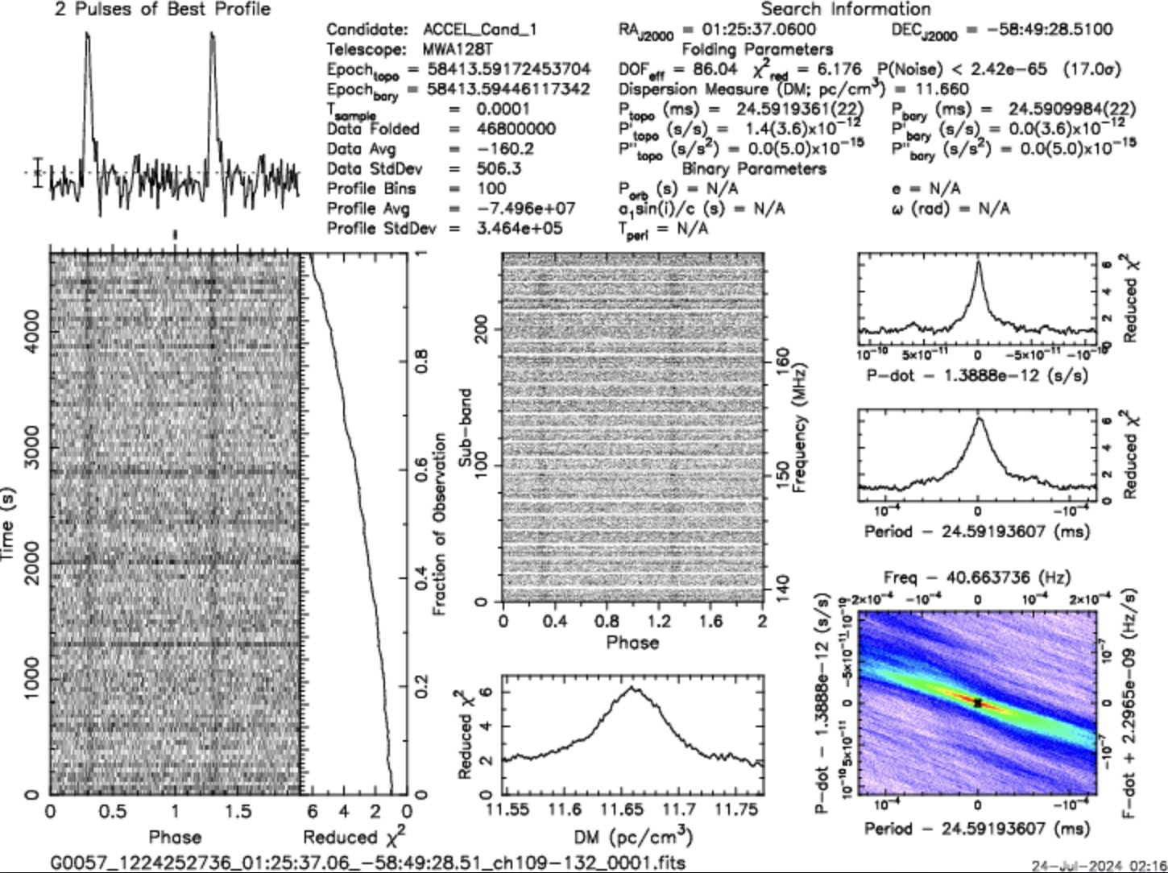
New pulsar candidate J0125

Slide 17
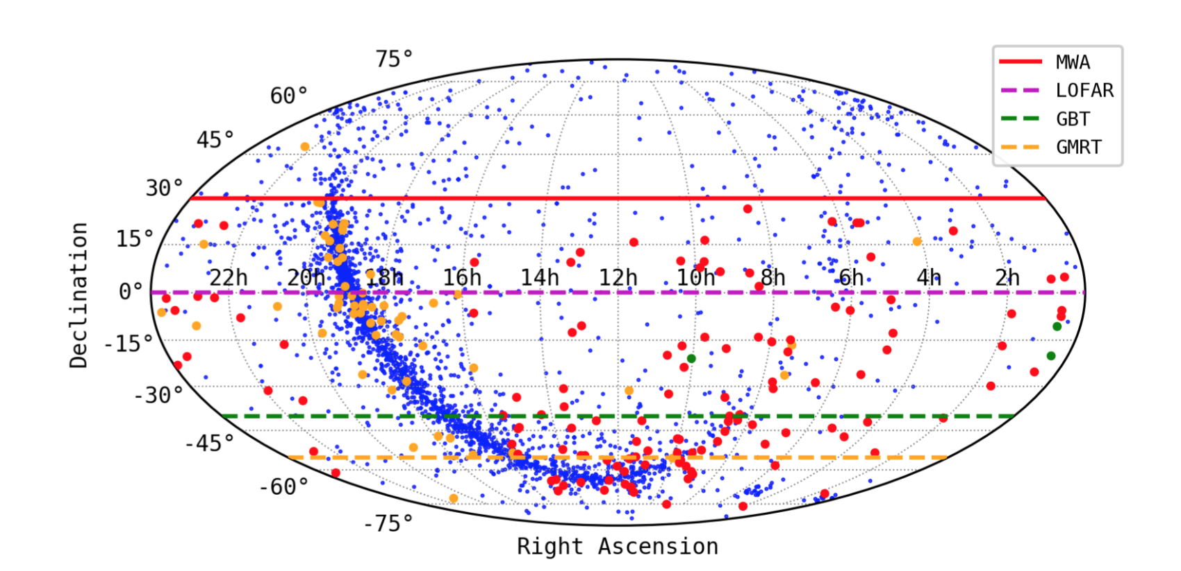
MWA Pulsar Detections
most detected with a higher sensitivity,
good subset of them in full polarimetry
200+ from the processing so far
142 from SMART observations
Known pulsars (ATNF catalogue)
MWA (low-frequency) detections
MWA (low-frequency) detections
SMART discoveries
Bhat et al. (2023b),PASA, 40, e020
Science prospects: low-frequency properties of a large sample for spectral analysis, pulsar population studies, survey forecasts (SKA-Low), and emission physics.
Data release: multiple data products (e.g. beamformed data, timer archives, profiles) will be made available for public access via Data Central services
17
Notes:
8/23/24
17
17
This is a number that will keep growing….
But at this point we are just past the double century mark

Slide 18
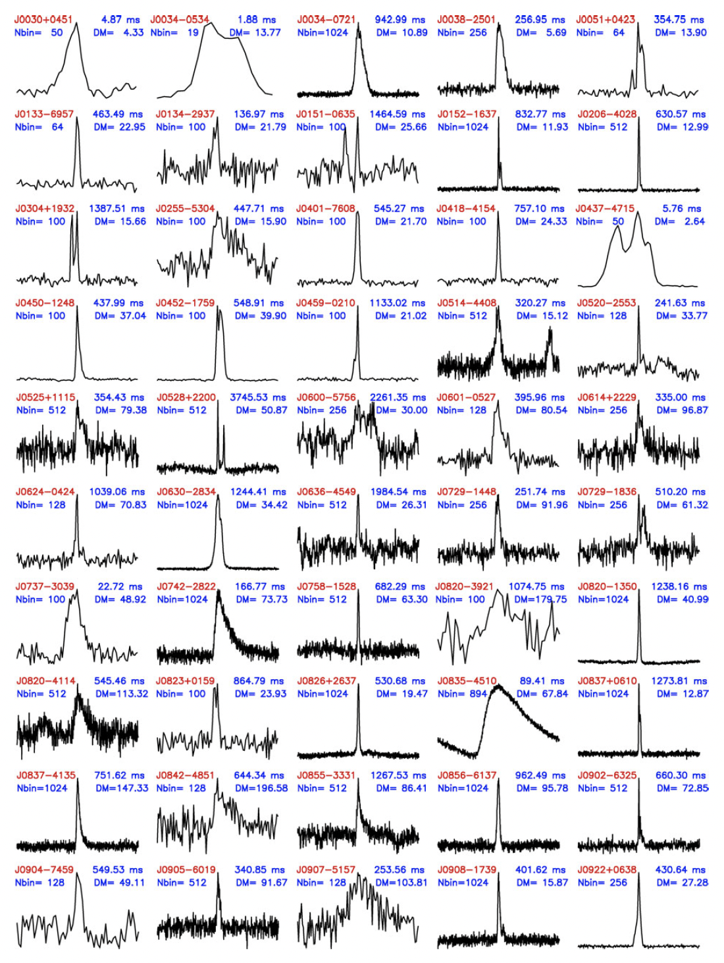
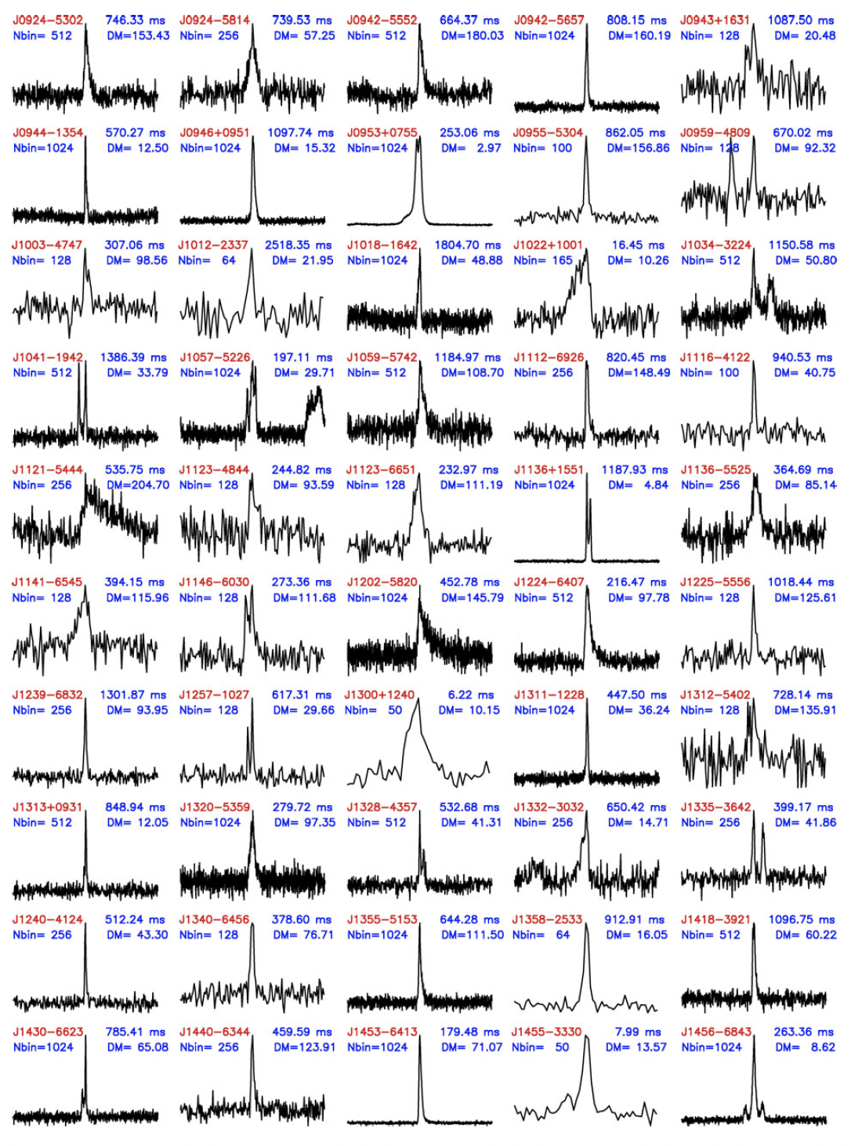
MWA Pulsar Census

Slide 19
MWA Pulsar Census
A voltage legacy data set of the metre-wavelength radio sky with flexible reprocessing options for future algorithms or phenomena, and an important reference for SKA-Low pulsar survey planning and verification

Slide 20
Summary
The SMART survey exploits the MWA’s large field of view (~610 deg²) and the voltage capture system (VCS) capability for data recording
SMART complements past/ongoing surveys in sky coverage & frequency band
Data collection 100% completed (2018-2023); total data volume ~4 Petabytes
~10% processed for a “first-pass” search, ~10% of which scrutinised for cands; 5 new pulsars, Redetections of 230+ pulsars (Bhat et al. 2023a,b; McSweeney et al. 2022; Swainston et al. 2021; Lee et al. in prep.; Bhat et al. in prep.)
Second pass processing (dwell time ~80 minutes) has commenced; periodicity (FFT + FFA), single-pulse, CDMT + acceleration searches planned
Legacy (voltage) data set for the low-frequency (southern) sky, an important reference survey for SKA-Low survey planning and verification.

