Slide 1
Welcome to Geneva !

Slide 2
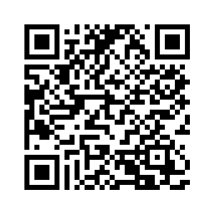
Swiss SKA Days 2024
SCHEDULE https://indico.skatelescope.org/event/1146/timetable/?view=standard
Lunch 12:15-13:15 – + today group photo
Afternoon: plenary session 13:15 – 14:55 coffee break parallel sessions 15:25-17:55
closing remarks 17:55-18
18:30-21: Apéro and Welcome Reception at the Musée d'Histoire des Sciences → 5 min walking distance – don’t forget to bring your two vouchers!
Tuesday & Wed: Arrival and coffee 8:30-9:00 Sessions start 9:00
Tuesday Events: CERN visit – meeting 16:30 @ CERN or Boat tour – meeting Boat stop Jardin Anglais 18:30 – we still have 4 seats left, come to the welcome desk to register and pay!

Slide 3
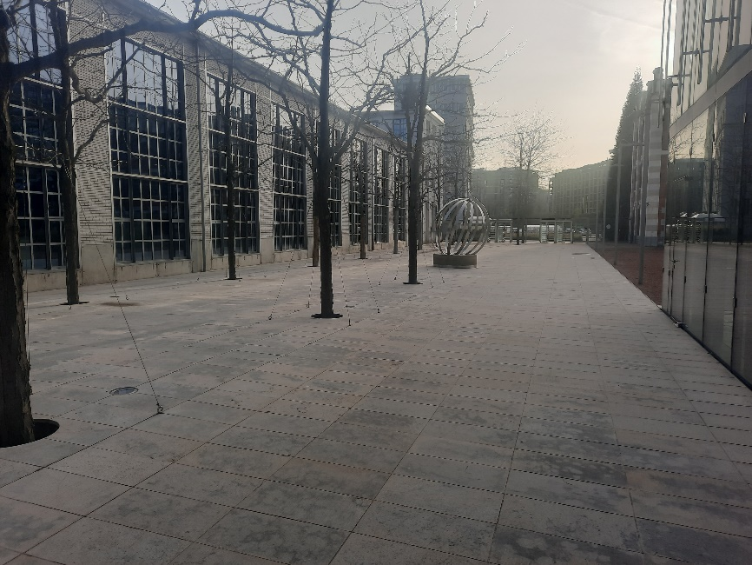
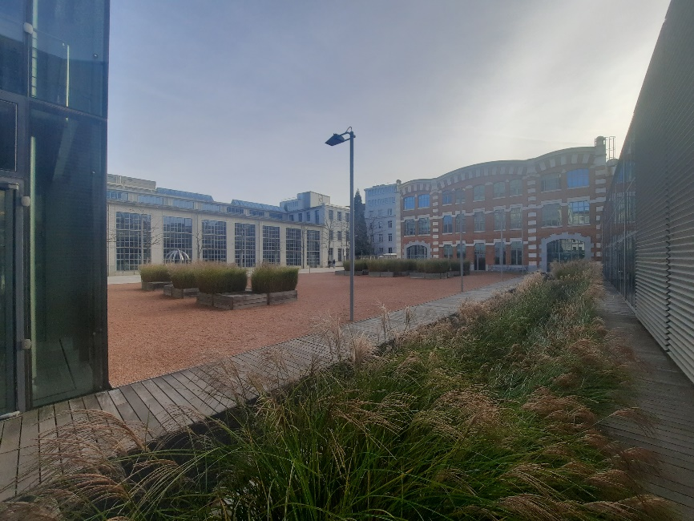
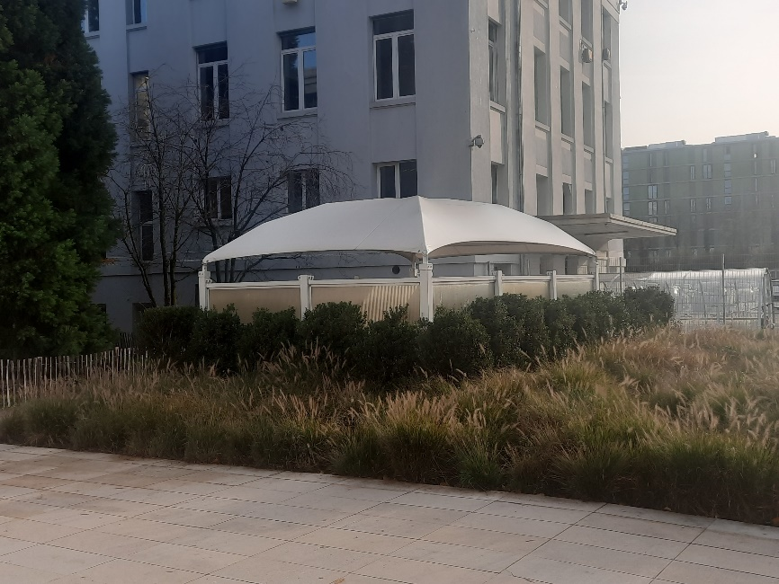
Food and drinks are forbidden in the auditorium and meeting rooms – Only water is allowed
The Biotech site is non smoking – a smoking area is available outside of the Campus Biotech. Ask staff for location.

Slide 4
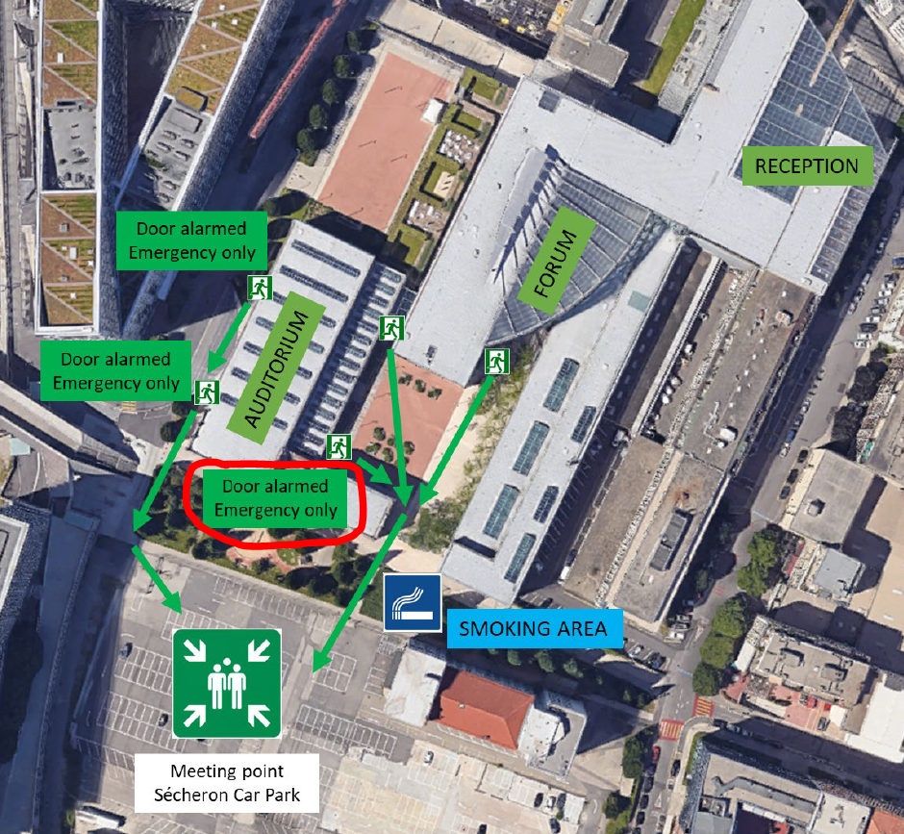
In case of evacuation, follow the signs and go to the meeting point (Sécheron car park).
Always keep clear doors and corridors (no chairs, tables, posters, …)

Slide 5
Badges
You were given a Biotech access badge at reception – you can keep it during the whole conference to access the building
Return your Biotech access badge before leaving the campus at the end of the conference.
Any lost badge will be billed 20CHF
Wifi
Name: CAMPUS_VISITORS
Password: welcomecampus

