Slide 1


The future of cosmological likelihood-based inference
Davide Piras (and many others)

Slide 2
But first… let me apologise
Notes:
Present you and work. Mention collaborators. Mention that you are open to questions, and that data science includes ML, etc.

Slide 3
But first… let me apologise
You are my target…
Notes:
Present you and work. Mention collaborators. Mention that you are open to questions, and that data science includes ML, etc.

Slide 4
But first… let me apologise
You are my target…
… and I’ll speak for the next 40 minutes

Slide 5
But first… let me apologise
You are my target…
… and I’ll speak for the next 40 minutes
So please have some jokes in return
Notes:
Present you and work. Mention collaborators. Mention that you are open to questions, and that data science includes ML, etc.

Slide 6
The future of cosmological likelihood-based inference
Davide Piras (and many others)

Slide 7
What do you mean with Bayesian inference?
inference

Slide 8
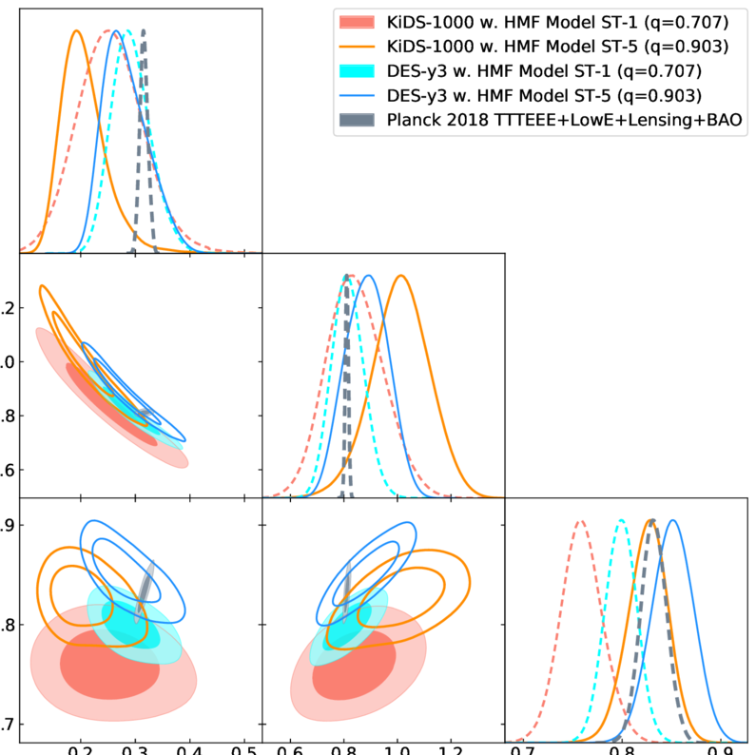
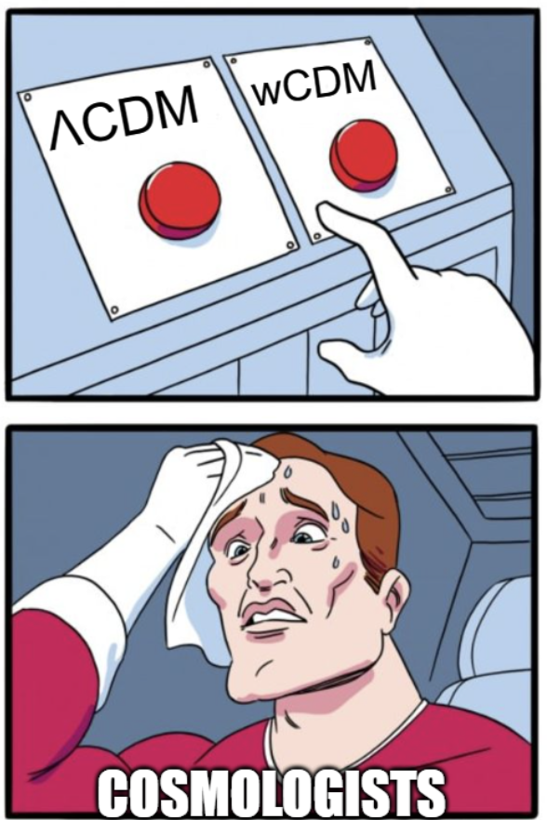
What do you mean with Bayesian inference?
Posterior contours Model selection

Slide 9
What do you mean with Bayesian inference?
Posterior contours
posterior = likelihood x prior
posterior =
evidence

Slide 10
What do you mean with Bayesian inference?
Posterior contours
posterior = likelihood x prior
posterior =
evidence

Slide 11
What do we need?
To perform inference, we need data

Slide 12
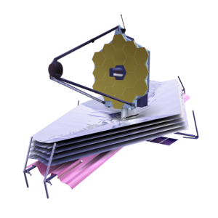
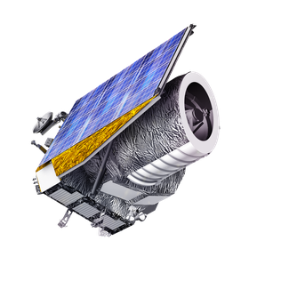
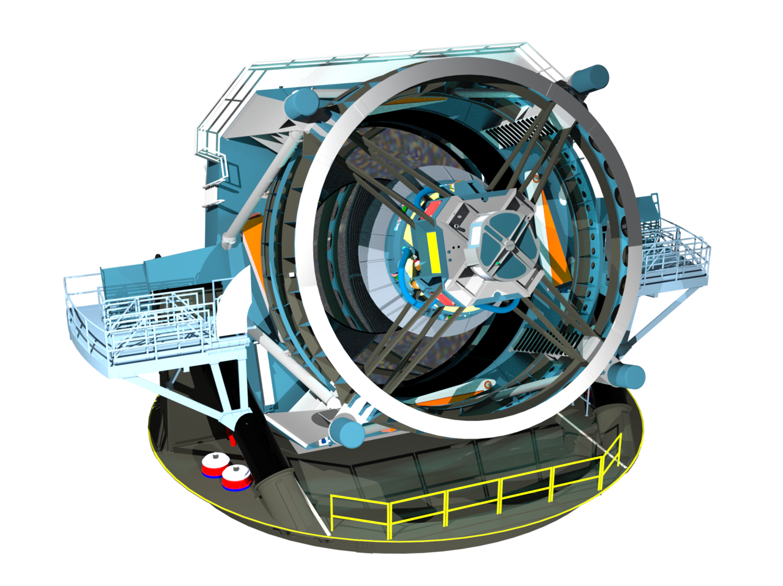
Big data incoming
JWST
Dec 2021
100 TB
Euclid
Jul 2023
>700 TB
Vera Rubin Observatory
Jan 2025
500000 TB
Notes:
Present you and work. Mention collaborators. Mention that you are open to questions, and that data science includes ML, etc.

Slide 13
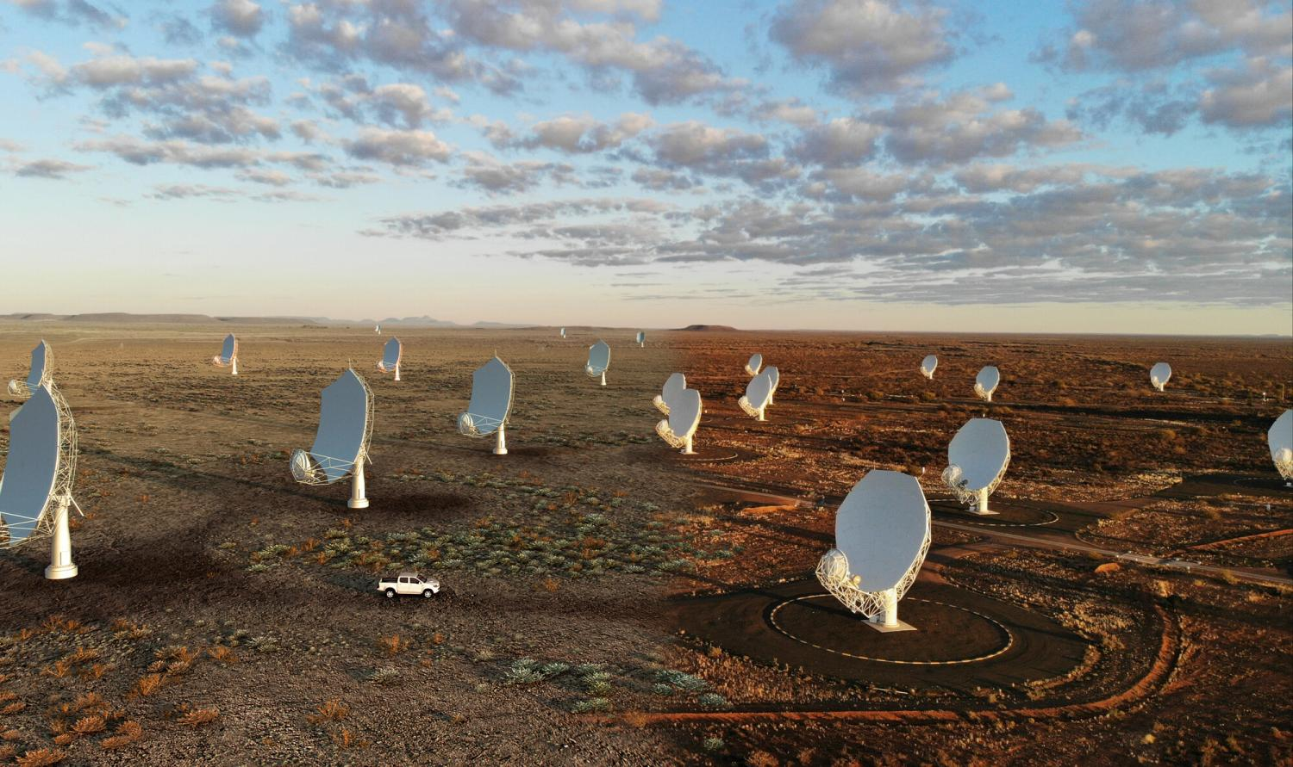
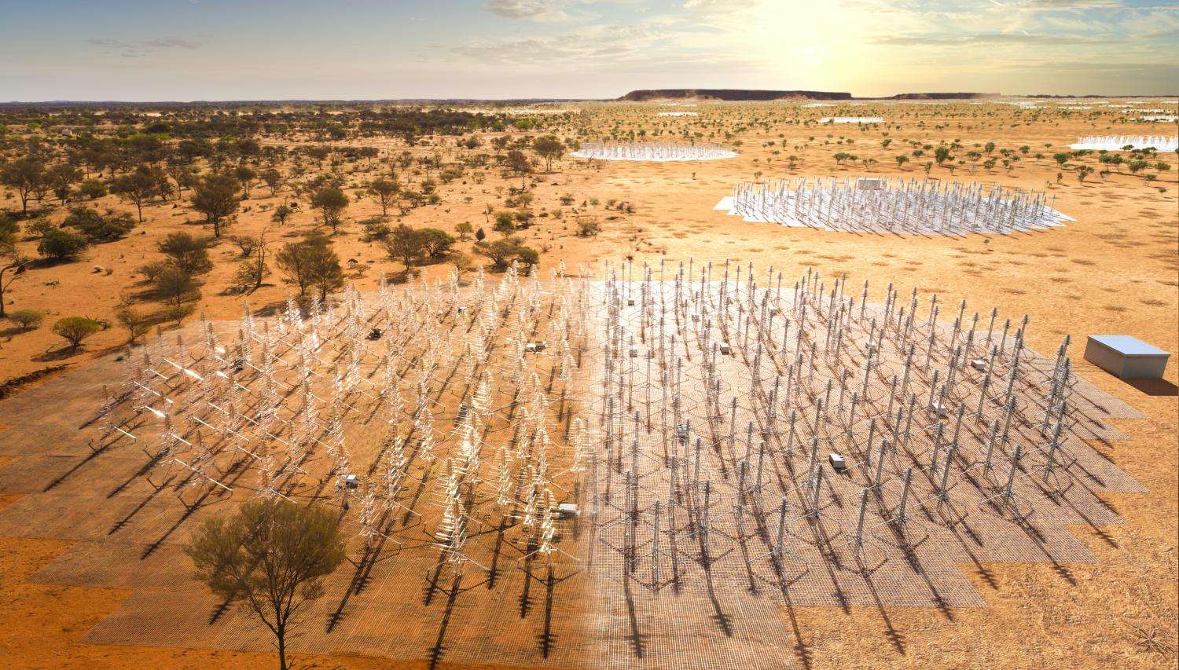
Big data incoming
JWST
Dec 2021
100 TB
Euclid
Jul 2023
700 TB
SKA
2028?
40000000000 TB
Vera Rubin Observatory
Jan 2025
500000 TB
Notes:
Present you and work. Mention collaborators. Mention that you are open to questions, and that data science includes ML, etc.

Slide 14

Big data incoming
SKA
Notes:
Present you and work. Mention collaborators. Mention that you are open to questions, and that data science includes ML, etc.

Slide 15
What do we need?
To perform inference, we need data

Slide 16
What do we need?
To perform inference, we need data
Before data comes, we need simulations

Slide 17
What do we need?
To perform inference, we need data
Before data comes, we need simulations
But simulations are expensive

Slide 18
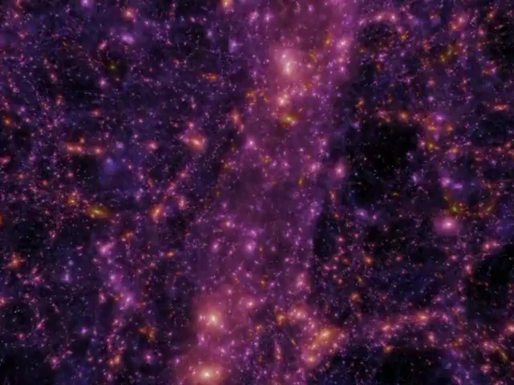
Notes:
Present you and work. Mention collaborators. Mention that you are open to questions, and that data science includes ML, etc.

Slide 19
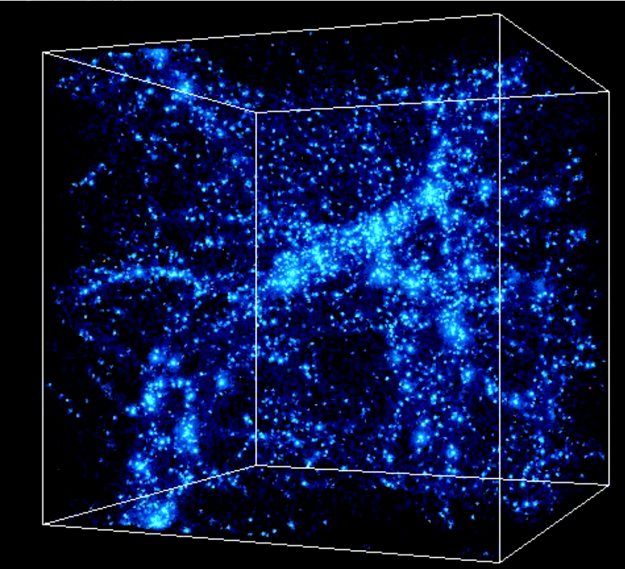

Notes:
Present you and work. Mention collaborators. Mention that you are open to questions, and that data science includes ML, etc.

Slide 20
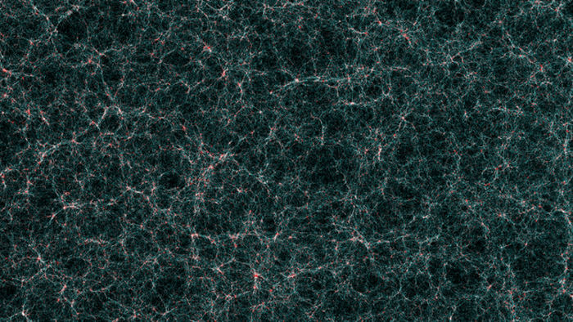

Notes:
Present you and work. Mention collaborators. Mention that you are open to questions, and that data science includes ML, etc.

Slide 21

The future paradigm
emulation

Slide 22

CosmoPower: flexible emulation of
cosmological power spectra
Code available
Notes:
Present yourself. You are going to talk about generative methods in Cosmology, as the title suggests. Mention other people that work with you.

Slide 23
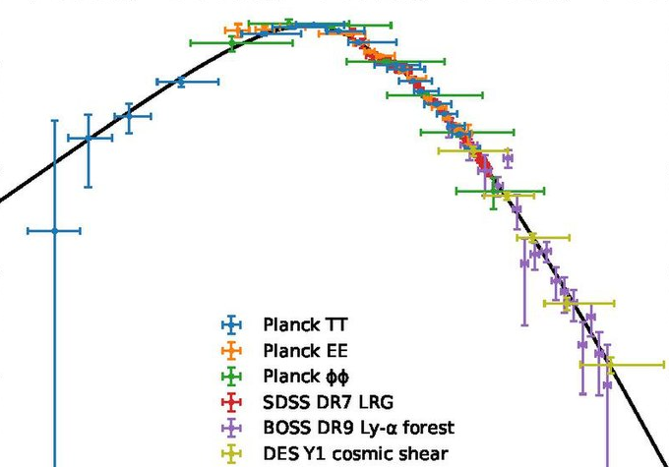

CosmoPower: flexible emulation of
cosmological power spectra
DISTILL
Theory
Measurements
Notes:
Present yourself. You are going to talk about generative methods in Cosmology, as the title suggests. Mention other people that work with you.

Slide 24
CosmoPower: flexible emulation of cosmological power spectra
Create labelled
training data
(
, ϴ)
Theory
cosmological parameters
Notes:
Present yourself. You are going to talk about generative methods in Cosmology, as the title suggests. Mention other people that work with you.

Slide 25
CosmoPower: flexible emulation of cosmological power spectra
Create labelled
training data
Train model
Theory
simple neural network
ϴ
Notes:
Present yourself. You are going to talk about generative methods in Cosmology, as the title suggests. Mention other people that work with you.

Slide 26
CosmoPower: flexible emulation of cosmological power spectra
Create labelled
training data
Train model
Plug trained model into likelihood
Notes:
Present yourself. You are going to talk about generative methods in Cosmology, as the title suggests. Mention other people that work with you.

Slide 27
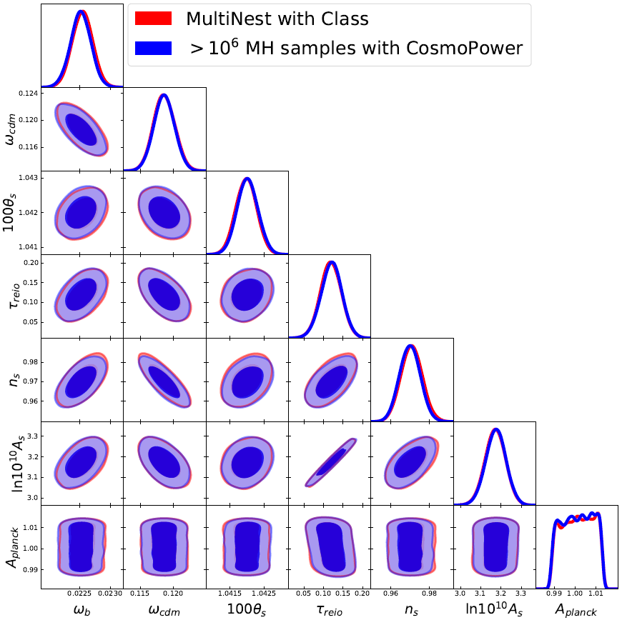
CosmoPower: flexible emulation of cosmological power spectra
Standard analysis (48 CPUs, few hours)
CosmoPower (1 GPU, 15 seconds)
Planck 2018
Spurio Mancini, Piras et al., MNRAS, 2021
Notes:
Present yourself. You are going to talk about generative methods in Cosmology, as the title suggests. Mention other people that work with you.

Slide 28

The future paradigm
emulation
+
differentiable programming

Slide 29

CosmoPower-JAX
JAX implementation of CosmoPower
+
=
Code available
Notes:
Present yourself. You are going to talk about generative methods in Cosmology, as the title suggests. Mention other people that work with you.

Slide 30
What is JAX?
Latest Google framework for machine learning
Notes:
Present yourself. You are going to talk about generative methods in Cosmology, as the title suggests. Mention other people that work with you.

Slide 31
What is JAX?
Latest Google framework for machine learning
Essentially, NumPy on steroids
Notes:
Present yourself. You are going to talk about generative methods in Cosmology, as the title suggests. Mention other people that work with you.

Slide 32
What is JAX?
Latest Google framework for machine learning
Essentially, NumPy on steroids
Allows for fast automatic differentiation on GPU
Notes:
Present yourself. You are going to talk about generative methods in Cosmology, as the title suggests. Mention other people that work with you.

Slide 33
CosmoPower-JAX
JAX implementation of CosmoPower
Can run Hamiltonian Monte Carlo
+
=
Notes:
Present yourself. You are going to talk about generative methods in Cosmology, as the title suggests. Mention other people that work with you.

Slide 34
CosmoPower-JAX
JAX implementation of CosmoPower
Can run Hamiltonian Monte Carlo
+
=
Hamiltonian Monte Carlo relies on derivatives of the likelihood
Notes:
Present yourself. You are going to talk about generative methods in Cosmology, as the title suggests. Mention other people that work with you.

Slide 35

The future paradigm
emulation
+
differentiable programming
+
gradient-based samplers

Slide 36
Next-generation survey analysis in JAX
Notes:
Present yourself. You are going to talk about generative methods in Cosmology, as the title suggests. Mention other people that work with you.

Slide 37
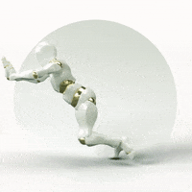
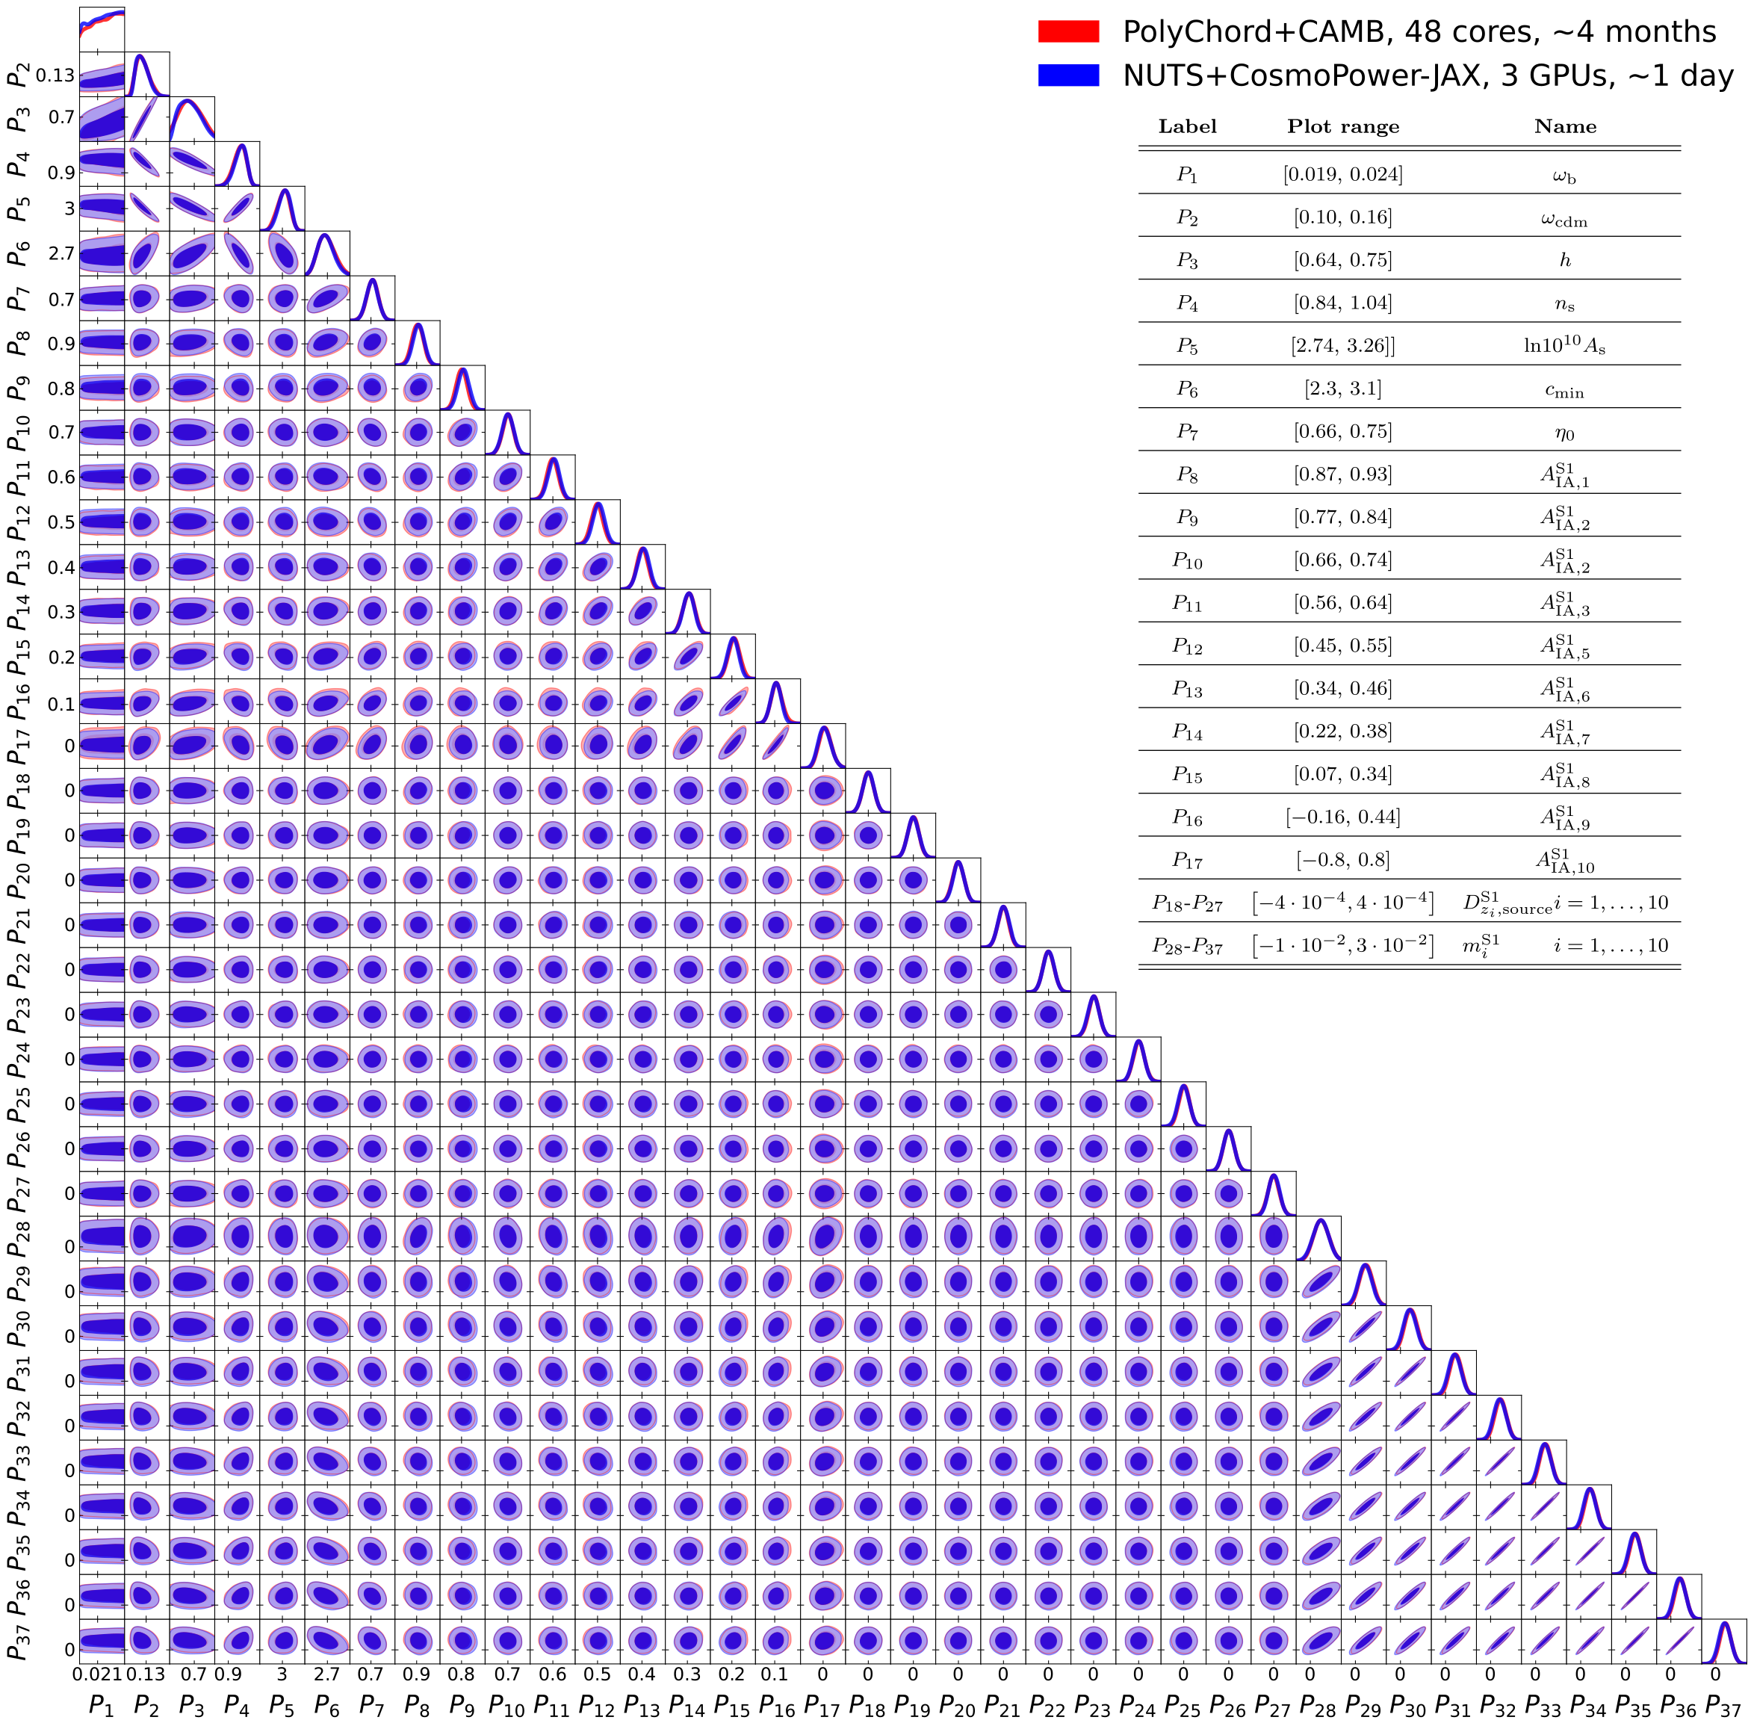
Next-generation survey analysis in JAX
Standard MCMC (48 CPUs, 4 months)
Hamiltonian MC + JAX emulator (3 GPUs, 1 day)
Cosmological parameters
Standard MCMC (cobaya, 48 cores, 4 months)
Hamiltonian MC (JAX emulator, 3 GPUs, 1 day)
Cosmic shear
(37 parameters)
Intrinsic alignment
Cosmic shear only
(37 parameters)
Redshift shift
Multiplication bias
Notes:
Present yourself. You are going to talk about generative methods in Cosmology, as the title suggests. Mention other people that work with you.

Slide 38

Joint survey analysis in JAX
Standard MCMC (48 CPUs, about 6 years)
Hamiltonian MC + JAX emulator (3 GPUs, 3 days)
3x(3x2)points statistics analysis:
157 parameters!
Piras & Spurio Mancini, Open Journal of Astrophysics, 2023
Notes:
Present yourself. You are going to talk about generative methods in Cosmology, as the title suggests. Mention other people that work with you.

Slide 39



Standard MCMC (48 CPUs, about 6 years)
Hamiltonian MC + JAX emulator (3 GPUs, 3 days)
Notes:
Present yourself. You are going to talk about generative methods in Cosmology, as the title suggests. Mention other people that work with you.

Slide 40

Standard MCMC (48 CPUs, about 6 years)
Hamiltonian MC + JAX emulator (3 GPUs, 3 days)
Notes:
Present yourself. You are going to talk about generative methods in Cosmology, as the title suggests. Mention other people that work with you.

Slide 41
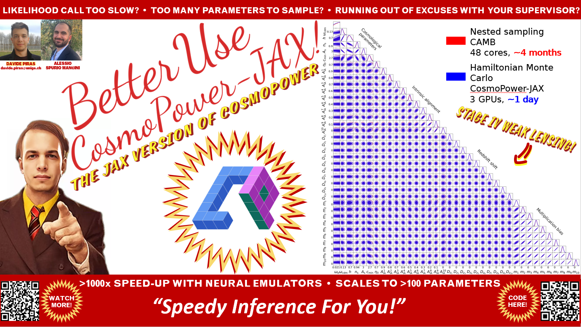

Slide 42
What about model selection?
Notes:
Present yourself. You are going to talk about generative methods in Cosmology, as the title suggests. Mention other people that work with you.

Slide 43
What about model selection?
posterior = likelihood x prior
posterior =
evidence
Notes:
Present yourself. You are going to talk about generative methods in Cosmology, as the title suggests. Mention other people that work with you.

Slide 44
What about model selection?
posterior = likelihood x prior
posterior =
evidence
Model with highest evidence is favoured
Notes:
Present yourself. You are going to talk about generative methods in Cosmology, as the title suggests. Mention other people that work with you.

Slide 45

The future paradigm
emulation
+
differentiable programming
+
gradient-based samplers
+
harmonic

Slide 46
What about model selection?
Estimate Bayesian evidence with harmonic
Notes:
Present yourself. You are going to talk about generative methods in Cosmology, as the title suggests. Mention other people that work with you.

Slide 47
What about model selection?
Estimate Bayesian evidence with harmonic
Based on harmonic mean estimator + normalizing flows
Notes:
Present yourself. You are going to talk about generative methods in Cosmology, as the title suggests. Mention other people that work with you.

Slide 48
What about model selection?
Estimate Bayesian evidence with harmonic
Based on harmonic mean estimator + normalizing flows
Robust and scalable code publicly available
Notes:
Present yourself. You are going to talk about generative methods in Cosmology, as the title suggests. Mention other people that work with you.

Slide 49
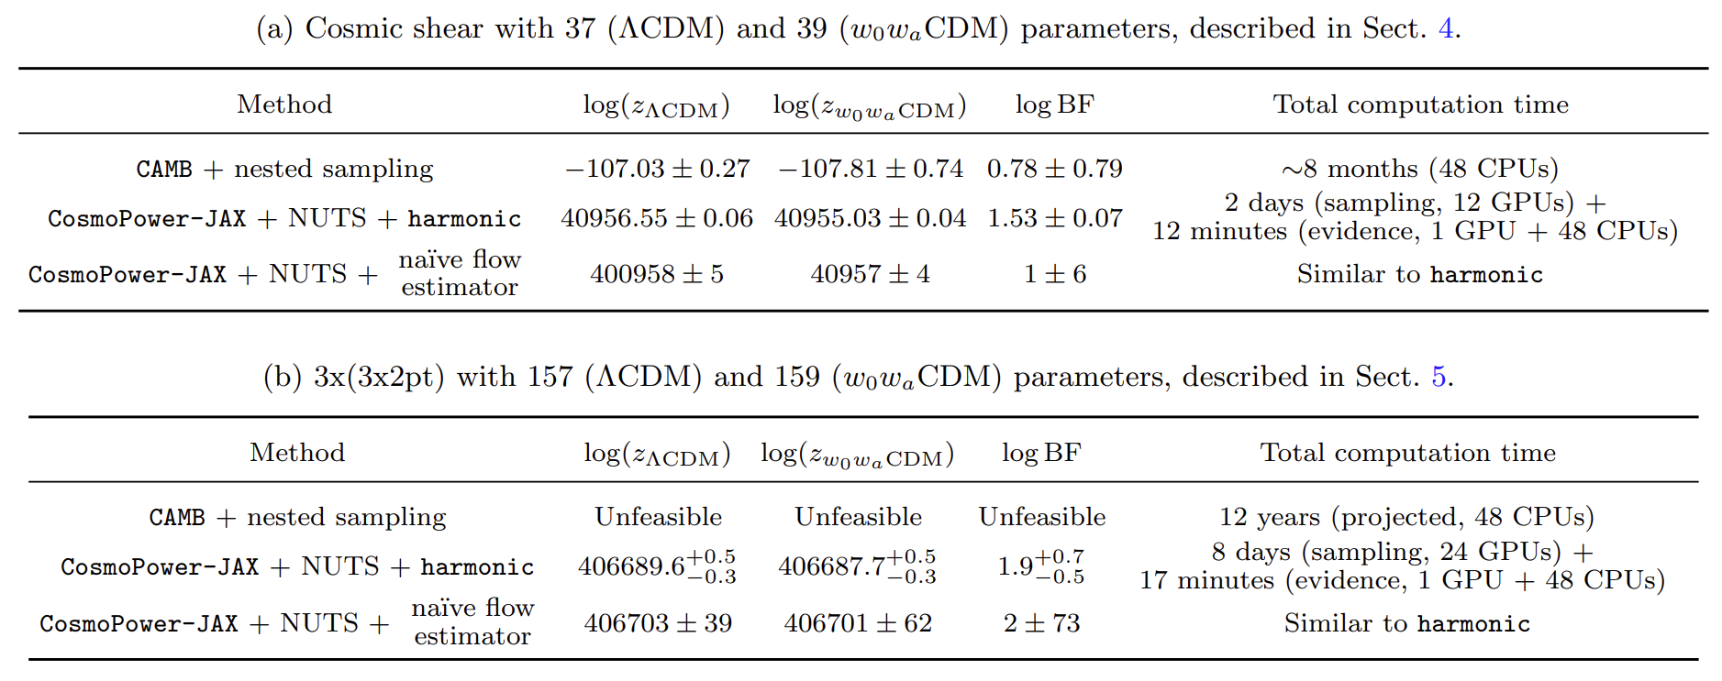
What about model selection?
Piras et al., Open Journal of Astrophysics, 2024
Notes:
Present yourself. You are going to talk about generative methods in Cosmology, as the title suggests. Mention other people that work with you.

Slide 50
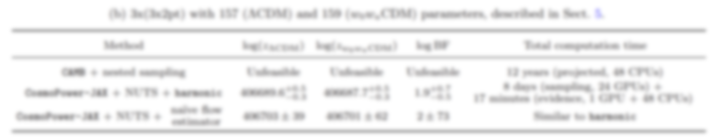
What about model selection?
Piras et al., Open Journal of Astrophysics, 2024
Notes:
Present yourself. You are going to talk about generative methods in Cosmology, as the title suggests. Mention other people that work with you.

Slide 51
Conclusions

Slide 52
Conclusions
emulation

Slide 53
Conclusions
emulation
+
differentiable programming

Slide 54
Conclusions
emulation
+
differentiable programming
+
gradient-based samplers

Slide 55
Conclusions
emulation
+
differentiable programming
+
gradient-based samplers
+
harmonic

Slide 56
Conclusions
emulation
+
differentiable programming
+
gradient-based samplers
+
harmonic
=
the future of likelihood-based inference
Happy to collaborate!

Slide 57
Extra slides
(and memes)

Slide 58

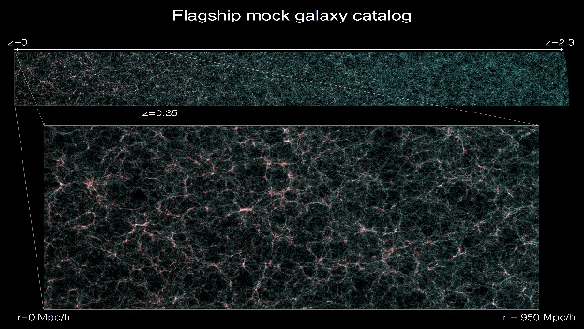
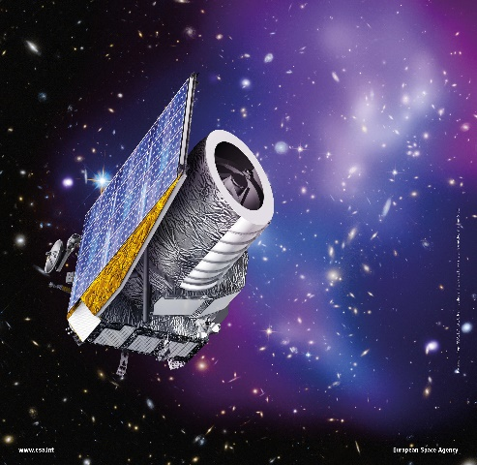
>10³ SIMULATIONS
FLAGSHIP SIMULATION
EUCLID

Slide 59
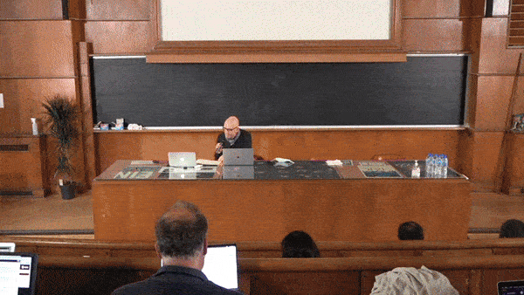
The starting idea
Can we use machine learning
to generate cosmological simulations?
Click here for video

Slide 60
Summarising
Can we use machine learning
to generate cosmological simulations?
No*
* more work to do

Slide 61


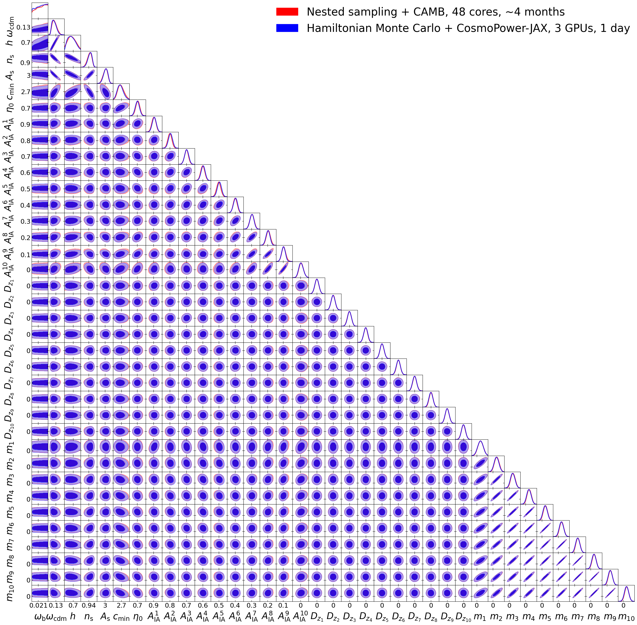






LIKELIHOOD CALL TOO SLOW? • TOO MANY PARAMETERS TO SAMPLE? • RUNNING OUT OF EXCUSES WITH YOUR SUPERVISOR?
Nested sampling
CAMB
48 cores, ~4 months
Hamiltonian Monte Carlo
CosmoPower-JAX
3 GPUs, ~1 day
Cosmological parameters
DAVIDE PIRAS
davide.piras@unige.ch
ALESSIO
SPURIO MANCINI
Intrinsic alignment
Redshift shift
Multiplication bias
>1000x SPEED-UP WITH NEURAL EMULATORS • SCALES TO >100 PARAMETERS
“Speedy Inference For You!”
WATCH MORE!
CODE HERE!

