Slide 1
SKA Data Challenge 3b: Inference Collaboration between the newbies at SKAO: Swiss & Swedish team (SEarCH)
Michele Bianco (ETHZ), Sambit K. Giri (Nordita), Davide Piras (UniGe), Chris Finlay (UniGe), Shreyam P. Krishna (EPFL), Timothée Schaeffer (UZH), Emmanuel de Salis (HES-SO), Mariia Drozdova (UniGe), Vitaliy Kinakh (UniGe), Kelly M. Hess (Chalmers), Philipp Denzel (ZHAW), Massimo De Santis (HES-SO), Merve Selcuk Simsek (FHNW), Hatem Ghorbel (HES-SO)
Swiss SKA Day 2024 Geneva, Sept 2024

Slide 2
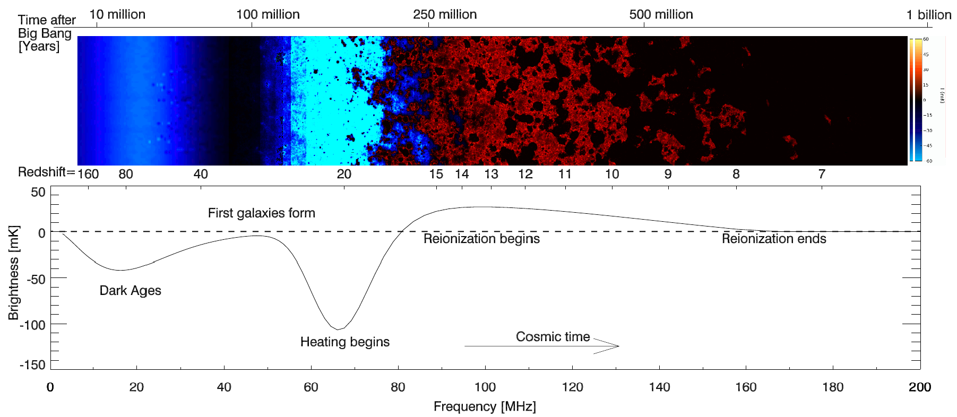
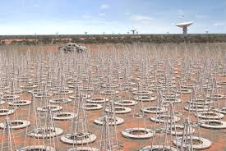
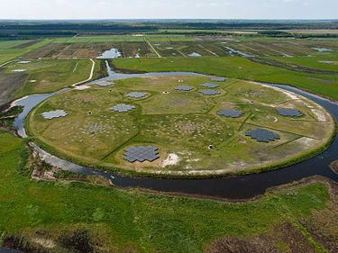
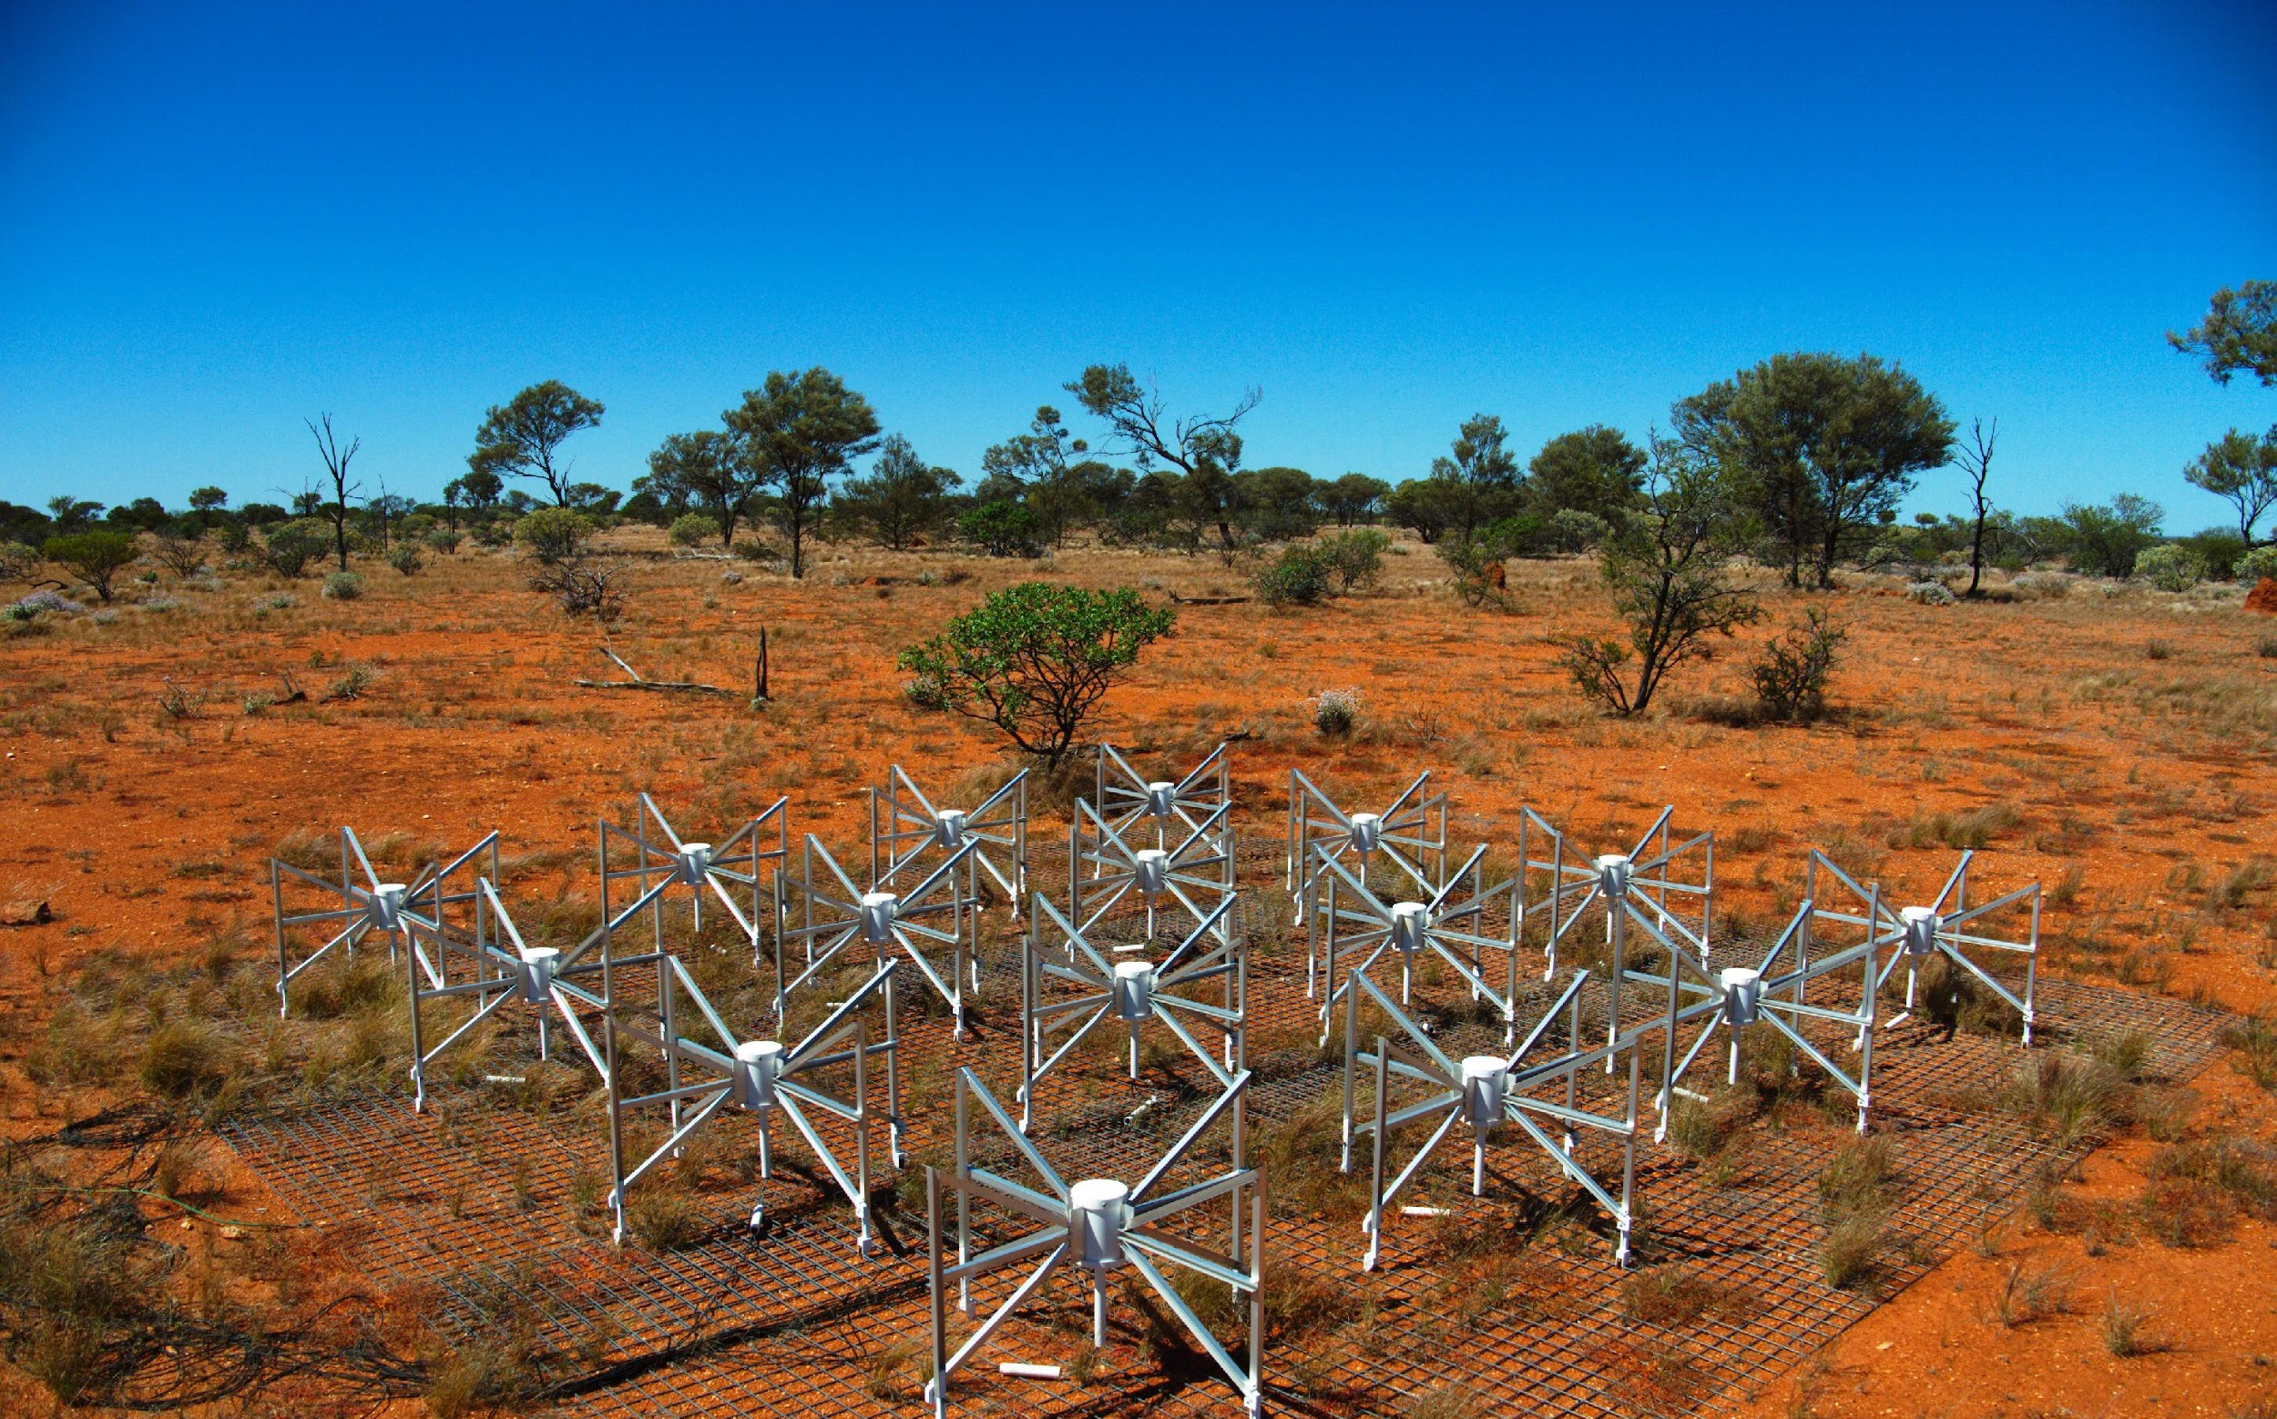
The Epoch of Reionization… in a Nutshell
1) Formation of the first ionizing sources (z∽20)
2) Hydrogen gets ionized/heated → 21-cm signal
3) Reionization expected to end (z∽6)
Epoch of Reionization (EoR)
SKA
EoR is the scientific goal of ongoing and future radio interferometry experiments (e.g. SKA-Low, LOFAR, MWA)
MWA
LOFAR
Notes:
Current and ongoing radio interferometry experiment aim to provide new observational constraints on cosmology and large scale structure

Slide 3
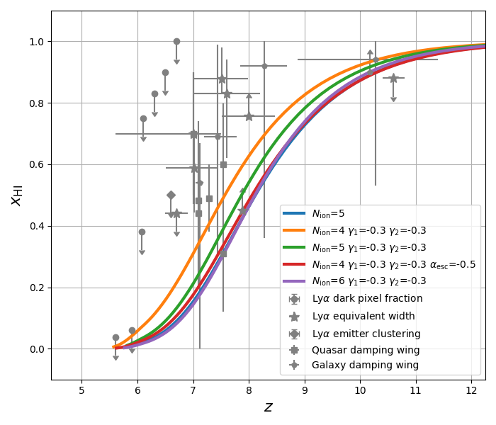
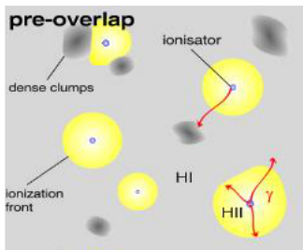
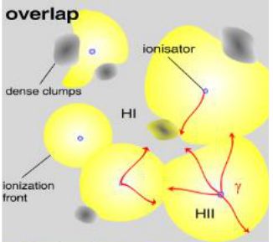
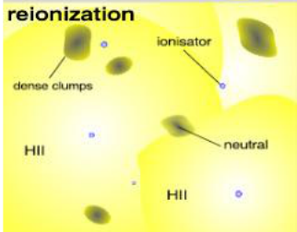
The Epoch of Reionization… in a Nutshell
The observed signal, δT_{b}(θ,z), depends on the redshift/frequency evolution of the hydrogen (HI) volume-averaged neutral fraction:
〈x_{HI}〉∊ [0, 1]
〈x_{HI}〉≈ 1
〈x_{HI}〉≈ 0.5
〈x_{HI}〉≈ 0
Reionization history

Slide 4
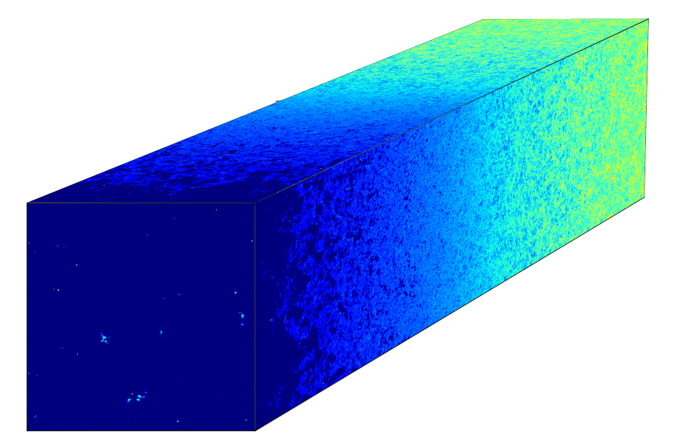
Tomographic Imaging of the 21-cm Signal
Square Kilometre Array (SKA-Low) will provide a sequence of images of redshifted 21-cm signal at different redshifts (observed frequencies).
3D tomographic dataset
a.k.a.
21-cm lightcone
Differential brightness
δT_{b}(θ,z) ∝ [1+δ_{b}(θ,z)] x_{HI}(θ,z)
z = 13.2 ν_{obs} = 100 MHz
Redshift evolution of the 21-cm signal spatial distribution throughout EoR
Dec
z , ν_{obs}
RA

Slide 5
Science Data Challenge 3
The goal of the SKA Data Challenge 3 is to test the full pipeline of the SKA-Low, from instrumental observations to cosmological & astrophysical predictions.
SDC3a Foreground:
Can we detect the 21-cm signal and remove foreground contamination?
Start: Observed visibility with systematics, gain error, foregrounds, etc.
Goal: Clean 2D power spectra (summary statistics) of the 21-cm signal.
SDC3b Inference: Can we infer the reionization history from the observed detection?
Start: 2D power spectra of the detected signal at observed frequency, ν_{obs}.
Goal: Infer the corresponding hydrogen neutral fraction〈x_{HI}〉.
The ending point of SDC3a is the starting point of SDC3b

Slide 6
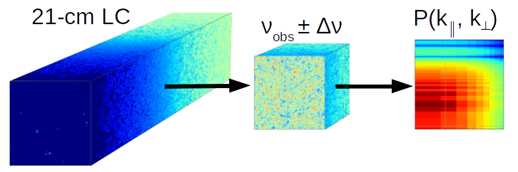
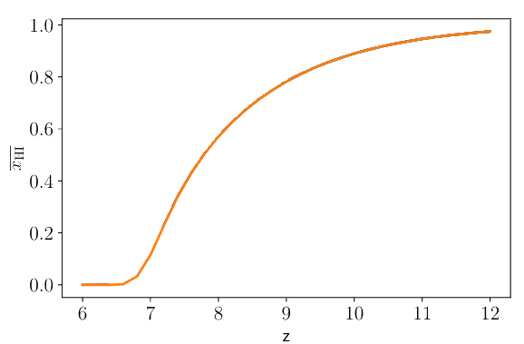
Setup of the SDC3b: Inference
Input dataset: 3D tomographic data simulated with two codes (different approaches)
Observational setups (for each dataset):
Realistic scenario: 21-cm + systematic noise + residual foreground
Ideal scenario: 21-cm + systematic noise
Infer EoR history
Prediction: (z, x_{HI}± Δx_{HI})
Analysis
21-cm sub-volume
2D Pk
Ground Truth: ν_{obs} ± Δν →〈x_{HI}〉
More info: https://sdc3.skao.int/challenges/inference and see Anna’s presentation

Slide 7
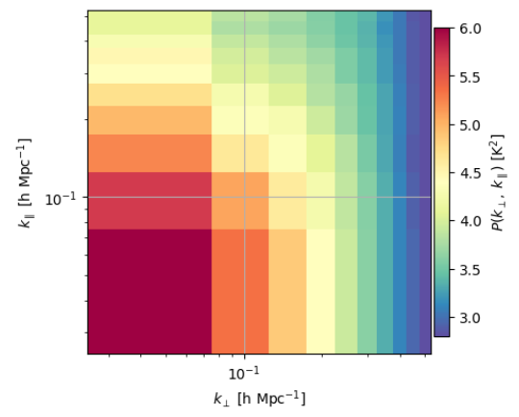
team framework
CH and SE are the newly arrived at SKAO → Joining forces for SDC3b
Registered at the SDC3b with two teams (Traditional & Modern SEarCH)
Traditional
2D Pk
Modern
21-cm lightcone
SDC3b Data
Forward model or Simulations
Model residual foreground & systematics (?)
with BEoRN @ UZH
MCMC inference
Model summary statistic
@ ETHZ, UniGe
EPFL
@ ETHZ, Stockholm
Prediction (z, x_{HI}± Δx_{HI})
SBI & ML
@ UniGe, HES-SO, ZHAW, FHNW, Chalmers

Slide 8
Traditional Method
Taylor expansion of the power spectra based on the theoretical equation:
We can generalize and parametrize the complex fields with a fitting function, F:
Complex field: difficult to model
Constant defined by Cosmology
Target of the SDC3b
To define and model based on simulations

Slide 9
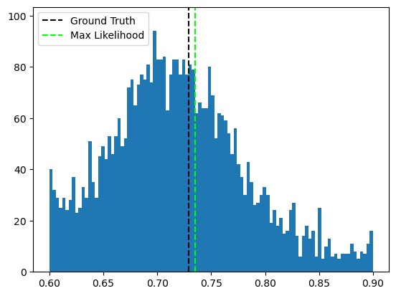
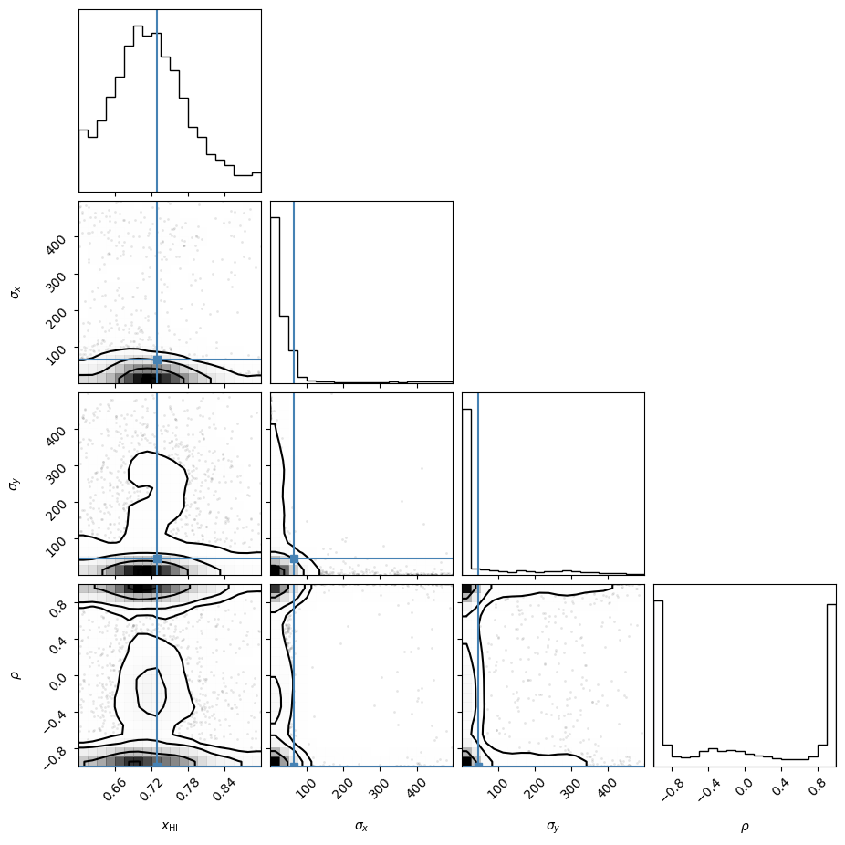
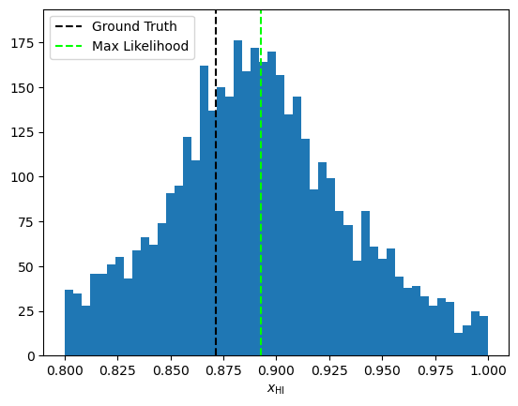
Traditional Method on SKACH dataset
Assumed Error
ΔP_{k}~ 10%
MCMC inference provides posterior of the analytical model parameters, from which:
Volume averaged neutral fraction〈x_{HI}〉
Next possible steps:
Develop an emulator for better field parametrization
Assumed Error
ΔP_{k}~ 1%
Qualitative evaluation on larger simulated dataset
Parametrize function with ML models?

Slide 10
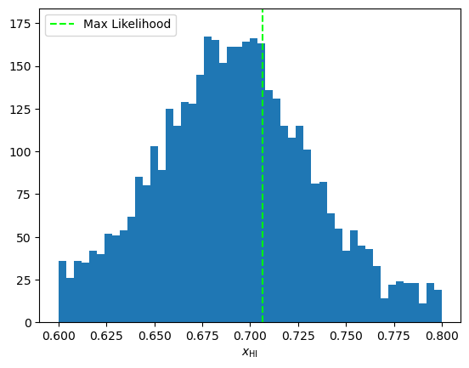
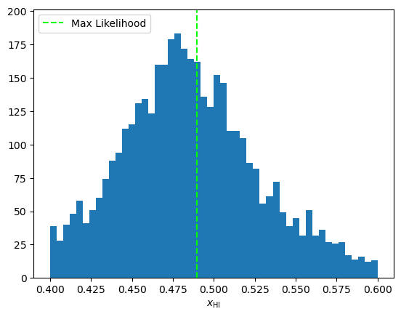
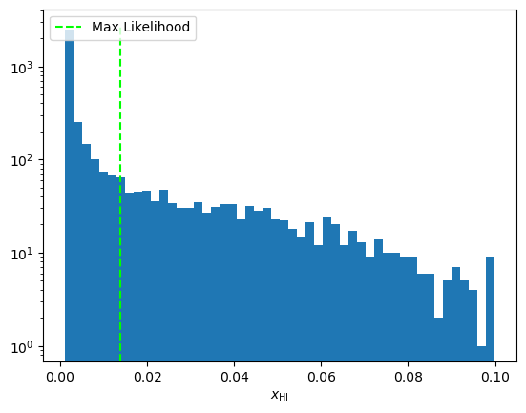
Traditional Method on SDC3b test data
The SKAO SDC3 organizers released a preliminary dataset for testing. We applied the Traditional approach with an analytical fitting function.
z = 7.98
z = 7.20
z | freq [MHz] | 〈x_{HI}〉
7.98 | 151 - 166 | 0.706
7.20 | 166 - 181 | 0.490
6.55 | 181 - 195 | 0.014
Preliminary
z = 6.55

Slide 11
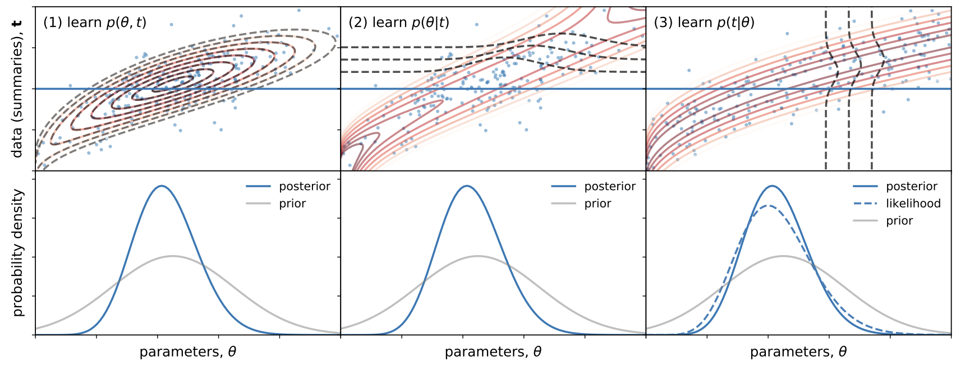
Modern Method
Employ simulation based inference (SBI)
Instead of Gaussian likelihood assumption, likelihood is learnt from simulations
Requires compression + density estimation: machine learning extensively used
Bias reduced → becoming standard approach

Slide 12
Summary & TODO List
Status of the Swiss & Swedish team at the SDC3b …
Employ SKACH dataset (recycled from SDC3a) for traditional method test
Testing traditional method (MCMC) on the testset of the SDC3b
Testing traditional method on data with noise & residual foreground
Prepare the semi-numerical code BEoRN for modern framework
Develop ML & SBI frameworks for modern method
Develop generative diffusion models for modelling summary statistics
Waiting for the ground truth of the SDC3b test dataset
Waiting for the official start of the challenge (SDC3b data)

