Slide 1
SKACH Spring Meeting: Communications Update
Winterthur, June 2024

Slide 2
Communication and Outreach, January 2024 – June 2024
Focus:
News
Events
Podcast series
Media assets
Progress Report
Website
Image Credit: Astrovinch

Slide 3
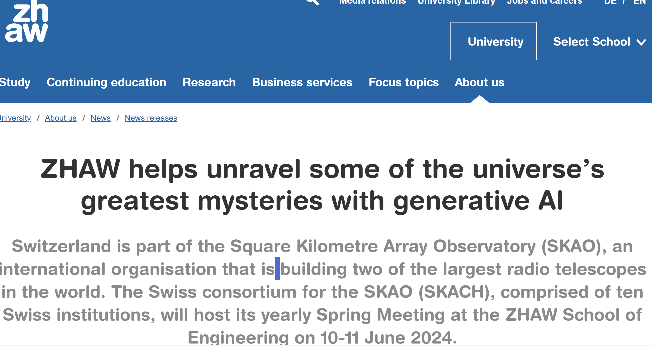
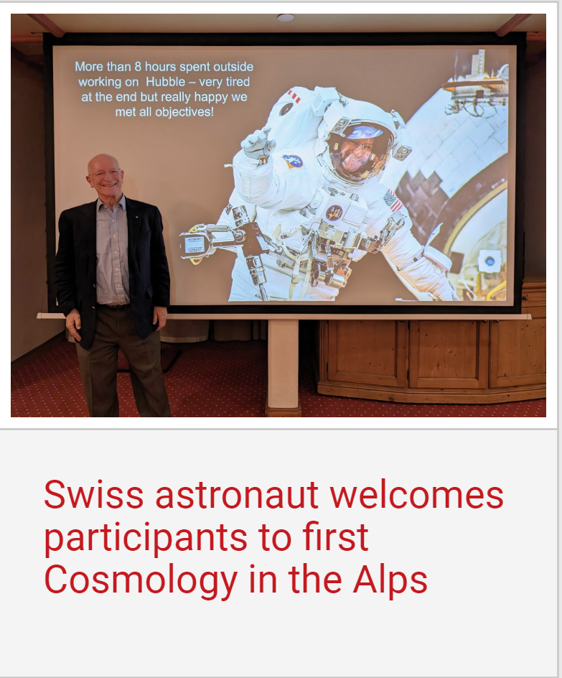
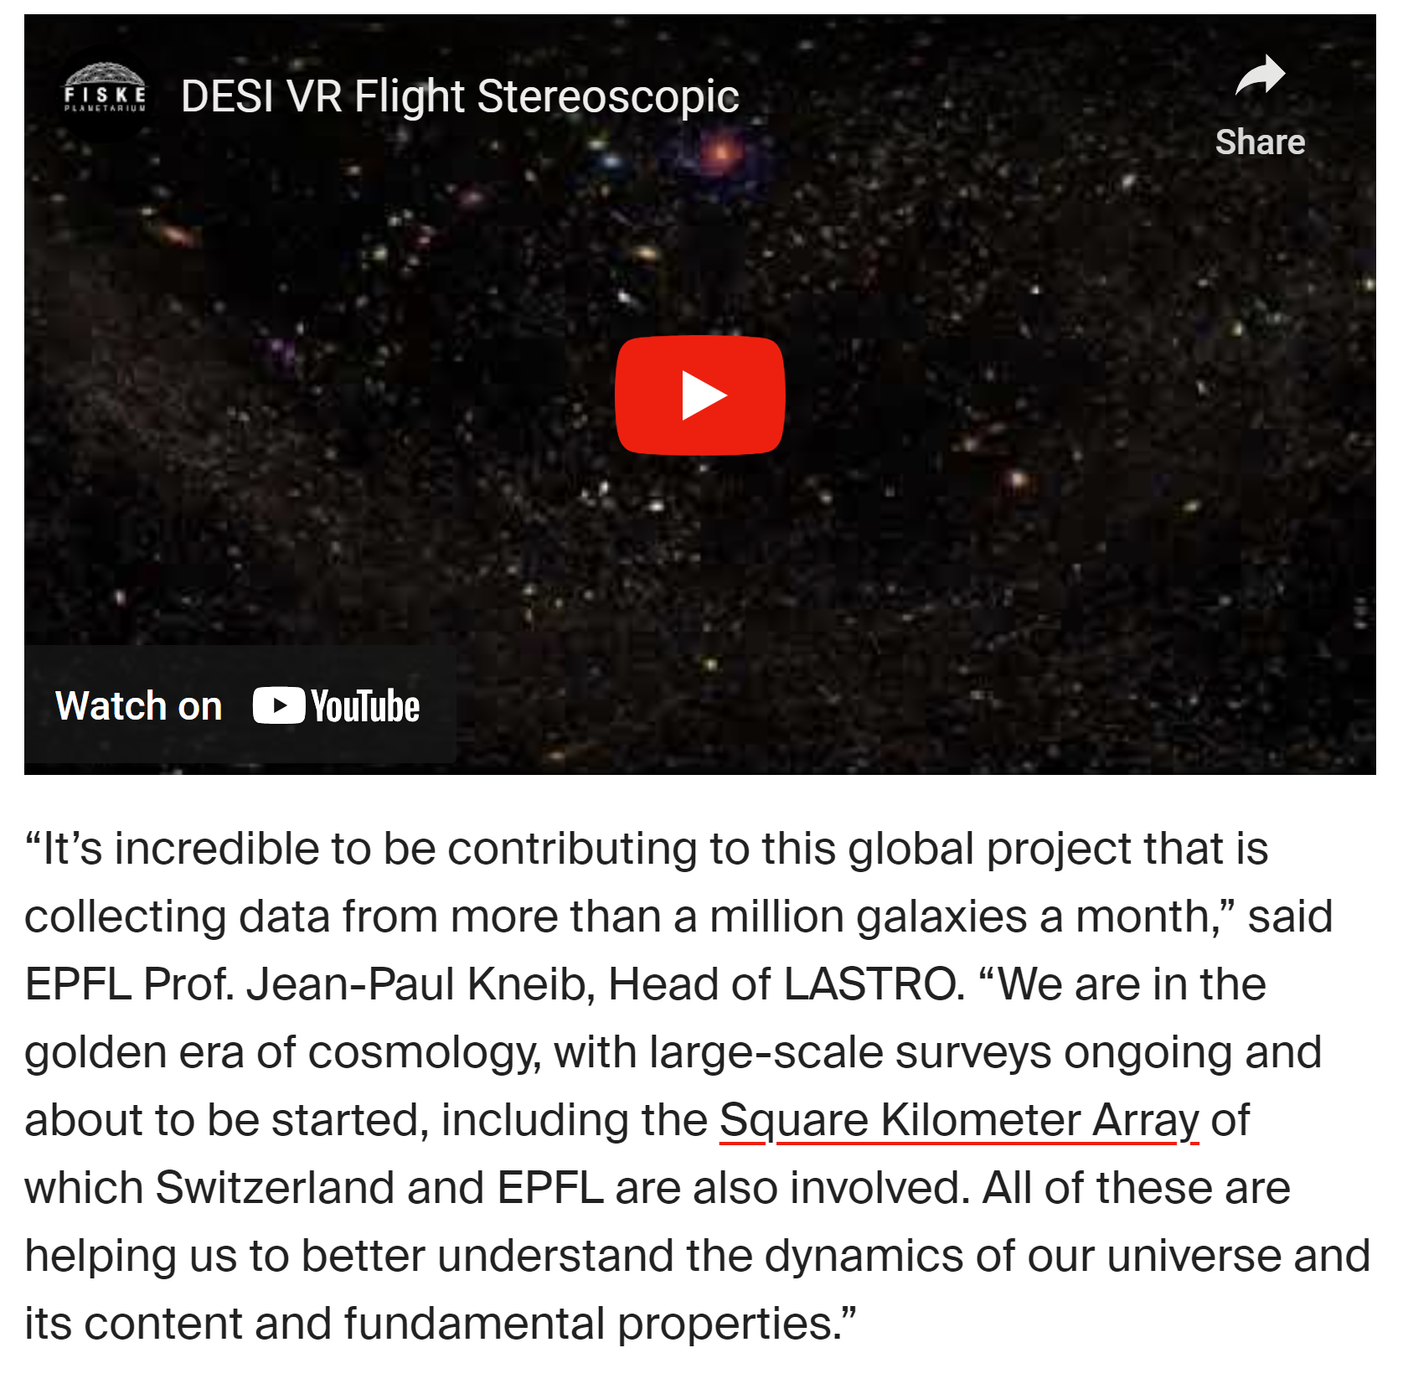
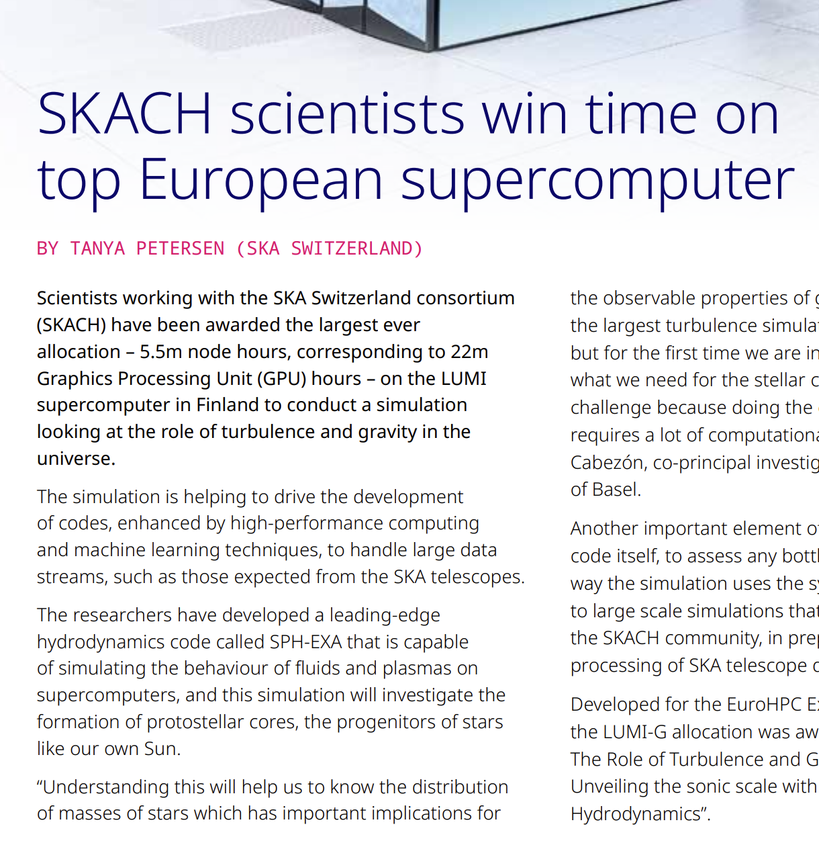
SKACH in the News, Feb – June 2024

Slide 4
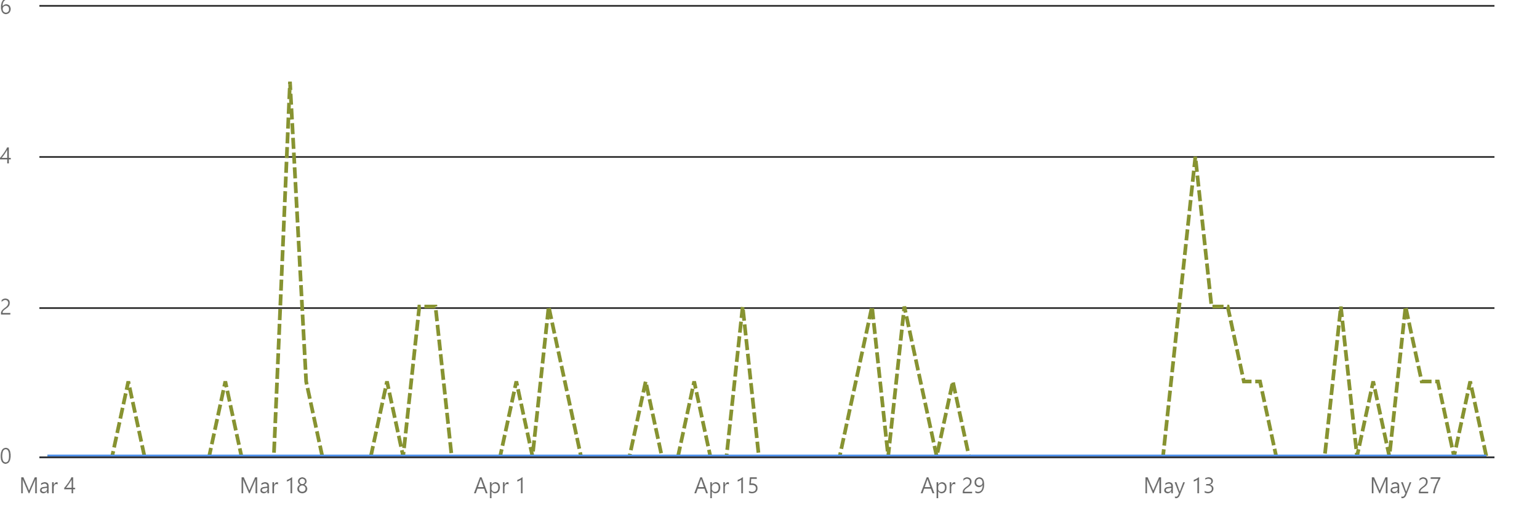
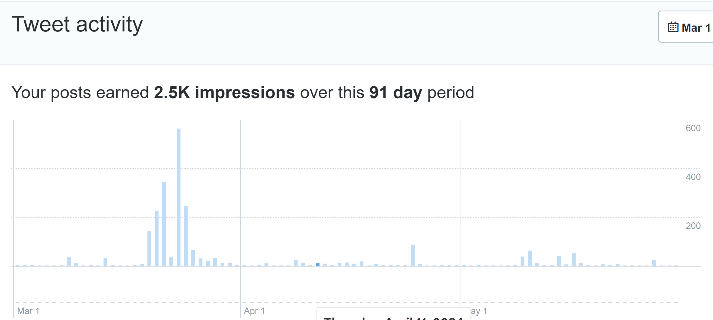
Our Social Channels
LinkedIn
LinkedIn
Consistent engagement
Cosmo in the Alps, Radio Cosmos, Fantasy Basel, Cosmos Archeology in Shanghai most popular posts
Spike in Basel based followers around Fantasy Basel (9-11 May)
End May: ChenChen Liu, Tristan Piguet – Science officers, Swiss Embassy China and Australia.
Twitter/X
Cosmo in the Alps
Low to no engagement since

Slide 5
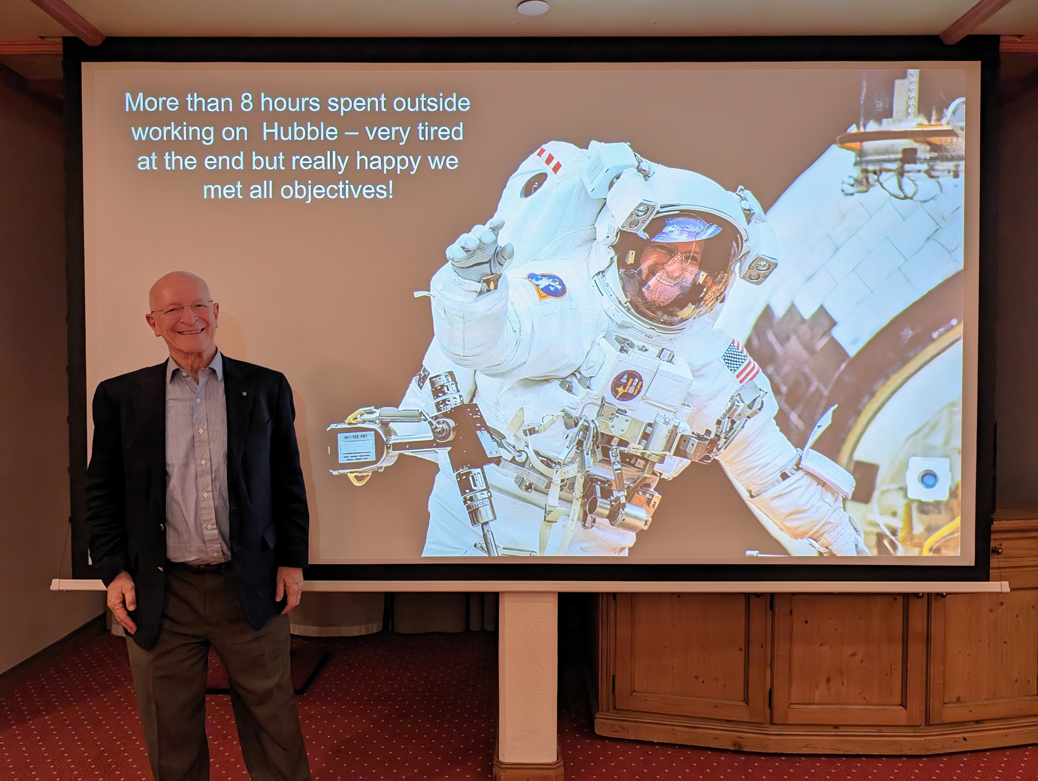
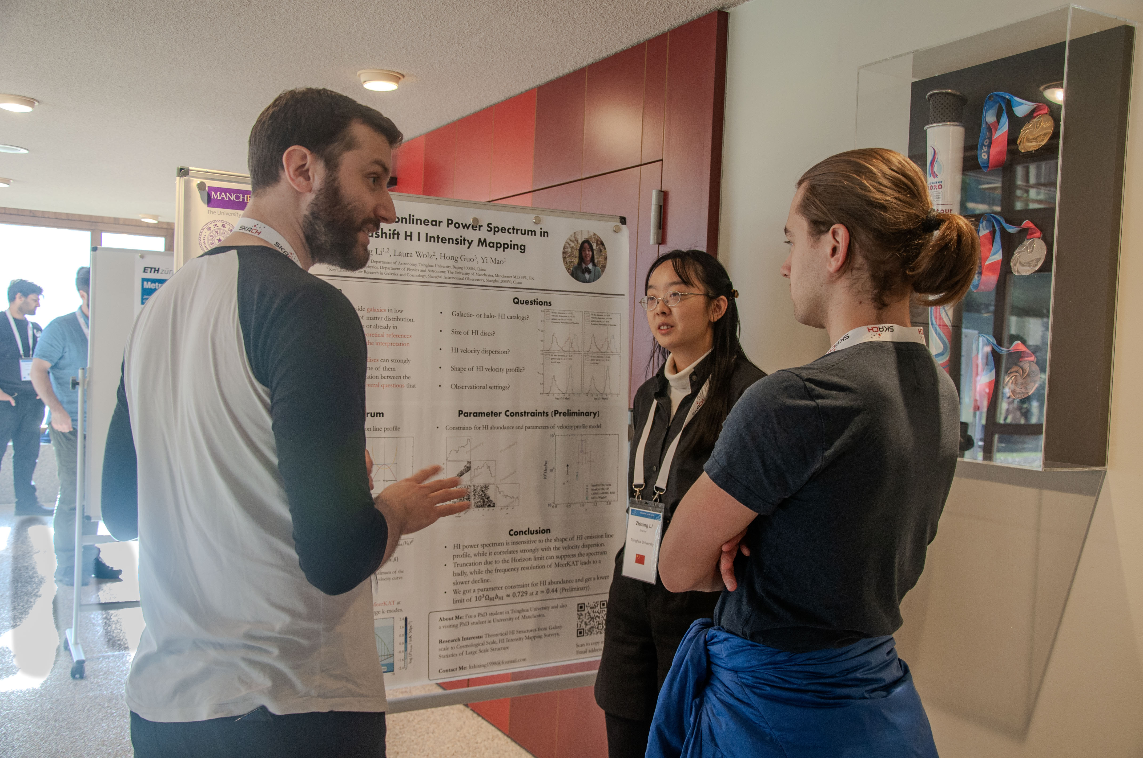
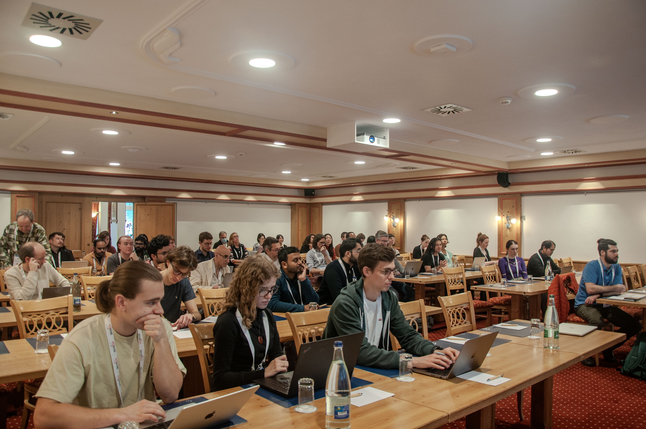
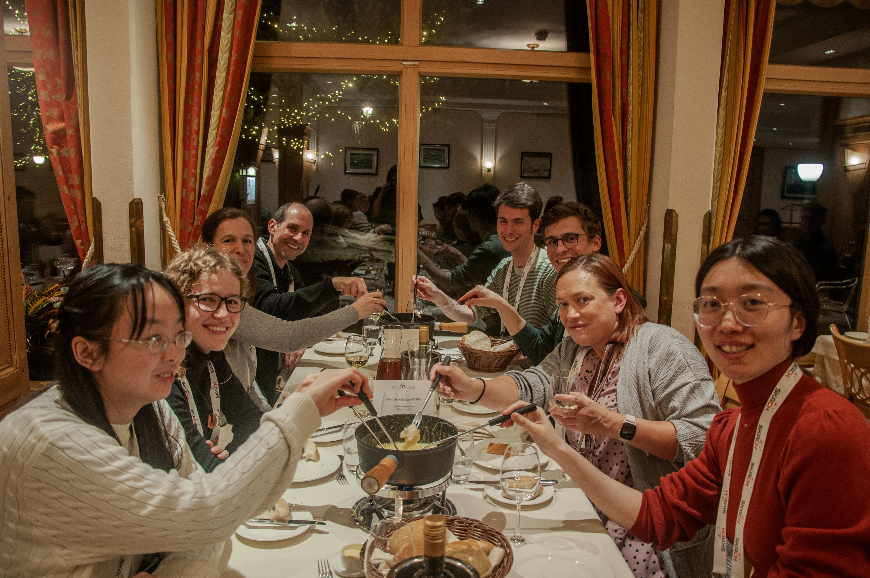
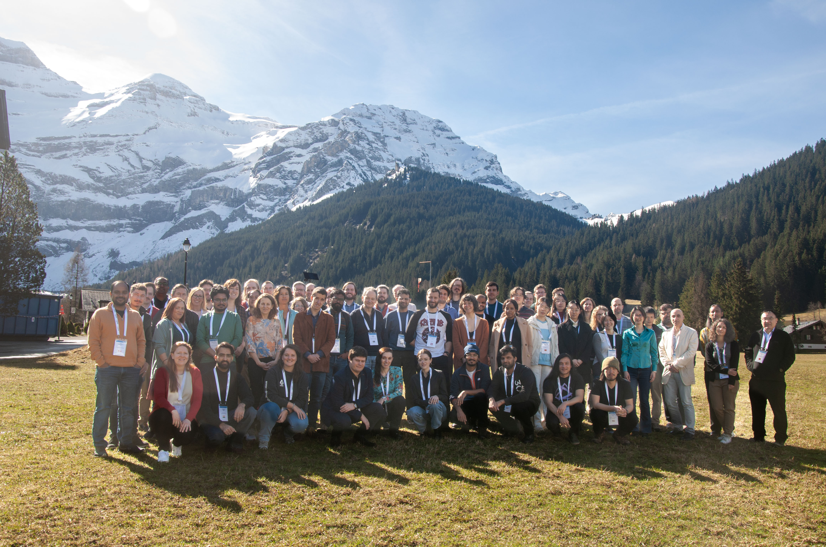
Cosmology in the Alps
Inaugural event in Switzerland
80 participants from around the globe
Matching senior researchers with early career researchers
Poster session
Special guest speaker Swiss astronaut, Claude Nicollier
Fondue and visit to Glacier 3000!

Slide 6
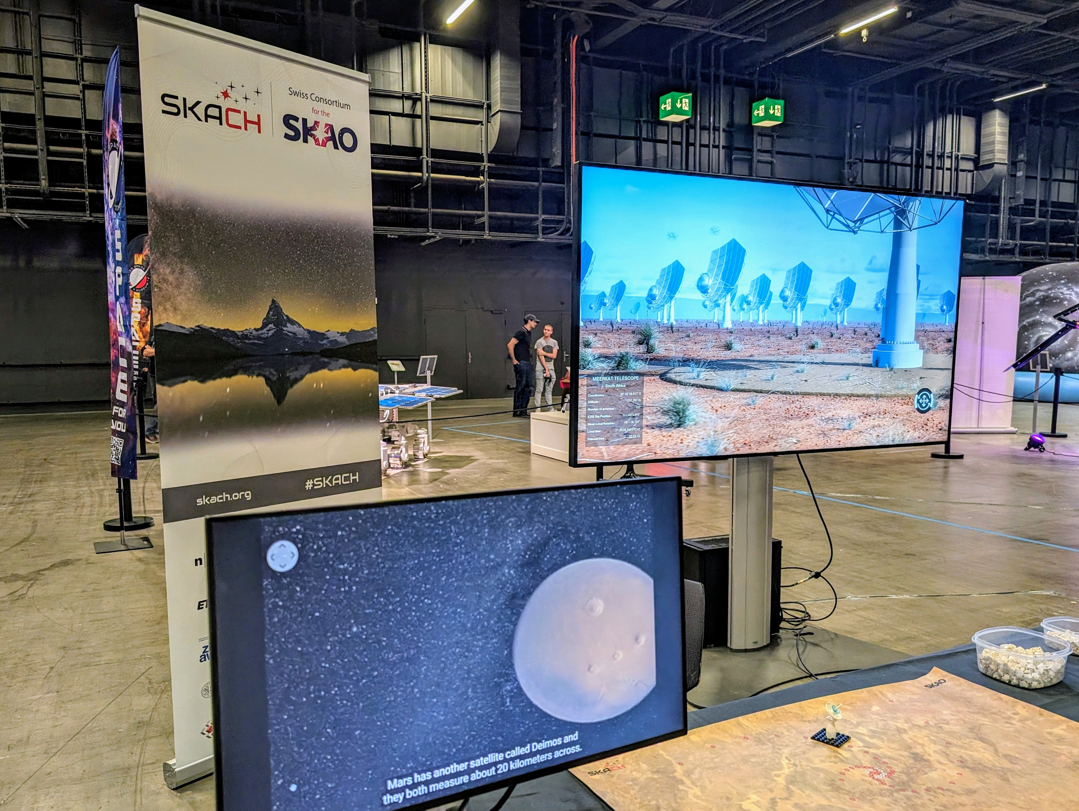
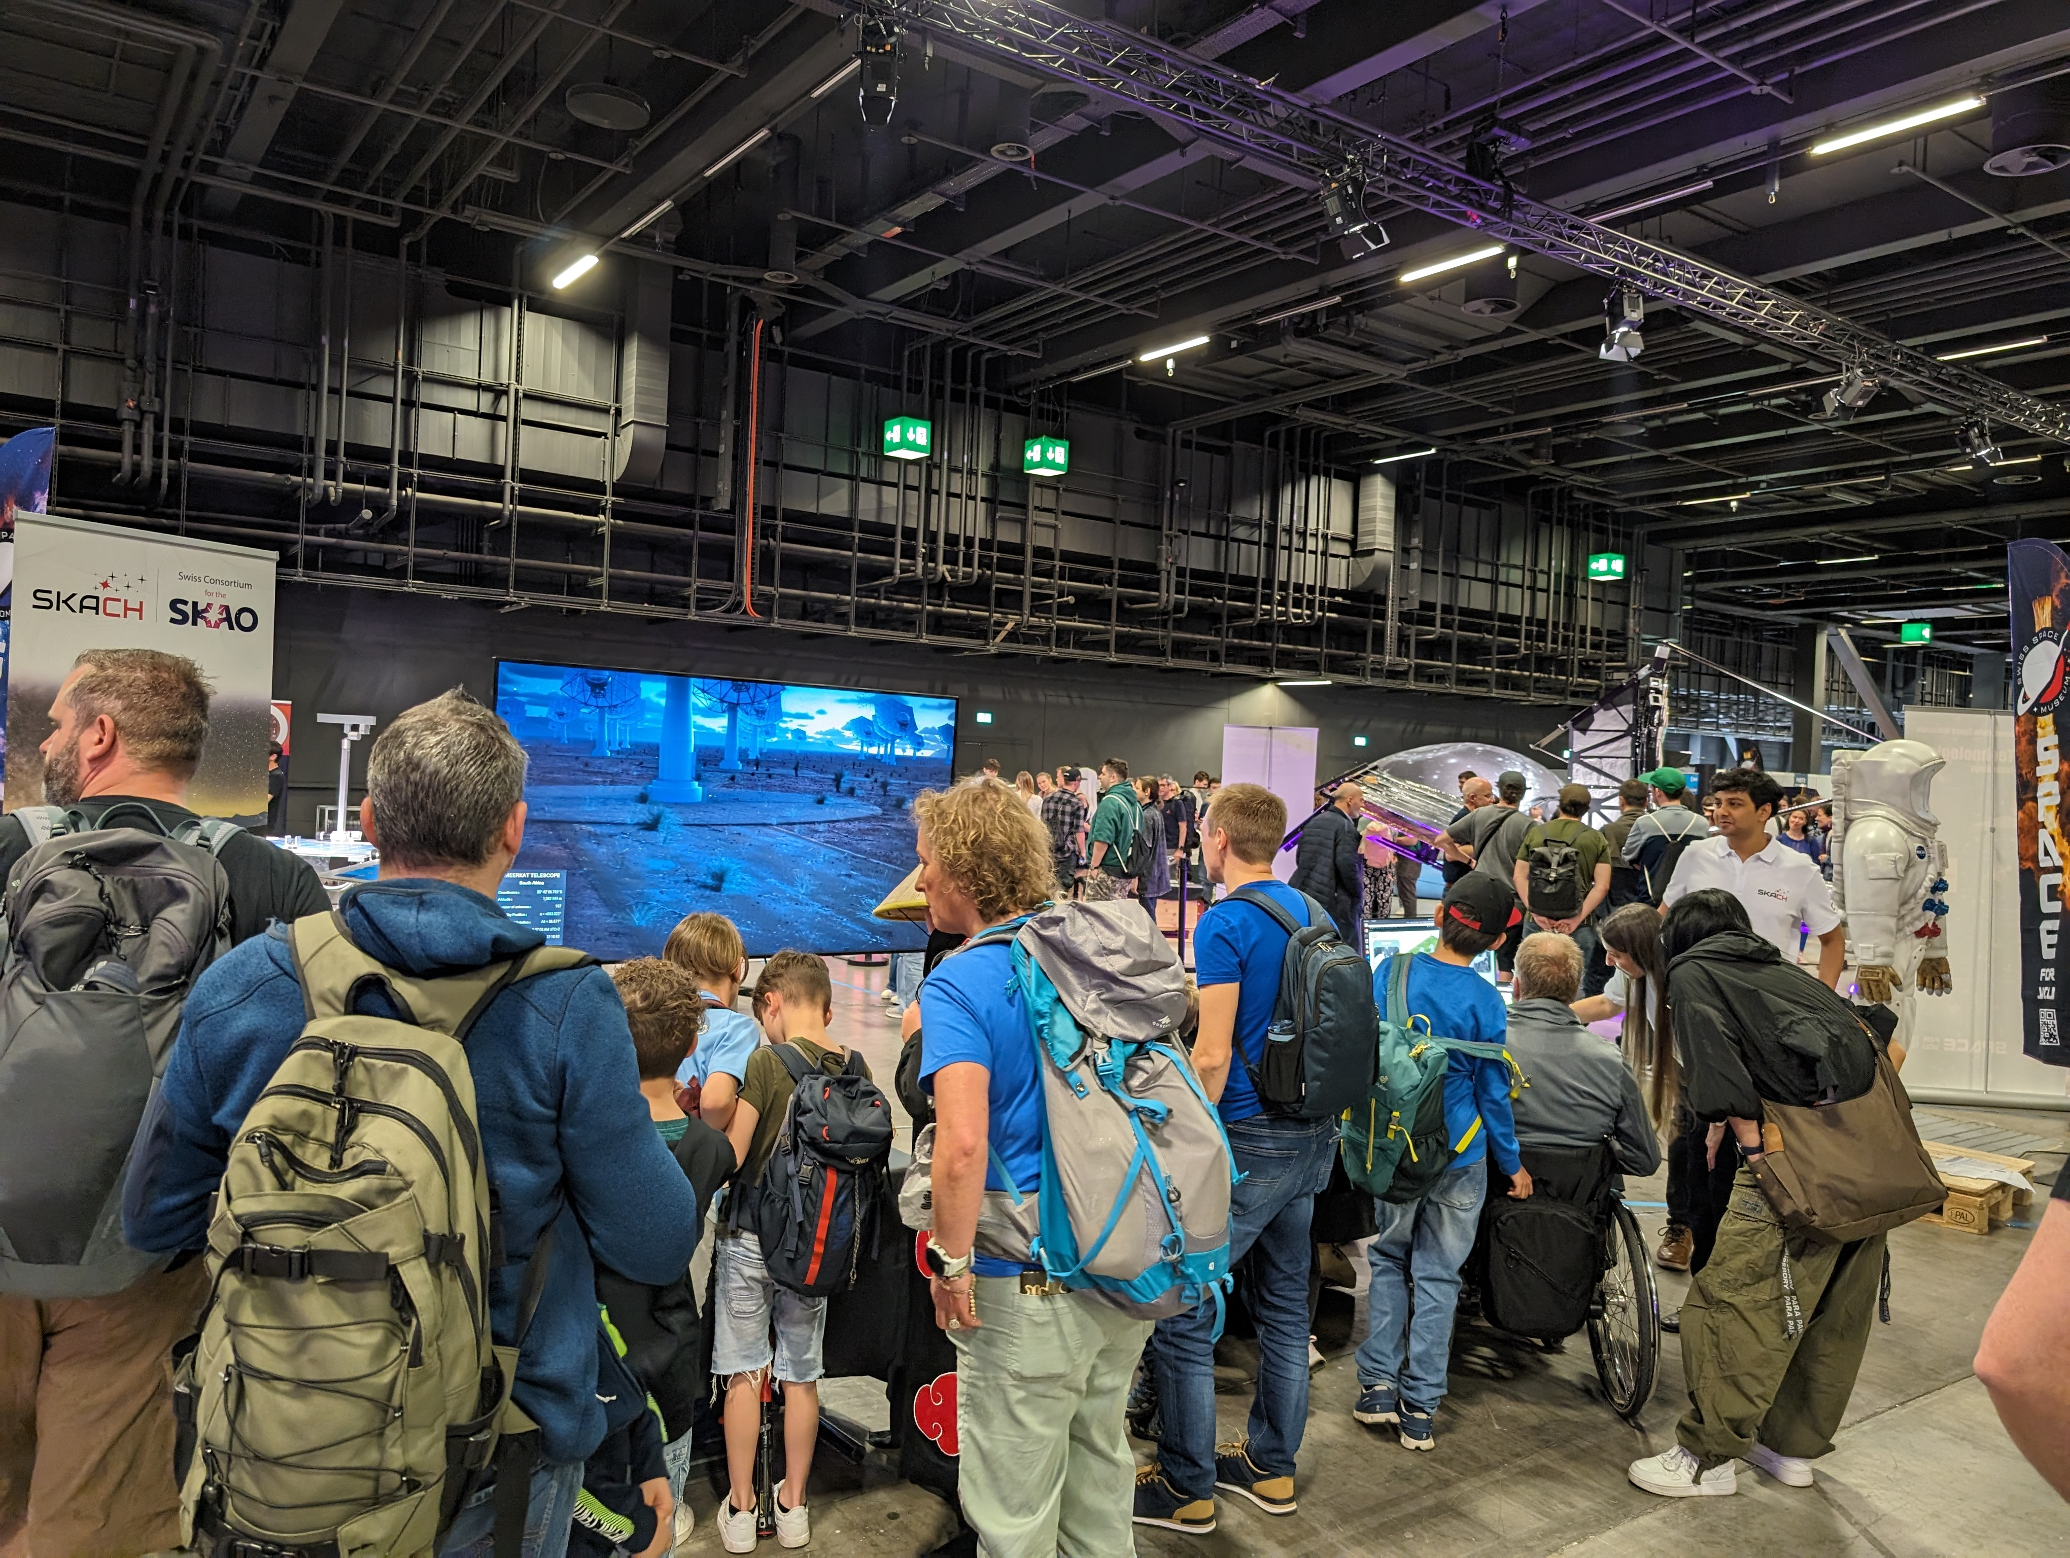
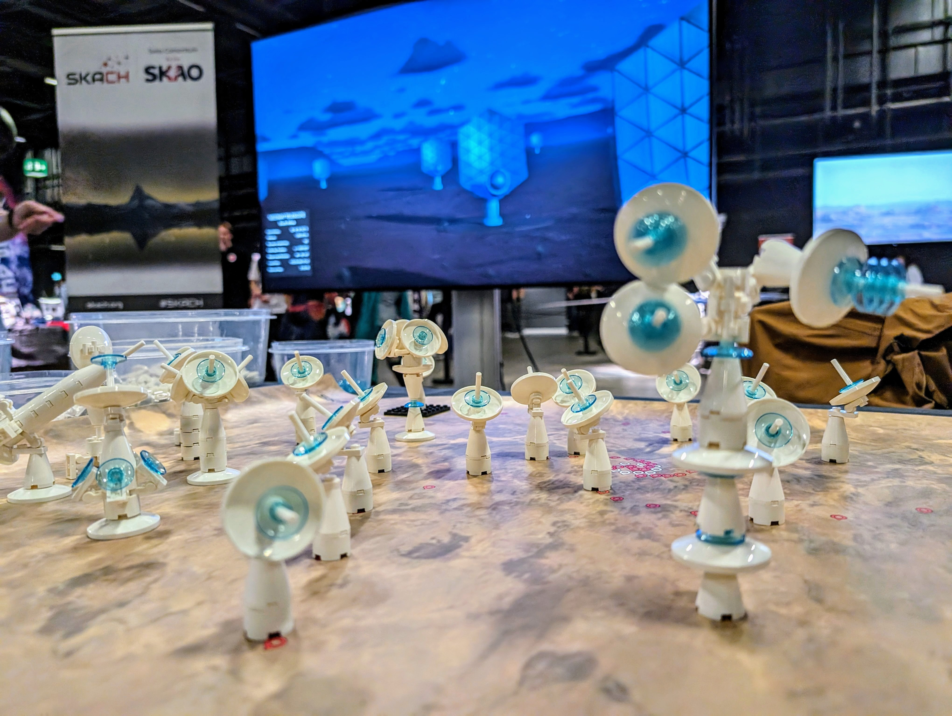
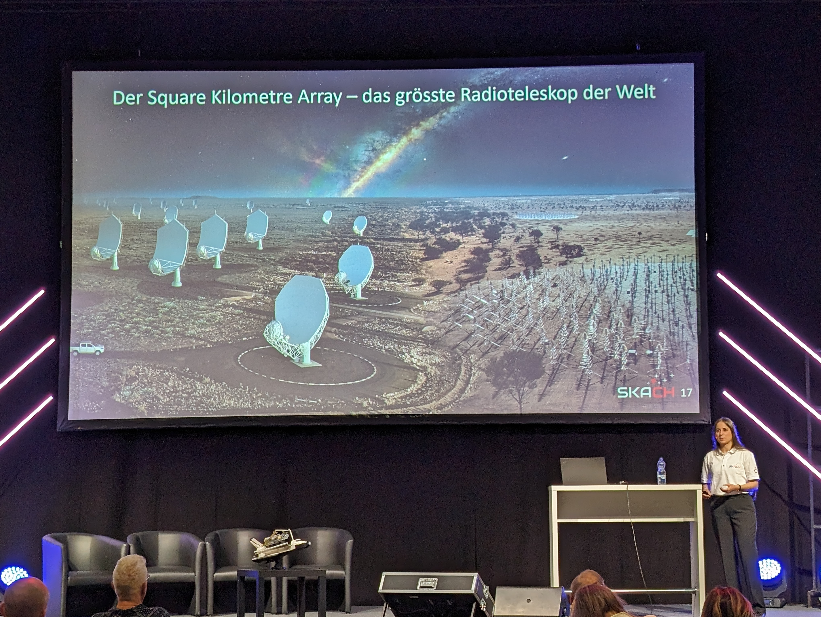
Fantasy Basel
The Swiss Comic Convention
88-thousand visitors over 3 days – around 10k visited our booth
Space Exhibition a mix of science and sci-fi
Very few people knew about SKAO before talking to us.
Thanks to Susanne for her great presentation on the main Space Stage.
Thanks to EPFL’s eM+ lab for the SKA Simulator
Shreyam’s simulation presentation was also a highlight

Slide 7
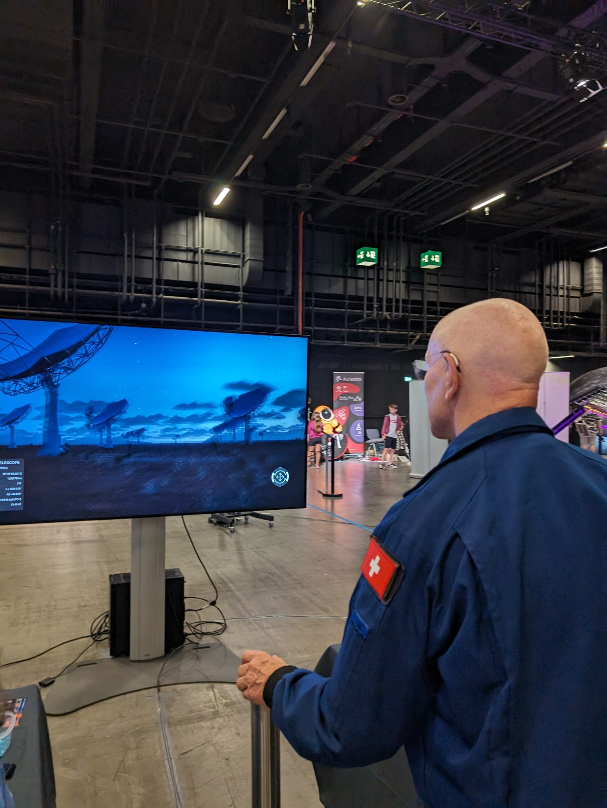
Feedback from two special VIPs
“Thanks for all your effort for brining SKAO and SKACH closer to the general public. I liked your booth very much!”
Laurent Salzarulo, Deputy Head of International Research Organizations at SERI

Slide 8
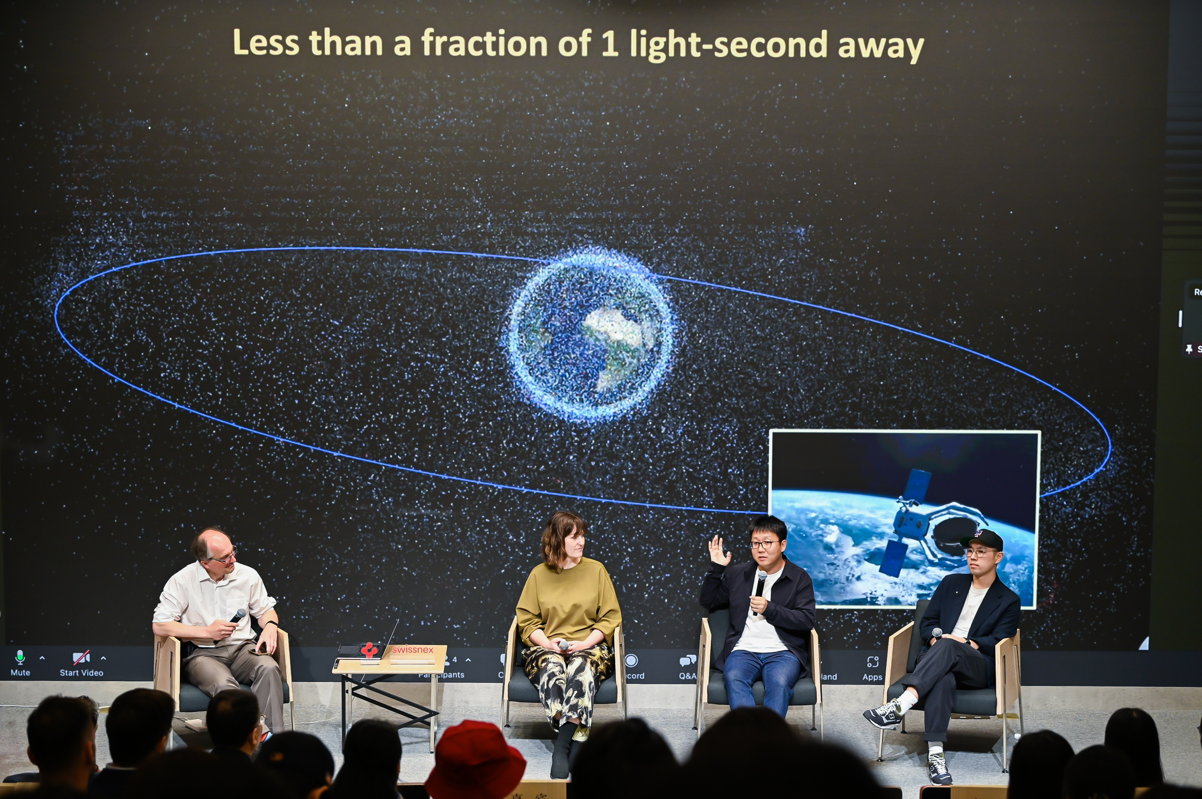
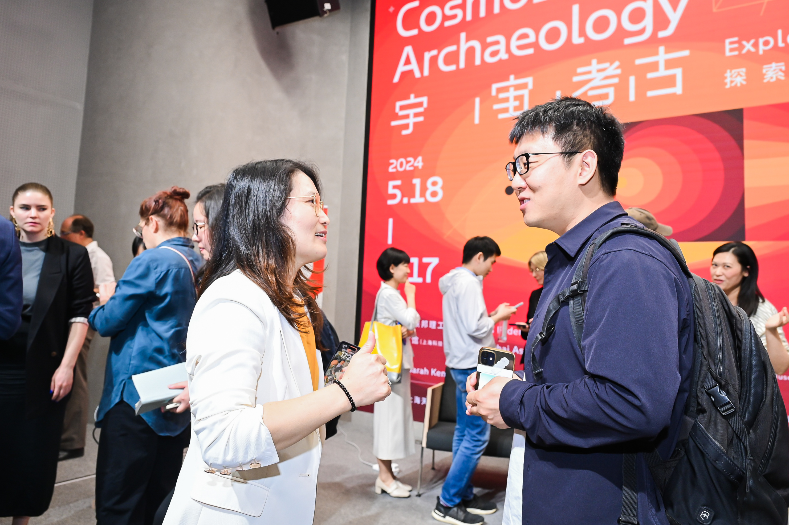
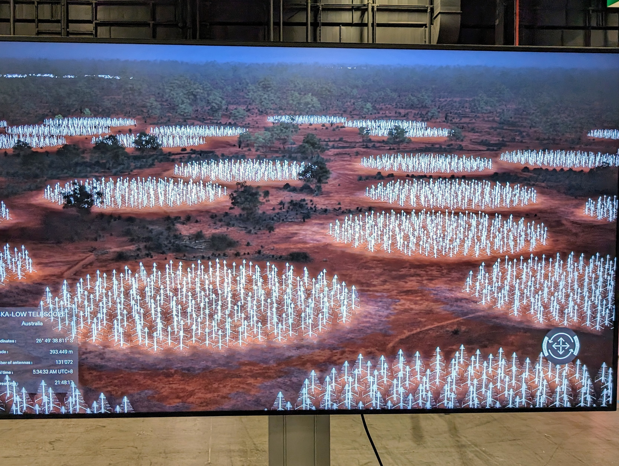
Cosmos Archeology Shanghai
The Cosmos Archaeology exhibition is on at the Shanghai Astronomy Museum
Opened with a series of events that brought together the worlds of art and science into interactive dialogues
Collaboration between Swissnex in China, EPFL Pavilions and the
Shanghai Astronomy Museum, Transforms astrophysical data into tangible realities
Includes the SKA-Simulator for the first time, along with Fantasy Basel, showing SKA Low in Australia.

Slide 9
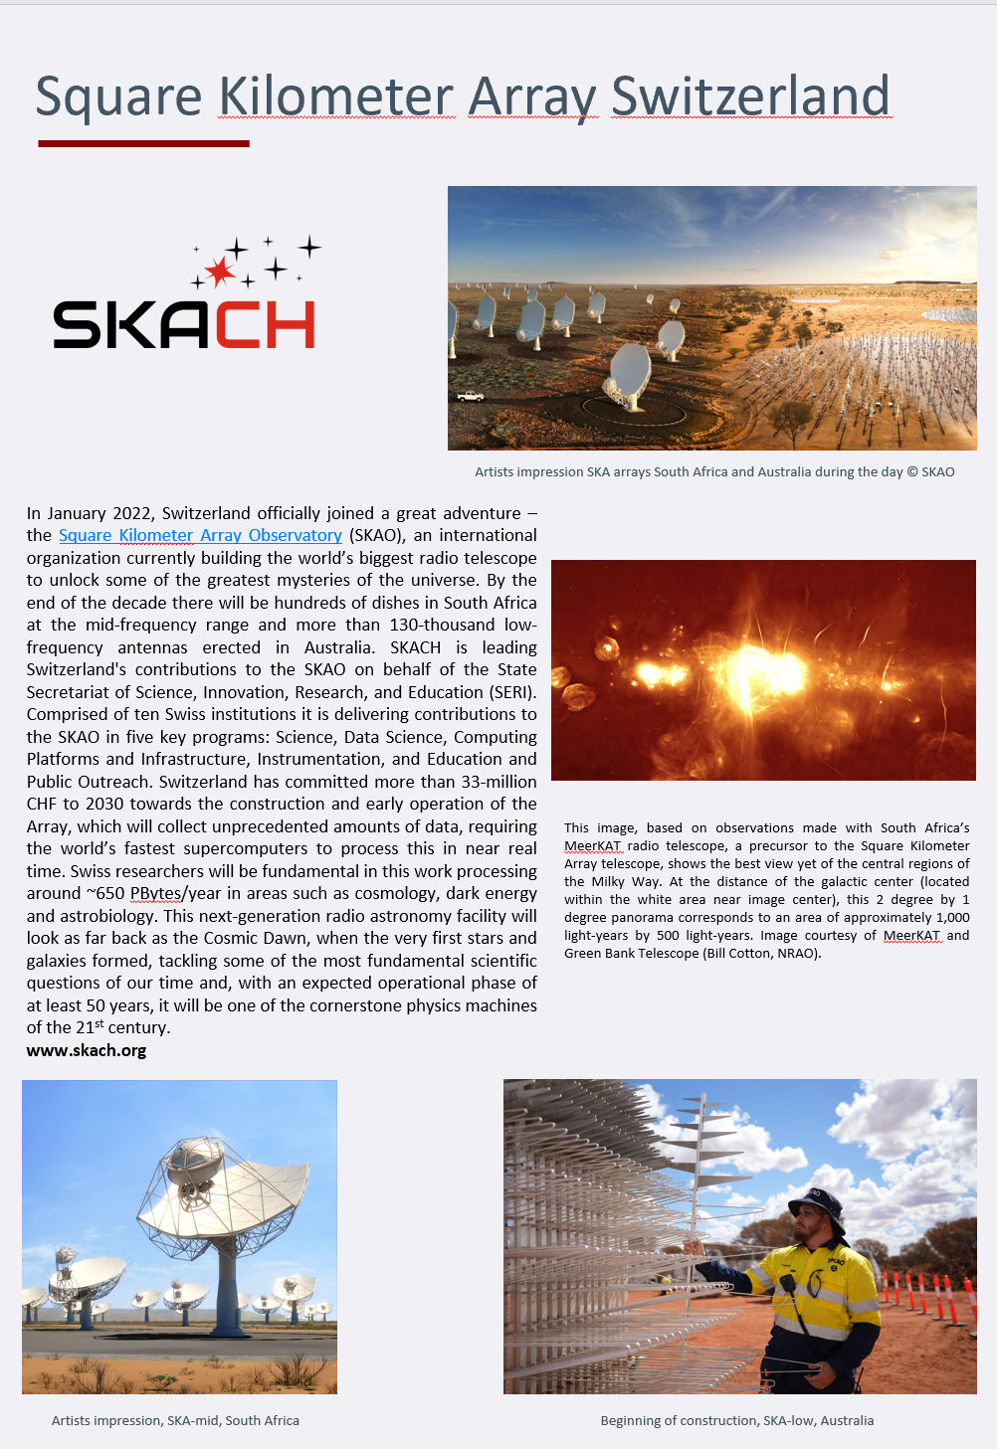
SPIE Astronomy Telescope & Instrumentation conference
15th and 21st June in Yokohama
Eighteen Swiss private companies and three institutional partners participating
Represented by our Industry Liaison Officer
Publicity at large booth, video presentation and booklet

Slide 10
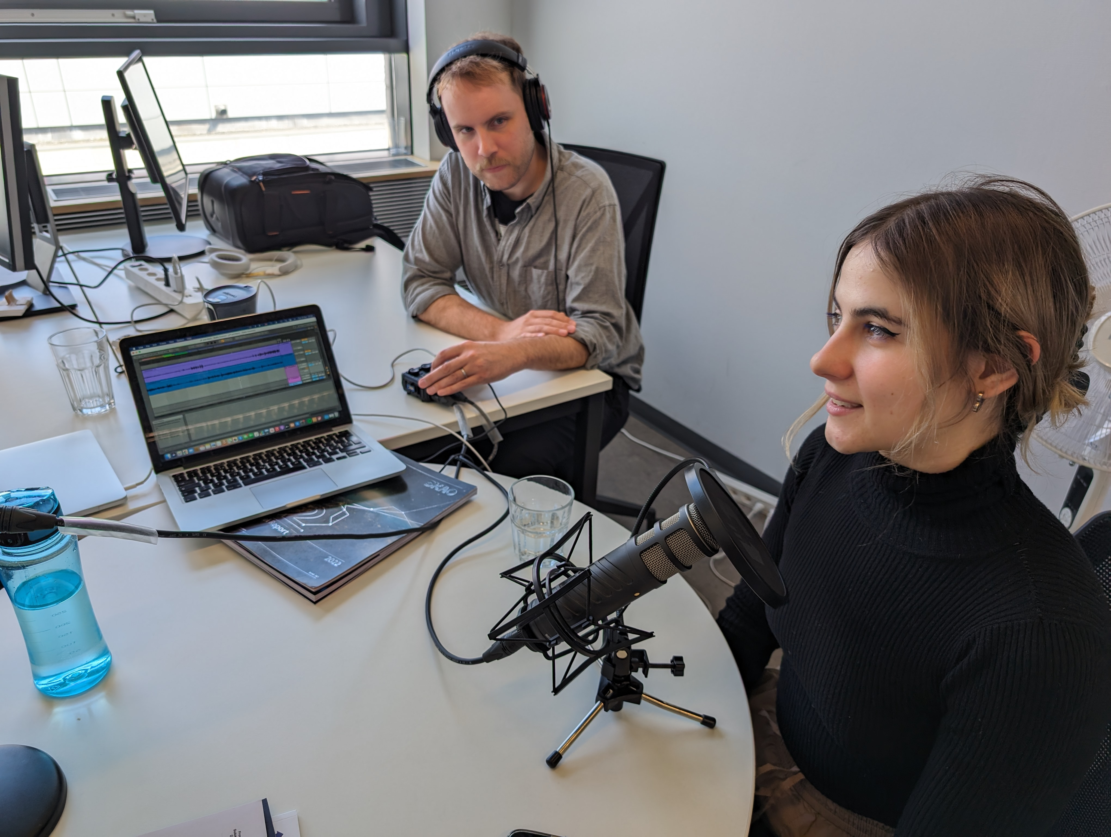
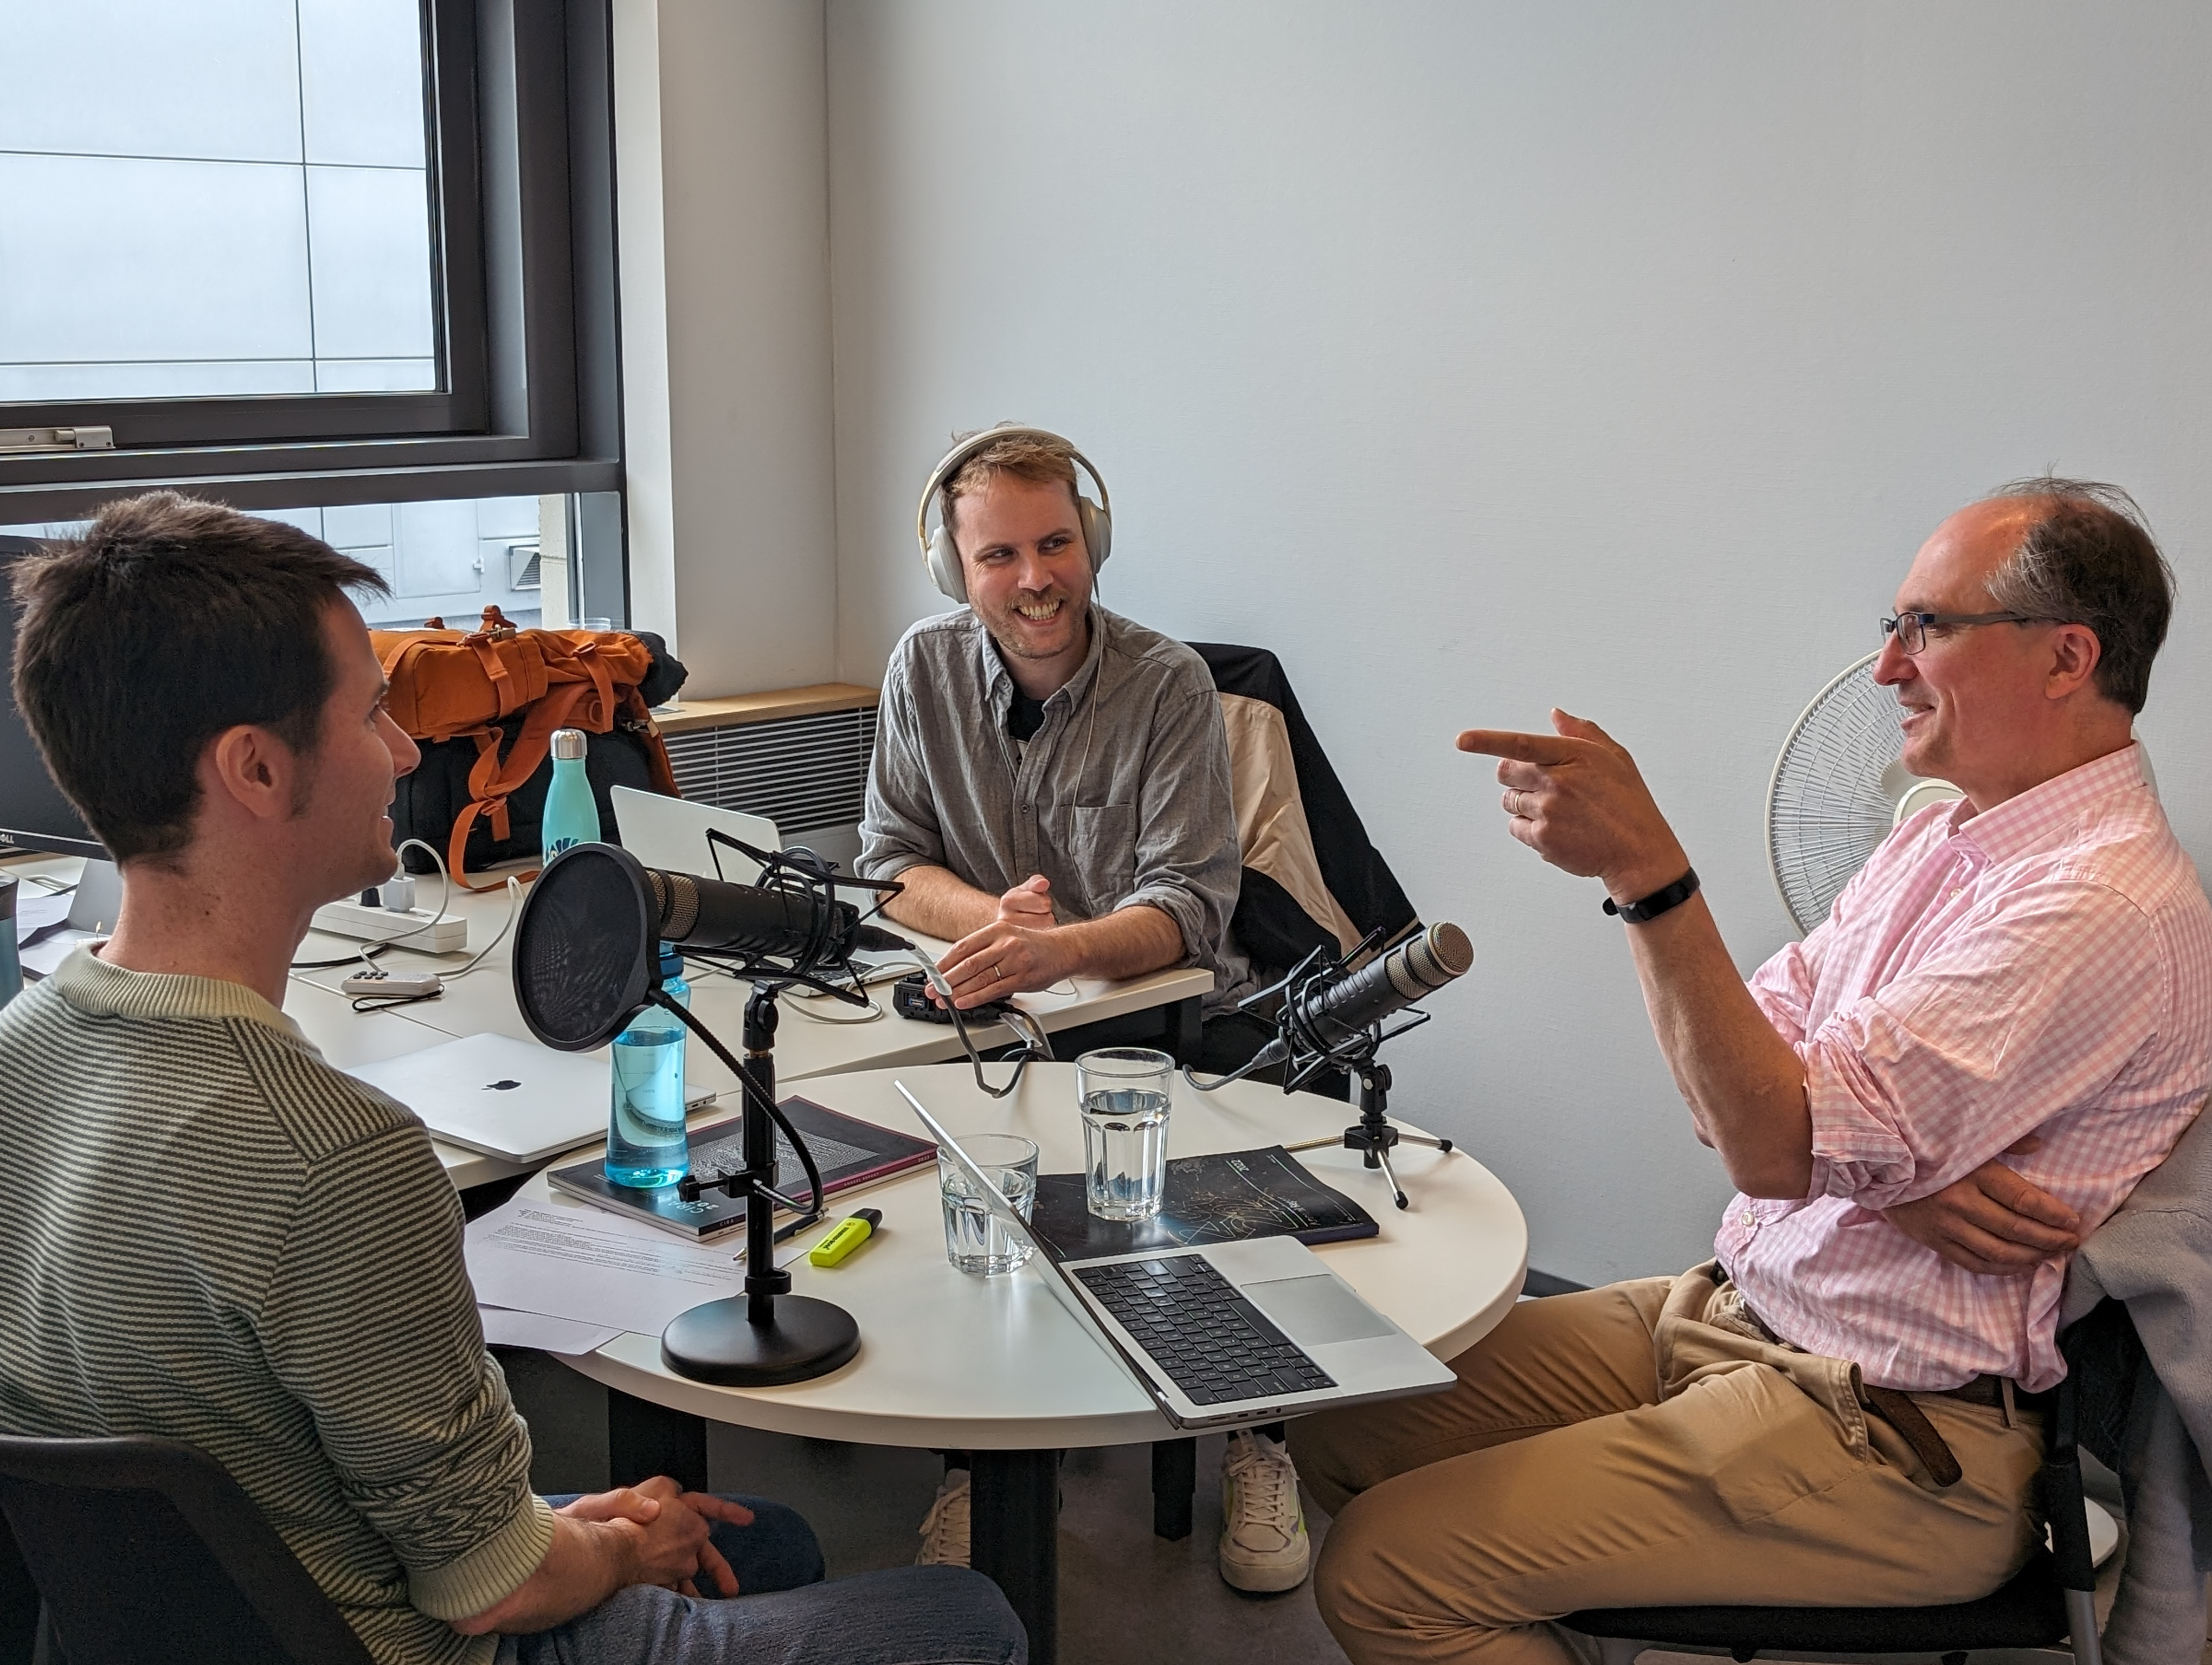
Making Waves Podcast Series:
Recorded the first episode in April: Radio Astronomy 101
Co-hosts Mark Sargent and Alexandra Lagutova (EPFL student)
First special guest: Jean-Paul Kneib
Second round of audio editing underway – all feedback very valuable for the second episode – the search for extra-terrestrial life.
Notes:
We received 5000 Francs from the Swiss Society for Astrophysics and Astronomy last fall/winter
We received 5000 euro from the IAU Office for Astronomy Outreach this past spring
We have contracted with a production company in Geneva to get started
Mark Sargent would host

Slide 11
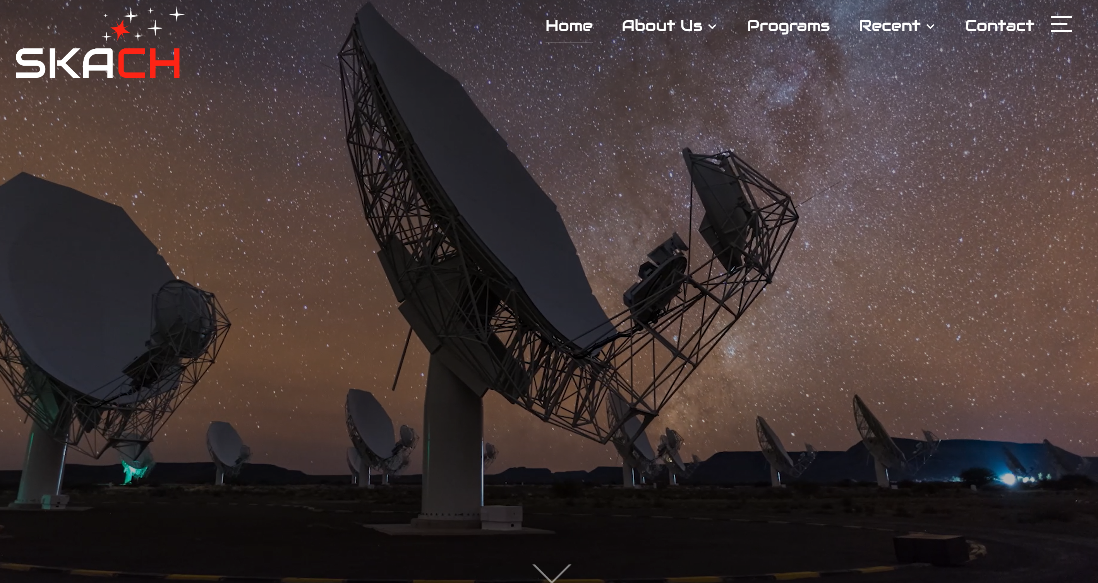
Website: SKACH.org
Notes:
we have finally added (almost) everyone in the consortium on the Team page (and use that as a reminder that they should send photos of themselves), that we created an “In the Media page” to highlight media coverage of SKACH, and having an open jobs and a news page that are (somewhat) up-to-date.

Slide 12
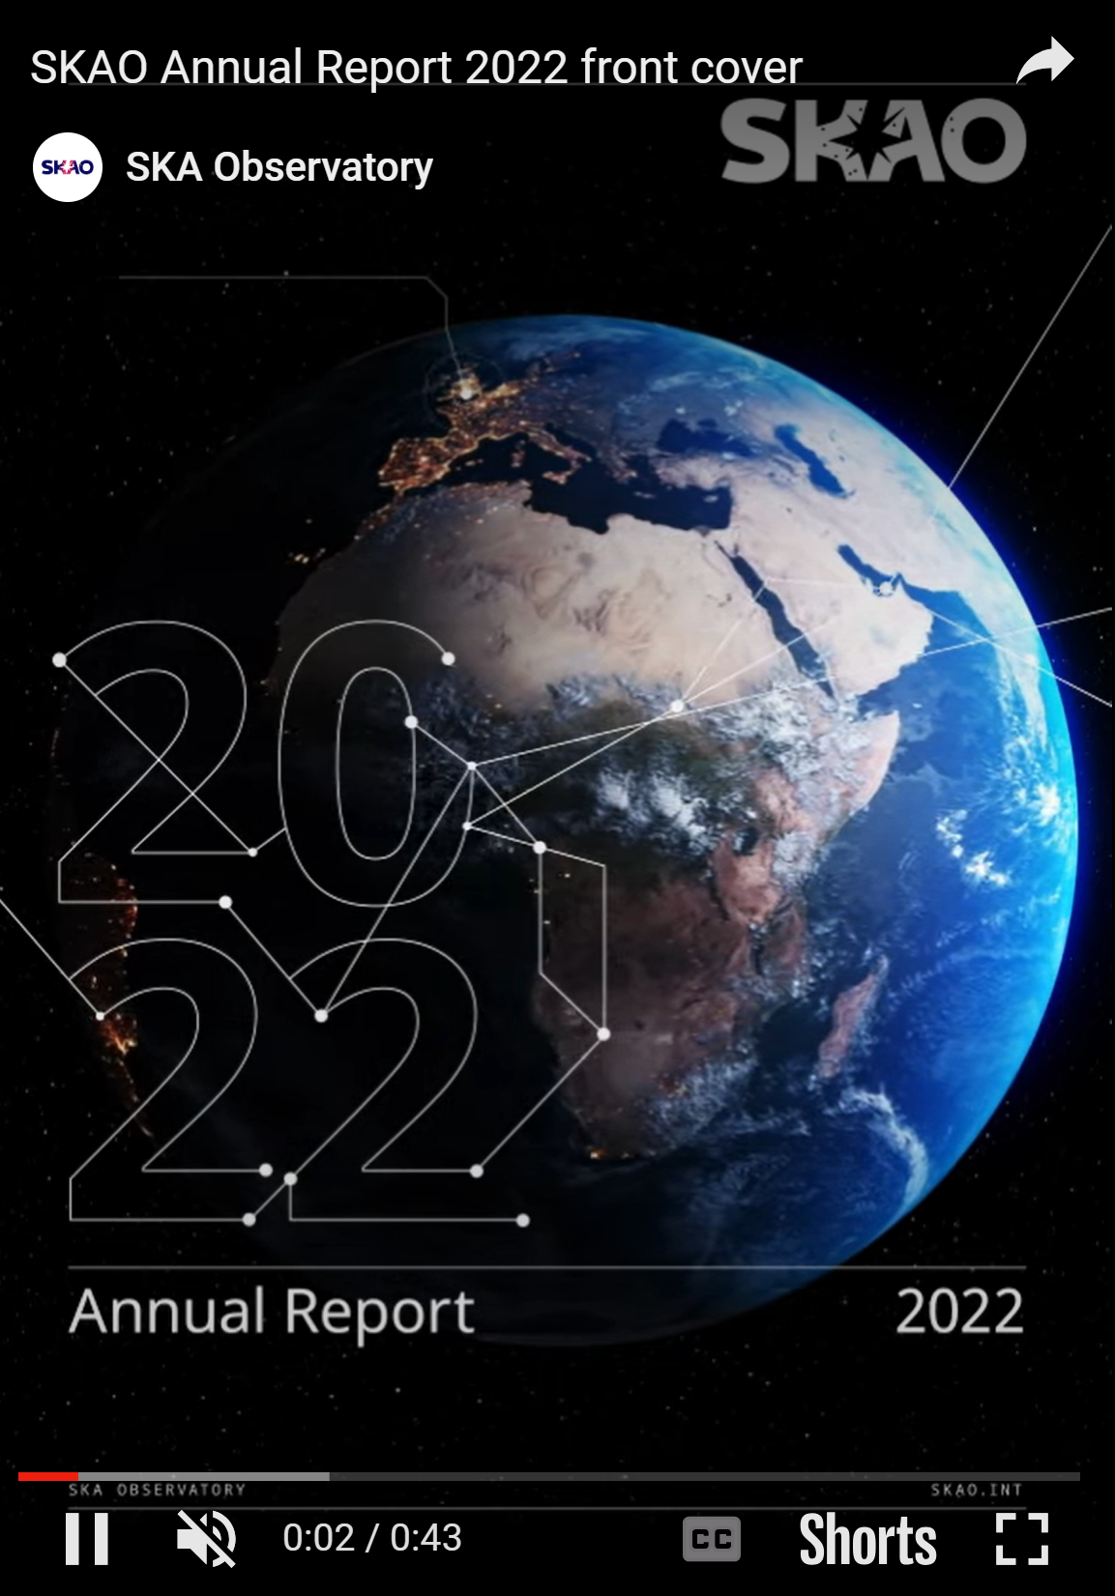
SKACH Progress Report
About 60 pages
Progress on all aspects of SKACH
Skeleton outline complete, full draft shortly
Commissioning articles and updates in February/March
Aim to complete by mid-year

Slide 13
Media assets
Building an image library, second half of 2024, gathering imagery of consortium members work and contributions
Working on text content
This will feed into
Website content
Updated SKACH ‘corporate’ video
SKACH Media Kit
Branded astronomy content

Slide 14
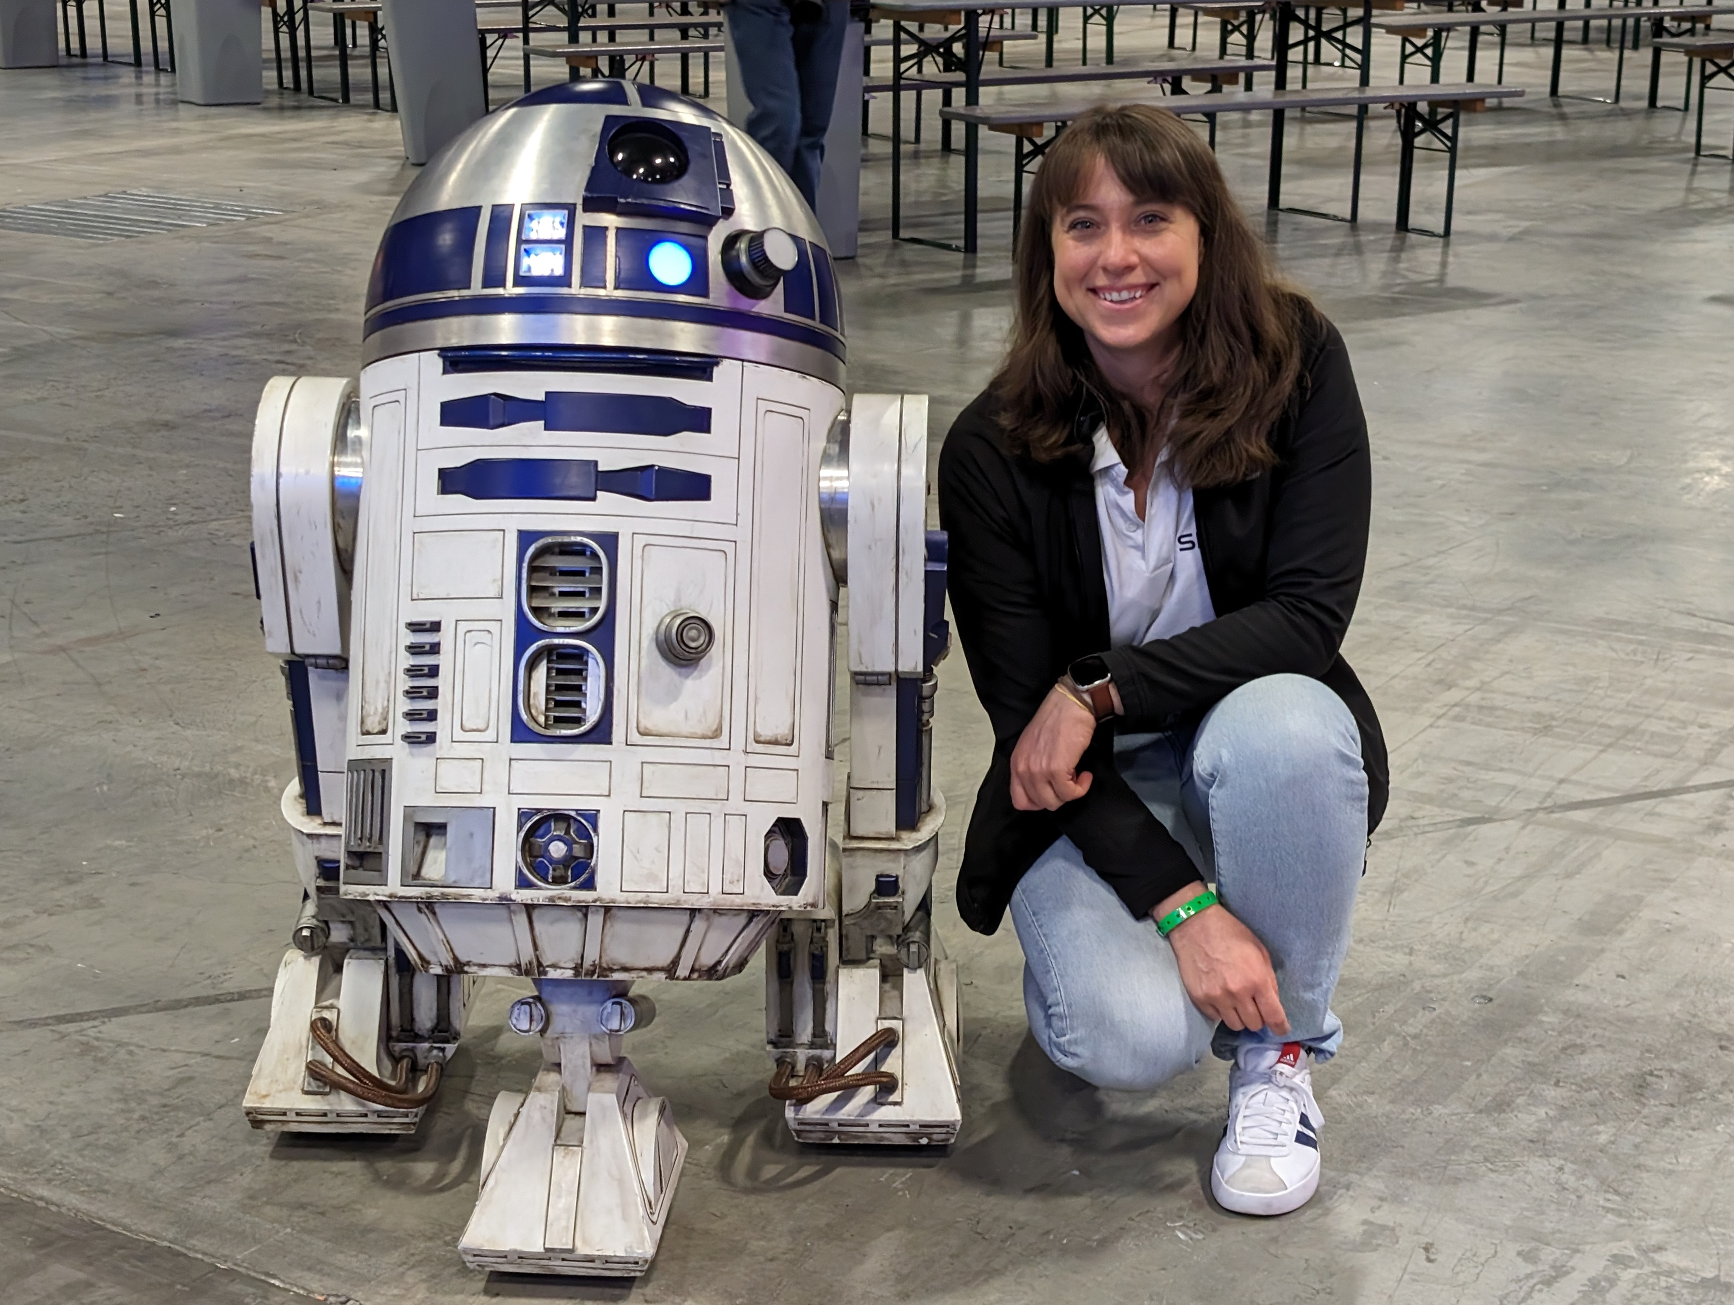
Image Credit: SKAO HQ

