Slide 1
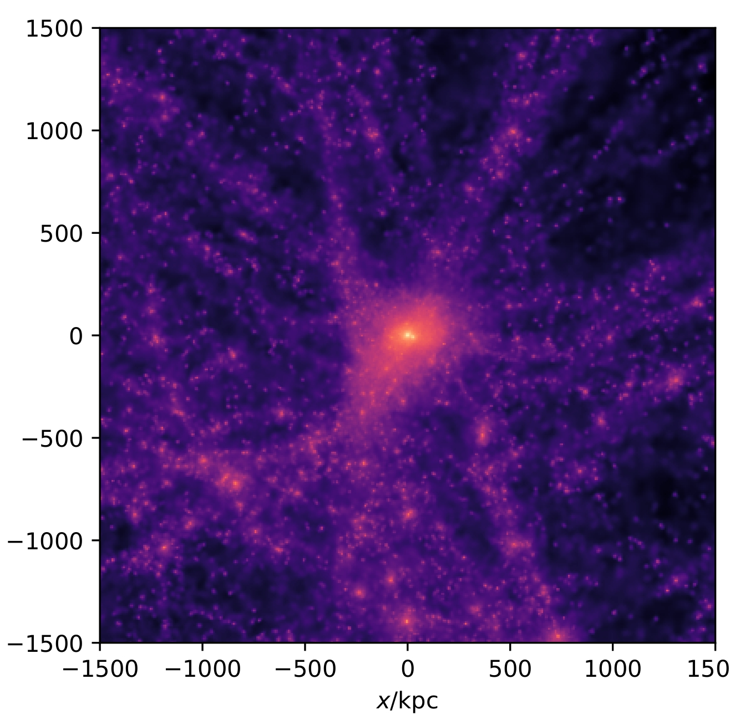
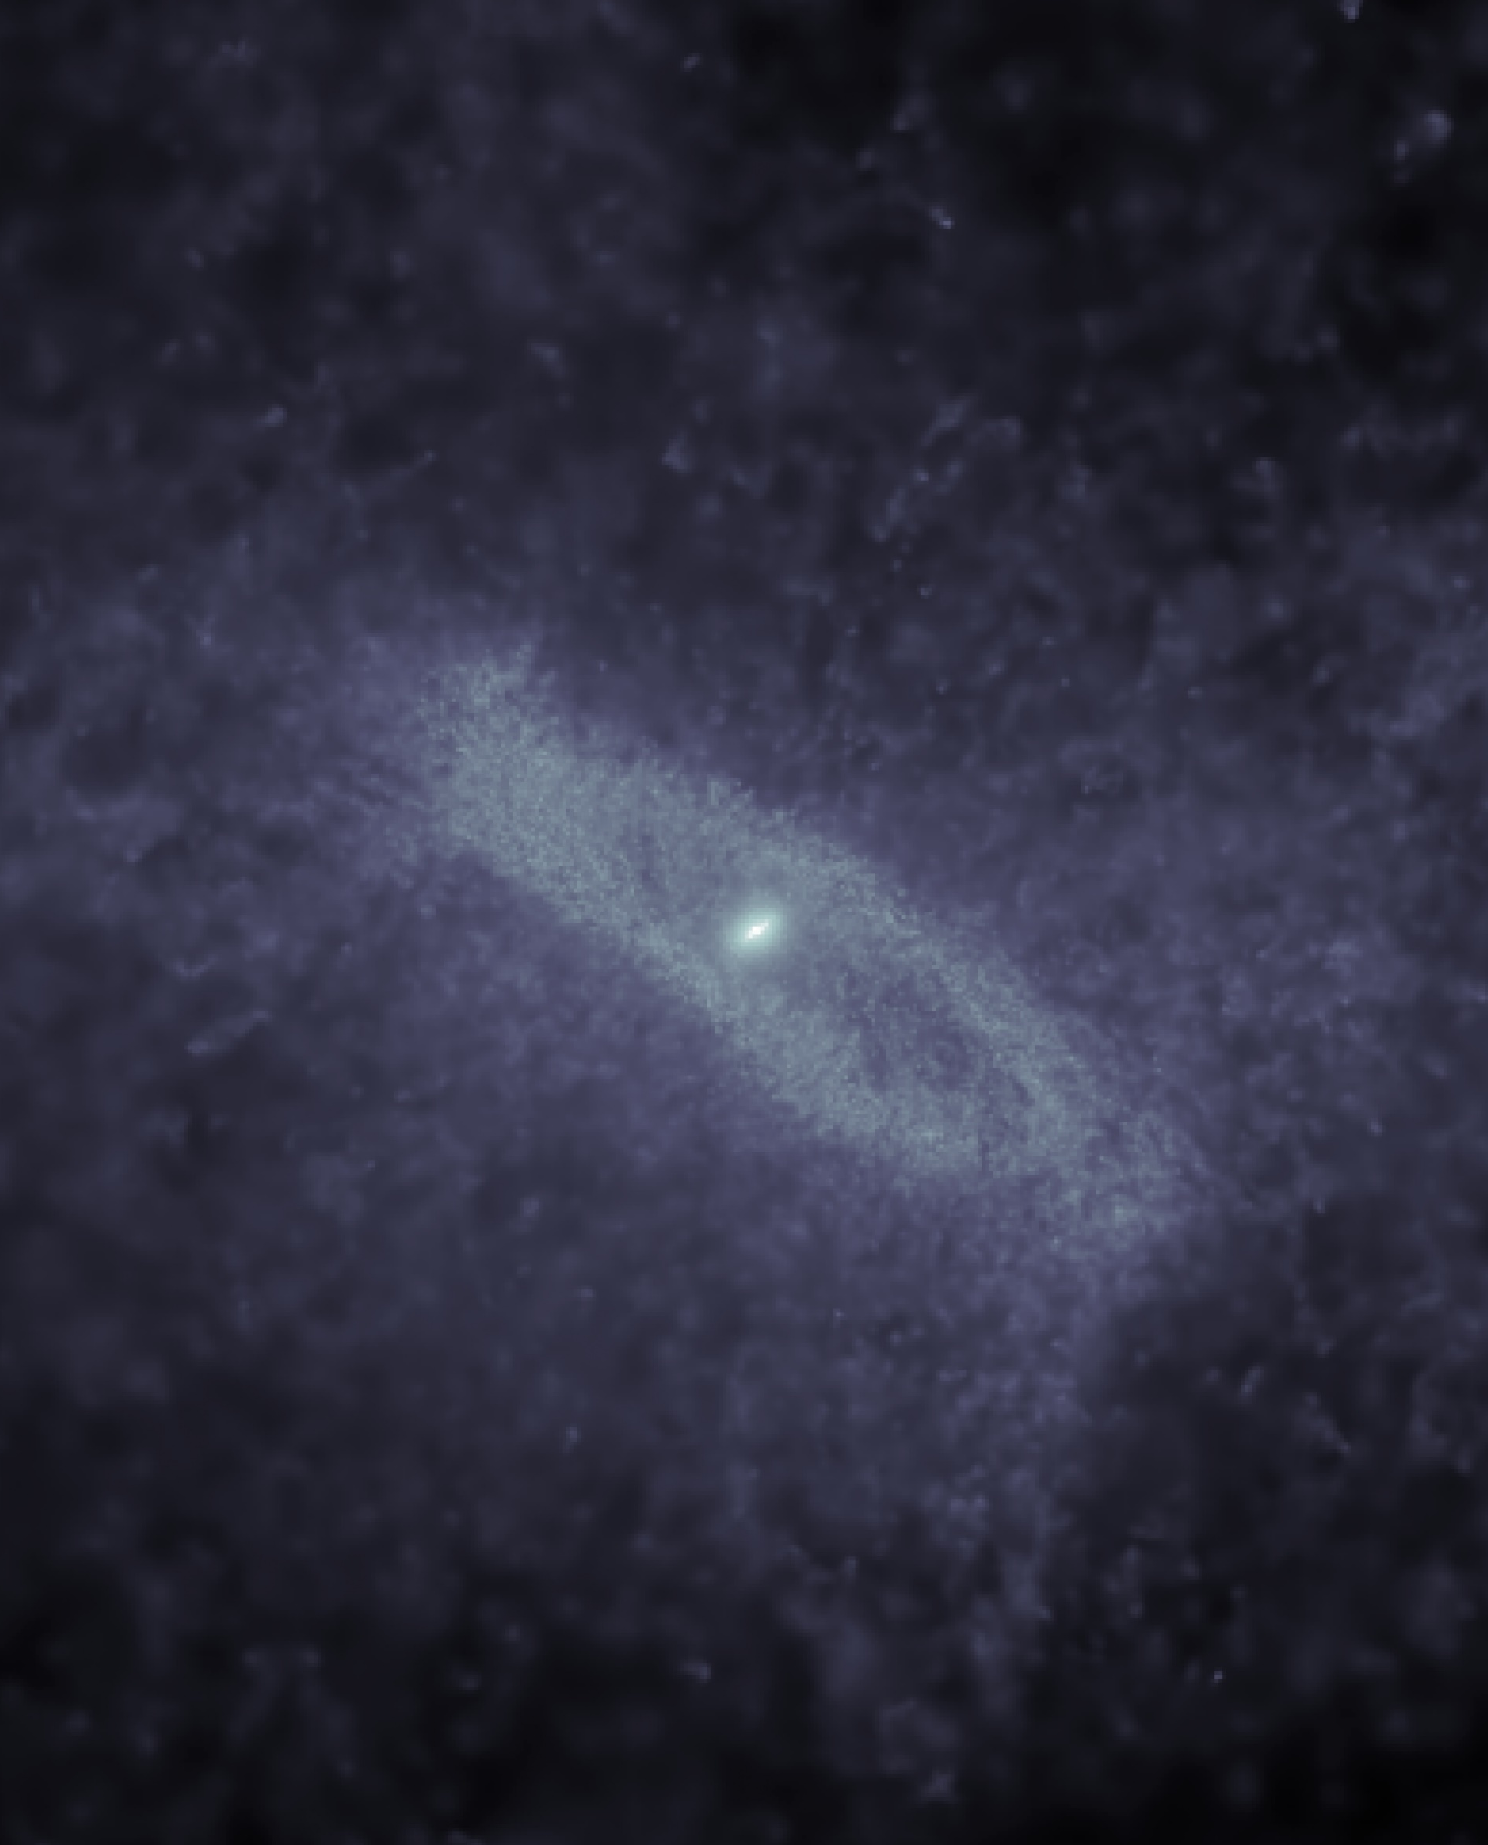
First Results of the Phoebos Simulation:
Galaxy Sizes during the Early Universe
SKACH spring meeting 2024
Floor van Donkelaar floor.vandonkelaar@uzh.ch
In collaboration with: Lucio Mayer, Pedro R. Capelo, Darren Reed

Slide 2
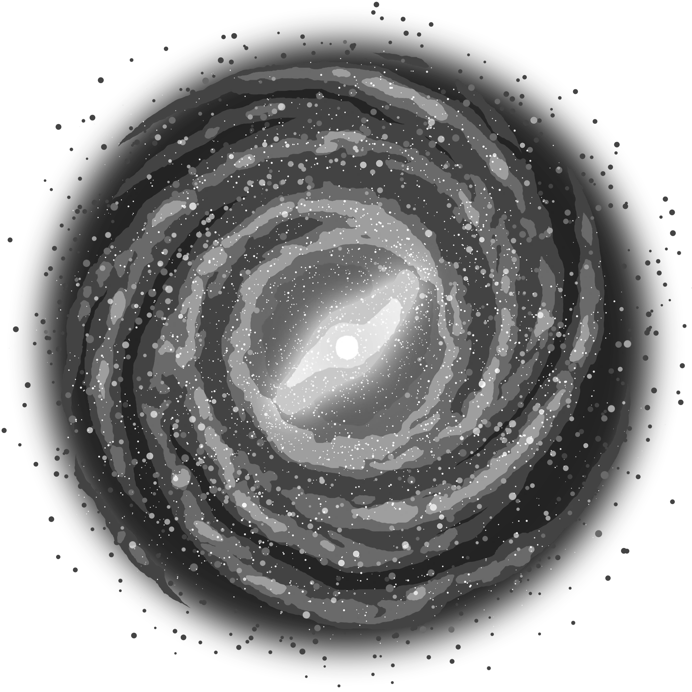
GÅLAXIËS
A lot
A lot
A lot
x 10
x 10
x 10

Slide 3
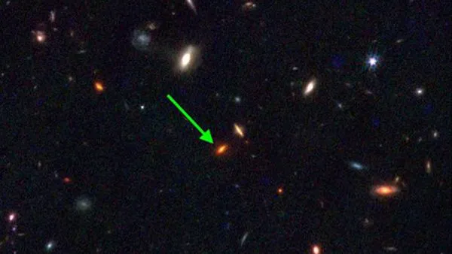
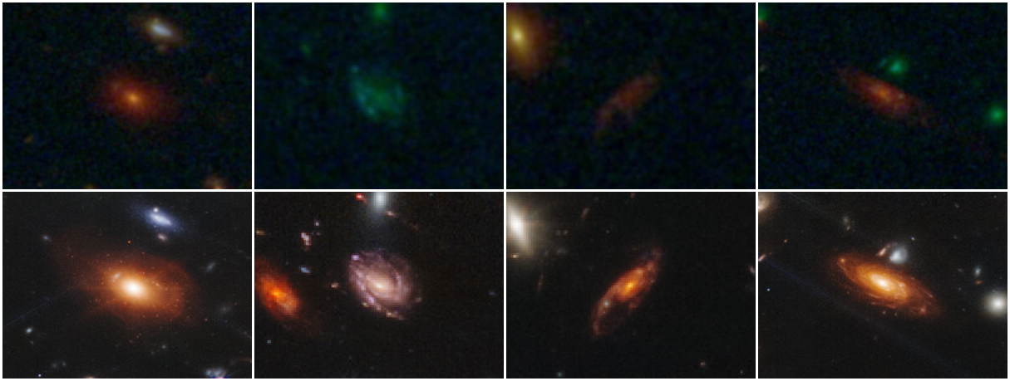
HST
JWST
Ferreira et al. 2022

Slide 4
PHOEBOS
Subgrid physics:
Spatially homogeneous time-dependent cosmic UV background (Haardt & Madau 2002 model).
solve directly for the non-equilibrium Saha equation
Turbulent diffusion of thermal energy
Metal diffusion
cooling of H and He species
cooling from the fine structure lines of metals
Supernova feedback
Blast wave feedback model of Stinson et al. (2006)
ILLUSTRIS, EAGLE etc.

Slide 5
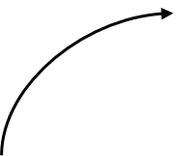
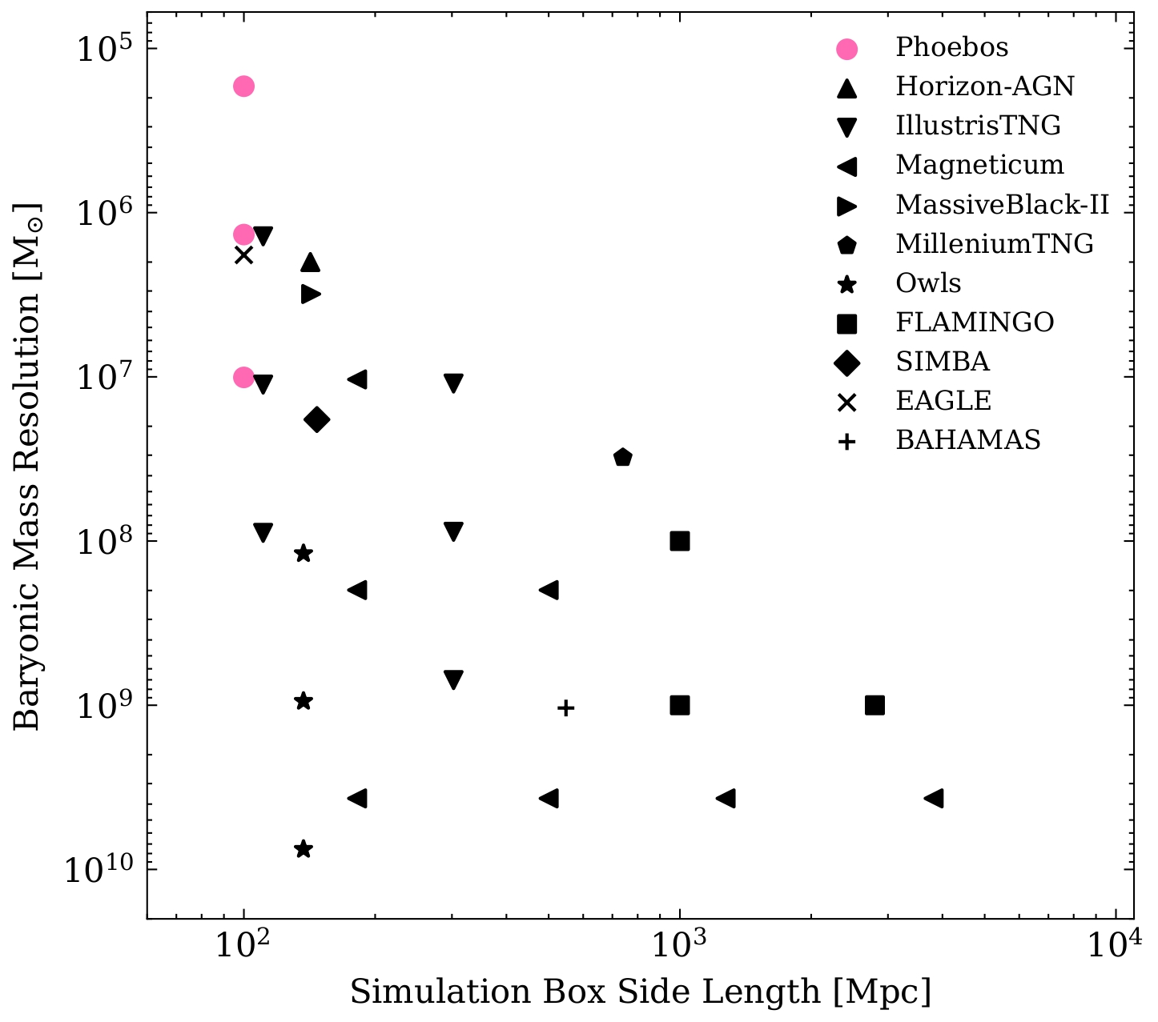
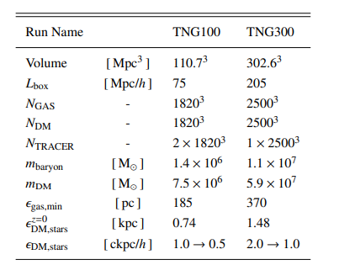
PHOEBOS

Slide 6
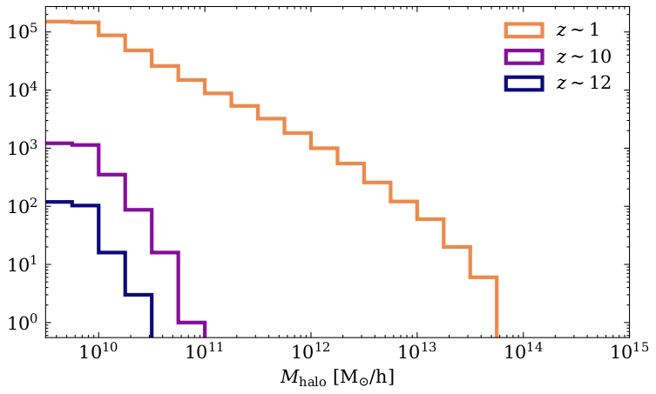
PHOEBOS
ULR
The halo mass function

Slide 7
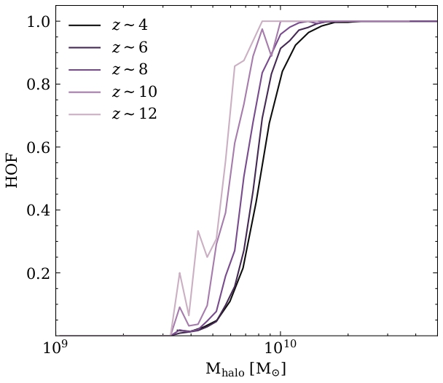
PHOEBOS
ULR
The halo occupation function
How massive should the halo be, before we find baryons within in it.

Slide 8
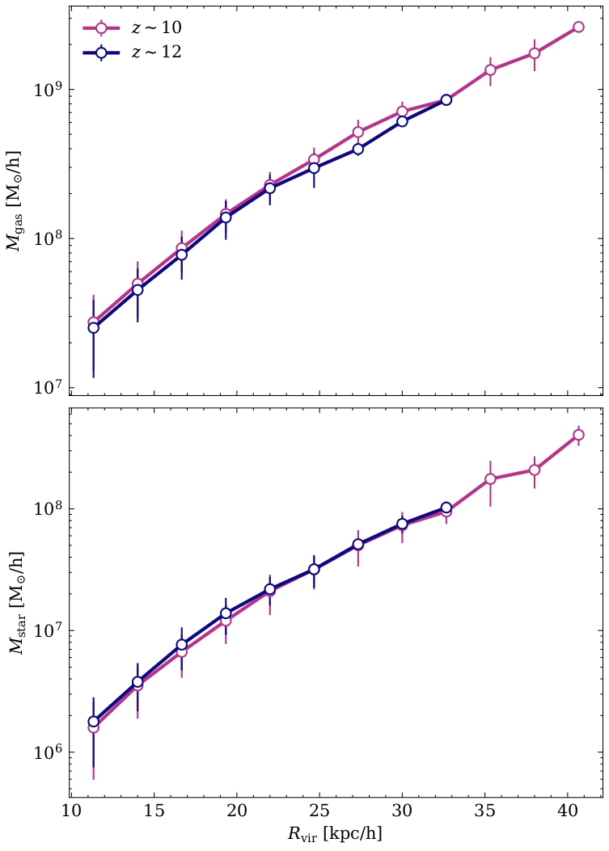
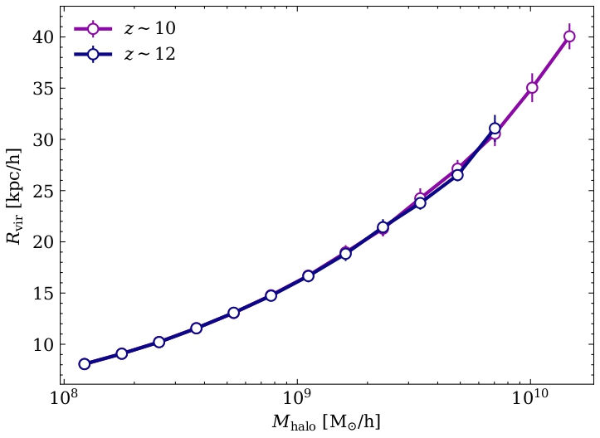
PHOEBOS
Baryon mass vs. halo mass relation
Small cut of MR (2/25)
Size vs. mass relation

Slide 9
Thank you for listening
Floor van Donkelaar floor.vandonkelaar@uzh.ch.ch
Please reach out ☺

