Slide 1
Faint Solar Transient Emission from SKA
Rohit Sharma¹, Andre Csillaghy², Simon Felix³
¹Space Planetary Astronomical Sciences & Engineering (SPASE),
IIT Kanpur
²FHNW, Windisch, Switzerland

Slide 2
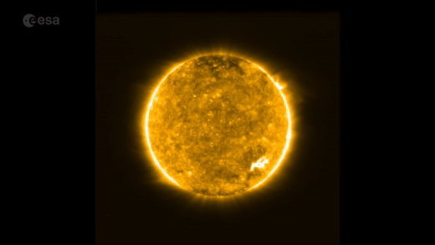
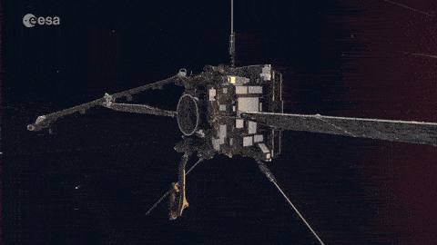
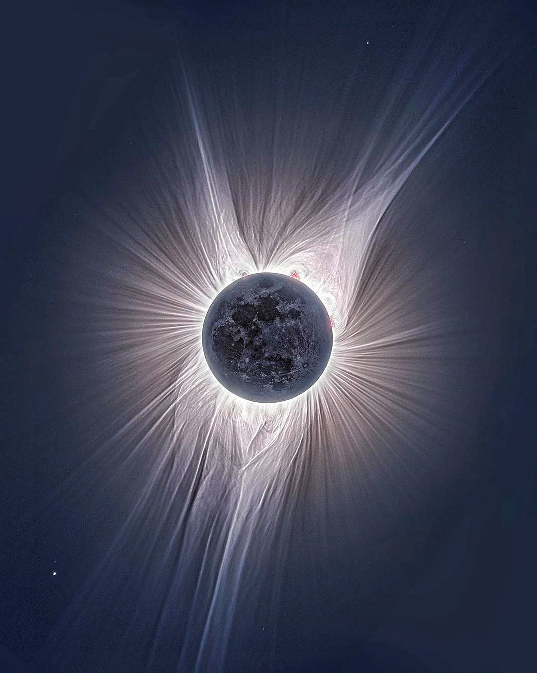
Dynamic ball of Plasma
Enormous length scales
Lot of structure
Wide range of timescales
High resolution Probes: Space-based observatories solar orbiter and parker solar probe

Slide 3
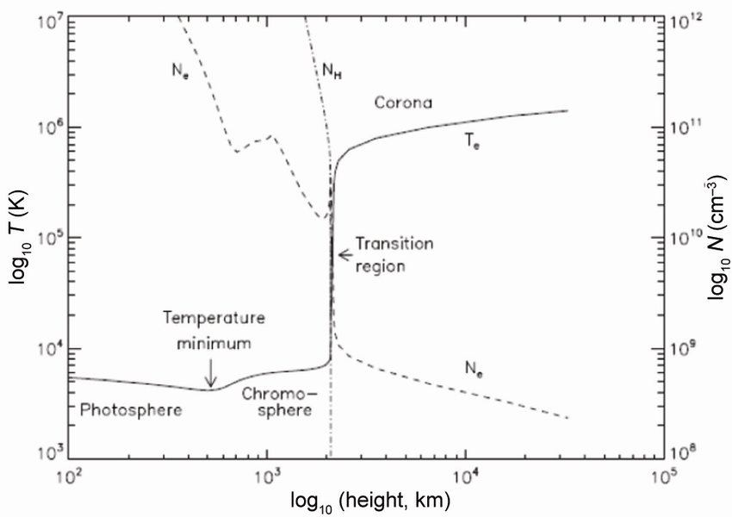
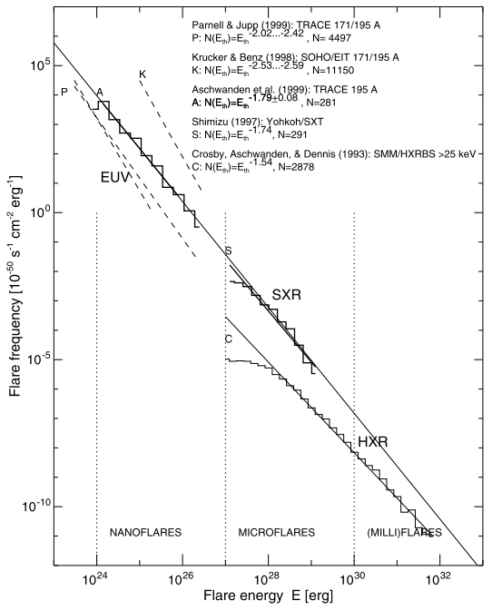
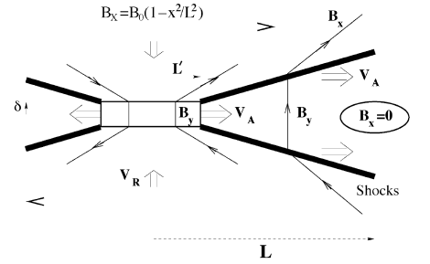
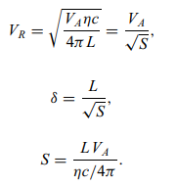
Coronal Heating
The Sun is dynamic plasma laboratory
Coronal heating and acceleration of solar wind
Flares/Microflares
Magnetic Reconnection and nonthermal particle acceleration
Radio Waves are direct Signature of nonthermal particles

Slide 4
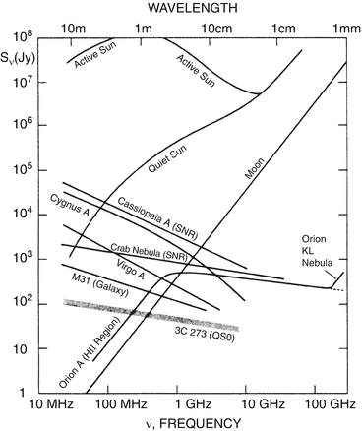
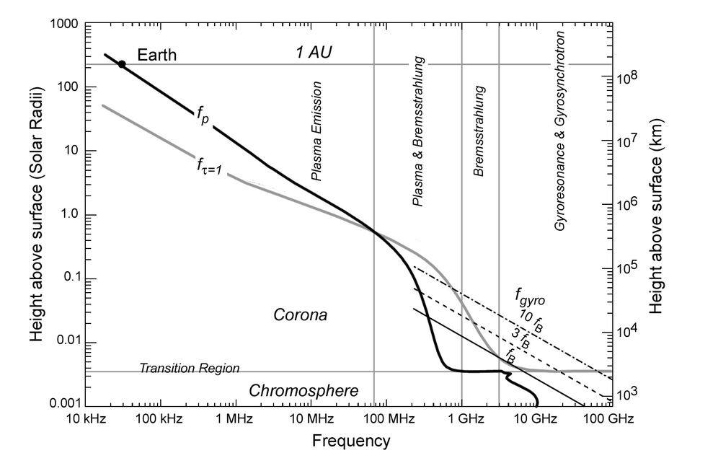
Diverse Scales of Emission
SKA Frequency Range

Slide 5
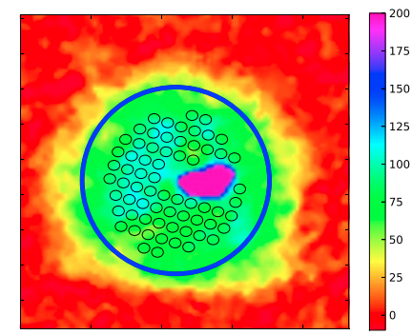
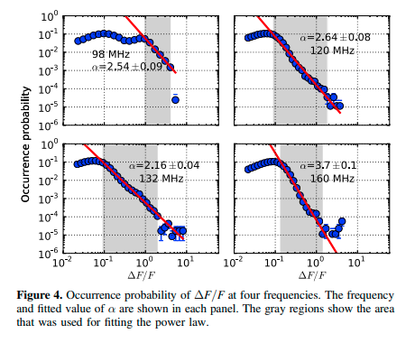
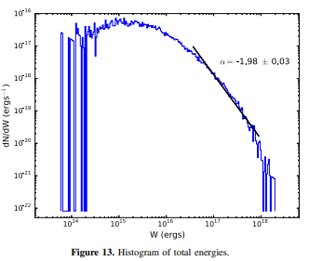
Radio Signatures of activity at weaker levels
Mondal et al. 2020
Sharma et al. 2018
Suresh et al. 2017

Slide 6
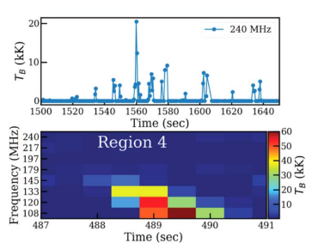
Weakest Radio bursts Movie
Sharma et al. 2022

Slide 7
First Spectroscopic Solar Image using MeerKAT
Observations were done in MeerKAT L-band on September 26 and 27, 2020 during perihelion of the Parker Solar Probe.
Images are made for every 15 minute temporal and 20 MHz spectral chunks.
Special care has been taken to account for spectral variability of the solar emission as well as chromatic primary beam.
This band averaged image is made by stacking all 20 MHz spectral chunks.
Kansabanik et al., 2024, ApJ 961 96

Slide 8
Importance of Simulations
Design better science optimised array and observing strategies
Simulate artifacts and manifestation in the image plane
Test new algorithms
Debugging Pipelines

Slide 9
Simulation Runs
Parametric Runs
Frequency (low - 50 MHz, 100 MHz, 200 MHz, 300 MHz /
high - 500 MHz, 1000 MHz, 1500 MHz, 2000 MHz )
Telescope Configuration – MWA, SKA-low | Meerkat, SKA-mid
Snapshot vs Long Synthesis Observations / 1 min vs 1 hour
Point Source study (mimicking bursts)

Slide 10
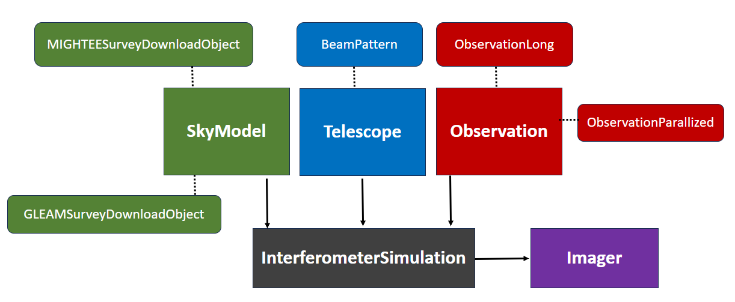
KARABO Workflow

Slide 11
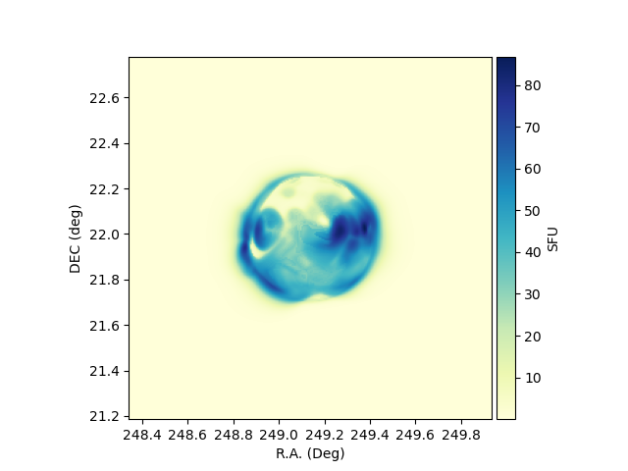
Skymodel
Sky Model – 15th Dec 2015 – FORWARD model
Skymodel – Solar disk
Free-free emission
Brightness Temperature T = T_{e}(1-e^{-t})
1 SFU ~ 10⁴ Jy
Assuming zero position angle
Source Contrast = Image max / RMS_{off}
240 MHz
$$T\left(ν\right)=T\left(240 MHz\right)×{(ν(MHz)/240)}^{2}$$
https://www2.hao.ucar.edu/modeling/FORWARD

Slide 12
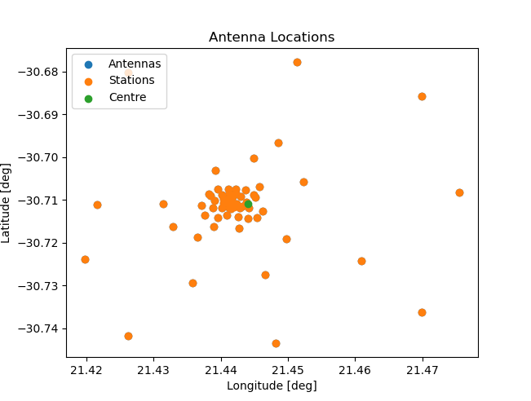
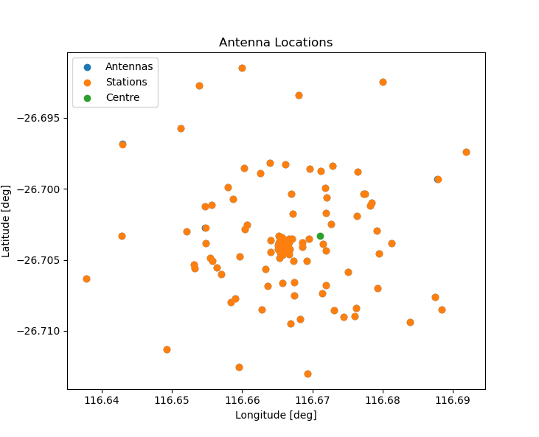
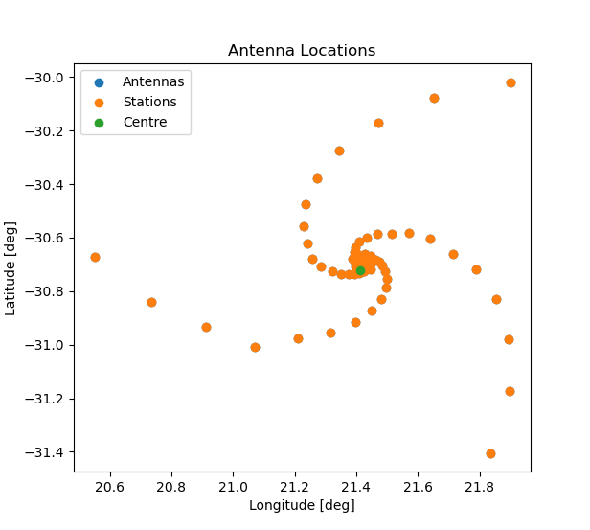
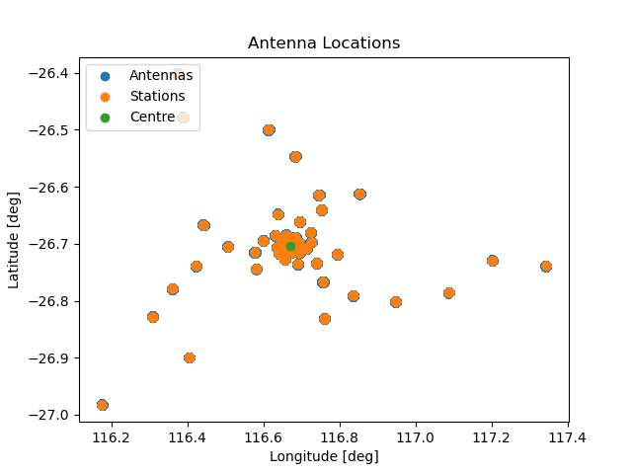
Telescopes
Telescope | # Elements | Max Baseline
MWA | 128 | 5 km
SKA-low | 512 | 74 km
Meerkat | 64 | 7.7 km
SKA-mid | 133 | 150 km
Meerkat
MWA
SKA-low
SKA-mid

Slide 13
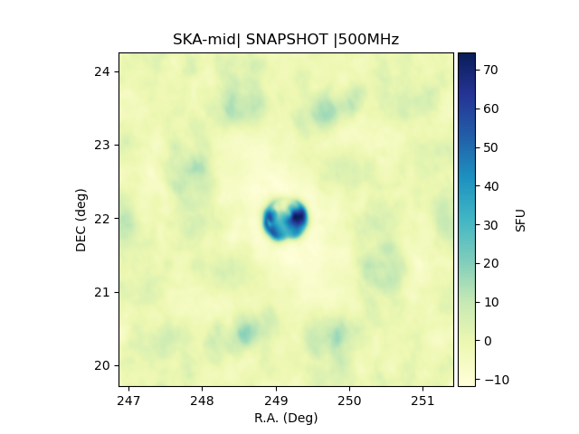
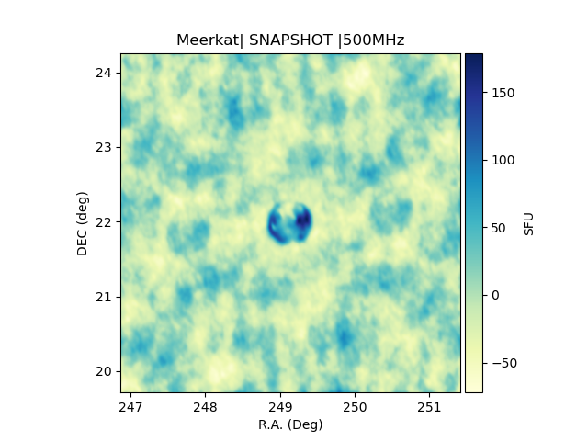
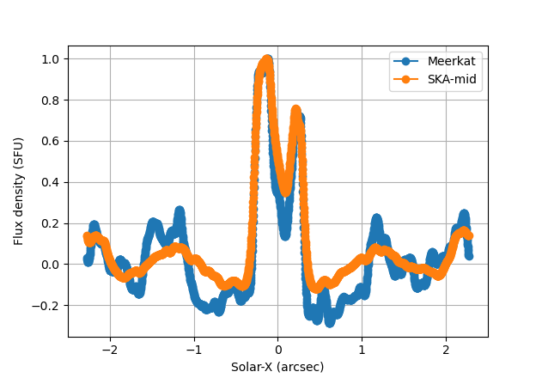
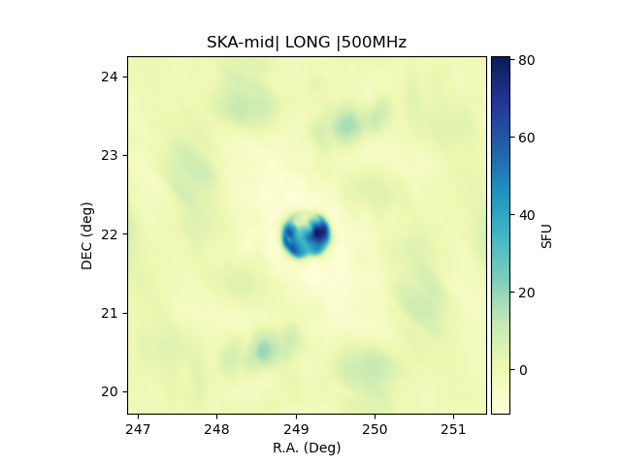
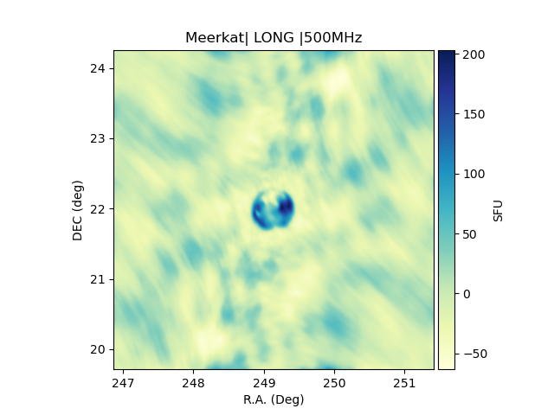
Simulated Images – SKA-mid and Meerkat
Amplitude Imperfections
Sky Model
SKA-mid Snapshot
Meerkat Snapshot
Smoothening
SKA-mid long
Meerkat long

Slide 14
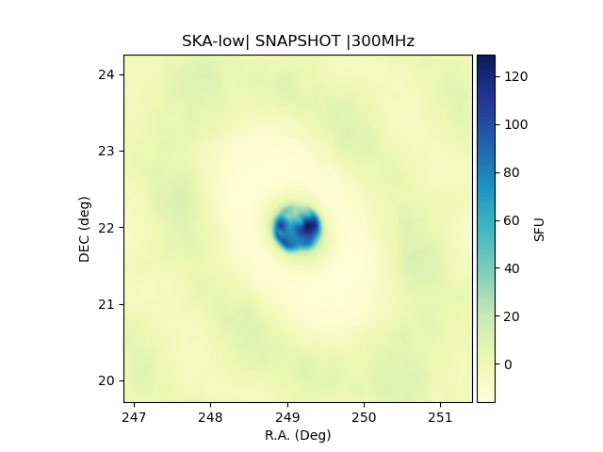
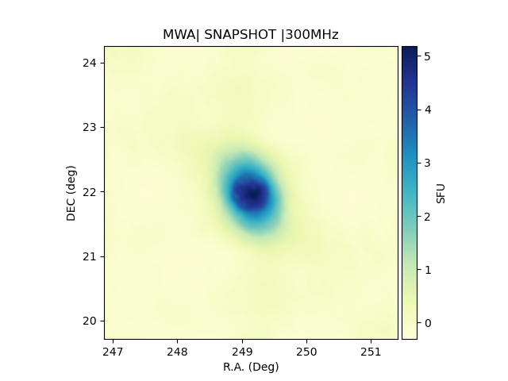
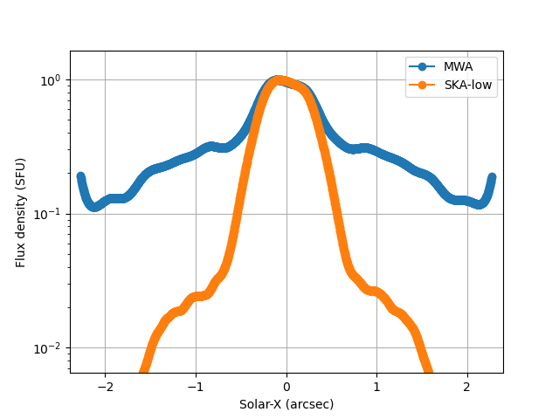
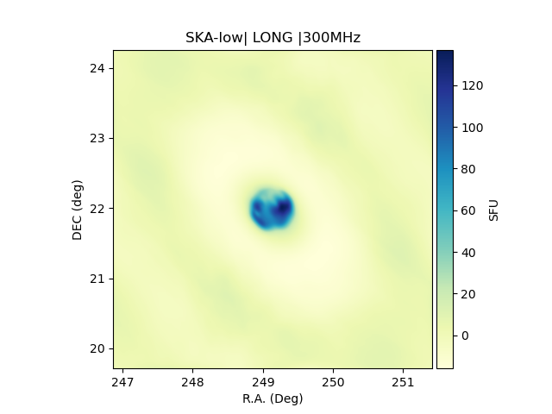
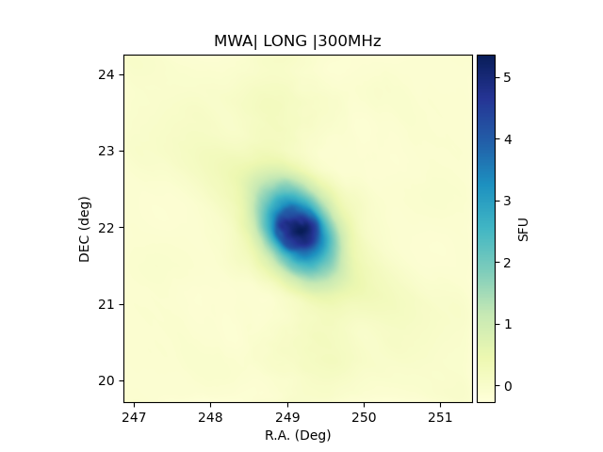
Simulated Images – SKA-low and MWA
Sky Model
Extended Aura
SKA-low Snapshot
MWA Snapshot
SKA-low long
MWA long

Slide 15
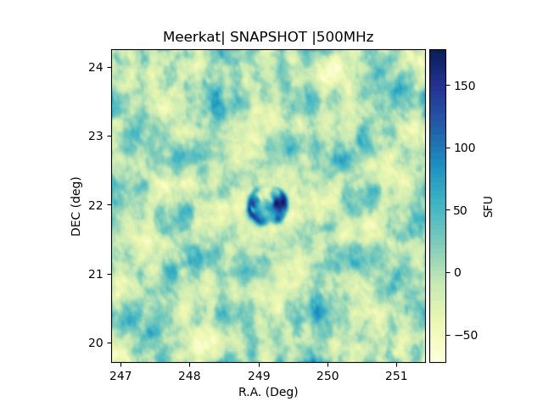
Frequency Dependence – Meerkat
Loss of flux at high frequencies

Slide 16
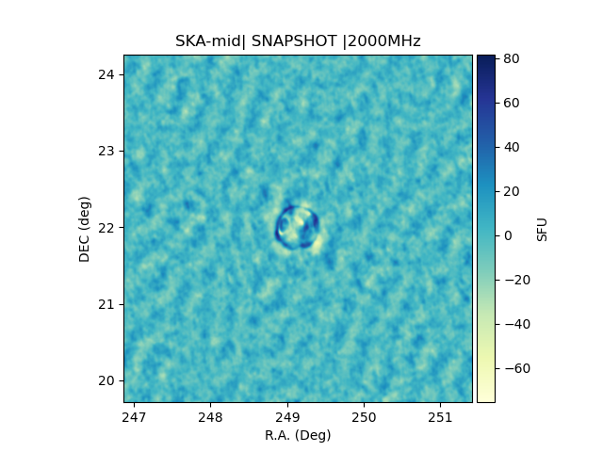
Frequency Dependence – SKA-mid
Better fidelity in SKA-mid

Slide 17
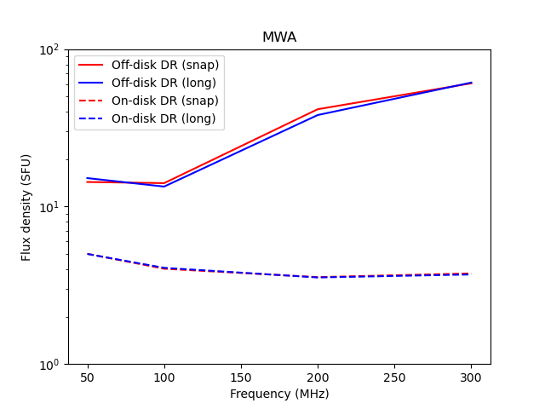
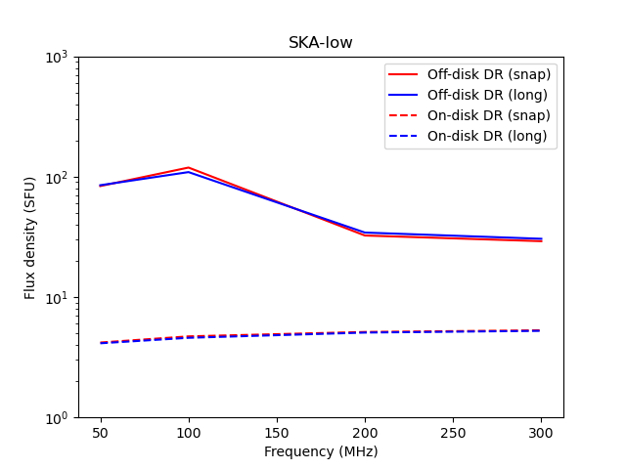
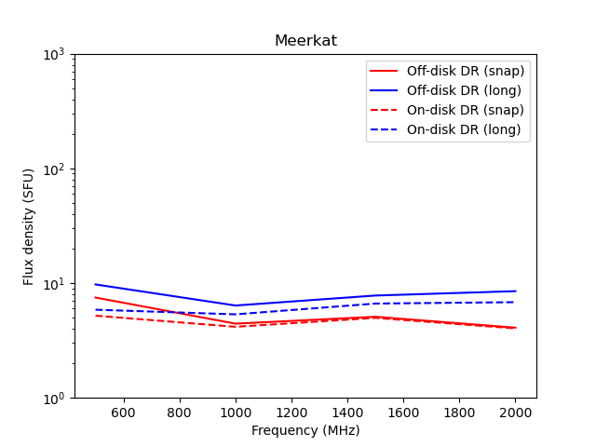
Sidelobe Improvements in dirty Image

Slide 18
Point Source Simulations
Sim 1: No point source
Sim 2: Point Source with 100 SFU mimicking burst source
Sim 3: Multiple point sources ~ 100 source at milli-SFU levels
(1)
(2)
(3)

Slide 19
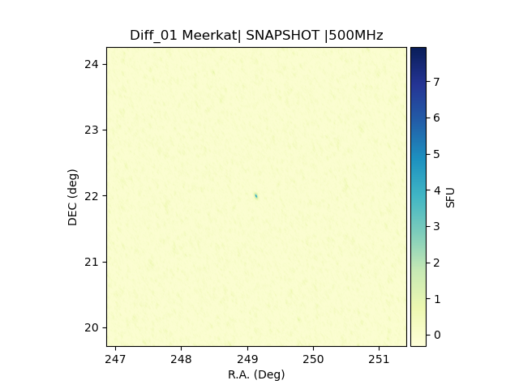
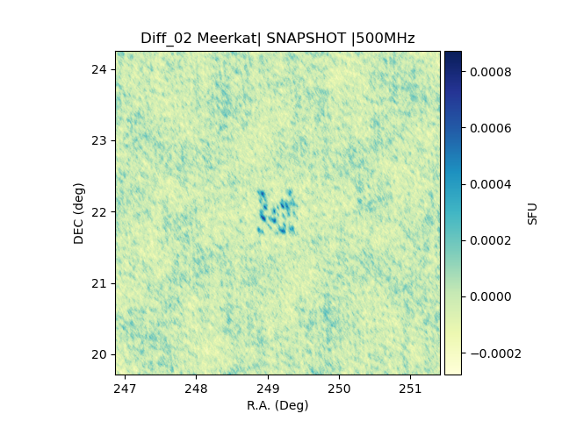
Point Source Simulation
Difference Images
Spotty Residuals
Smoother Residuals

Slide 20
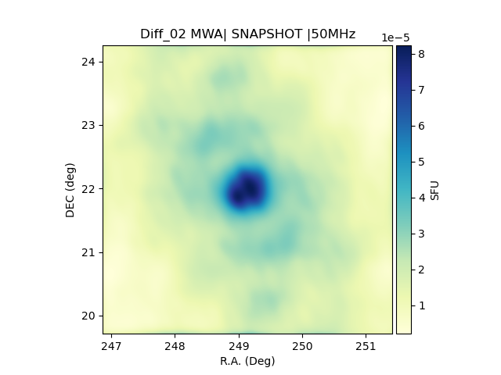
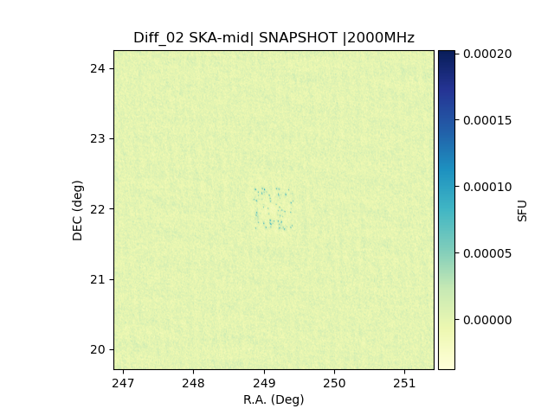
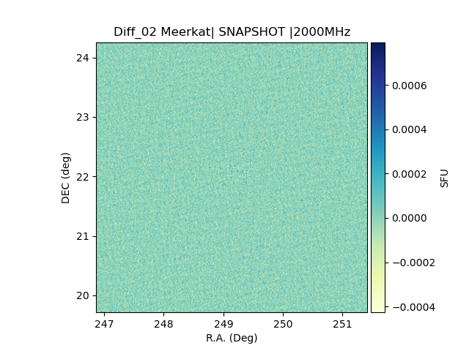
Point Source Detection – Residual Image maps
Diffuse/
Extended Sources
Significant improvements in faint source detection
No detection possible with Meerkat

Slide 21
Conclusions
Detecting faint solar burst are crucial for coronal heating
Simulations are vital to understand instrument characteristics
Faint burst detection will be uniformly possible across wide range of frequency (50 MHz to >2 GHz)
Amplitude errors will be reduced in SKA data analysis, i.e. more accurate flux densities
Orders of magnitude improvement in image fidelity with SKA
Residual features needs to be studied in more detail with noise

